Slide 1




A Randomized Comparison of Personalized Management for Medical and Interventional Therapy Based on Coronary Atherosclerotic Plaque Versus Usual Care for Symptomatic Patients with Suspicion of CAD
Todd C. Villines, MD; Borek Foldyna, MD, PhD, Melissa Aquino, MS, Vidhya Kumar, PhD, Udo Hoffmann, MD, MPH, Maros Ferencik, MD, PhD - on behalf of the PARAMOUNT Study Investigators

Slide 2
DISCLOSURE SLIDE
Maros Ferencik reports serving as a consultant for Cleerly, HeartFlow, Elucid, BioMarin, serving on an advisory board of Cleerly, Elucid, serving on a speaker bureau for HeartFlow; and has stock options in Elucid
Borek Foldyna reports institutional research support from NIH/NHLBI, AstraZeneca, MedImmune, Cleerly, and MedTrace, and consulting fees from Cleerly all outside the submitted work.
Todd Villines reports serving as a non-commercial (clinical trial leadership) consultant to Abcentra, AngioInsight, Cleerly, HeartFlow and Milestone, has received author royalties from Wolters-Kluwer (UpToDate) for authorship on cardiac CT topics, and reports research grant funding from the National Institutes of Health.
Melissa Aquino, Vidhya Kumar, and Udo Hoffmann are employees of Cleerly.
Funding for the PARAMOUNT study provided by Cleerly, Inc

Slide 3
BACKGROUND
THE UNMET NEED
THE OPPORTUNITY
THE CLINICAL APPROACH
Traditional risk assessment and functional testing do not adequately identify clinically important nonobstructive coronary atherosclerosis, potentially missing opportunities for preventive treatment.
Artificial intelligence-enabled
quantitative computed tomography (AI-QCT) enables standardized assessment of plaque burden, composition, stenosis, and plaque-based ischemia to support more precise CAD characterization and staging.
Quantitative disease assessment may help physicians tailor preventive therapies and select patients more appropriately for invasive evaluation and revascularization.
PARAMOUNT HYPOTHESIS
Plaque-based care improves diagnostic certainty, lipid lowering, and medical and interventional management compared with usual care over 180 days.
First ever prospective, randomized trial evaluating AI-enabled plaque-based care versus usual care with functional testing
CAD = coronary artery disease

Slide 4
PARAMOUNT RCT
Purpose
Compare traditional diagnostic pathways with a novel, AI-enabled diagnose-stage-treat approach for the management of atherosclerotic coronary artery disease
Design
Prospective, randomized, open-label trial testing a hierarchical composite primary endpoint using the win ratio approach
  Symptomatic patients with suspected coronary artery disease (CAD)
  Randomized to personalized, plaque-based care versus usual care
21 sites across the U.S.
  Representative mix: academic, hospital systems, private clinics, range of experience with AI-QCT and AI-QCT_{ISCHEMIA}

Slide 5
PARAMOUNT Study Design
523 Symptomatic Adult Patients with Suspicion of CAD, No Known Obstructive CAD, LDL-C > 100
Baseline Assessment: Dx Certainty, Labs/Risk Factors, Patient Reported Outcomes (PRO)
Randomization (1:1)
AI-Assisted Quantitative Coronary Plaque & Ischemia Informed Management:
Reassess Diagnostic Certainty of CAD
Usual Care with Functional Testing:
Reassess Diagnostic Certainty of CAD
180 Day Follow-Up Assessment: Lab/Risk-Factors; PROs
Composite Primary Endpoint | Secondary Endpoints
Improvement in diagnostic certainty of angina attributable to CAD Δ in LDL-C at 180 days Freedom from ICA without obstructive CAD Freedom from PCI without clinically significant stenosis | Δ in patient risk factors, patient reported outcomes Modeling of cost outcomes
AI = artificial intelligence; CAD = coronary artery disease; Dx = diagnostic; ICA = invasive coronary angiography; LDL = low-density lipoprotein;
PCI = percutaneous coronary intervention; PRO = patient-reported outcome; w/o = without; Δ = change
Notes:
Symptomatic Patients Undergoing Clinically-Indicated CCTA (n~500)

Slide 6
Composite Primary Endpoint
Hierarchical Win Ratio best captures the sum of the key outcomes of medical and interventional care
1
Improvement in diagnostic certainty
2
Reduction in LDL‑C
3
Freedom from ICA
4
Freedom from PCI
from baseline to 180 days
without evidence of obstructive CAD
without clinically significant coronary stenosis
of angina attributed to CAD
Win: Shifts from uncertain to certain
e.g. Probable to Definitely Yes
Win: Greater reduction beyond 10% threshold
Win: Plaque-based care arm favorable vs. Usual Care unfavorable.
Win: Plaque-based care arm favorable vs. Usual Care unfavorable.
Loss / Tie: Reverse occurs, or outcomes match.
Loss / Tie: Reverse occurs, or outcomes match.
Hierarchical Testing
Sample size of 500 to provide >90% power to test the primary endpoint
Primary efficacy endpoint analyzed using an unmatched win-ratio method
CAD = coronary artery disease; ICA = invasive coronary angiography; LDL-C = low-density lipoprotein cholesterol; PCI = percutaneous coronary intervention.
Notes:
CAD = coronary artery disease; ICA = invasive coronary angiography; LDL-C = low-density lipoprotein cholesterol; PCI = percutaneous coronary intervention.

Slide 7
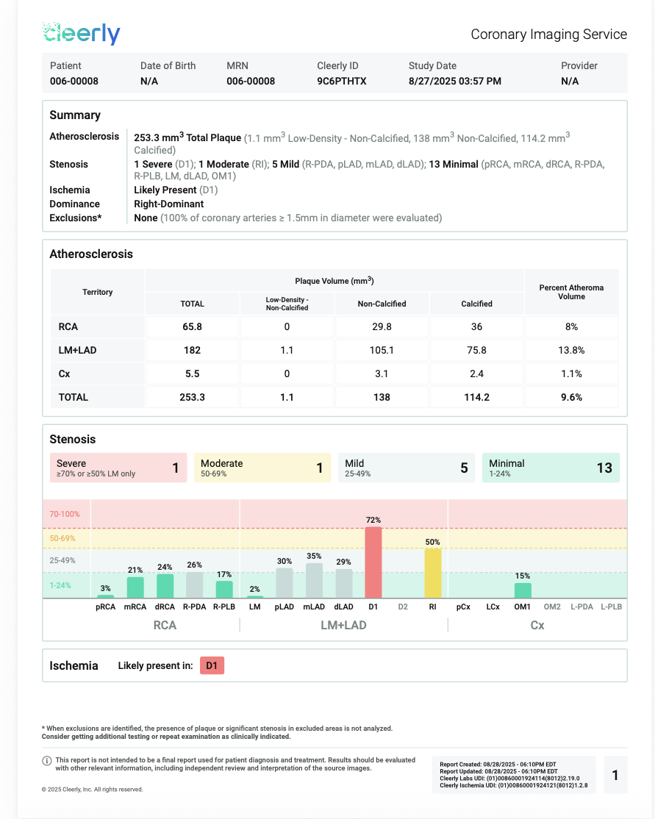
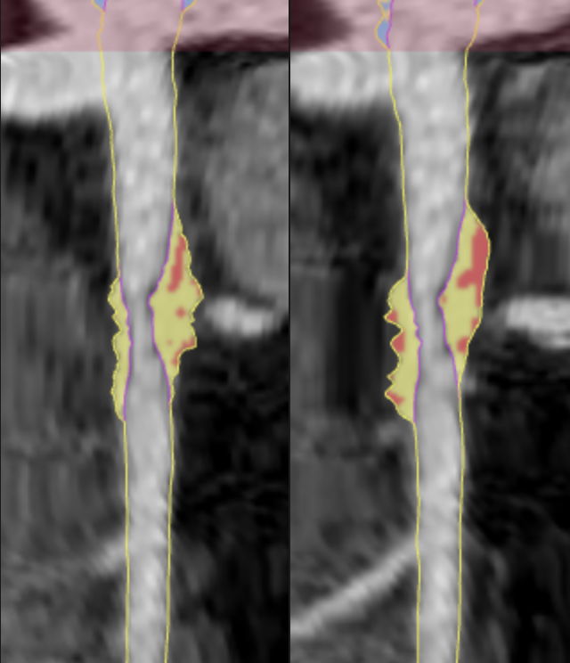
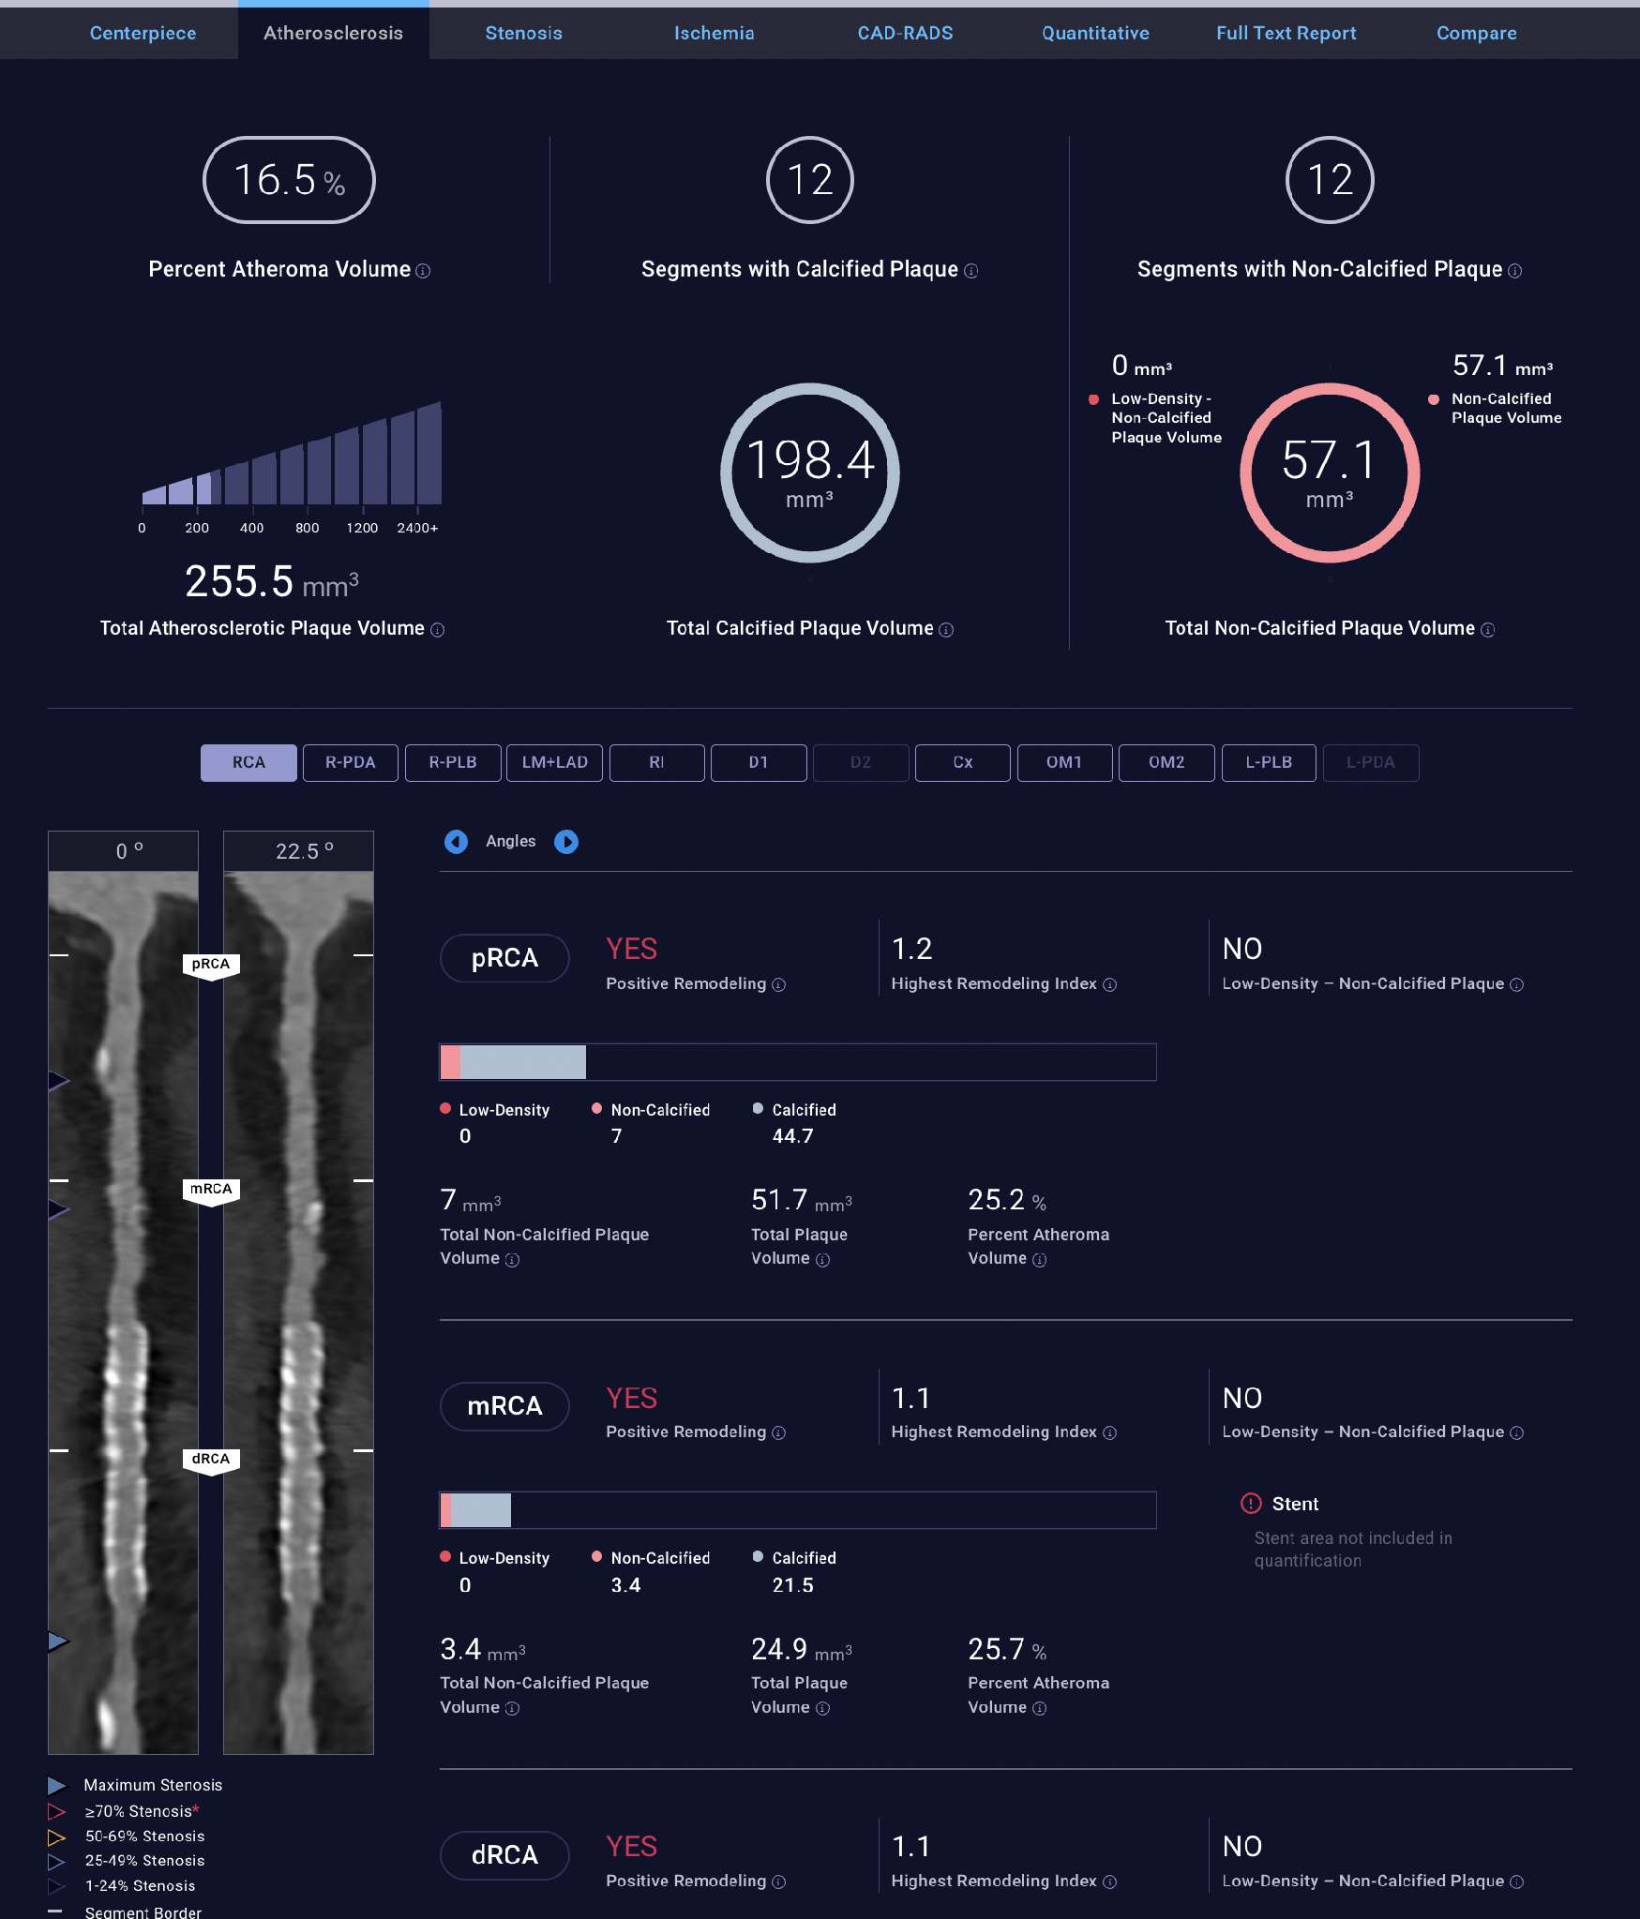
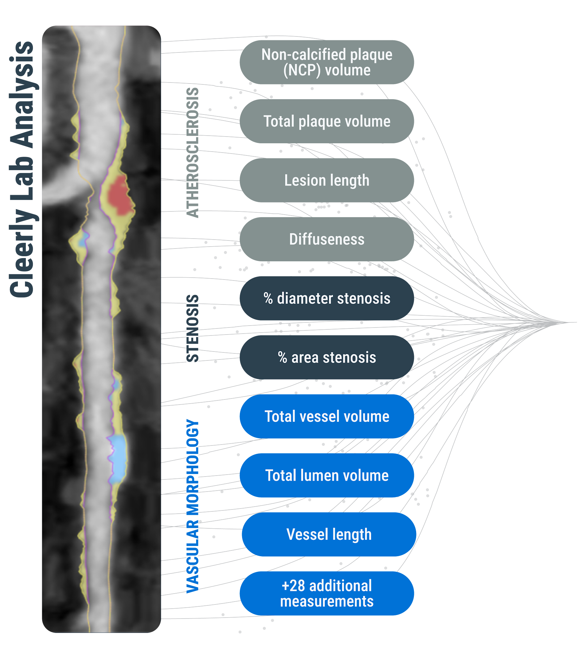
Analysis
Reporting
Plaque Analysis (AI-QCT)
Ischemia Analysis (AI-QCT_{ISCHEMIA})
Predictive outputs
No
Ischemia Likely
Ischemia Likely
or
Based on the threshold equivalent to invasive fractional flow reserve (FFR) measures of >0.80 vs. ≤0.80
AI = artificial intelligence; AI-QCT = artificial intelligence–enabled quantitative computed tomography; FFR = fractional flow reserve
Notes:
- explanation of how measurements are taken - plaque measurement
- report is given
tx recs based (trx based on plaque) and IX based on ischemia and good practice
AI-QCT ISCHEMIA utilizes 37 AI-QCT–derived athero-sclerotic plaque and stenosis features in a randomforest model

Slide 8
Results

Slide 9


Selected Baseline Characteristics
Overall (n=523)
Characteristic | Overall (n=523) | Plaque-Based Care (n = 262) | Usual Care (n = 261)
Cardiovascular Risk Factors, n/N (%)
Hypertension (%) | 262 (50.1) | 124 (47.3) | 138 (52.9)
Diabetes (%) | 65/519 (12.5) | 24/260 (9.2) | 41/259 (15.8)
Hyperlipidemia (%) | 412/513 (80.3) | 203/257 (79.0) | 209/256 (81.6)
Current smoking (%) | 52 (9.9) | 21 (8.0) | 31 (11.9)
Fx history of premature CAD (%) | 190/480 (39.6) | 100/238 (42.0) | 90/242 (37.2)
Baseline Measures and Therapy
LDL-C (mg/dL), mean ± SD | 128.0 ± 32.8 | 129.0 ± 34.8 | 127.1 ± 30.7
Baseline statin or LLT use (%) | 31.6% | 31.4% | 31.7%
PREVENT Risk, median (Q1,Q3) | 3.8 (1.7, 7.9) | 3.8 (1.9, 7.0) | 3.7 (1.7, 8.6)
Median Age: 57 years
Median BMI: 29.7 kg/m²
Missing 0.6%
Missing 10.9%
Male
42%
White
48.4%
Female
57%
Non-white
40.7%
Sex
Race
BMI = body mass index; CAD = coronary artery disease; LDL-C = low-density lipoprotein cholesterol

Slide 10
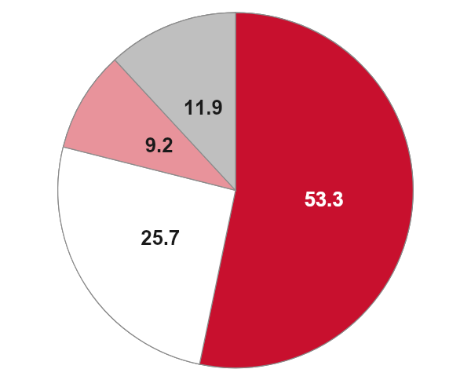
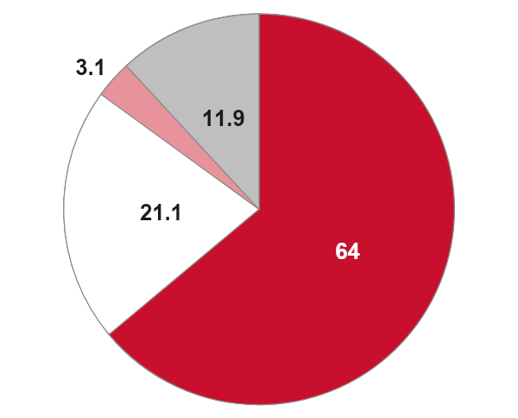
Usual Care Arm – Functional Testing
11.9%
11.9%
Test Results (N = 230)
9.2%
3.1%
80
171
(73.9%)
70
53.3%
21.1%
64.0%
60
25.7%
50
Percentage (%)
40
30
Stress Test Modality
Type of Stress
20
31
(13.5%)
Nuclear (n=139, 53.3%)*
Exercise (n=167, 64.0%)
13
(5.7%)
10
(4.4%)
10
Pharmacologic (n=55, 21.1%)
6
(2.6%)
Exercise (n=67, 25.7%)
0
Both (e.g. walk+reg.) (n=8, 3.1%)
Normal
Mildly abnormal
Moderately abnormal
Severely abnormal
Indeterminate
Echo (n=24, 9.2%)
Missing (n=31, 11.9%)
Missing (n=31, 11.9%)
Interpretation of results adapted from: Hoffmann U, et al. Circ. 2017
*50% of nuclear scans were PET

Slide 11
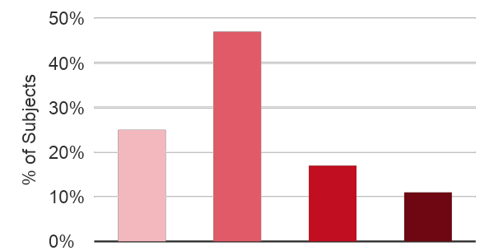
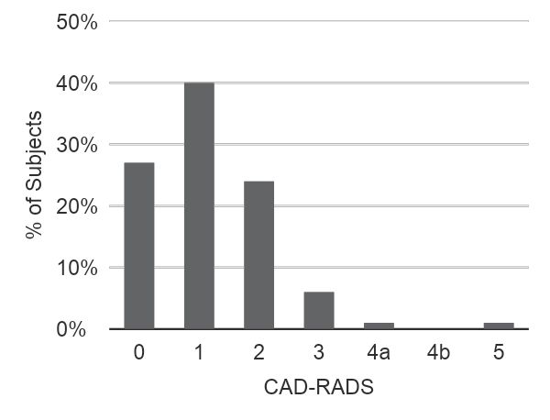
Plaque Based Care Arm – Staging, CAD-RADS, Ischemia
Intention-to-Diagnose (n = 236)
Plaque Burden
CAD-RADS Score
Plaque-Based Ischemia
Assessment
CAD-RADS 3+ (>50% stenosis) = 21 subjects (8.8%)
Ischemia Likely
23 (9.7%)
Ischemia Unlikely
213 (90.3%)
No Plaque (Stage 0)
Low
(Stage 1)
Moderate (Stage 2)
High (Stage 3)
itd and total
CAD-RADS = Coronary Artery Disease Reporting and Data System; CAD = coronary artery disease
Notes:
>25% in stage 2 and 3 is high number - moderate coronary disease

Slide 12
Primary Endpoint:
Plaque-based care demonstrated a 2:1 advantage over usual care.
Plaque-Based Care vs. Usual Care
262 vs. 261 patients (68,382 patient pairs)
Hierarchical Component
Treatment Wins
(%)
Remaining Ties
(Proceed to next component)
(%)
Treatment Losses
(%)
Win Difference
(% points)
1.
Improvement in
Diagnostic Certainty
26.53%
63.58%
9.89%
16.64%
2.
Reduction in LDL-C
19.35%
31.23%
13.00%
6.36%
3.
ICA without
Obstructive CAD
0.81%
30.04%
0.39%
0.43%
4.
Freedom from PCI
without clinically significant stenosis
0.00%
29.96%
0.08%
-0.08%
Overall Hierarchical Composite
(All components)
46.69%
29.96%
23.36%
Win Difference
23.35%
Win Ratio =
46.69%
=
2.00
(95% CI 1.37 - 2.56), p < 0.0001
23.36%
Percentages are based on all 68,382 treatment-control pairs. At each hierarchical component, pairs that are not resolved (ties) proceed to the next component.
Final ties represent pairs that remain unresolved after all components and are not included in the win ratio. Win ratio is calculated as the ratio of total treatment wins to total treatment losses (ties are not included).
CAD = coronary artery disease; CI = confidence interval; ICA = invasive coronary angiography; LDL-C = low-density lipoprotein cholesterol; PCI = percutaneous coronary intervention.

Slide 13
Primary Endpoint Components
Primary Endpoint Component | Measure | Coronary Plaque-Based Care (N = 262) | Usual Care (N = 261) | P-value
Diagnostic Certainty of Angina attributable to CAD | Increased diagnostic certainty | 40% | 19% | < 0.0001
Reduction in LDL-C from baseline to 180 days | LS mean change, mg/dL (95% CI) | −22.7 (−27.4, −18.0) | −15.1 (−19.9, −10.3) | 0.0264
Freedom from ICA without obstructive CAD | Free of ICA without obstructive CAD n/N (%) | 256/262 (97.7%) | 249/261 (95.4%) | 0.1478
Freedom from PCI without clinically significant stenosis | Free of PCI without clinically significant stenosis, n/N (%) | 262/262 (100.0) | 260/261 (99.6) | 0.4990
CAD = coronary artery disease; CI = confidence interval; ICA = invasive coronary angiography; LDL-C = low-density lipoprotein cholesterol; PCI = percutaneous coronary intervention.

Slide 14
Diagnostic Certainty of Angina
Attributable to CAD
Question: How certain are you that the presenting anginal symptoms are due to coronary artery disease?
Answers: Definitely Yes, Probable, Unlikely, Definitely No
Increase: Shifts from Probable/Unlikely to Definitely Yes/No
Usual Care
(n = 262)
80%
19%
1%
P = < 0.0001
Plaque-Based Care
(n = 262)
60%
40%
0%
0%
25%
50%
75%
100%
Participants (%)
Decreased
No Change
Increased
CAD = coronary artery disease

Slide 15
LDL-C at Baseline and Day 180
A. Observed LDL-C
B. Change in LDL-C from Baseline to Day 180
P = 0.8105
160
P = 0.0273
P = 0.0264
0
120
−5
−22.7
(−27.4, −18.0)
−15.1
(−19.9, −10.3)
LDL-C (mg/dL)
−10
80
−15
LS Mean Change in LDL-C (mg/dL)
−20
40
−25
129.0
127.1
104.1
111.7
−30
0
−35
Baseline
Day 180
Plaque-based care
(N = 262)
Usual care
(N = 261)
Plaque-based care (N = 262)
Usual care (N = 261)
Values at Baseline and Day 180 are observed means (± SD). Change from baseline shows least-squares (LS) mean changes with 95% confidence intervals, estimated using an ANCOVA model adjusted for baseline LDL-C.
ANCOVA = analysis of covariance; CI = confidence interval; LDL-C = low-density lipoprotein cholesterol;
LS = least-squares; SD = standard deviation
Notes:
Change in medical management
Overall: 188/470 (40.0%)
Plaque-based care: 134/240 (55.8%)
Usual Care: 54/230 (23.5%)
<.0001*

Slide 16
Change in LDL-C by Plaque Burden
LS mean change in LDL-C, Baseline to Day 180 (LS Mean ± SE, ANCOVA Model)
0
−10
−20
LS Mean Change in LDL-C (mg/dL)
−30
−40
Overall ANCOVA: p = 0.0038
−50
LDL-C (mg/dL)
None (Stage 0)
(n=49)
Low (Stage 1)
(n=99)
Moderate (Stage 2)
(n=39)
High (Stage 3)
(n=26)
LS mean change ± SE (mg/dL)
−8.5 ± 5.3
−22.2 ± 3.8
−33.0 ± 6.0
−36.9 ± 7.3
95% CI
−19.0, 2.0
−29.6, −14.8
−44.8, −21.2
−51.3, −22.4
Absolute LDL-C at D180 (mg/dL)
117 ± 30
107 ± 42
92 ± 40
89 ± 52
ANCOVA = analysis of covariance; CI = confidence interval; D180 = Day 180; LDL-C = low-density lipoprotein cholesterol;
LDL-C = low-density lipoprotein cholesterol; LS = least-squares; SE = standard error; mg/dL = milligrams per deciliter
Notes:
Change in medical management
188/470 (40.0%)
134/240 (55.8%)
54/230 (23.5%)
<.0001*

Slide 17
Change in LDL-C by Stress Test Result
LS mean change in LDL-C, Baseline to Day 180 (LS Mean ± SE, ANCOVA Model)
0
−10
−20
LS Mean Change in LDL-C (mg/dL)
−30
−40
Overall ANCOVA: p = 0.7821
−50
LDL-C (mg/dL) | Normal (n=146) | Mildly Abnormal (n=27) | Moderately Abnormal (n=6) | Severely Abnormal (n=11)
Observed Mean Change ± SD | −13.8 ± 34.8 | −12.8 ± 33.5 | −14.7 ± 31.4 | −21.7 ± 58.9
LS Mean Change (SE) | −13.3 (2.6) | −15.8 (6.1) | −10.0 (12.8) | −22.7 (9.5)
95% CI | −18.5, −8.2 | −27.7, −3.8 | −35.3, 15.3 | −41.3, −4.0
ANCOVA = analysis of covariance; CI = confidence interval; D180 = Day 180; LDL-C = low-density lipoprotein cholesterol;
LDL-C = low-density lipoprotein cholesterol; LS = least-squares; SE = standard error; mg/dL = milligrams per deciliter
Notes:
Change in medical management
188/470 (40.0%)
134/240 (55.8%)
54/230 (23.5%)
<.0001*

Slide 18
Invasive Angiography and Revascularization
Intervention | Plaque-Based Care (n = 262) | Usual Care (n = 261) | P value
Invasive Catheterization | 21 (8.0) | 20 (7.7) | 0.8808
Obstructive CAD on Catheterization* | 15 (71.4) | 8 (40.0) | 0.0427
Catheterizations with Subsequent Revascularization | 13 (61.9) | 8 (40.0) | 0.1607
Freedom from ICA without Obstructive CAD | 256 (97.7) | 249 (95.4) | 0.1478
Total Revascularizations | 13 (5.0) | 8 (3.1) | 0.2693
PCI Procedures† | 10 (76.9) | 7 (87.5) | 1.0000
CABG Procedures† | 4 (30.8) | 1 (12.5) | 0.6065
Freedom from PCI without Clinically Significant Stenosis | 262 (100.0) | 260 (99.6) | 0.4990
Data are n (%) PCI and CABG are counted as unique procedures per patient *Denominator is invasive catheterization (21 and 20) †Denominator is total revascularizations (13 and 8)
CABG = coronary artery bypass grafting; CAD = coronary artery disease; ICA = invasive coronary angiography; PCI = percutaneous coronary intervention.
Notes:
CABG = coronary artery bypass grafting; CAD = coronary artery disease; ICA = invasive coronary angiography; PCI = percutaneous coronary intervention.

Slide 19
Safety Endpoints
Finding | Plaque-Based Care (n = 262) | Usual Care (n = 261)
CCTA-related adverse events | 0 | 0
ICA-related adverse events | 0 | 0
Cardiovascular Events
Death | 0 | 0
Non-fatal myocardial infarction | 3 (0.6) | 2 (0.8)
Stroke | 0 | 0
Hospitalization due to UAP | 1 (0.2) | 1 (0.4)
Data are n (%) PCI and CABG are counted as unique procedures per patient ⁺Non-procedure-related
CABG = coronary artery bypass grafting; CCTA = coronary computed tomography angiography; ICA = invasive coronary angiography; PCI = percutaneous coronary intervention; UAP = unstable angina pectoris.

Slide 20
Key Takeaways

Slide 21
Key Takeaways
First randomized trial of AI-enabled plaque-based care
PARAMOUNT is the first prospective, randomized trial comparing AI-enabled, plaque-based care with usual care using functional testing.
Win Ratio 2:1 favoring plaque-based care
Plaque-based care increased physician diagnostic certainty and led to a greater LDL-C reduction
Fewer unnecessary trips to the cath lab
In the plaque-based care arm, more of those catheterizations found obstructive CAD
‘Diagnosing, Staging and Treating’ CAD improves medical and interventional care for stable chest pain patients

Slide 22
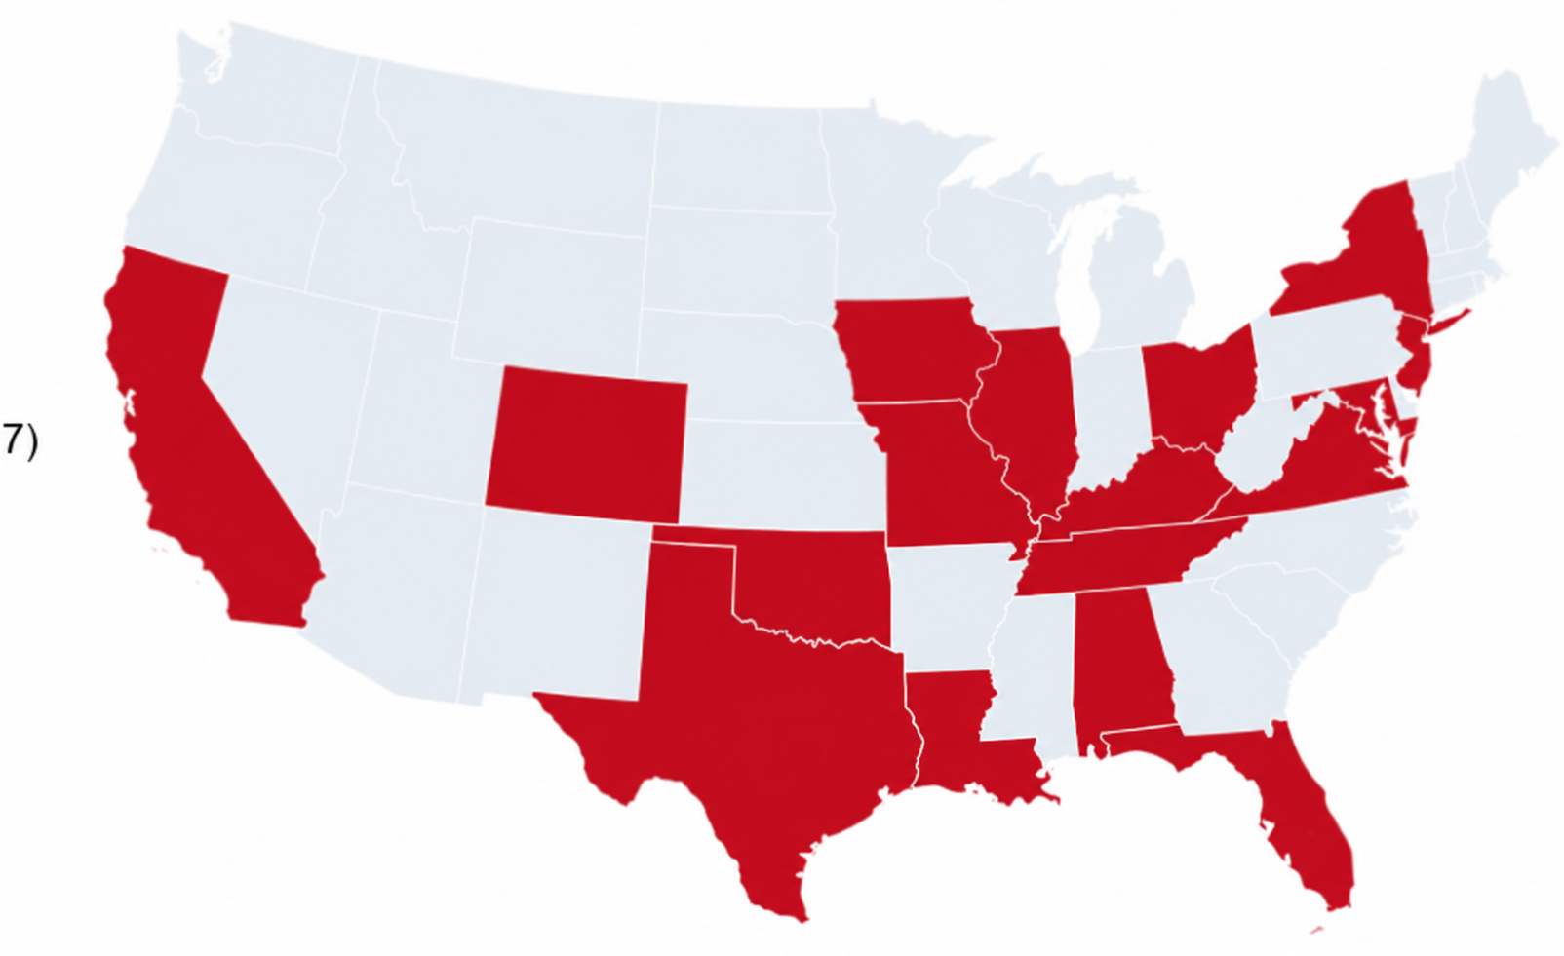
THANK YOU to PARAMOUNT Participants, Investigators, & Sites!
21
Clinical trial sites
Academic Research Hospital (7)
Community Hospital (4)
Community practice (10)
17
States

Slide 23
THANK YOU to PARAMOUNT Participants, Investigators, & Sites!
Suvasini Lakshmanan
Lundquist
Torrance, CA
Christopher Angus
Intermountain Health
Denver, CO
Robert Hendel
Tulane University School of Medicine
New Orleans, LA
Monica Aggarwal
Flourish Orlando
Winter Park, FL
Sara Collins
Flourish Bowie
Bowie, MD
Kashif Shaikh
University of Tennessee
Knoxville, TN
Mazen Abu-Fadel
Oklahoma Cardiovascular Research Group
OK City, OK
Gil Vardi
St. Louis Heart and Vascular
St. Louis, MO
Travis Huffman
St. Elizabeth
Edgewood, KY
Amir Rafie
Valiance Huntington Park
Burbank, CA
Enrico Martin
Mercy One
West Des Moines, Iowa
Augustin DeLago
Capital Cardiology
Albany, NY
Aamer Jamali
Valiance Tarzana
Tarzana, CA
Saihari Sadanandan
Tampa Cardiovascular Interventions & Research
Tampa, FL
Milind Parikh
Cardiovascular Institute of San Diego
San Diego, CA
Nayef Abouzaki
Chippenham (HCA)
Richmond, VA
Andrey Espinoza
Advanced Heart & Vascular Institute of Hunterdon
Flemington, NJ
Giridhar Mundluru
Medical City Fort Worth (HCA)
Fort Worth, TX
Donald Wayne
University of Cincinnati
Cincinnati, OH
Jason Cole
Mobile Cardiology
Mobile, AL
Amit Pursnani
NorthShore Cardiovascular Institute
Evanston, IL

Slide 24
Thank You
Todd C. Villines, MD; Borek Foldyna, MD, PhD, Melissa Aquino, MS, Vidhya Kumar, PhD, Udo Hoffmann, MD, MPH, Maros Ferencik, MD, PhD - on behalf of the PARAMOUNT Study Investigators
PARAMOUNT Methods Paper: JACC: Advances 2026

