Slide 1



American Heart Association Saturday November 7, 2026
Interleukin-6 Inhibition for Atherosclerotic Disease:
Primary Report of the Ziltivekimab Cardiovascular Outcomes Study (ZEUS)
Paul M Ridker, A Michael Lincoff, Nikolaus Marx, Ann Marie Navar, Naveed Sattar,
Katherine R Tuttle, Lance A Sloan, Lale Tokgozoglu, Andreas Andersen, Florian MM Baeres, Kathrine Ekstrom, Mads DM Engelmann, Sofia Gerward, G. Kees Hovingh,
Anders Hvelplund, and Vlado Perkovic on behalf of the ZEUS Investigators
Heart and Vascular Institute

Slide 2
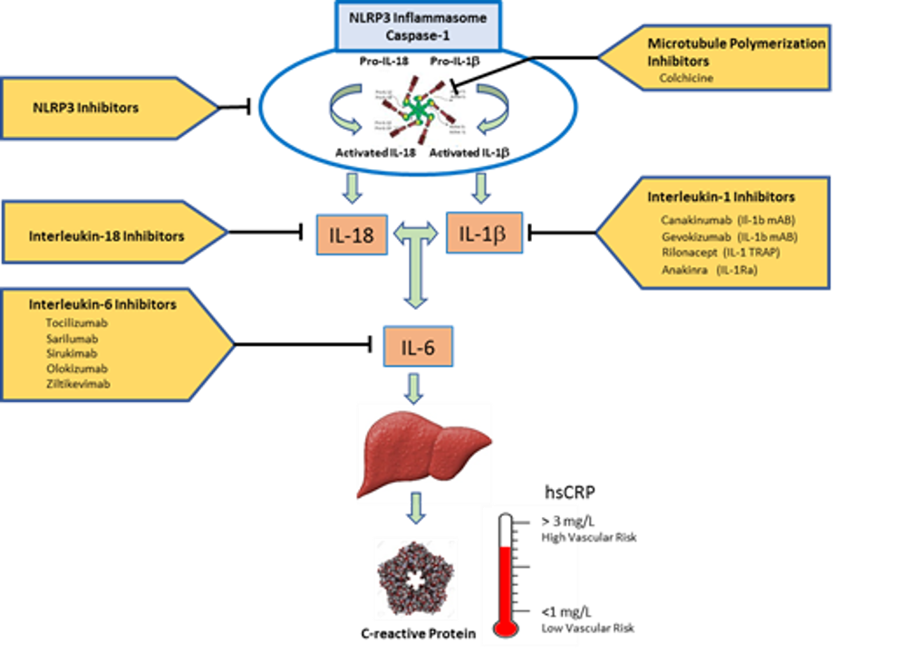
Background I : How to Target Innate Immunity in Atherosclerotic Disease?
Cardiovascular inflammation is a proven therapeutic target for the treatment and prevention of myocardial infarction, stroke, and cardiovascular death.
Over the past decade, randomized clinical trials targeting cardiovascular inflammation have focused primarily on the NLRP3 to IL-1 to IL-6 to CRP pathway of innate immunity.
This pathway has multiple potential targets including upstream inhibition of the NLRP3 inflammasome, central inhibition of IL-18 and IL-1β, and downstream inhibition of IL-6.
While all these approaches lower the clinical biomarker hsCRP, it is uncertain which point of intervention is causal and will result in fewer cardiovascular events.
Upstream
Central
Downstream
Ridker AHA 2026
Circulation 2020;141:787-789

Slide 3
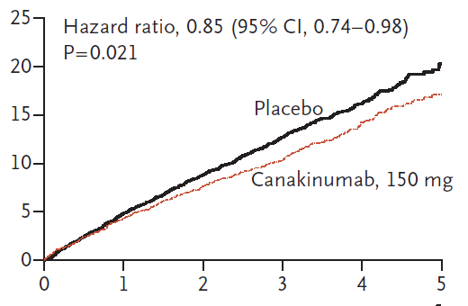
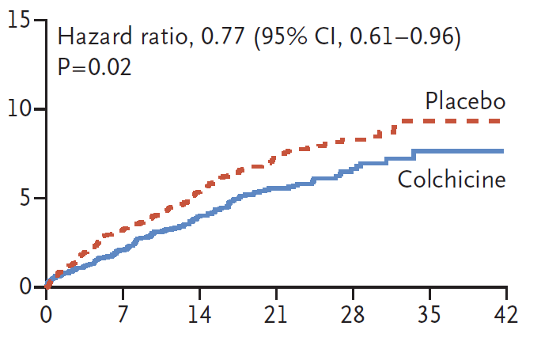
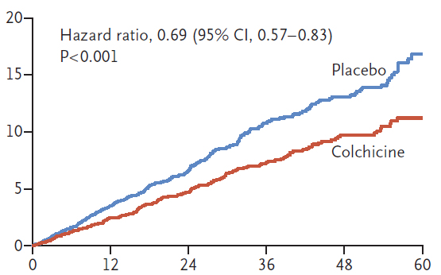
Background II : Canakinumab and Colchicine as Anti-Inflammatory Therapeutics
in Stable ASCVD
CANTOS
In 2017, the CANTOS trial demonstrated that IL-1β inhibition with canakinumab among patients with stable coronary disease reduced recurrent cardiovascular events by 15% in the absence of LDL lowering¹.
In 2019 and 2021, the COLCOT and LoDoCo2 trials confirmed the inflammation hypothesis of atherosclerosis by demonstrating that colchicine reduces cardiovascular events by 23 to 31% in patients with stable atherosclerotic cardiovascular disease (ASCVD)^{2,3.}
However, because colchicine is metabolized by the kidney, use of low-dose colchicine is relatively contraindicated among patients who have chronic kidney disease (CKD).
Thus, we sought a novel anti-inflammatory therapy for patients with ASCVD and CKD, a group with exceptionally high-risk and considerable unmet need.
COLCOT
LoDoCo2
¹NEJM 2017;377:1119-31; ²NEJM 2019;381:2497-2505; ³NEJM 2021;384:776-779
Ridker AHA 2026

Slide 4
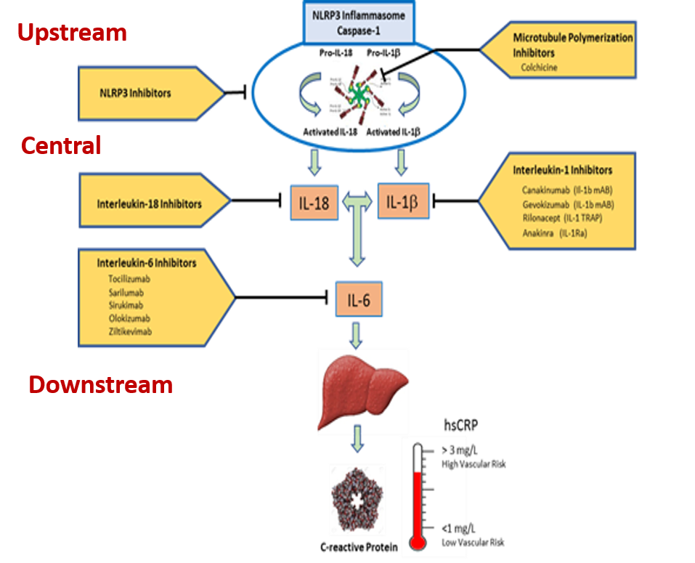
Background III: In the setting of ASCVD + CKD, why focus on downstream inhibition of IL-6?
Moving downstream from IL-1β inhibition in CANTOS to target IL-6 in ZEUS is supported by:
Mendelian randomization studies implicating IL-6 signaling in ASCVD initiation and progression.
Epidemiologic evidence that inflammatory biomarkers including IL-6 predict MACE and CV death among individuals with CKD.
Experimental studies in mice and humans.
Phase II studies in STEMI and non-STEMI in which IL-6 receptor antagonism safely reduced area under the hsCRP and troponin curves and improved indices of myocardial salvage.
Hypothesis generating evidence from the CANTOS IL-1β inhibition trial suggesting that event reduction was proportionate to the magnitude of reduction in downstream IL-6.
Circ Res 2021;128:1728-1746
Ridker AHA 2026
Circulation 2020;141:787-789

Slide 5
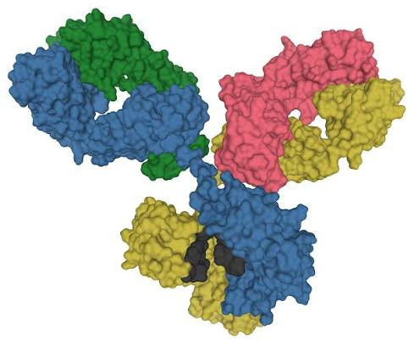
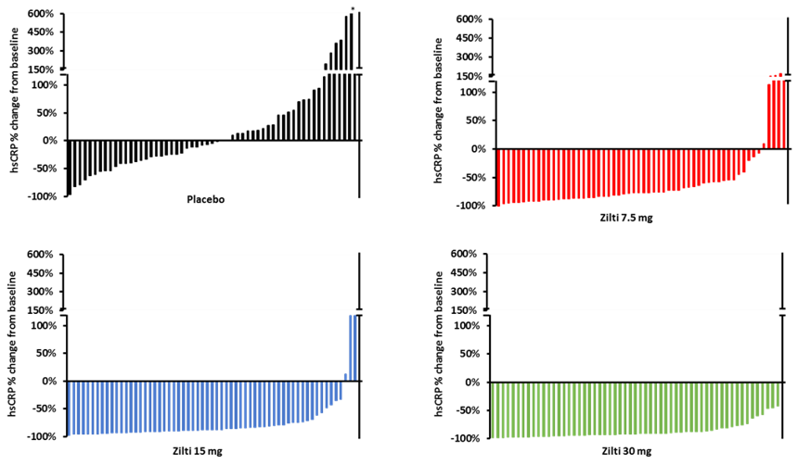
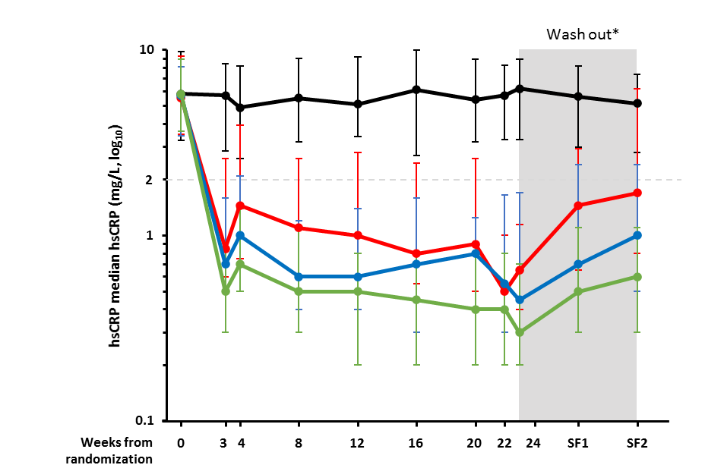

Background IV: Why Ziltivekimab and at What Dose?
Ziltivekimab is a monoclonal antibody that directly binds IL-6 and thus should inhibit both classical and trans IL-6 signaling.
The selected dose of 15mg SC monthly used in ZEUS was based upon the phase II RESCUE trial in which patients with CKD and atherosclerotic risk treated with ziltivekimab achieved large and persistent reductions in downstream hsCRP.
Placebo
7.5 mg
15.0 mg
30.0 mg
Ridker AHA 2026
Lancet 2021;397:2060-2069

Slide 6
ZEUS : Conduct and Design I
JAMA Cardiol 2026;11:89–97
The Ziltivekimab Cardiovascular Outcomes Study (ZEUS) was designed as a global, randomized, double-blind, placebo-controlled trial to evaluate whether IL-6 inhibition would reduce rates of cardiovascular events among high-risk individuals with ASCVD, CKD, and evidence of cardiovascular inflammation defined as hsCRP > 2 mg/L.
Randomisation (1:1)
6,376 participants
Serum hsCRP ≥2 mg/L
Established ASCVD*
CKD defined as either eGFR
≥15 to <60 mL/min/1.73 m²
or eGFR ≥60 mL/min/1.73 m² with UACR ≥200 mg/g
Ziltivekimab 15 mg s.c. once monthly + SoC
Placebo s.c. once monthly + SoC
Optional
pre-screening
Screening
(2 weeks)
Treatment
period
Follow-up
(3 months)
Observation period, event-driven until the pre-specified
number of first MACE (1,044) has been accrued
Objective
Primary endpoint
Confirmatory secondary endpoints
To demonstrate the superiority
of ziltivekimab 15 mg s.c.
once-monthly in reducing
the risk of MACE compared
with placebo
Time to first occurrence of
3-point MACE:
CV death
Non-fatal MI
Non-fatal stroke
Time to first occurrence of expanded 4-point MACE
Number of hospitalisations for HF or urgent HF visit
or CV death
Time to first occurrence of a composite CKD endpoint*
Time to occurrence of all-cause mortality
Ridker AHA 2026
* sustained reduction in eGFR of at least 40% from baseline, death from kidney failure or cardiovascular causes, or kidney failure

Slide 7
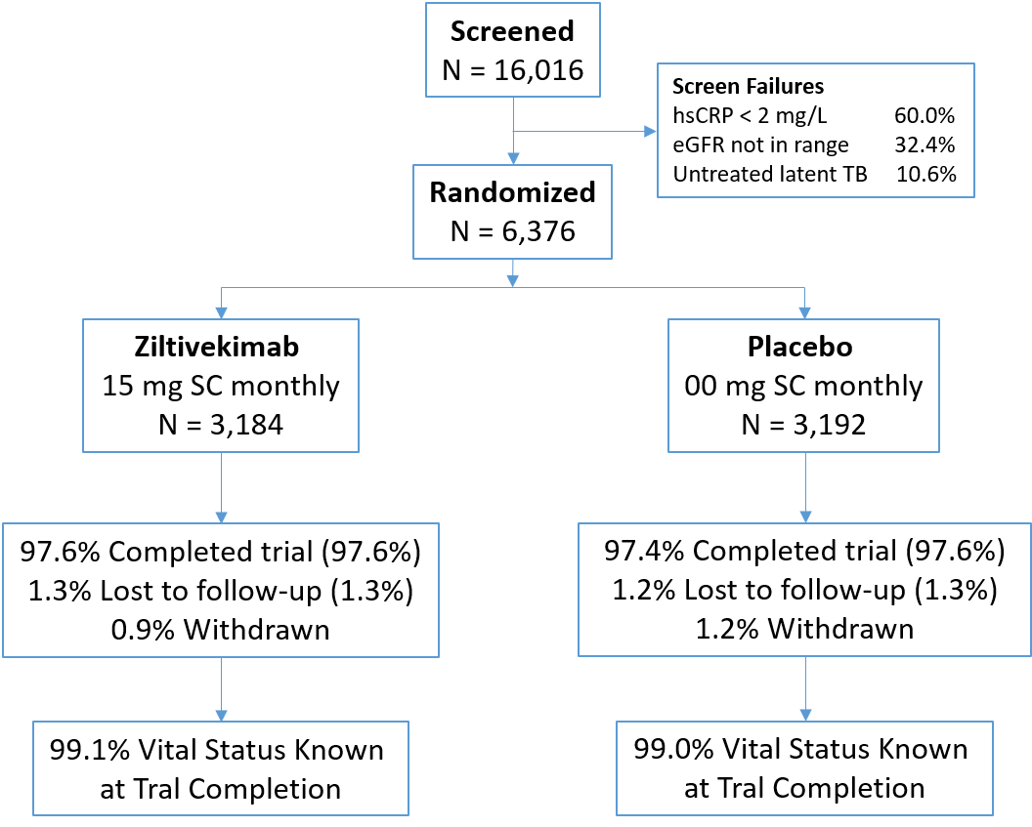
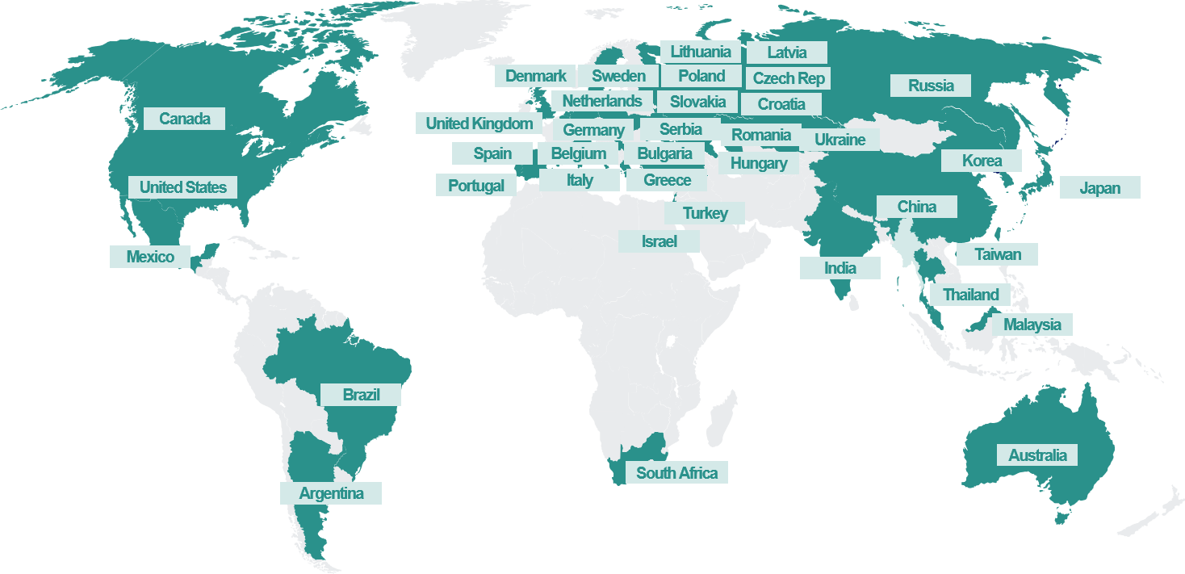
ZEUS : Conduct and Design II
6,376 participants at 757 sites in 38 countries
Median on-treatment period 33 months (IQR 27 – 42, max 55)
Adherence to trial regimen averaged 85.6% over time
1.3% lost to follow-up, vital status known for 99.1%
ASCVD, CKD, hsCRP >2 mg/L
Ridker AHA 2026

Slide 8
ZEUS : Baseline Characteristics
All Participants With Prevalent ASCVD, CKD, and hsCRP > 2 mg/L
Characteristic | Ziltivekimab (N = 3184) | Placebo (N = 3192)
Age (years) | 69.4 | 69.4
Female sex, (%) | 27.9 | 27.1
Body mass index (kg/m²) | 30.3 | 30.2
Current smoker, (%) | 13.9 | 13.2
Diabetes, (%) | 66.5 | 65.1
Hypertension, (%) | 92.3 | 92.1
Heart failure, (%) | 42.8 | 41.5
eGFR (mL/min/1.73 m²) | 44.5 | 44.5
hs-CRP (mg/L), median (IQR) | 4.5 (2.8–8.5) | 4.5 (2.7–8.5)
IL-6 (pg/mL), median (IQR) | 4.9 (3.2–7.7) | 4.8 (3.2–7.7)
LDL-C (mg/dL), median (IQR) | 72 (54–96) | 71 (54–94)
Concomitant Medications | %
Lipid Lowering | 92.6
RAAi | 76.4
SGLT2i (beginning) | 37.1
(completion) | 52.1
GLP1rA (beginning) | 11.4
(completion) | 18.6
Ridker AHA 2026

Slide 9
ZEUS : Results I
Increasing Tertiles of Both hsCRP and IL-6 Associate with Increasingly High Risks of Major Adverse Cardiovascular Events and Death
MI, Stroke, CV Death
All-Cause Mortality
Incidence Rate
(100 person years)
Incidence Rate
(100 person years)
<3.3 3.3-6.8 > 6.8
(mg/L)
<3.7 3.7-6.4 > 6.4
(pg/mL)
<3.3 3.3-6.8 > 6.8
(mg/L)
<3.7 3.7-6.4 > 6.4
(pg/mL)
Ridker AHA 2026

Slide 10
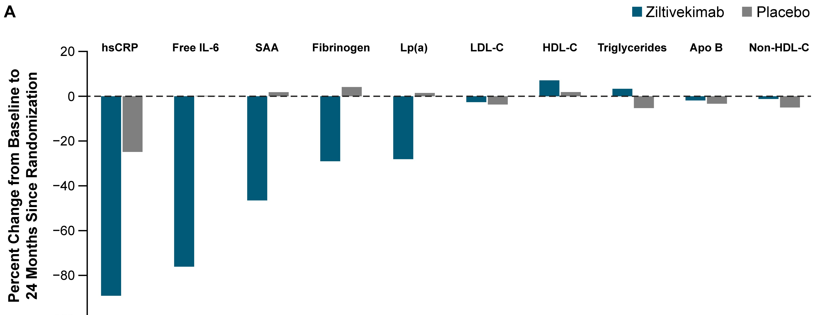
ZEUS : Results II
Placebo-Adjusted Effects of Ziltivekimab on Inflammatory and Other Biomarkers
-33%
-29%
-48%
-76%
-64%
Placebo adjusted percent change from baseline
Ridker AHA 2026

Slide 11
ZEUS : Results III
Evidence of Target Engagement - Long-term effects of ziltivekimab on hsCRP and free IL-6
Median Percent Change in hsCRP
Median Percent Change in free IL-6
20
20
Placebo
0
Placebo
0
-20
-20
-40
% change from baseline in hsCRP
-40
% change from baseline in IL-6
-60
Ziltivekimab
-60
Ziltivekimab
-80
-80
-100
-100
0
1
3
6
12
18
24
30
36
42
48
0
1
3
6
12
18
24
Months
Months
64% Placebo-Adjusted Change in hsCRP
76% Placebo-Adjusted Change in free IL-6
Ridker AHA 2026

Slide 12
ZEUS : Primary and Secondary Endpoints
Endpoint | Ziltivekimab N (%) IR* | Placebo N (%) IR* | HR (95%CI)
Primary Endpoint: 3-point MACE | 561 (17.6) 6.7 | 565 (17.7) 6.8 | 0.99 (0.88–1.11)
Cardiovascular death | 353 (11.1) 4.0 | 356 (11.2) 4.1 | 0.99 (0.86–1.15)
Nonfatal myocardial infarction | 143 (4.5) 1.7 | 148 (4.6) 1.7 | 0.97 (0.77–1.22)
Nonfatal stroke | 114 (3.6) 1.3 | 124 (3.9) 1.4 | 0.92 (0.71–1.18)
Expanded 4-point MACE**
Number of heart failure hospitalizations, urgent heart failure visits, or CV death
Composite kidney endpoint***
All-cause mortality
*IR = incidence rate per 100 participant years of observation. ** inclusive of hospitalization for unstable angina requiring urgent revascularization
*** sustained reduction in eGFR of at least 40% from baseline, death from kidney failure or cardiovascular causes, or kidney failure
(onset of sustained eGFR <15ml per minute per 1.73m2 or initiation of chronic kidney replacement therapy).
Ridker AHA 2026

Slide 13
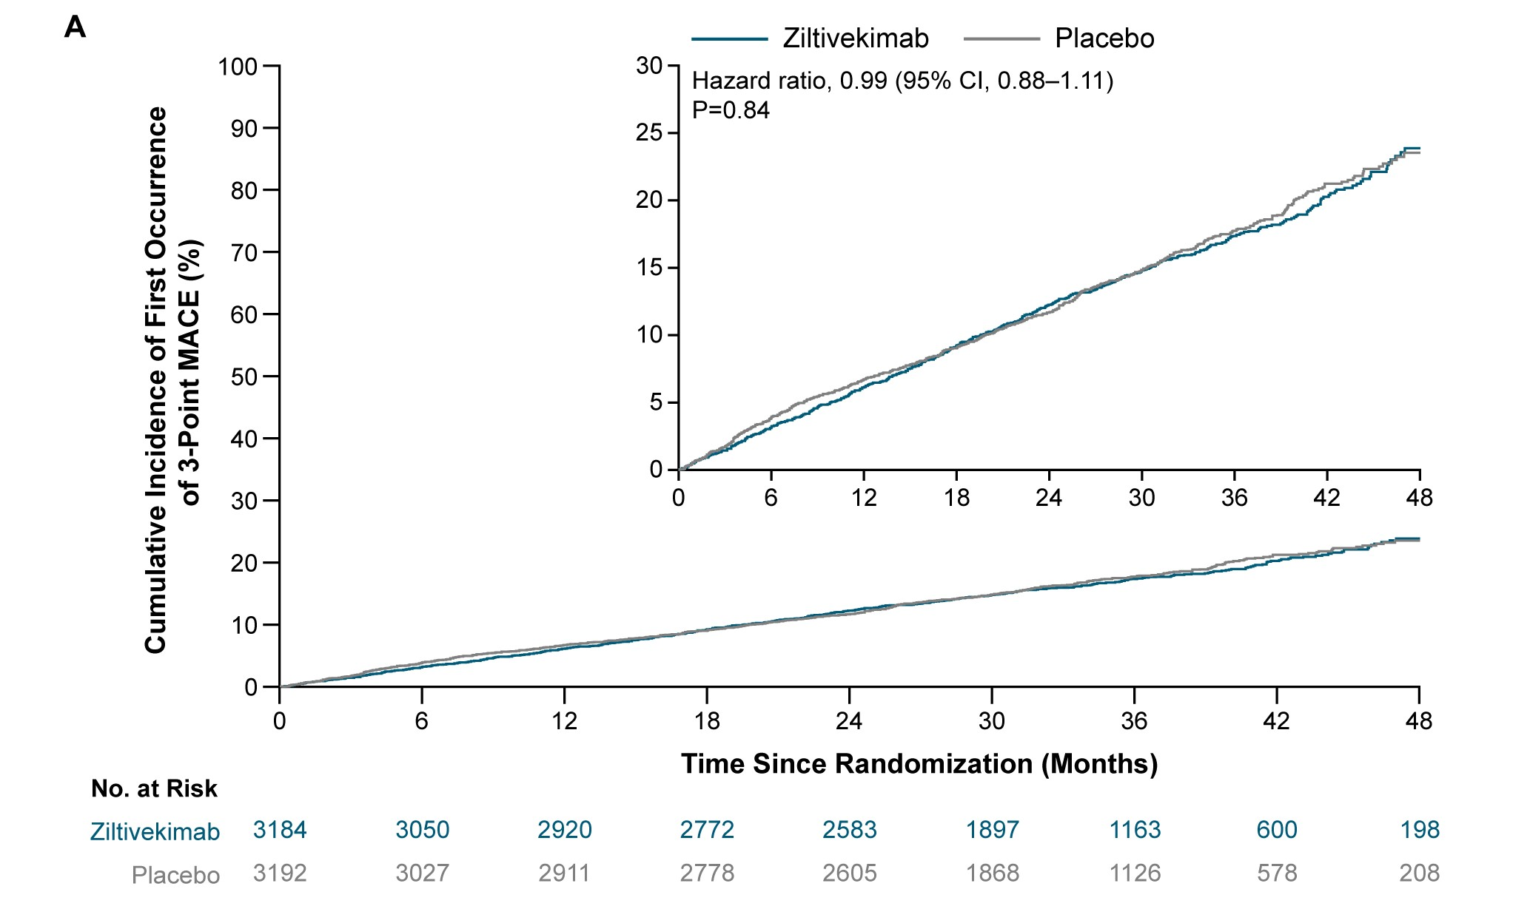
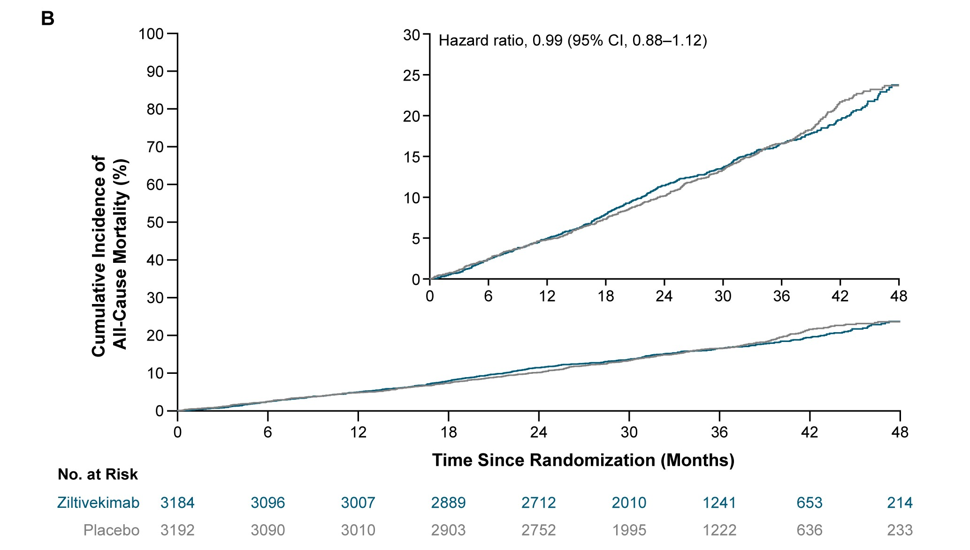
ZEUS : Primary Results
3-Point MACE
All-Cause Mortality
Cumulative Incidence of
3-point MACE (%)
Cumulative Incidence of
All-Cause Mortality (%)
Months
Months
Ridker AHA 2026

Slide 14
ZEUS : Primary Endpoint, Selected Pre-Specified Subgroups
Subgroup | HR (95% CI) |  | No. of events / analysed participants
Sex
Female | 0.93 (0.74; 1.17) |  | 292/1,754
Male | 1.01 (0.88; 1.16) |  | 834/4,622
Age
<65 years | 1.03 (0.81; 1.30) |  | 276/1,690
65–<75 years | 0.97 (0.81; 1.16) |  | 481/2,711
≥75 years | 0.98 (0.80; 1.20) |  | 369/1,975
BMI (kg/m²)
<25 | 0.76 (0.57; 1.00) |  | 203/1,150
25–<30 | 1.03 (0.84; 1.26) |  | 381/2,243
≥30 | 1.06 (0.90; 1.26) |  | 539/2,969
hsCRP
<median | 0.88 (0.74; 1.06) |  | 470/3,188
≥median | 1.07 (0.92; 1.25) |  | 656/3,188
IL-6
<median | 0.92 (0.76; 1.10) |  | 449/3,141
≥median | 1.04 (0.89; 1.21) |  | 659/3,147
Subgroup | HR (95% CI) |  | No. of events / analysed participants
T2D
No | 1.00 (0.79; 1.26) |  | 293/2,180
Yes | 0.98 (0.85; 1.12) |  | 833/4,196
SGLT2i
No | 1.00 (0.86; 1.16) |  | 677/4,013
Yes | 0.98 (0.82; 1.18) |  | 449/2,363
Incretins
No | 1.00 (0.88; 1.13) |  | 999/5,651
Yes | 0.89 (0.63; 1.26) |  | 127/725
ASCVD subtype
CHD | 0.97 (0.84; 1.13) |  | 687/4,228
Cerebrovascular disease | 0.91 (0.65; 1.27) |  | 140/766
PAD | 1.24 (0.78; 1.97) |  | 73/453
Polyvascular disease | 1.01 (0.77; 1.31) |  | 224/916
Subgroup | HR (95% CI) |  | No. of events / analysed participants
Heart failure
No | 0.88 (0.74; 1.05) |  | 512/3,687
Yes | 1.08 (0.92; 1.27) |  | 614/2,689
eGFR (mL/min/1.73 m²)
<30 | 0.99 (0.79; 1.24) |  | 298/1,157
30–<45 | 0.91 (0.75; 1.11) |  | 404/2,130
≥45 | 1.05 (0.87; 1.27) |  | 424/3,089
KDIGO groups at baseline
Very high risk | 0.98 (0.84; 1.14) |  | 655/2,847
High risk | 1.02 (0.81; 1.29) |  | 283/1,727
Low/moderate risk | 0.90 (0.68; 1.20) |  | 188/1,795
1.0
1.5
2.0
Favours ziltivekimab
Favours placebo
1.0
1.5
2.0
1.0
1.5
2.0
Median high-sensitivity CRP was 4.5 mg/liter.
Median interleukin-6 was 4.88 pg/l.
Favours ziltivekimab
Favours placebo
Favours ziltivekimab
Favours placebo
Ridker AHA 2026

Slide 15
ZEUS : Primary and Secondary Endpoints
Endpoint | Ziltivekimab N (%) IR* | Placebo N (%) IR* | HR (95%CI)
Primary Endpoint: 3-point MACE | 561 (17.6) 6.7 | 565 (17.7) 6.8 | 0.99 (0.88–1.11)
Cardiovascular death | 353 (11.1) 4.0 | 356 (11.2) 4.1 | 0.99 (0.86–1.15)
Nonfatal myocardial infarction | 143 (4.5) 1.7 | 148 (4.6) 1.7 | 0.97 (0.77–1.22)
Nonfatal stroke | 114 (3.6) 1.3 | 124 (3.9) 1.4 | 0.92 (0.71–1.18)
Expanded 4-point MACE* | 586 (18.4) 7.0 | 592 (18.5) 7.1 | 0.99 (0.88–1.10)
Number of heart failure hospitalizations, urgent heart failure visits, or CV death** | 794 (17.1) 9.1 | 842 (17.6) 9.6 | 0.94 (0.83-1.07)
Composite kidney endpoint*** | 643 (20.2) 7.8 | 617 (19.3) 7.4 | 1.05 (0.94-1.17)
All-cause mortality | 538 (16.9) 6.2 | 542 (17.0) 6.2 | 0.99 (0.88–1.12)
* inclusive of hospitalization for unstable angina requiring urgent revascularization. ** Mean ratio rather than hazard ratio
*** sustained reduction in eGFR of at least 40% from baseline, death from kidney failure or cardiovascular causes, or kidney failure
(onset of sustained eGFR <15ml per minute per 1.73m2 or initiation of chronic kidney replacement therapy).
Ridker AHA 2026

Slide 16
ZEUS : Safety and Adverse Events
Adverse Event | Ziltivekimab N (%) | Placebo N (%)
Serious adverse event | 1738 (54.6%)​ | 1750 (54.8%)​
Serious adverse event of infection | 651 (20.4%)​ | 571 (17.9%)​
Cellulitis | 93 (2.9%)​ | 31 (1.0%)​
Infection as primary cause of hospitalization | 544 (17.1%)​ | 472 (14.8%)​
Opportunistic infection | 87 (2.7%)​ | 71 (2.2%)​
Death due to infection | 101 (3.2%)​ | 80 (2.5%) ​
Malignant neoplasms | 205 (6.4) | 213 (6.7)
Serious adverse event of Hemorrhage | 161 (5.1%)​ | 129 (4.0%)​
Serious adverse event of Venous thromboembolism | 51 (1.6%)​ | 20 (0.6%)​
*
*
*
*
* Fisher’s exact p-value < 0.05
Ridker AHA 2026

Slide 17
ZEUS : Controversies and Possible Reasons for Neutral Findings I
Wrong Target or Non-Modifiable Disease?
Compared to CANTOS (a positive trial of IL-1β inhibition), ZEUS (a neutral trial of IL-6 inhibition) evaluated a much higher risk population raising the possibility that advanced disease may be less amendable to modification by anti-inflammatory therapy.
Characteristic | CANTOS (IL-1β) ASCVD + hsCRP > 2 | ZEUS (IL-6) ASCVD + hsCRP > 2 + CKD
Age (years) | 61 | 69
Diabetes (%) | 40 | 66
Heart Failure (%) | 22 | 42
KDIGO Class High or Very High (%) | 11.4 | 71.8
eGFR (ml/min/1.73m²) | 80 | 45
Endpoint
3-Point MACE (IR/100 PY) | 4.5 | 6.8
All Cause Mortality (IR/100 PY) | 3.0 | 6.2
Ridker AHA 2026

Slide 18
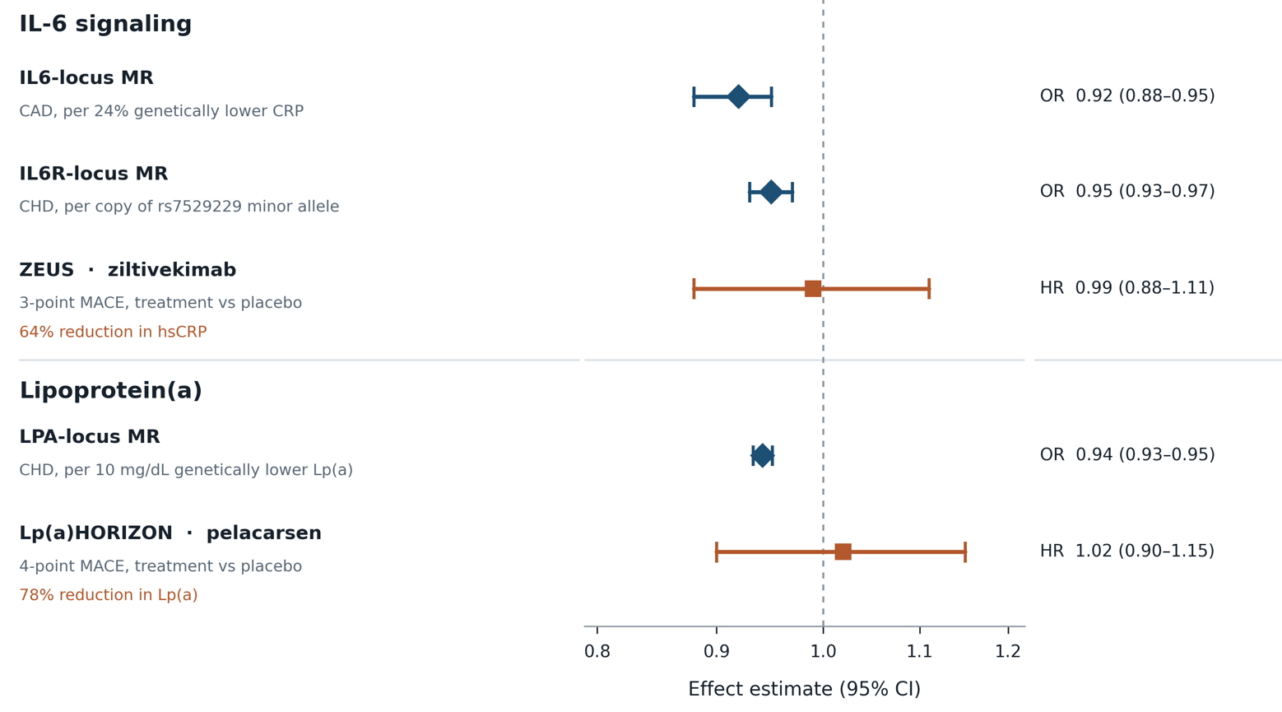
ZEUS : Controversies and Possible Reasons for Neutral Findings II
Genetic Causality is Not Therapeutic Reversibility
Conflicting Evidence from Mendelian Randomization Studies and Randomized Control Trials
Ridker AHA 2026
Courtesy of M. Shapiro

Slide 19
ZEUS : Conclusions and Considerations of a Neutral Trial
Cardiovascular inflammation is highly prevalent and remains a mechanistically compelling therapeutic target beyond lipid lowering.
The CANTOS, LoDoCo2 and COLCOT trials have proven that anti-inflammatory therapy can reduce
cardiovascular event rates. The relevant question moving forward is what drug in which patient group?
ZEUS evaluated a selected population with established ASCVD and significant CKD raising the possibility that highly advanced disease may be less amendable to anti-inflammatory modification.
“The horse may already have been out of the barn”
The HERMES and ARTEMIS trials will provide further insights on the effect of ziltivekimab in very different trial populations, HFpEF/HFmrEF and acute coronary ischemia, respectively.
In addition to diet, exercise, and smoking cessation - all of which lower hsCRP - statins, colchicine, canakinumab, and GLP1rAs positively impact patients with residual inflammatory risk.
The NLRP3 to IL-1 to IL-6 signaling process is complex but biologically compelling. Several promising opportunities for downstream IL-6 inhibition remain in earlier modifiable disease as well as multiple opportunities for direct targeting of the upstream NLRP3 inflammasome.
Ridker AHA 2026

Slide 20
Ongoing and Anticipated Randomized Trials of Interleukin-6 Inhibition
IL-6 Inhibitor | Trial | Population | Sample Size
Ziltivekimab Novo Nordisk | ZEUS NCT05021835 | ASCVD, CKD, hsCRP > 2 mg/L | 6376 Completed
 | HERMES NCT05636176 | HFpEF/HFmrEF, hsCRP > 2 mg/L | 4873 Fully Enrolled
 | ARTEMIS NCT06118281 | Acute STEMI and non-STEMI | 8348 Fully Enrolled
Clazakizumab CSL Behring | POSIBIL₆ESKD NCT05485961 | Dialysis, diabetes or ASCVD, hsCRP > 2 mg/L | 2190 Enrolling
Pacibekitug Tourmaline / Novartis | In Development
IL-6 = interleukin-6; ASCVD = atherosclerotic cardiovascular disease; CKD = chronic kidney disease; hsCRP = high sensitivity C-reactive protein; HFpEF = heart failure with preserved ejection fraction; HFmrEF = heart failure with mid-range ejection fraction; STEMI = ST elevation myocardial infarction
Ridker AHA 2026
JACC 2026;88:299-301

Slide 21
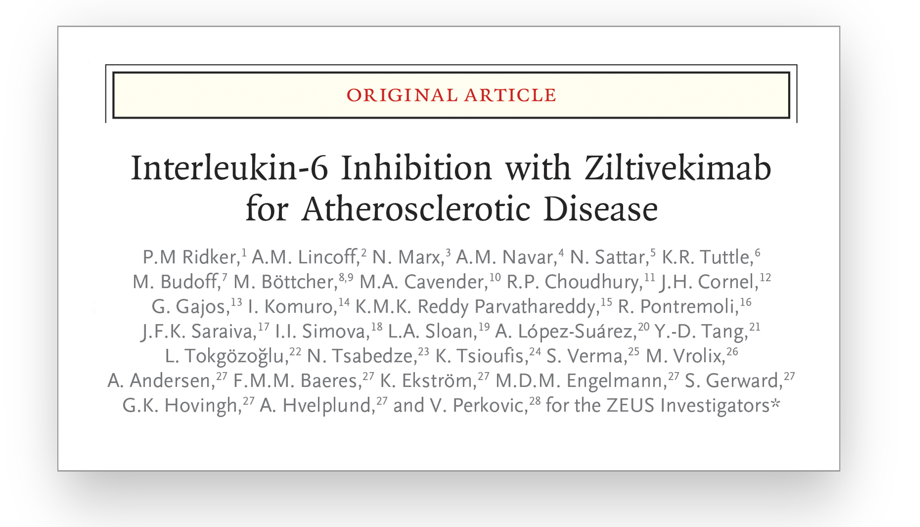


The ZEUS Executive Committee wishes to thank the trial sponsor, the trial staff at our 757 clinical sites
in 38 countries, and most importantly the 6,376 participants in our trial
Science in Depth ZEUS Presentation: Sunday November 8, N230B 9:45 AM

