Slide 1

The Lp(a) Horizon Trial
Pelacarsen in Patients with Elevated Lp(a) and Cardiovascular Disease
Steven E. Nissen MD MACC
On behalf of the investigators and our extraordinary patients
Study Sponsor:
Novartis Pharmaceuticals

Slide 2
Executive Committee
Steven E. Nissen
Study Chair
Leslie Cho
Principal Investigator
Eran Leitersdorf
Ulf Landmesser
A. Michael Lincoff
Michael Blaha
Stephen J. Nicholls
Børge G. Nordestgaard
Ryuichi Morishita
Sotirios Tsimikas
Hui Cao, Anastasia Lesogor (sponsor representatives)
Jackie McCluskey Seth Frndak & Kathy Wolski (C5), Jing Wang (NVS) Brian Manning C5Research Lead Project Manager Statisticians Novartis Trial Manager

Slide 3
Background
Lipoprotein(a) is a genetically-determined causal risk factor for ACSVD
and aortic stenosis with no approved pharmacological treatments.
The LPA gene encodes for apolipoprotein(a), an essential and rate limiting component required for production of lipoprotein(a).
Pelacarsen is an antisense oligonucleotide (ASO) designed to degrade hepatic mRNA coding for apolipoprotein(a).
The current study is a Phase 3 cardiovascular outcome trial examining the safety and efficacy of pelacarsen in patients with elevated lipoprotein(a) and pre-existing cardiovascular disease.

Slide 4
Lp(a) Horizon Trial Design
A double-blind, placebo-controlled trial in patients with cardiovascular event 3 months to 10 years prior to enrollment.
Risk factor optimization implemented during 30-to-90-day period
(if needed) to strictly meet secondary prevention guidelines.
Eligibility required lipoprotein(a) values ≥70 mg/dL (~148 nmol/L) at screening, stratified based on values ≥90 mg/dL (~192 nmol/L).
Patients randomized 1:1 to pelacarsen 80 mg or placebo
self-administered subcutaneously each month at home.

Slide 5
Primary and Key Secondary Endpoints
Primary endpoint: 4-component MACE (CV death, nonfatal stroke, nonfatal MI or urgent coronary revascularization).
Multiplicity-controlled key secondary endpoints:
  3-component MACE (without revascularization)
  3-component MACE with CHD death rather than CV death
  Lipoprotein(a) change at 12 months
Event driven until 993 primary end points accrued, assuming
a maximum follow up of 4.25 years.

Slide 6
Study Milestones
14,244 patients screened and 8350 randomized at 797 sites
in 42 countries (8322 included in efficacy analyses).
Patients enrolled December 2019 to July 2022 with a median duration of follow-up 57 months (4.7 years).
Although conducted during the pandemic, complete assessment for the primary endpoint in 97.2% and vital status in 99.3%.
Blinded interim analyses conducted by DMC after 55% and 75% of primary end points accrued.

Slide 7
Selected Baseline Characteristics
Characteristic | Pelacarsen N=4157 | Placebo N=4165
Mean Age (years) | 59.7 | 59.7
Female sex | 26.9% | 27.0%
White | 77.9% | 78.4%
Median LDL cholesterol (mg/dL) | 65.0 | 64.2
Median hsCRP (mg/L) | 0.8 | 0.8
High-intensity statin | 77.1% | 78.2%
Systolic Blood pressure | 125.5 mmHg | 125.1 mmHg
Diabetes mellitus | 25.8% | 26.9%
Median lipoprotein(a) | 235.6 nmol/L | 236.2 nmol/L
Lipoprotein(a) ≥90mg/dL | 256.8 nmol/L | 257.0 nmol/L

Slide 8
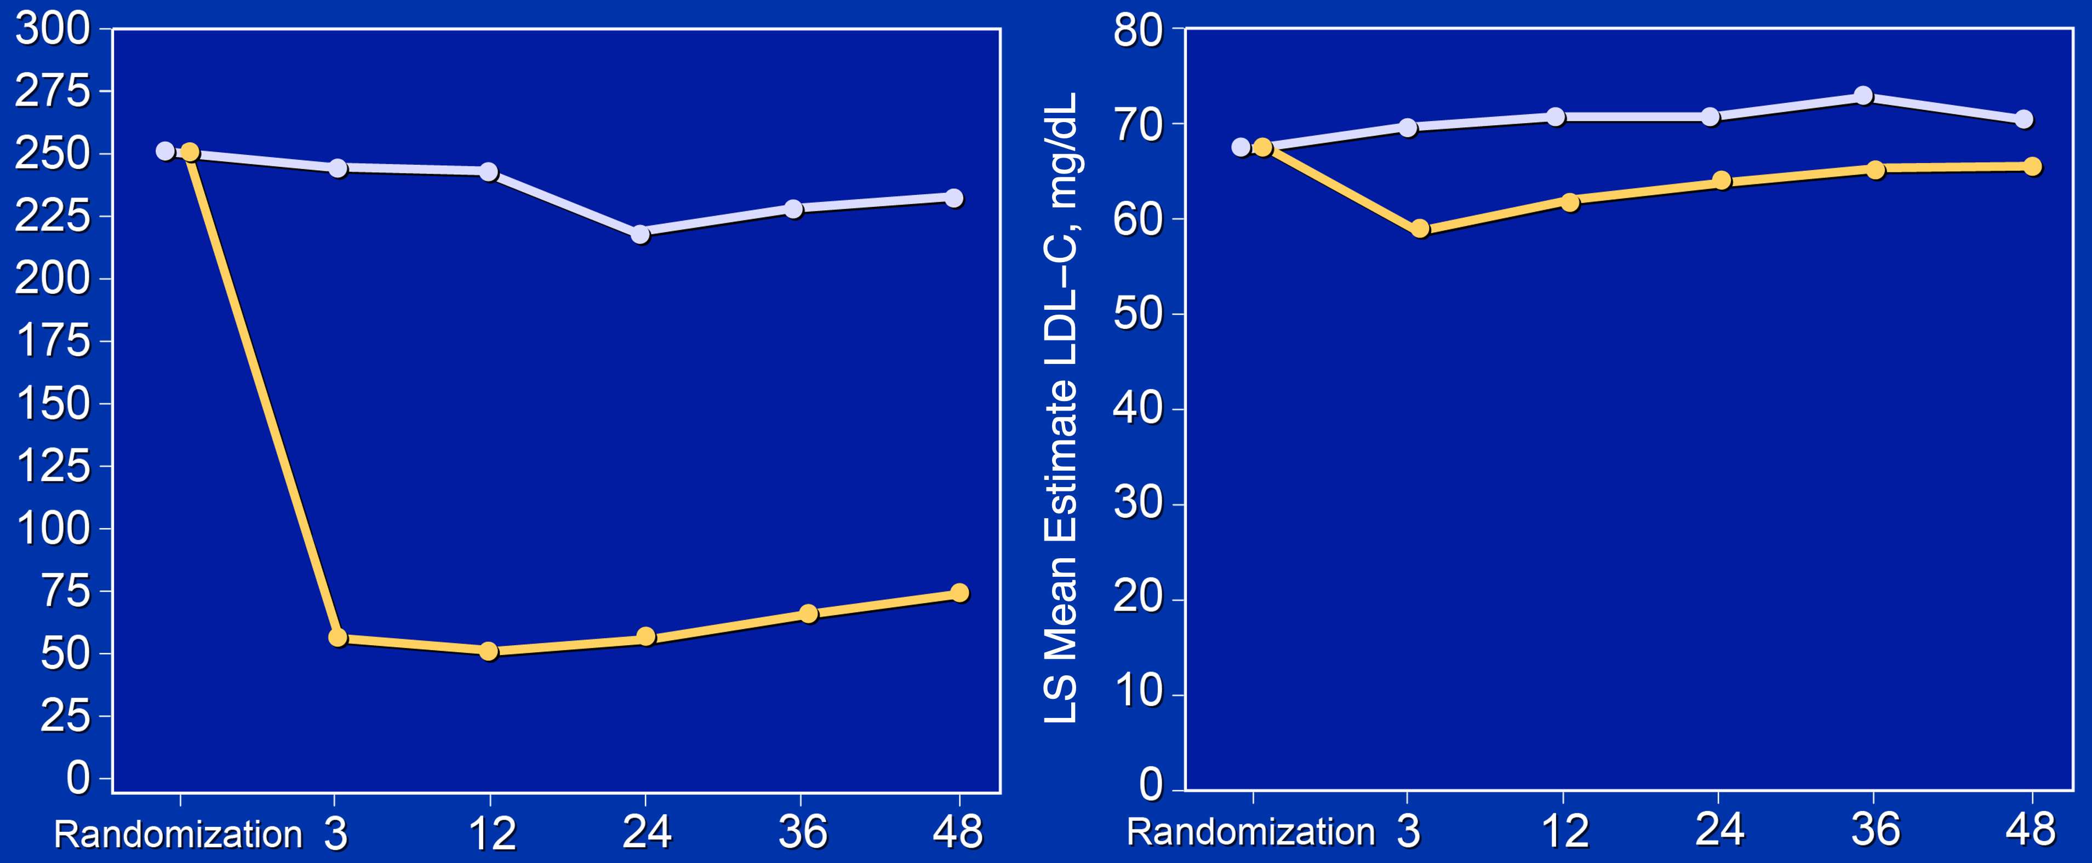
Effect of Trial Regimens on Lipoprotein(a) and LDL-C
Lipoprotein(a) over Time
LDL Cholesterol over Time
71 mg/dL
234 nmol/L
-13.3%
62 mg/dL
-77.7%
(174 nmol/L)
LS Mean Estimate Lp(a), nmol/L
Placebo
Pelacarsen
64 nmol/L
Placebo
Pelacarsen
Months Since Randomization
Months Since Randomization

Slide 9
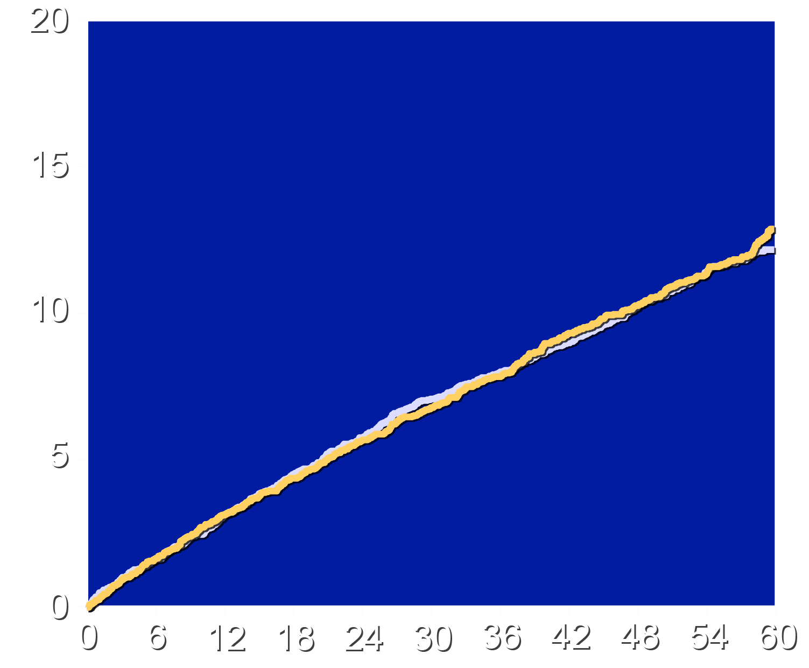
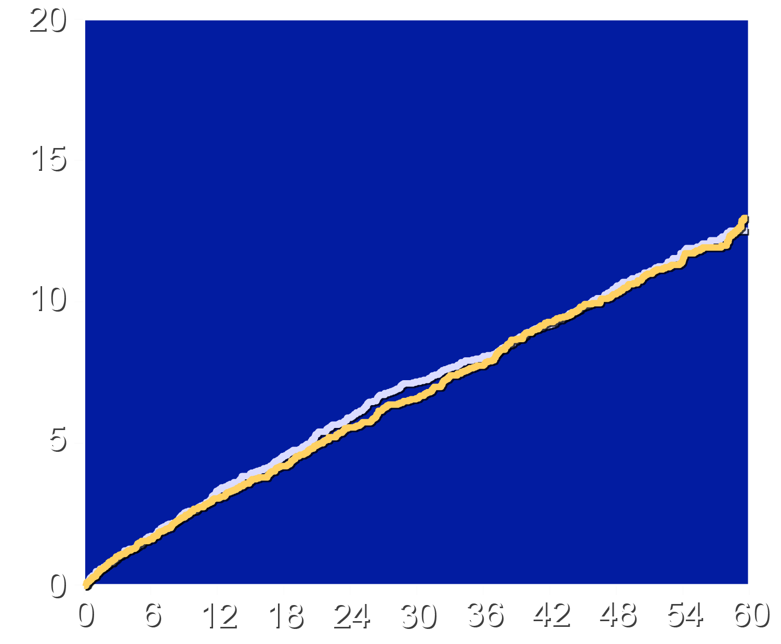
Effects of Trial Regimens on 4-component MACE
Full Population (≥70 mg/dL)
Subpopulation (≥90 mg/dL)
HR 1.02 (95% CI 0.90–1.15)
P = 0.69
HR 1.00 (95% CI 0.87–1.15)
P = 0.82
Cumulative Incidence (%)
Placebo
Pelacarsen
Placebo
Pelacarsen
Months Since Randomization
Months Since Randomization

Slide 10
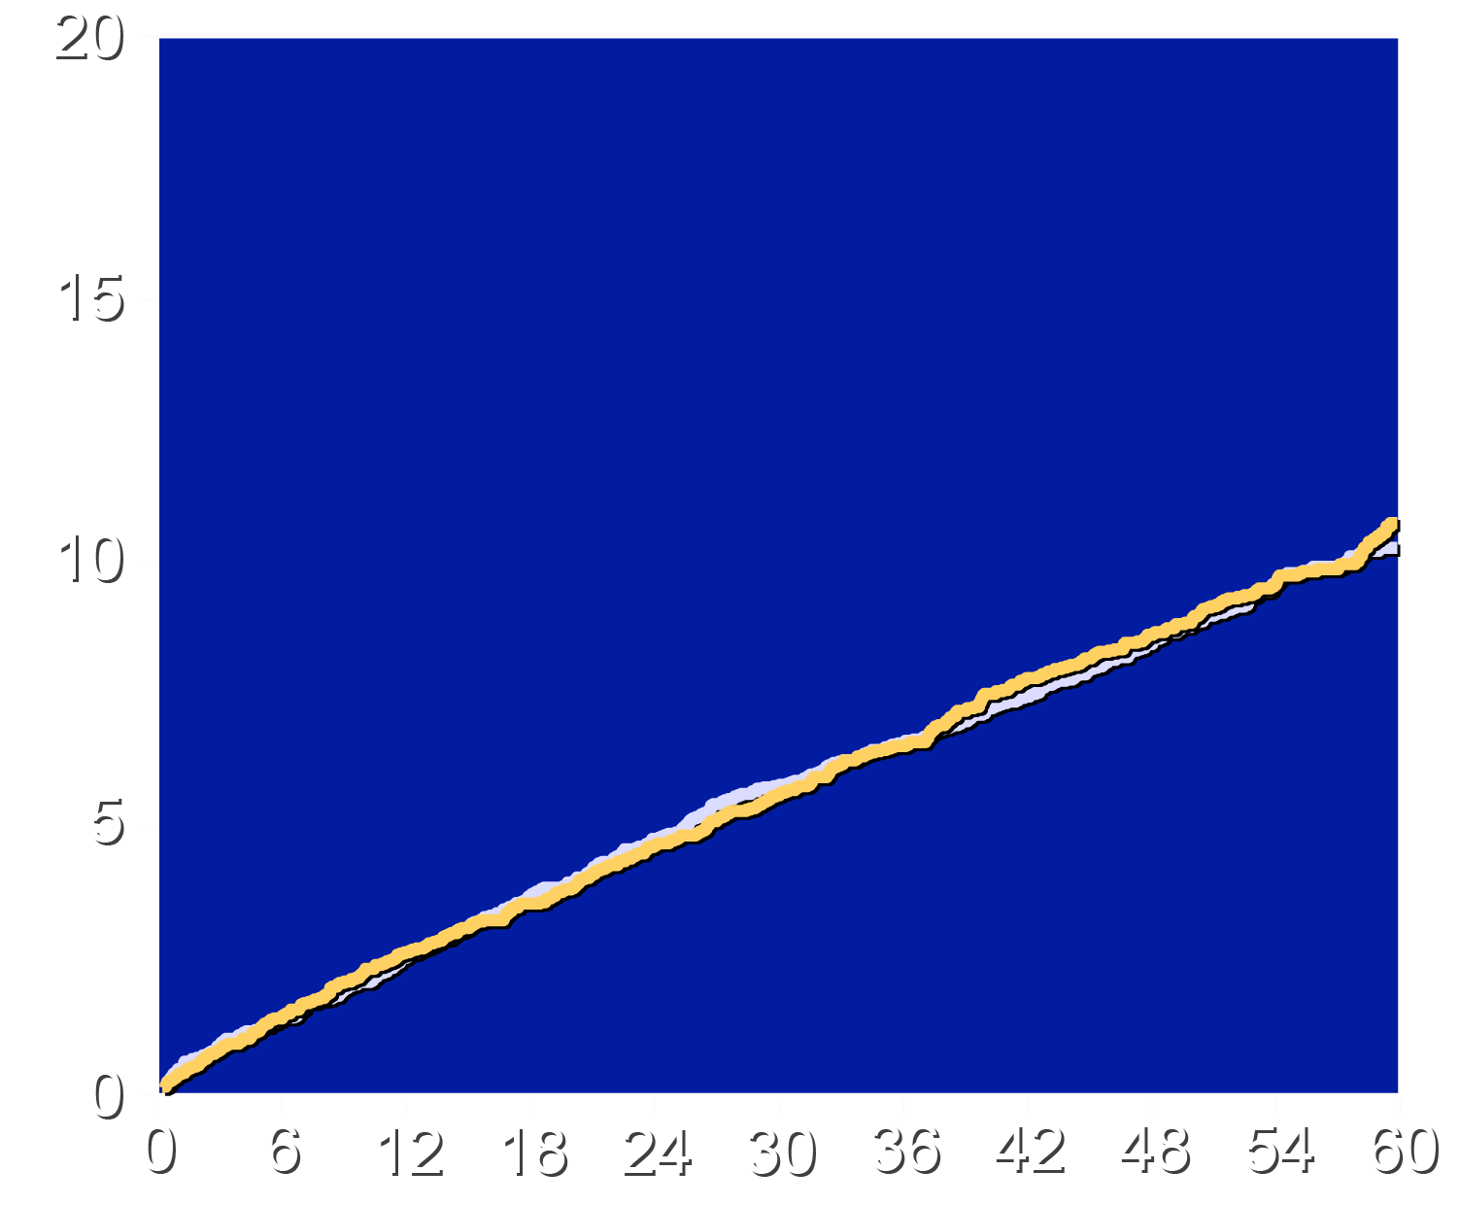
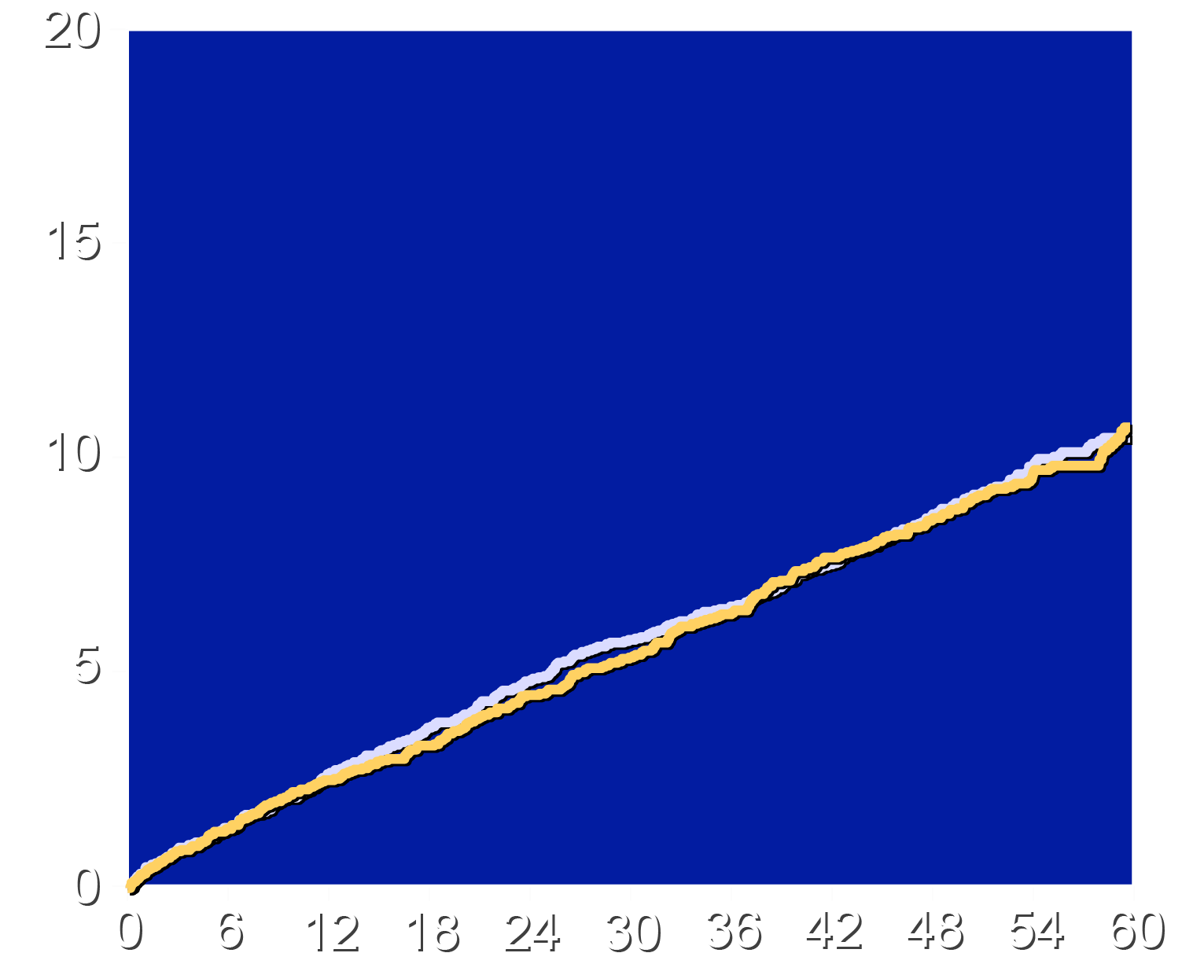
Effect of Trial Regimens on 3-component MACE
Full Population (≥70 mg/dL)
Subpopulation (≥90 mg/dL)
HR 1.01 (95% CI 0.88–1.16)
HR 0.99 (95% CI 0.85–1.15)
Cumulative Incidence (%)
Placebo
Pelacarsen
Placebo
Pelacarsen
Months Since Randomization
Months Since Randomization

Slide 11
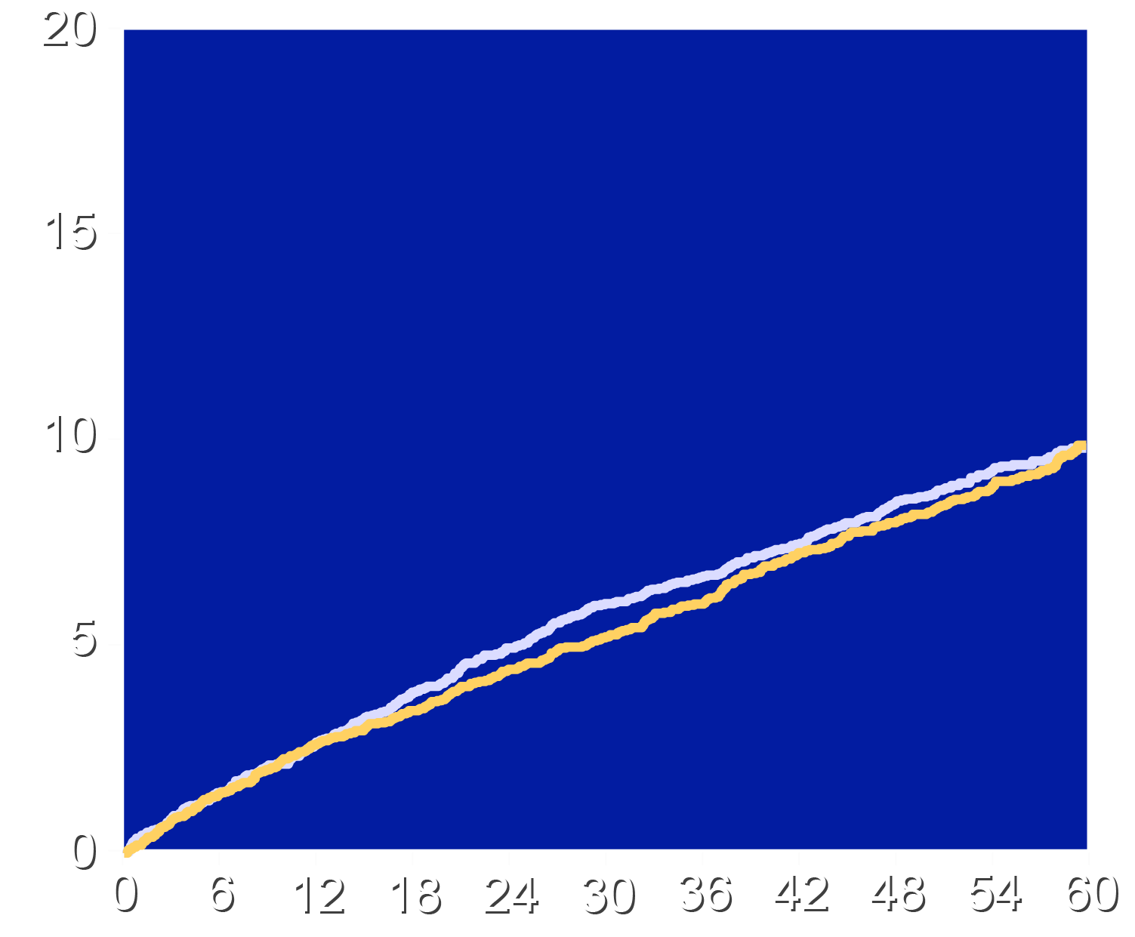
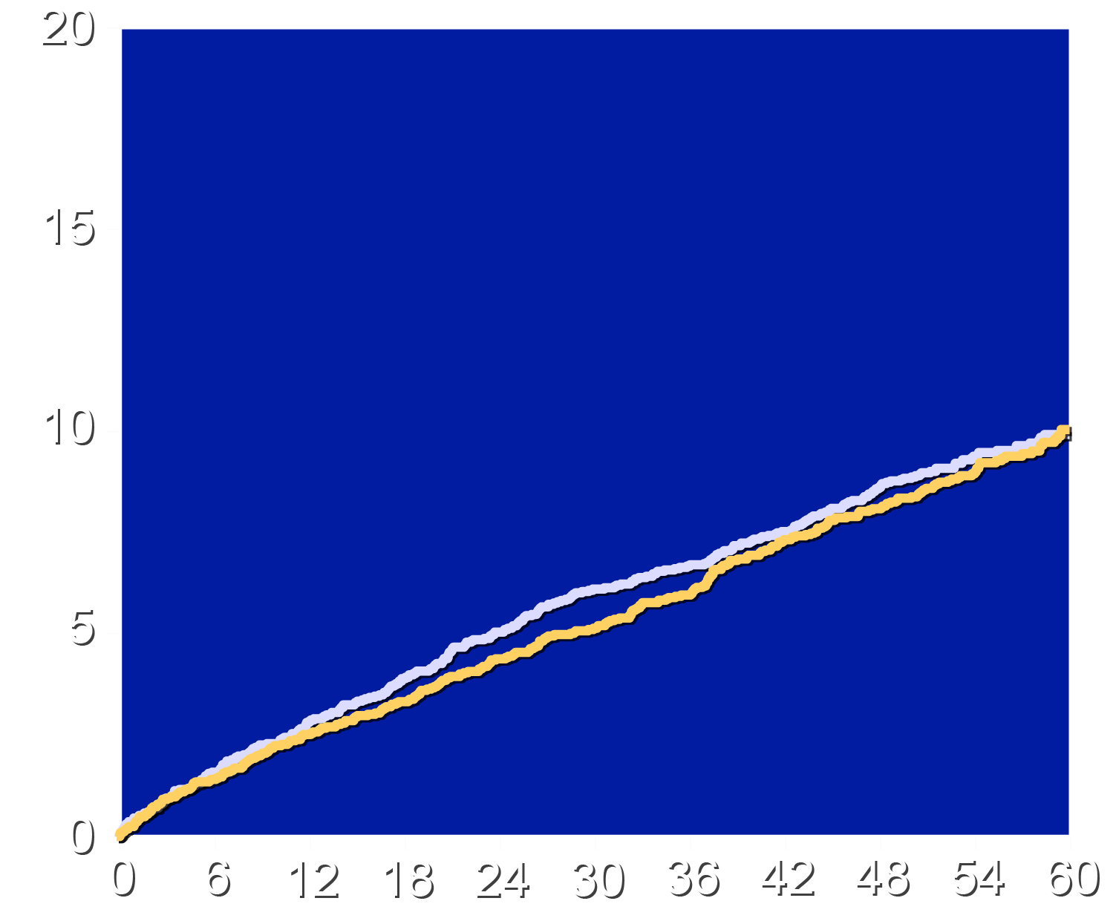
Effect of Trial Regimens on 3-component CHD MACE
Full Population (≥70 mg/dL)
Subpopulation (≥90 mg/dL)
HR 0.97 (95% CI 0.85–1.12)
HR 0.98 (95% CI 0.84–1.15)
Cumulative Incidence (%)
Placebo
Pelacarsen
Placebo
Pelacarsen
Months Since Randomization
Months Since Randomization

Slide 12
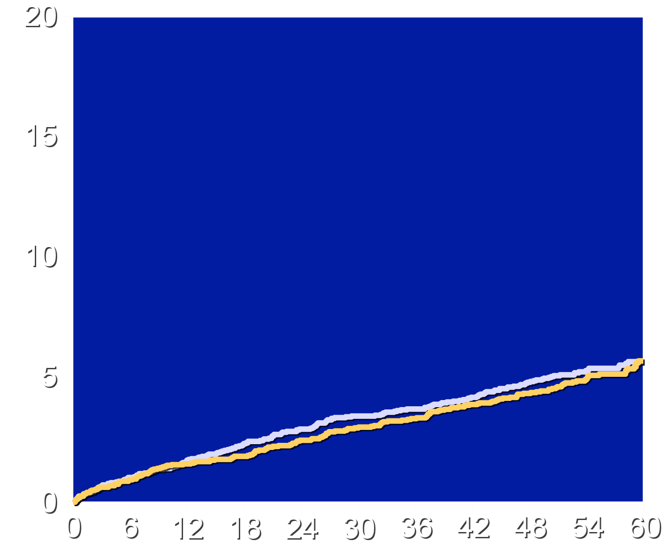
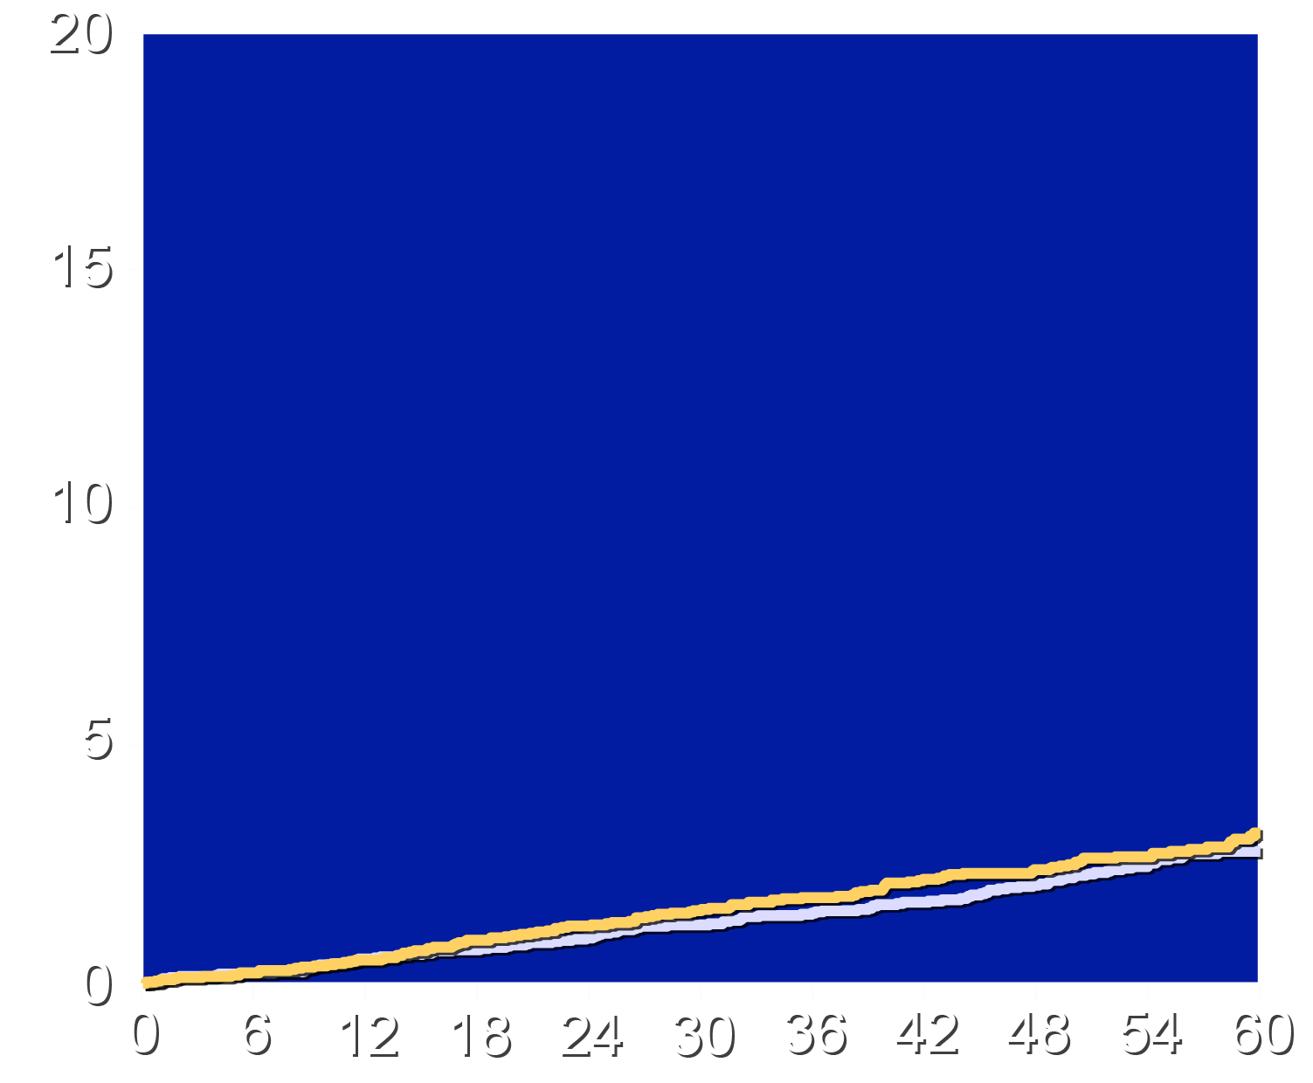
Outcomes: MACE End Point Components (MI and Stroke)
Myocardial Infarction
Stroke
HR 0.99 (95% CI 0.82-1.18)
HR 1.06 (95% CI 0.82-1.37)
Cumulative Incidence (%)
Placebo
Pelacarsen
Placebo
Pelacarsen
Months Since Randomization
Months Since Randomization

Slide 13
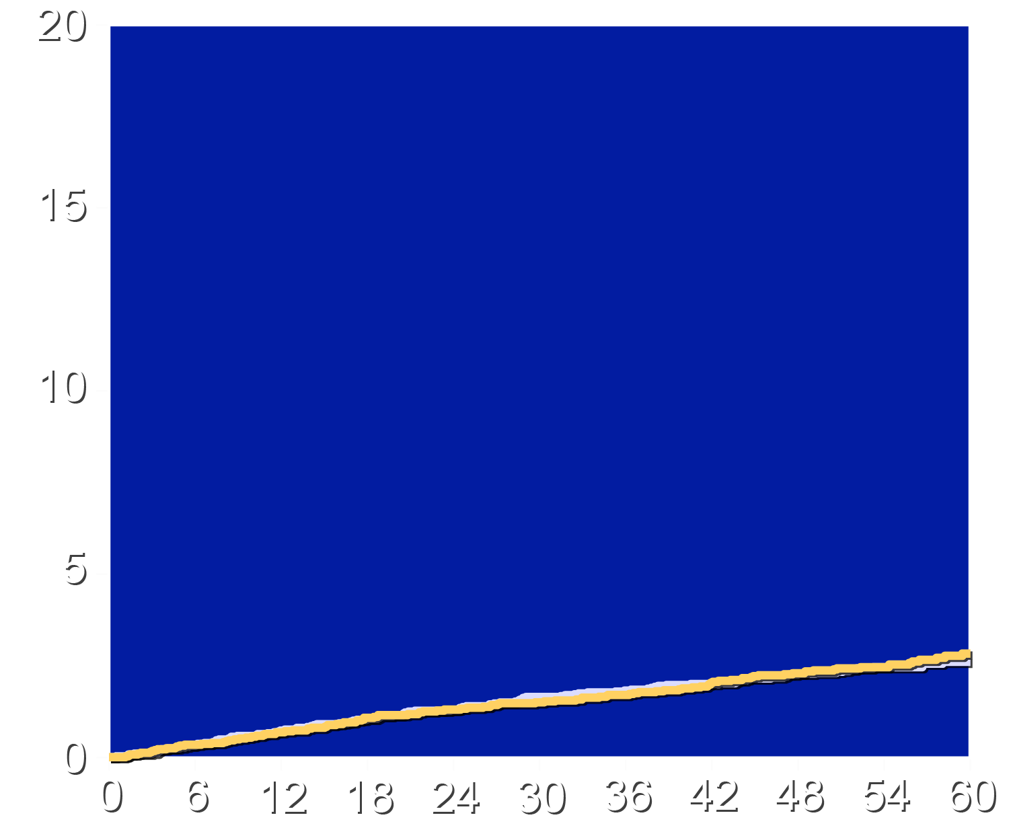
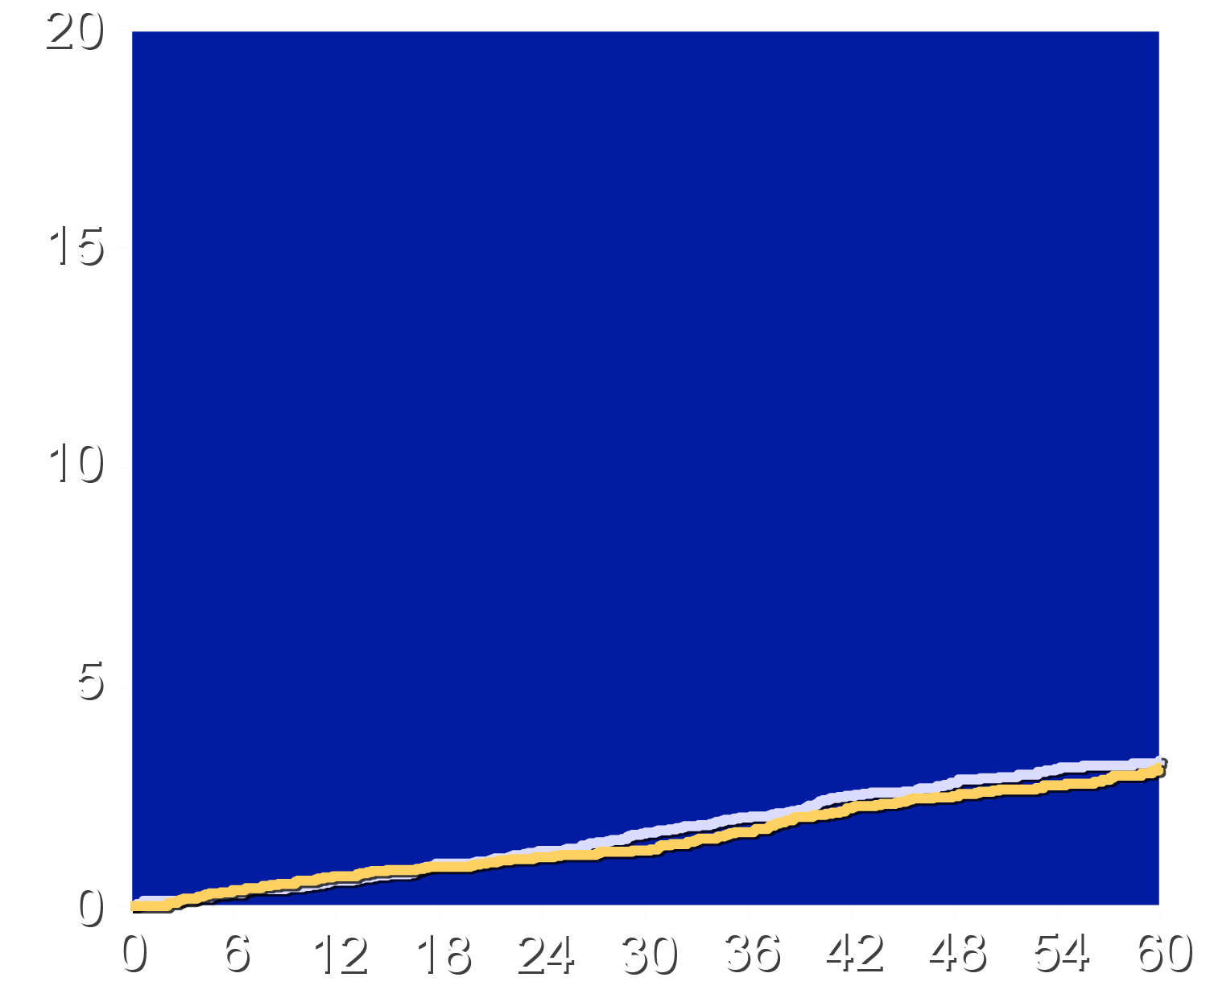
End Point Components (Revascularization and CV Death)
Urgent Revascularization
Cardiovascular Death
HR 1.04 (95% CI 0.80-1.36)
HR 0.93 (95% CI 0.73-1.19)
Cumulative Incidence (%)
Placebo
Pelacarsen
Placebo
Pelacarsen
Months Since Randomization
Months Since Randomization

Slide 14
Investigator-Reported Adverse Effects
Characteristic | Pelacarsen N=4166 | Placebo N=4154
Drug-related adverse event | 56.8% | 18.0%
Adverse event leading to drug discontinuation | 20.6% | 7.5%
Serious Adverse Events | 37.3% | 41.1%
Constitutional symptoms | 31.9% | 5.8%
Investigator-reported hypersensitivity reactions | 17.1% | 5.4%
Adjudicated hypersensitivity events
“Yes” or probable allergic reaction | 0.6% | 0.02%
“Yes” or probable anaphylaxis | 0.46% | 0
Reactions resulting in hospitalization | 0.19% | 0

Slide 15
Limitations
The trial enrolled only patients with prior cardiovascular events. Effects in a primary prevention populations not studied.
Tolerability issues resulted in drug discontinuation in an excess of pelacarsen-treated patients (35.1% vs. 18.3%) with an excess due to adverse events (20.6% vs. 7.5%).
These results are applicable to pelacarsen, an antisense oligonucleotide. siRNA therapeutics reduce Lp(a) to a greater extent and may be better tolerated.

Slide 16
Conclusions
In patients with a prior CV event the antisense oligonucleotide pelacarsen reduced median lipoprotein(a) levels by 174 nmol/L (77.7%) from 234 nmol/L to 64 nmol/L.
The reduction in lipoprotein(a) levels did not result in reduction
in the first occurrence of major adverse cardiovascular events.
These results apply to this ASO and secondary prevention patients.
Background therapy was optimized with baseline LDL cholesterol and blood pressure amongst the lowest achieved of any CV outcome trial, which may have precluded showing further benefits.

Slide 17
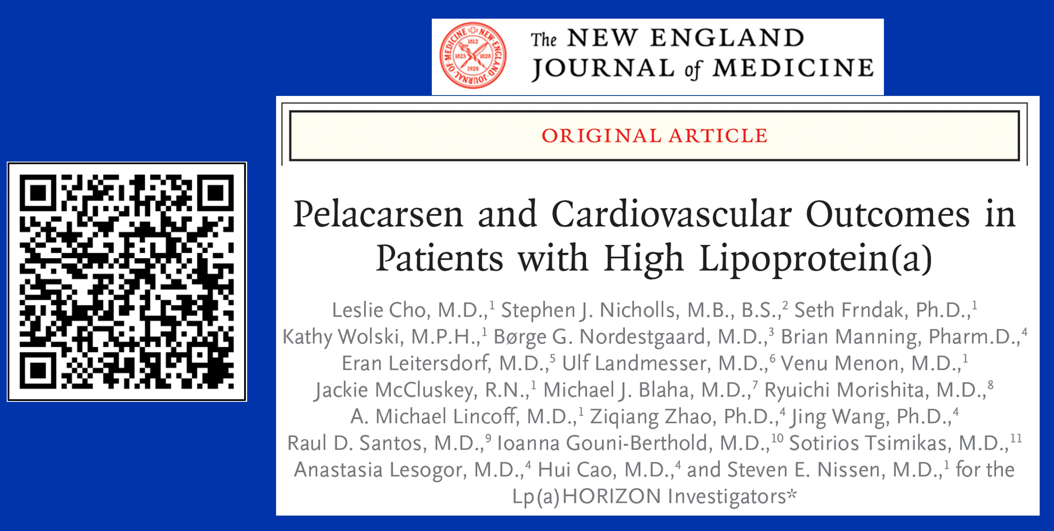
Lp(a) Horizon: Primary NEJM Publication

Slide 18
Additional Thoughts
Although these results are disappointing, they provide scientific insights that help inform future research efforts.
The Lp(a) Horizon trial is not the end of the story. Ongoing trials are studying different populations (e.g. primary prevention and aortic stenosis) and different therapies (e.g. siRNA).
A single trial does not provide definitive evidence of a lack
of benefit of lowering lipoprotein(a) as a strategy to reduce the cardiovascular risk.

Slide 19
Extended Analysis of The Lp(a) Horizon Trial
Steven E. Nissen MD MACC
Study Sponsor:
Novartis Pharmaceuticals

Slide 20
Background
The neutral results of the Lp(a) Horizon trial were unexpected based on observational and Mendelian randomization studies.
Prior to database lock, the academic authors prespecified secondary analyses to further explore the CV effects of pelacarsen.
The findings described in this secondary analyses are academic and exploratory in nature and are intended to complement, rather than replace, the prespecified primary analyses.
These findings may inform design and conduct of ongoing and future trials of treatments designed to reduce lipoprotein(a) levels.

Slide 21
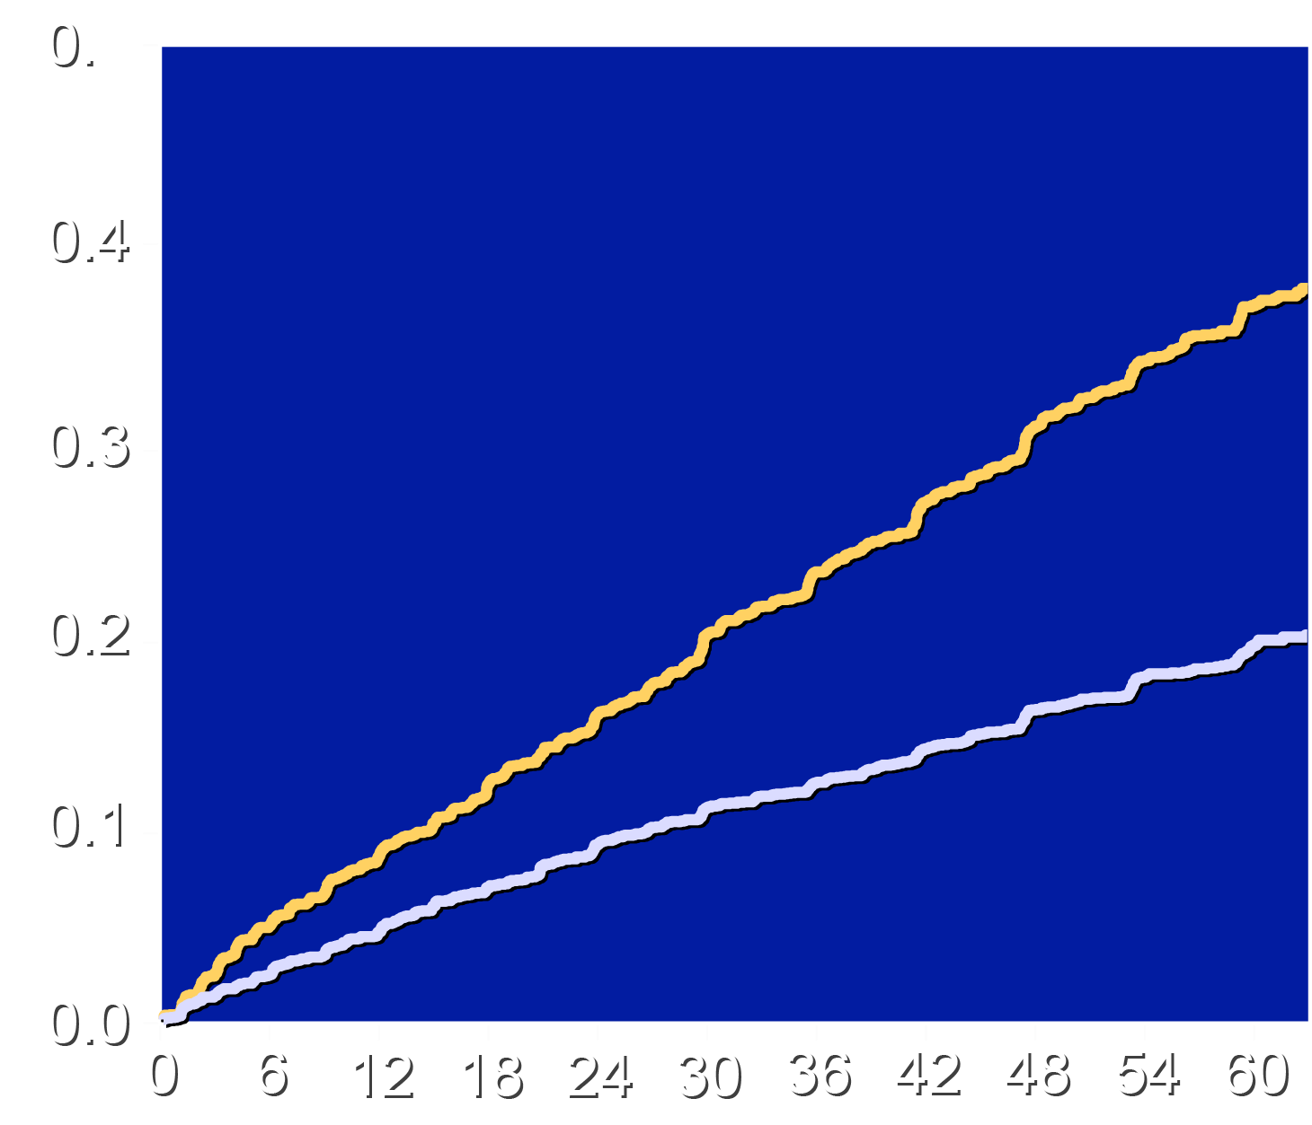
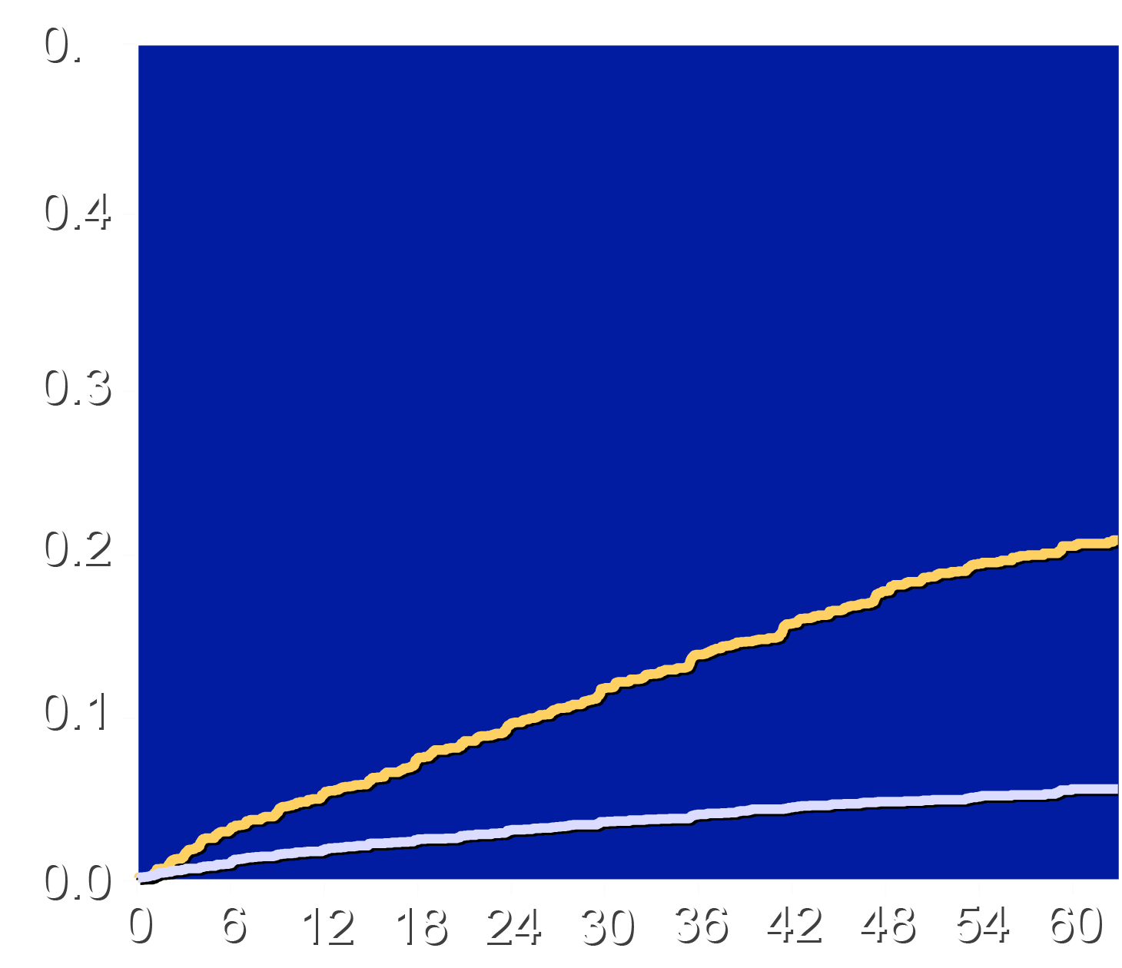
Time to Study Drug Discontinuation: Placebo vs. Pelacarsen
Stopped for Any Reason
Stopped for An Adverse Event
Placebo
Pelacarsen
Placebo
Pelacarsen
35.1%
Cumulative Incidence (%)
20.6%
18.3%
7.5%
Months Since Randomization
Months Since Randomization

Slide 22
Prespecified Secondary Analyses
On-treatment analysis (while patients were taking study drug and for 112 days after discontinuation).
Uninterrupted treatment (completed trial with no interruption of treatment >60 days)
Analysis of total events (including first and subsequent events)
Landmark analyses based on Lp(a) reductions and achieved levels after 3 months treatment.
Subgroups by baseline characteristics (above and below median)
for lipoprotein(a), LDL-C, hsCRP, time from qualifying events.

Slide 23
Patients with Events: Selected Baseline Characteristics
Characteristic | Pelacarsen N=511 | Placebo N=503
Mean Age (years) | 62.4 | 61.8
Female sex | 27.0% | 24.9%
Median LDL cholesterol (mg/dL) | 71.6 | 73.8
Median hsCRP (mg/L) | 1.1 | 1.2
High-intensity statin | 78.7% | 73.6%
Systolic Blood pressure | 126 mmHg | 126 mmHg
Diabetes mellitus | 34.4% | 37.8%
Median lipoprotein(a) | 236 nmol/L | 241 nmol/L

Slide 24
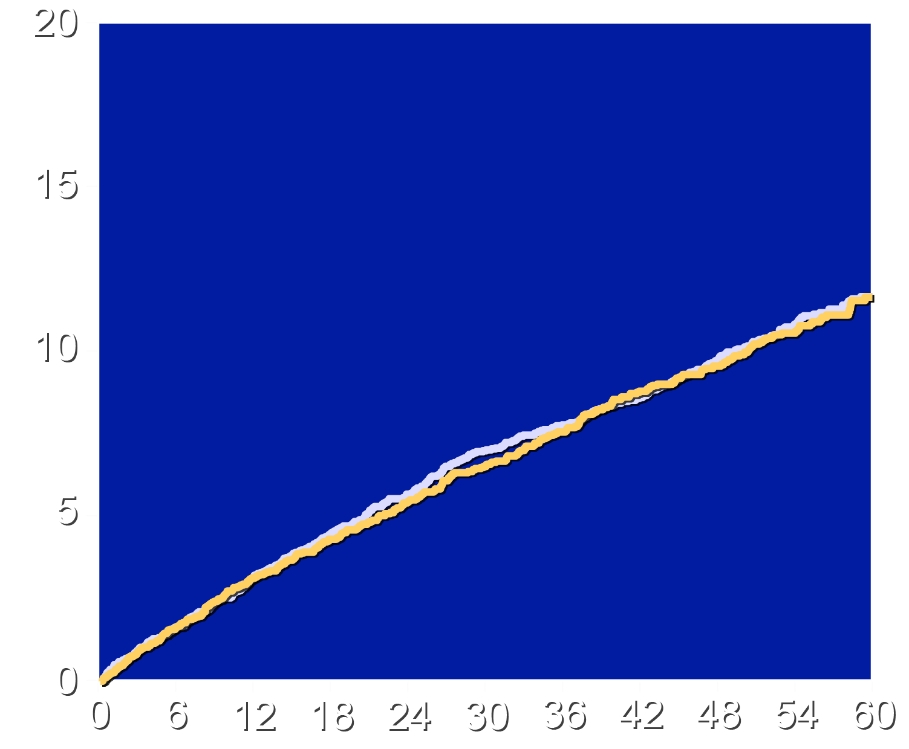
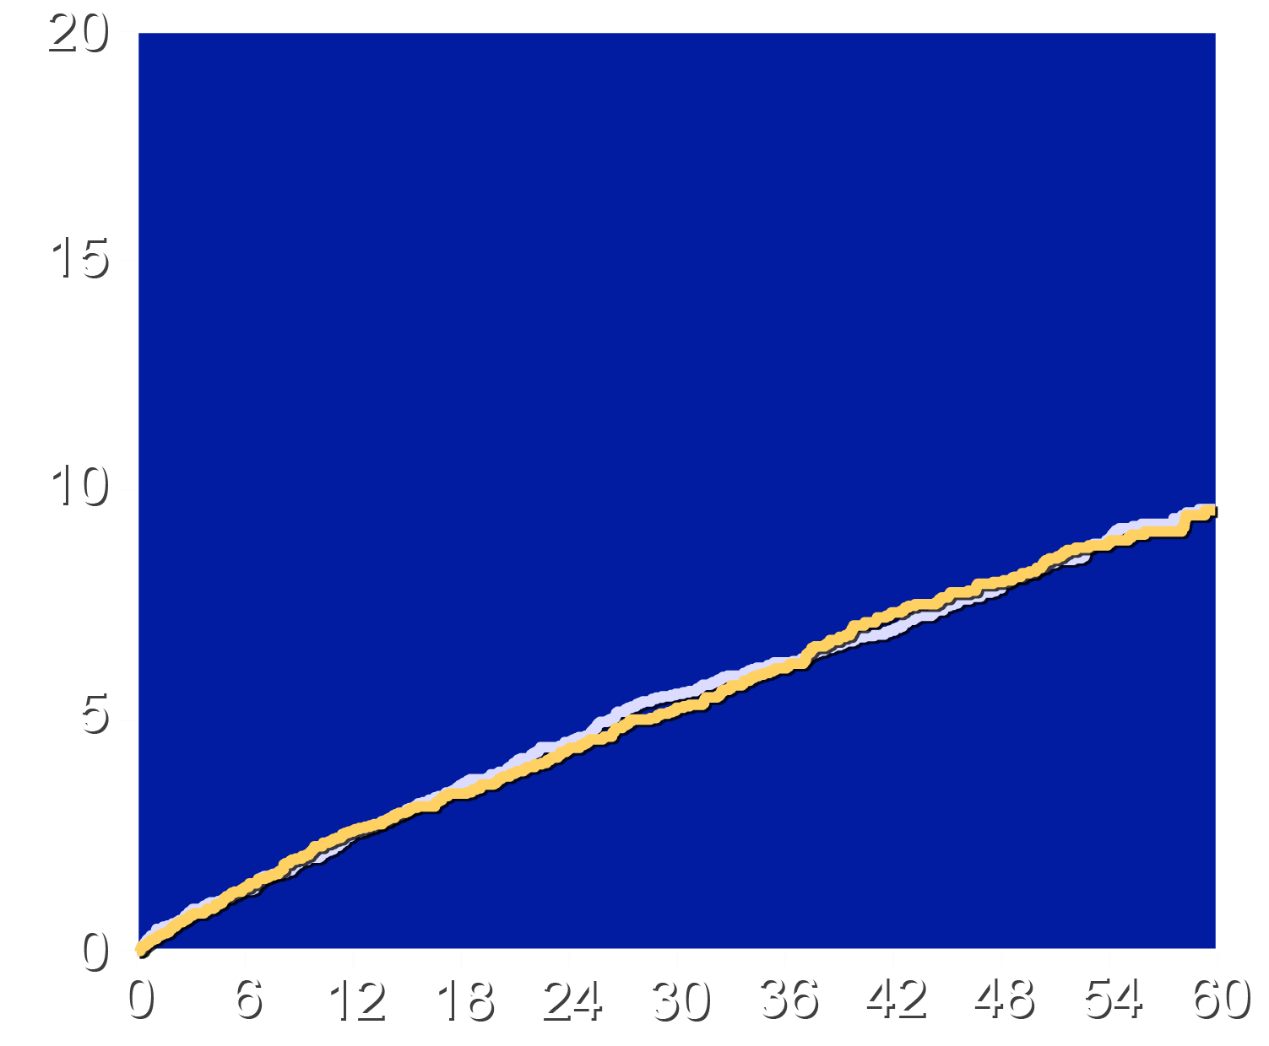
On-Treatment: Population with Lipoprotein(a) ≥70 mg/dL
4-component MACE
3-component MACE
HR 0.98 (95% CI 0.85-1.12)
HR 0.98 (95% CI 0.85-1.15)
Cumulative Incidence (%)
Placebo
Pelacarsen
Placebo
Pelacarsen
Months Since Randomization
Months Since Randomization

Slide 25
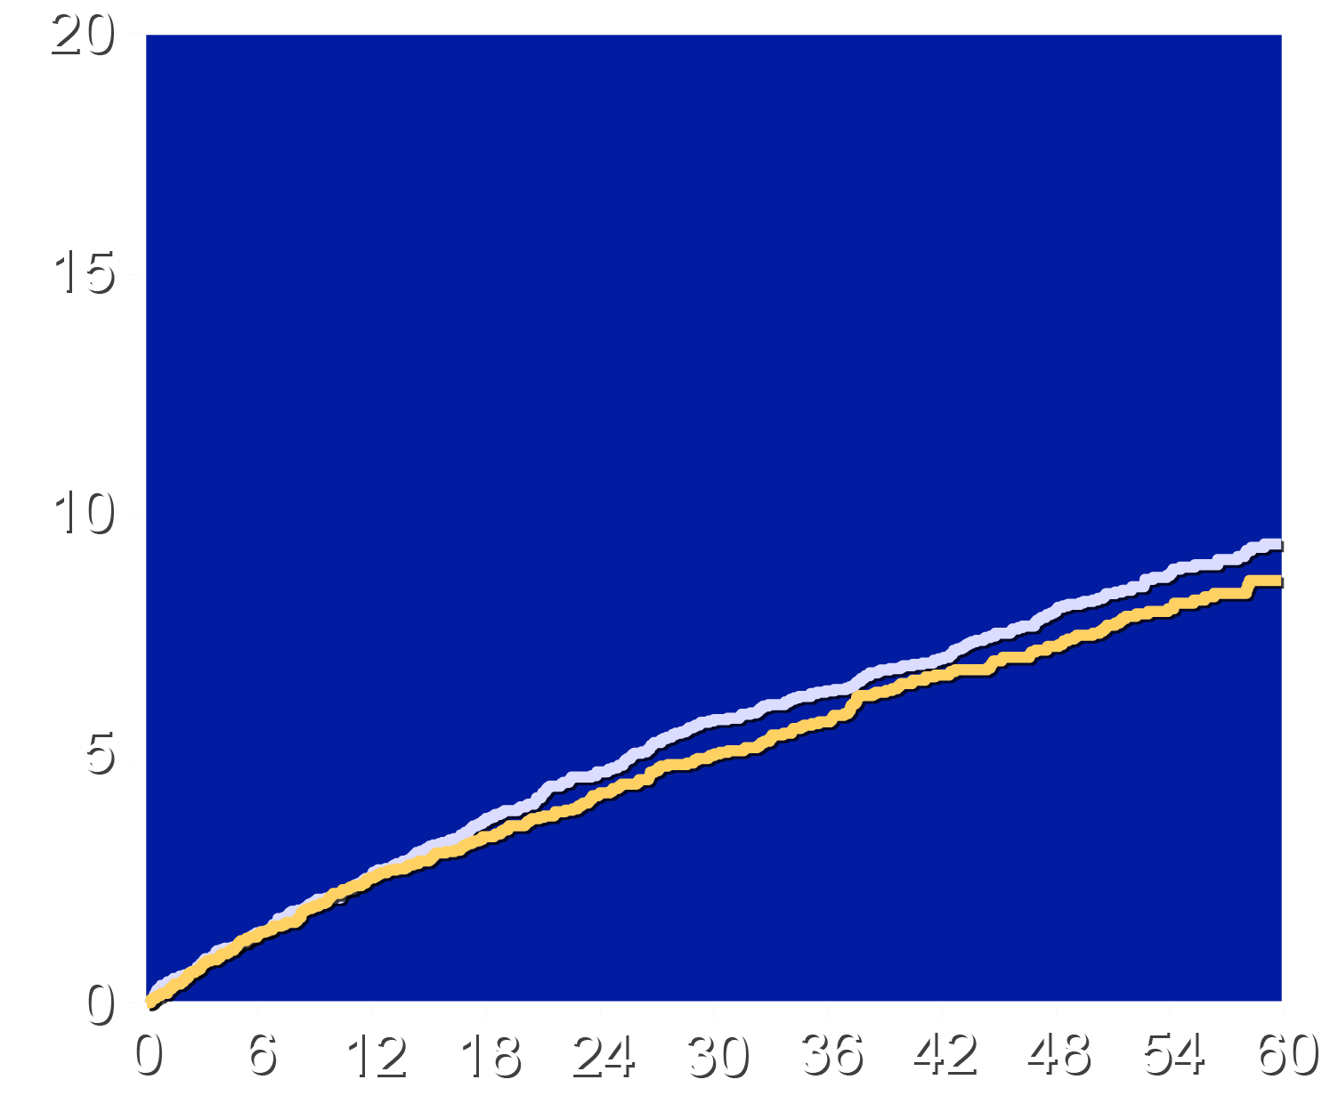
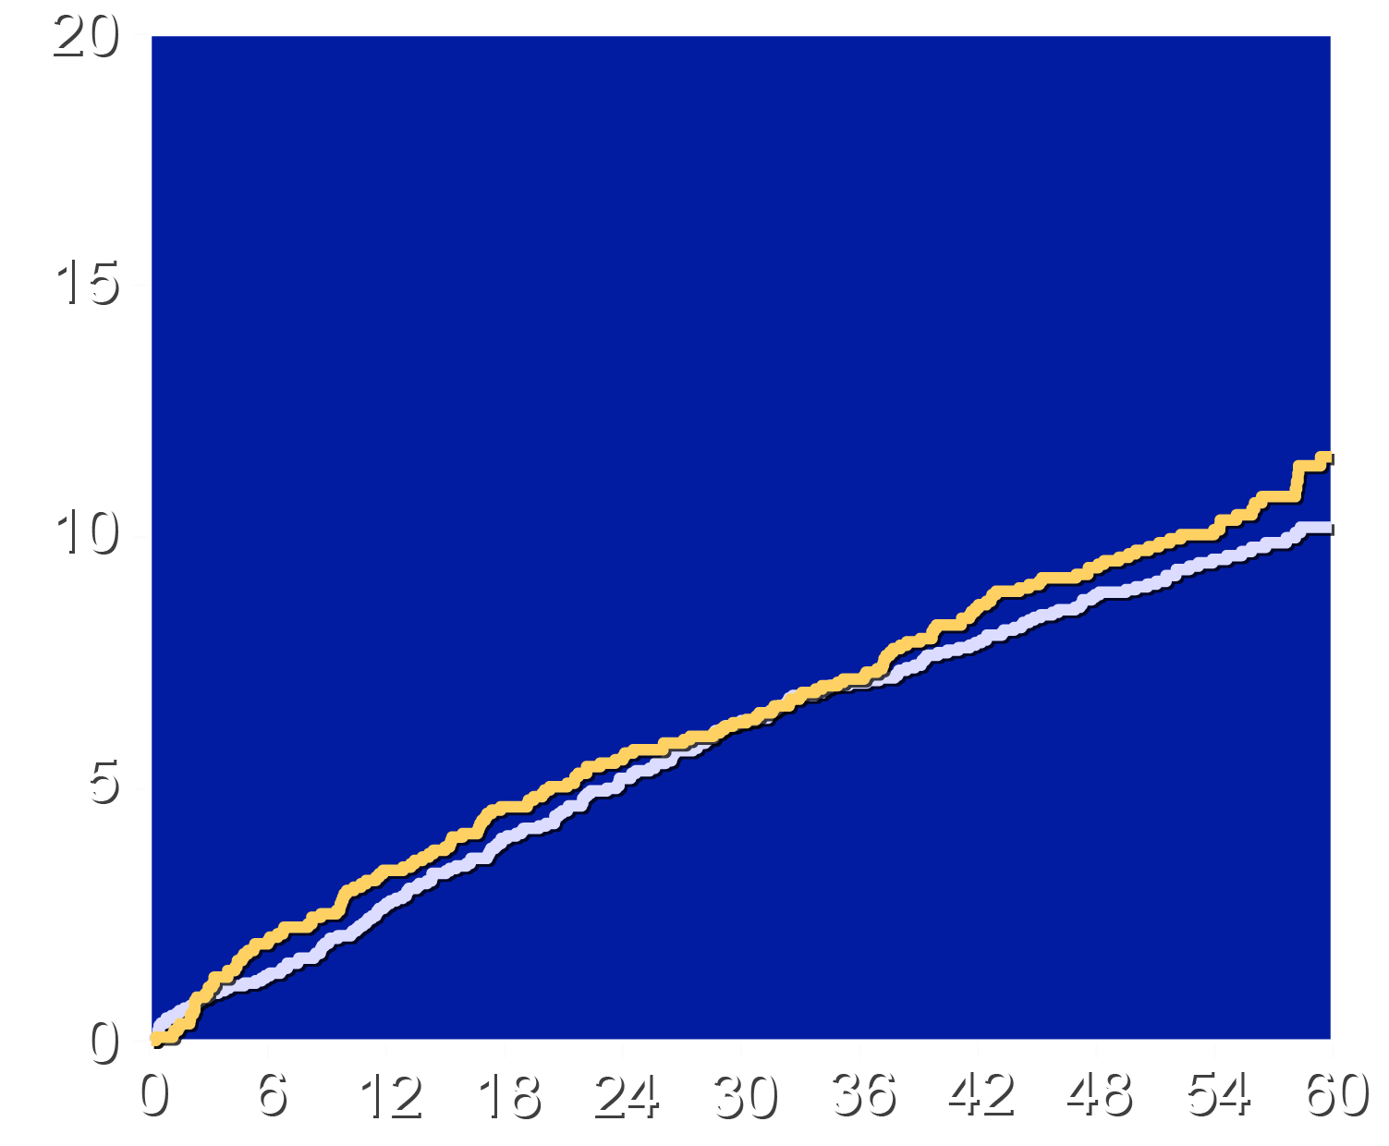
Outcomes for On-Treatment and Uninterrupted Treatment
On-Treatment (CHD MACE-3)
Uninterrupted Treatment (MACE-4)
HR 0.92 (95% CI 0.79-1.07)
HR 1.09 (95% CI 0.89-1.34)
Cumulative Incidence (%)
Placebo
Pelacarsen
Placebo
Pelacarsen
Months Since Randomization
Months Since Randomization

Slide 26
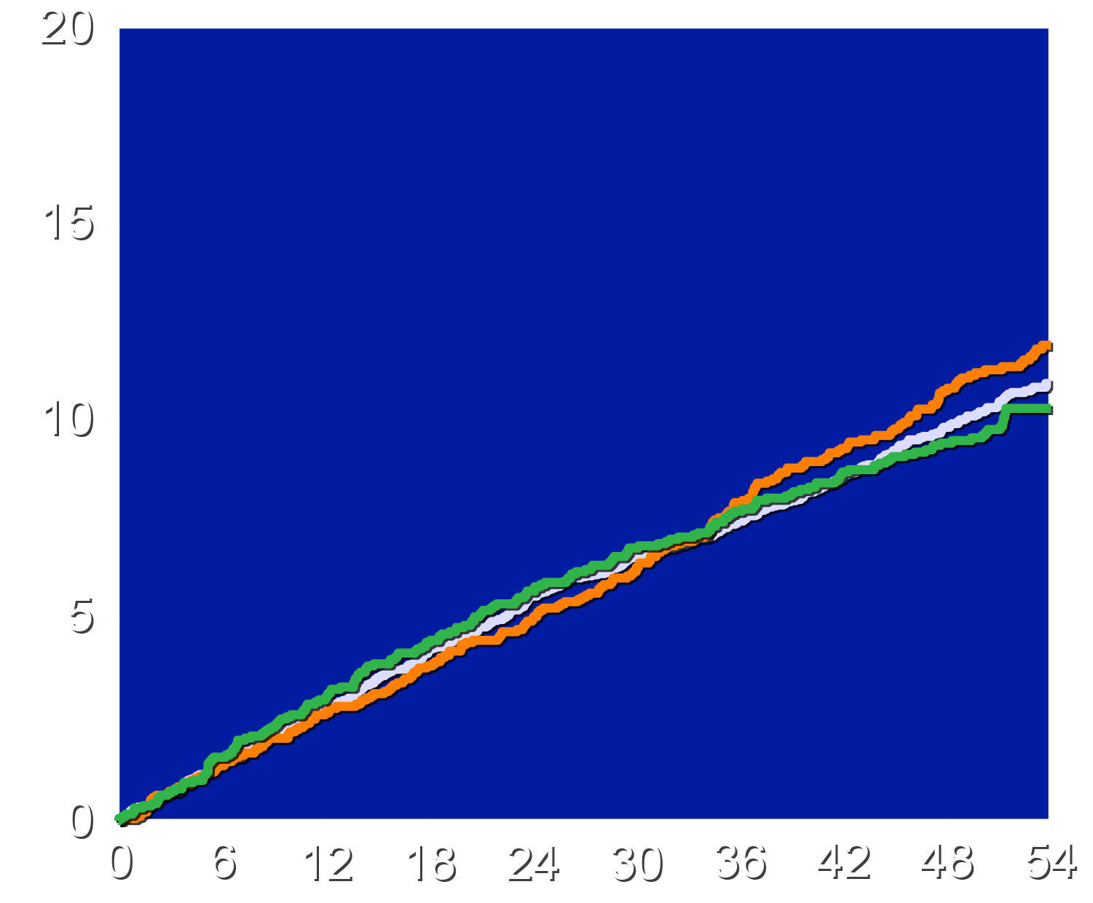
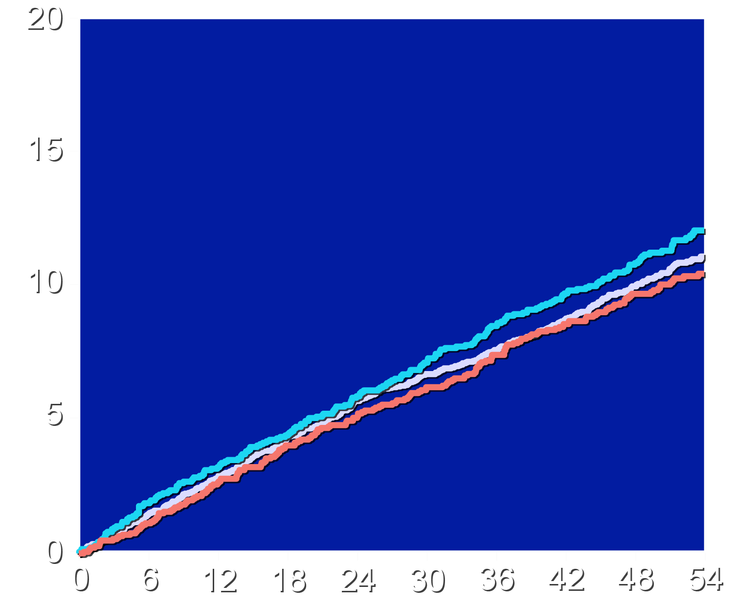
Landmark Analyses: Lp(a) Reductions and Achieved Levels
Lipoprotein(a) Reduction at 3 Months
Achieved Lipoprotein(a) at 3 Months
<170 nmol/L HR 1.03 (95% CI 0.87-1.23)
≥170 nmol/L HR 1.09 (95% CI 0.92-1.29)
>69.5 nmol/L HR 1.03 (95% CI 0.87-1.22)
≤69.5 nmol/L HR 1.10 (95% CI 0.93-1.29)
Cumulative Incidence (%)
Placebo
Lp(a) reduction <170 nmol/L
Lp(a) reduction ≥170 nmol/L
Placebo
Achieved Lp(a) >69.5 nmol/L
Achieved Lp(a) ≤69.5 nmol/L
Months Since Randomization
Months Since Randomization

Slide 27
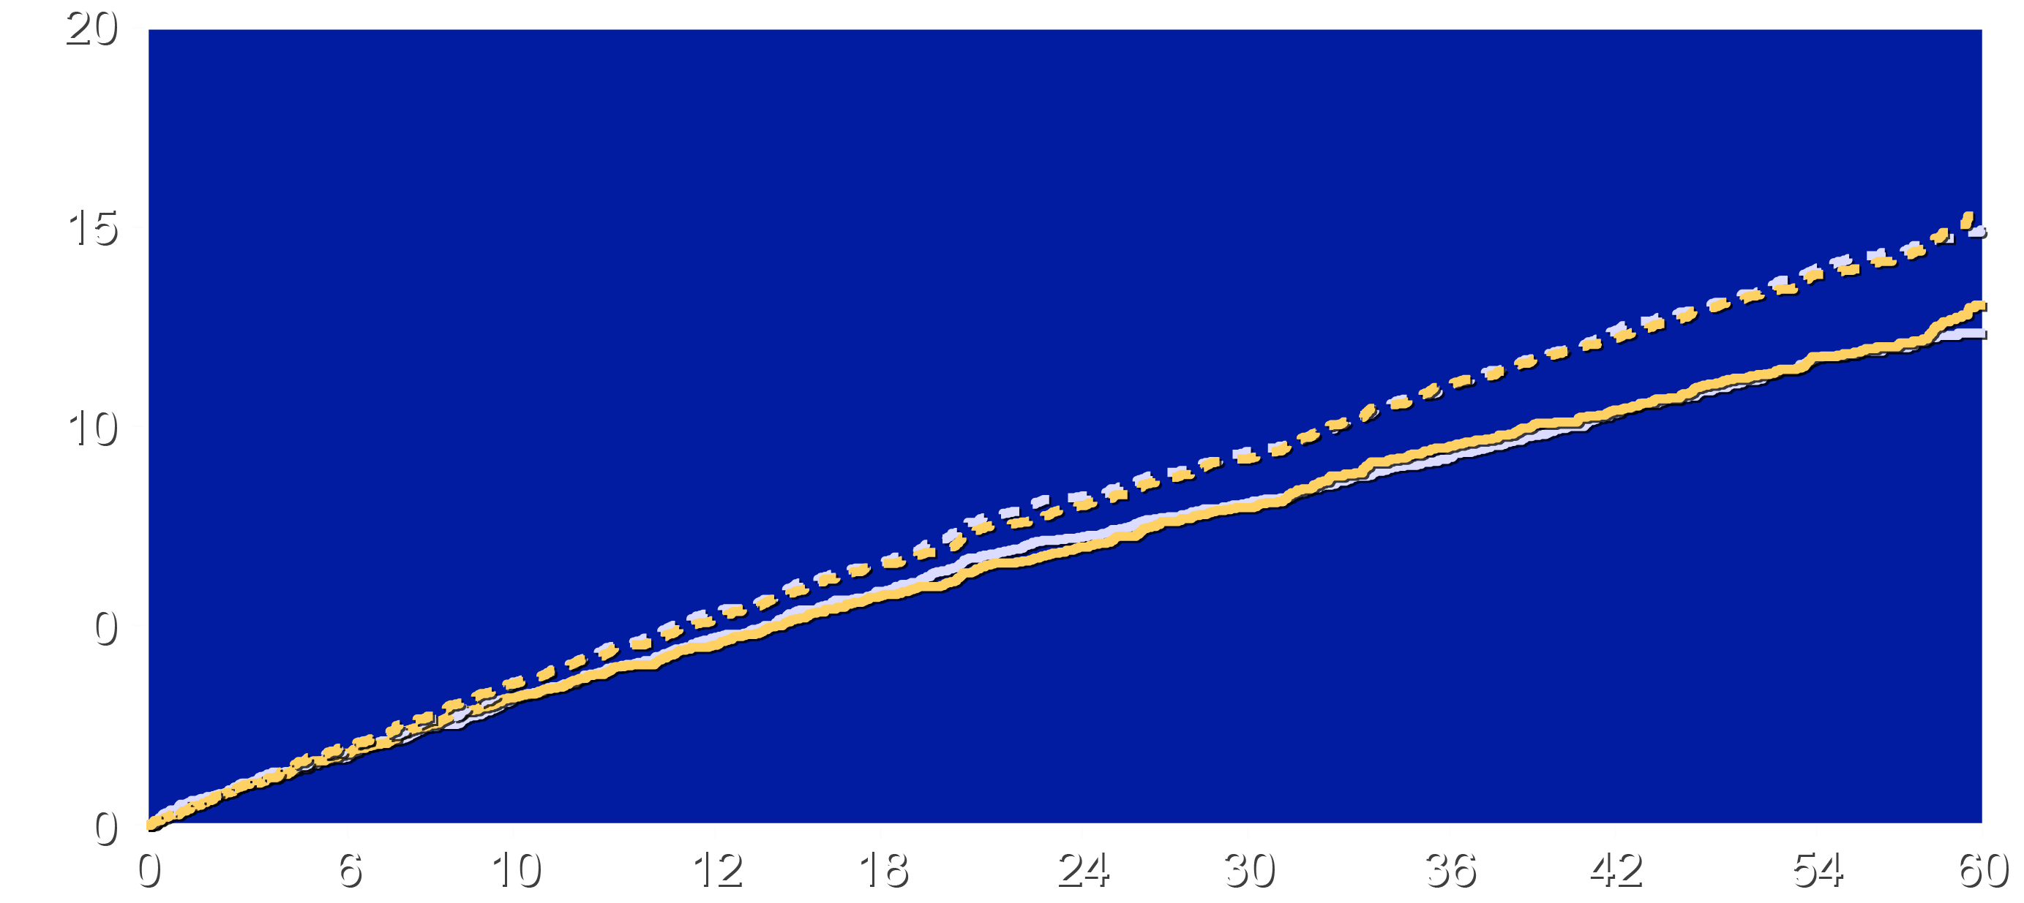
Results for First Event and Total Events Analyses
Outcomes based on 4-component MACE end point
Total Events HR 1.00 (95% CI 0.87-1.14)
First Events HR 1.02 (95% CI 0.90-1.15)
Placebo
First Event
Total Events
Pelacarsen
First Event
Total Events
Cumulative Incidence (%)
Months Since Randomization

Slide 28
Results for Prespecified Multiplicity-Controlled Subgroups
 | Mean for subgroup | Hazard Ratio (95% CI)
Baseline Lipoprotein(a) value (median 236 nmol/L)
<Median | 196.6 nmol/L | 1.08 (0.90 to 1.29)
≥Median | 335.9 nmol/L | 0.97 (0.81 to 1.15)
Baseline LDL cholesterol (median 65 mg/dL)
<Median | 49.1 mg/dL | 1.14 (0.94 to 1.37)
≥Median | 87.7 mg/dL | 0.93 (0.79 to 1.10)
Baseline hsCRP (median 0.8 mg/L)
<Median | 0.4 mg/L | 1.08 (0.88 to 1.33)
≥Median | 3.8 mg/L | 0.99 (0.85 to 1.15)
Time from Qualifying Event (median 2.3 years)
<Median | 1.05 years | 0.93 (0.78 to 1.10)
≥Median | 5.29 years | 1.14 (0.96 to 1.35)

Slide 29
Limitations
These extended analyses are exploratory and not a substitute for the primary prespecified outcomes.
The results may not apply to other lipoprotein(a) lowering therapies that work by different mechanisms.
The trial studied only secondary prevention patients and results may be different for treatment of high-risk patients
who have not had a cardiovascular event.

Slide 30
Conclusions
On-treatment and uninterrupted treatment analyses showed similar results to intention-to-treat analyses (HRs 0.92 to 1.09).
Analyses that included both first and subsequent events were consistent for the primary MACE-4 outcomes (hazard ratio 1.00).
Landmark analyses based on magnitude of 3-month lipoprotein(a) reductions and achieved levels showed no heterogeneity of effects (hazard ratios 1.03 to 1.10).
Subgroup analyses were broadly consistent with the primary outcome (hazard ratios 0.93 to 1.14).

Slide 31
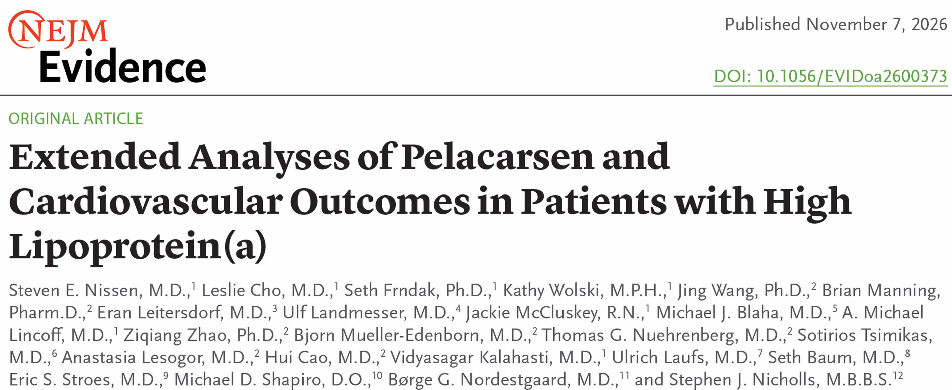


Slide 32
Final Thoughts
Ongoing trials studying different populations (e.g. primary prevention or aortic stenosis) and different therapies may show better results and should continue to completion.
The authors would like to acknowledge the sponsor (Novartis Pharmaceuticals) for their willingness to make a large investment in the effort to help patients with high lipoprotein(a).
We also want to acknowledge the willingness of our patients
to volunteer for this trial requiring monthly injections for as long as 7 years.

Slide 34
Backup

Slide 35
MACE-4: Selected Subgroups by Baseline Characteristics
Hazard Ratio (95%)
Sex
Female
Male
Baseline SBP
≤110 mmHg
>110 mmHg
Baseline Diabetes Mellitus Type 2
Yes
No
Baseline hs-CRP
<Median (0.8 mg/L)
≥Median (0.8 mg/L)
Baseline LDL-C
<70 mg/dL (1.8 mmol/L)
≥70 mg/dL (1.8 mmol/L)
1.11 (0.87, 1.41)
0.99 (0.86, 1.14)
0.99 (0.71, 1.38)
1.02 (0.90, 1.17)
0.97 (0.79, 1.20)
1.05 (0.90, 1.23)
1.08 (0.88, 1.34)
0.99 (0.85, 1.15)
1.12 (0.94, 1.32)
0.92 (0.77, 1.10)
0.50
1.00
2.00

