Slide 1



Platelet Reactivity Testing to Guide P2Y12 Inhibitor De-Escalation After Acute Coronary Syndrome
The EPIC17-VERONICA Randomized Clinical Trial
VERifynow to Optimise platelet iNhIbition in Coronary Acute syndromes
Iñigo Lozano, MD, PhD, on behalf of the EPIC17-VERONICA investigators

Slide 2
Disclosure of Relevant Financial Relationships
Within the prior 24 months, I have had a financial relationship with
a company producing, marketing, selling, re-selling, or distributing healthcare products used by or on patients:
Nature of Financial Relationship | Ineligible Company
Grant/Research Support | Abbott, BBraun, Biotronik, Terumo
Consultant Fees/Honoraria | Medtronic, Boston Scientific
All Relevant Financial Relationships have been mitigated.
Faculty disclosure information can be found on the app

Slide 3
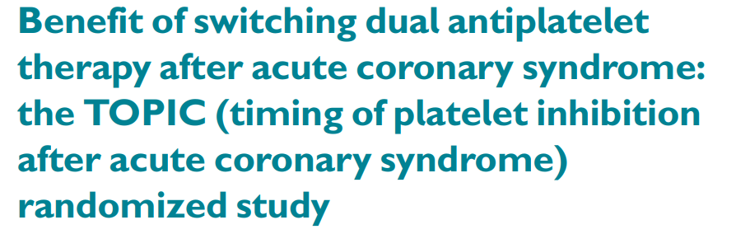
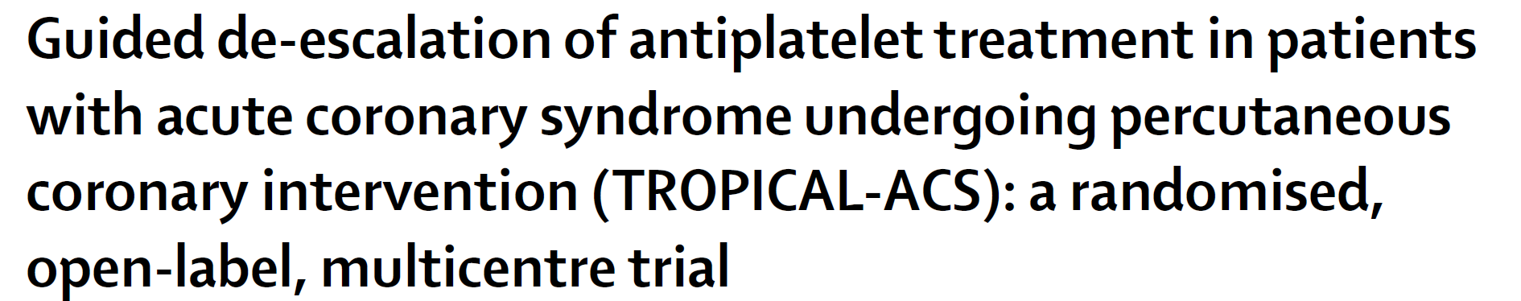
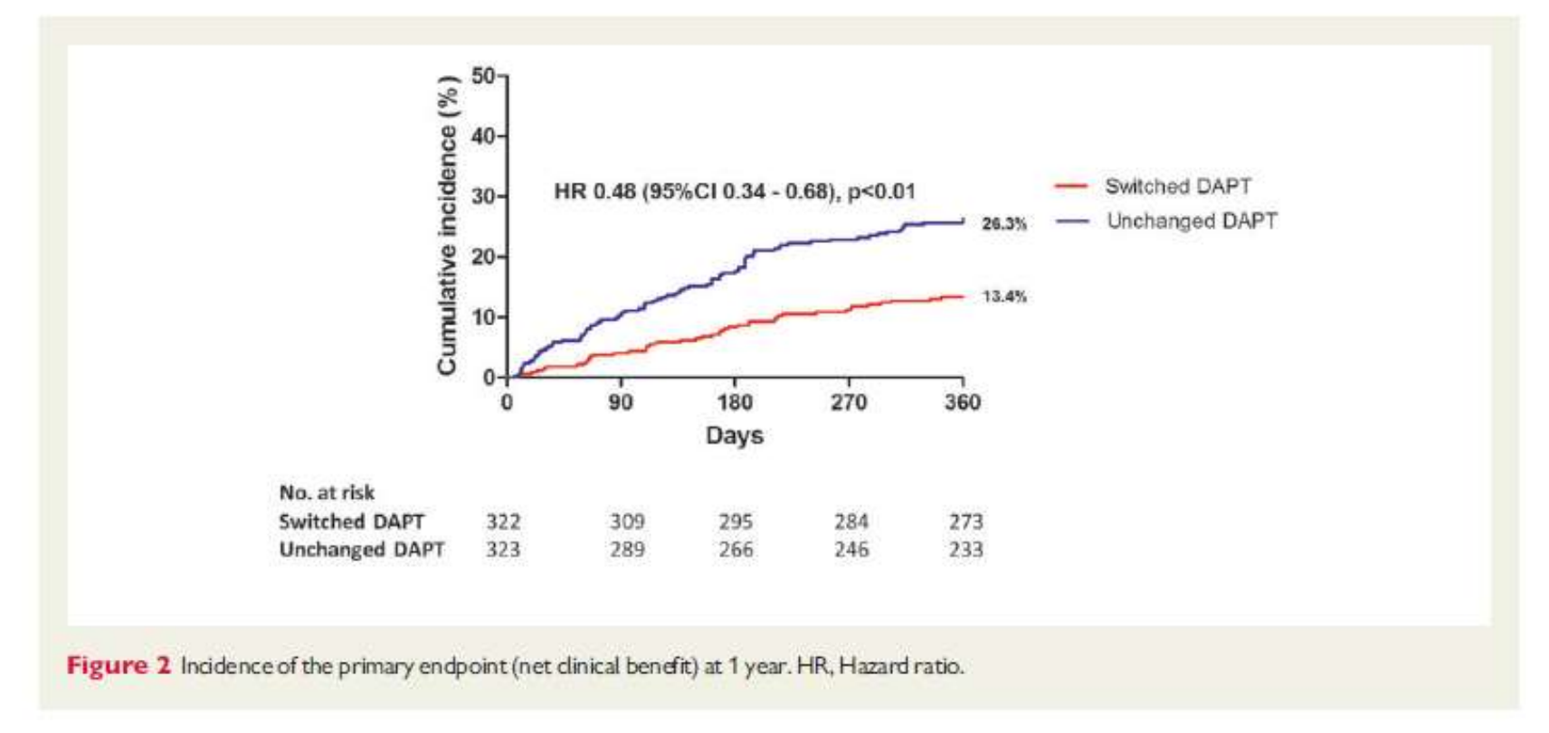
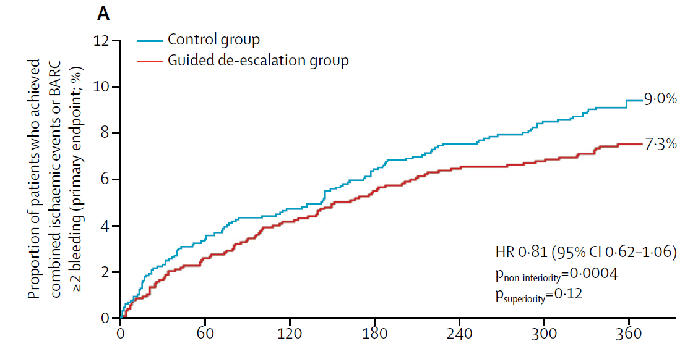
Background
Eur Heart J. 2017;38(41):3070-8
Lancet 2017; 390: 1747–57
Notes:
The TOPIC trial showed that unguided de-escalation from prasugrel or ticagrelor to clopidogrel 1 month after an ACS improved net clinical benefit, driven by a reduction in bleeding without an increase in ischaemic events. TROPICAL-ACS explored the role of PFT in tailoring DAPT: an early switch from prasugrel to clopidogrel guided by PFT, with patients showing high on-treatment platelet reactivity returned to prasugrel, was non-inferior to standard prasugrel therapy.
The question that follows is whether PFT-guided de-escalation offers any advantage over a simpler, unguided strategy.

Slide 4
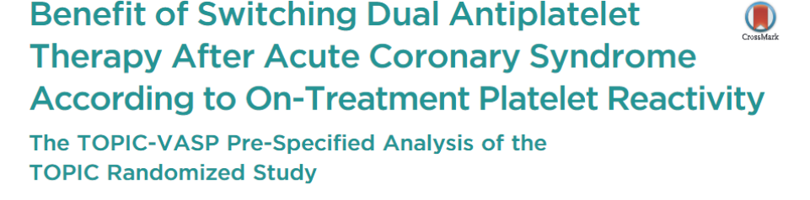
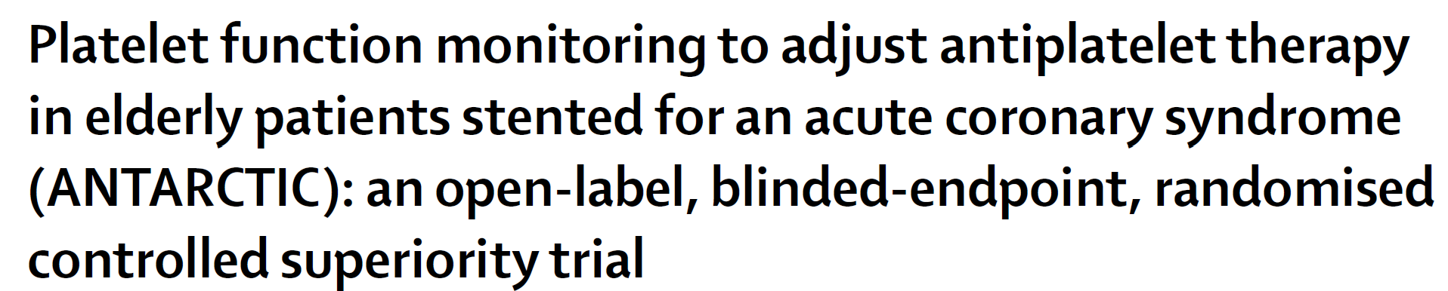
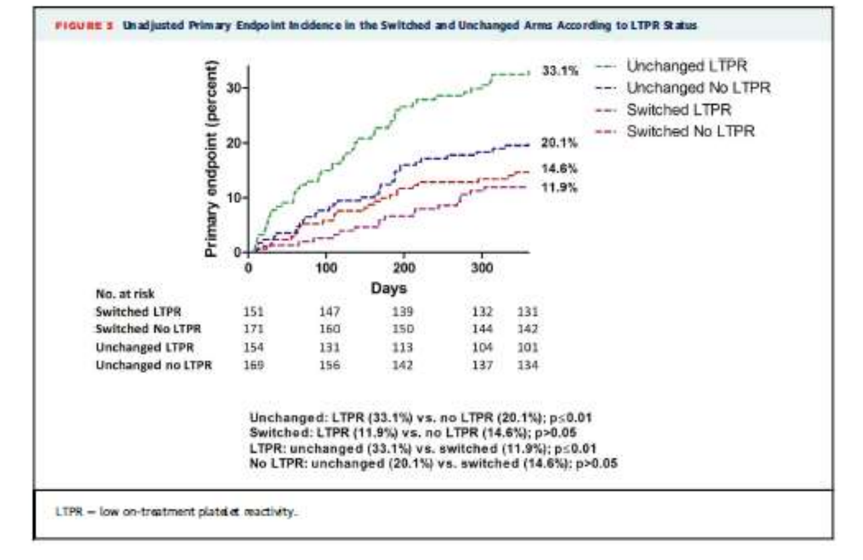
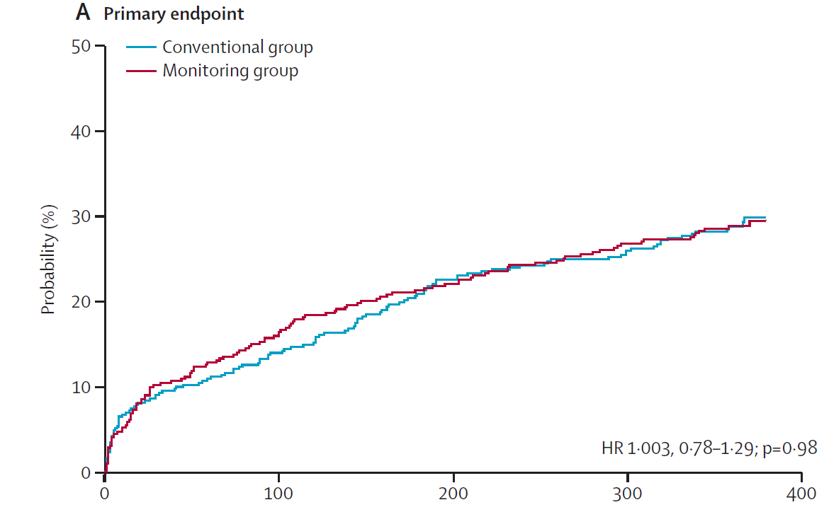
Key question: can PFT prospectively help to tailor the best approach?
Lancet 2016; 388: 2015–22
JACC Cardiovasc Interv. 2017;10(24):2560-70
Notes:
ANTARCTIC, which was not a de-escalation trial, tested whether PFTcould help tailor DAPT in a high-bleeding-risk population, the elderly, but the result was neutral. Finally, in the TOPIC-VASP substudy, the patients who benefited most from de-escalation were those with low on-treatment platelet reactivity, as the rate of events in those who continued with Prasugrel or ticagrelor reached 33.1 % of net cardiac events, compared to only 11.9 % in those who underwent de-escalation. However, these results came from a subanalysis and therefore should be tested in an specific trial.

Slide 5
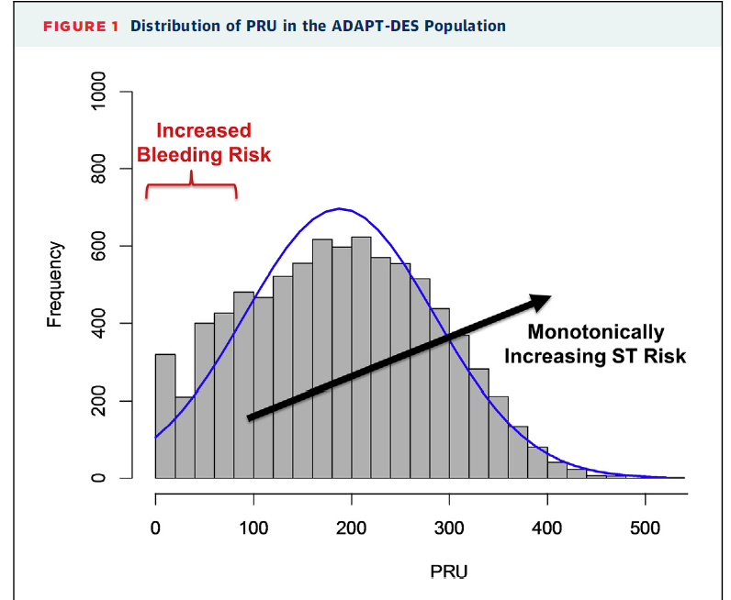
Background: the low-PRU evidence gap
High PRU: well characterised
Stent thrombosis risk rises steadily with platelet reactivity on clopidogrel
Low PRU: much less evidence
Linked to bleeding, but no randomised data on how to manage these patients
VERONICA
PRU ≤30
VERONICA randomised only patients with PRU ≤30 to continue potent P2Y12 inhibition or de-escalate to clopidogrel
PRU = P2Y12 reaction units; ST = stent thrombosis. Source: ADAPT-DES (Kirtane AJ et al. J Am Coll Cardiol Intv 2015;8:1978–87).
Notes:
Large registries such as ADAPT-DES have characterised what happens at the upper end of the PRU distribution: the higher the platelet reactivity on clopidogrel, the higher the risk of stent thrombosis. At the lower end, where bleeding risk concentrates, there is much less information, and no randomised trial had selected patients by low reactivity. VERONICA addresses this gap by randomising only patients with PRU of 30 or less.

Slide 6
Aims and design
Key question: can PFT prospectively select de-escalation candidates?
Aim: Evaluate the benefit of de-escalation to clopidogrel in ACS patients with low platelet reactivity based on PRU test (VerifyNow, Werfen).
Design: Multicenter, randomized, open-label superiority trial, 16 sites in Spain.
Population: ACS + bioresorbable-polymer SES, on ASA + prasugrel 10 mg /ticagrelor 180 mg.
Primary end point: NACE (CV death, nonfatal MI, nonfatal stroke, BARC ≥ 2).
Secondary end point: Individual components plus total death or definite stent thrombosis.
Eligibility: VerifyNow P2Y12 assay, 30–40 days post-PCI, randomized 1:1 those with PRU≤ 30.
Intervention: Continue potent P2Y12 inhibitor vs. de-escalate to clopidogrel, 11 more months.
Notes:
VERONICA aimed to evaluate de-escalation to clopidogrel in ACS patients with low platelet reactivity, measured with the VerifyNow PRU test 30 to 40 days after discharge. It was a multicenter, randomized, open-label superiority trial at 16 sites in Spain. We included ACS patients with a bioresorbable-polymer sirolimus-eluting stent, on aspirin plus prasugrel or ticagrelor. The primary endpoint was net adverse events: cardiovascular death, nonfatal myocardial infarction, nonfatal stroke, or BARC 2 or higher bleeding. Secondary endpoints included the individual components, all-cause death and definite stent thrombosis.

Slide 7
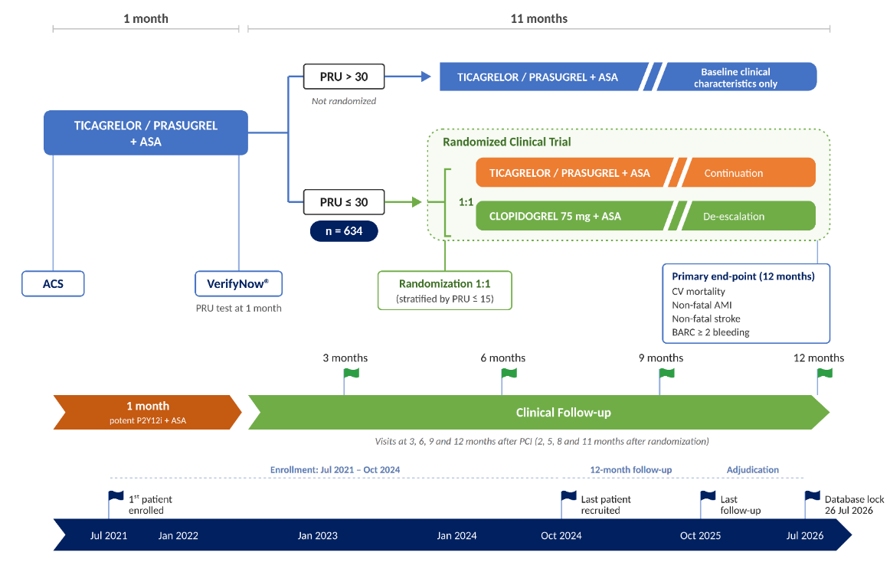
Roadmap
Notes:
Eligible patients underwent the PRU test 30-40 days after discharge and those with PRU ≤ 30 were randomized to continue on Prasugrel or ticagrelor or de-escalation to clopidogrel. Patients were followed at 2,5, 8 and 11 months after randomization to assesss for NACE

Slide 8
Statistics
Aim of the study: Built on TOPIC-VASP (33.1 % vs 11.9 %)
More conservative approach: 22 % vs. 14 %
Sample size: 634 patients (317/arm) for 80% power* (real 75 %)
Intention-to-treat; two-sided P < .05
Cumulative incidence: Kaplan-Meier or Gray’s test (when competing events)
Treatment effect: Cox model, Fine-Gray model (competing events)
All analyses stratified by PRU ≤15 (one model, separate baseline hazard functions)
Multiple imputation by chained equations of missing data
Sensitivity: Cross-over, bleeding BARC ≥ 3
Notes:
Trial underpowered by design. Because of funding to run the trial, different design options were considered, including a Bayesian analysis and a one-sided test. By mistake, the one-sided parameters were kept in the final sample size calculation, which gave a theoretical power of 70%. This error was not detected until the end of the trial. Complete follow-up was achieved in all patients w/o the expected 10 % drop-outs, so the final power was 75%.

Slide 9
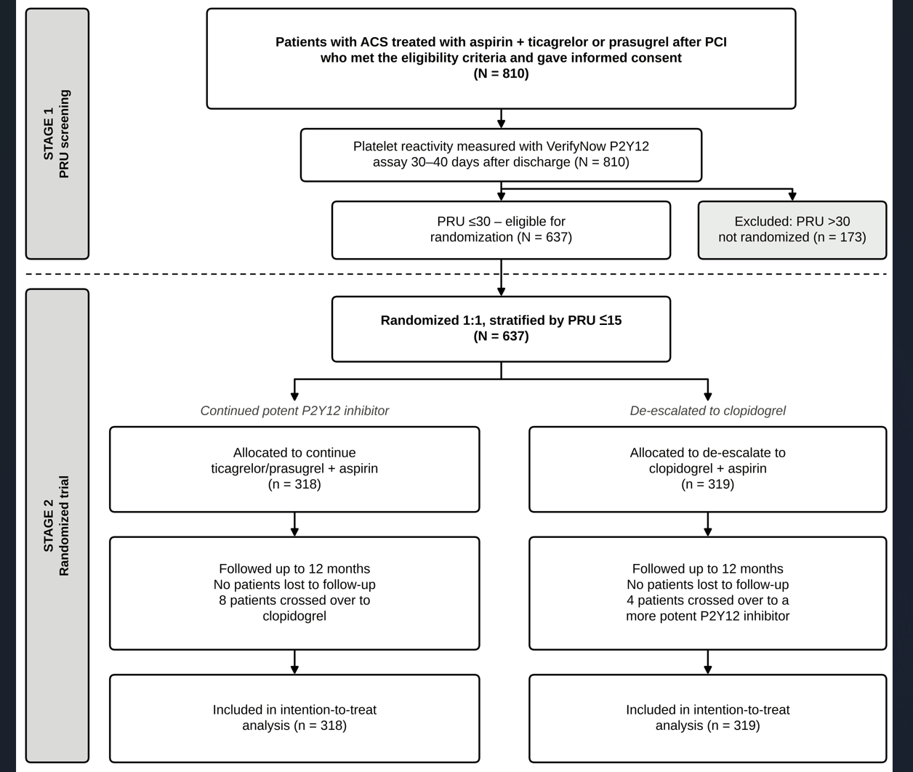
Results: Patient Flow
810 patients tested with VerifyNow
637 (78.6 %) PRU ≤30 → randomized 1:1
318 continued potent P2Y12 inhibitor; 319 de-escalated to clopidogrel
Follow-up: complete to 11 months; no patients lost
Crossover: 12 patients, 8 to clopidogrel, 4 to prasugrel/ticagrelor
Notes:
810 patients were tested with VerifyNow. Of these, 637, 79%, had a PRU of 30 or less and were randomized: 318 continued potent therapy and 319 were de-escalated to clopidogrel. Follow-up was complete at 11 months, with no patients lost, and crossover was low, 12 patients in total.

Slide 10
Results: Baseline Characteristics
CHARACTERISTIC | Ticagrelor/Prasugrel (n = 318) | Clopidogrel (n = 319)
Age, mean (SD), y | 60.5 (9.5) | 61.3 (9.8)
Female sex, n (%) | 55 (17.3) | 63 (19.7)
Diabetes mellitus, n (%) | 70 (22.0) | 59 (18.5)
Prior myocardial infarction, n (%) | 30 (9.4) | 33 (10.3)
Type of ACS, n (%)
Unstable angina | 30 (9.5) | 33 (10.3)
NSTEMI | 132 (41.6) | 139 (43.6)
STEMI | 155 (48.9) | 147 (46.1)
eGFR (CKD-EPI) <60 mL/min/1.73 m², n (%) | 20 (6.4) | 31 (9.7)
BMI, mean (SD), kg/m² | 28.1 (4.2) | 27.3 (4.0)
P2Y12 inhibitor at discharge, n (%)
Prasugrel | 76 (23.9) | 80 (25.1)
Ticagrelor | 241 (75.8) | 239 (74.9)
No. of lesions treated, mean (SD) | 1.36 (0.70) | 1.46 (0.81)
ACE inhibitor/ARB, n (%) | 230 (76.4) | 196 (65.1)
No. of vessels treated, mean (SD) | 1.24 (0.50) | 1.29 (0.57)
Treated vessel, n (%)
Left main | 5 (1.6) | 8 (2.5)
Left anterior descending | 183 (57.7) | 172 (53.9)
Circumflex | 87 (27.5) | 100 (31.3)
Right coronary artery | 120 (37.9) | 130 (40.8)
Notes:
Baseline characteristics were well balanced between the two arms. This was a relatively low-risk population: mean age was about 61 years and 20% of diabetics. Nearly half presented with STEMI, and three out of four were on ticagrelor. The only notable differences were a slightly higher body mass index and more frequent use of ACE inhibitors or ARBs in the potent-therapy arm; the analysis was adjusted for ACE inhibitor or ARB use, w/o significant change.

Slide 11
Results: Primary and secondary
OUTCOME, n (%) | Ticagrelor/ Prasugrel (n = 318) | Clopidogrel (n = 319) | HR (95% CI); p-value¹
Primary endpoint (NACE) | 42 (13.2) | 38 (11.9) | 0.88 (0.57 to 1.37); 0.737
Cardiovascular death | 0 (0.0) | 3 (0.9) | ―
Myocardial infarction | 4 (1.3) | 9 (2.8) | 2.38 (0.73 to 7.78); 0.453¹
Stroke | 2 (0.6) | 2 (0.6) | ―
Bleeding, BARC ≥ 2 | 38 (11.9) | 28 (8.8) | 0.76 (0.46 to 1.24); 0.527¹
Unplanned revascularization | 6 (1.9) | 13 (4.1) | 2.88 (1.03 to 8.06); 0.173¹
¹ Holm-adjusted p-values in the secondary outcomes
No cases of definite stent thrombosis occurred in either group
One non-cardiac death (pancreatic cancer, control group)
Notes:
These are the main results. The primary endpoint occurred in 13.2% of patients who continued prasugrel or ticagrelor and in 11.9% of those de-escalated to clopidogrel, with a hazard ratio of 0.88 and a confidence interval crossing one. No significant differences were registered in myocardial infarction and bleeding and these numerical differences should be seen as exploratory. There were three cardiovascular deaths, all in the clopidogrel arm, and stroke was rare and identical in both groups. Importantly, there were no cases of definite stent thrombosis.

Slide 12
Results: Primary Endpoint (NACE)
1.00
0.95
HR 0.88 (0.57 to 1.37); p =0.737
Survival probability
0.90
0.85
0
2
4
6
8
10
Months
Ticagrelor or prasugrel
Clopidogrel
Ticagrelor or prasugrel
At Risk
318
313
308
300
297
295
292
287
282
281
276
18
Events
0
5
10
18
21
23
26
31
36
37
42
42
Clopidogrel
At Risk
319
317
312
311
306
302
297
295
290
286
283
26
Events
0
2
7
8
13
17
22
24
29
33
36
38
Notes:
The curves run close together and their confidence bands overlap throughout, with 42 versus 38 events at the end of follow-up. HR 0.88 (0.57 to 1.37), p = 0.737: de-escalation was not superior.

Slide 13
Results: Myocardial infarction
5%
4%
3%
HR 2.38 (0.73 to 7.78); p¹ = 0.453
¹ Holm-adjusted p-value
Cumulative incidence of IAM
2%
1%
0%
0
2
4
Months
6
8
10
Ticagrelor or prasugrel
Clopidogrel
Ticagrelor or prasugrel
At Risk
318
318
317
315
313
312
Events
0
0
1
2
4
4
Clopidogrel
At Risk
319
317
314
313
313
309
Events
0
2
5
6
6
9
Notes:
4 MIs (1.3%) with ticagrelor or prasugrel versus 9 (2.8%) with clopidogrel. The hazard ratio of 2.38 has a very wide confidence interval, 0.73 to 7.78, which reflects the small number of events, and the Holm-adjusted p-value is 0.453. This numerical excess is not significant and should be read as hypothesis-generating; the types of MI are detailed two slides later.

Slide 14
Results: Bleeding BARC ≥ 2
15%
10%
HR= 0.76 (0.46 to 1.24); p¹ = 0.527
¹ Holm-adjusted p-value
Cumulative incidence of bleeding
5%
0%
0
2
4
Months
6
8
10
Ticagrelor or prasugrel
Clopidogrel
Ticagrelor or prasugrel
At Risk
318
308
297
294
286
280
Events
0
10
21
24
32
38
Clopidogrel
At Risk
319
313
310
301
294
291
Events
0
5
8
16
23
26
Notes:
38 patients (11.9%) bled with the potent inhibitor versus 28 (8.8%) with clopidogrel; HR 0.76 (0.46 to 1.24), Holm-adjusted p = 0.527. The direction is the one expected from TOPIC and TROPICAL-ACS, less bleeding after de-escalation, but in VERONICA the difference is not significant.

Slide 15
Results: Unplanned revascularization
6%
HR= 2.88 (1.03 to 8.06); p¹ = 0.173
¹ Holm-adjusted p-value
4%
Cumulative incidence
2%
0%
0
2
4
Months
6
8
10
Ticagrelor or prasugrel
Clopidogrel
Ticagrelor or prasugrel
At Risk
318
318
317
315
312
311
Events
0
0
1
2
5
5
Clopidogrel
At Risk
319
317
311
310
307
304
Events
0
2
8
9
12
14
Notes:
6 patients (1.9%) versus 13 (4.1%) needed an unplanned revascularization; HR 2.88 (1.03 to 8.06). The unadjusted confidence interval just excludes 1, but after Holm correction for multiple secondary comparisons the p-value is 0.173, so this is not significant. It is an exploratory signal.

Slide 16
Results: MI and Revascularization
Myocardial infarction | Ticagrelor/ Prasugrel (n = 318) | Clopidogrel (n = 319)
Patients, n (%) | 4 (1.3) | 9 (2.8)
HR 2.38 (95%CI 0.73 to 7.78); adjusted p¹: 0.453
Type (Fourth Universal Definition)
Type 1 | 3 | 5
Type 4c | 1 | 4
Unplanned revascularization | Ticagrelor/ Prasugrel (n = 318) | Clopidogrel (n = 319)
Patients, n (%) | 6 (1.9) | 13 (4.1)
HR 2.88 (95%CI 1.03 to 8.06); adjusted p¹: 0.173
Procedures, both groups (n = 19)
PCI / CABG | 17 / 2
Restenosis | 6 (5 with NSTEMI)
Different lesion | 13
Intention-to-treat analysis. No definite stent thrombosis in either group.
¹ Holm-adjusted p-values
Notes:
The excess with clopidogrel is spread across type 1 MI (5 versus 3) and type 4c MI (4 versus 1). Most revascularizations (13 of 19) were for a different lesion, that is, disease progression rather than stent failure, and only 6 were for restenosis, 5 of them presenting as NSTEMI. There was no definite stent thrombosis. Numbers are small, and these findings are hypothesis-generating only.

Slide 17
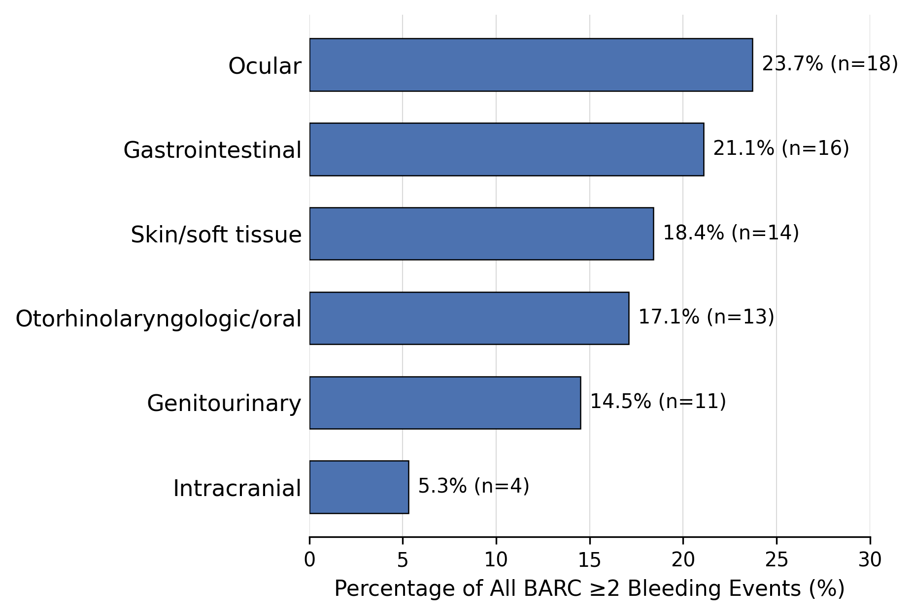
Results: Bleeding Outcomes
Bleeding, No. (%) | Ticagrelor/ Prasugrel (n = 318) | Clopidogrel (n = 319)
Patients, BARC ≥ 2 | 38 (11.9) | 28 (8.8)
HR 0.76 (95% CI 0.46 to 1.24); adjusted p¹: 0.527
Type of bleeding (events)ᵃ
BARC 2 | 35 (83.3) | 27 (79.4)
BARC 3a | 2 (4.8) | 2 (5.9)
BARC 3b | 3 (7.1) | 2 (5.9)
BARC 3c | 2 (4.8) | 3 (8.8)
Total bleeding events | 42 | 34
Anatomical site, all BARC ≥2 events (n = 76)
ᵃ Percentages of all BARC ≥2 events per group; some patients had >1 event. Distribution of bleeding severity, P = .90 (χ²).
ITT
¹ Holm-adjusted p-values
Notes:
About 80% of bleeding events in both arms were BARC 2, and the distribution of severity was similar (p = 0.90). The numerical reduction with clopidogrel was therefore mostly in minor bleeding; serious bleeding was uncommon and similar between arms. The most frequent sites were ocular, gastrointestinal and skin or soft tissue; intracranial bleeding occurred in 4 patients.

Slide 18
Conclusions
First trial to select candidates by confirmed very low reactivity (PRU ≤30)
Event rates were lower than anticipated, limiting the power of the trial.
Neutral result: No evidence that guided de-escalation reduces NACE.
Take-home: cannot recommend routine PFT-guided de-escalation over standard therapy in patients with low platelet reactivity.

