Slide 1

Impact of intravenous iron repletion on
mechanisms of exercise intolerance in HFpEF
The IRONMET-HFpEF trial primary results
Gregory Lewis MD glewis@mgb.org, @glewiscardiol
Mass General Brigham Heart and Vascular Institute Director of Heart Failure
Jeffrey and Mary Ellen Jay Chair in Cardiology & Director, CPET Laboratory
Professor of Medicine, Harvard Medical School
Gregory D. Lewis, MD¹; Nora K. Horick, MS²; Fabely Moreno, BS¹; Kenneth Lim, BS¹; Diane Cocca-Spofford, RN¹; Takenori Ikoma, MD, PhD,¹; Paridhi Gupta, MD¹; Carly Camphausen, BS¹, Laura Caccamo, NP¹; Charounipha Soydara, NP¹; Shaina McGinnis, BS¹; Chloe Newlands, MS¹; Skyler Williams, BA¹; Alexandra Minasian, MS¹; Nicholas Iskenderian, BA¹; Isabela Landsteiner, MD ¹; Bhavani Iyer, MS ¹; Justin Joseph, BS ¹; Alvaro Delgado, MD ¹; Helena Tattersfield, MS ¹; Elizabeth Moore, BS ¹; Veronica Platt, BS ¹; Sujin Lee, MD ^{1,3}; Rajeev Malhotra, MD ¹
Mass General Brigham Heart and Vascular Institute, Cardiology Division, Boston, MA, USA, Massachusetts General Hospital Department of Biostatistics, Boston, MA, USA
Mass General Brigham Heart and Vascular Institute, Vascular Surgery Division, Boston, MA, USA

Slide 2
Disclosures
Presenter: Gregory D. Lewis, MD
Trial funding
National Heart, Lung, and Blood Institute R01HL159514 (Lewis and Malhotra)
R01HL131029 and R01HL151841 (Lewis)
Research support
NIH, AHA, Amgen, AstraZeneca, Alexion, Bayer, Corvia, Cytokinetics, Gradient Denervation Technologies, Haya, Imbria, Kardigan, Natera, Pfizer, Salubris
Advisory roles
AskBio, Edwards, Kardigan, Merck, Pharmacosmos, Rivus

Slide 3
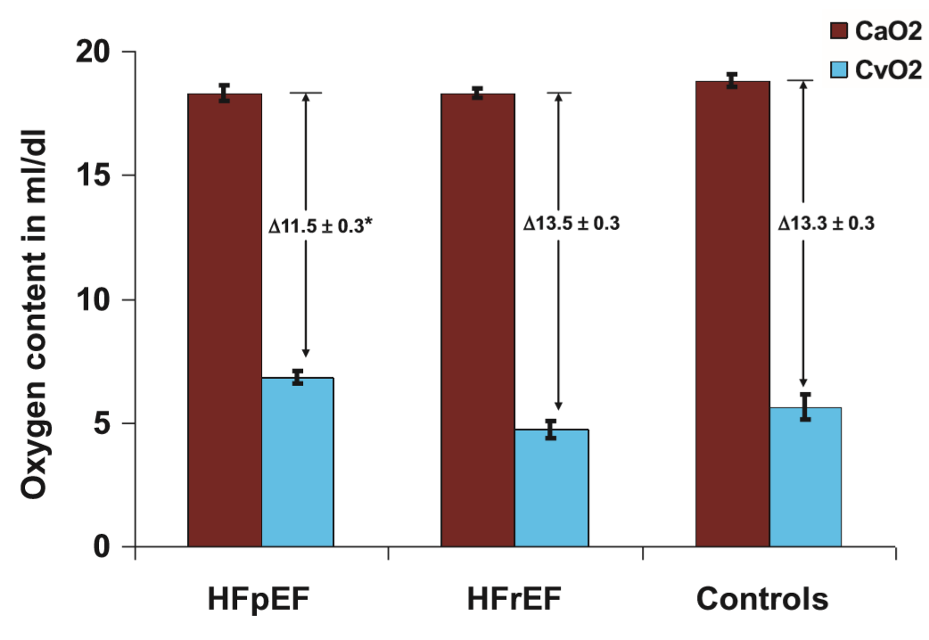
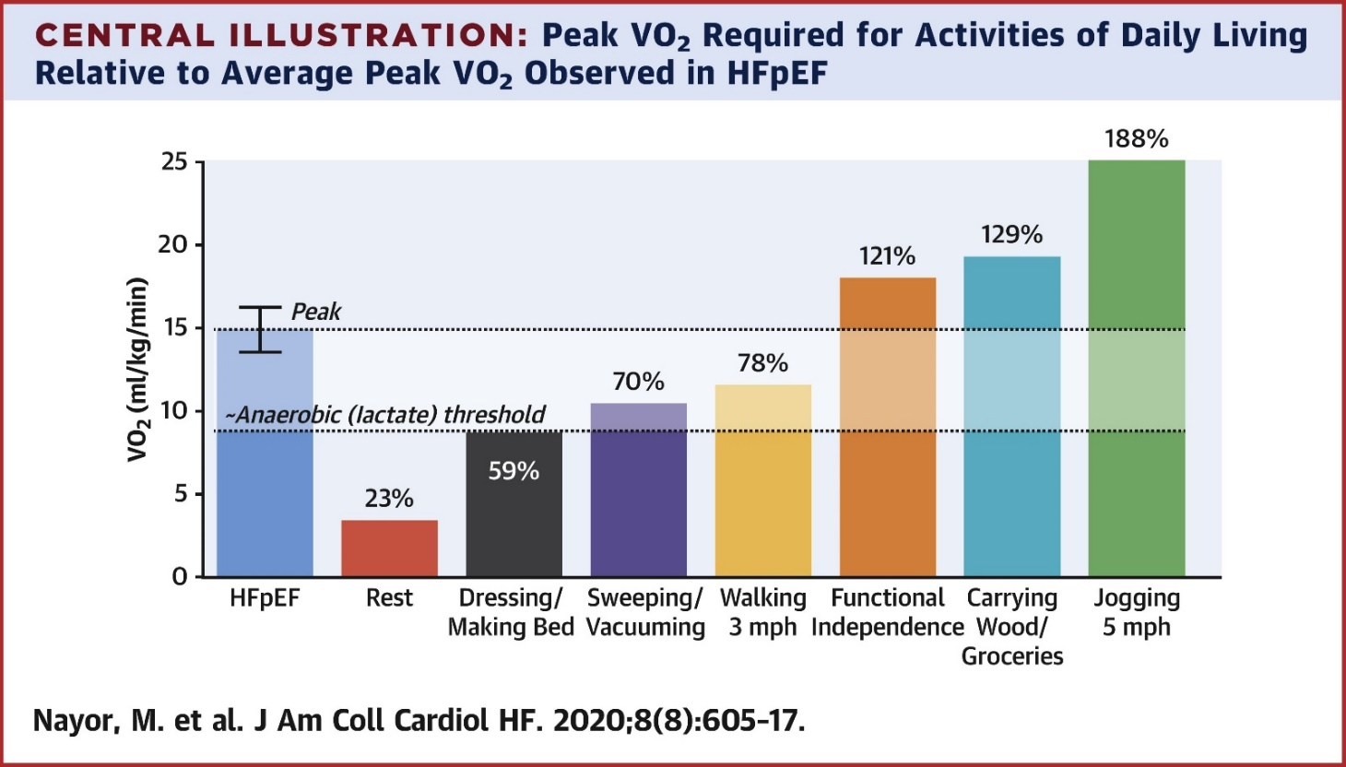
Background
Patients with HFpEF experience severe limitations in exercise capacity
Peak oxygen uptake (VO₂) is the gold standard measurement of exercise capacity and
a potent predictor of heart failure outcomes
VO₂ = Cardiac Output x Peripheral Oxygen Extraction (CaO₂ – CvO₂)
14 studies
HFpEF→ ↓ peripheral oxygen extraction during
exercise compared to HFrEF and controls
Nayor M….Lewis G, JACC 2020
Bhella, et al. Eur J Heart Fail. 2011 ; Haykowsky et al, J Gerontol A Biol Sci Med Sci. 2013; Haykowsky et al. Am J Cardiol. 2014;
Kitzman et a. Am J Physiol.2014 , Zamani P ESC HF 2021, Lefer D, Allerton T, JACC BTS, 2024

Slide 4
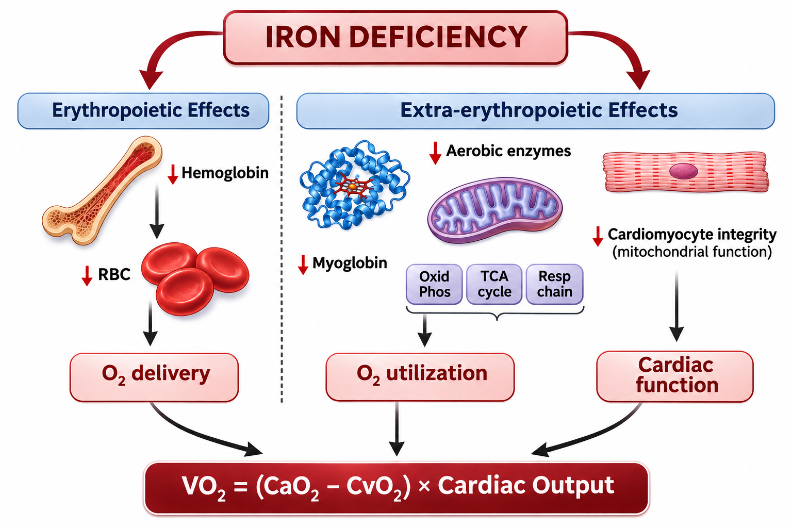
Background
Mechanisms by which iron deficiency impacts exercise capacity (peak VO₂)
Dhakal B….Lewis G, Circ HF 2015
Adapted from Lewis G, Malhotra R, Circ HF 2015

Slide 5
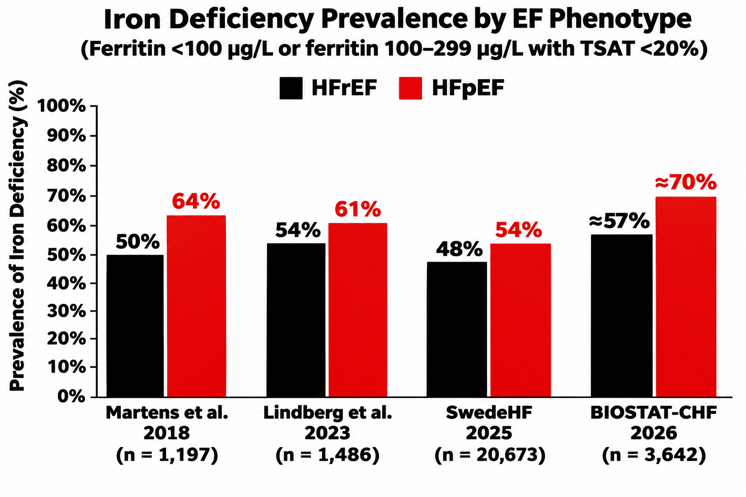
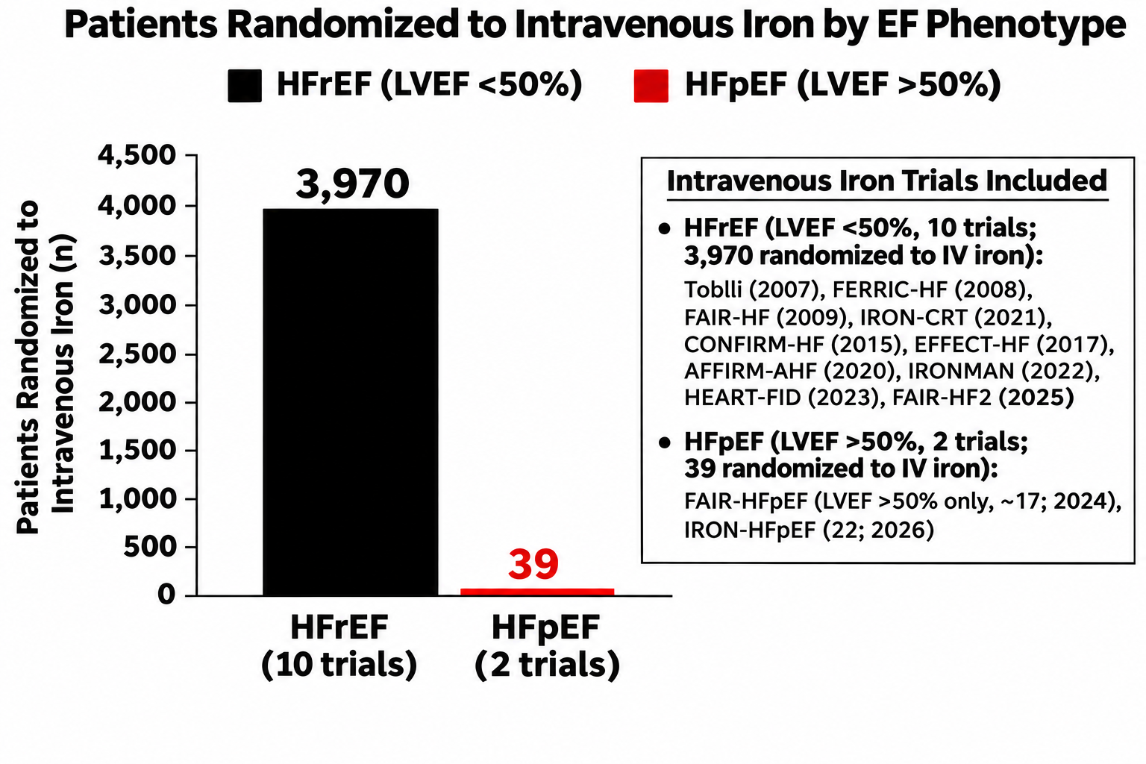
Background
Iron deficiency Prevalence in HFrEF and HFpEF, and Trials of IV Iron Repletion
In heart failure, iron deficiency is associated with ↑ mortality and ↓ exercise capacity¹⁻³
Klip IT, Am Heart J 2013; Comin-Colet Eur J Heart Fail 2013; Lee JACC HF 2025

Slide 6
HYPOTHESIS
Single-dose ferric derisomaltose (FDI), compared to placebo, will improve peak Vo₂ in patients with HFpEF and iron deficiency

Slide 7
Methods
Trial design and eligibility
FDI: Ferric derisomaltose; CPET: cardiopulmonary exercise test; KCCQ, Kansas City Cardiomyopathy Questionnaire

Slide 8
Results
Table 1. Baseline characteristics
Characteristic | FDI (n = 44) | Placebo (n = 21) | All (N = 65)
Age, years | 66.5 (55.5, 73.5) | 70.0 (67.0, 76.0) | 68.0 (58.0, 76.0)
Female sex | 32 (72.7%) | 15 (71.4%) | 47 (72.3%)
Body mass index, kg/m² | 33.2 (28.6, 38.8) | 29.7 (27.0, 34.5) | 31.3 (27.7, 37.3)
Left ventricular ejection fraction, % | 65 (60, 67) | 64 (61, 70) | 65 (60, 68)
NYHA class III | 21 (47.7%) | 9 (42.9%) | 30 (46.2%)
Peak VO₂, mL/kg/min | 12.7 (10.6, 15.8) | 12.2 (11.6, 14.6) | 12.4 (10.8, 15.5)
Six-minute walk distance, m | 323 (256, 421) | 311 (274, 355) | 323 (268, 408)
Ferritin, ng/mL | 55 (27.5, 68.5) | 34 (23, 88) | 47 (27, 72)
Transferrin saturation, % | 16 (11, 20) | 15 (9.5, 19) | 15 (11, 20)
Hepcidin, ng/mL | 12.7 (4.5, 20.7) | 6.3 (4.3, 21.2) | 9.8 (4.5, 20.7)
Values are median (interquartile range) or n (%). One FDI participant lacked a baseline walk distance.
Baseline hepcidin was missing for 3/44 FDI patients (6.8%) and 1/21 placebo patients (4.8%).

Slide 9
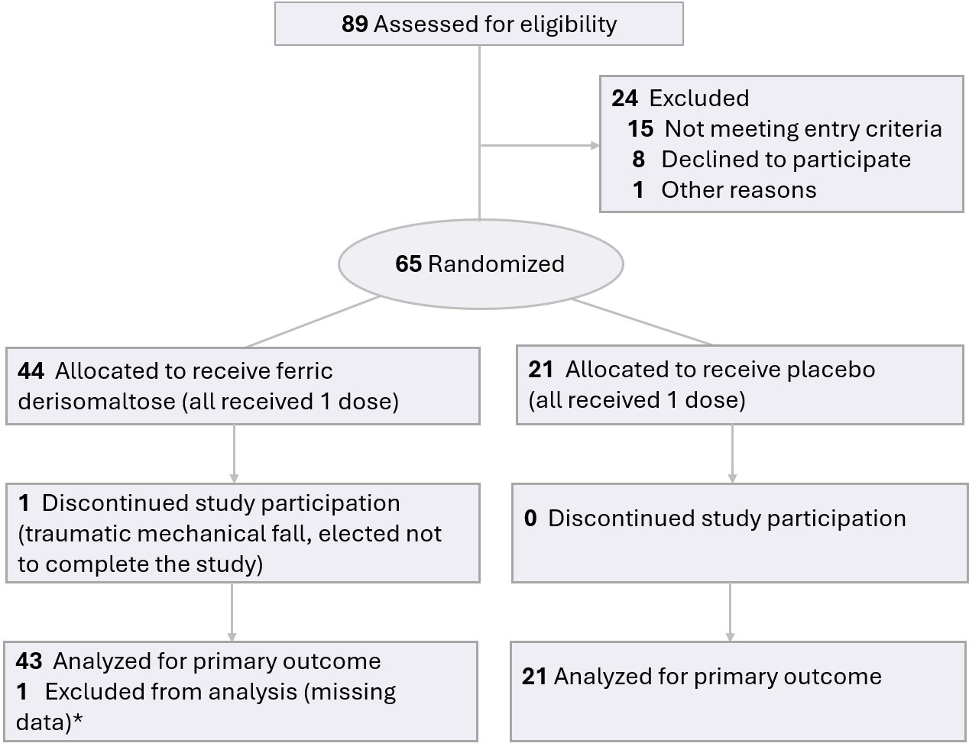
Results
Enrollment and follow-up
98.5% participant retention with primary endpoint data
*A sensitivity analysis included all 65 participants. One patient elected not to complete the trial after a mechanical fall

Slide 10
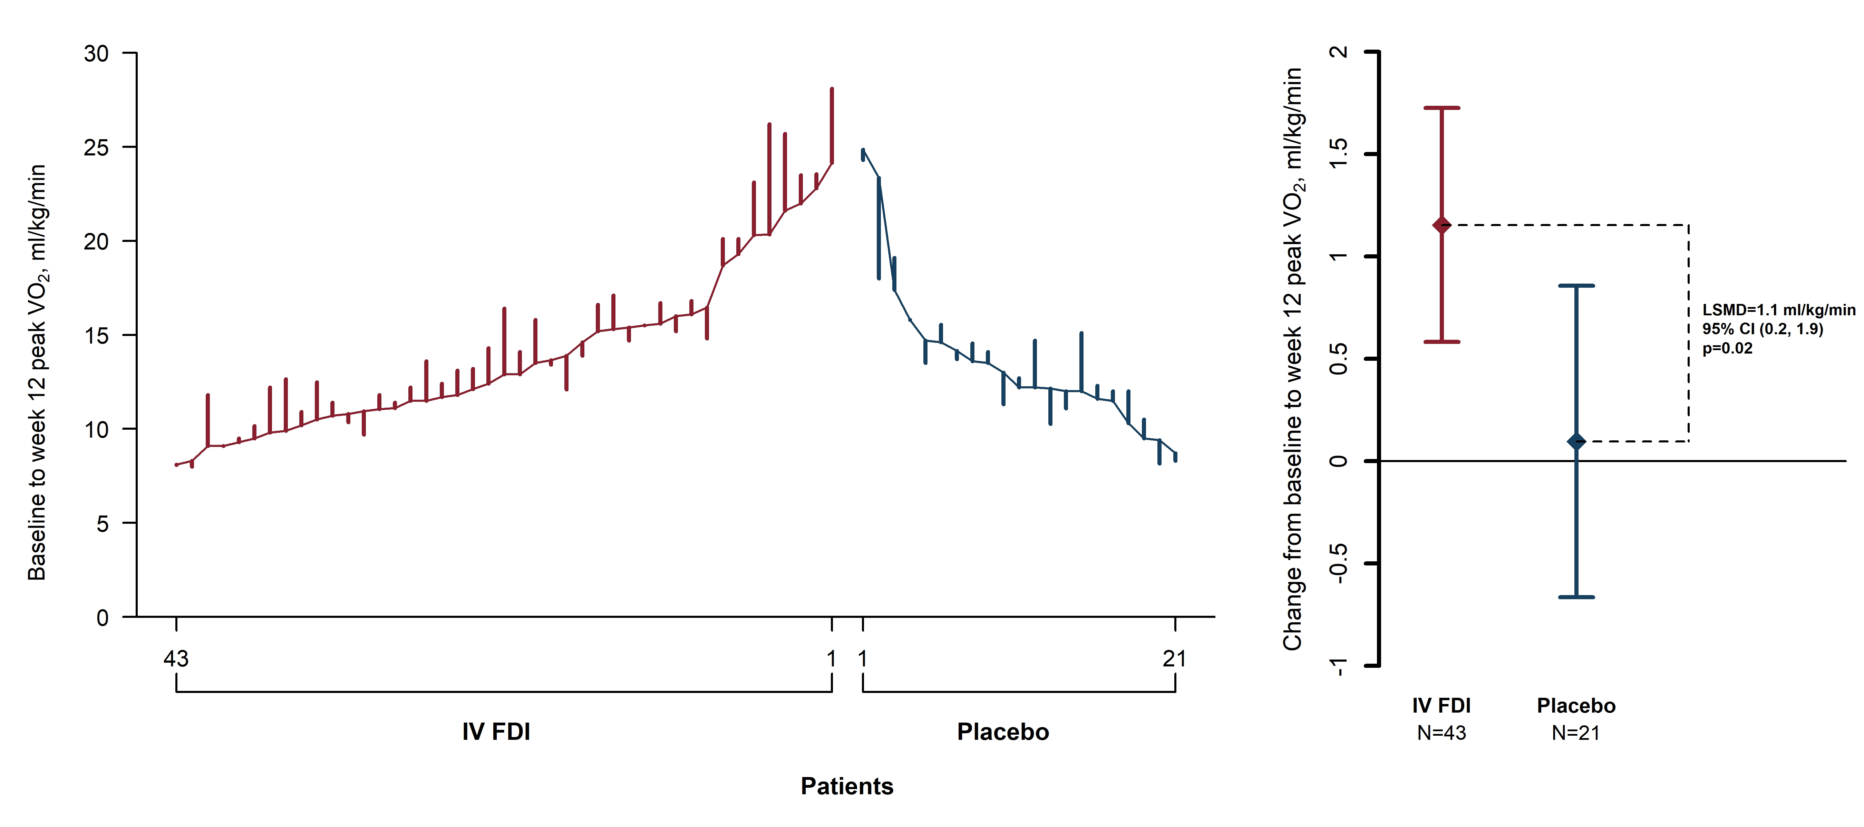
Results
Primary Endpoint: FDI improved peak oxygen uptake at 12 weeks
+1.1 mL/kg/min
p = 0.02
Endpoint analysis was by ANCOVA with adjustment for baseline peak VO₂ and sex. A sensitivity analysis with imputation of single
missing peak VO₂ value yielded identical results.

Slide 11
Results
Pre-specified secondary endpoints: functional capacity and health status
Week 12 differences between FDI and placebo
Secondary end point | Adjusted difference FDI vs. Placebo (95% CI) | P value
Six-minute walk distance, m | +41.1 (9.5 to 72.8) | 0.012
VO₂ at anaerobic threshold, mL/min | +46.4 (0.7 to 92.2) | 0.047
Improvement in NYHA class, % | +26 (6 to 47) | 0.013
KCCQ overall summary score, points | +4.4 (−2.4 to 11.2) | 0.20
KCCQ = Kansas City Cardiomyopathy Questionnaire.
Estimates account for baseline values and sex

Slide 12
Results
Iron indices and hemoglobin at 12 weeks
Adjusted differences in change from baseline, FDI minus placebo
Secondary end point | Difference (95% CI) | P value
Transferrin saturation, percentage points | +9.4 (4.9 to 13.9) | <0.001
Ferritin, ng/mL | +182.6 (127.7 to 237.5) | <0.001
Serum iron, µg/dL | +15.7 (0.4 to 31.1) | 0.045
Hemoglobin, g/dL | +1.4 (0.9 to 1.9) | <0.001
Hepcidin, ng/mL | +40.4 (27.6 to 53.2) | <0.001
Estimates account for sex and baseline values.

Slide 13
Results
Adverse events during the trial
Event category | FDI (n = 44) Patients, n (%) | FDI Events | Placebo (n = 21) Patients, n (%) | Placebo Events
Any adverse event | 15 (34.1%) | 18 | 11 (52.4%) | 17
Serious adverse event | 3 (6.8%) | 3 | 3 (14.3%) | 4
Drug-related adverse event | 2 (4.5%) | 2 | 0 (0.0%) | 0
Drug-related serious adverse event | 0 (0.0%) | 0 | 0 (0.0%) | 0
Participants with events and total event counts; Two FDI recipients had drug-related symptoms. One had transient flu-like symptoms and one had lip fullness and nausea that did not interrupt the infusion. No deaths occurred.

Slide 14
Key Take Home Points
1. Iron deficiency is highly prevalent in HFpEF and associated with increased mortality and functional impairment
2. IRONMET was the largest trial of IV iron repletion in HFpEF to date, with high participant retention and comprehensive assessment of exercise capacity with CPET
3. Single dose FDI (1000mg) resulted in
  Robust target engagement ↑ Tsat, ↑ ferritin, ↑ Hemoglobin
  Consistent improvement across multiple distinct exercise endpoints
  ↑ pVO₂, ↑VO₂@AT, ↑6MWT, ↑ improvement in NYHA class
  Concordant 6MWT findings with FAIR-HFpEF (n=39, ↑ 49m)
  No drug-related serious adverse events

Slide 15
Conclusions
Limitations, Unanswered Questions, and Future Directions
-Evaluation of larger, more diverse HFpEF populations
NCT07643818 ISLE-HFpEF (N=150), NCT07686692 INFUSE-HFpEF (N=300)
-Evaluation of durability of functional improvement, timing of re-dosing
-Evaluation of other clinically important outcomes with iron repletion

Slide 16
IRONMET in context: HFpEF placebo/sham
controlled trials targeting exercise capacity
Mueller
Exercise
PRESERVE-HR
BB withdrawal
Smart
Exercise
Edelmann
Exercise
IRONMET
IV iron
PRESERVED-
HF
Dapaglifozin
STEP-HFpEF
Semaglutide
FAIR-HFpEF
IV iron
Ex-DHF
Exercise
Haykowsky
Exercise
Kitzman Exercise
Borlaug
IV nitrite
SECRETExercise
SUMMIT
Tirzepatide
CADENCE
Sotatercept
0.3mg/kg
↑ Exercise capacity
2011 2012 2013 2014 2015 2016 2017 2018 2019 2020 2021 2022 2023 2024 2025 2026
No ↑ exercise capacity
RELAX
Sildenafil
NEAT-HFpEF
Mononitrate
Borlaug Inhaled nitrite
EDIFY
Ivabradine
REDUCE
LAP-HF I
Interatrial shunt
VITALITY-HFpEF
Vericiguat
EMPERIAL-Preserved
Empaglifozin
Sarma Nitroglycerin
INABLE-Training
Nitrite
KNO3CK OUT HFpEF
Nitrate
Aldo-DHF
Spironolactone
HFpEF
Ivabradine
Upadhya Spironolactone
CAMEO-DAPA
Dapaglifozin
INDIE-HFpEF
Inhaled nitrite
CAPACITY
HFpEF
Praliciguat
DETERMINE-Preserved
Dapaglifozin
REBALANCE-HF
Splanchnic denervation
HuMAIN-HFpEF
HU6
RAPID-HF
Atrial pacing
Therapeutic Mechanism
PARALLAX
Sacubitril/
Valsartan
MRA and ARNI
cGMP augmentation
Device therapy
Exercise/Diet
Heart rate modulation
Metabolic modulation
Activin inhibition
Iron repletion

Slide 17
IRONMET in context: HFpEF placebo/sham-controlled
trials targeting exercise capacity
Sample-Size Weighted Average
% Change in Exercise Capacity
BB withd/ Ivabr withd (3)
Device – Spl Denerv (1)
ARNI (1)
cGMP stim/PDE5i (4)
MRA (2)
Nitrite/ Nitrate (6)
Device – IAS (1)
Ketone ester (1)
Exercise Training (7)
Pacing (1)
Trimetazidine (1)
SGLT2i (4)
GLP1 (2)
IV iron (3)
HU6 (1)
Postulated Improvement in
Central Hemodynamics/LV Filling Pressures
Exercise HR
Augmentation
Myocardial
Energetics
Metabolic/
Weight loss
Multi-organ/Peripheral
O₂ Utilization

Slide 18



The Effect of Intravenous Iron Repletion on Mechanisms of Exercise Intolerance in Heart Failure with Preserved Ejection Fraction: The IRONMET-HFpEF Trial
Gregory D. Lewis, MD; Nora K. Horick, MS; Fabely Moreno, BS; Kenneth Lim, BS;
Diane Cocca-Spofford, RN; Takenori Ikoma, MD, PhD; Paridhi Gupta, MD; Carly Camphausen, BS;
Laura Caccamo, NP; Charounipha Soydara, NP; Shaina McGinnis, BS; Chloe Newlands, MS;
Skyler Williams, BA; Alexandra Minasian, MS; Nicholas Iskenderian, BA; Isabela Landsteiner, MD;
Bhavani Iyer, MS; Justin Joseph, BS; Alvaro Delgado MD; Helena Tattersfield, MS; Elizabeth Moore, BS; Veronica Platt, BS ; Sujin Lee, MD; Rajeev Malhotra, MD
CIRCULATION. 2026; [PUBLISHED ONLINE AHEAD OF PRINT]. DOI: 10.1161/CIRCULATIONAHA.126.084009

Slide 19
Thank you
We thank the following individuals for their contributions to this clinical trial
Participants and their families
Data Safety and Monitoring Board members
NHLBI for sponsoring the trial
Pharmacosmos for in kind contribution of study medication
ClinicalTrials.gov NCT04945707

