Slide 1
Coronary CT Angiography-Guided vs. IVUS-Guided PCI
The Randomized P4 Trial
Carlos Collet, MD, PhD
On behalf of the P4 investigators

Slide 2
Disclosures
Carlos Collet, MD, PhD
Within the prior 24 months, I have had financial relationships with companies that produce, market, sell, resell, or distribute healthcare products used by or on patients.
Grant support / Research contracts
Abbott Vascular; Boston Scientific Corporation; GE Healthcare;
Shockwave Medical; Heartflow, Insight Lifetech; AngioInsight
Consulting / Honoraria / Speaker’s bureau
Abbott; Boston Scientific Corporation; Medtronic; GE Healthcare;
Shockwave Medical; Medyria; Siemens Healthineers; AngioInsight
Royalties / Intellectual property rights
Coroventis Research
Equity / Stocks / Options
Boston Scientific Corporation; Powerful Medical; CathFlow; Medyria; Cryotherapeutics

Slide 3
PCI decisions are often made during the procedure
Interpret
Think
Diagnose
Decide
Treat
React
3

Slide 4
PCI decisions are often made during the procedure
Interpret
Think
Diagnose
Decide
Treat
React
IVUS
4

Slide 5
Complex decisions within seconds

Slide 6
The value of PCI planning
Better prepared
Less variability
Shared decision-making
6

Slide 7
How could coronary CT support PCI planning?

Slide 8
What should
inform strategy?
Plaque
characteristics
Clinical
Clinical
Angiographic
Angiographic
Physiology
8

Slide 9
What should
inform strategy?
Plaque
characteristics
Clinical
Angiographic
Physiology
9

Slide 10


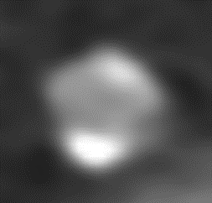


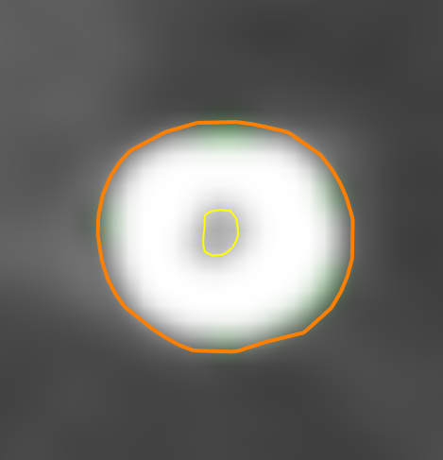
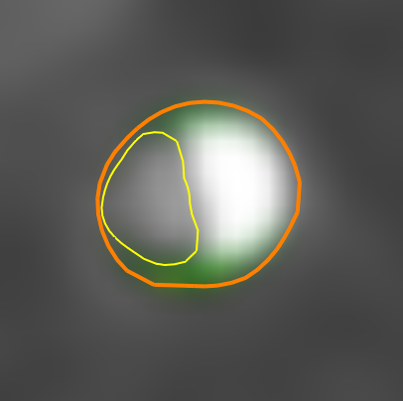

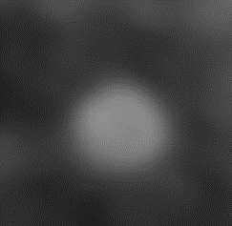
CCTA provides information about lesion characteristics
LCx
A
Dg1
LD 3.50 mm
B
Dg2
Normal to normal
Lesion length 48 mm
C
Dg2
MLA 0.37 mm²
AS 86 %
PB 97 %
D
E
LD 2.95 mm
Curved Multiplanar Reconstruction (Curved MPR)
Straight MPR
Cross-sections

Slide 11
Morphological and physiological assessment before the cath lab
Plaque
Calcium
Physiology
3D plaque
3D calcium reconstruction
Physiological assessment
Notes:
Clinical reveal built from the same case in user-supplied image(20261031-125905).png. Original higher-resolution plaque and physiology assets reused from P4_LBT_TCTLayout(1).pptx slide 11 (image72.png and image73.png). Calcium is cropped from the supplied slide image, preserving all displayed clinical pixels. No vessel contours, plaque, calcium, colors, or physiological values synthesized or modified. Image scaling preserves the intrinsic aspect ratio of each cropped view. Labels and composition are editable; clinical images remain original raster assets. Slide 1: fully visible static version. Slide 2: three native click-triggered fade reveals (plaque, calcium, physiology). Start by showing the title, then introduce the domains in sequence. Playback should be checked in PowerPoint on the presentation machine.

Slide 12
P4 trial hypothesis
Can a CCTA-guided PCI strategy achieve similar clinical outcomes compared with IVUS-guided PCI?

Slide 13
Study design

Slide 14
P4 trial design
Stable coronary artery disease or stabilized ACS
≥1 lesion with diameter stenosis >70% and FFR_{CT} ≤0.80
Central core laboratory confirmation of eligibility
Patients randomized 1:1
CT-guided PCI strategy
IVUS-guided PCI strategy
FFR_{CT} Planner and CT planning
Online CT guidance and stent enhancement
Mandatory IVUS assessment
before and after PCI
Primary endpoint: target-vessel failure at 12 months

Slide 15

Study design
International, randomized, open-label trial
23
8
Investigator initiated
Regulatory sponsor: CoreAalst
centers
countries
Central core laboratory
analyses
Blinded endpoint
adjudication
Independent safety oversight
Data and safety monitoring
board (DSMB)
Grant support
Notes:
Source: supplied study-design slide image(20261101-055400).png and original P4 map/branding assets. Content retained: 23 centers, 8 countries; international randomized open-label trial; investigator initiated; regulatory sponsor CoreAalst; central core laboratory analyses; blinded endpoint adjudication; independent DSMB safety oversight; grant support from GE HealthCare and HeartFlow. Original map retained unchanged. Typography, statistics, oversight statements, markers, and footer elements aligned on consistent grids. Text and annotations editable, map and logos are original image assets.

Slide 16
Key inclusion and exclusion criteria
Eligible population
Major exclusions
Clinical criteria
Presentation / anatomy
Age 18–79 years
STEMI or left main disease
Chronic coronary syndrome
or stabilized NSTE-ACS
Previous revascularization
Clinical indication for revascularization
Previous PCI in the target vessel
or prior CABG
Lesion criteria
Diameter stenosis >70% and FFR_{CT} ≤0.80
Renal function
Reference vessel diameter 2.5–4.0 mm
eGFR ≤30 mL/min/1.73 m²
No more than 2 target vessels
Body mass index
BMI ≥35 kg/m²
Imaging
Insufficient CCTA image quality
Notes:
Rebuilt from user-supplied image(20261031-124604).png. All clinical inclusion/exclusion criteria and threshold operators retained exactly: age 18–79; chronic coronary syndrome or stabilized NSTE-ACS; revascularization indicated; diameter stenosis >70% and FFRCT ≤0.80; reference vessel 2.5–4.0 mm; no more than 2 target vessels; exclusions STEMI/left main disease, previous target-vessel PCI or CABG, eGFR ≤30 mL/min/1.73 m², BMI ≥35 kg/m², insufficient CCTA image quality. Consistent 28-pixel text baseline grid; identical column padding, header alignment, category-to-body offsets, and section spacing. All text and panels editable; only original CRF/TCT logo raster.

Slide 17
Study endpoints
Primary endpoint
Key secondary endpoints
Target-vessel failure
Procedure duration
at 12 months
Contrast volume
Composite of
Radiation dose
Cardiac death
Target-vessel myocardial infarction
Individual components
of the primary endpoint
Ischemia-driven target-vessel
revascularization

Slide 18
Two imaging approaches to guide PCI
CT-guided PCI
IVUS-guided PCI
Plan reviewed
before the procedure
Mandatory IVUS
before and after PCI
Standardized CT package
Anatomy, plaque and
FFR_{CT} Planner
Lesion morphology
and vessel sizing
3D CT synchronized with the C-arm
Mandatory stent enhancement
IVUS permitted for bailout only
Pre-specified IVUS optimization criteria
No access to the CT planning package
All participating interventional cardiologists completed a dedicated coronary CT course.
Notes:
Alternative 3: image-led comparison of the P4 protocol-defined guidance strategies slide. Content from the user-supplied slide image(20261031-010313).png and P4_LBT_TCTLayout(1).pptx slide 22. Shared operator preparation: all participating interventional cardiologists completed a dedicated coronary CT course. CT strategy: standardized anatomy, plaque and FFRCT Planner package reviewed before the procedure; 3D CT synchronized with the C-arm; mandatory stent enhancement; IVUS only for bailout. IVUS strategy: mandatory pre-PCI assessment of morphology and vessel sizing; mandatory post-PCI IVUS; expansion ≥80% acceptable and ≥90% optimal; no access to the CT planning package. Layout does not imply that IVUS assessment occurs before coronary instrumentation. All text and layout shapes editable. The image-led alternative uses an original illustrative CT model (slide 23) and a conceptual IVUS illustration already used in the presentation (slide 4); neither is presented as comparative trial evidence.

Slide 19
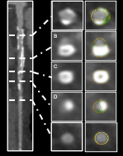
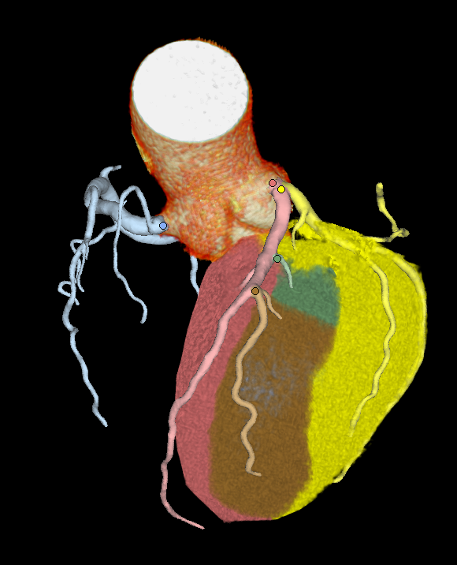
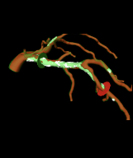
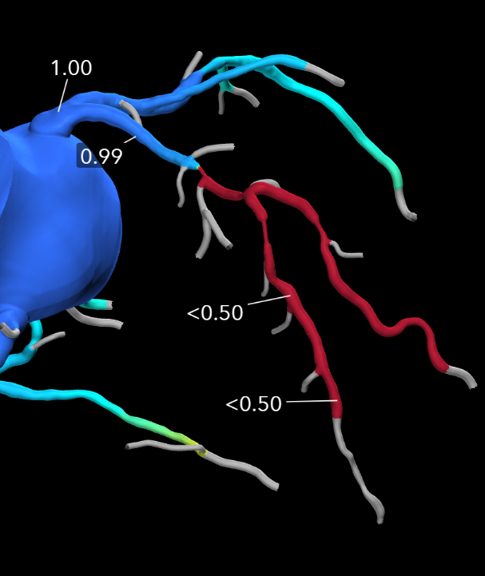
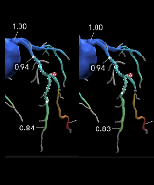
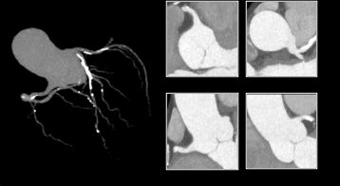
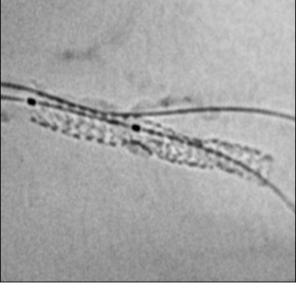
CT-guided PCI: The P4 approach
01
02
03
04
05
06
07
Anatomy
Morphology
and length
Myocardial
mass
Best achievable
projection
FFR_{CT}
PCI
strategy
Stent
optimisation
Coronary tree and ostia
Calcium and tortuosity
Expected guiding support
Lesion location
Plaque composition
Lesion length
Myocardium at risk
Side-branch territory
Optimal projection
for the target lesion
Lesion significance
Focal or diffuse CAD
Predicted
post-PCI FFR
Stent enhancement
following PCI
Catheter selection
Anticipate complexity
Lesion preparation
Stent length
Side-branch
protection
C-arm
angulation
PCI appropriateness
PCI strategy
Stent
expansion
Notes:
Sources: user-provided gray/white CT planning package slide image(20261101-052230).png and black P4 approach slide image(20261101-052240).png. All seven clinical components retained: anatomy, morphology/length, myocardial mass, projection, FFRCT, PCI strategy, and stent optimisation. Anatomy, morphology, projection and paired PCI strategy views are cropped from the supplied slide without altering clinical pixels. Higher-resolution myocardial mass, FFRCT and stent images reused from the original P4_LBT_TCTLayout(1).pptx slide 23 (image88, image90, image83). Image aspect ratios preserved. No clinical findings, physiological values or anatomy synthesized or changed. Clinical decisions summarize the supplied black slide. Text and annotations editable; clinical visuals are separate image objects.

Slide 20
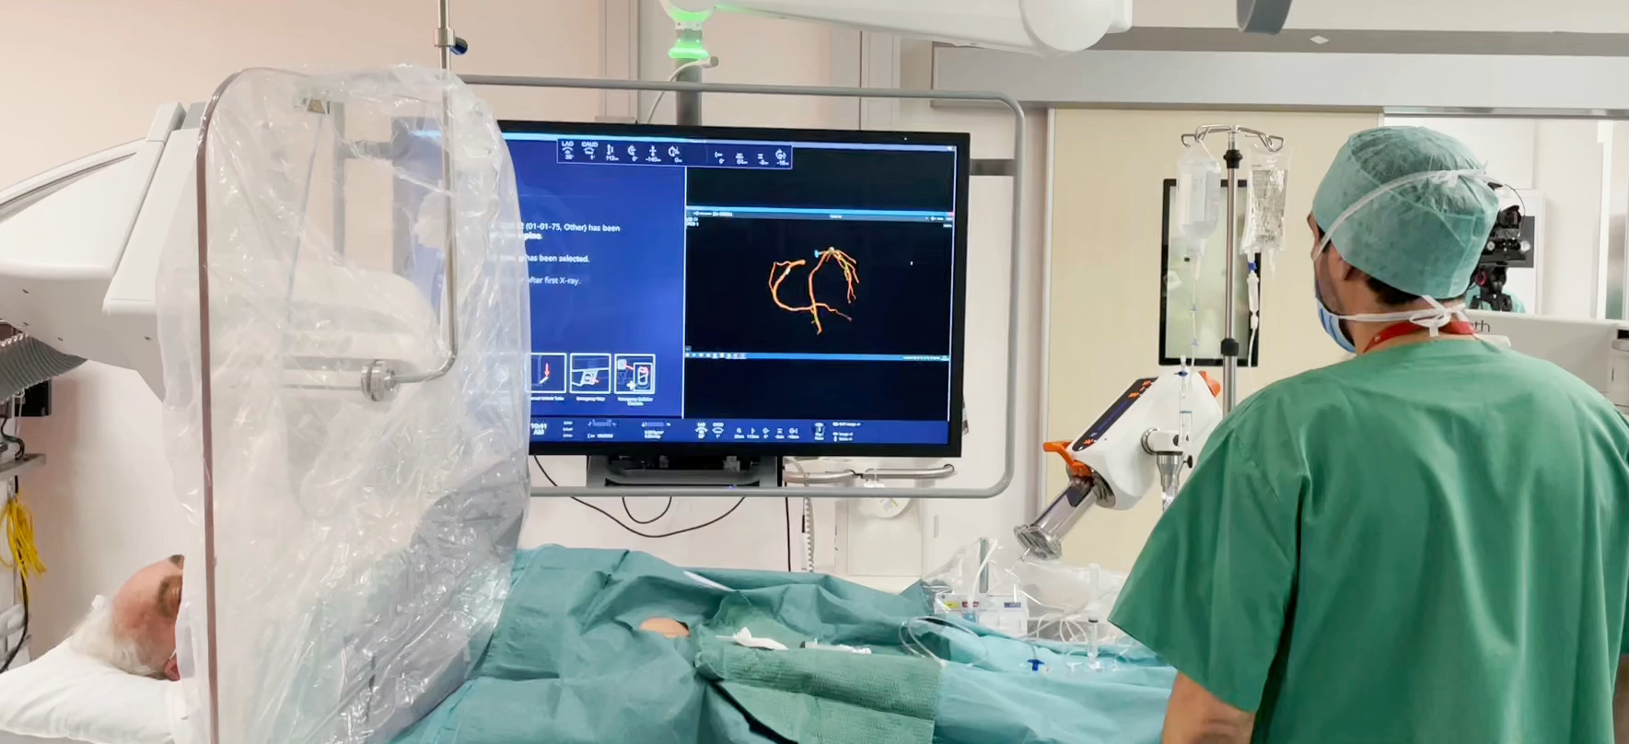
Side-by-side visualisation with the angiogram

Slide 21
Sample size and statistical analysis
Noninferiority design
Sample-size assumptions
Required enrollment
Assumed 12-month TVF, each group
7.2%
1,090
Absolute noninferiority margin
4.5%
Statistical power
80%
patients
One-sided α
0.025
Includes 5% anticipated attrition
Primary analysis: intention to treat, with supportive per-protocol analysis.
Notes:
Source: user-supplied sample-size/statistical-analysis slide image(20261031-125014).png and P4_LBT_TCTLayout(1).pptx slide 33. Assumed 12-month target-vessel failure 7.2% in each group; absolute noninferiority margin 4.5 percentage points; 80% power; anticipated 5% attrition; calculated enrollment requirement 1,090. The margin is expressed as percentage points, not a relative percentage. Noninferiority tested at one-sided alpha 0.025; only if established, superiority tested at two-sided alpha 0.05. Primary analysis ITT with supportive per-protocol analysis, retained from the presentation’s earlier statistical-analysis slide. TVF means target-vessel failure; pp means percentage points. No new sample-size calculation performed. All content editable.

Slide 22
Results

Slide 23
Enrollment, randomization, and follow-up
1624 patients were assessed for eligibility from March 2022 through August 2025
519 screen failures
1105 patients underwent randomization
556 patients were allocated to
CT-guided PCI strategy
549 patients were allocated to
IVUS-guided strategy
6 Withdrew consent
2 Lost to follow-up
4 Withdrew consent
548 (98.6%) patients completed 1-year follow-up
545 (99.3%) patients completed 1-year follow-up

Slide 24
Baseline characteristics
Characteristic | CT guidance (N = 556) | IVUS guidance (N = 549)
Clinical characteristics
Age, median (IQR), years | 65 (58–71) | 64 (58–70)
Male sex, n/N (%) | 432/556 (77.7) | 433/549 (78.9)
Diabetes mellitus, n/N (%) | 100/544 (18.4) | 122/536 (22.8)
Chronic kidney disease, n/N (%) | 91/538 (16.9) | 65/527 (12.3)
Stable ischemic heart disease, n/N (%) | 546/555 (98.4) | 536/549 (97.6)
Anatomical and functional characteristics
Two-vessel coronary disease, n (%) | 187 (33.6) | 171 (31.1)
Three-vessel coronary disease, n (%) | 15 (2.7) | 23 (4.2)
Chronic total occlusion, n/N (%) | 47/534 (8.8) | 43/525 (8.2)
Severe calcification, n/N (%) | 60/534 (11.2) | 87/525 (16.6)
SYNTAX score (IQR) | 8 (5–13) | 9 (6–14)
FFR_{CT}​ value | 0.69±0.10 | 0.69±0.09

Slide 25
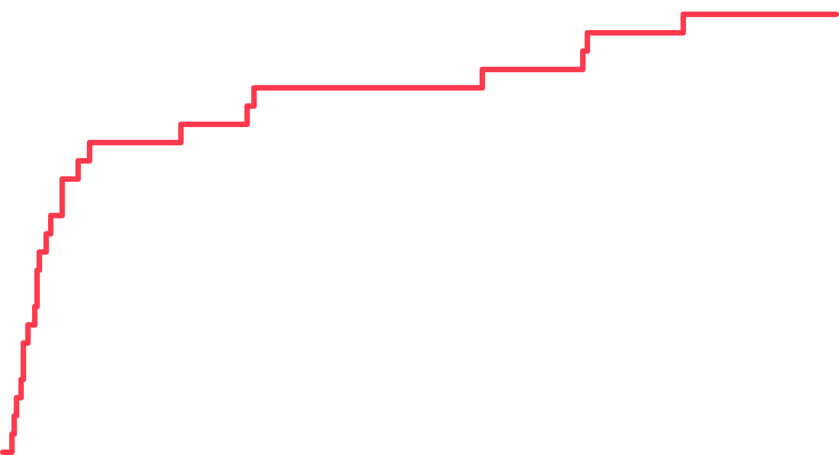
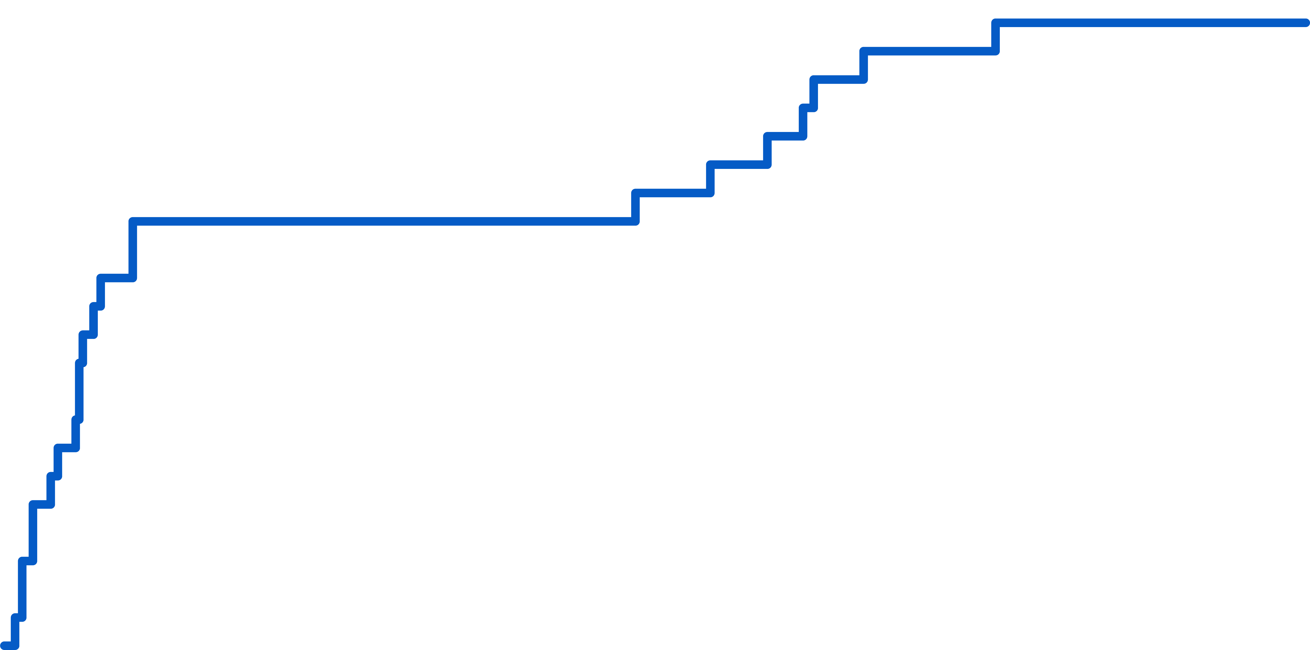
Target-vessel failure at 12 months
6
CCTA-guided PCI
Risk difference −0.42 percentage points
95% CI −2.82 to 1.99
4.1%
5
P < 0.001 for noninferiority
4
23 / 556 patients
Cumulative incidence (%)
3
IVUS-guided PCI
4.6%
2
1
25 / 549 patients
0
0
90
180
270
365
No. at risk
Days since randomization
CCTA
556
534
532
527
443
IVUS
549
528
525
520
435

Slide 26
CT-guided PCI met the noninferiority criterion
Target-vessel failure at 12 months
CT-guided PCI
IVUS-guided PCI
Risk difference (CT − IVUS), primary ITT
4.1%
4.6%
−0.42 percentage points
95% CI −2.82 to 1.99
23 / 556 patients
25 / 549 patients
P < 0.001 for noninferiority
Favors CT
Favors IVUS
NI margin +4.5%
Intention-to-treat
−0.42 (−2.82 to 1.99)
Per-protocol
−0.83 (−3.33 to 1.66)
−6
−4
−2
0
2
4
6
Risk difference, CT − IVUS (percentage points)
Notes:
Source: user-supplied noninferiority results slide image(20261031-004844).png. All supplied scientific values retained. CT observed event proportion: 23/556, 4.1%; IVUS: 25/549, 4.6%. Primary ITT risk difference CT minus IVUS: −0.42 percentage points, 95% CI −2.82 to 1.99; P<0.001 for noninferiority; P=0.73 for superiority. Per-protocol risk difference −0.83 percentage points, 95% CI −3.33 to 1.66. Prespecified noninferiority margin +4.5 percentage points. Forest plot rebuilt as editable PowerPoint vector shapes with exact linear coordinates on a −6 to +6 axis. Markers represent estimates; bars represent 95% CIs. Both upper CI limits lie below the margin; crossing zero does not establish superiority. pp denotes percentage points. All labels, bars, markers, and margin are editable.

Slide 27
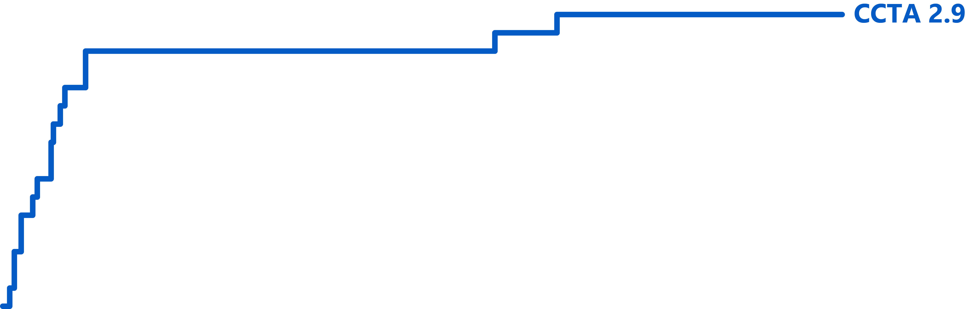
Components of the primary endpoint
CCTA-guided PCI
IVUS-guided PCI
Cardiac death
Target-vessel
myocardial infarction
Ischemia-driven target-vessel
revascularization
Risk difference: −0.36 pp
Risk difference: −0.58 pp
Risk difference: −0.02 pp
95% CI −0.87 to 0.14
95% CI −2.65 to 1.48
95% CI −1.43 to 1.39

Slide 28
Target-vessel failure across subgroups
12-month target-vessel failure; risk difference CT − IVUS
Events / patients
Risk difference (percentage points)
Subgroup
CT
IVUS
−10
−5
0
5
10
Difference (95% CI)
Favors CT
Favors IVUS
NI margin +4.5 pp
All patients
23/556
25/549
−0.42 (−2.82 to 1.99)
Age
≤65 years
13/281
13/304
0.35 (−3.00 to 3.70)
>65 years
10/275
12/245
−1.26 (−4.75 to 2.23)
Sex
Male
17/432
20/433
−0.68 (−3.38 to 2.01)
Female
6/124
5/116
0.53 (−4.76 to 5.81)
Hypertension
Yes
15/368
16/359
−0.38 (−3.32 to 2.56)
No
8/177
9/179
−0.51 (−4.94 to 3.92)
Dyslipidemia
Yes
19/463
23/460
−0.90 (−3.59 to 1.79)
No
4/82
2/78
2.31 (−3.52 to 8.15)
Diabetes mellitus
Yes
3/100
3/122
0.54 (−3.79 to 4.87)
No
20/444
22/414
−0.81 (−3.71 to 2.09)
Extent of coronary disease
Single-vessel disease
12/354
16/362
−1.03 (−3.86 to 1.80)
Multivessel disease
11/181
9/163
0.56 (−4.38 to 5.50)
SYNTAX score
Low (≤22)
21/502
20/488
0.08 (−2.40 to 2.57)
Intermediate (23–32)
2/28
2/27
−0.26 (−14.00 to 13.47)
High (≥33)
0/5
1/5
−20.00 (−55.06 to 15.06)
Calcium
Severe
3/60
7/87
−3.05 (−10.99 to 4.90)
Non-severe
20/474
16/438
0.57 (−1.96 to 3.09)
−10
−5
0
5
10

Slide 29

0
1
2
3
4
5
6
7
8
9
10
11
12
13
14
15
16
17
Shorter procedure duration with CT guidance
63 min
46 min
17 min saved
Better prepared
More effective
Medians (IQR); difference in medians, p<0.001. Invasive procedure only, not total radiation or contrast burden.

Slide 30
Contrast volume and invasive-procedure radiation exposure
Contrast volume
-20.0 ml
Radiation
-2.91 Gy•cm²
CCTA 150 ml (120-208)
CCTA 35.6 (16.1-66.6)
IVUS 170 ml (125-220)
IVUS 38.5 (21.5-71.4)
Difference 95% CI – 25.0 to 0.0, p<0.001
Difference 95% CI – 9.03 to 3.80, p=0.07

Slide 31
Advanced calcium modification was used
more often with CT guidance
Patients receiving an advanced calcium-modification device
p<0.001
2.5-fold greater use of advanced calcium-modification devices
CT versus IVUS
Advanced devices: intravascular lithotripsy, rotational or orbital atherectomy.

Slide 32
Limitations
Applicability
Patients required CCTA with sufficient image quality. Women comprised 22% of the trial population.
Guidance strategies
CT guidance included plaque, physiology, mass and stent-enhancement imaging.
Event rates and margin
Primary-event rates were lower than anticipated; non-inferiority should be interpret interpret alongside the confidence interval for additional clinical context .
Follow-up
Follow-up was 12 months, longer follow-up is required.

Slide 33
In summary…

Slide 34
P4: Key conclusions
Clinical outcomes
Procedural efficiency
Clinical implications
CT-guided PCI was noninferior to IVUS-guided PCI for target-vessel failure at 12 months.
CT guidance shortened procedures and reduced contrast use.
P4 supports a CT-based pathway for PCI planning and procedural guidance in selected patients
44
Notes:
Source: user-supplied P4 conclusions slide. CT-guided PCI was noninferior to IVUS-guided PCI for target-vessel failure at 12 months. CT guidance shortened procedures and reduced contrast use. P4 supports a CT-based pathway for PCI planning and procedural guidance in selected patients. The comparison concerns the complete protocol-defined guidance strategies. All text and layout elements are editable. Original CRF/TCT logo retained.

Slide 35
Moving PCI planning upstream
Interpret
Think
Read
Decide
Treat
React

Slide 36
Better-informed decisions before entering the cath lab
Read
Think
Process
Shared decisions
Treat

Slide 37
Thank you to the P4 investigators and collaborators
Barts Heart Centre, London
Centro Cardiologico Monzino, Milan
St Francis Heart Center, Roslyn
Daniel A. Jones
Gianluca Pontone
Ziad Ali
Freeman Hospital, Newcastle
Galeazzi–Sant’Ambrogio, Milan
Aichi Medical University
Ian Purcell; Alan Bagnall
Daniele Andreini; Antonio L. Bartorelli
Tetsuya Amano
St George’s Hospital, London
Humanitas Research Hospital, Rozzano
Semmelweis University, Budapest
James C. Spratt
Giulio Stefanini; Gianluca Mincione
Béla Merkely
Guy’s and St Thomas’, London
University Hospital of Ferrara
CHU Lille, Lille
Divaka Perera
Simone Biscaglia
Eric Van Belle
Liverpool Heart and Chest Hospital
Aarhus University Hospital
University of British Columbia
Timothy Fairbairn
Nicolaj Støttrup; Bjarne Nørgaard
Jonathon Leipsic (Committee member)
Royal Bournemouth Hospital
Rigshospitalet, Copenhagen
Victorian Heart Hospital, Monash
Peter O’Kane
Thomas Engstrøm
Brian Ko (Committee member)
Golden Jubilee National Hospital
Gentofte Hospital, Hellerup
Fiona Stanley Hospital, Perth
Richard Good
Niels Thue Olsen
Abdul Ihdayhid (CEC/DSMB Chair)
ZAS Middelheim, Antwerp
Minneapolis Heart Institute
Yamaguchi University, Ube
Carlo Zivelonghi
Yader Sandoval
Yosuke Miyazaki (CEC/DSMB member)
AZORG, Aalst
Cedars-Sinai, Los Angeles
Hospital Clínic Barcelona
Adriaan Wilgenhof; Jeroen Sonck
Hasan Jilaihawi
Salvatore Brugaletta (CEC member)
UZ Brussel, Brussels
Kaoru Tanaka
With gratitude to our patients, research teams, core laboratories, trial committees, and the OPTIMA team.
Notes:
Acknowledgments source verification: Supplementary-Appendix-clean-Final-JAL-CC_Proof_clean.pdf, pages 3–4 (investigators) and 20–21 (Table S1: 23 enrolling centers), Library ID libfile_1207e2e57fc0819184f3316427c92f45. Main manuscript author affiliations: draft_Proof_hi.pdf, PDF pages 1–4, Library ID libfile_ecfe3769f9e081919207f2736d3f1abb. Selected manuscript co-authors are matched to institutions; listing does not assign formal site-PI status. Institutional names shortened for display; full names retained in the source documents. Updated at user request: Lausanne and the Swiss flag removed. Country order UK, Belgium, Italy, Denmark, United States, Japan, then Hungary and France to retain all 23 enrolling centers. Lille restored because it is one of the 23 centers in Table S1 and was omitted from the reference image. The slide is an acknowledgments summary, not an exhaustive author or site-team roster. Jonathon Leipsic: University of British Columbia, Vancouver, Canada; Brian Ko: Victorian Heart Hospital, Monash University, Melbourne, Australia. Affiliations verified from the manuscript affiliation list, PDF page 4. These two collaborators appear within the main list and are not counted among the 23 recruiting centers. Committee names, affiliations and roles verified in Supplementary Appendix page 7: Abdul Ihdayhid, Fiona Stanley Hospital, Perth, Australia (CEC and DSMB Chair); Yosuke Miyazaki, Yamaguchi University, Ube, Japan (CEC and DSMB member); Salvatore Brugaletta, Hospital Clínic Barcelona, Spain (CEC member). All text, flags, and annotations editable; original CRF/TCT blue-wave background includes the logo.

Slide 38

Simultaneous publication
38

Slide 39
Thank you

