Slide 1

REDUCE:
A Randomized Controlled Trial of Spironolactone-Based Blood Pressure Management After Stroke
Jordana Cohen, MD, MSCE on behalf the co-authors
University of Pennsylvania, Philadelphia, PA

Slide 2
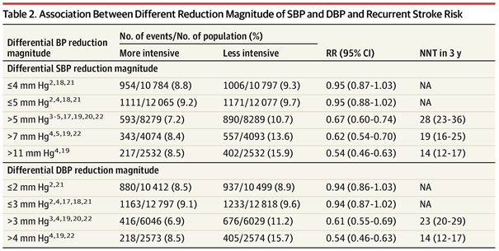
Blood pressure control after stroke is suboptimal
Blood pressure is the most important modifiable risk factor for recurrent stroke
Jones DW, et al. Hypertension 2025;152(11):e114-e218
Hsu CY, et al. JAMA Neurol. 2023;80(5):506-515

Slide 3
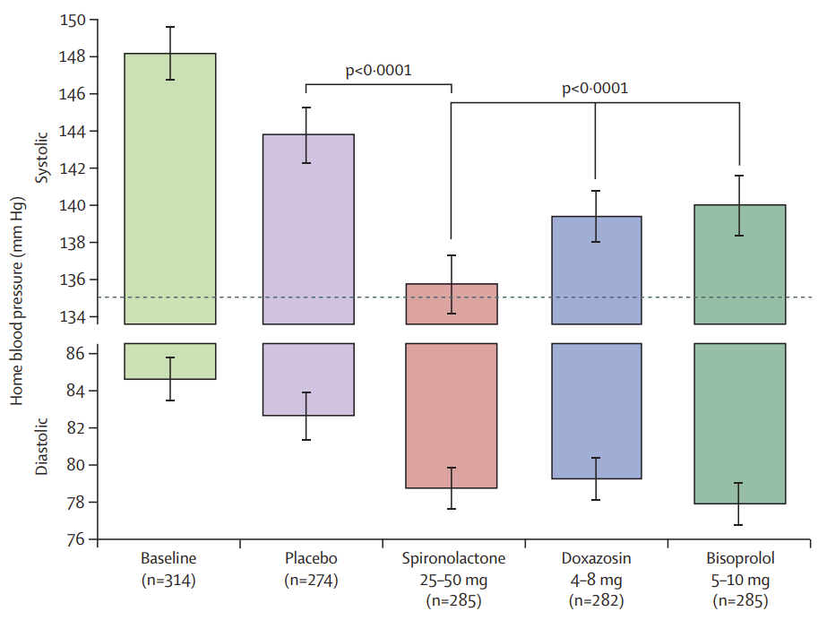
Blood pressure control after stroke is suboptimal
Guidelines recommend a blood pressure target of <130/80 mmHg for most stroke survivors, but evidence guiding additional treatment selection when BP remains above target is limited
Mineralocorticoid receptor antagonism is an effective 2nd-line antihypertensive medication but has not been carefully examined in patients post-stroke
Jones DW, et al. Hypertension 2025;152(11):e114-e218
Williams B, et al. Lancet 2015; 386(10008): 2059–68

Slide 4
The Regulating Blood Pressure During Recovery from Intracerebral Hemorrhage and Ischemic Stroke (REDUCE) Trial
Multicenter, randomized, open-label trial across 5 U.S. Centers
Key inclusion criteria:
  Adults with prior ischemic or hemorrhagic stroke
  Systolic blood pressure 120-200 mmHg based on a run-in period of home blood pressure monitoring
Key exclusion criteria:
  eGFR <45 mL/min/1.73m
  Clinically significant hyperkalemia
Randomized 1:1 to
  Spironolactone-based blood pressure treatment with 25mg daily added to existing treatment, uptitrated to 50mg at 2-4 weeks
  Standard care in which clinicians received guideline recommendations and home blood pressure readings

Slide 5
REDUCE Trial: Methods
Primary endpoint:
  Home systolic blood pressure at 3 months using standardized measurements (duplicate morning and evening readings over 3-5 days), analyzed as ITT
Second endpoints:
  Home diastolic blood pressure at 3 months
  Home systolic and diastolic blood pressure at 6 months
  Achievement of blood pressure target <130/80 mmHg at 3 months
  Number of concomitant antihypertensive medications at 3 months

Slide 6
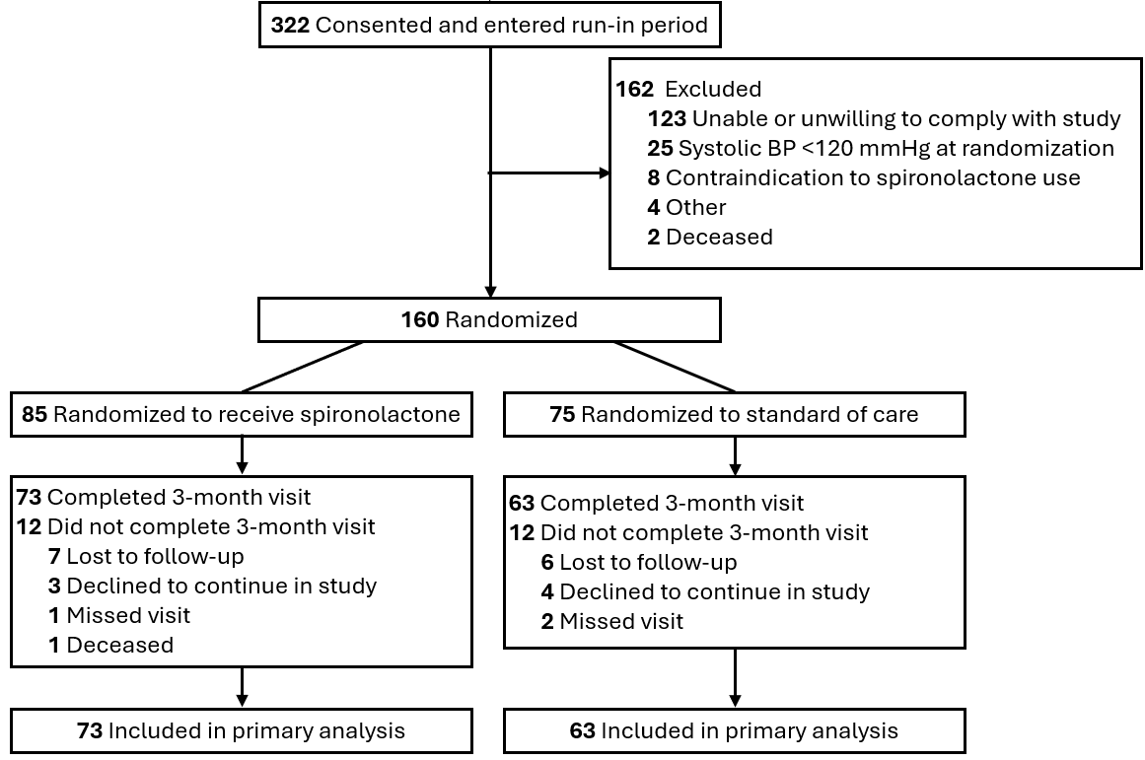
REDUCE Enrollment, Randomization, and Follow-up
Notes:
We had anticipated a sample size of 200 but given enrollment constraints, we randomized 160 participants; 85 were randomized to spironolactone and 75 were randomized to standard care; 136 contributed data to the primary outcome and 145 contributed any outcome data.

Slide 7
REDUCE Trial: Results
Baseline Characteristics | Spironolactone (N=85) | Standard of Care (N=75)
Age – yr, mean (SD) | 64.4 (10.7) | 61.8 (12.6)
Female sex, N (%) | 28 (33%) | 32 (43%)
Black race, N (%) | 22 (26%) | 25 (33%)
Hispanic, N (%) | 15 (18%) | 11 (15%)
Intracerebral hemorrhage, N (%) | 45 (53%) | 42 (56%)
Diabetes, N (%) | 22 (26%) | 21 (28%)
Atrial fibrillation, N (%) | 10 (12%) | 8 (11%)
Current smoker, N (%) | 9 (11%) | 8 (11%)
Home systolic blood pressure – mmHg, mean (SD) | 136 (9.98) | 136 (12.7)
Home diastolic blood pressure – mmHg, mean (SD) | 81.8 (9.71) | 83.6 (10.0)
Antihypertensive medications – N, mean (SD) | 1.8 (1.1) | 2.0 (1.1)
Notes:
Baseline characteristics were well-balanced across groups. Mean age was 63 years, 37% were female, 29% were Black race, 54% had intracerebral hemorrhage, 46% had ischemic stroke, mean baseline SBP was 136 mmHg, and participants were receiving a mean of 2 antihypertensive medications

Slide 8
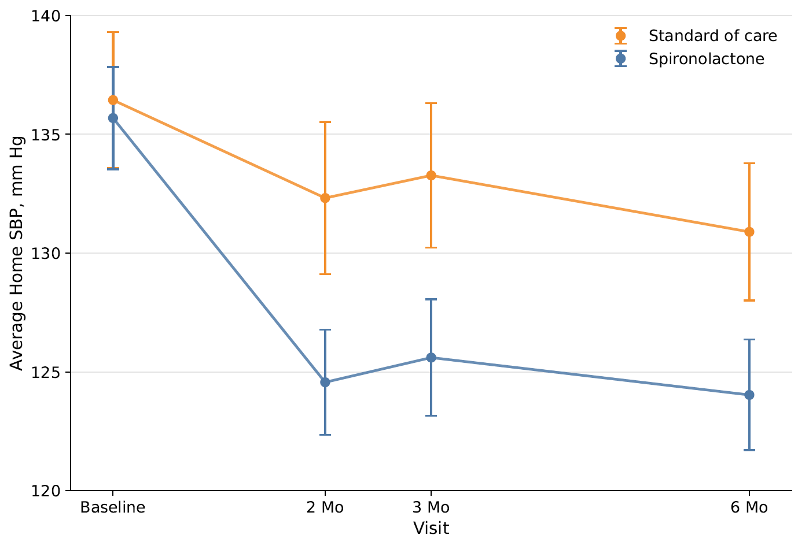
REDUCE Trial:
Key Findings
Primary Endpoint
Secondary Endpoint
133.3 mmHg
130.9 mmHg
-7.7 (-11.6, -3.8)
P=0.0002
-6.9 (-10.6, -3.2)
P=0.0004
125.6 mmHg
124.0 mmHg
Notes:
At 3 months, spironolactone substantially reduced home SBP (125.6 vs 133.3 mmHg; mean difference -7.7 [95% CI, -11.6, -3.8]; P=0.0002) compared with standard care. The BP reductions persisted at 6 months (SBP 124.0 vs 130.9 mmHg; mean difference -6.9 [95% CI, -10.6, -3.2]; P=0.0004)

Slide 9
REDUCE Trial: Secondary Endpoint Results
3-month DBP mean difference -4.1 mmHg (95% CI -7.0, -1.2) mmHg; P=0.0056
Multiple imputation including all 160 randomized participants at 3 months, SBP mean difference -6.9 mmHg (95% CI -10.7 to -3.0; P<0.001)
More participants receiving spironolactone achieved the blood pressure target <130/80 mmHg at 3 months (52% vs 30%; P=0.01)
Participants receiving spironolactone were on 2.6 vs. 2.1 antihypertensive medications at 3 months (mean difference 0.5; 95% CI 0.2-0.9; P=0.004)

Slide 10
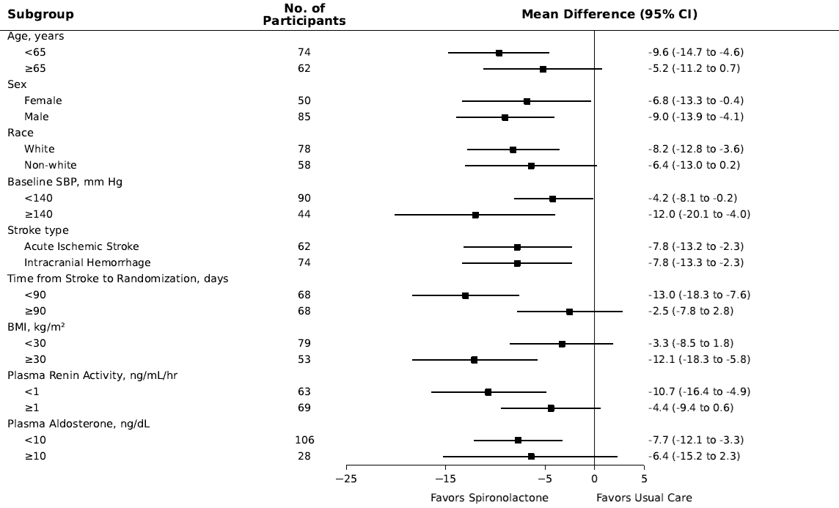
REDUCE Trial: Subgroup Analyses
Notes:
Treatment effects were greater among participants with shorter time from stroke to randomization (<90 vs ≥90 days) and obesity (BMI ≥30 vs <30 kg/m²; interaction P<0.05 for both)

Slide 11
REDUCE Trial: Adverse Events
Spironolactone vs. usual care
  Serious adverse event rates 15% vs 16%
  Hypotension 8% vs 1%
  Lightheadedness 5% vs 1%
  Hyperkalemia 4% vs 0% (did not result in any life-threatening complications)

Slide 12
REDUCE Trial: Summary and Conclusions
In a diverse population of patients with prior intracerebral hemorrhage or ischemic stroke, spironolactone-based blood pressure management produced clinically important and durable reductions in home blood pressure compared with standard care
Blood pressure reductions of this magnitude are associated with meaningfully lower cerebrovascular risk
In contrast to prior trials showing substantial blood pressure-lowering with spironolactone, participants in our trial were receiving only two antihypertensive medications at baseline, suggesting that spironolactone should not be reserved for individuals with resistant hypertension post-stroke
Despite blood pressure above recommended targets, participants assigned to standard care experienced little treatment intensification during follow-up, highlighting an important implementation gap in secondary stroke prevention

Slide 13
Thank you!
jco@pennmedicine.upenn.edu
Principal Investigator
Kevin Sheth, Yale School of Medicine
Yale New Haven Hospital: Site PI, Rachel Forman; Co-Investigators, Adam de Havenon, Guido Falcone, Lauren Sansing, Richa Sharma; Study Coordinators, Hailey Brigger, Alison Champagne, Anna Crawford, Emma Peasley, Maia Schlechter, Annabelle Shanks, Anna Schwartz, Julia Zabinska.
Hospital of the University of Pennsylvania: Site PI, Steven Messe; Co-Investigators, Debbie Cohen, Raymond Townsend; Study Coordinators, MaryLiz DeSanto, Ashlynn Solomon; Data Coordination, Jordana Cohen, Wei Yang
Atrium Health Wake Forest Baptist: Site PI, Cheryl Bushnell; Co-Investigators, Stacey Wolfe; Study Coordinators, Krystal Schmidt, Barbara Tibbs.
Temple University Hospital: Site PI, Michael T. Mullen; Study Coordinators, Sandra Combs, Colin Malefakis.
The University of Texas Health Science Center at Houston-McGovern Medical School: Site PI, Munachi Okpala; Co-Investigators, Anjail Sharrief, Sunil Sheth; Study Coordinators, Gabretta Cooksey, Mariel Flake-Rojas.

Slide 14
Extra slides

Slide 15
REDUCE Trial: Secondary Endpoint Results
3-month DBP mean difference -4.1 mmHg (95% CI -7.0, -1.2) mmHg; P=0.0056
6-month DBP mean difference -3.9 mmHg (95% CI, -6.8, -1.0); P=0.0096
Across all available measurements:
  SBP mean difference -7.5 mmHg (95% CI, -10.6 to -4.3; P<0.001)
  DBP mean difference -4.4 mmHg (95% CI, -6.8 to -2.1; P<0.001)
Multiple imputation including all 160 randomized participants at 3 months:
  SBP mean difference -6.9 mmHg (95% CI -10.7 to -3.0; P<0.001)
  DBP mean difference -3.2 mm Hg (95% CI -5.9 to -0.5; P=0.02)
More participants receiving spironolactone achieved the blood pressure target <130/80 mmHg at 3 months (52% vs 30%; P=0.01)
Participants receiving spironolactone were on 0.5 (95% CI 0.2-0.9; P=0.004) more antihypertensive medications at 3 months

