Slide 1



Coronary Sinus Reducer for Refractory Angina in ANOCA
REMEDY-PILOT: REducing Microvascular dysfunction in patients with angina, ischaemia and unobstructED coronarY arteries – a PILOT study [NCT05492110]
Chief Investigator:
Ranil de Silva PhD FRCP
Kevin Cheng MA BMBCh MRCP
National Heart & Lung Institute
Imperial College London, UK
On behalf of the REMEDY-PILOT Investigators
Sunday 1st November 2026
Notes:
Thank you for the kind introduction/Good morning, my name is Kevin Cheng and I am a BHF-funded Clinical Research Fellow at Imperial College London & Royal Brompton Hospital
On behalf of the investigators, it is my pleasure to present the results of the REMEDY-PILOT trial, a randomised, double-blinded, sham-controlled trial of CS Reducer in patients with refractory angina, ANOCA and CMD

Slide 2
Disclosure of Relevant Financial Relationships
Within the prior 24 months, I have had a financial relationship with
a company producing, marketing, selling, re-selling, or distributing healthcare products used by or on patients:
Nature of Financial Relationship | Ineligible Company
Honoraria | Johnson & Johnson MedTech
Research Funding: | Institution
Clinical Research Training Fellowship (FS/CRTF/22/24369) | British Heart Foundation
Clinical Study Grant (CS/F/20/35120)
All Relevant Financial Relationships have been mitigated.
Faculty disclosure information can be found on the app.
Notes:
Here are my disclosures

Slide 3


ANOCA & CMD
CorMiCA
ChaMP-CMD
ILIAS ANOCA
MARINA
$$$$
ANOCA & CMD is highly prevalent
Significant morbidity & healthcare costs
Stratified treatment trials show promise
Patel M, et al. N Engl J Med. 2010; 362(10):886.895.
Sara JD, et al. JACC Cardiovasc Interv. 2015; 1445-1453.
Shaw LJ, et al. Circulation. 2006; 114:894-904.
Schumann CL, et al. JACC Cardiovasc Imaging. 2021; 14:1369-1379.
de Silva R, et al. Eur Heart J. 2025; 46:3739-3757.
Ford T, et al. JACC. 2018; 72:2841-2855.
Sinha A, et al. Circulation. 2024; 149:36-47.
Boerhout CKM, et al. Eur Heart J. 2025; 46:4396-4406.
Koh J-S, et al. Circ Cardiovasc Interv. 2020;13:e008204.
Notes:
In patients undergoing investigation for angina with non-obstructed coronary arteries, coronary microvascular dysfunction is observed in ~40% of patients. This condition is common
Patients with coronary microvascular dysfunction experience a significant burden of symptoms which impairs quality of life and incurs excess healthcare costs
Trials which have employed a treatment strategy stratified by the results of microvascular function testing have demonstrated the potential benefits of pharmacologic approaches to improving symptoms and quality of life in these patients
However, despite this, a significant proportion of patients continue to experience life-limiting angina

Slide 4
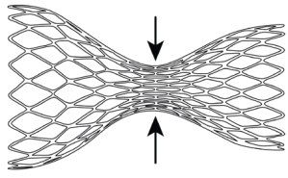
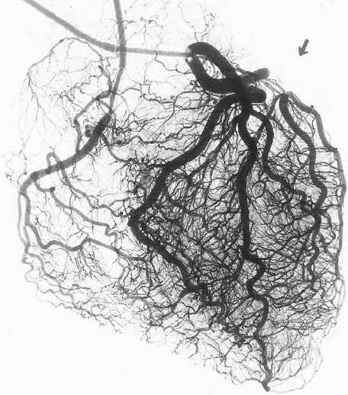
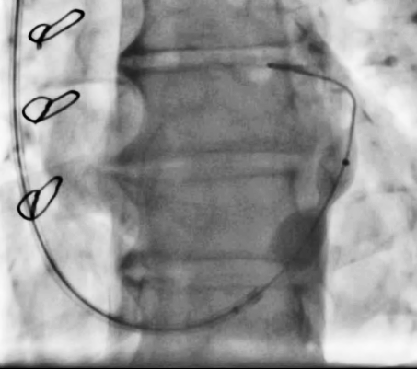

Rationale for CS Reducer in CMD
Non-randomised CS Reducer studies in ANOCA
 | Tryon et al. (n=30) | Konigstein et al. (n=40) | Włodarczak et al. (n=25)
CFR
Hyperaemic resistance
Symptoms & QoL
CS Reducer:
Improves angina in CAD
Redistributes blood flow through an effect on the microcirculation
Biologically plausible therapy for patients with ANOCA & CMD
No randomised, double-blind,
sham-controlled trial
Foley M, et al. Lancet. 2024; 403: 1543-1553
Cheng K, et al. J Cardiovasc Magn Reson. 2025; 101868
Cheng K, et al. Journal of Nuclear Cardiology. 2024; 33:101803
Tryon D, et al. JACC Cardiovasc Interv. 2024; 17:2893-2904.
Konigstein M, et al. Can J Cardiol. 2026: S0828-282X(26)00531-3.
Włodarczak S, et al. JACC Cardiovasc Interv. 2026; 19:1969-1971.
Notes:
The Coronary Sinus Reducer is a hourglass shaped stainless-steel mesh that is percutaneously implanted into the coronary sinus via internal jugular venous access
Two randomised double-blind sham-controlled trials have demonstrated that CS Reducer improves physician and patient-reported angina in patients with refractory angina secondary to advanced coronary artery disease
These observations are thought to result from redistribution of blood flow towards ischaemic myocardium through an effect on the coronary microcirculation. The Coronary Sinus Reducer may therefore be a biologically plausible treatment for patients with refractory angina, ANOCA and CMD
Several non-randomised, open-label, non-sham-controlled studies have suggested that CSR improves coronary flow reserve and hyperaemic resistance correlating with improved physician-adjudicated angina and quality of life
However, to date, no randomised, double-blind, sham-controlled trial of CSR in these patients [refractory angina, ANOCA and CMD] has been performed

Slide 5
Research questions
For patients with refractory angina, ANOCA and CMD:
Is a sham-controlled trial of CS Reducer
feasible and acceptable?
Does CS Reducer improve coronary microvascular function, symptoms and quality of life?
Notes:
We undertook the REMEDY-PILOT trial to answer 2 research questions:
For patients with refractory angina, ANOCA and CMD:
1. Is a sham-controlled trial of CS Reducer feasible and acceptable
2. Does CS Reducer improve coronary microvascular function, symptoms and quality of life

Slide 6

Refractory angina, ANOCA and CMD
Quantitative perfusion CMR
ORBITA angina app
Questionnaires
Investigator-initiated
Single-centre
Randomised, double-blind, sham-control
Stratified treatment trial
Objective endpoints
Angina Heart Team review
Randomised 1:1 in the cath lab
CS Reducer
Sham
HYPOTHESIS
In patients with refractory angina, unobstructed coronary arteries and reduced myocardial perfusion reserve (MPR):
CS Reducer improves endocardial MPR¹, symptoms and quality of life
Blinded follow-up for 6 months
Quantitative perfusion CMR
ORBITA angina app
Questionnaires
1. Rahman H, et al. JACC Cardiovasc Imaging. 2021; 14:978-986.
Notes:
We designed the REMEDY-PILOT trial as an:
Investigator initiated
Single centre
Randomised double-blind, sham-controlled stratified treatment trial with objective endpoints
To test the hypothesis that in patients with RA, unobstructed epicardial coronary arteries and reduced global myocardial perfusion reserve that CS reducer, compared to a sham procedure, improves endocardial MPR, symptoms and quality of life

Slide 7

Inclusion Criteria
Refractory angina (CCS Class II-IV) for ≥3 months despite maximally tolerated medical therapy
Global MPR ≤ 2.2 by CMR
Unobstructed coronary arteries with ≤50% epicardial stenoses
Exclusion Criteria
Haemodynamically significant epicardial CAD
PCI within previous 6 months; or for previous Type 1 MI or CTO
LVEF<45%; increased LV mass index by CMR
Cardiomyopathy
Severe valvular heart disease/valve replacement
Coronary vasospasm confirmed by previous coronary function testing
Significant myocardial bridge on angiography
Procedural exclusions to CS Reducer implantation
Notes:
Key inclusion criteria were:
Refractory angina (CCS Class II-IV) for ≥3 months despite maximally tolerated medical therapy
Global MPR<2.2 is the threshold that has been benchmarked with invasive Doppler CFR for the diagnosis of CMD
For those of you who are unfamiliar, MPR is the ratio of stress myocardial blood flow divided by rest myocardial blood flow and therefore is the MRI equivalent of a coronary flow reserve
Key exclusion criteria included:
Significant obstructive epicardial coronary artery disease, confirmed at the time of randomisation
Structural heart disease such as reduced LVEF, cardiomyopathy and severe valvular disease
***Other ANOCA mechanisms***
And procedural exclusions to CS Reducer implantation

Slide 8


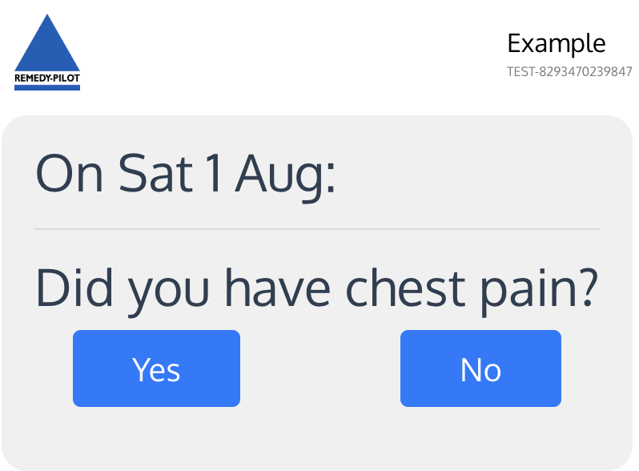
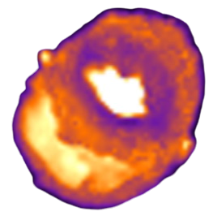
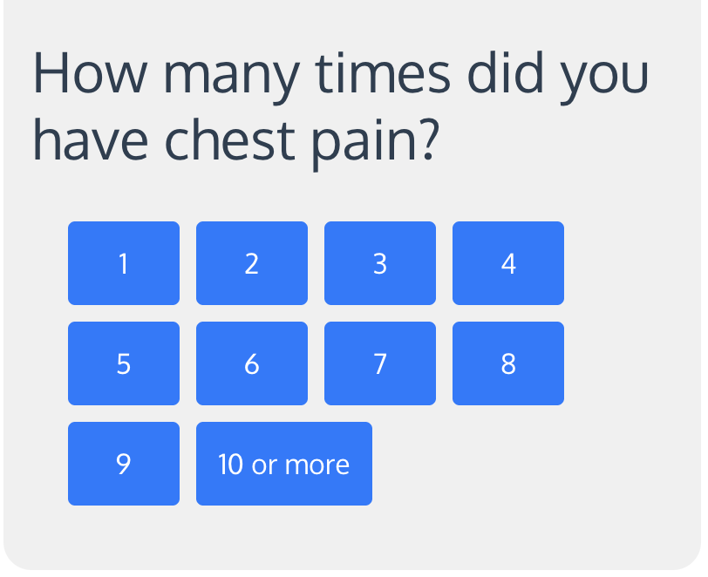



Baseline
Angina Heart Team discussion
Daily symptom tracking
Enrolment visit
Reduced global MPR on CMR
Cardiac catheterisation laboratory
Stress perfusion CMR
Unobstructed coronary arteries
Number of daily angina episodes
Maximally tolerated medical therapy
Questionnaires
I
II
III
IV
CCS class
Notes:
At baseline, patients attended for a quantitative perfusion cardiac MRI, questionnaires and adjudication of CCS class
They were then discussed in a specialist Angina Heart Team to confirm eligibility for study participation (don’t spell out)
The ORBITA angina app was started so participants could record their number of daily angina episodes
Participants then proceeded to the cath lab for invasive assessment and the randomised trial procedure (next slide)

Slide 9

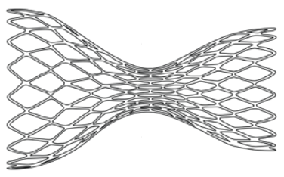
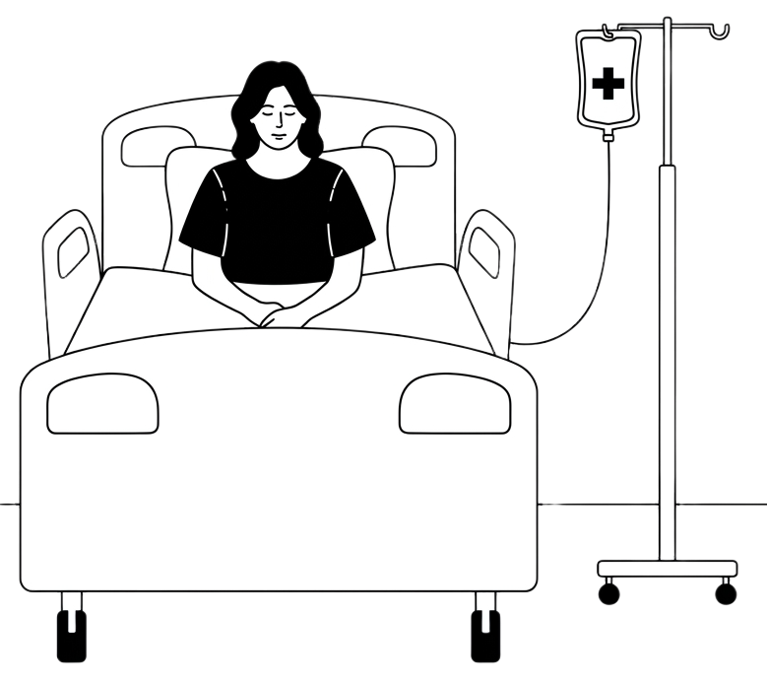
Invasive randomised procedure
CS REDUCER
SHAM
10Fr internal jugular access
X
Right atrial pressure measurement
CS Reducer implantation
Simulated procedure but no implantation
Randomised
1:1
Coronary sinus venogram
Coronary angiogram
Auditory and visual isolation
Handover to blinded ward team
Deep conscious sedation
Formal blinding assessment of treatment allocation
Recovery & discharge
Notes:
All participants underwent:
10Fr internal jugular venous access
Right atrial pressure measurement
Coronary sinus venogram
Coronary angiography
[Prior to randomisation], to ensure robustness blinding of participants, auditory and visual isolation were established together with deep conscious sedation with intravenous benzodiazepines and opiates
Patients were then randomised 1:1 on the cath lab table either to CS Reducer implant or a sham procedure in which operators simulated the Reducer procedure but no device was implanted
All participants received dual anti-platelet therapy for 6 months irrespective of treatment allocation
Prior to discharge, formal blinding assessment of the participants, ward staff and the blinded research staff was performed

Slide 10

Blinded follow-up
Telephone call
Daily symptom tracking
Follow-up visit
Analysis
Blinded Core Labs
Stress perfusion CMR
CMR
ORBITA angina app
6-weeks
6-months
Number of daily angina episodes
Adverse events
Questionnaires
I
II
III
IV
CCS class
Notes:
Blinded follow-up was performed by a parallel study team separate from those involved in the cath lab procedure
Participants underwent structured follow-up for 6-months, during which they recorded their number of daily angina episodes
At the end of follow-up, participants underwent repeat stress perfusion cardiac MRI, questionnaires and CCS class adjudication
Blinded core labs analysed the data from the CMRs and the ORBITA angina app

Slide 11
Primary endpoint
Change in segmental endocardial myocardial perfusion reserve (MPR)¹
at 6-months follow-up by blinded core laboratory analysis
Sample size
54 participants would provide 80% power to detect a 25% between-group difference in change in myocardial perfusion reserve
at 5% significance accounting for up to 10% drop-out
Analysed according to intention-to-treat
1. Rahman H, et al. JACC Cardiovasc Imaging. 2021; 14:978-986.
Notes:
The primary endpoint was the between-group difference in change in segmental endocardial myocardial perfusion reserve from baseline to follow-up.
Endocardial MPR was selected as the primary outcome measure due to previous studies showing a strong correlation with invasive Doppler CFR
The study sample size of 54 participants was based on the ability to detect a 25% between-group difference in change in myocardial perfusion reserve with power of 80% at P<0.05

Slide 12
Feasibility
Consent rate
Premature withdrawal, loss to follow-up, crossover rates
Key secondary endpoints
Patient-reported symptoms | ORBITA angina app
Physician adjudicated symptoms | CCS class
Quality of life | SAQ
Additional CMR perfusion metrics | Endocardial:epicardial MBF ratio at stress
Safety
Device-related significant adverse events (SAEs)
All endpoints analysed according to intention-to-treat
Notes:
The key secondary endpoints consisted of patient and physician-adjudicated symptoms, quality of life and additional MRI perfusion metrics
Feasibility and safety were also assessed

Slide 13
Results
Assessed for eligibility (n=284)
May 2023 – February 2026
Excluded (n=210)
Enrolment
Eligible patients identified (n=74)
Excluded (n=19)
Declined to participate (n=1)
Feasibility & acceptability
Consent rate | 26%
Withdrawal prior to randomisation | 1%
Loss to follow-up | 0%
Crossover | 0%
Met inclusion/exclusion criteria (n=54)
Randomised after baseline visit (n=54)
CS Reducer implantation (n=27)
Allocation
Sham procedure
(n=27)
Received allocation (n=27)
Received allocation (n=27)
6-month follow-up (n=27)
Primary data available
(n=26)
Follow-up
6-month follow-up (n=27)
Primary data available
(n=27)
Notes:
Between May 2023 and February 2026, we evaluated 284 participants for eligibility of whom 74 were screened.
54 participants met the eligibility criteria and were successfully randomised 1:1 to CSR of sham
All patients completed 6 month follow-up and there were no crossovers.
In 1 participant the primary endpoint data was not available due to a technical issue with the cardiac MRI data adjudicated by the blinded core laboratory

Slide 14
Study
Population
 |  | CS Reducer (n=27) | Sham (n=27)
Median age |  | 65 (57-72) | 65 (59-70)
Sex | Female | 12 (44%) | 12 (44%)
 | Male | 15 (56%) | 15 (56%)
Diabetes mellitus | Non-insulin dependent | 4 (15%) | 6 (22%)
 | Insulin-dependent | 6 (22%) | 3 (11%)
Hypertension |  | 14 (52%) | 19 (70%)
Hypercholesterolaemia |  | 22 (82%) | 22 (82%)
Smoking | Never | 16 (59%) | 18 (67%)
 | Ex | 10 (37%) | 7 (26%)
 | Current | 1 (4%) | 1 (4%)
Previous PCI |  | 7 (26%) | 9 (33%)
Median LVEF (%) |  | 71 (68-74) | 69 (67-73)
Median no. anti-anginals |  | 4 (3-4) | 4 (3-4)
Baseline CCS class | II | 2 (7%) | 3 (11%)
 | III | 9 (33%) | 8 (30%)
 | IV | 16 (59%) | 16 (59%)
Notes:
In terms of demographics, participants were well-matched with a mean age of 65 years
90% of participants were in CCS class 3 or 4 despite a median 4 anti-anginal medications

Slide 15
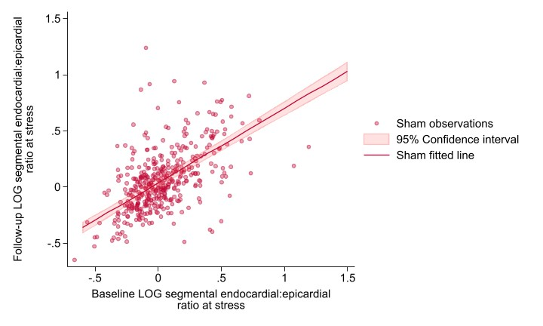
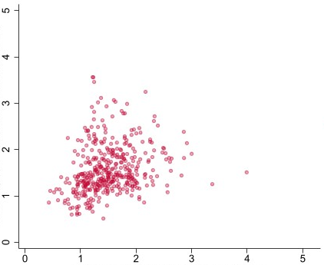
Primary endpoint
Sham
Follow-up segmental endocardial MPR
Baseline segmental endocardial MPR
Resting MBF corrected for rate-pressure product¹
¹Brown LAE, et al. Eur Heart J Cardiovasc Imaging. 2023; 24:426-34
Notes:
For the primary endpoint, MRI data were calculated for each myocardial segment from the 16-segment AHA model.
For segments with evaluable baseline and follow-up data, we present data for baseline endocardial myocardial perfusion reserve on the x-axis and follow-up on the y-axis.
Each data point represents a myocardial segment analysed from participants randomised to the sham group
[PAUSE]

Slide 16
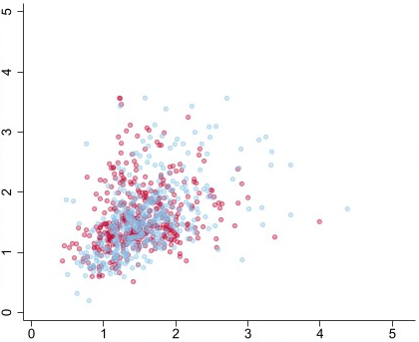
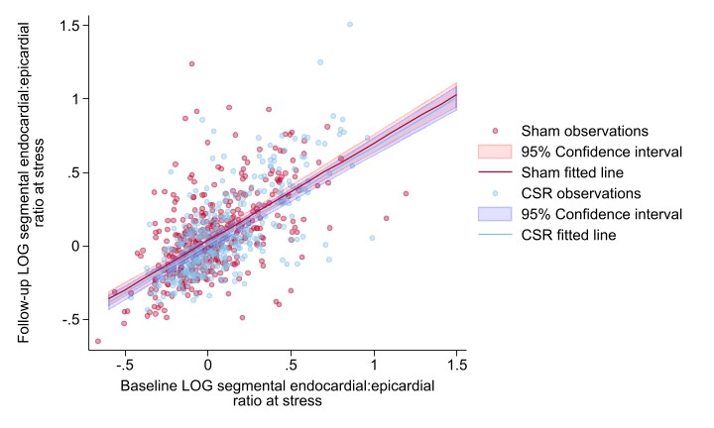
Primary endpoint
Sham
CS Reducer
Mean (SD) | CS Reducer | Sham | Adjusted treatment effect (95% CI)
Baseline | 1.58 (0.53) | 1.53 (0.49) | -0.03 (-0.22, 0.15)
Follow-up | 1.55 (0.58) | 1.58 (0.52)
Follow-up segmental endocardial MPR
P=0.72
Baseline segmental endocardial MPR
Resting MBF corrected for rate-pressure product¹
¹Brown LAE, et al. Eur Heart J Cardiovasc Imaging. 2023; 24:426-34
Notes:
Here is shown the segmental data for those participants randomised to the CS Reducer arm overlaid
Compared to the segments from the sham arm, there was no significant between-group difference in change in endocardial myocardial perfusion reserve from baseline to follow-up with a p value of the adjusted treatment effect of 0.72

Slide 17
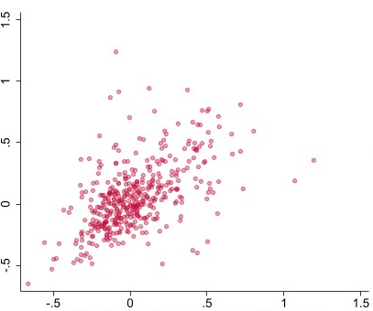
Secondary endpoint
Sham
Follow-up log (segmental endocardial:epicardial ratio at stress)
Baseline log (segmental endocardial:epicardial ratio at stress)
Notes:
For the pre-specified secondary MRI endpoint, we present data for baseline segmental endocardial:epicardial myocardial blood flow ratio on the x-axis and follow-up on the y-axis.
The data are presented on a log scale. Each data point represents a myocardial segment analysed from participants randomised to the sham group

Slide 18
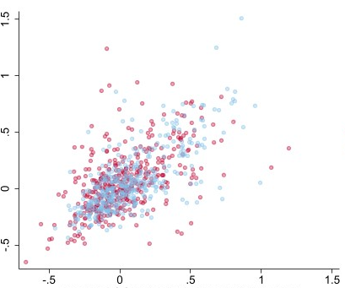
Secondary endpoint
Sham
CS Reducer
Mean (SD) | CS Reducer | Sham | Adjusted relative treatment effect (95% CI)
Baseline | 1.13 (0.34) | 1.08 (0.31) | 1.004 (0.954-1.057)
Follow-up | 1.11 (0.38) | 1.11 (0.35)
Follow-up log (segmental endocardial:epicardial ratio at stress)
P=0.88
Baseline log (segmental endocardial:epicardial ratio at stress)
Notes:
This graph shows the segmental data for those participants randomised to the CS Reducer arm
“No significant difference in the adjusted relative treatment effect of CS Reducer compared to sham with a P value of 0.88”
Turning our attention to the key secondary symptom endpoints…
[PAUSE]
****NOTES: Compared to the segments from the sham arm, there was no significant between-group difference in change in endocardial:epicardial blood flow ratio from baseline to follow-up with a p value of the adjusted relative treatment effect of 0.88***

Slide 19
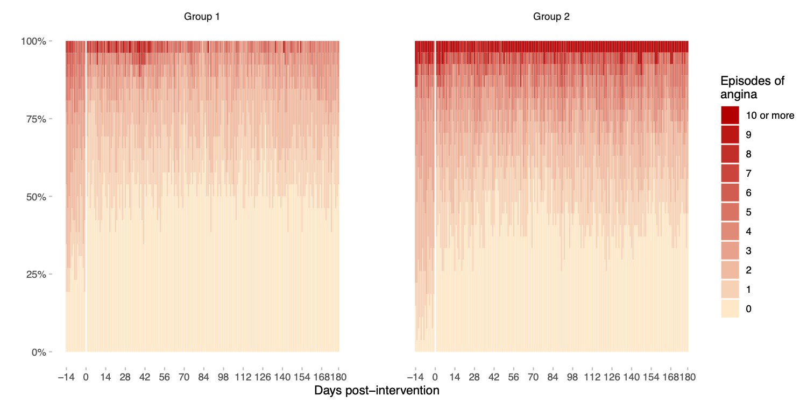
Number of daily angina episodes
CS Reducer
Sham
Proportion of patients
OR 0.92 (95% CrI 0.42 to 2.04)
Pr(Benefit) = 0.41
Notes:
These plots show the results of patient-reported daily angina episodes in the CS Reducer arm (on the left) and the sham arm (on the right)
On the x-axis is time, with the 14-day run-in period prior to randomisation followed by the 6-month follow-up period
On the y-axis is the cumulative proportion of patients experiencing increasing number of daily angina episodes.
We observed improvements after randomisation in both arms.
Compared to baseline, the change in number of daily angina episodes was not statistically different between groups with an odds ratio of 0.92 and a probability of benefit of 0.41

Slide 20
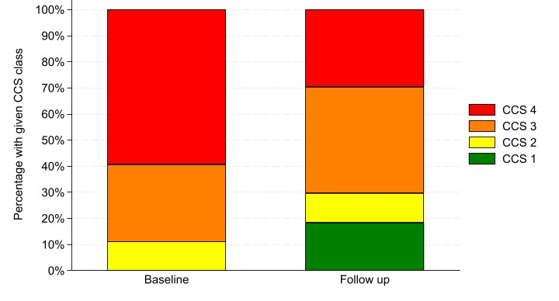
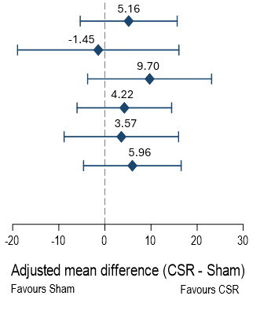
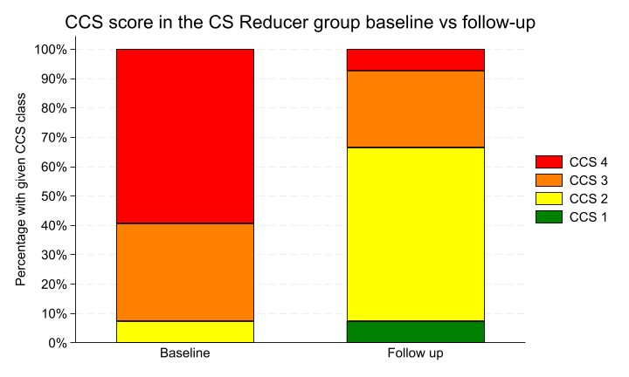
Seattle Angina Questionnaire
CCS Class
Sham
Physical limitation
Angina stability
Angina frequency
Treatment satisfaction
Quality of life
CS Reducer
Summary score
Odds ratio: 0.30 (95%CI: 0.10-0.87)
P=0.03
Notes:
This slide shows the results from the Seattle Angina Questionnaire. There was no significant difference between CS Reducer and the sham procedure in each domain.
[***THIS NOW SHOWS THE CCS CLASS***] Interestingly, for physician-adjudicated CCS class, which was adjudicated by a blinded follow-up assessor, we observed significant improvements after CS Reducer compared with sham
***** NOTES: Despite excellent assessor blinding, the improvement in CCS class was not corroborated by daily angina frequency or any SAQ domain, potentially reflecting the limited granularity and subjectivity of physician-adjudicated angina classification.***

Slide 21
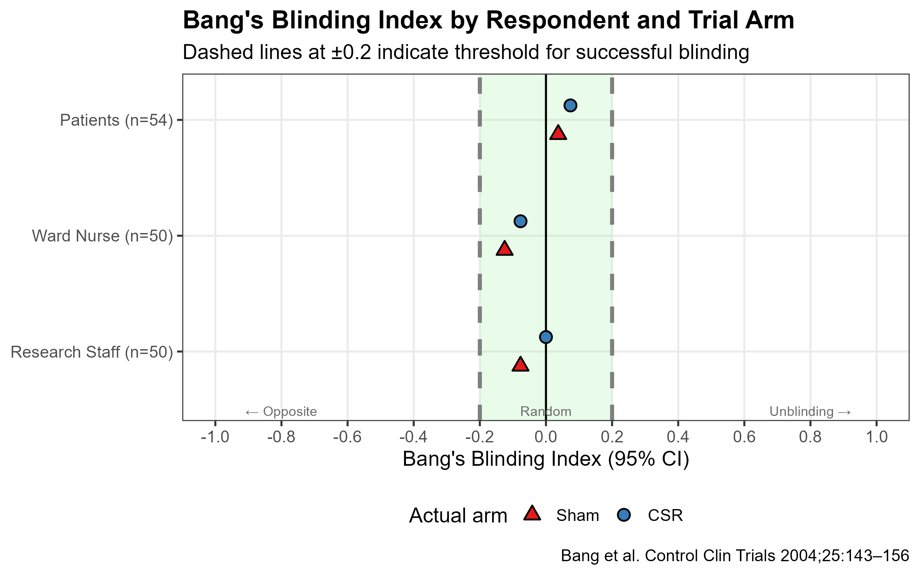
Blinding assessment
Effective blinding
Patients
CS Reducer
Sham
CS Reducer
Ward team
Sham
Research team
CS Reducer
Sham
Blinding Index
Bang et al. Control Clin Trials 2004; 25:143-156
Notes:
With respect to the quality of blinding, effective blinding was confirmed for patients, the ward team and the blinded research team
****EXPLAIN THIS A BIT MORE IF MORE TIME****

Slide 22
Device-related SAEs
 | CS Reducer (n=27) | Sham (n=27)
Death | 0 | 0
Myocardial infarction | 0 | 0
Stroke | 0 | 0
Device embolisation | 0 | 0
Tamponade | 1 | 0
Major bleeding | 0 | 0
Notes:
CS Reducer implantation was safe with only one device-related SAE reported and no embolisations

Slide 23
REMEDY-PILOT in context
First randomised, double-blind, sham-controlled stratified treatment trial of CS Reducer in patients with refractory angina, ANOCA and CMD
CS Reducer implantation was acceptable and safe
CS Reducer did not improve CMR perfusion metrics, symptoms or quality of life over a sham procedure
Ongoing analyses and additional studies are needed to define a role for Reducer therapies in ANOCA and CMD
Notes:
To conclude, REMEDY-PILOT is the first…

Slide 24




REMEDY-PILOT team
The patients
Study CI Ranil de Silva
Co-investigators Dudley Pennell Divaka Perera Peter Collins Jonathan Hill Thomas Luescher
CMR Unit Chiara Bucciarelli-Ducci Francisco Alpendurada Ricardo Wage Matteo Sclafani Elif Gövdeli
Research nurses Marion Delacruz Ian Woodcraft Marcus Farias Anthony Barbera
Imperial CTU Statistics Emanuela Falaschetti Zohra Zenasni Lorna Hazell
CMR Core Lab Amedeo Chiribiri Can Karamanli Caterina Guerra
ORBITA angina app Matthew Shun-Shin Rasha Al-Lamee
Trial Steering Committee Anthony Mathur (Chair) Shrilla Banerjee Sarah Clarke Maria George Stephen Hoole Thomas Keeble Peter O’Kane
Data Safety Monitoring Board Jonathan Byrne (Chair) Tim Lockie Francesca Fiorentino
Bradford Teaching Hospitals NHS Foundation Trust Paul Sainsbury
East and North Hertfordshire NHS Trust Diana Gorog
East Kent Hospitals University NHS Foundation Trust Rajiv Rampat
Epsom and St Helier University Hospitals NHS Trust John Foran
Kingston Hospital NHS Foundation Trust Rupert Williams
Liverpool University Hospitals NHS Foundation Trust Michael Fisher, Joel Giblett
London North West University Healthcare NHS Trust Ahmed Elghamaz, Aamir Ali
Oxford University Hospitals NHS Foundation Trust Giovanni De Maria
St George’s University Hospitals NHS Foundation Trust Juan Carlos Kaski
Funders
Sponsor
CS/F/20/35120
FS/CRTF/22/24369
Notes:
Finally/most importantly, I want to thank the patients who agreed to participate in this trial
And I would like to acknowledge the entire REMEDY-PILOT team who enabled the successful delivery of this work.
Thank you for your attention

Slide 25
REMEDY-PILOT in context
First randomised, double-blind, sham-controlled stratified treatment trial of CS Reducer in patients with refractory angina, ANOCA and CMD
CS Reducer implantation was acceptable and safe
CS Reducer did not improve CMR perfusion metrics, symptoms or quality of life over a sham procedure
Ongoing analyses and additional studies are needed to define a role for Reducer therapies in ANOCA and CMD
Notes:
To conclude, REMEDY-PILOT is the first…

