Slide 1

Transcatheter Tricuspid Valve Repair in Symptomatic Severe Tricuspid Regurgitation:
The Randomized CLASP II TR Trial
Charles J. Davidson, MD
Northwestern Memorial Hospital
Northwestern University, Feinberg School of Medicine, Chicago, Illinois, USA
Suzanne V. Arnold, MD, MHA
Saint Luke's Mid America Heart Institute
University of Missouri-Kansas City, Kansas City, Missouri, USA
on behalf of the CLASP II TR Trial Investigators

Slide 2
Disclosure of Relevant Financial Relationships
Within the prior 24 months, I have had a financial relationship with
a company producing, marketing, selling, re-selling, or distributing healthcare products used by or on patients:
Nature of Financial Relationship | Ineligible Company
Charles J. Davidson, MD
Grant/Research Support | Edwards Lifesciences, CroiValve, V-Dyne, Cardio Mech, Abbott
Equity | ReValve
Suzanne V. Arnold, MD, MHA
Grant/Research Support (Institutional) | FDA, NIH/NHLBI
All relevant financial relationships have been mitigated. Faculty disclosure information can be found on the app. CLASP II Trial (NCT04097145) is funded by Edwards Lifesciences.

Slide 3
Background
Symptomatic severe TR is associated with increased mortality, heart failure hospitalization, and poor health status
Transcatheter tricuspid valve intervention has expanded treatment options and demonstrated safety and efficacy in patients at increased surgical risk
Objective
The CLASP II TR trial is a prospective, multicenter, randomized, controlled pivotal trial to evaluate the safety and effectiveness of the PASCAL transcatheter valve repair system + optimal medical therapy (OMT) vs. OMT alone in patients with symptomatic ≥severe TR
Notes:
2

Slide 4
PASCAL Precision Transcatheter Valve Repair System
CAUTION: U.S. law restricts this device to sale by or on the order of a physician. See instructions for use for full prescribing information.
Notes:
3

Slide 5
Trial Leadership & Oversight
Global Principal Investigators
Trial Oversight
Echocardiographic Core Laboratory
Cardiovascular Research Foundation
Martin B. Leon
Michael J. Mack
Charles J. Davidson
Rebecca T. Hahn Nicole Cristell
Clinical Events Committee (CEC)
Data Safety Monitoring Board (DSMB)
Amrut Ambardekar
Carey Kimmelstiel
Pablo Quintero
Gregory Smaroff
David E. Thaler
Sergio Waxman
Daniel Blanchard
Timothy Collier
Barry Greenberg
Ehtisham Mahmud
Thomas McAndrew
Richard Schatz
Study Chairs
Central Screening Committee (CSC)
Gorav Ailawadi
Allen S. Anderson
Scott Chadderdon
Stanley Chetcuti
Adnan Chhatriwalla
Robert Cubeddu
Abhijeet Dhoble
Mackram Eleid
Neil Fam
Santiago Garcia
Isaac George
William Gray
Edwin Ho
Ignacio Inglessis
Bahram Khadivi
Yukari Kobayashi
Susheel Kodali
D. Scott Lim
Jacob Mishell
Akhil Narang
Jonathan Passeri
Jyothy Puthumana
Andrew Rassi
Rahul Sharma
Robert Smith
Molly Szerlip
Michael Young
Firas Zahr
Alan Zajarias
Notes:
4

Slide 6


450 Patients Enrolled at 58 Sites
Canada
Top 5 Enrolling Sites
1 | Mayo Clinic Rochester
2 | Oregon Health and Science University
3 | Northwestern University
4 | Kaiser Permanente San Francisco Medical Center
5 | Columbia University Medical Center
United States
Notes:
5

Slide 8
Key Study Criteria
Key Inclusion Criteria
Age ≥ 18 years
TR ≥ severe
Signs/symptoms of TR or prior HFH
Optimal medical therapy at screening
Suitable for edge-to-edge repair
Key Exclusion Criteria
Anatomy precluding proper implantation
LVEF ≤ 25%
Evidence of severe RV dysfunctionª
Severe CKD^{b}
Severe pulmonary hypertension^{c}
Life expectancy < 12 months
ªAssessed by echo core lab. ^{b}Estimated glomerular filtration rate ≤25 mL/min/1.73m² or requiring chronic renal replacement therapy. ^{c}Pulmonary artery systolic pressure >60 mmHg by echo Doppler or >70 mmHg by right heart catheterization (RHC), or pulmonary vascular resistance >5 Wood units by RHC.
Notes:
7

Slide 9
Methods
Primary endpoint was a hierarchical pairwise comparison using win ratio at 6 months:
  All-cause mortality
  RVAD implantation or heart transplant
  TVI elective or non-elective
  Number of HFH
  Health status improvement assessed by KCCQ-OS scoreª
At study initiation, the primary endpoint timing was 24 months
  This was subsequently revised to 6 months due to control group attrition following regulatory approval of alternative transcatheter therapies
The secondary safety endpoint was a composite of MAEs at 30 days
Secondary effectiveness, clinical, and echocardiographic endpoints were assessed at 12 months
ªA patient was considered a winner for KCCQ if the score improved by at least 5 points from baseline and was at least 5 points greater than the comparator.
Notes:
8

Slide 10
Patient Enrollment and Follow-up
mITT
mITT, modified intent-to-treat
Notes:
9

Slide 11
Baseline Characteristics
 | Device N=294 Mean ± SD or % | Control N=148 Mean ± SD or %
Age, years | 79.1±7.3 | 80.2±6.7
Female​ | 48.0 | 49.3
NYHA class III-IV | 59.2 | 57.4
KCCQ-OS score, points | 57.0±22.9 | 59.5±22.1
STS-PROM (MV repair), % | 7.6±6.0 | 7.3±5.4
Left ventricular ejection fraction, % | 52.5±7.2 | 52.3±7.2
TAPSE, mm | 13.3±3.8 | 13.4±3.6
PASP, mmHg | 42.6±13.6 | 41.7±11.0
Atrial fibrillation​ | 91.8 | 91.2
CKD stage ≥ 3 | 65.0 | 68.2
HFH in past 12 months | 29.6 | 23.0
RV lead CIED or ICD | 13.3 | 14.9
Prior valve surgery/intervention | 33.7 | 35.8
TR Etiology | Device N=294​ % | Control N=148 %
Primaryª | 7.2 | 6.1
Secondary^{b} | 77.1 | 75.0
Mixed | 15.4 | 16.9
Lead-related | 0.3 | 1.4
Indeterminate | 0.0 | 0.7
TR Grade ≥ Severe^{c} | Device N=294​ % | Control N=148 %
Severe | 58.2 | 57.4
Massive | 26.9 | 29.7
Torrential | 15.0 | 12.8
Data from patients with available assessments. ªDegenerative, organic, structural or pacer related. ^{b}Functional or nonstructural. ^{c}For inclusion, baseline TR severity can be determined by TTE or TEE. Baseline TR data is from TEE for 6 patients.
Notes:
10

Slide 12
Procedural Characteristics
 | Patients N=294
Device implanted successfully | 92.5%
Number of implanted devicesª
1 | 48.9%
2 | 47.8%
3 | 3.3%
Mean number of devices implantedª | 1.5 ± 0.6
PASCAL Ace implantª | 99.3%
Device time (min)^{b} | 106 (71, 160)
Post-procedure LOS (days) | 1 (1, 2)
Discharged to home | 98.3%
ªIn patients with device implanted (N=272). ^{b}Device time is the time from PASCAL Implant System insertion to guide sheath or steerable guide removal. Values are mean ±SD; median (Q1, Q3) or %
Notes:
11

Slide 13
Primary Endpoint at 6 Months
Win Ratio = 1.98
(95% CI, 1.47, 2.67)
Finkelstein-Schoenfeld: P<0.001*
*One-sided P-value

Slide 14
Device Safety Outcomes to 1 Year
CEC-adjudicated Event | 30 Days N=290* Patients % (n)) | 0-365 Days N=294 Patients % (n)
Composite MAE | 6.9% (20) | 20.1% (59)
Single leaflet device attachmentª | 3.4% (10) | 4.8% (14)
Severe bleeding^{b} | 3.1% (9) | 8.5% (25)
Major access site and vascular complications | 1.0% (3) | 1.0% (3)
Cardiovascular mortality | 0.3% (1) | 5.4% (16)
Stroke | 0.3% (1) | 1.4% (4)
Myocardial infarction | 0.0% (0) | 0.3% (1)
New need for renal replacement therapy | 0.0% (0) | 2.0% (6)
Non-elective TVI, percutaneous or surgical | 0.0% (0) | 0.7% (2)
Major cardiac structural complications | 0.0% (0) | 0.0% (0)
*The denominator includes patients who had a MAE, or did not have a MAE and were followed for at least 30 days. 4 patients did not have a MAE and were followed <30 days. ª Data from echo core lab adjudication based on echo date. ^{b}Fatal, life threatening, extensive, or major bleeding, as defined by MVARC.

Slide 15
TR Severity to 1 Year
Adjudicated by core laboratory, Cardiovascular Research Foundation. ªWilcoxon signed rank test (paired analysis). ^{b}Fisher’s Exact Test

Slide 16
All-cause Mortality to 1 Year
P_{Log-rank} =0.125
Device
Control
CEC-adjudicated. Kaplan-Meier estimates ± standard error.

Slide 17
Heart Failure Hospitalization to 1 Year
P_{Log-rank} =0.831
Device
Control
CEC-adjudicated. Kaplan-Meier estimates ± standard error.

Slide 18
Annualized HFH at 1 year
ªP-values are from a Poisson regression model using generalized estimated equations with a log link and the log of person-time as an offset.

Slide 19
Tricuspid Valve Interventions Through 1 Year
P_{Log-rank} =0.001
Device
Control
CEC-adjudicated. Kaplan-Meier estimates±standard error.

Slide 20
Control Group Outcomes up to 1 year by TVI Status
Disease characteristics at most recent assessment prior to TVI | Control Group
 | With TVI N = 20 | Without TVI N = 128
Massive / Torrential TR | 47.4% | 40.2%
Annualized rate of HFH | 0.41 | 0.16
KCCQ (Mean ± SD) | 52.0 ± 19.2 | 64.9 ± 20.2
NYHA III/IV | 47.4% | 38.3%

Slide 21
Change in KCCQ-OS Score to 1 Year - Unadjusted

Slide 22
Health Status After Tricuspid- Transcatheter Edge-to-Edge Repair
Suzanne V. Arnold, MD, MHA
on behalf of the CLASP II TR Trial Investigators

Slide 23
Health Status Methods
Health status assessed at baseline, 30 days, 6 months, 1 year, 2 years
  Kansas City Cardiomyopathy Questionnaire (KCCQ)*
    Scores 0-100; higher=better; MCID=5 points
    Primary Health Status Endpoint: Overall Summary score (KCCQ-OS)
  SF-36 Physical and Mental Summary Scores
    Population mean 50 ± 10; higher=better; MCID=2.5 points
Due to expected pattern of early health status improvement with T-TEER and commercial TVI in the control arm, 6-month health status outcome was prespecified as primary
Health status over 6 months compared between groups using mixed effects linear repeated measures models
Categorical analyses integrated survival and health status
*Validated in TR: Arnold SV et al. JAMA Cardiol. 2024. MCID, minimal clinically important difference

Slide 24
Key Health Status Outcome: KCCQ-OS
KCCQ-OS, Kansas City Cardiomyopathy Questionnaire Overall Summary score. Error bars and value in parentheses represent 95% confidence intervals.

Slide 25
Key Health Status Outcome: KCCQ-OS
Control
KCCQ-OS, Kansas City Cardiomyopathy Questionnaire Overall Summary score. Error bars and value in parentheses represent 95% confidence intervals.

Slide 26
Key Health Status Outcome: KCCQ-OS
Device
Control
Δ13.7 Δ10.9
(10.1, 17.3) (7.0, 14.7)
KCCQ-OS, Kansas City Cardiomyopathy Questionnaire Overall Summary score. Error bars and value in parentheses represent 95% confidence intervals.

Slide 27
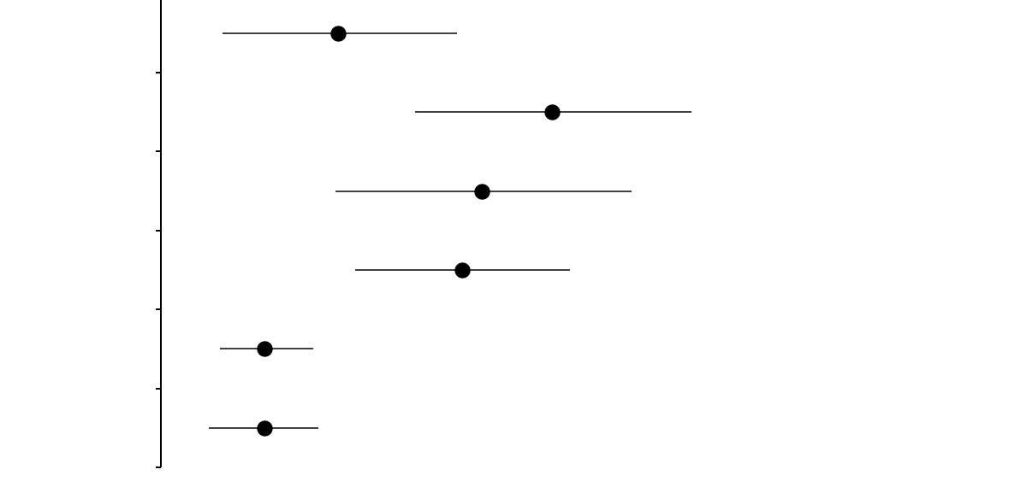
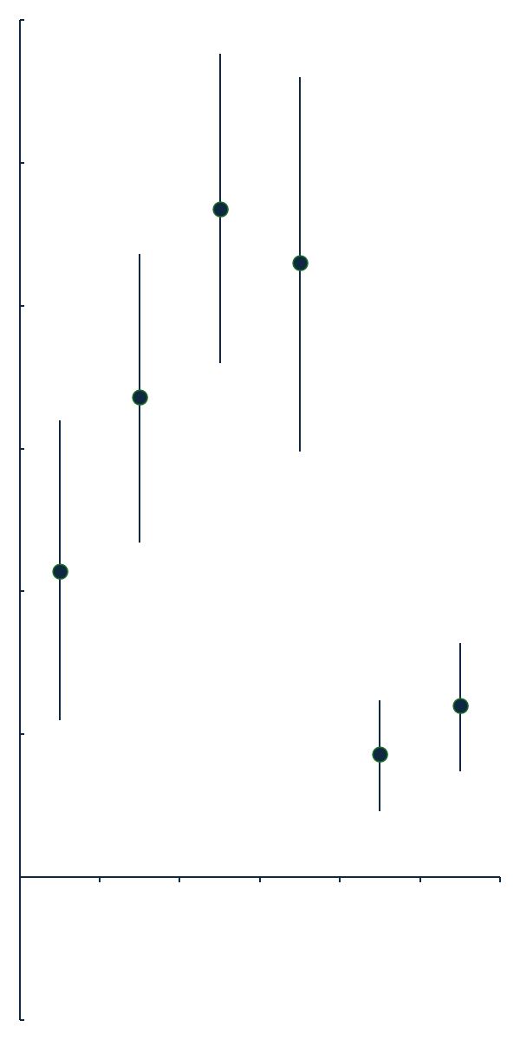
KCCQ Domains and SF-36 at 6 Months
KCCQ
Physical Limitations
Total Symptoms
Quality of Life
Social Limitations
Physical Summary
Mental Summary
6.3
MCID 5 points
13.9
11.4
10.7
SF-36
-5 | 0 | 5 | 10 | 15 | 20 | 25 | 30
Mean Between Group Difference
(Device – Control)
KCCQ, Kansas City Cardiomyopathy Questionnaire; MCID, minimal clinically important difference. Error bars represent 95% confidence intervals.

Slide 28
KCCQ Domains and SF-36 at 6 Months
KCCQ
Physical Limitations
Total Symptoms
Quality of Life
Social Limitations
Physical Summary
Mental Summary
6.3
MCID 5 points
13.9
11.4
10.7
SF-36
3.7
MCID 2.5 points
3.7
-5 | 0 | 5 | 10 | 15 | 20 | 25 | 30
Mean Between Group Difference
(Device – Control)
KCCQ, Kansas City Cardiomyopathy Questionnaire; MCID, minimal clinically important difference. Error bars represent 95% confidence intervals.

Slide 29
Survival and Health Status at 6 Months
Device
Control
NNT 3.2
NNT 3.8
NNT 5.4
Alive with moderate improvement
(≥10 points in KCCQ-OS)
Alive with large improvement
(≥20 points in KCCQ-OS)
Alive and well
(6-month KCCQ-OS ≥60 and no decline from baseline of ≥10 points)
All treatment comparisons P<0.001
KCCQ-OS, Kansas City Cardiomyopathy Questionnaire Overall Summary score; NNT, number needed to treat

Slide 30
Change in Health Status at 6 Months
57%
18%
Small
Dead
Device
Large
Moderate
No Change
Worse
Dead
Control
Large
Moderate
Small
No Change
Worse
25%
25%
Treatment comparison P<0.001
Degree of change (in points): large: ≥20; moderate: ≥10 and <20; small: ≥5 and <10; no change >-5 and <5; worse: ≤-5

Slide 31
Predicted Benefit of T-TEER at 6 Months According to
Baseline KCCQ-OS
Est. Effect of T-TEER
P-interaction = 0.012
Baseline KCCQ-OS Score
Notes:
30

Slide 32
Exploratory Analysis
Effect of Device vs. Control on 1-Year Health Status
 | Between-Group Difference (Device ̶ Control) | P-value
KCCQ Overall Summary
KCCQ Physical Limitations
KCCQ Total Symptoms
KCCQ Quality of Life
KCCQ Social Limitations
SF-36 Physical Component Score
SF-36 Mental Component Score
*IPW: Modeled probability of death or commercial TVI. Patients were then weighted by the inverse of this probability within the mixed effects linear models for repeated measures
KCCQ, Kansas City Cardiomyopathy Questionnaire; IPW, inverse probability weighting; TVI, tricuspid valve intervention

Slide 33
Exploratory Analysis
Effect of Device vs. Control on 1-Year Health Status
 | Between-Group Difference (Device ̶ Control) | P-value
KCCQ Overall Summary | 12.5 (8.4 to 16.5) | <0.001
KCCQ Physical Limitations | 8.0 (3.7 to 12.4) | <0.001
KCCQ Total Symptoms | 15.9 (10.9 to 20.9) | <0.001
KCCQ Quality of Life | 13.6 (7.9 to 19.3) | <0.001
KCCQ Social Limitations | 11.9 (7.4 to 16.3) | <0.001
SF-36 Physical Component Score | 4.6 (2.9 to 6.4) | <0.001
SF-36 Mental Component Score | 4.4 (2.6 to 6.3) | <0.001
*IPW: Modeled probability of death or commercial TVI. Patients were then weighted by the inverse of this probability within the mixed effects linear models for repeated measures
KCCQ, Kansas City Cardiomyopathy Questionnaire; IPW, inverse probability weighting; TVI, tricuspid valve intervention

Slide 34
Limitations
Open label trial with potential for placebo effect
Centers and operators had limited prior experience with the PASCAL system
Control group attrition occurred following regulatory approval of alternative transcatheter therapies that led to increase in TVI at 6 months
Notes:
33

Slide 35
Conclusions
CLASP II TR trial met its 6-month primary endpoint demonstrating superiority of the PASCAL system + OMT compared with OMT alone in symptomatic ≥ severe TR patients driven by KCCQ improvement
There was no significant difference in mortality or HFH between groups at 1 year
Treatment with the PASCAL system resulted in
  Significant TR reduction, with 80% of patients achieving ≤ moderate TR at 1 year vs. 30% in the control group
  Substantial improvement in patient-reported health status that was evident by 30 days and persisted through 1 year
The CLASP II TR trial demonstrates safety and efficacy of the PASCAL system to
improve health status in symptomatic patients with ≥ severe TR
Notes:
34

