Slide 1



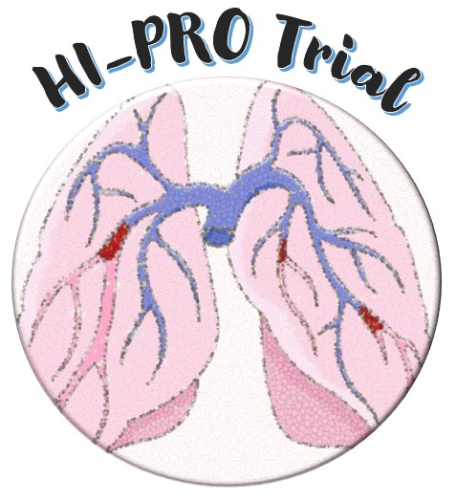




Apixaban vs Placebo to Prevent Recurrences in Provoked Venous Thromboembolism With Enduring Risk Factors: One-Year Extension Results From the HI-PRO Trial
Behnood Bikdeli, MD, MS
Division of Cardiovascular Medicine, Heart and Vascular Institute, Mass General Brigham, Thrombosis Research Group, Brigham and Women’s Hospital
Harvard Medical School
Yale/ YNHH Center for Outcomes Research and Evaluation (CORE)
@bbikdeli

Slide 2
Disclosures
HI-PRO was an investigator-initiated randomized trials (PI: Dr. Piazza), funded by BWH/Pfizer alliance. No investigator effort or consultant fees to Dr. Bikdeli.
Career Development Award from the American Heart Association and VIVA Physicians (#938814) and (# 26BCDA1622734).
Scott Schoen and Nancy Adams IGNITE Award (past) and the Mary Ann Tynan Research Scientist award (current) from the Mary Horrigan Connors Center for Women’s Health and Gender Biology at Brigham and Women’s Hospital.
Member of the Medical Advisory Board for the VascuLearn Network
Data Safety and Monitory Board of the NAIL-IT trial funded by the National Heart, Lung, and Blood Institute, and Translational Sciences.
Editor fees from Mass Medical Society (NEJM Clinician) and Elsevier (Thrombosis Research, JACC)
Eleanor and Miles Shore Award (BWH).
Co-investigator, STAT-CAT trial (NHLBI)

Slide 3
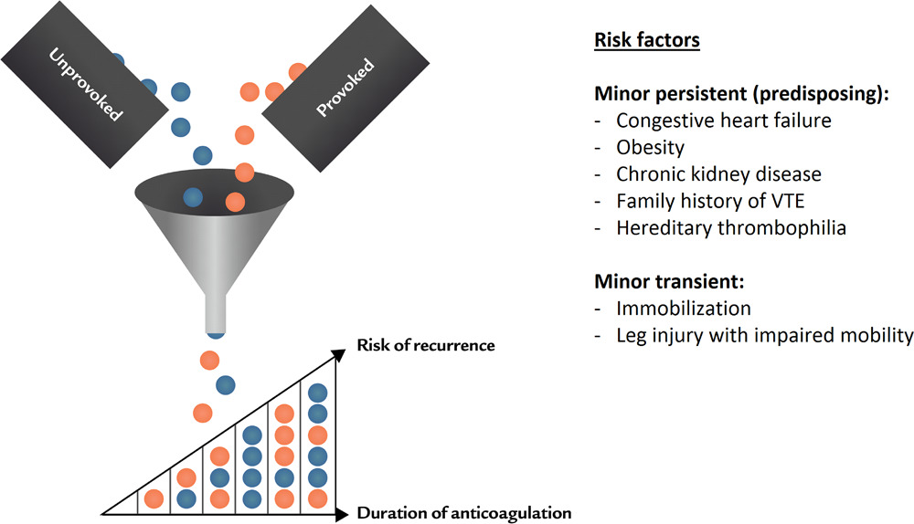
Duration of anticoagulation of anticoagulation after VTE
Cancer-associated, unprovoked, or provoked
What about enduring risk factors?
Bleeding risk
Patient preferences and life choices
Albertsen IE, et al. Circulation. 2018; 138: 2591-2593.

Slide 4

Duration of anticoagulation of anticoagulation after VTE
SRMA for non-surgical provoked VTE
4.2 (95% CI, 2.8-5.6) per 100 PYs
SRMA for unprovoked VTE
10.3 (95% CI: 8.6-12.1) per 100 PYs
“provoked” is a very heterogenous group.
25 year-old otherwise healthy individual with DVT after sports injury
75 year-old individual with COPD and IBD
Same recs?
Lorio A, et al. Arch Intern Med. 2010; 170: 1710-6.
Khan F, et al. BMJ. 2019 ; 366: 4363.

Slide 5
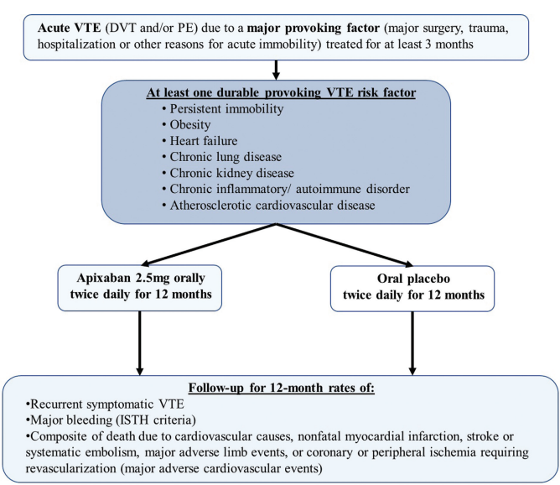
HI-PRO Design
Bikdeli B, et al. Thromb Haemost 2022;122:1061–1070.

Slide 6
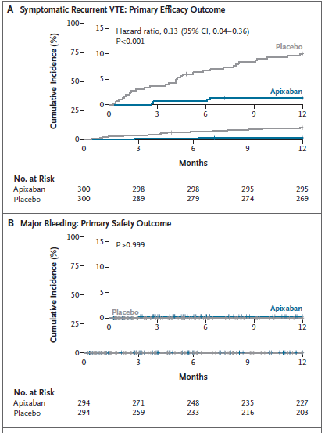
HI-PRO, 12-month results
Piazza G, et al. N Engl J Med. 2025; 393: 1166-1176.

Slide 7
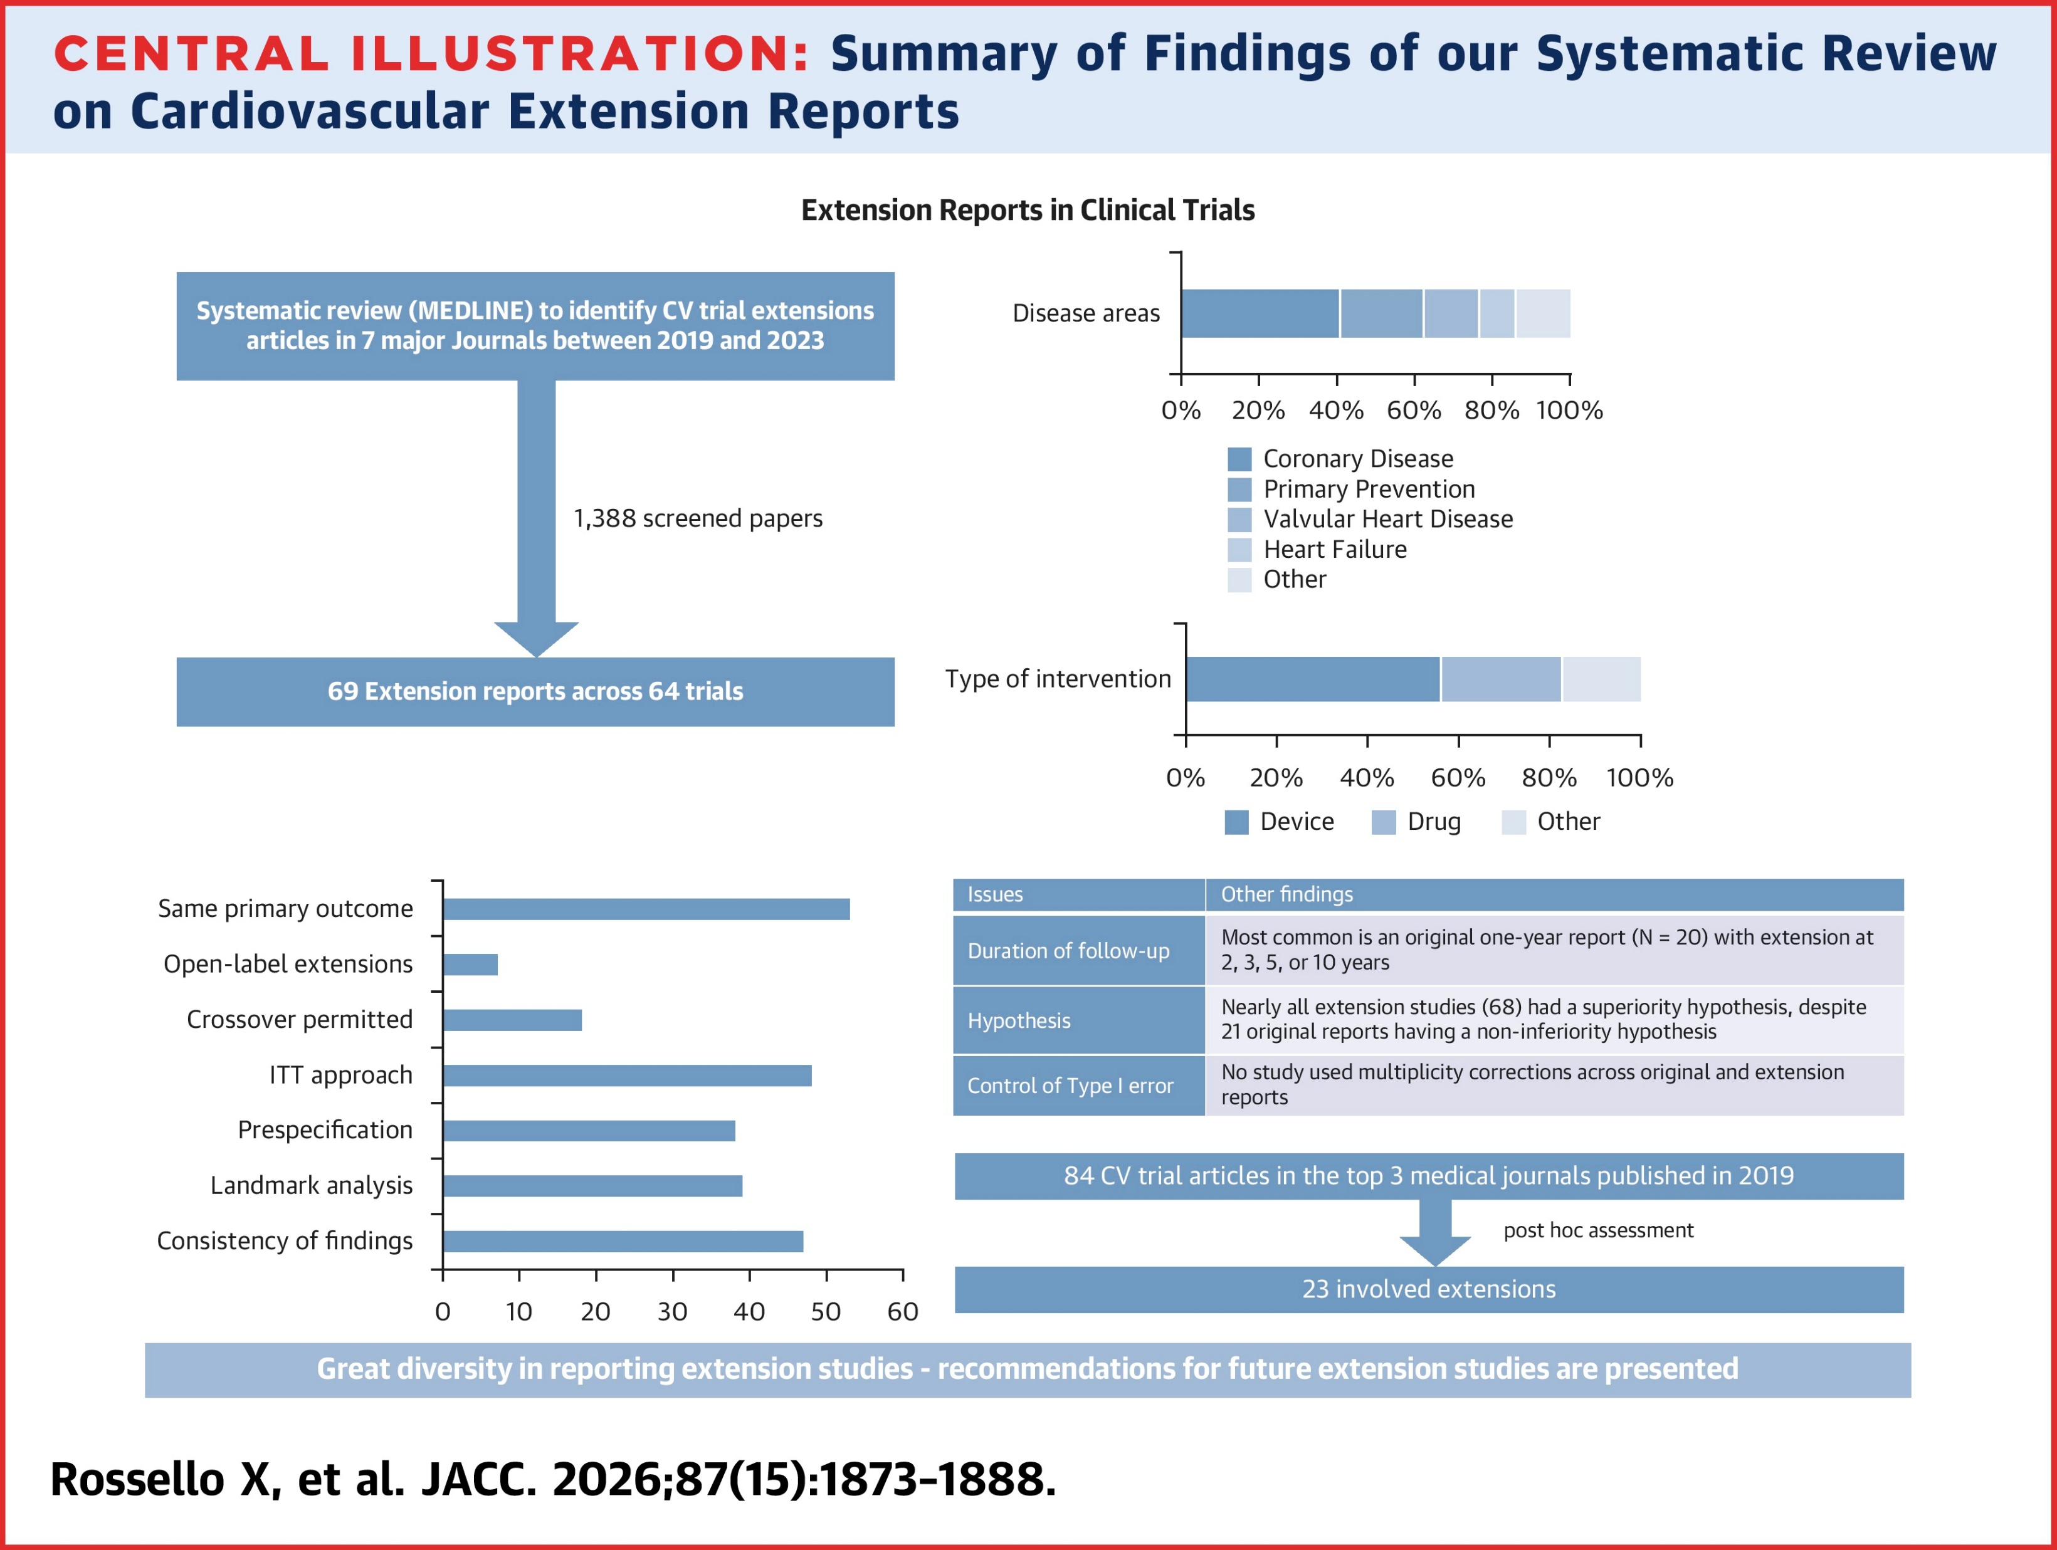
Extension Reports of RCTs
Legacy effect vs continued benefit
Regression to the mean
Extension in a VTE anticoagulation trial?
Legacy: vascular remodeling, ↓ fibrosis
VS
Loss of protection from a short-acting drug

Slide 8
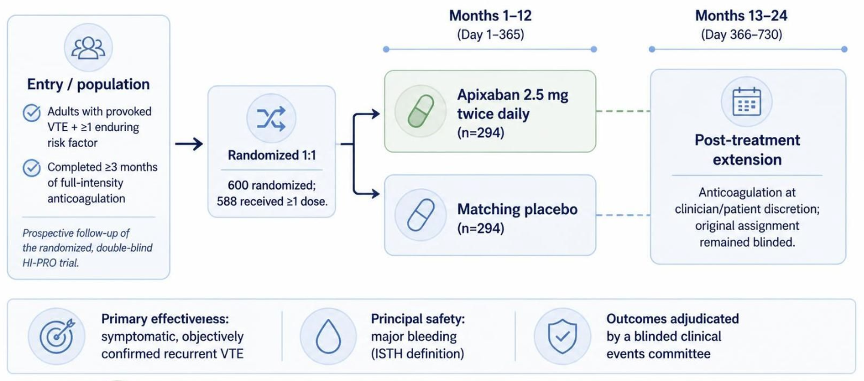

HI-PRO

Slide 9
HI-PRO Extension Study

Slide 10
HI-PRO Extension Study
SAP prepared in advance of analyses

Slide 11
CONSORT Diagram
1,195 assessed for eligibility
209 patients declined
386 did not meet the eligibility criteria
600 patients underwent randomization
Apixaban group
Placebo group
300 patients were assigned to receive apixaban 2.5 mg twice daily
300 patients were assigned to receive a placebo twice daily
6 did not take any doses of the assigned medication during the one-year randomized trial
6 did not take any doses of the assigned medication during the one-year randomized trial
294 were included in
The modified intention-to-treat analysis
294 were included in
the modified intention-to-treat analysis

Slide 12
CONSORT Diagram
1,195 assessed for eligibility
209 patients declined
386 did not meet the eligibility criteria
600 patients underwent randomization
Apixaban group
Placebo group
300 patients were assigned to receive apixaban 2.5 mg twice daily
300 patients were assigned to receive a placebo twice daily
6 did not take any doses of the assigned medication during the one-year randomized trial
6 did not take any doses of the assigned medication during the one-year randomized trial
294 were included in
The modified intention-to-treat analysis
294 were included in
the modified intention-to-treat analysis
241 were excluded due to <80% treatment adherence:
- Year 1 randomized phase (n=50)
- Year 2 extension phase (n=191)
100 were excluded due to <80% treatment adherence:
- Year 1 randomized phase (n=57)
- Year 2 extension phase (n=43)
53 were included in the
per-protocol analysis
194 were included in the
per-protocol analysis

Slide 13
Patient Characteristics
Characteristic | Total (N = 588) | Apixaban (N = 294) | Placebo (N = 294) | Standardized difference (%)
Mean age – years (SD) | 59.5 ± 15.2 | 59.1 ± 15.2 | 59.9 ± 15.2 | 4.6%
Female sex – N (%) | 334 (56.8) | 172 (58.5) | 162 (55.1) | 6.9%
Race – N (%)
White | 476 (81.0) | 241 (82.0) | 235 (79.9) | 5.2%
African American | 68 (11.6) | 32 (10.9) | 36 (12.3) | 4.3%
Asian | 5 (0.8) | 4 (1.3) | 1 (0.3) | 11.1%
Other | 15 (2.5) | 8 (2.7) | 7 (2.4) | 2.2%
Unknown | 24 (4.1) | 9 (3.1) | 15 (5.1) | 10.3%
Mean body mass index – kg/m² (SD) | 30.6 ± 6.7 | 30.7 ± 6.8 | 30.4 ± 6.6 | 4.1%
Current smoker – N (%) | 32 (5.4) | 15 (5.1) | 17 (5.8) | 3.0%
Comorbid conditions at baseline – N (%)
Prior VTE | 123 (20.9) | 65 (22.1) | 58 (19.7) | 5.9%
History of coronary artery disease | 103 (17.5) | 49 (16.7) | 54 (18.4) | 4.5%
History of peripheral artery disease | 23 (3.9) | 12 (4.1) | 11 (3.7) | 1.8%
History of stroke or TIA | 31 (5.3) | 17 (5.8) | 14 (4.8) | 4.6%
History of heart failure | 15 (2.6) | 10 (3.4) | 5 (1.7) | 10.8%
Family history of VTE – N (%) | 152 (25.9) | 78 (26.5) | 74 (25.2) | 3.1%

Slide 14
VTE Characteristics
Characteristic | Total (N = 588) | Apixaban (N = 294) | Placebo (N = 294) | Standardized difference (%)
VTE diagnosis for eligibility – N (%)
Only DVT | 281 (47.8) | 139 (47.3) | 142 (48.3) | 2.0%
Only PE | 139 (23.6) | 76 (25.9) | 63 (21.4) | 10.4%
Both PE and DVT | 168 (28.6) | 79 (26.9) | 89 (30.3) | 7.5%
Provoking factors for VTE – N (%)
Acute medical illness | 109 (18.5) | 55 (18.7) | 54 (18.4) | 0.9%
Surgery | 197 (33.5) | 98 (33.3) | 99 (33.7) | 0.7%
Trauma | 112 (19.0) | 61 (20.7) | 51 (17.3) | 8.7%
Pregnancy | 11 (1.9) | 7 (2.4) | 4 (1.4) | 7.5%
Infection | 95 (16.2) | 42 (14.3) | 53 (18.0) | 10.2%
Hormonal contraceptive or replacement therapy | 69 (11.7) | 42 (14.3) | 27 (9.2) | 15.9%
Hospitalization within 3 months before the VTE event | 54 (9.2) | 23 (7.8) | 31 (10.5) | 9.4%
Immobility | 184 (31.3) | 79 (26.9) | 105 (35.7) | 19.2%
COVID-19 | 49 (8.3) | 23 (7.8) | 26 (8.8) | 3.7%
Long-haul travel | 99 (16.8) | 46 (15.6) | 53 (18.0) | 6.4%
Enduring risk factors for VTE – N (%)
Persistent immobility | 38 (6.5) | 15 (5.1) | 23 (7.8) | 11.1%
Obesity (BMI ≥30 kg/m²) | 282 (48.0) | 138 (46.9) | 144 (49.0) | 4.1%
Heart failure | 15 (2.6) | 10 (3.4) | 5 (1.7) | 10.8%
Chronic lung disease | 133 (22.6) | 77 (26.2) | 56 (19.0) | 17.1%
Chronic inflammatory or autoimmune disorder | 307 (52.2) | 149 (50.7) | 158 (53.7) | 6.1%
Atherosclerotic cardiovascular disease | 173 (29.4) | 84 (28.6) | 89 (30.3) | 3.7%
Chronic kidney disease | 63 (10.7) | 31 (10.5) | 32 (10.9) | 1.1%
Chronic liver disease | 22 (3.7) | 9 (3.1) | 13 (4.4) | 7.2%

Slide 15
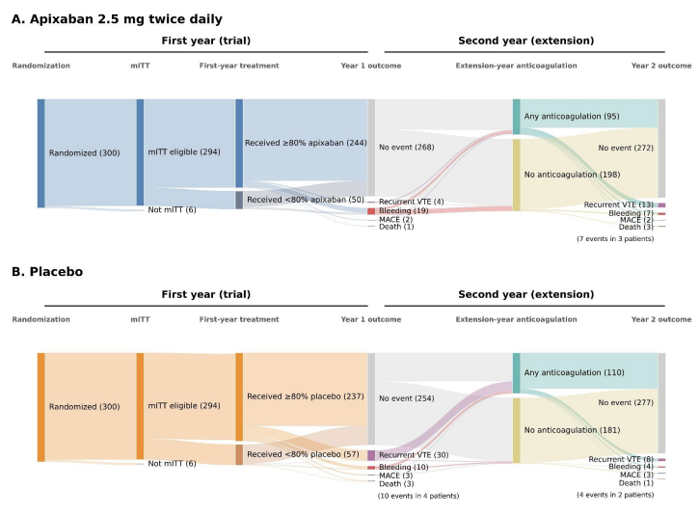
Antithrombotic Strategies
in year 2
 | Assigned to apixaban | Assigned to placebo
Any anticoagulant in year 2 | 95 | 110

Slide 16
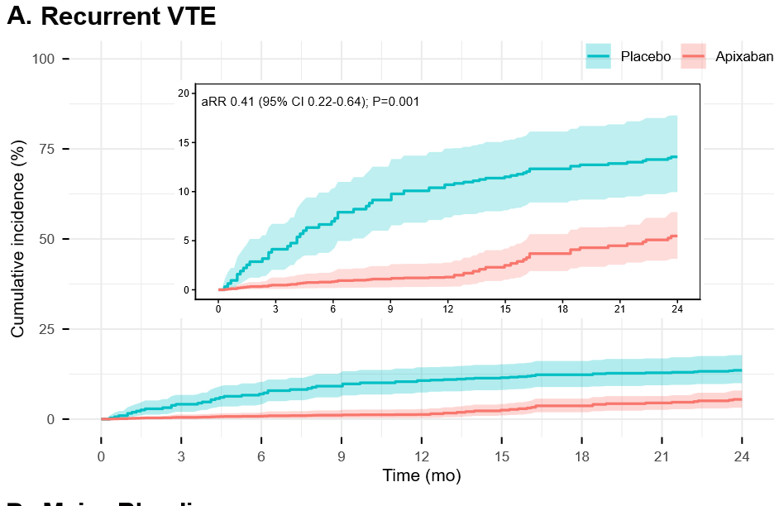
Recurrent VTE (mITT)
Per protocol analysis aRR: 0.45 (95% CI: 0.11, 0.99)

Slide 17
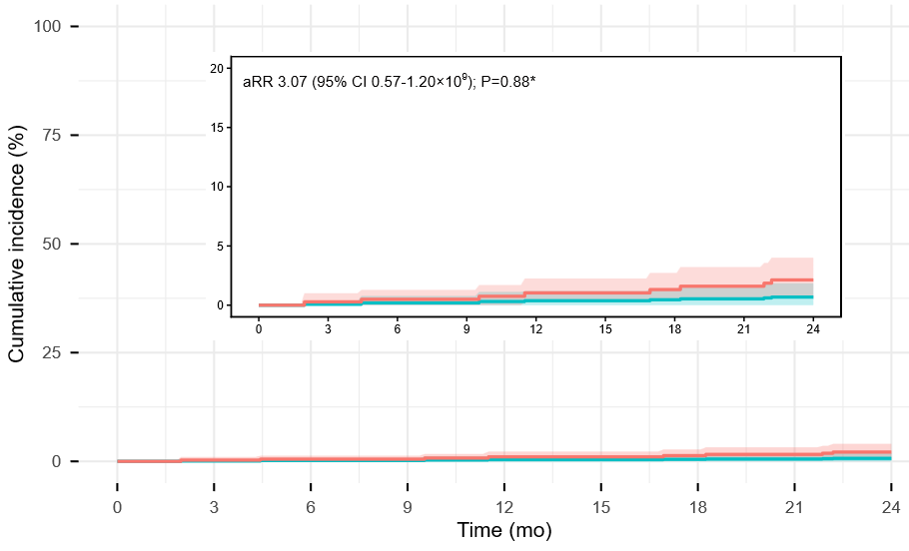
Major Bleeding (mITT)

Slide 18
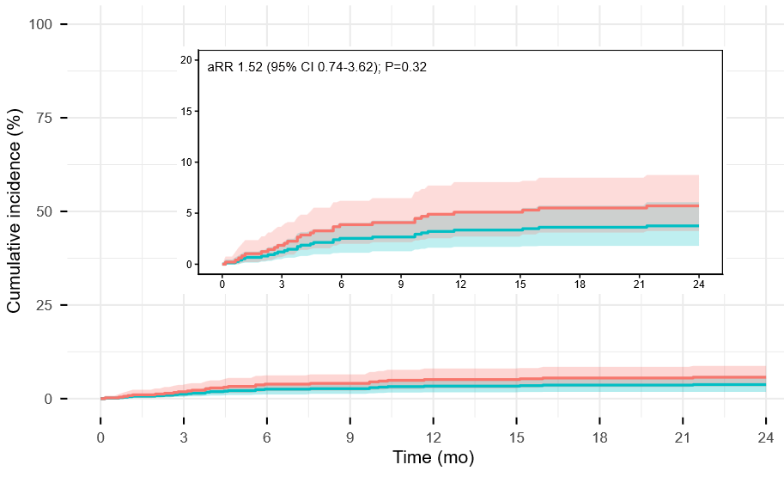
CRNMB (mITT)

Slide 19
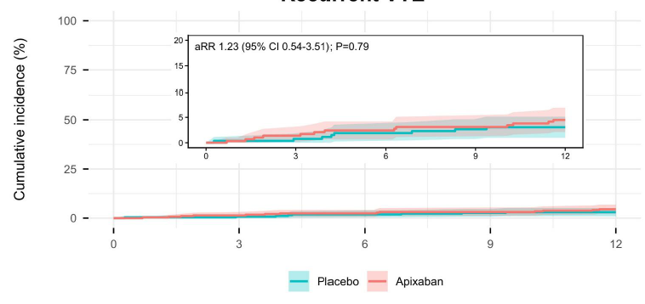
Recurrent VTE, landmark from day 366

Slide 20
Discussion
12-month of being assigned to low-intensity apixaban vs placebo ↓2-year risk of recurrent VTE
No increase in major bleeding.
No sustained benefit in landmark analysis for year 2 with non-proportional hazards.
Aligns with biology for a short acting drug.
Comparison with prior extension studies
PADIS-PE (warfarin)
RE-SONATE (dabigatran)
Couturaud F, et al. JAMA. 2015; 314: 31-40.
Schulman S, et al. N Engl J Med. 2013;368:709-718.

Slide 21
Limitations
Although intentional by design, HI-PRO Extension is different from a 2-year randomized study of low-intensity apixaban vs placebo.
From a single high-volume academic medical center.
Non-proportional hazards complicated the analytics, although foreseen in the SAP.

Slide 22
Conclusions
1-year treatment with low-intensity apixaban compared with placebo reduced the overall 2-year risk of recurrence. However, the hazard was nonproportional, with loss of benefit within the period without active treatment.
Results have implications for clinicians and patients with provoked VTE and enduring risk factors for shared decision-making.
Gregory Piazza, MD, MS (PI)
Sina Rashedi, MD, MPH; Mariana B. Pfeferman, MD; Arvind K. Pandey, MD; Darsiya Krishnathasan, MS; Justin Y. Lim, BS; Candrika D. Khairani, MD, MMSc; Antoine Bejjani, MD; Ruth H. Morrison, RN, BSN; Heather Hogan, RN, BSN; John Fanikos, RPH, MBA; Junyang Lou, MD, PhD; Lisa Rosenbaum, MD; Piotr S. Sobieszczyk, MD; Umberto Campia, MD; Marie D. Gerhard-Herman, MD; Pedro Ruiz Artacho, MD, PhD, Samuel Z. Goldhaber, MD; David W. Stein, PhD
@bbikdeli

