Slide 1

AntiCoagulation versus AcetylSalicylic Acid after Transcatheter Aortic Valve Implantation
- A prospective randomized open-label blinded-endpoint trial
Øyvind H. Lie
MD PhD MSc, FESC
Oslo University Hospital
Norway
August 30th, 2026
Funding: Public research grant from South-Eastern Norway Health Authorities

Slide 2




Slide 3

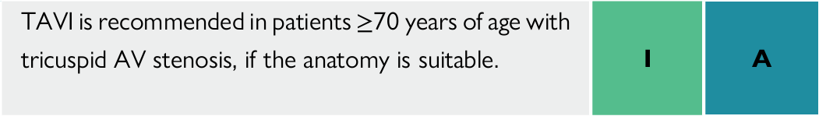
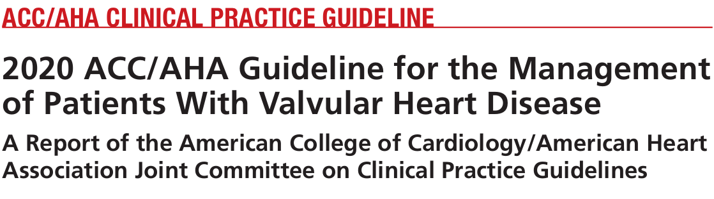
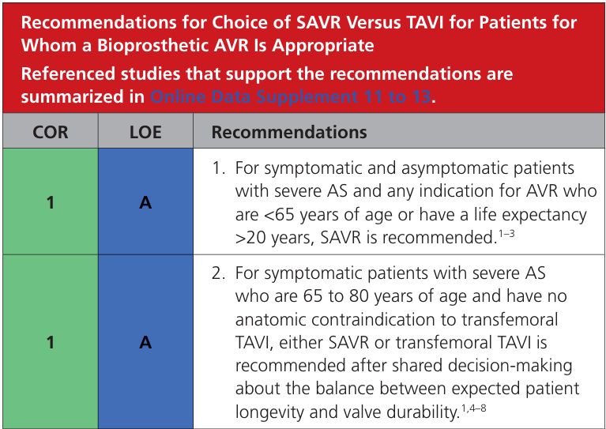
Background
Transcatheter aortic valve implantation (TAVI) is increasingly being performed in younger and healthier patients with severe aortic valve stenosis
  Increasing importance of optimal valve durability
Antithrombotic therapy after TAVI is a key element of optimizing valve durability and clinical outcomes
  After SAVR
    Anticoagulation should be considered
  After TAVI
    No other indication for anticoagulation → antiplatelet monotherapy
    Other indication for anticoagulation → anticoagulation monotherapy

Slide 4

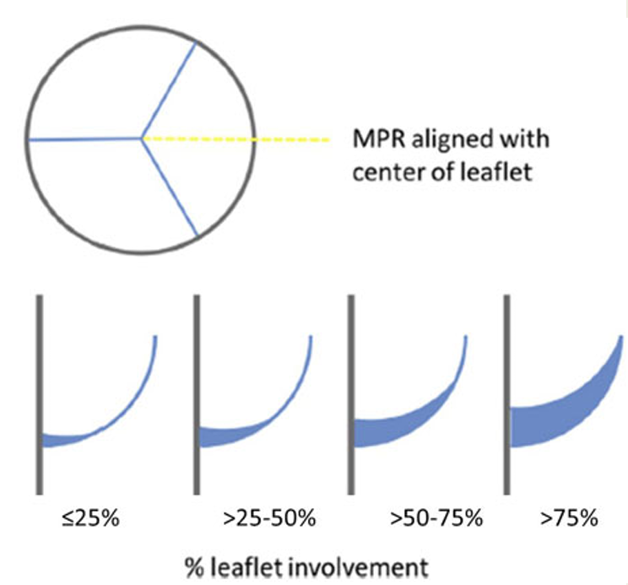
Leaflet thrombosis
Subclinical leaflet thrombosis is a concerning phenomenon
  Organized thrombus formation along prosthesis leaflets
  Can occur during first 12 months
  Associated with worse outcome
    Early valve degeneration
    Thromboembolic events
    Death
  Unclear causal relationship
Lower incidence in patients on anticoagulation therapy
Lower incidence after SAVR than after TAVI
Can be reversible with anticoagulation
European Heart Journal (2021) 42, 1825–1857 doi:10.1093/eurheartj/ehaa799

Slide 5
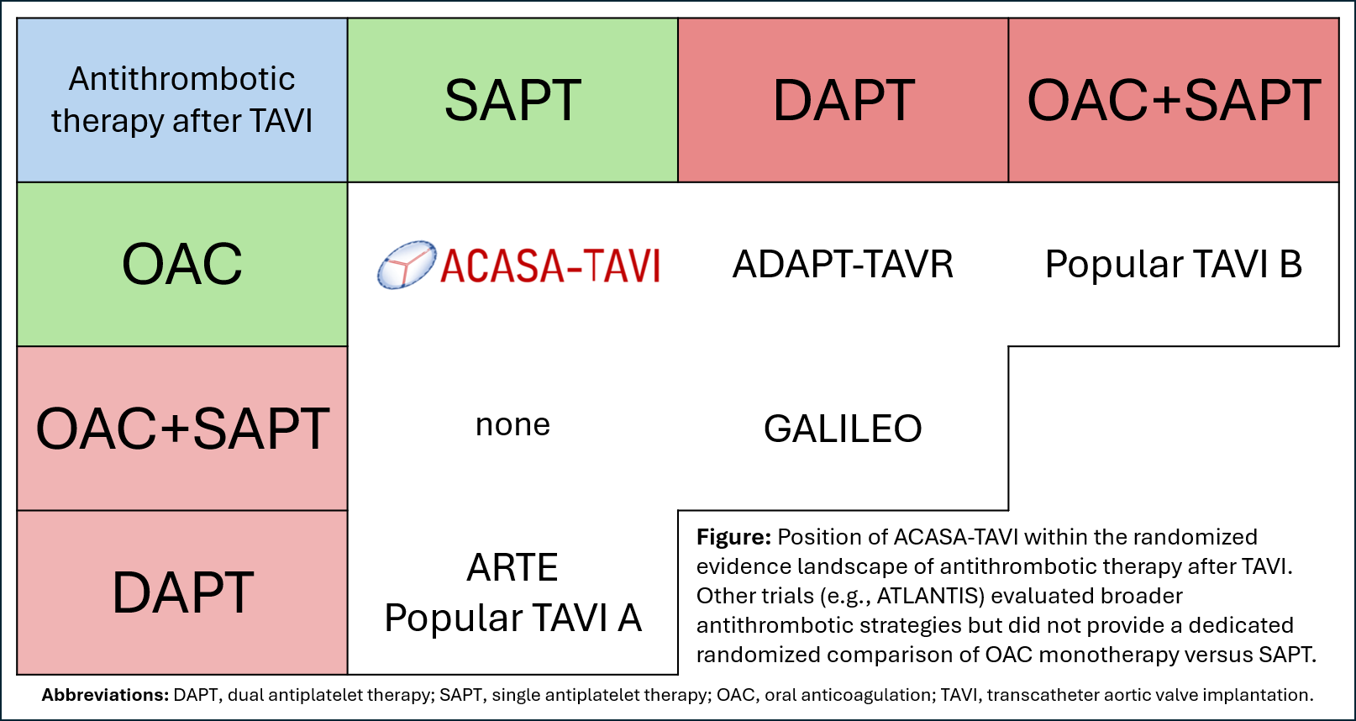
Previous trials in the field
*OAC vs SAPT after 3 months
Reproduced from Dodgson CS et al, American Heart Journal 2023 - https://doi.org/10.1016/j.ahj.2023.08.010

Slide 6
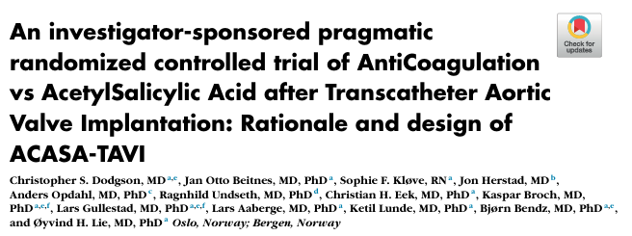
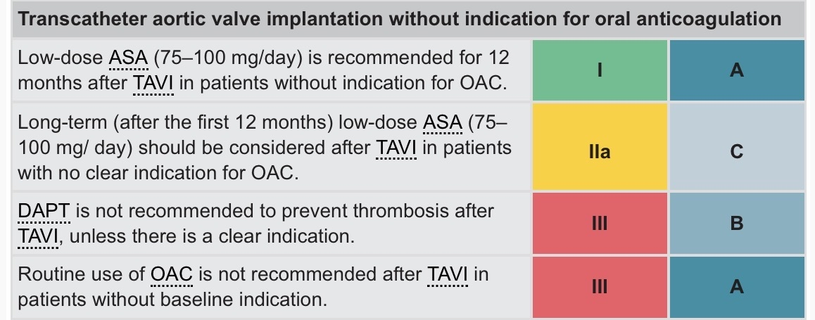
Methods
Compound clinical question:
  Can NOAC monotherapy reduce occurrence of leaflet thrombosis without an unacceptable safety penalty compared with ASA after TAVI?
Prospective randomized open-label blinded-endpoint (PROBE) trial
Patients aged 65-80 years old at the time of TAVI
  Population where valve durability is a key concern (AHA/ACC)
  No other indication or contraindication for NOAC or ASA
  Randomized 1:1 to a 12-month monotherapy strategy of either:
    Anti factor Xa type NOAC with standard dosing, or
    ASA 75 mg daily (standard of care)
Dodgson CS et al, American Heart Journal 2023 - https://doi.org/10.1016/j.ahj.2023.08.010
ASA
versus
NOAC
2025 ESC/EACTS Guidelines for the management of valvular heart disease. European Heart Journal 2025, https://doi.org/10.1093/eurheartj/ehaf194

Slide 7
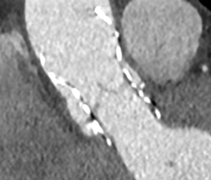
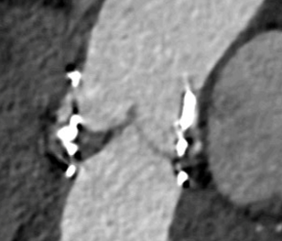

Co-primary endpoints
Prevention of leaflet thrombosis is desirable, but only relevant if it does not cause more than a marginal increase in bleeding or other clinical harm
  →Co-primary endpoints
Primary efficacy endpoint (superiority)
  Hypoattenuated leaflet thickening / HALT
    Relevance highlighted in VARC-3, recommended trial endpoint
    Blinded core-lab CT assessment
Primary safety endpoint (non-inferiority)
  Potential safety concerns with NOAC monotherapy
    Adjudicated VARC-3 bleeding events (concern of increased bleeding)
    Stroke and myocardial infarction (concern with omission of ASA)
    Death (mortality concern in GALILEO)
360 participants would provide >80% power for both endpoints
  No alpha adjustment → both null hypotheses must be rejected to conclude on either of them, reflecting the compound clinical question
No HALT
HALT
CT images from ACASA-TAVI core lab

Slide 8
Results
 | NOAC n = 180 | ASA n = 180
Age, y | 74.0 (3.8) | 74.9 (3.6)
Female, No. (%) | 75 (41.7%) | 59 (32.8%)
Body mass index (kg/m²) | 28.3 (4.9) | 27.9 (4.5)
NYHA functional class III or IV, No. (%) ª | 54 (30.5%) | 50 (28.4%)
EuroSCORE II (%) ^{b} | 1.7 (1.2 – 2.5) | 1.8 (1.4 – 2.8)
Hypertension, No. (%) | 125 (69.4%) | 125 (69.4%)
Diabetes mellitus, No. (%) | 56 (31.1%) | 43 (23.9%)
Coronary artery disease, No. (%) | 31 (17.2%) | 52 (28.9%)
Chronic obstructive pulmonary disease, No. (%) | 30 (16.7%) | 18 (10.0%)
Previous stroke, No. (%) | 18 (10.0%) | 22 (12.2%)
NT-proBNP (ng/L) [ref. <250] | 399 (190 – 764) | 418 (203 – 867)
eGFR (mL/min/1.73m²) [ref. >60] | 79.5 (65 – 90) | 77.0 (64 – 88)
Left ventricular ejection fraction (%) | 54.1 (7.9) | 53.7 (8.1)
Aortic valve mean gradient (mmHg) | 50.6 (13) | 48.7 (12)
Bicuspid aortic valve, No. (%) | 26 (14.4%) | 25 (14.0%)
Valve-in-valve, No. (%) | 3 (1.7%) | 4 (2.2%)
Balloon-expanded valve (%) | 133 (73.9%) | 126 (70.0%)
Predilatation (%) ^{d} | 68 (37.8%) | 66 (36.7%)
Postdilatation (%) ^{d} | 18 (10%) | 16 (8.9%)
NOAC group → 51% apixaban, 41% edoxaban, and 8% rivaroxaban

Slide 9
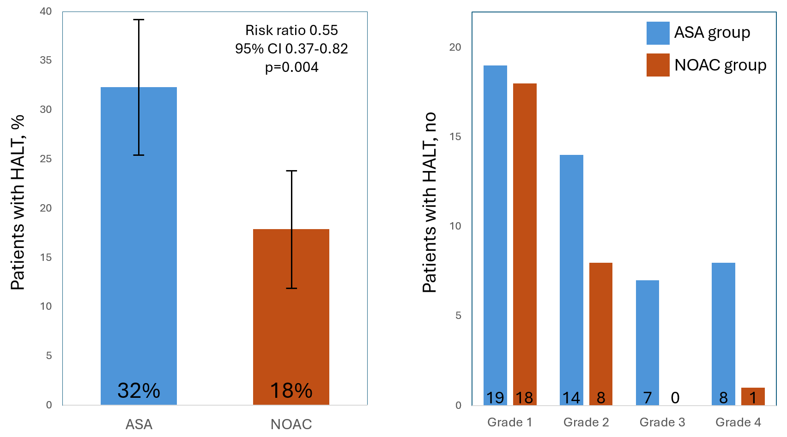
Primary efficacy endpoint - HALT
NOAC reduced the occurrence of HALT compared to ASA
  Consistent in supporting analyses
Severe changes almost exclusively in ASA group
  HALT grade 3-4 → 9.0% vs 0.6%
Primary efficacy endpoint Observed values, no imputation | NOAC n (%) | ASA n (%)
HALT | 27 (16.2%) | 48 (28.6%)
Grade 1 (≤25 % leaflet involved) | 18 | 19
Grade 2 (26 – 50 % leaflet involved) | 8 | 14
Grade 3 (51 – 75 % leaflet involved) | 0 | 7
Grade 4 (>75 % leaflet involved) | 1 | 8
Treatment policy estimand, unadjusted primary analysis. Composite strategy; intercurrent death imputed as HALT+. Missing data handled by multiple imputation.

Slide 10
Primary safety endpoint
Lower rates of primary safety endpoint than anticipated
  ≈ 10% versus anticipated ≈ 30%
  35% predefined margin therefore large
Point estimate in favor of NOAC
95% CI consistent with up to 2.8% worse with NOAC
Post-hoc application of actual 35% margin also met
  Consistent in supporting analyses
Post hoc
35% relative margin
Non-inferiority
margin
p for non-inferiority < 0.001
-9.5%
-3.3%
2.8%
Primary safety endpoint | NOAC n (%) | ASA n (%)
Any first event occurring | 13 (7.5%) | 19 (10.6%)
VARC-3 bleeding event | 4 | 5
Myocardial infarction | 2 | 2
Stroke from any cause | 5 | 3
Death | 2 | 9
11.9%
NOAC better
ASA better
Treatment policy estimand, adjusted primary analysis. Missing data handled by multiple imputation.
Predefined supplementary principal stratification estimand for intercurrent treatment deviations.

Slide 11
Secondary endpoints
Low rates of clinically relevant bleeding
  No clear difference between groups
  Life-threatening or fatal bleeding (type 3 or 4) only occurred in ASA group
Low rates of thromboembolic events
  No clear difference between groups
12 patients (3%) died
  2 i NOAC group and 10 in ASA group
Hemodynamic valve deterioration (HVD) stage 2 or 3 occurred in 13,7%*
  No clear difference between groups
No clear difference in adverse events between the treatment groups
Key secondary and safety endpoints | NOAC n (%) | ASA n (%) | Estimate (95% CI) With imputation for missing data
VARC-3 bleeding events, n=352 | 4 (2.3%) | 7 (4%) | Risk difference -1.7% (-5.8% to 2.2%)
Type 1 bleeding event | 4 | 3
Type 2 bleeding event | 0 | 0
Type 3 bleeding event | 0 | 3
Type 4 bleeding event | 0 | 1
Thromboembolic events, n=348 | 7 (4%) | 5 (2.9%) | Risk difference 1.1% (-3.0% to 5.3%)
Myocardial infarction | 2 | 2
Stroke from any cause | 5 | 3
Death, n=360 | 2 (1.1%) | 10 (5.6%) | Risk difference -4.4% (-8.9% to -0.6%)
Death from definite cardiovascular cause | 2 | 5
HVD Stage 2 or 3*, n=335 | 21 (12.6%) | 25 (14.9%) | Risk ratio 0.71 (0.44 to 1.15)
No HVD | 122 | 103
Stage 1 HVD | 24 | 40
Stage 2 HVD | 21 | 25
Stage 3 HVD | 0 | 0
Serious adverse events
Total number of events | 106 | 131
Patients experiencing ≥ 1 event | 64 (35.6%) | 75 (41.7%)
Adverse events
Total number of events | 269 | 246
Patients experiencing ≥ 1 event | 121 (67.2%) | 112 (62.2%)
* HVD was estimated using the delta values from discharge echocardiography to 12 months, not from 1-3 months to 12 months as suggested in VARC-3

Slide 12
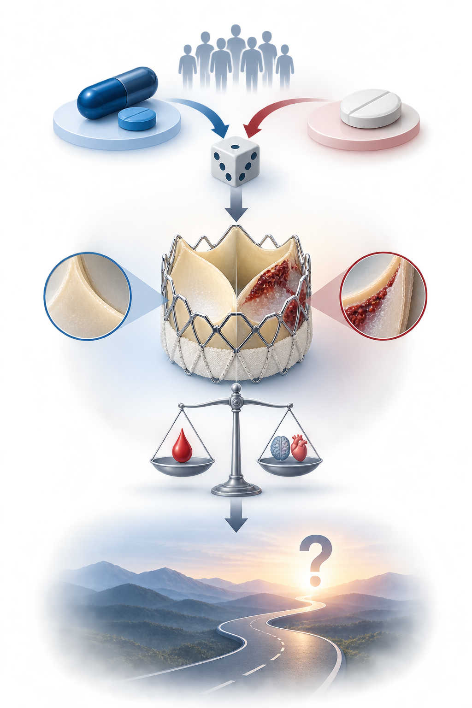
Discussion
The two monotherapy strategies were compared in a randomized controlled trial with clinically relevant endpoints
NOAC monotherapy reduced subclinical leaflet thrombosis without an unacceptable safety penalty
Impact on long-term clinical outcomes remains to be established
Limitations
  Modest sample size for primary safety endpoint, not powered for components of composite
    Secondary endpoints to be interpreted with caution
  Lower than anticipated rate of primary safety endpoint
  Relatively young and low-risk population in Norway
    Not necessarily applicable to octogenarians and higher risk populations

Slide 13

Conclusions
A strategy of NOAC monotherapy compared with ASA monotherapy for 12 months after TAVI
  Reduced the occurrence of leaflet thrombosis
  AND
  Was non-inferior for bleeding, thromboembolic events or death
Anticoagulation monotherapy can be beneficial after TAVI in selected patients
These results can inform future antithrombotic treatment paradigms
Effect on major clinical outcomes will be reported after 5 and 10 years

Slide 14







Thank you
In memory of
Dr. Lars Aaberge
1954-2026

Slide 15
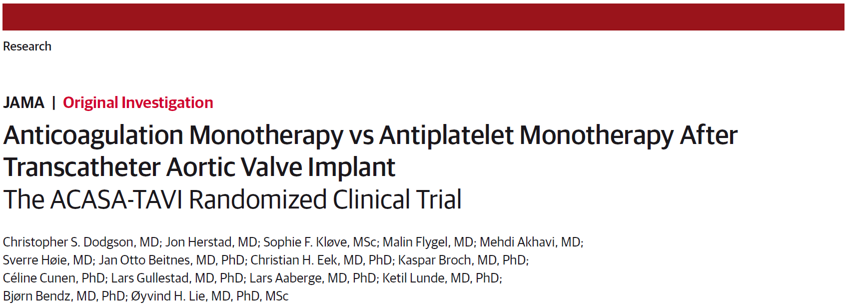


Anticoagulation Monotherapy vs Antiplatelet Monotherapy After Transcatheter Aortic Valve Implant
The ACASA-TAVI Randomized Clinical Trial
Dodgson CS, Herstad J, Kløve SF, et al
Published online August 30, 2026
European Society of Cardiology Congress 2026
Available at jama.com

