Slide 1

SHIELD-MI
Intravenous Dexrazoxane in Hemorrhagic Myocardial Infarction
A non-randomized, double-blind, placebo-controlled, sequential-cohort phase IIa study
Keyur P. Vora, MD, MS
Medical Imaging Research Institute
Indiana University School of Medicine
Indianapolis, Indiana, USA
SHIELD-MI Investigators
Keyur P. Vora, MD, MS; Kinjal Bhatt, MD; Shrenik Doshi, MD; Vishal Poptani, MD; Andreas Kumar, MD, MS;
Robert Finney, PhD; Cynthia Taub, MD; Grant Reed, MD; Rishi Puri, MD; Balaji Tamarappoo, MD, PhD;
Edward Fry, MD; Timothy Henry, MD; Jay Traverse, MD; Ankur Kalra, MD, MSc; Rohan Dharmakumar, PhD
Simultaneously Published: Vora et al. Intravenous Dexrazoxane for Hemorrhagic Myocardial Infarction: The SHIELD MI Study. European Heart Journal. August 2026

Slide 2
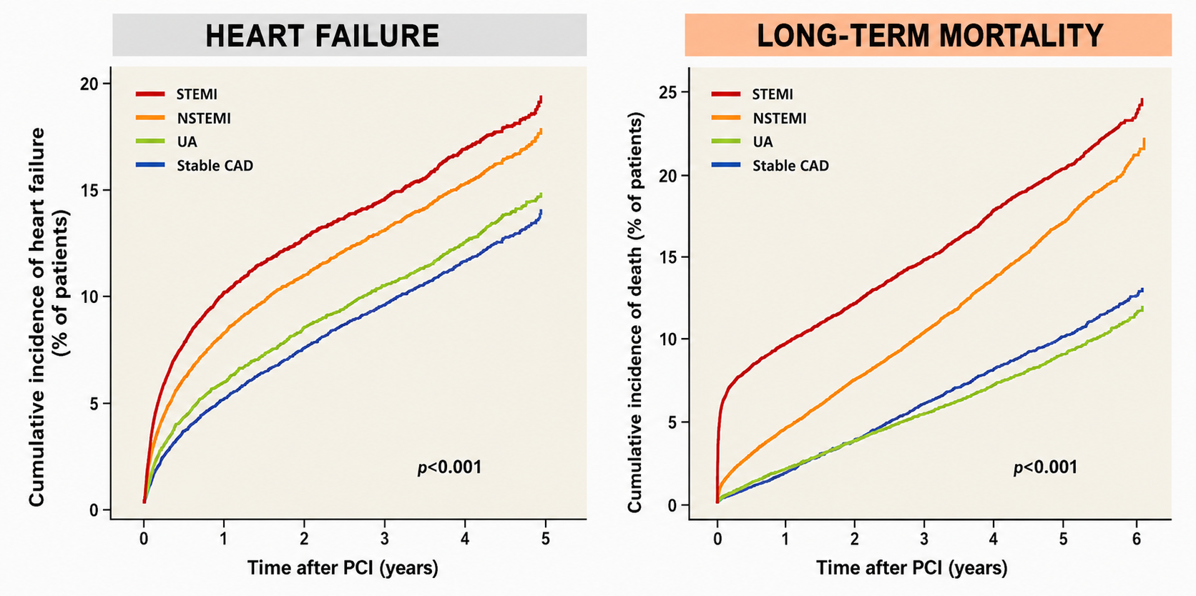
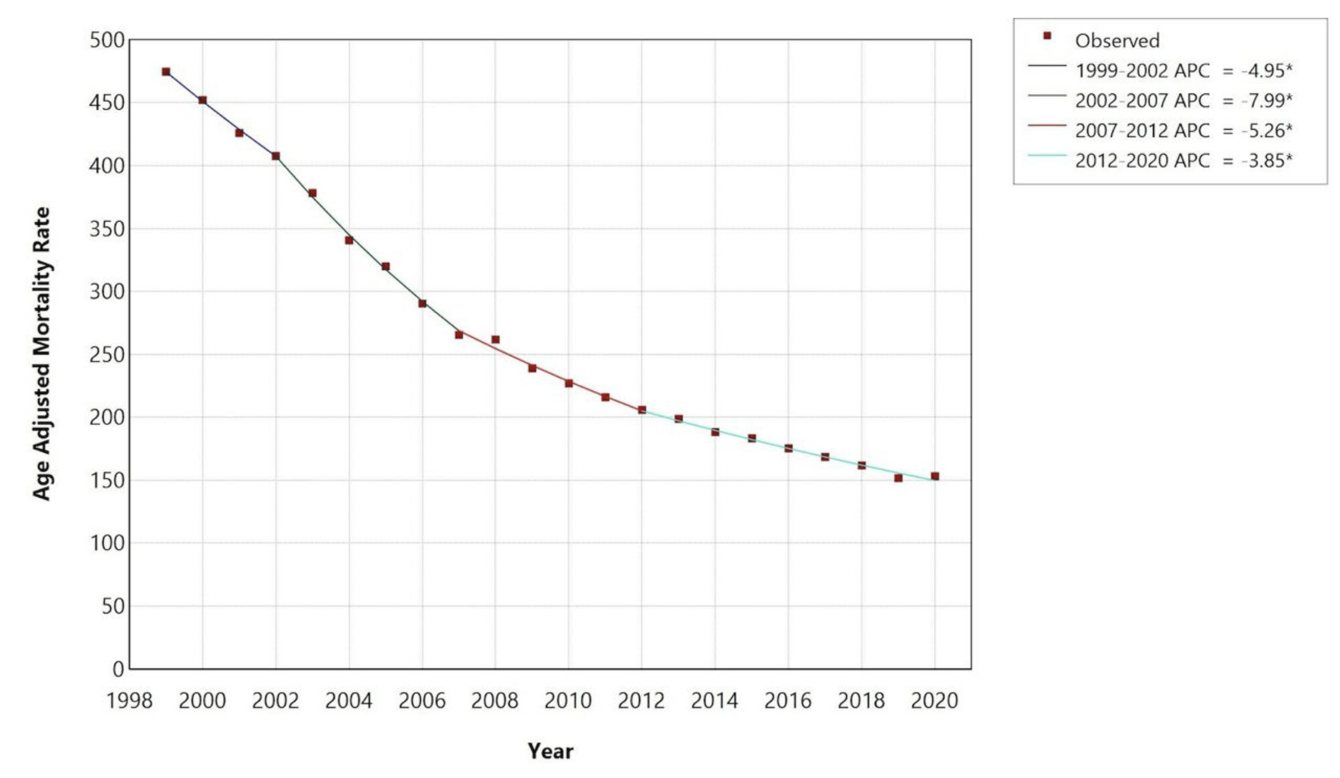
Short- and Long-Term Mortality and Morbidity After PCI
IMMEDIATE MORTALITY
CDC-WONDER Database (n = 2,354,971)
Fokkema ML et al. Eurointervention 2016

Slide 3
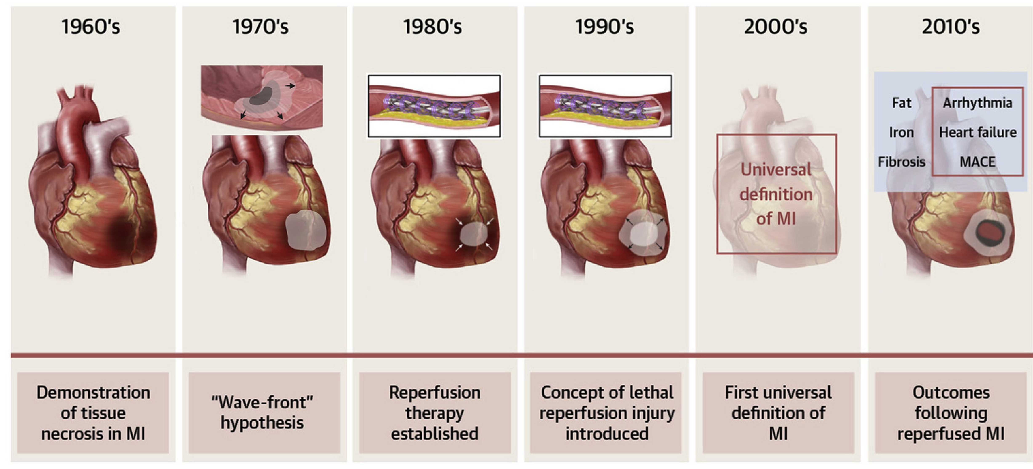
Historical Perspective
Dharmakumar R et al. JACC Advances 2025

Slide 4
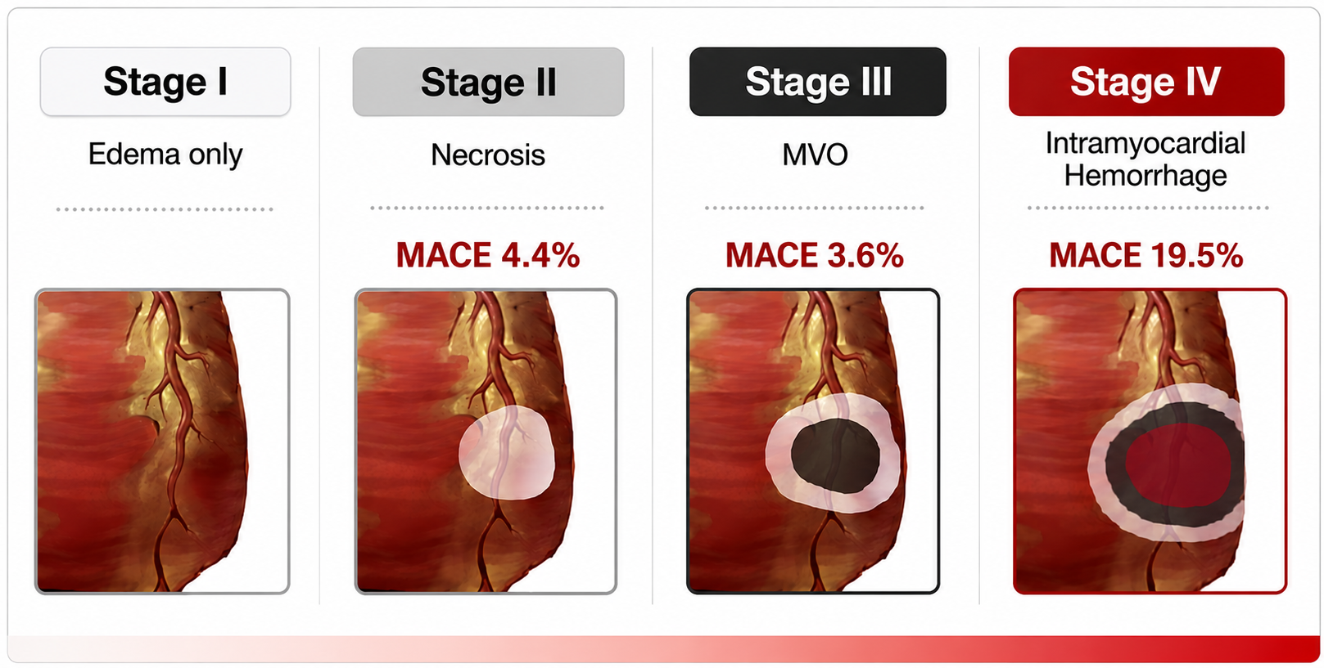
2020’s – Stages of Tissue Injury in Reperfused MI
Kumar et al. CJC 2024; Dharmakumar et al. JACC Advances. 2025; Lechner et al. JACC 2024

Slide 5
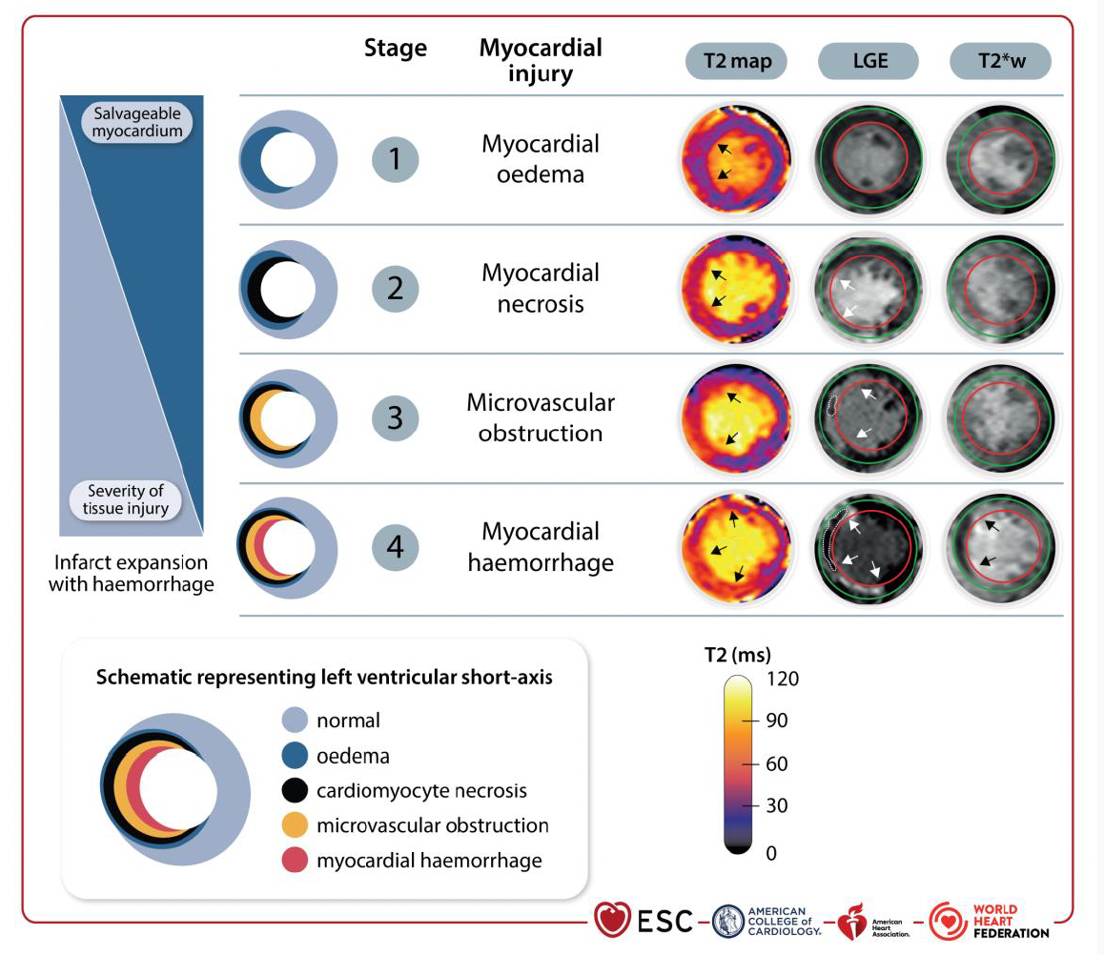
2026 – A Defining Year of 5th Universal Definition of MI
5th Universal Definition of Myocardilal Infarction. EHJ, Circulation, JACC, Global Heart 2026

Slide 6
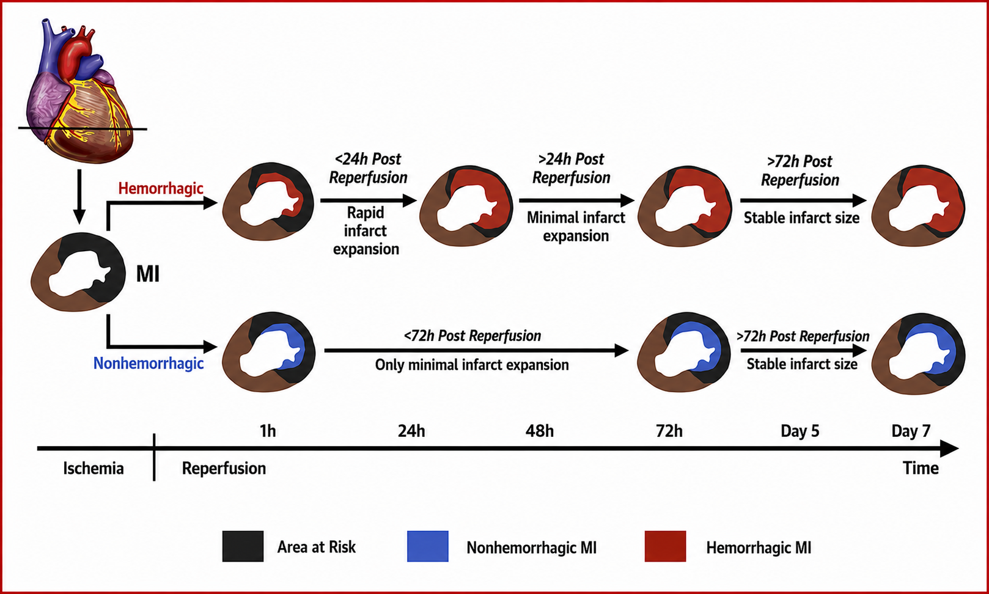
Intramyocardial Hemorrhage (IMH) Drives
Infarct Expansion < 24 Hours of Reperfusion
Liu et al. JACC 2022

Slide 7
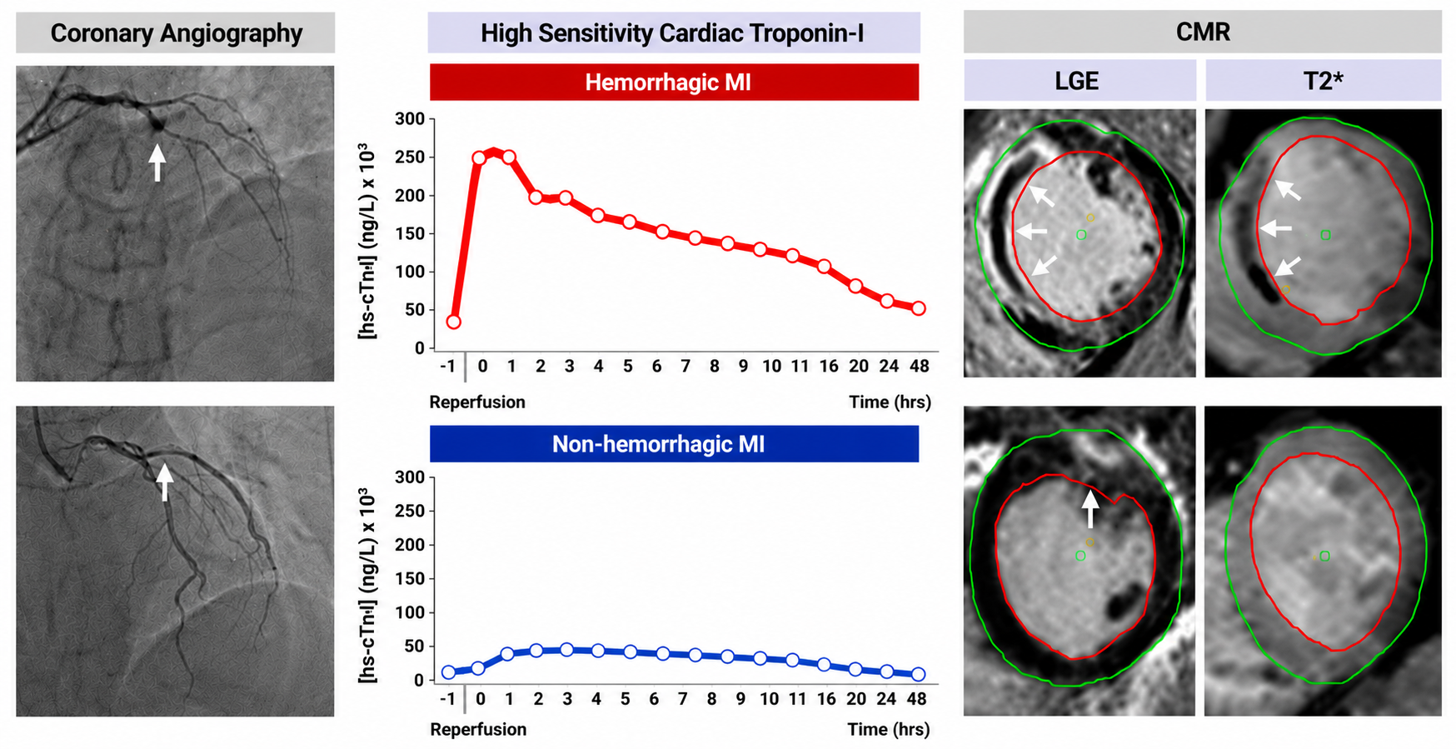
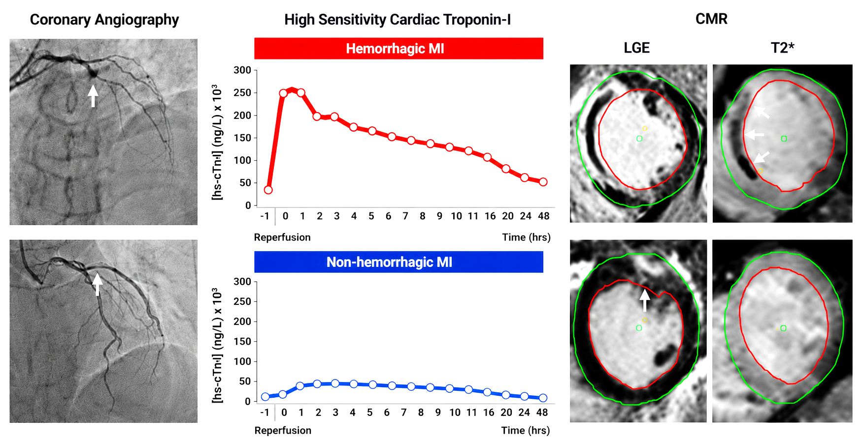
Diagnosis of Hemorrhagic MI
Vora KP et al. NEJM Evidence 2025

Slide 8
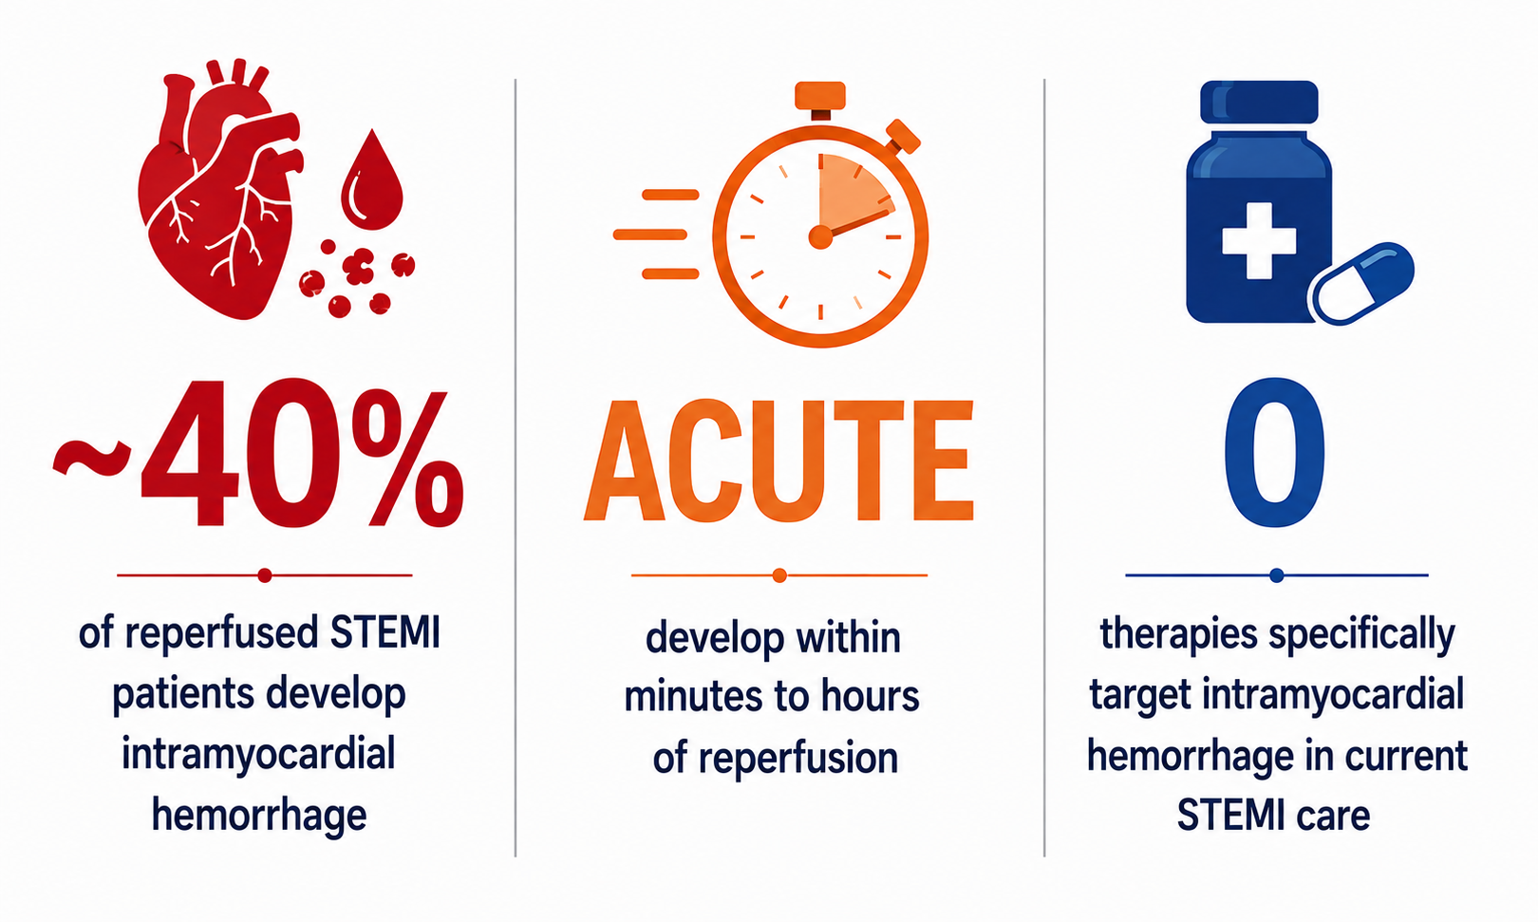
Intramyocardial Hemorrhage :
A Common, Acute, Untreated Target in Reperfused STEMI
Can intramyocardial hemorrhage be targeted in STEMI management?
Vyas et al. JSCAI 2022

Slide 9
SHIELD MI: Hypothesis, Primary and Secondary End Points
Hypothesis:
250 mg Intravenous dexrazoxane delivered pre-PCI and then at 4, 8, and 12 hours post-PCI is safe and reduces tissue injury and improves functional outcomes compared to placebo control on CMR performed 48-72 hours post PCI
Primary Endpoints:
LVEF and Intramyocardial hemorrhage (IMH) Volume
Secondary Endpoints:
Infarct Size and Microvascular Obstruction

Slide 10
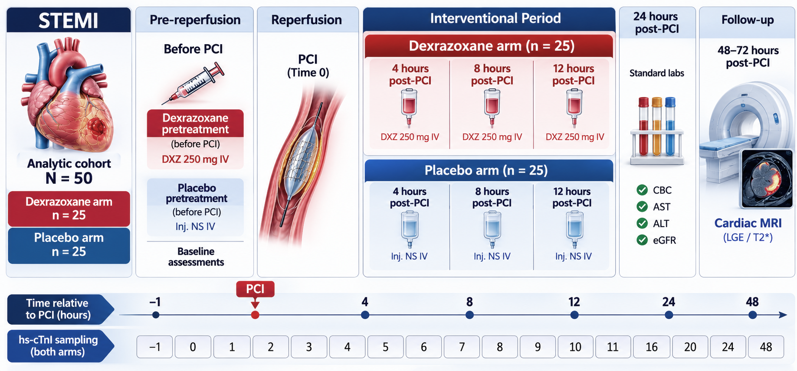
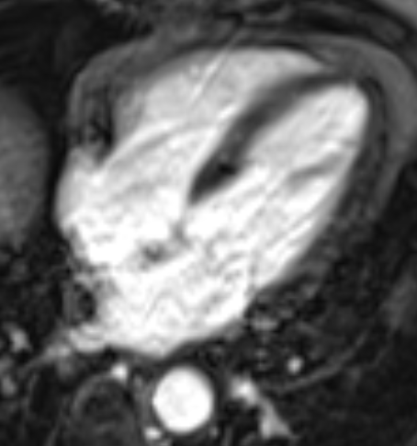
SHIELD-MI: Study Design

Slide 11
SHIELD-MI: Inclusion & Exclusion Criteria
Eligibility centered on first STEMI undergoing primary PCI with feasible consent and cardiac MRI endpoint assessment.
INCLUSION
EXCLUSION
POST-ENROLMENT FILTERS
Doorway into study
Baseline safety exclusions
Analytic cohort / CMR-evaluable set
• PCI or CABG within prior year
• Dialysis dependence or end-stage renal disease
• Cardiogenic shock
• Known pre-existing LVEF <40%
• Pregnancy or breastfeeding
• Anthracycline chemotherapy
• Iron-chelation therapy or iron-storage disease
• Investigational drug/device trial < 90 days
• Other condition preventing safe DXZ or study completion
• Age 18–79 years
• First STEMI presentation
• Primary PCI planned
• Consent pathway available
• No contraindication to cardiac MRI
• Multivessel disease requiring CABG
• Balloon angioplasty without stenting
• Hemodynamic instability preventing CMR
• CMR not completed within 48–72 h
• Non-diagnostic CMR
• Placebo patient failed clinical matching algorithm

Slide 12
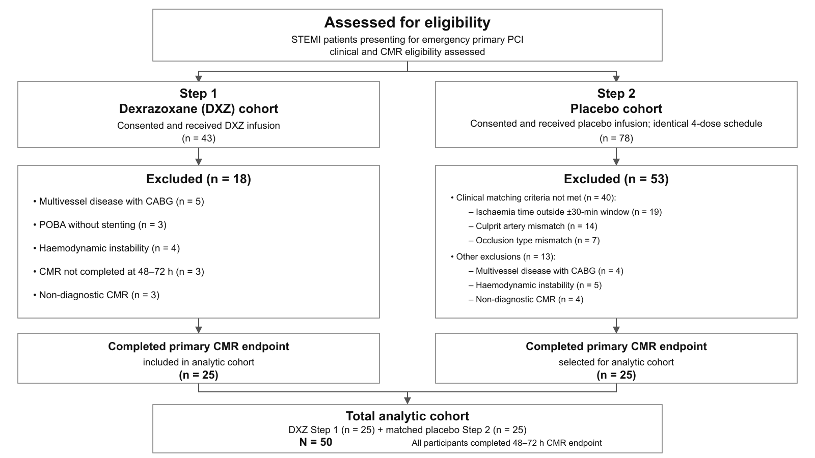
SHIELD-MI: TREND Flowchart

Slide 13
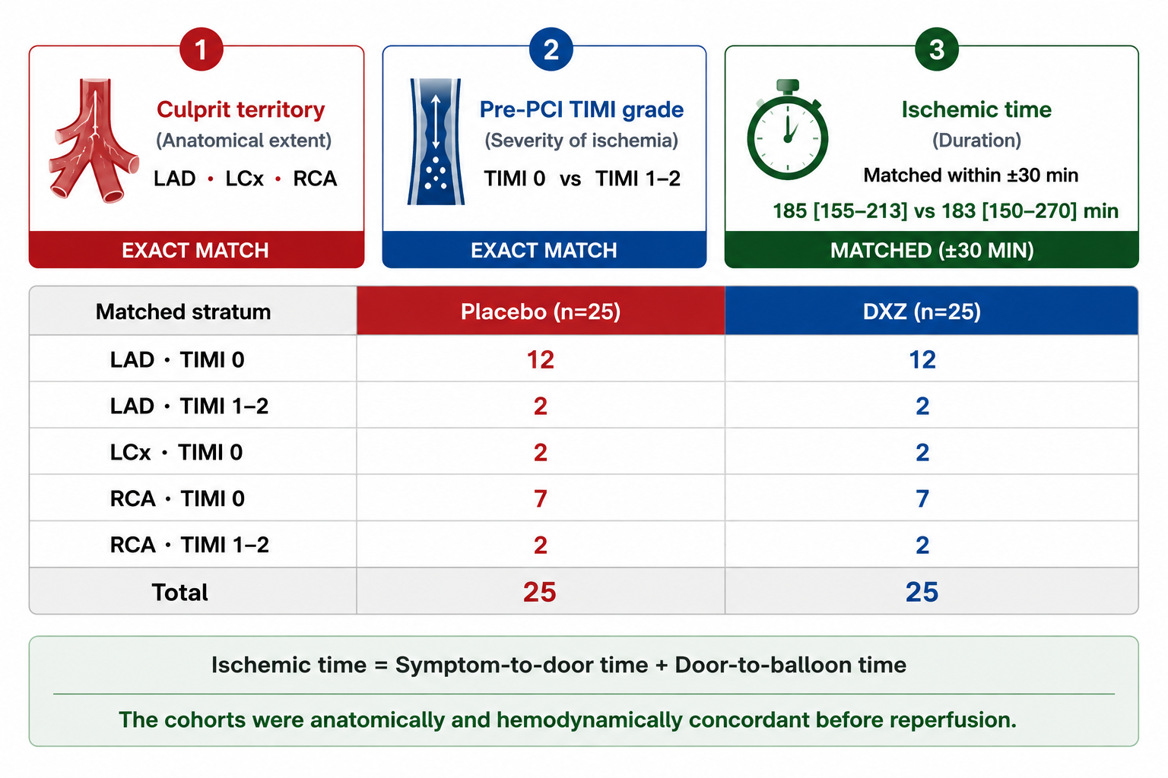
Treatment and Placebo Cohort Matched Prior to PCI

Slide 14
Safety of Intravenous Dexrazoxane in STEMI Patients
Dexrazoxane was well tolerated: all treated patients completed the four-dose regimen, with no drug-related serious adverse events or major bleeding.
Parameter | Pre-PCI | Post-PCI x 24h
Hemoglobin [g/dL] | 13.6 (2.2) | 12.7 (2.2)
White blood cell count [/µL] | 10,991 (2,474) | 9,846 (2,636)
Platelet count [/µL] | 271,122 (76,740) | 277,458 (103,828)
SGOT (AST) [U/L] | 223 (70) | 438 (387)
SGPT (ALT) [U/L] | 49 (20) | 95 (71)
Prothrombin time [s] | 12.5 (0.7) | 14.8 (3.3)
APTT [s] | 25.3 (1.8) | 28.6 (2.1)
INR | 1.0 (0.0) | 1.2 (0.08)

Slide 15
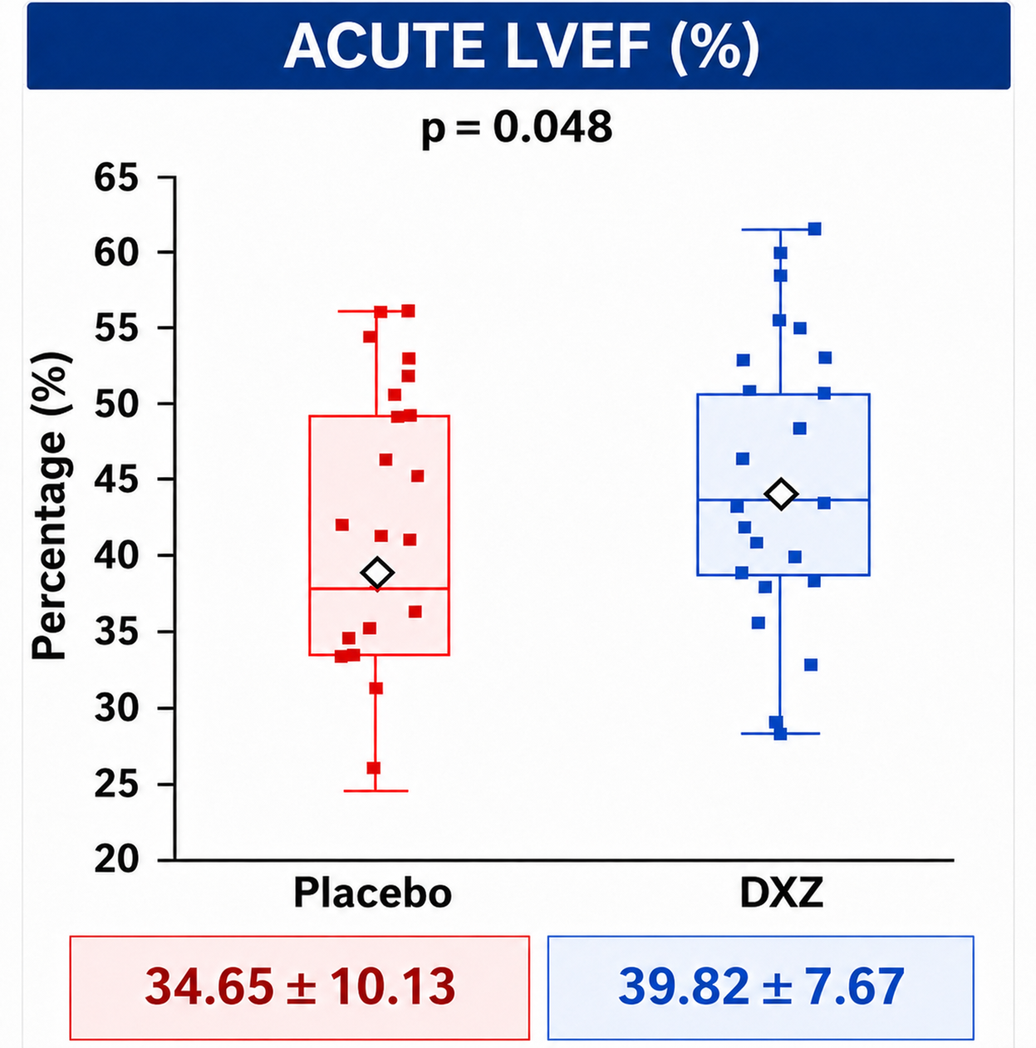
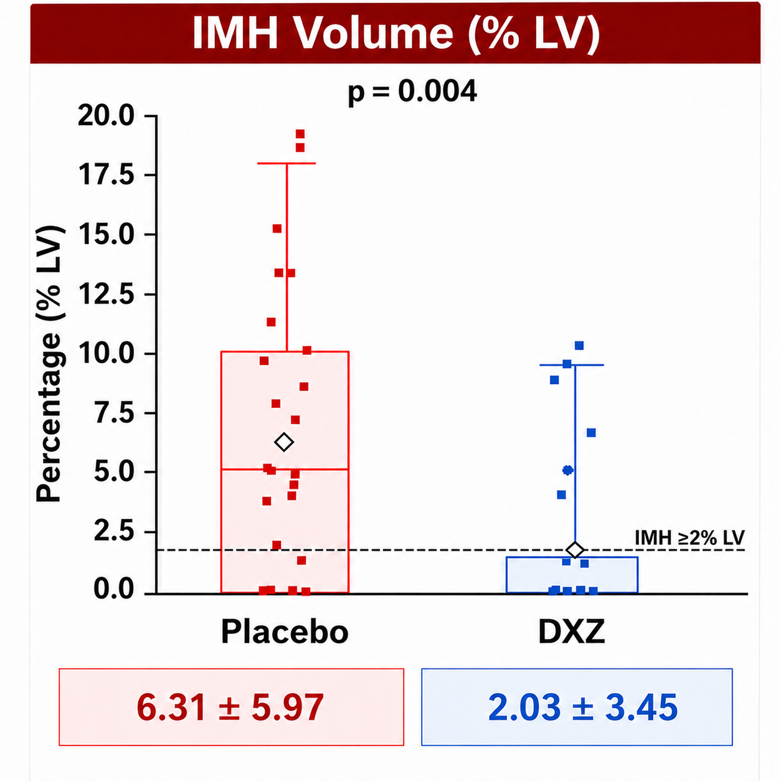
Primary End-points: Acute LVEF and IMH Volume

Slide 16
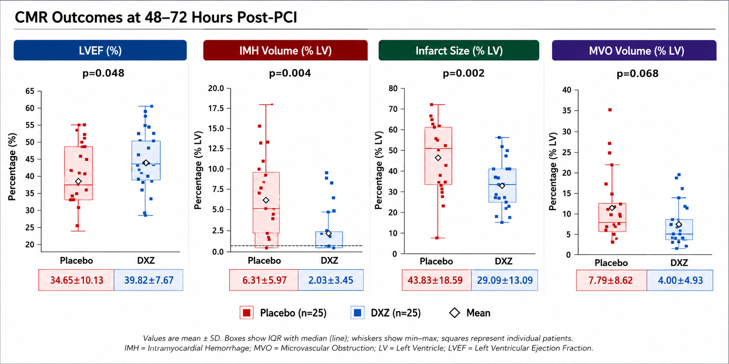
Secondary End-points: Acute Infarct Size & MVO Volume
Acute

Slide 17
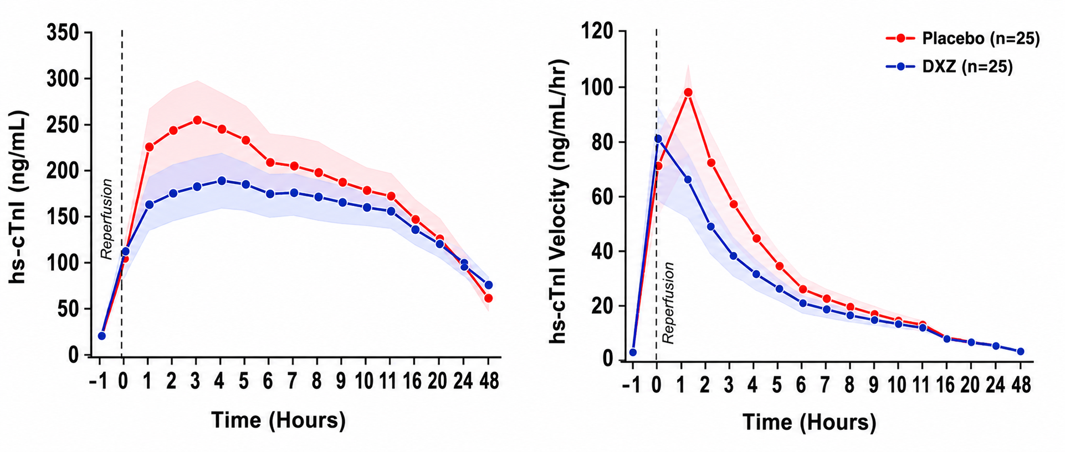
Post-PCI Troponin Kinetics was Blunted in DXZ Cohorts
High-sensitivity Cardiac Troponin-I Concentration
High-sensitivity Cardiac Troponin-I Velocity

Slide 18
Summary
OBJECTIVE: SHIELD-MI evaluated whether peri-procedural intravenous dexrazoxane can therapeutically target intramyocardial hemorrhage in reperfused STEMI patients.
SAFETY: No drug-related serious adverse events or major bleeding observed.
EFFECT: Dexrazoxane was associated with fewer hemorrhagic infarctions, lower intramyocardial hemorrhage volume, smaller infarcts, and better early ventricular function.
TARGET: Our findings provide the first clinical evidence that intramyocardial hemorrhage is a modifiable therapeutic target in STEMI.
FUTURE: A randomised trial being planned will determine causality and long-term clinical outcomes.
If ‘TIME IS MUSCLE’ then ‘MUSCLE IS OUTCOME’

