Slide 1
His-Alternative II
A randomized, controlled, clinical study on Conduction System pacing versus Biventricular pacing for HFrEF patients who are candidates for CRT.
Michael Vinther, Berit Thornvig Philbert, Jesper Hastrup Svendsen, Jesper James Linde, Ulrik Winsløw, Hillah Saffi, Emil Anton Frandsen, Mohamed Zuhair, Nandita Kaza, Zachary Whinnett, Daniel Keene, Niels Risum.
31 August 2026

Slide 2


Methods – Study design
Two centres
Investigator initiated
2:1 randomization to either CSP-CRT or BiV-CRT
Funding
Clinical Research Unit at the Heart Centre, Rigshospitalet
Unrestricted grants from Medtronic Inc and Abbott Medical A/S
Rigshospitalet, Copenhagen
NHS Trust, Hammersmith, London

Slide 3


Methods – Patients
Inclusion criteria
Exclusion criteria
Age ≥18 years
Sinus rhythm
NYHA class II-IV
LVEF ≤35%
Optimal medical therapy for heart failure
Broad QRS with one of the following:
  LBBB according to Strauss’ criteria
  Paced QRS with >90% RV pacing
Existing CRT system
Permanent atrial fibrillation
Renal function: eGFR <30 mL/min/1.73 m²
AMI or CABG <3 months before enrolment

Slide 4
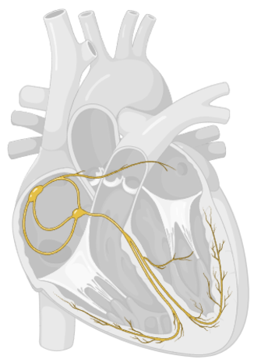
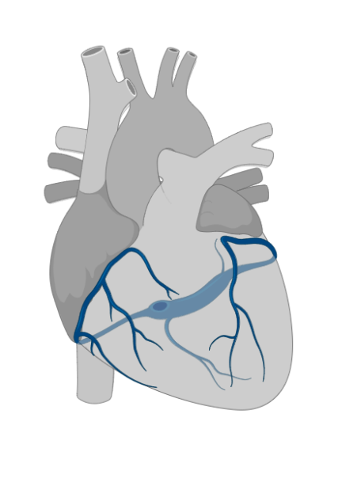
Methods – Device implantation
Conduction system pacing
1: His bundle pacing with threshold <2.5V at 1 ms for capture of HIS and LBB
2: Left bundle branch pacing with r’ in V1 and narrowing of QRS
3: Cross over to biventricular pacing

Slide 5
Methods – Device implantation
Biventricular pacing
1: Coronary sinus lead with
QLV last third of QRS
Threshold <4 V at 1 ms
Threshold for phrenic nerve capture > 2x threshold for myocardial capture
2: Cross over to conduction system pacing

Slide 6


Methods – Primary Endpoints
1. Non-inferiority of the relative change in left ventricular end-systolic volume (LVESV) from baseline to 6 months with a non-inferiority margin of 10%
2. Successrate of implanting CSP-CRT

Slide 7
Methods – Secondary and Safety Endpoints
Secondary endpoints
CRT response defined as ≥15 % reduction in LVESV
Changes in clinical parameters: QRS duration, LVEF, NT-proBNP
Changes in symptoms: NYHA functional class, Minnesota Living with Heart Failure Questionnaire
Changes in functional capacity: 6-min walk test
Safety endpoints
Periprocedural device-related complications (pneumothorax, hemothorax, pericardial bleeding or cardiac tamponade)
Later device-related complications (>30 days post implantation)

Slide 8
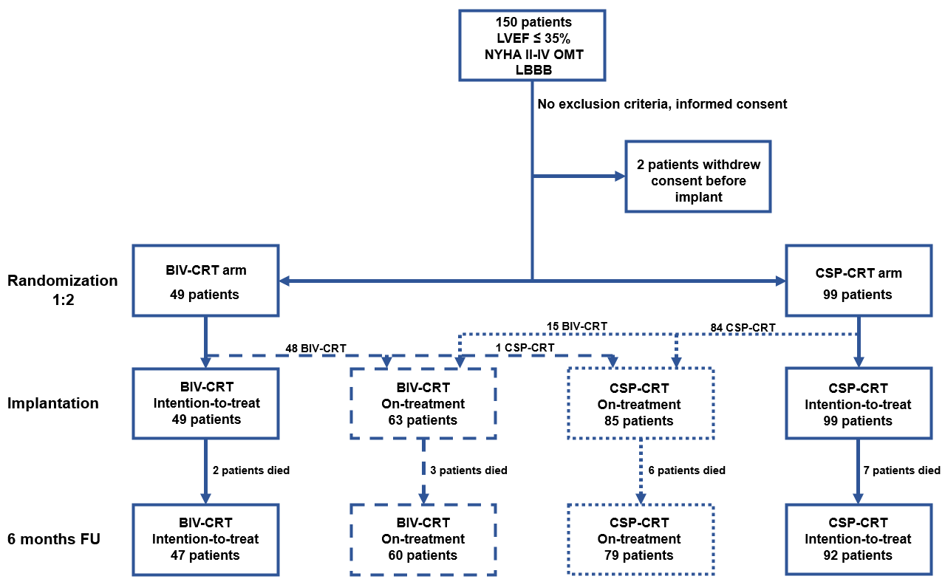
Results - flowchart

Slide 9
Results - Baseline characteristics
Randomisation group | BIV | HIS/LBB
Number of patients | 49 | 99
Male gender | 32 (65 %) | 64 (65 %)
Age (y) | 67.6 ± 12.5 | 68.8 ± 10.9
BMI | 28 ± 6 | 28 ± 6
Non-ischaemic CM | 43 (88 %) | 71 (72 %)
Upgrades | 4 (8 %) | 9 (9 %)
QRS (ms) | 166 ± 13 | 168 ± 17
LVEF Simpson | 27 ± 6 | 28 ± 7
LVESV (ml) | 149 ± 65 | 134 ± 62

Slide 10
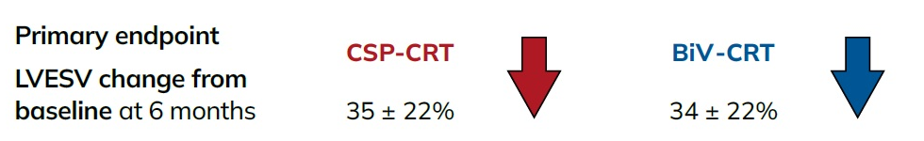
Results - Primary endpoint Intention-to-treat
Between group differences 0.9%
95% CI -6.9 % to 8.7%
P=0.003 for non-inferiority
p=0.8 for superiority

Slide 11
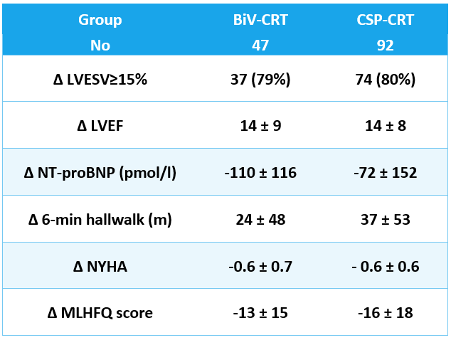
Results - Secondary endpoints Intention-to-treat
No significant differences
between BIV-CRT and CSP-CRT

Slide 12
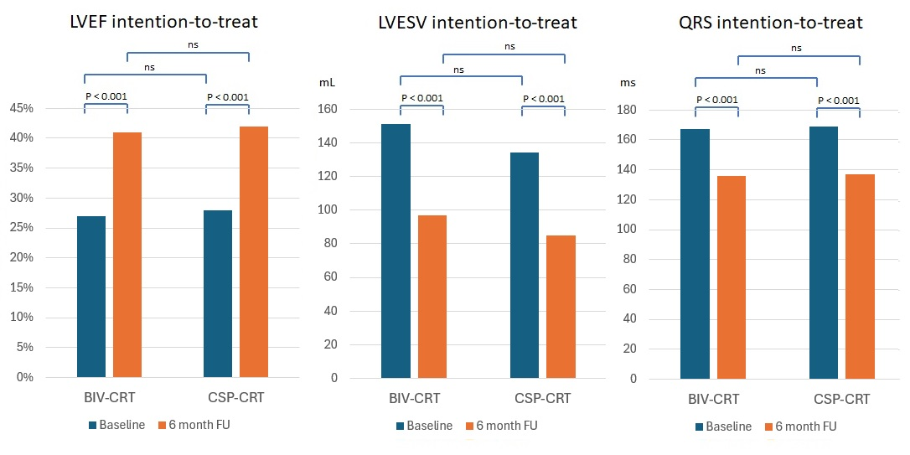
Results - Secondary endpoints Intention-to-treat

Slide 13
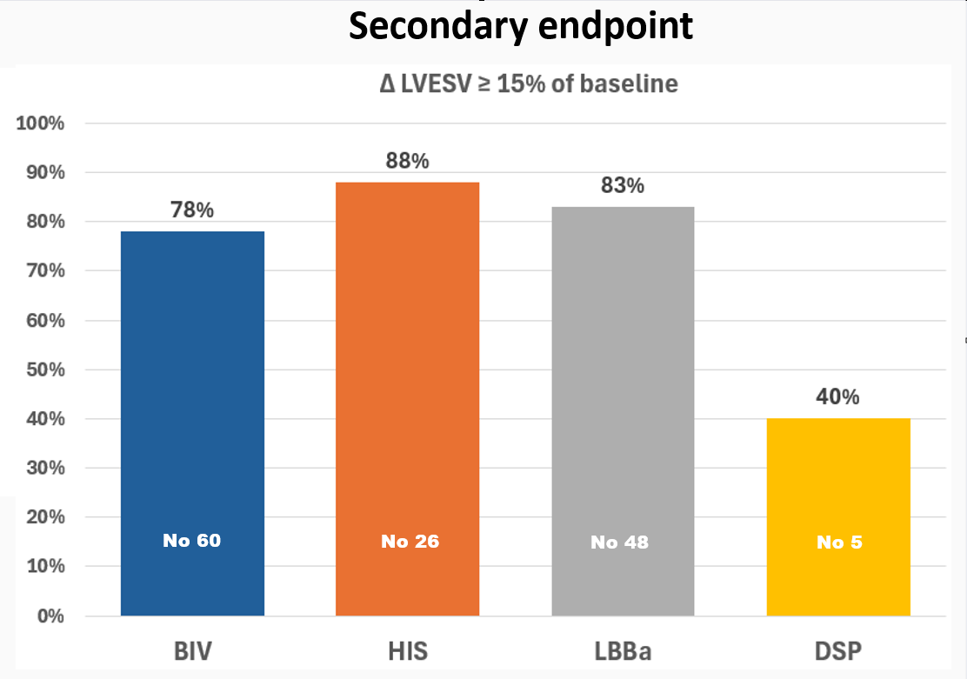
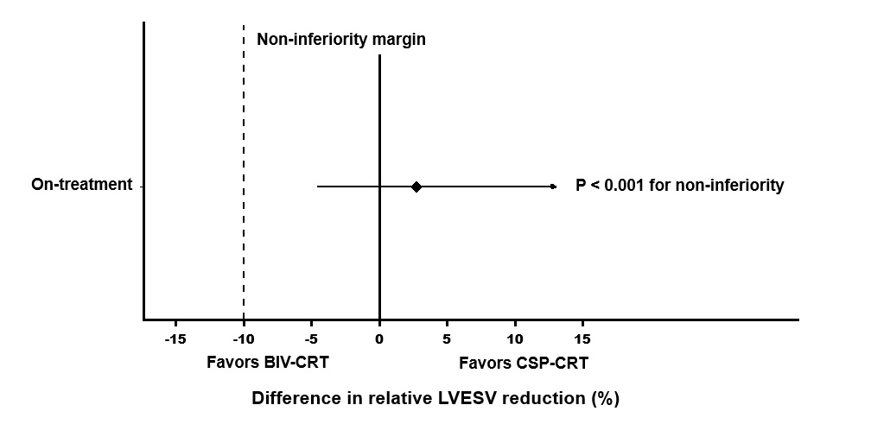
Results - On-treatment
Primary endpoint
Between group differences 2.7%
95% CI -4.6% to 10.0%
p<0.001 for non-inferiority
p=0.6 for superiority

Slide 14
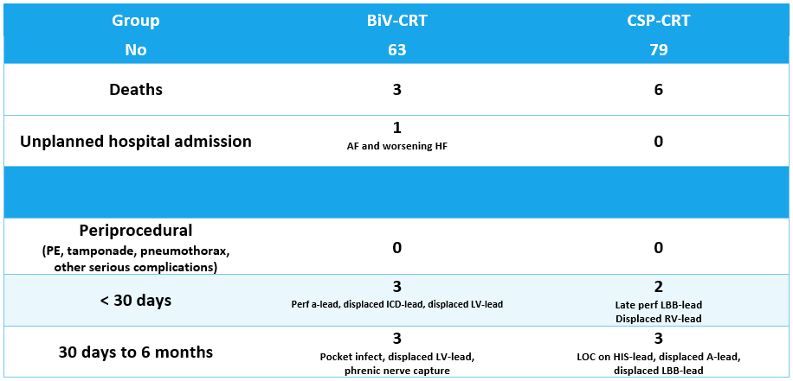
Results - Safety

Slide 15
Conclusion
In HFrEF patients who had SR and LBBB fulfilling Strauss criteria or had >90% RV-pacing, CSP-CRT delivered either as HIS-CRT or LBB-CRT proved non-inferior to BIV-CRT in the relative reduction of LVESV at 6-month follow-up
Both CSP-CRT and BIV-CRT provided extensive and comparable improvements in electrocardiographic, echocardiographic and clinical parameter
CSP-CRT and BIV-CRT had similar safety profiles
CSP-CRT shows promise as an alternative resynchronization strategy to BIV-CRT but we need larger randomized studies with longer follow-up to firmly establish the future role of CRT delivered with Conduction System Pacing

Slide 16











Emil
Niels
Berit
Hillah
Ulrik
Thank you
Jesper
Jesper
Mohamed
Nandita
Zach
Dan

Slide 17
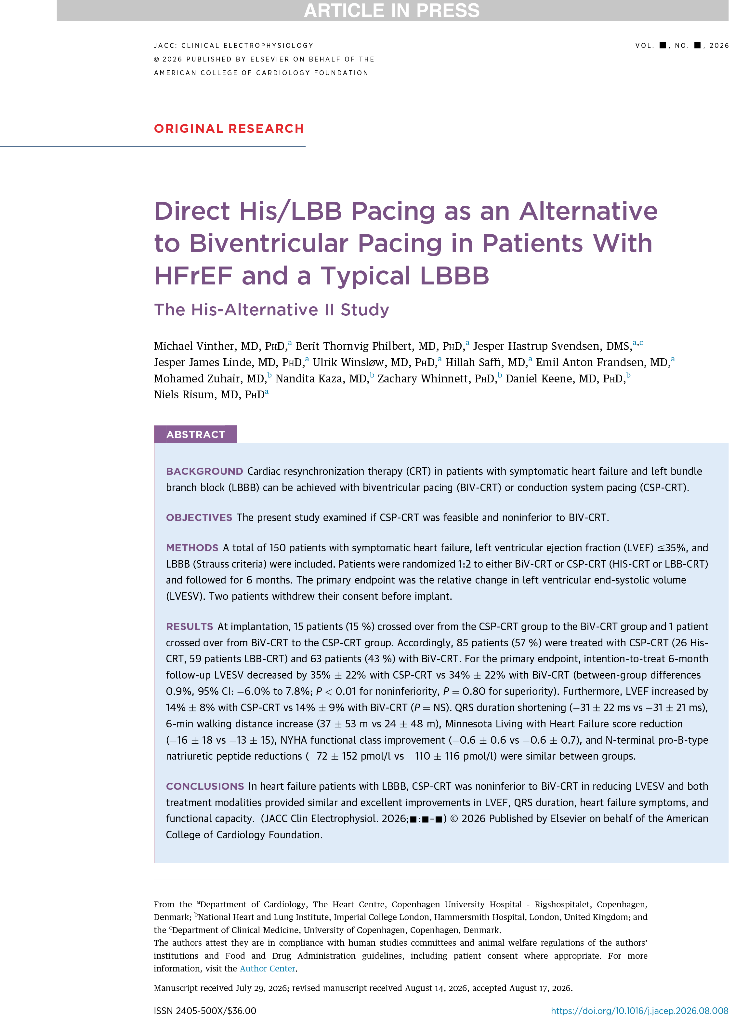

Simultaneously published in
JACC: Clinical Electrophysiology
10.1016/j.jacep.2026.08.008

