Slide 1
Clinical Benefit of Personalized Electrical Resynchronization in Cardiac Resynchronization Therapy using Automatic Dynamic AV Optimization:
The SyncAV Trial
Niraj Varma, MD, PhD¹, Lluis Mont, MD, PhD², Balbir Singh, MD³, Brian Wisnoskey, PhD⁴, Bernard Thibault, MD⁵, Kartikeya Bhargava, MD⁶, Grant Kim, MS⁴ Pedro Marques, MD⁷, Joaquin Fernandez de la Concha, MD⁸, Erich Kiehl, MD⁹, Andrea Grammatico, PhD⁴, Kwangdeok Lee, PhD⁴, Wojciech Zareba, MD, PhD¹⁰ on behalf of the SyncAV Investigators ​
​
¹Cleveland Clinic, Cleveland, OH, USA, ²University of Barcelona, Barcelona, Spain, ³Max Super Specialty Hospital, New Delhi, India, ⁴Abbott, Sylmar, CA, USA, ⁵Institut de Cardiologie de Montreal, Montreal, Quebec, Canada, ⁶Medanta Hospitals, Haryana, India, ⁷Hospital de Santa Maria, Lisboa, Portugal, ⁸Hospital Universitario de Badajoz, Badajoz, Spain, ⁹Sentara Norfolk General Hospital, Norfolk, VA, USA, ¹⁰University of Rochester Medical Center, Rochester, NY, USA​

Slide 2
Presenter (NV) Disclosures
Abbott, Impulse Dynamics, EBR, Anumana, Octagos, Murj
      Research grants/ Honoraria/Speaking/Consulting
      Membership on Advisory Committees and/or Review Panels
  The SyncAV trial was funded by Abbott

Slide 3
Cardiac Resynchronization Therapy (CRT)
Improves outcomes in patients with LBBB and LVEF ≤ 35%
30% individuals may not benefit (“non-responders”) - multifactorial (Varma ADVANCE CRT JACC 2019)
Among electrical factors:
    Baseline QRS morphology (nLBBB), duration (QRSd < 150 ms)
    ? Longer PR interval (Friedman Circ 2016; Rattanawong 2018)
    ? Paced QRS duration (shortening), morphology (intrinsicoid in V1, V2 )
    → Fixed settings are programmed irrespective of electrical result
What is lacking is:
Electrocardiographic metric(s) for Resynchronization / Incomplete electrical resynchronization (IeR)
CRT guided by paced effects
Automatic algorithm permitting individualized programming of electrical paced effect

Slide 4
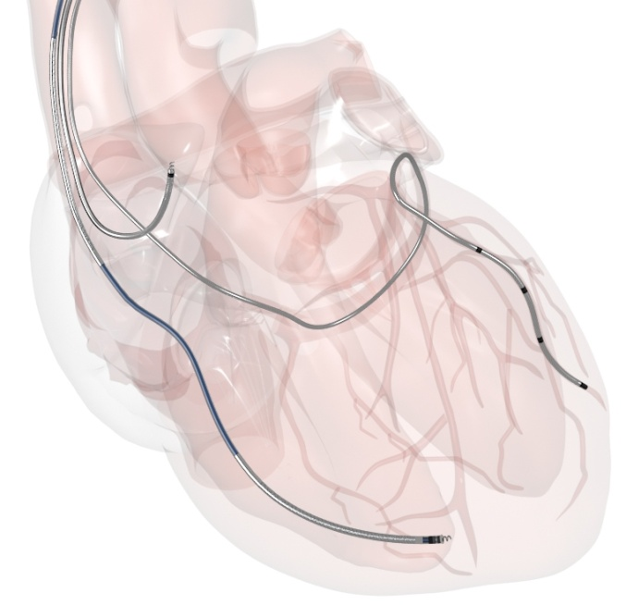
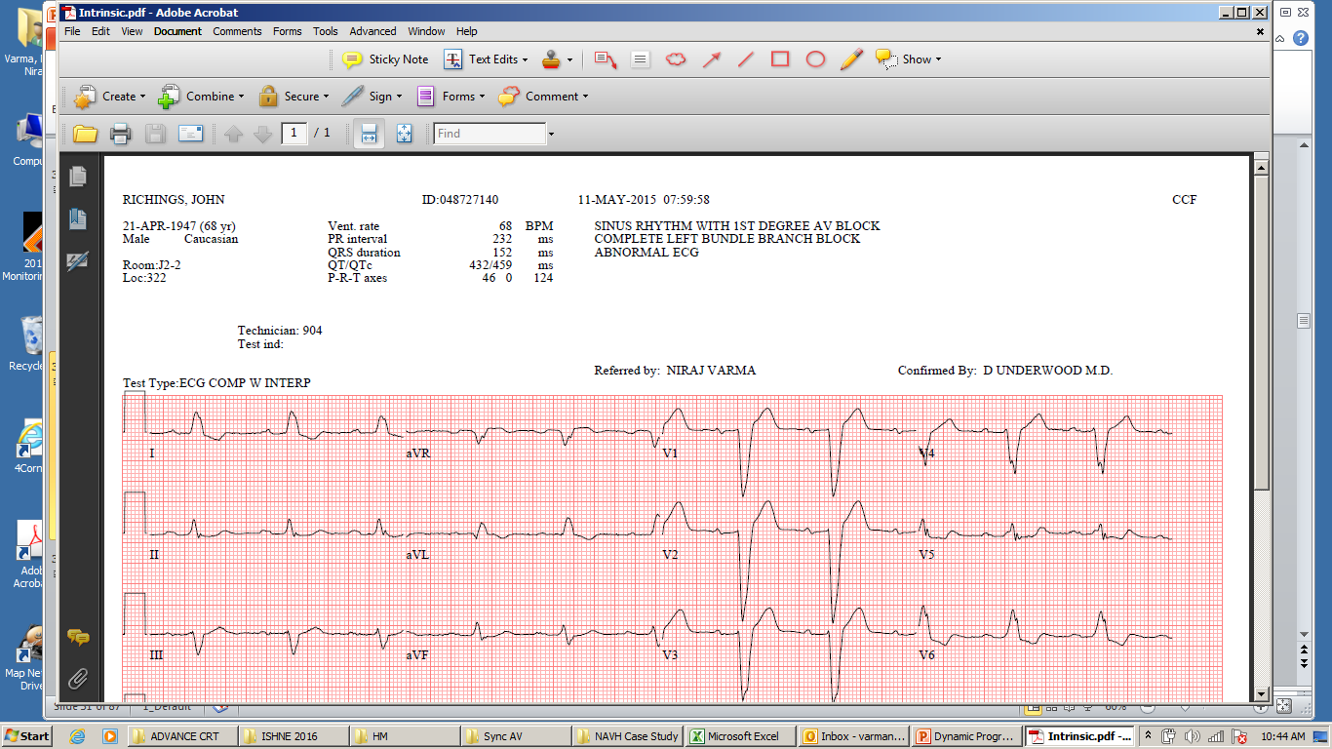
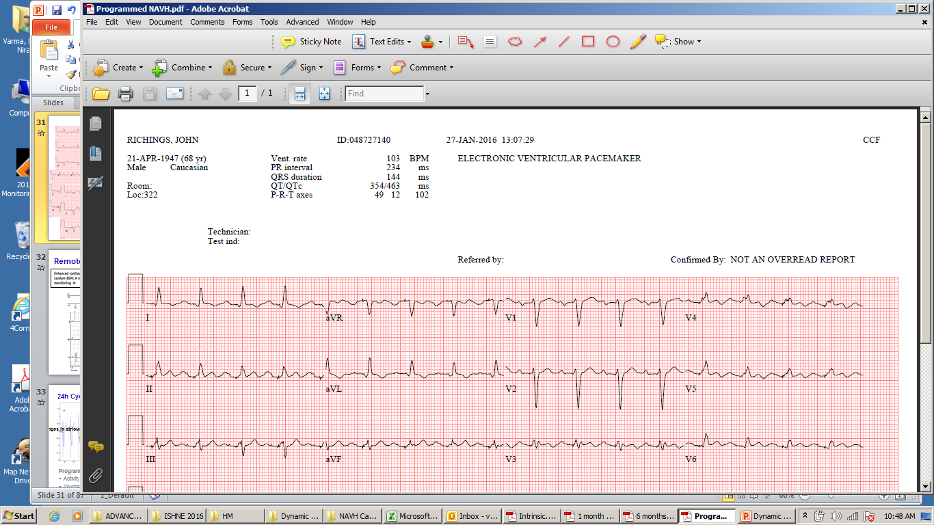
Biventricular Fusion Pacing
“Fused” AV
LBBB
Fixed AV (110 ms)
Dynamic AV
CRT
“Fused” AV
*
Fixed AV (110 ms)
Loses triple fusion when PR ≥183 ms
Varma, Wisnoskey JAHA 2019; Wisnoskey, Varma. Europace. 2024

Slide 5
Biventricular Fusion Pacing
IeR
rS in V1/V2
Paced QRSd
Triple Fusion
CRT
pAV/PR < 60% ≥ 60%
*
Paced AV/PR (pAV/PR)
- Determines contribution of intrinsic RBB activation and thereby global QRSd abbreviation
- pAV/PR ≥ 60% → Ventricular fusion pacing (“triple fusion”)
- Needs patient individualization, and accommodation of naturally varying AV intervals
Intrinsic PR Interval is paramount to QRS optimization
Varma, Wisnoskey JAHA 2019; Wisnoskey, Varma. Europace. 2024

Slide 6
SyncAV Trial
Hypothesis Maximized QRSd reduction (maintaining pAV/PR ≥ 60%) improves CRT outcomes in patients with LBBB and HF despite GDMT
Tested with SyncAV, an automatic closed-loop, device-based algorithm designed to deliver consistent ventricular fusion pacing with a dynamic programmable AV delay (pAV/PR)
Methods Investigator-initiated global, prospective, single-blind, parallel, multicenter trial randomizing pts with LBBB (ESC criteria), LVEF ≤ 35%, QRSd ≥ 120 ms, PR ≤ 280 ms, w/o AF to SyncAV vs FIXED AV (standard of care)
Primary Endpoint | ΔLVESV (mL) from baseline to 12 months, as a continous variable (powered)
Secondary Endpoint | Proportion of patients with LVESV ↓ ≥ 15% at 12 months vs baseline (powered)
Other secondary/ descriptive endpoints | ΔQRSd post-CRT Incidence of incomplete electrical resynchronization (IeR = pAV/PR < 60%) and Outcomes: All-cause mortality, HF hospitalizations, AF burden (> 10 days), LVESV ↑ >15%

Slide 7
Results
Baseline demographics | SyncAV | Fixed AV Delay
Age (Years) | 66 ± 11 (646) | 65 ± 11 (642)
Female | 36.5% (236/646) | 36.4% (234/642)
NYHA Class I / II/ III/ IV | 3.7/ 52.8/ 41.0/ 2.3% | 2.5/ 58.6/ 36.6/ 2.3%
Non-Ischemic Cardiomyopathy: | 66.7% (431/646) | 67.4% (433/642)
QRS Duration* | 164 ± 24 (581) | 165 ± 24 (561)
PR Interval (ms)* | 182 ± 28 (579) | 183 ± 29 (553)
True LBBB Morphology* | 91.0% (533/586) | 90.8% (516/568)
LVESV (ml)** | 142 ± 63 (636) | 142 ± 70 (636)
LVEF (%)** | 31 ± 10 (512) | 31 ± 10 (518)
Hypertension | 63.2% (408/646) | 62.1% (399/642)
Renal Disease | 13.0% (84/646) | 13.1% (84/642)
COPD | 7.1% (46/646) | 5.5% (35/642)
ACE Inhibitors/ARBs | 33.7% (218/646) | 31.8% (204/642)
Entresto | 53.4% (345/646) | 58.6% (376/642)
SGLT2 Inhibitors | 0.9% (6/646) | 1.2% (8/642)
Beta Blockers | 86.2% (557/646) | 87.4% (561/642)
Diuretics | 77.7% (502/646) | 79.6% (511/642)
1686 enrolled
167 had non-analyzable baseline echo
62 unsuccessful implant
52 withdrawn by physician/site
30 were not implanted
23 withdrew consent
16 did not meet eligibility criteria
24 lost to follow-up or non-compliant
7 died
17 other reasons
1288 randomized
SyncAV
(Operator optimized)
N= 646
Fixed AV delay
(110 ms)
N= 642
60 exited study early
16 Died
51 exited study early
14 Died
570
12-month visit
577
Clinical Endpoint Analysis
59 missing/non-analyzable LVESV data
72 with non-matched contrast use
76 missing/non-analyzable LVESV data
75 with non-matched contrast use
439
1º and 2º
Endpoint Analyses
426
Core Laboratories:
*ECG Maastricht University, Netherlands
**ECHO MedStar Health Research Institute, USA

Slide 8
Results
Intrinsic
Fixed AV
SyncAV
 | SyncAV | Fixed AV Delay | P-value
Paced QRS Duration | 123 ± 19 ms | 138 ± 24 ms | <0.0001
pAV/PR | 74% ± 14% | 61% ± 9% | <0.0001

Slide 9
Primary Endpoint
Overall LVESV ↓ at 12 months
Fixed AV
Sync AV
p=0.054
Wilcoxon Rank-Sum
P = 0.054
Negative response
Increased structural remodeling

Slide 10
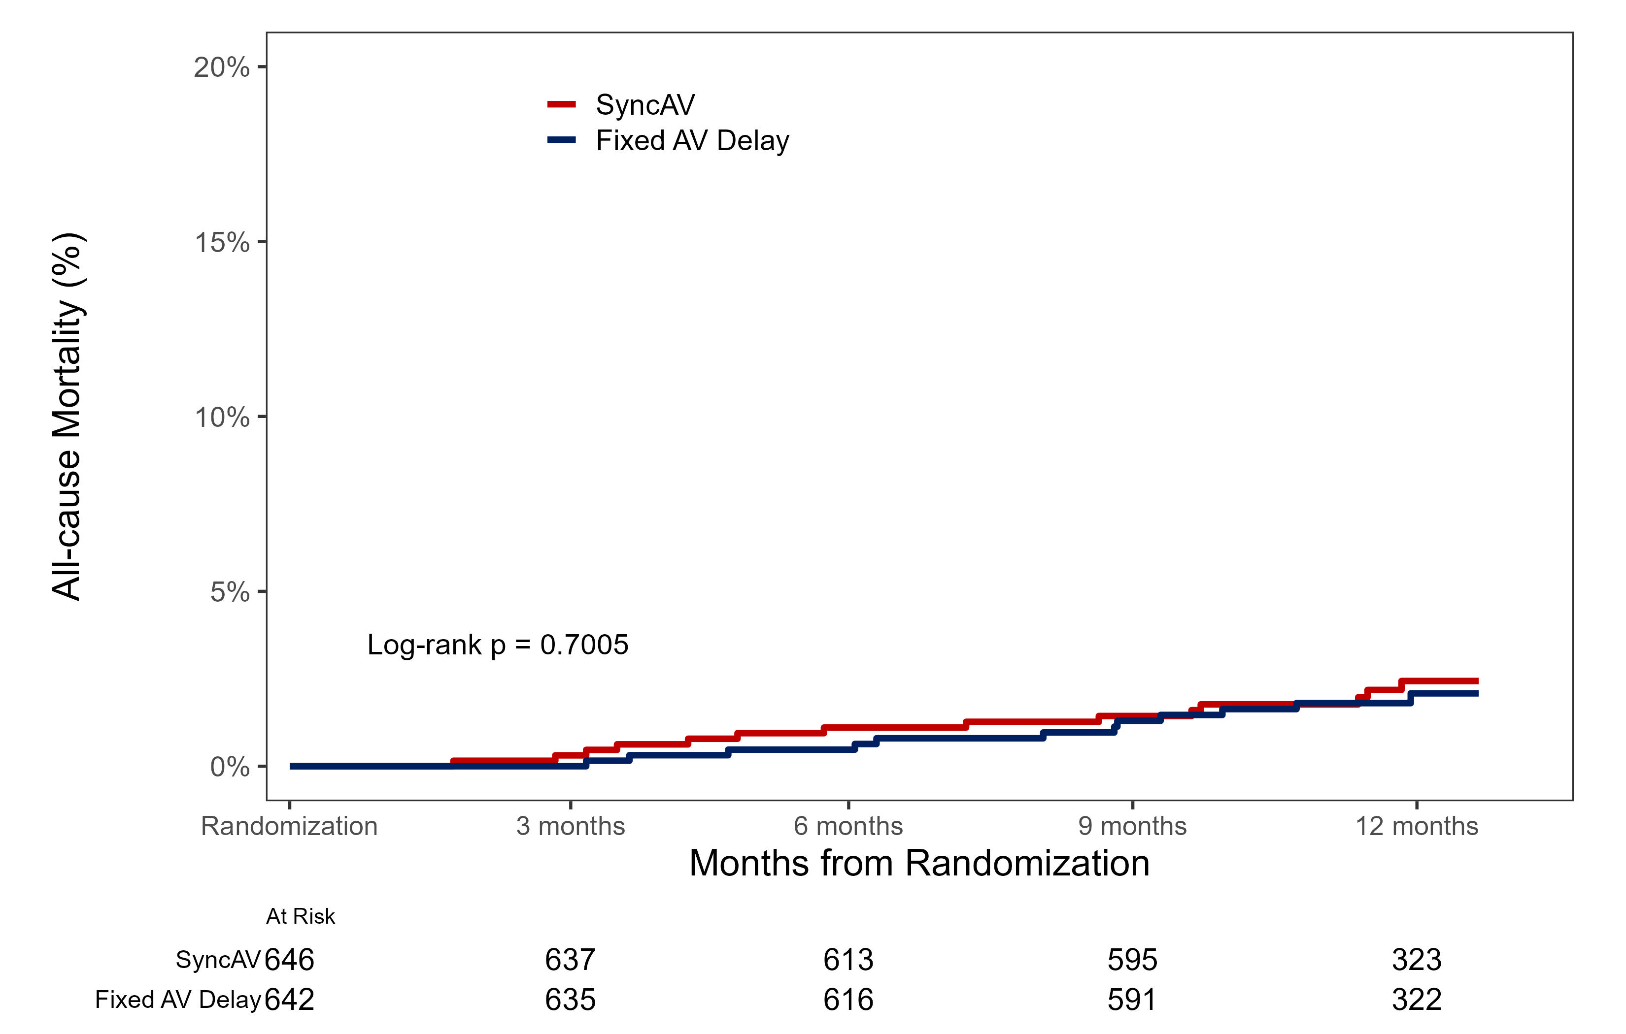
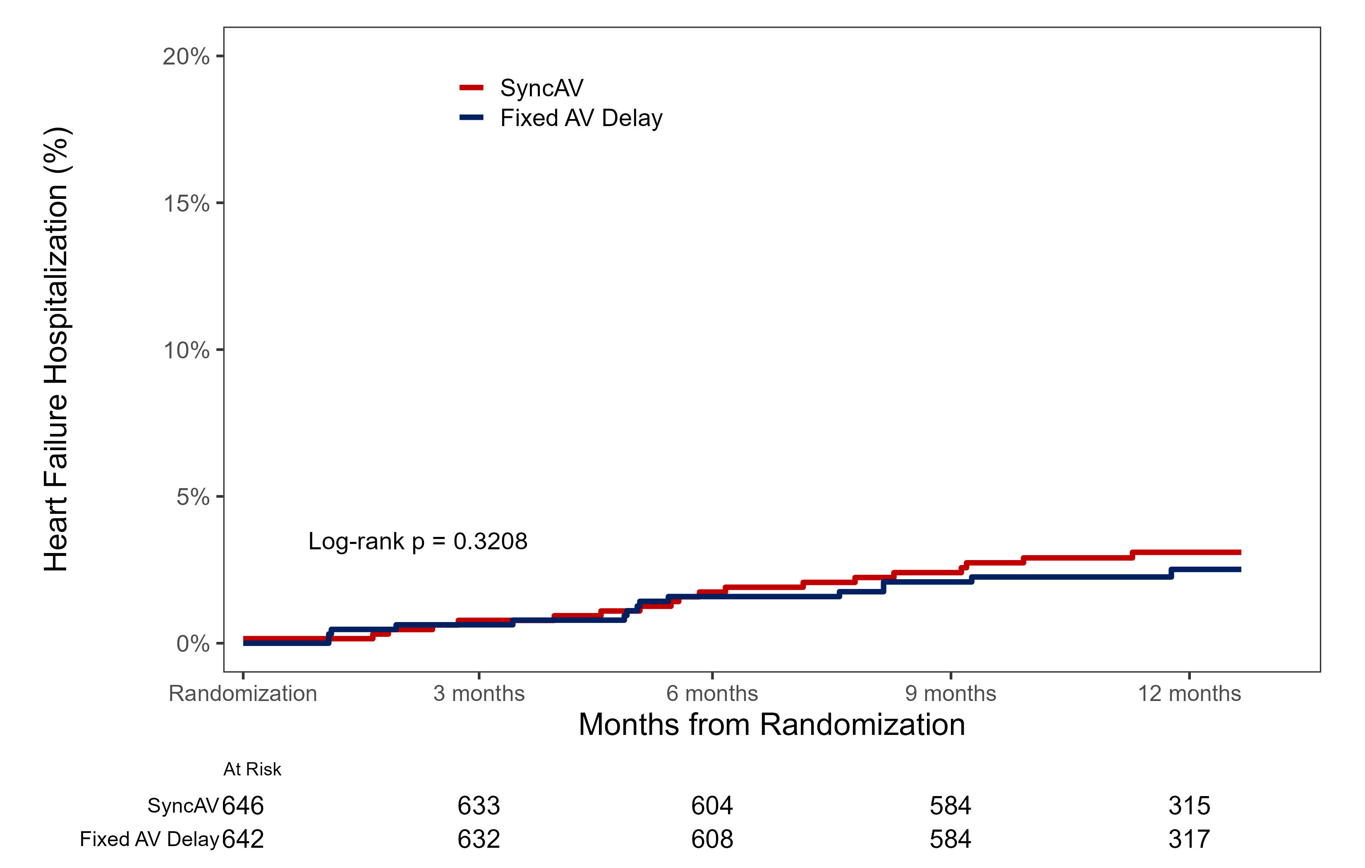
Secondary Endpoint
Clinical Endpoints
Proportion of CRT Responders (LVESV ↓ ≥ 15%)
SyncAV
All-Cause Mortality (%)
Fixed AV
P = 0.1616
2.4%
2.1%
HF Hospitalization (%)
SyncAV
Fixed AV
3.1%
2.7%
CRT Response Rate: CCS Improved/Non-progressor
SyncAV 90.4% vs 92.6% Fixed AV (p = 0.21)
AF (> 10 days) occurred less frequently in SyncAV
(2.0% vs Fixed AV 4.4%, p=0.027)

Slide 11
Incomplete Electrical Resynchronization (IeR)
183 ms
Question:
Are outcomes improved at
longer PR intervals by programmed electrical resynchronization?
Fixed AV (110 ms)
pAV/PR 60% 40%
IeR

Slide 12

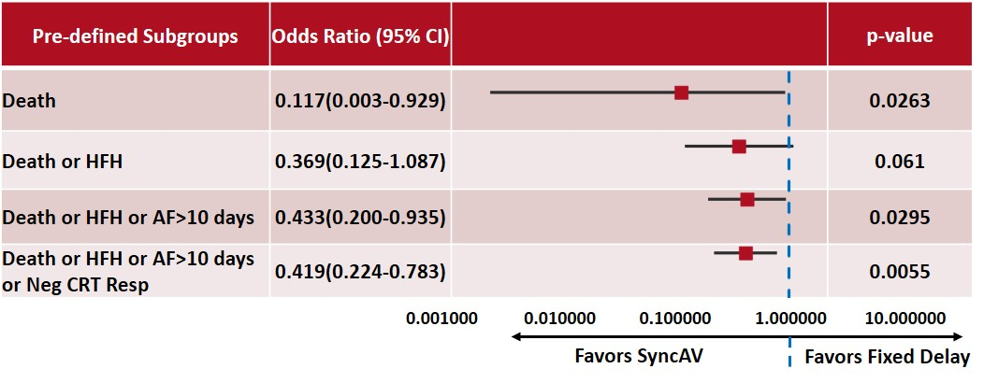
Composite Endpoint – Patients Dichotomized by PR 185 ms
  PR interval < 185 ms
 | SyncAV | Fixed AV Delay | P-value
Paced QRS Duration | 123 ± 19 ms | 133 ± 24 ms | <0.001
pAV/PR | 71% ± 16% | 67% ± 6% | <0.0001
Clinical Events* | 10.4% | 7.4% | 0.25
  PR interval ≥ 185 ms
PR ≥ 185 ms
 | SyncAV | Fixed AV Delay | P-value
Paced QRS Duration | 124 ± 20 ms | 146 ± 22 ms | <0.0001
pAV/PR | 78% ± 11% | 52% ± 5% | <0.0001
Clinical Events* | 10.3% | 21.5% | 0.0055
Favors SyncAV
Favors Fixed
*Clinical Events: Death, HFH, AF burden > 10 days, LVESV↑ > 15%

Slide 13
Limitations
Primary and Secondary endpoints
  Large proportion of patients with non-analyzable echoes
Clinical endpoints
  Low clinical event rates across the study population
  Analysis by PR interval is exploratory

Slide 14
Conclusion
1st large scale CRT trial to measure paced effects and guide CRT optimization by electrical principles
Overall CRT results are unprecedented compared to prior CRT trials
SyncAV resulted in best electrical resynchronization, but FIXED programming (standard of care) overlapped significantly, accounting for similar overall outcomes
SyncAV is an electrical programming solution for patients with longer PR intervals (50% of our cohort), regarded as less responsive to CRT

