Slide 1
ECLIPSE-CKD - Salt Substitute in Chronic Kidney Disease
Dong Shui on behalf of the trial team
Munich, Germany
August 30, 2026

Slide 2
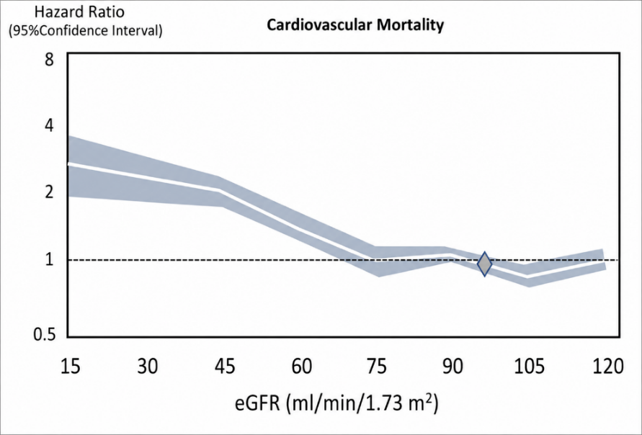
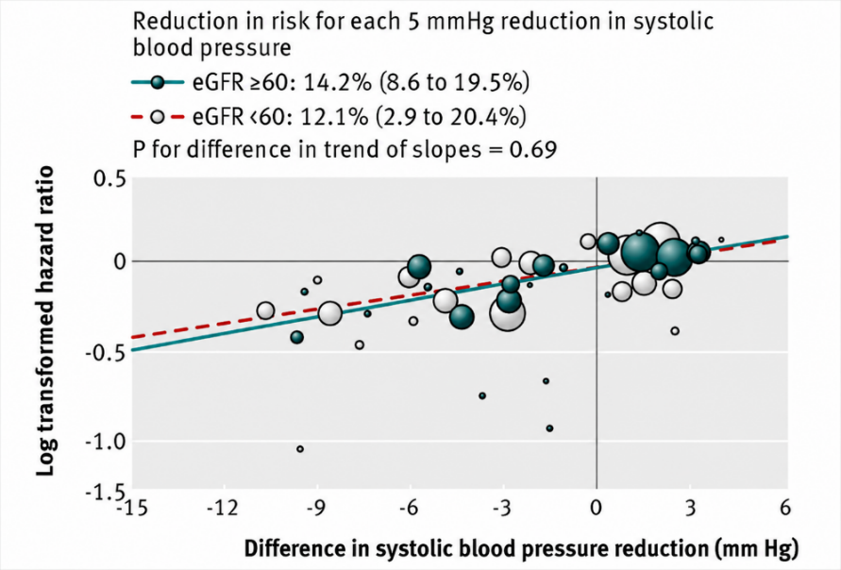
Background
CKD markedly increases cardiovascular risk.
Elevated BP is a key modifiable risk factor of cardiovascular events in CKD.
Meta analyses of RCTs have shown that BP lowering reduces cardiovascular events in this population.
But the BP control in this population remains suboptimal.
Katharina et al. 2025; Ku et al., 2019; Zeng et al., 2026

Slide 3
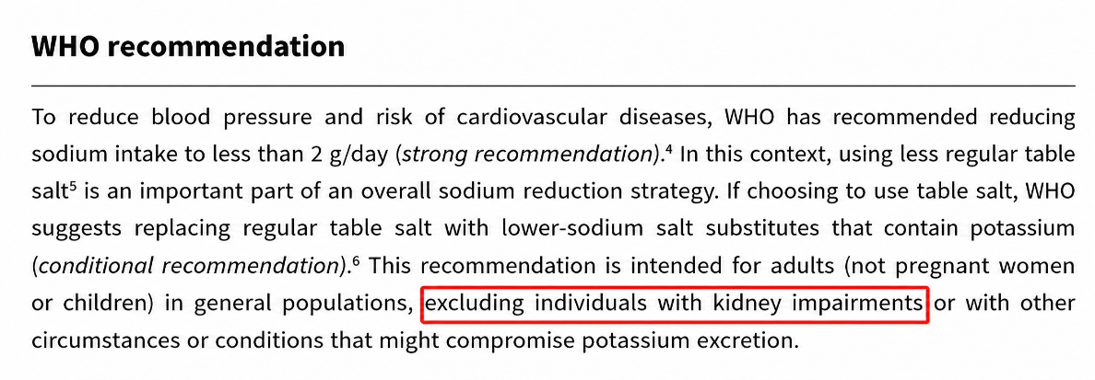
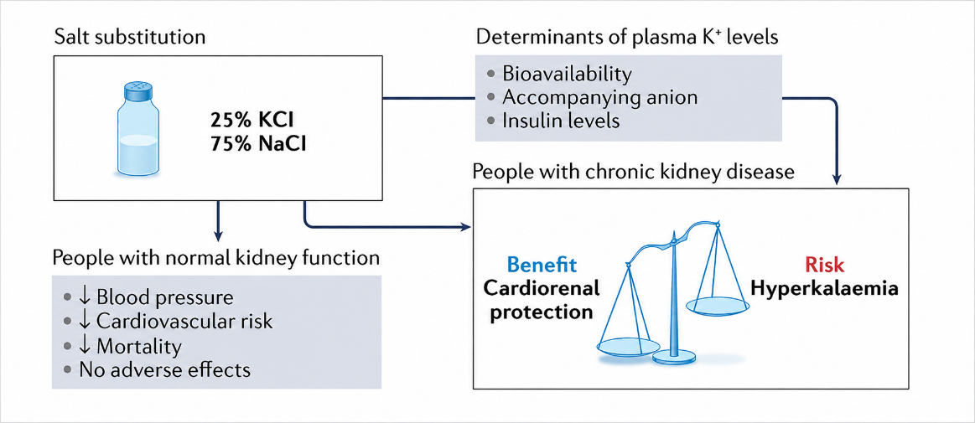
Background
Salt substitutes lower BP in diverse populations.
Patients with CKD remain excluded from recommendations owing to limited efficacy and safety evidence.
They may benefit but may face increased hyperkalemia risk, with the benefit-risk profile varying by CKD stage.
Modelling studies suggested substantial benefits in CKD.
BUT direct evidence from RCTs remain scare.
Yin et al., 2022; WHO guideline on lower-sodium salt substitutes, 2025; Trieu et al., 2025

Slide 4
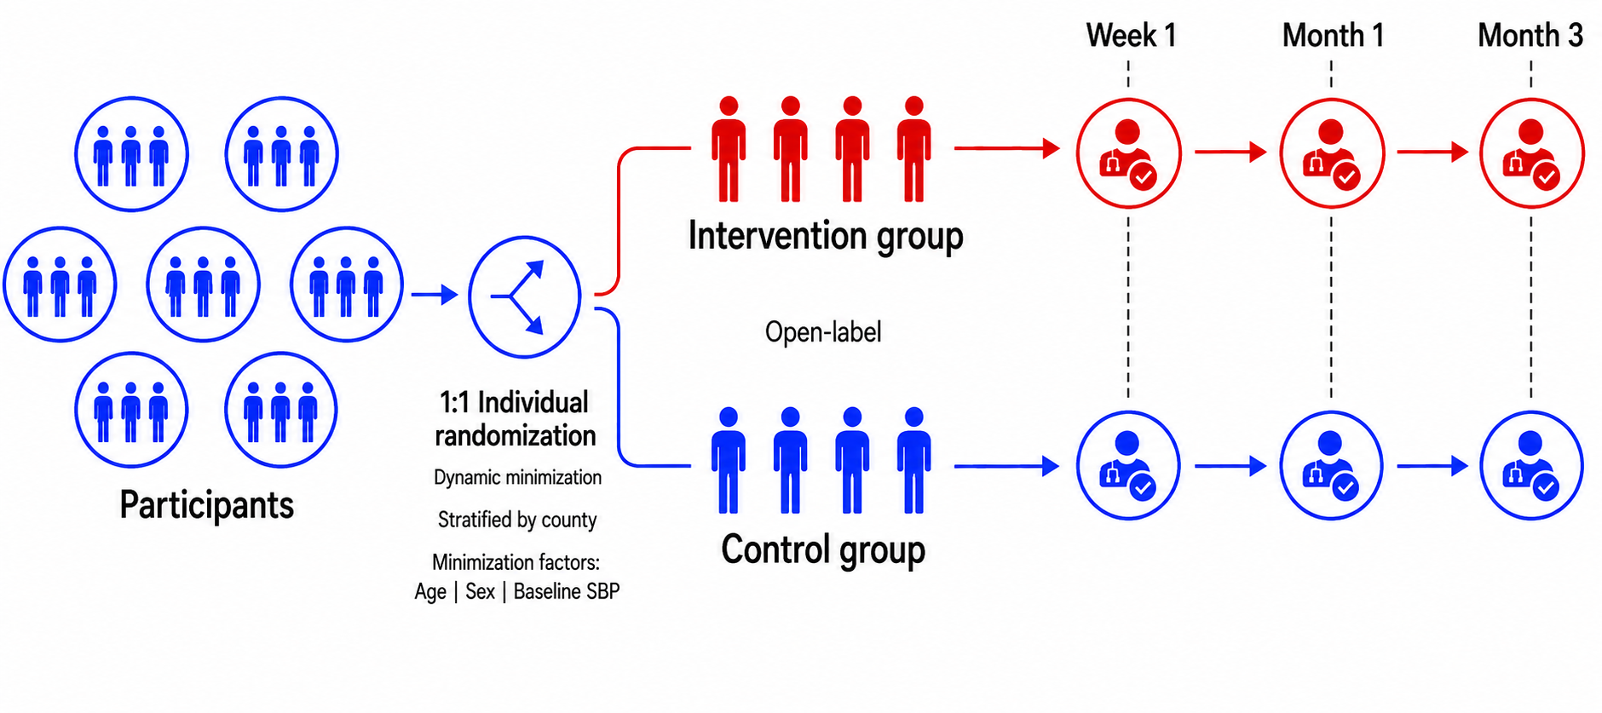
Objective and study design
Objective: ECLIPSE-CKD trial aims to assess the efficacy and safety of salt substitute versus regular salt in adults with hypertension and stage G2 or G3a CKD.

Slide 5
Inclusion and exclusion criteria
Inclusion criteria
  Adults aged ≥18 years
  Hypertension
  eGFR 45–89 mL/min/1.73 m²
  Serum potassium ≤5.5 mmol/L
Exclusion criteria
  Serious kidney disease
  Hyperkalemia or history of hyperkalemia
  Contraindications to salt substitute
  Current use of salt substitute

Slide 6
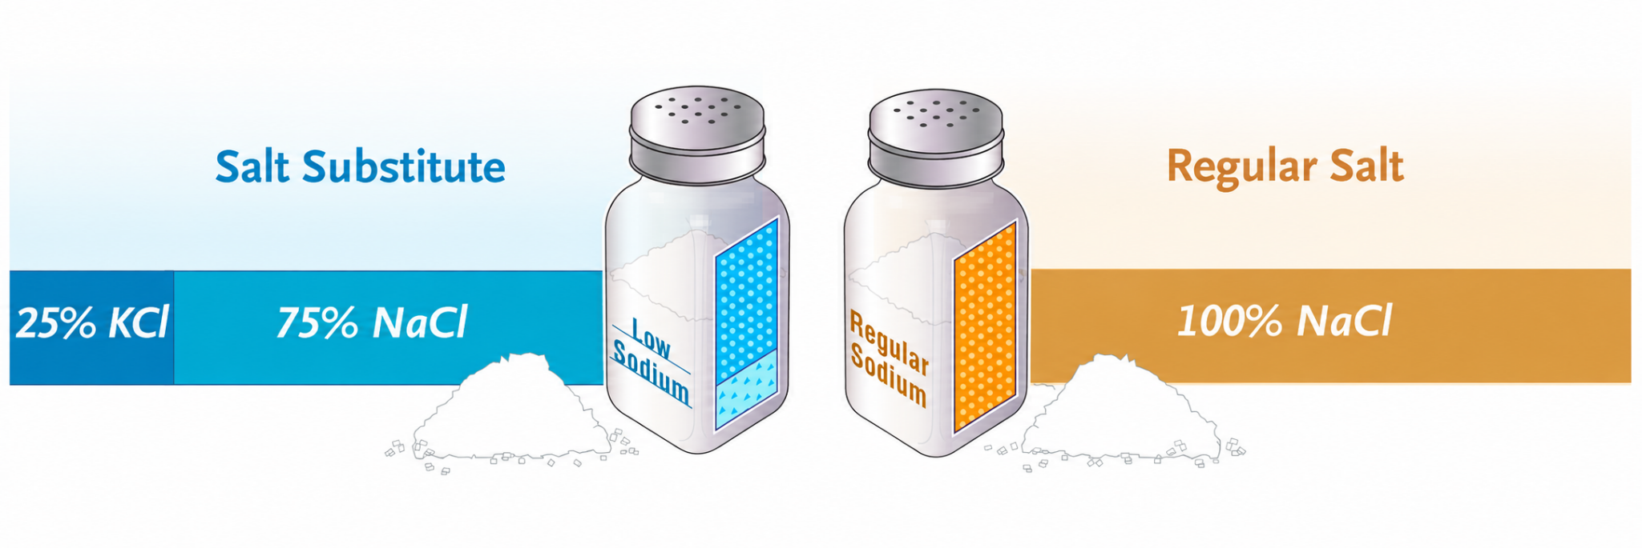
Intervention and control
Intervention group: | Control group:
Replace all regular salt with salt substitute for cooking, seasoning and food preservation | Continue to use regular salt

Slide 7
Outcomes
Primary outcome - Change in SBP from baseline to month 3
Secondary outcomes - Changes in DBP and serum potassium
Process outcomes - Changes in 24-h urinary sodium and potassium excretion
Exploratory outcome - Change in eGFR
Safety outcomes -
  Hyperkalemia
  Hypokalemia
  Hospitalization from any cause
  Death from any cause

Slide 8
Sample size
A sample size of 634, based on the below assumptions:
Power = 80%
Size effect = 5 mm Hg
Standard deviation = 20 mm Hg
Alpha = 0.05
Drop out = 20%
Yin et al., 2022; Neal et al. 2017

Slide 9
Statistical analysis
Analyses followed the intention-to-treat principle.
Primary outcome - Linear mixed model
  Fixed effects for treatment group, visit, and their interaction
  Random intercept for county and participant
Secondary outcomes and other outcomes
  Analyzed using the same modelling approach
Safety outcomes
  Summarized as numbers by treatment group
Pre-specified subgroup analyses
  Treatment effects assessed using interaction terms
All tests were two-sided, with P<0.05 indicating statistical significance.

Slide 10
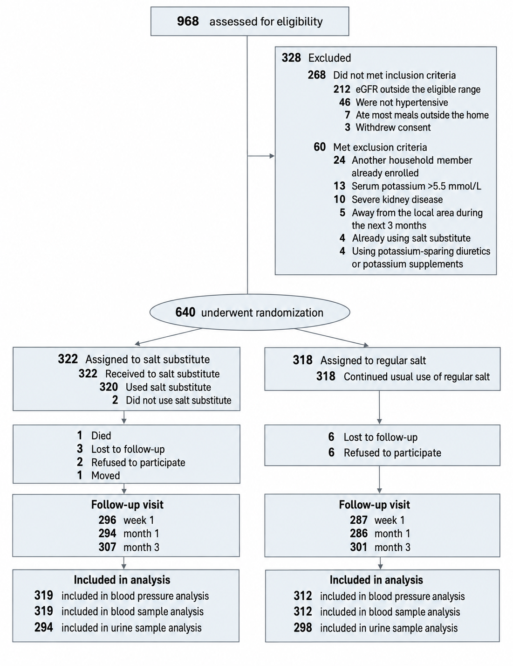
Participants
968 participants were assessed eligibility, and 640 underwent randomization;
322 participants were assigned to the salt substitute group and 318 to the regular salt group;
Follow-up rates were high, with 307 and 301 participants completing the month 3 visit, respectively;
Overall, 631 participants (98.6%) were in included the primary analysis: 319 in the salt substitute group and 312 in the regular salt group.

Slide 11
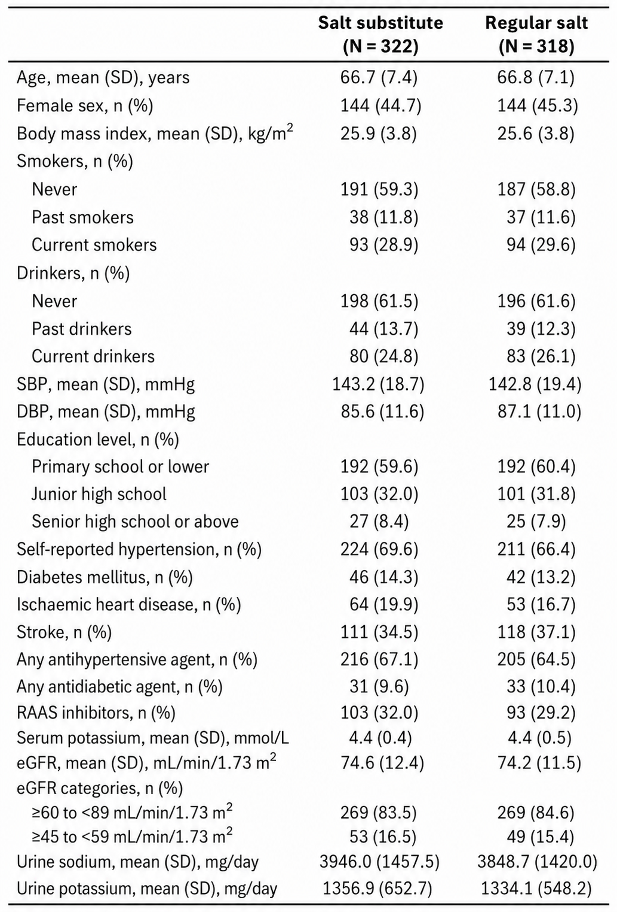
Baseline characteristics
Mean age was 66.7 years; 45.0% were women; mean BMI was 25.8 kg/m²;
Mean BP was 143.0/86.3 mm Hg; 65.8% received antihypertensive treatment;
Mean serum potassium was 4.4 mmol/L and eGFR 74.4 mL/min/1.73m²; 84.1% had G2 and 15.9% G3a CKD;
Baseline characteristics were well balanced between groups.

Slide 12
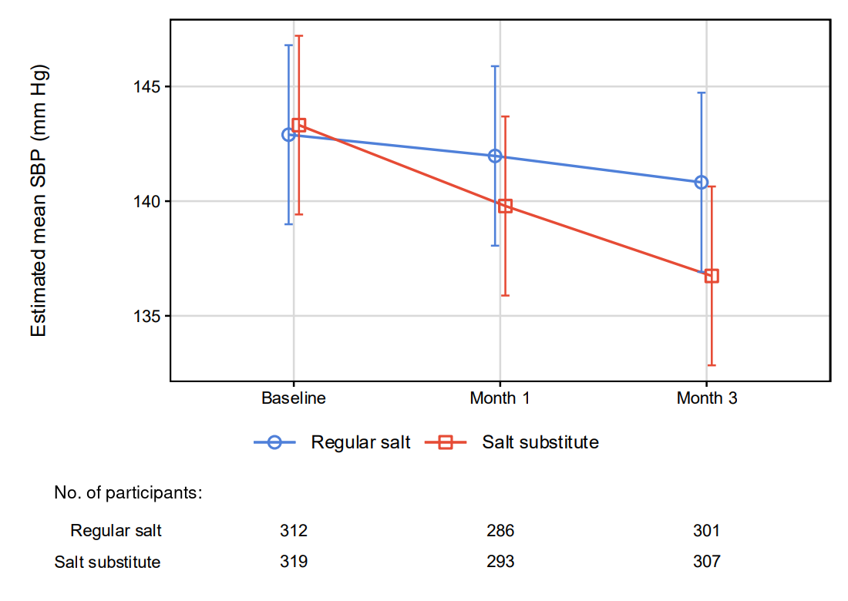
Primary outcome
Salt substitute group: -6.6 mm Hg;
Regular salt group: -2.0 mm Hg;
Between-group difference in change:
-4.3 mm Hg (95% CI: -6.4 to -2.2; P<0.001).

Slide 13
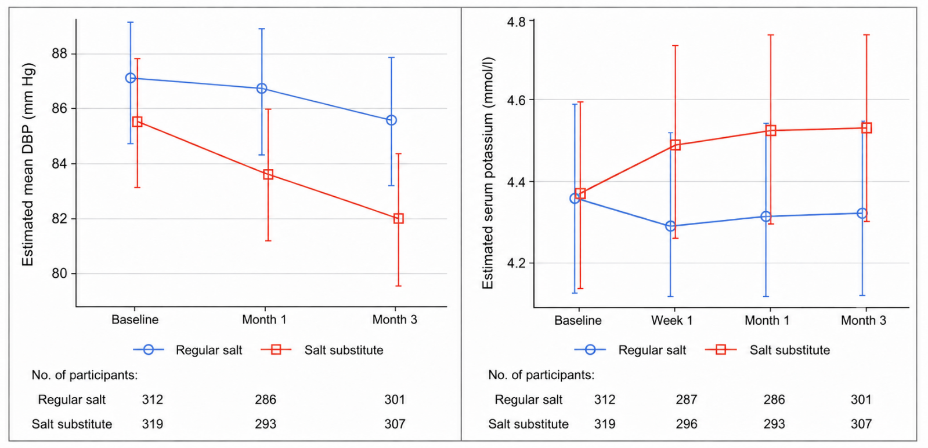
Secondary outcomes
DBP
Salt substitute group: -3.5 mm Hg;
Regular salt group: -1.5 mm Hg;
Between-group difference in change:
-1.9 mm Hg (95% CI: -3.1 to -0.8; P=0.001).
Serum potassium
Salt substitute group: 0.2 mmol/L;
Regular salt group: 0.0 mmol/L;
Between-group difference in change:
0.2 mmol/L (95% CI: 0.2 to 0.3; P<0.001).

Slide 14
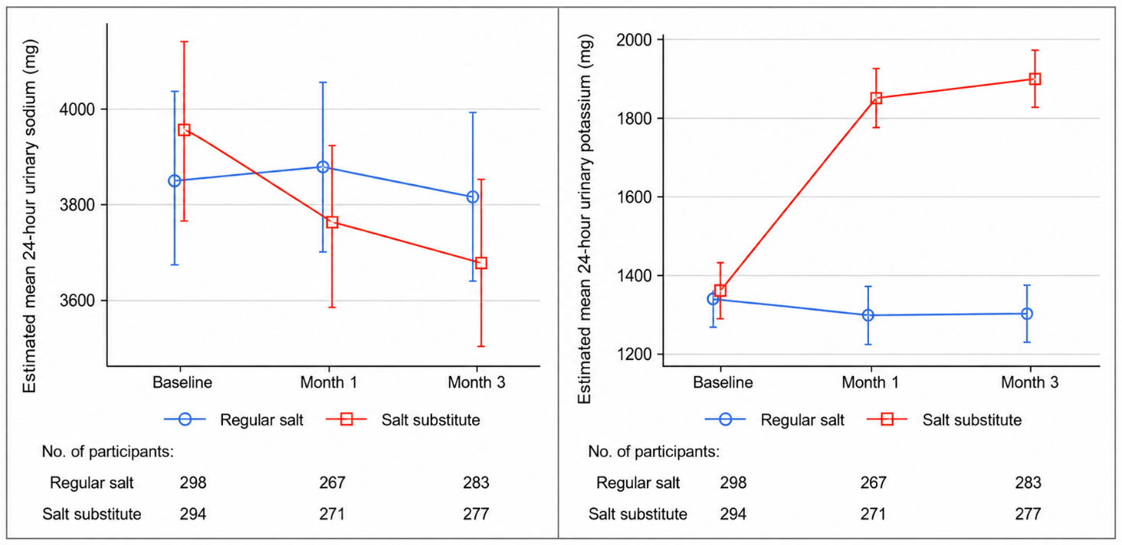
Process outcomes
24-h urinary sodium excretion
Salt substitute group: -289.3 mg/d;
Regular salt group: -34.6 mg/d;
Between-group difference in change:
-258.5 mg/d (95% CI: -454.9 to -62.0; P=0.010).
24-h urinary potassium excretion
Salt substitute group: 544.8 mg/d ;
Regular salt group: -41.1 mg/d;
Between-group difference in change:
573.4 mg/d (95% CI: 473.4 to 673.3; P<0.001).

Slide 15
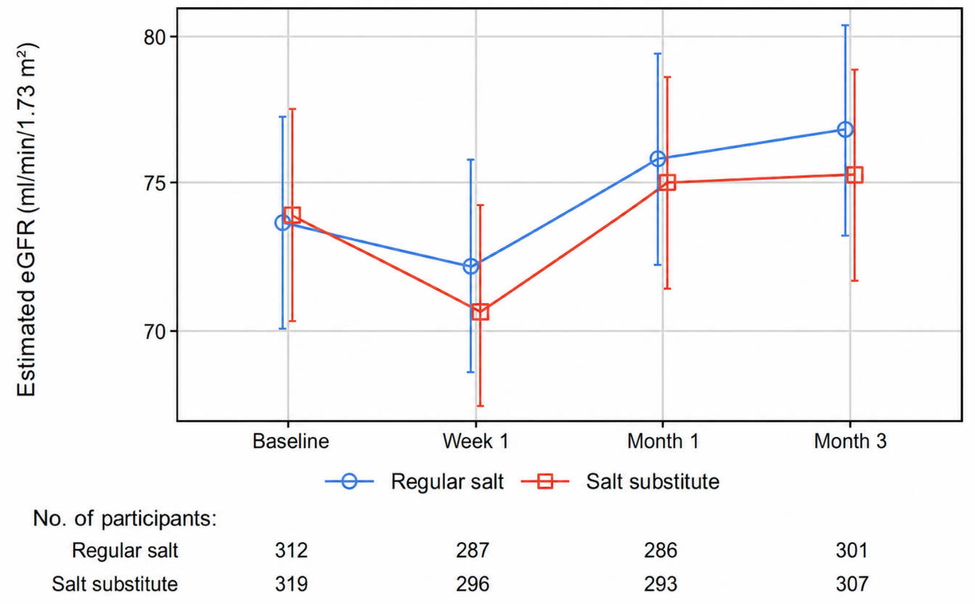
Exploratory outcome
Salt substitute group: 1.4 mL/min/1.73m²;
Regular salt group: 3.2 mL/min/1.73m²;
Between-group difference in change:
-1.8 mL/min/1.73m² (95% CI: -2.5 to -1.2; P<0.001).

Slide 16
Safety outcomes
Hyperkalemia: No events in either group;
Hypokalemia: 9 events with salt substitute versus 23 with regular salt;
Hospitalization: 16 events with salt substitute versus 21 with regular salt;
Death: 1 event with salt substitute versus none with regular salt.

Slide 17
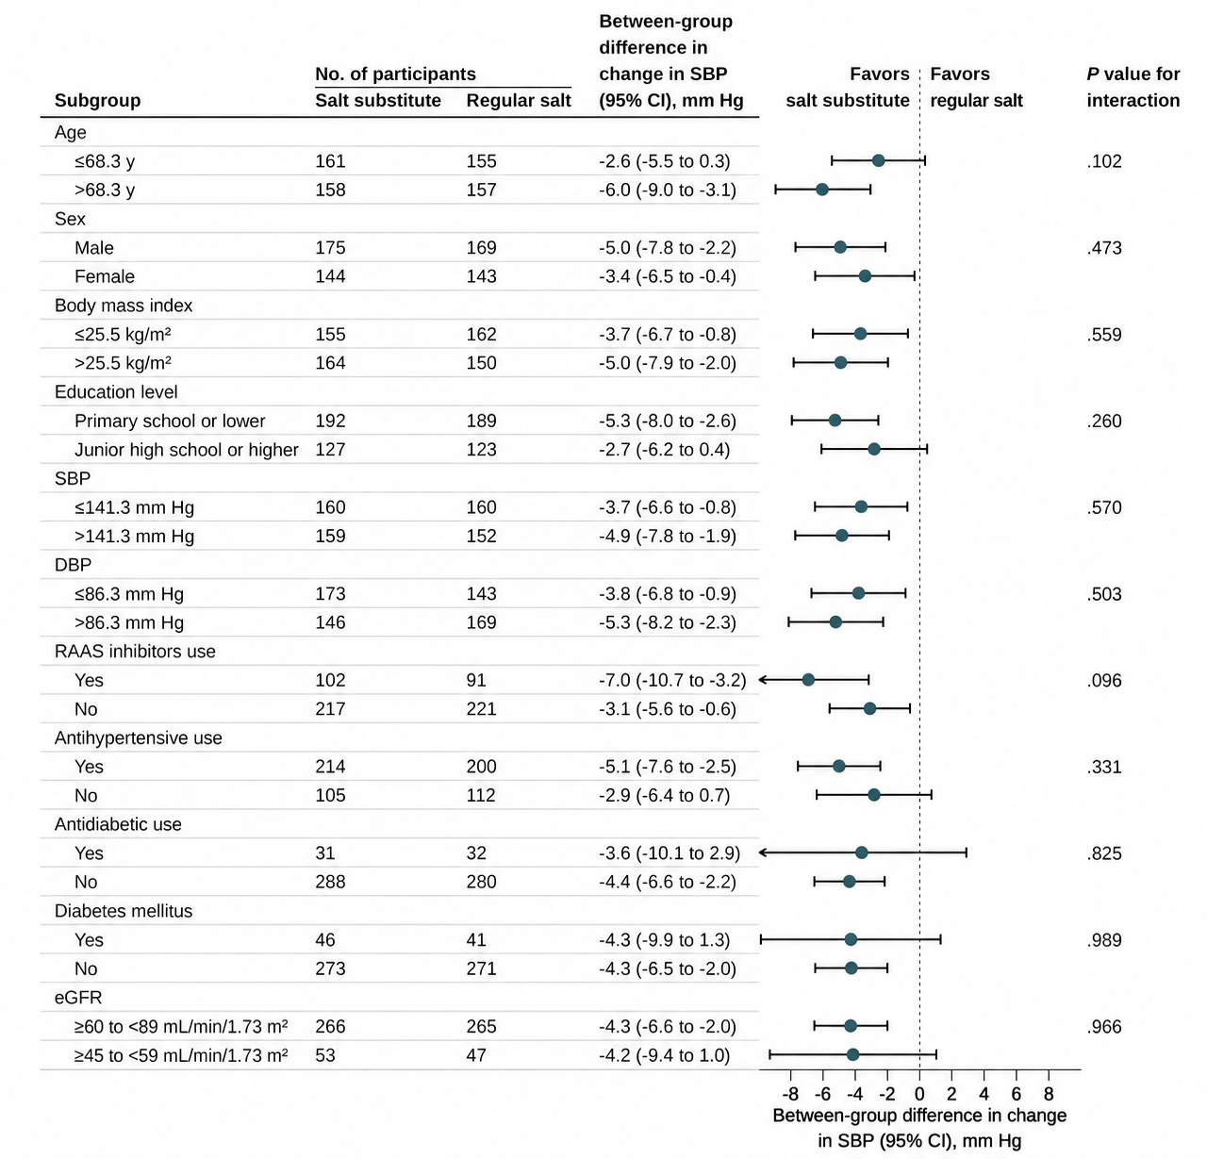
Subgroup analyses
The effect of salt substitution on SBP was generally consistent across all prespecified subgroups, with no significant treatment-by subgroup interactions (all P for interaction > 0.05).

Slide 18
Conclusions
Among adults with hypertension and stage G2 or G3a CKD, salt substitution lower BP and modestly increased serum potassium, with no episodes of hyperkalemia over 3 months.
Salt substitution may offer a practical strategy for BP management in early-stage CKD, although larger and longer-term trials are need to establish its long-term safety and effects on cardiovascular and kidney outcomes.

Slide 19
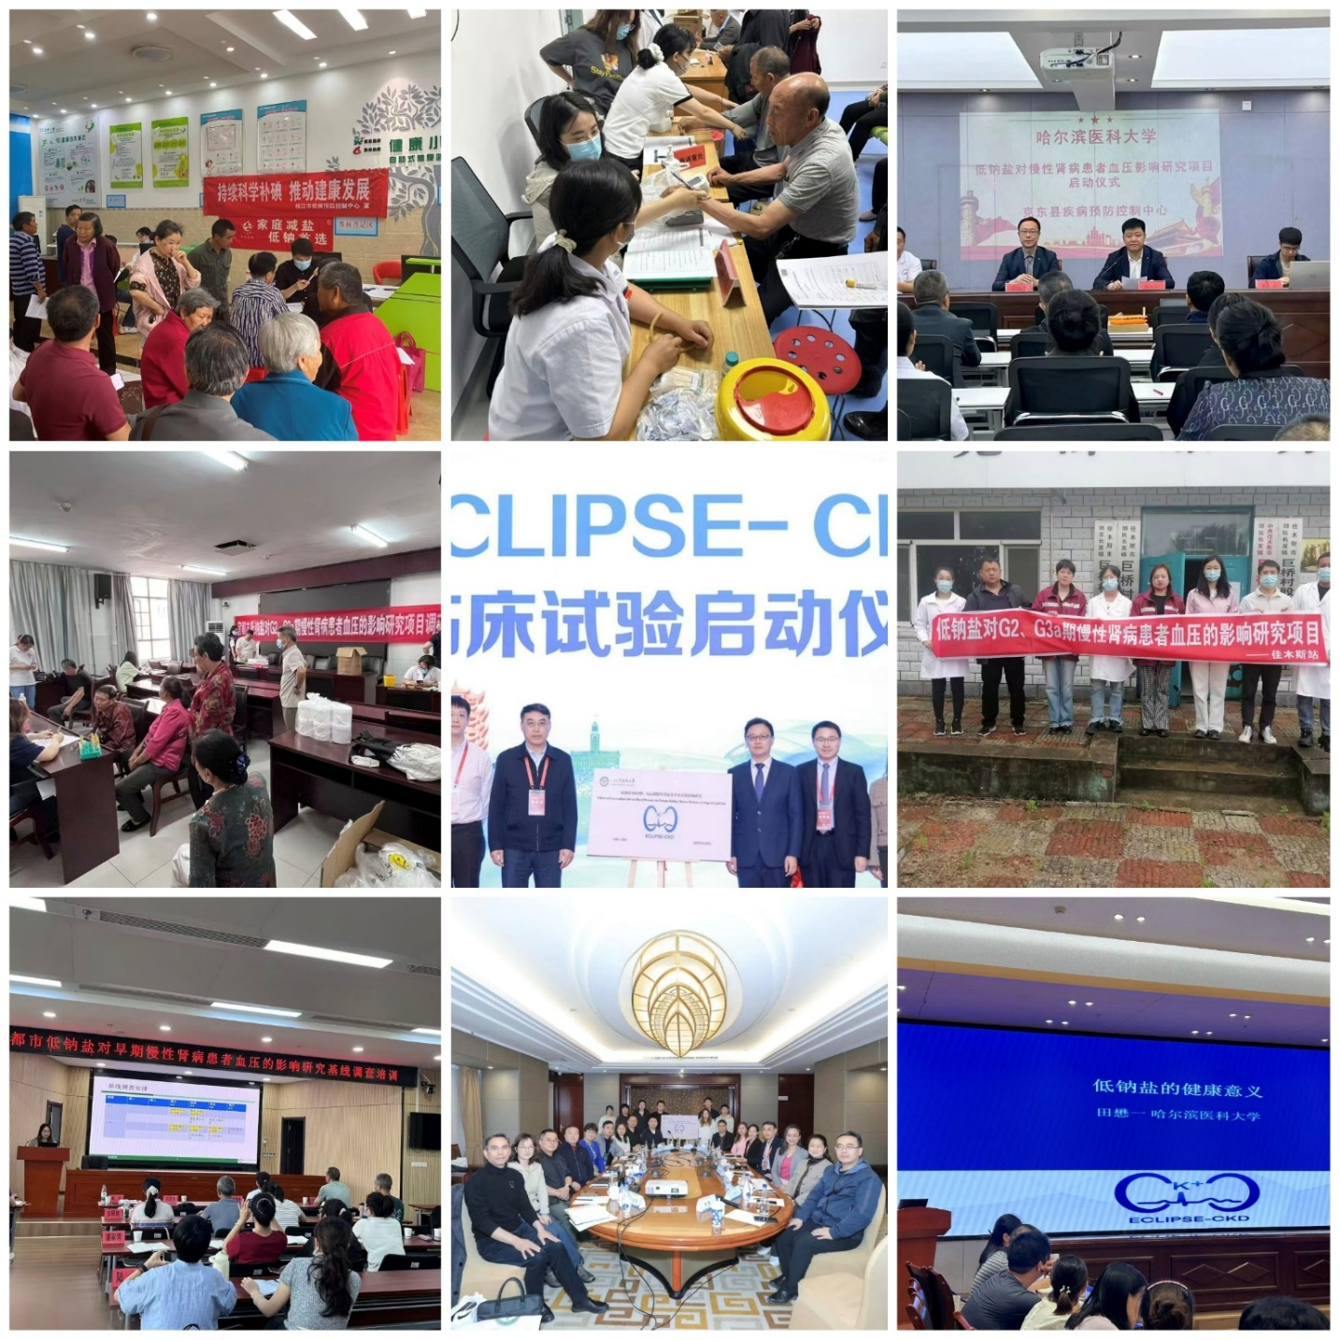
Acknowledgements
Centers for Disease Control and Prevention of Yichang, Jiamusi, Qiqihar, Zhijiang, Yidu, Jiaoqu, Tangyuan, Huachuan, Kedong, and Gannan for their contributions to the ECLIPSE-CKD trial;
China National Salt Industry Corporation and Hubei Salt Group Ltd. for donating the salt substitute;
Trial steering committee, safety endpoint adjudication committee, and data safety monitoring board.

Slide 20
Thank you!
shuidong@hrbmu.edu.cn

