Slide 1










LIBREXIA ACS:
Milvexian after Recent Acute Coronary Syndromes
Ph. Gabriel Steg
on behalf of the LIBREXIA ACS investigators
Hôpital Bichat, Assistance Publique – Hôpitaux de Paris,
Université Paris-Cité, INSERM U-1148-LVTS, Paris, France,
FACT: French Alliance for Cardiovascular clinical Trials
Innovation Chair - Institut Universitaire de France
@gabrielsteg.bsky.social
LIBREXIA ACS was funded by Bristol Myers Squibb and Janssen Research & Development, LLC., a Johnson & Johnson Company

Slide 2
PG Steg - Disclosures
Consulting, speaking, clinical trials : Abcentra, Amarin, Amgen, AstraZeneca, Bayer, BMS, Boehringer-Ingelheim, Idorsia, Janssen, Lilly, Merck, Novartis, Novo-Nordisk, Pfizer, Sanofi
Deputy Editor at Circulation
Chief Medical Officer, Bioquantis

Slide 3
Despite Modern Treatment, Residual Ischemic Risk After ACS Persists
US claims cohort, 239,234 patients hospitalized for ACS, 2005–2018
(Optum Research Database; mean age 69.2 years)
PRIMARY END POINT: CV DEATH, NONFATAL MI, OR NONFATAL ISCHEMIC STROKE
5-yr: 33.4%
0
1
2
3
4
5
Steen DL, Khan I, Andrade K, Koumas A, Giugliano RP. J Am Heart Assoc. 2022;11(9):e022198.

Slide 4

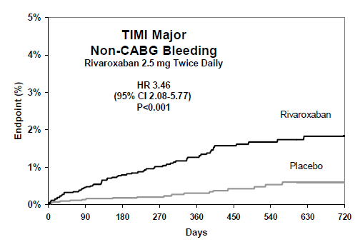
Low Dose Factor Xa Inhibition Post ACS Added to APT Reduced Ischemic Events but was Limited by Increased Bleeding
ATLAS ACS 2-TIMI 51: Rivaroxaban 2.5 mg BID vs Placebo
PRIMARY EFFICACY OUTCOME
PRIMARY SAFETY OUTCOME
CV death, MI, or stroke (Kaplan–Meier, mITT)
TIMI major bleeding not related to CABG
10.7%
HR 0.84 (95% CI, 0.72–0.97) P = 0.02
HR 3.46 (95% CI, 2.08–5.77) P < 0.001
9.1%
Mega JL, et al; ATLAS ACS 2-TIMI 51 Investigators. N Engl J Med. 2012;366:9-19
ACS: acute coronary syndromes,; APT: antiplatelet therapy

Slide 5
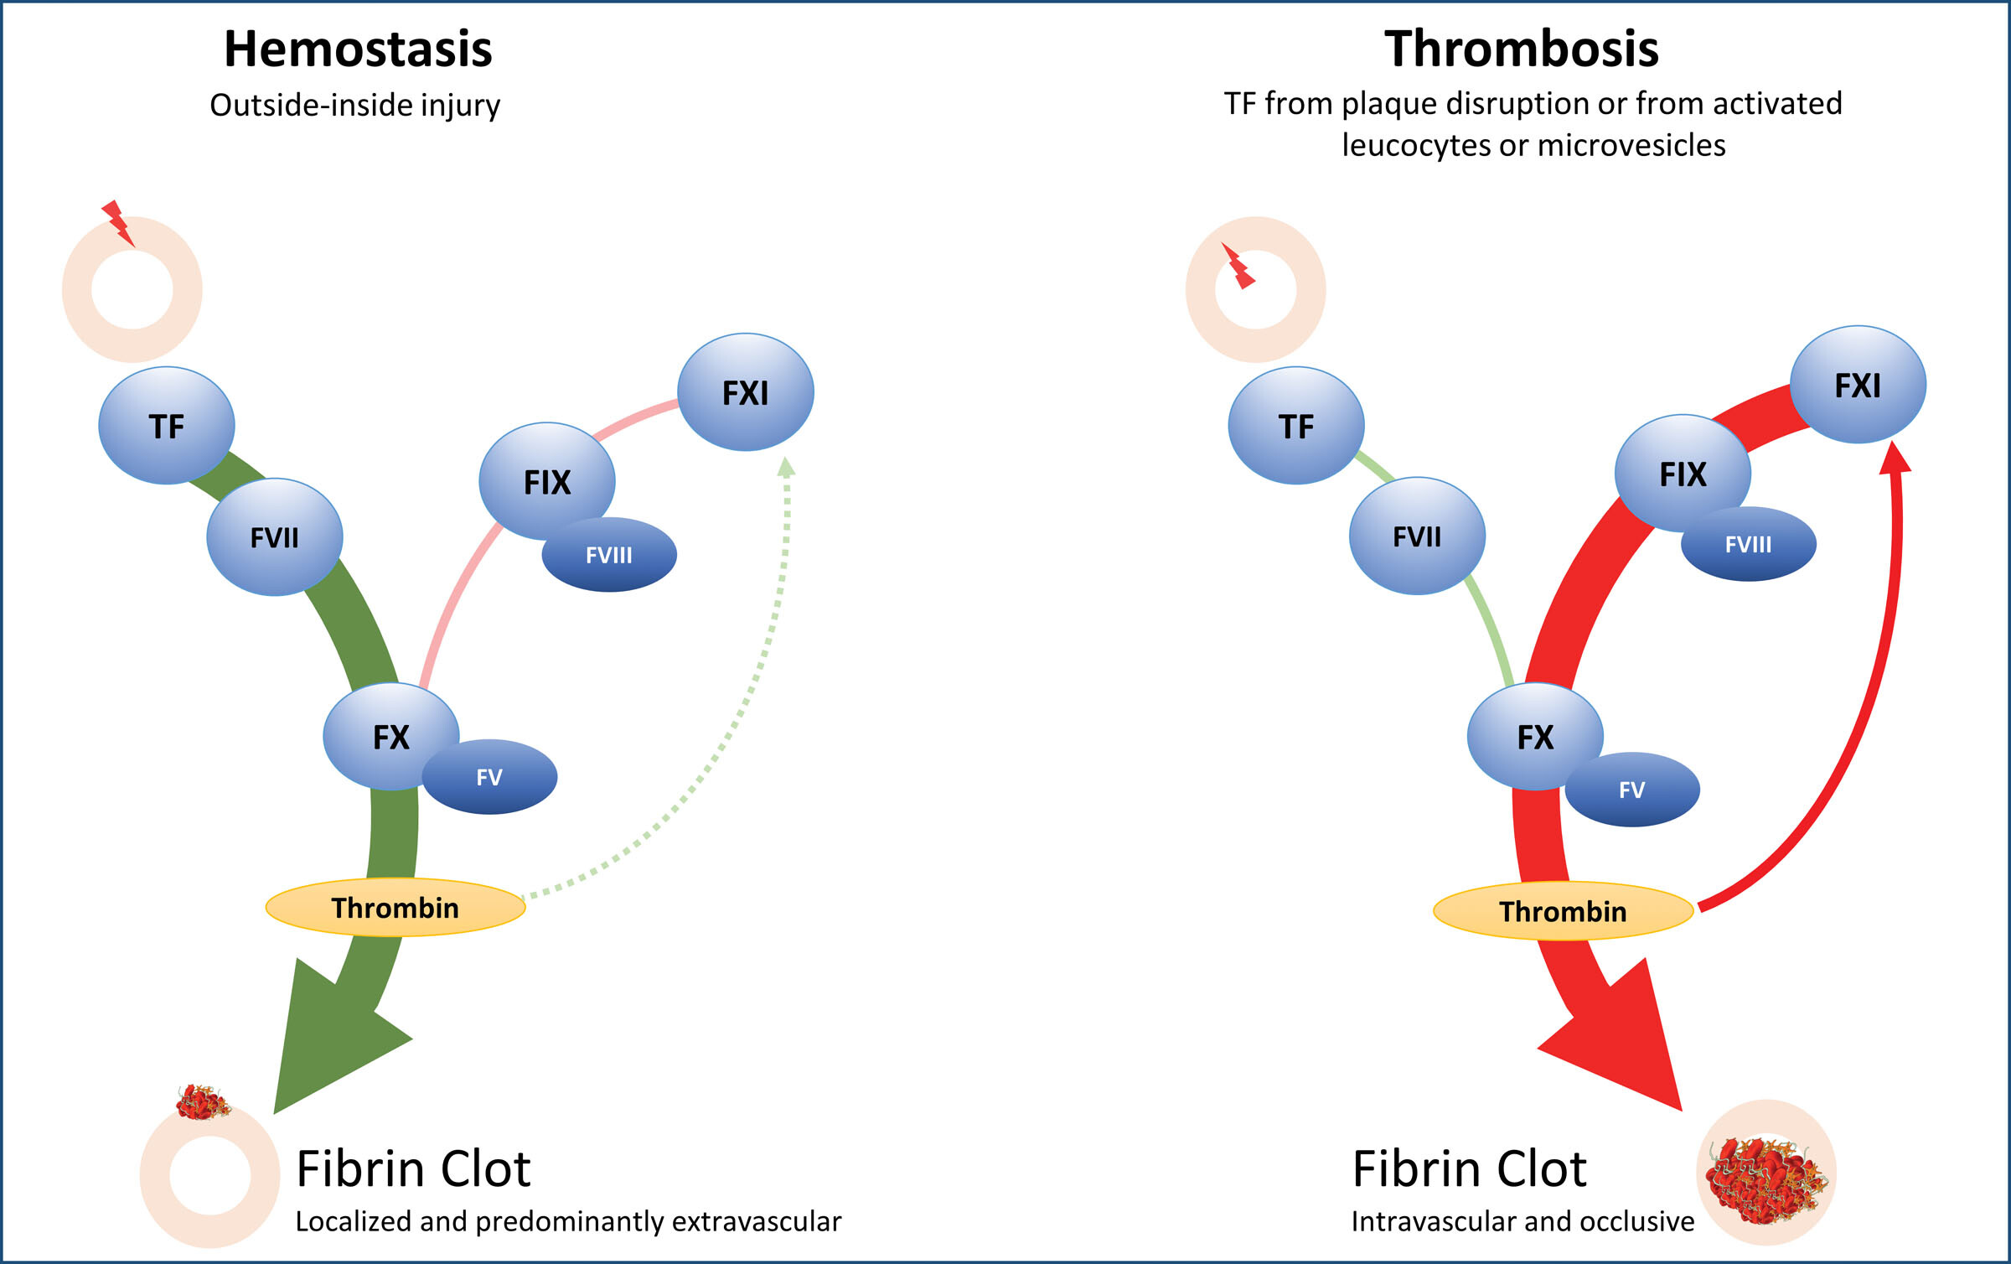
Factor XI is Essential to Thrombosis but Dispensable for Hemostasis
Extrinsic pathway
Intrinsic pathway
PolyP
NETs
Chan. Arteriosclerosis, Thrombosis, and Vascular Biology. 2023;43:1755-63.

Slide 6
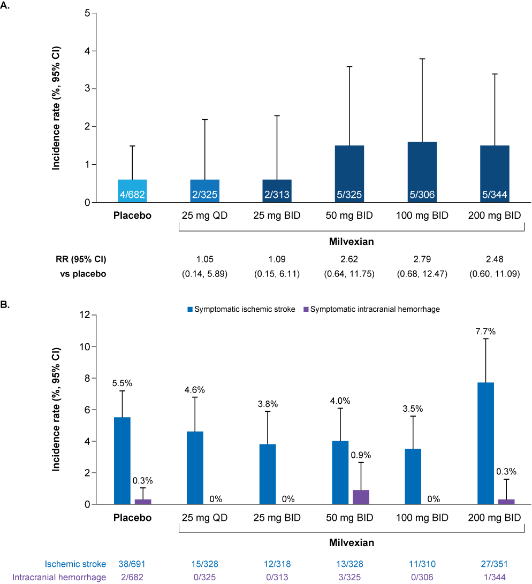
Milvexian is an Oral Factor XIa Inhibitor
Phase 2 Data Support Antithrombotic Activity with a Low Observed Bleeding Signal
Major bleeding
Efficacy and safety of Milvexian in the phase II AXIOMATIC SSP trial
Recurrent symptomatic ischemic stroke and ICH
Sharma M et al. Lancet Neurol 2024; 23:46-59

Slide 7
Factor XIa and Thrombin Generation Are Elevated in ACS and Predict Recurrent CV Events
Lower Levels of Factor XI Activity Are Associated with Lower Risk of CV events
ACS vs non-ACS: p<0.05
1.9 ± 1.1 vs 1.4 ± 0.7 pM
Loeffen, van Oerle, Leers, et al. PLoS One 2016; 11(7): e0158355
Preis, Hirsch, Kotler, et al. Blood 2017; 1210-1215

Slide 8
Background
Despite modern management, post-ACS patients remain at risk of CV death, recurrent MI, and ischemic stroke
Prior strategies incorporating oral anticoagulation, including factor Xa inhibition, reduced ischemic events but were limited by clinically meaningful increased bleeding
Milvexian, an oral factor XIa inhibitor, is designed to target thrombosis with the potential to preserve hemostasis.
Factor XI levels are associated with the risk of cardiovascular events
LIBREXIA-ACS was designed to evaluate whether milvexian, when added to standard antiplatelet therapy after high-risk ACS, reduces major ischemic cardiovascular events compared with placebo without excessive bleeding

Slide 9
Key Inclusion and Exclusion Criteria
Inclusion Criteria
Age ≥ 18 years An index event of ACS : spontaneous cardiac ischemia diagnosis of ACS (STEMI, NSTEMI, or UA) elevated cardiac biomarkers ≥ 2 risk factors
Risk Factors (at least 2)
≥65 years old Diabetes History of a prior MI Multivessel CAD History of CABG prior to index event PAD or cerebrovascular disease Conservative management (ie no PCI or CABG after index ACS) One or more high-risk angiographic feature
Exclusion Criteria
Type 2 MI or periprocedural MI as the index ACS Minimal or no obstructive coronary artery disease on angiography Planned staged PCI after randomization Any condition requiring chronic anticoagulation Conditions with an increased risk of bleeding History of ischemic stroke or TIA Killip Class 3 or 4
STEMI: ST segment elevation myocardial infarction, NSTEMI: non-ST segment elevation myocardial infarction, TIA: transient ischemic attack, UA: unstable angina

Slide 10
Study Design
Week 4
Visit
Week 13
Visit
Week 26
Visit
Week 39
Visit
Week 52
Visit
Visit every
13 weeks
until TED
End of
Treatment
Visit
End of
Study
Visit
Day 1
Acute Coronary Syndrome
(STEMI, NSTEMI, UA;
Biomarker +)
≥ 2 risk factors
R
MILVEXIAN 25 mg BID
Screening
Day -7 to Day 1
PLACEBO BID
30 Days
≤30 Days
Variable Treatment Duration
Planned antiplatelet treatment and duration as intended by the investigator
1:1
Stratified by
Antiplatelet Strategy
GTED*
End of
Study
*Global Targeted Endpoint Date (GTED) will occur when the projected target number of participants with a primary efficacy event will be reached

Slide 11
Stratification of Randomization by
Planned Antiplatelet Strategy
Post-ACS Population with risk factors
(≤7 days after presentation of ACS index event)
Investigator Pre-specified
Intended Antiplatelet
Strategy:
Stratification at Baseline
DAPT >90 days
(± De-escalation)
DAPT De-escalation to SAPT at ≤90 days
SAPT Only
Until End of Study
Blinded
Study Intervention
Milvexian
Placebo
Milvexian
Placebo
Milvexian
Placebo
DAPT period
SAPT period

Slide 12
Endpoints
Primary Efficacy :
MACE : CV death, MI, and ischemic stroke
Secondary Objectives:
Major Adverse Vascular Events (MAVE), the composite of:
  MACE
  Major Adverse Limb Events (MALE): acute limb ischemia [ALI] and major vascular non-traumatic amputation
  Symptomatic VTE (PE and DVT)
Composite of All-Cause Mortality, MI, and ischemic stroke
CV mortality
All cause mortality
Principal Safety :
BARC categories 3c and 5
(i.e., ICH and fatal bleeding)
Additional Safety :
Other bleeding definitions
  BARC categories 3b, 3c, and 5
  ISTH major bleeding
  GUSTO severe or life-threatening bleeding
  Non-CABG TIMI major bleeding
  CABG TIMI major bleeding
  Clinically relevant nonmajor bleeding (using BARC, ISTH, GUSTO, TIMI scales)

Slide 13
Statistical Considerations
Approximately 16,000 participants to be enrolled.
Overall incidence of participants with one or more primary outcome event ~5.8%.
875 participants with one or more primary outcome events:
  90% Power with alpha 0.05 (two-sided) for a 20% reduction.
One interim analysis at ~525 participants with one or more primary outcome events, for futility only.
IDMC Recommendation after interim analysis (Nov 2025): “Due to insufficient conditional power to achieve the study's primary objective assessed at the planned interim analysis (…), the IDMC recommends study discontinuation on the basis of futility.”
This recommendation was accepted on 13 Nov 2025, enrollment was halted and trial end date declared on 14 Nov 2025.

Slide 14
Trial Disposition
Screened
N=14,799
In summary
14,194 patients randomized
98.2% completed clinical follow-up
Treatment discontinued
prior to GTED in 20.1%
10 pts lost to follow-up
Screen Failures
N=605 (4.1%)
Randomized
N=14,194
Milvexian
N=7,094
(Full Analysis Set)
Placebo
N=7,100
(Full Analysis Set)
86 not treated (1.2%)
73 not treated (1.0%)
Milvexian
N=7,008 treated
Safety Analysis Set
N=14,035
Placebo
N=7,027 treated
Completed Clinical Assessment
N=6,966 (98.2%)
Clinical Assessment Not Completed (N=128, 1.8%)
Withdrawal of consent=66 (0.9%)
Lost to follow-up=3 (<0.1%)
Other=59 (0.8%)
Discontinued Treatment Prior to GTED
N=1,419 (20.2%)
Discontinued Treatment Prior to GTED
N=1,397 (19.9%)
Clinical Assessment Not Completed (N=134, 1.9%)
Withdrawal of consent=55 (0.8%)
Lost to follow-up=7 (0.1%)
Other=72 (1.0%)
Completed Clinical Assessment
N=6,966 (98.1%)
GTED: Global Targeted Endpoint Date

Slide 15

A Global Trial
Top 10 Enrolling Countries by Randomised Participants
Characteristic | Milvexian (N=7094) | Placebo (N=7100)
Geographic Region – no. (%)
Asia | 1570 (22.1%) | 1572 (22.1%)
Western Europe | 1424 (20.1%) | 1419 (20.0%)
Eastern Europe | 1783 (25.1%) | 1785 (25.1%)
North America | 454 (6.4%) | 460 (6.5%)
South America | 1355 (19.1%) | 1354 (19.1%)
Other | 508 (7.2%) | 510 (7.2%)
Bulgaria
828
Serbia
671
China
918
United States
661
Korea, Rep.
488
Israel
526
Japan
606
Brazil
1,720
India
656
Argentina
926
14,194
893
44
Randomised participants
Enrolling sites
Countries

Slide 16
Key Baseline Demographics
ITT
Characteristic | Milvexian (N = 7094) | Placebo (N = 7100)
Age — yr | 63.1 ± 10.6 | 63.2 ± 10.5
Male sex — no. (%) | 5542 (78.1%) | 5543 (78.1%)
Type of index MI - no. (%)
STEMI | 4085 (57.6%) | 4067 (57.3%)
NSTEMI | 2615 (36.9%) | 2644 (37.2%)
UA with Elevated Cardiac Biomarkers | 393 (5.5%) | 389 (5.5%)
PCI performed for index MI – no. (%) | 6516 (91.9%) | 6496 (91.5%)
Time from index ACS to randomization (median) | 4.0 | 4.0
PCI Prior to index ACS event | 1690 (23.8) | 1597 (22.5)
History of Heart Failure | 1659 (23.4) | 1659 (23.4)
History of Hypertension | 5181 (73.0) | 5083 (71.6)
Current Smokers | 2326 (32.8) | 2313 (32.6)
GRACE Risk Score (median) | 104 | 104

Slide 17
Risk Factors
ITT
Characteristic | Milvexian (N=7094) | Placebo (N=7100)
Age ≥ 65 yr | 3545 (50.0) | 3559 (50.1)
Diabetes mellitus | 3014 (42.5) | 3154 (44.4)
History of a Prior MI (other than index event) | 1606 (22.6) | 1569 (22.1)
Multivessel CAD | 4961 (69.9) | 4966 (70.0)
Hx of CABG prior to index ACS event | 325 (4.6) | 309 (4.4)
Hx of PAD or cerebrovascular disease | 742 (10.5) | 752 (10.6)
Conservative management (ie No PCI) | 578 (8.1) | 604 (8.5)
High Risk Angiographic Feature (1 or more) | 5364 (75.6) | 5379 (75.8)
% of Participants with 3 or more risk factors | 3932 (55.4) | 3998 (56.3)

Slide 18
Concomitant Medications During the Study
Safety set
Characteristic | Milvexian (N=7008) | Placebo (N=7027)
Lipid modifying agents | 6781 (96.8%) | 6807 (96.9%)
Statin* | 6607 (93.1%) | 6628 (93.4%)
Renin angiotensin system modifying agents | 5750 (82.0%) | 5678 (80.8%)
Beta blockers | 5598 (79.9%) | 5590 (79.6%)
Acid blocking agents | 5001 (71.4%) | 4983 (70.9%)
Diuretics | 2518 (35.9%) | 2554 (36.3%)
Nitrates | 1497 (21.4%) | 1496 (21.3%
Calcium channel blockers | 1463 (20.9%) | 1406 (20.0%)
SGLT2 inhibitors | 1348 (19.2%) | 1366 (19.4%)
*At randomization

Slide 19
Background Antiplatelet Therapy
ITT
Characteristic | Milvexian (N=7094) | Placebo (N=7100)
Planned Background AP Strategy
DAPT >90 days ± de-escalation to SAPT | 6581 (92.8) | 6588 (92.8)
DAPT ≤90 days w de-escalation to SAPT | 403 (5.7) | 409 (5.8)
SAPT | 110 (1.6) | 103 (1.5)
Actual AP taken at randomization
DAPT | 6761 (96.5) | 6753 (96.2)
ASA + clopidogrel | 2495 (35.6) | 2525 (36.0)
ASA + ticagrelor | 2709 (38.7) | 2674 (38.1)
ASA + prasugrel | 1557 (22.2) | 1554 (22.1)
SAPT | 244 (3.5%) | 264 (3.8%)
ASA | 123 (1.8) | 140 (2.0)
Clopidogrel | 46 (0.7) | 51 (0.7)
Ticagrelor | 56 (0.8) | 56 (0.8)
Prasugrel | 19 (0.3) | 17 (0.2)

Slide 20
Primary Efficacy Endpoint: CV Death, MI, Ischemic Stroke
ITT, Up to GTED
Median exposure 10 months
Range 0-31
Median exposure 10 months
Range 0-31
Median exposure 10 months
Range 0-31
GTED: Global Targeted Endpoint Date

Slide 21
Primary Efficacy Endpoint
ITT, Up to GTED
End Point | Milvexian |  | Placebo |  | Hazard Ratio (95% CI) | P Value
 | n/N (%) | Event rate per 100 Subject-Years (95% CI) | n/N (%) | Event rate per 100 Subject-Years (95% CI)
 | N=7094 |  | N=7100
Cardiovascular death, MI, or ischemic stroke | 384 (5.4%) | 5.60 (5.06, 6.19) | 365 (5.1%) | 5.33 (4.81, 5.90) | 1.05 (0.91, 1.21) | 0.50
CV death | 110 (1.6%) | 1.54 (1.28, 1.86) | 112 (1.6%) | 1.57 (1.30, 1.89) | 0.98 (0.75, 1.28) | -
MI | 249 (3.5%) | 3.61 (3.19, 4.09) | 236 (3.3%) | 3.43 (3.02, 3.89) | 1.05 (0.88, 1.26) | -
Ischemic Stroke | 60 (0.8%) | 0.85 (0.66, 1.10) | 46 (0.6%) | 0.66 (0.49, 0.88) | 1.30 (0.89, 1.91) | -
GTED: Global Targeted Endpoint Date

Slide 22
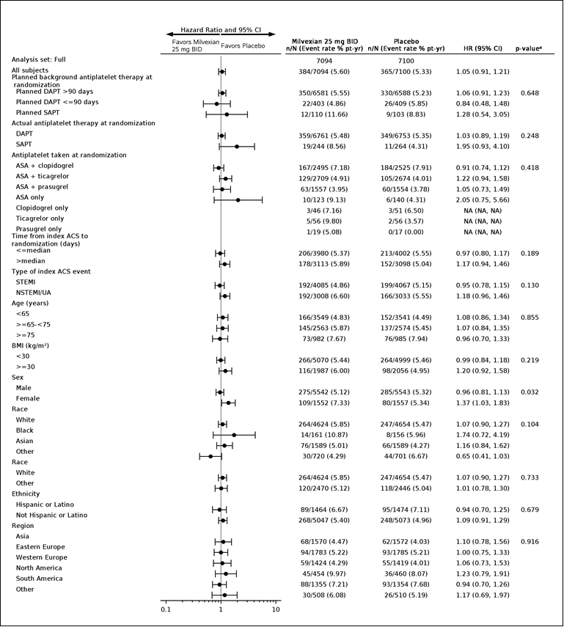
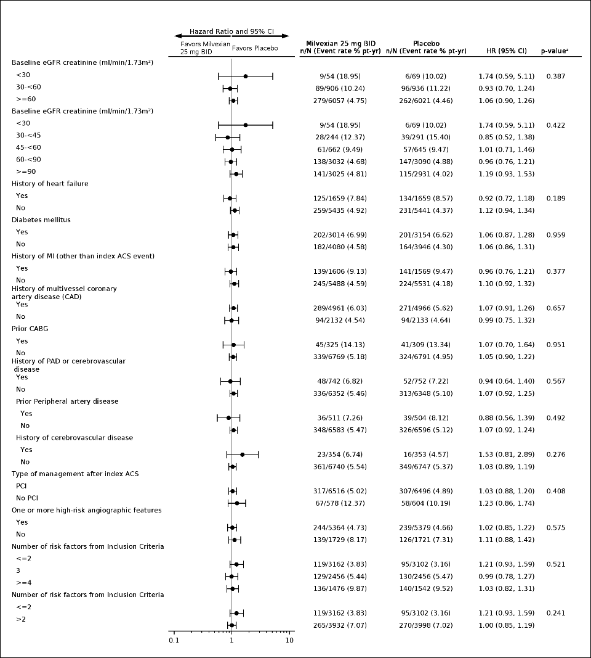
Subgroup Analysis of the Primary Efficacy Endpoint
ITT, Up to GTED

Slide 23
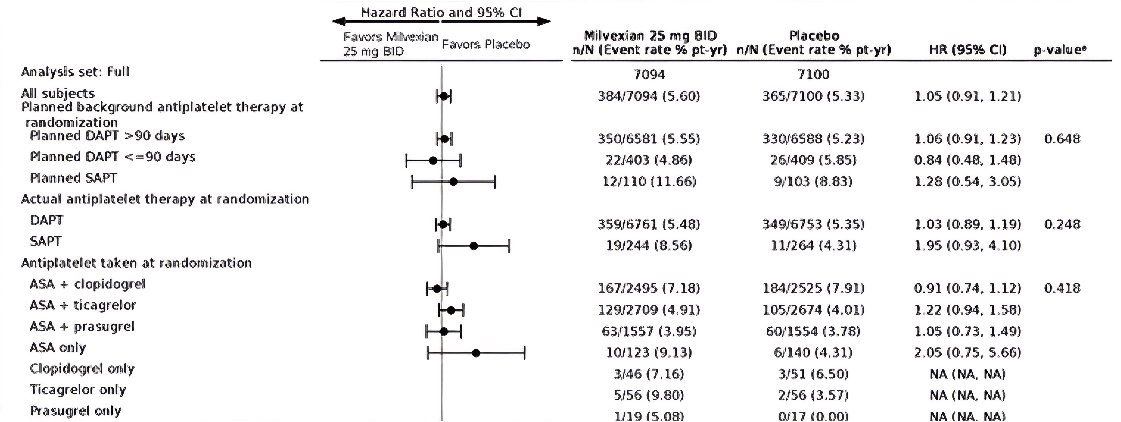
Subgroup Analysis of the Primary Efficacy Endpoint
ITT, Up to GTED

Slide 24
Principal Safety Endpoint: BARC 3c/5
Safety, On-Treatment

Slide 25
Key Secondary Bleeding Endpoints:
Safety, On-Treatment
BARC 3b, 3c and 5 Bleeding
Non-CABG TIMI Major Bleeding
ISTH Major Bleeding

Slide 26



Librexia trial program (Milvexian)
The LIBREXIA Trial Program: >46,000 pts
NCT05757869
Milvexian 100 mg bid
vs
Apixaban 5 mg bid
Population:
AF pts
NCT05702034
Milvexian 25 mg bid
vs
Placebo
On top of antiplatelet Rx
Population:
Acute non-cardioembolic ischemic stroke or high-risk TIA pts
NCT05754957
Milvexian 25 mg bid
vs
Placebo
On top of antiplatelet Rx
Population:
Recent ACS pts
Ongoing
Ongoing
Stopped for futility
Nov 2025

Slide 27
Conclusion
Despite background therapy with PCI & prolonged DAPT with a majority of participants receiving potent P2Y12 inhibitors, the incidence of MACE was high : there remains an unmet need in this population
Milvexian did not reduce MACE after ACS on top of standard of care antiplatelet therapy at the dose studied (25 mg bid)
Milvexian did not increase BARC 3c/5 bleeding and appears safe
Milvexian is currently being evaluated for 2 other indications:
  Secondary Stroke Prevention and Atrial Fibrillation

Slide 28
Placeholder for NEJM Announcement

Slide 29
Trial Organization
LIBREXIA Program Executive Council
Chair: RA Harrington
K Mahaffey, CSP Lam, CM Gibson, PG Steg, R Mehran, JI Weitz, K Pieper, SC Johnston, GJ Hankey, J Li, D Li, AN Plotnikov
LIBREXIA ACS Executive Committee
Co Chairs: CM Gibson & PG Steg
R Al-Lamee, MC Bahit, S Goto; R Mehran, S Mehta, JI Weitz, R Aronson ES Barnathan
Steering Committee: MC Bahit, Argentina; G Figtree, Australia; K Huber, Austria; P Vranckx, Belgium; JC Nicolau, R Lopes, Brazil; V Velchev, Bulgaria; S Mehta, Canada; C Pincetti, Chile; J Ge, China; D Cerovec, Croatia; M Solar, Czechia; Z Motovska, Czechia; M Bottcher, Denmark; M Viigimaa, Estonia; G Ducrocq, France; C Bode, D Duerschmied, Germany; D Tousoulis, Greece; B Merkely, Hungary; D Xavier, India; B Lewis, Israel; G Ambrosio, Italy; S Yasuda, Japan; S Goto, Japan; HJ Kang, DW Park, Korea, Republic of; A Erglis, Latvia; R Slapikas, Lithuania; A Fong, Malaysia; JL Leiva Pons, Mexico; J Cornel, Netherlands; H White, New Zealand; S Kedev, North Macedonia; R Sy, Philippines; J Trebacz, Poland; J Morais, Portugal; D Vinereanu, M Dorobantu, Romania; N Tasic, Serbia; J Tan, Singapore; A Bohm, Slovakia; L Burgess, South Africa; JL Lopez Sendon, Spain; H Bueno, Spain; M Valgimigli, Switzerland; CE Chiang, Taiwan; P Sritara, Thailand; U Guray, Turkey; R Al-Lamee, T Johnson, United Kingdom; D Angiolillo, A Kirtane, S Baron, United States; TD Ho, Vietnam

Slide 30
Librexia ACS Operational Committees
Adjudication Committee
Co-Chairs: K Mahaffey, D Cutlip
K Alexander, C Berger, A Desai, E Elfand, M Hlatky, J Januzzi, W Levy, W Omar, M Poulin, P Quintero; J Robbins, M Sabe; J Silver; S Varshney; N Waks, C Babikian, K Dombrowski, P George; K Hirsch; M Leary; S Lee; D Thaler; Z Threlkeld, A Aday, A Chun, E Gravereaux, N Leeper; MD Qamar, E Secemsky, S Waxman
IDMC
Chair: D Moliterno
LB Goldstein, C Granger; ML O’Donoghue, JM Connors, J de Lemos, D Easton, N El Husseini, J Gregson; NA Marston, N Pagidipati; S Pocock, L Williams, FWA Verheugt
Sponsor Members
AN Plotnikov, AC Lindsay, P Vieira Pires, R Notani, TJ Povsic, H Deng, D Li, R Aronson, ES Barnathan

Slide 31

Thank you to the Entire Librexia ACS Team, IQVIA,
The EC/SC/PIs/Coordinators and all of the Participants and their Families

