Slide 1



Extremely Long Duration Lp(a) Reduction Following a Single Dose of Kylo-11:
Final Data from a First-in-Human Study
Ashish Sarraju MD FACC FASPC
C5 Research, Cleveland Clinic
ESC Congress 2026
Late-Breaking Clinical Science:
Rewriting Cardiovascular Disease on Gene and Molecular Therapies
August 28, 2026
Disclosures:
Dr. Sarraju serves/has served as a consultant or on steering committees or trial leadership activities for Arrowhead, CRISPR Therapeutics, Kardigan, Kylonova, Kalexo, Ionis, New Amsterdam Pharma, Mineralys, Novartis, vTv Therapeutics.
The Sponsor, Kylonova, is a wholly owned subsidiary of Hygieia Pharma, an SBP GROUP company.
NCT06363851

Slide 2
Background
Elevated lipoprotein(a) [Lp(a)] concentrations are an established causal risk factor for ASCVD.
There are no pharmacologic treatments approved by regulatory authorities for Lp(a) lowering independent of LDL-C.
Kylo-11 is a very long acting, noncanonical siRNA therapy to reduce hepatic apolipoprotein(a) expression, with two N-acetyl-galactosamine moieties at the 3’ sense terminus and another two at the 5’ antisense terminus.

Slide 3
Study Design
Randomised, placebo-controlled, single-site (China), first-in-human phase 1.
Kylo-11 or placebo administered subcutaneously in 8:2 fashion to 70 participants across 7 dosing cohorts.
Participants had baseline Lp(a) of 75-200 nmol/L (cohorts 1-6) or >200 nmol/L (cohort 7) and were otherwise generally healthy.
Participants received 9, 30, 75, 225, 450, 600, or 225 (cohort 7) mg of Kylo-11 or matching placebo, and were followed for up to 48 weeks.

Slide 4
Endpoints and follow-up
Primary safety outcome: Adverse events through 24 weeks graded using the Common Terminology Criteria for Adverse Events.
Secondary pharmacodynamic outcome: Percent and absolute changes in Lp(a) concentrations over time.
Follow-up: Participants were followed for at least 24 weeks. If Lp(a) concentrations did not return to at least 80% of baseline, follow-up could be continued for up to 48 weeks.

Slide 5
Baseline Characteristics | Dose group
 | 9 mg (n=8) | 30 mg (n=8) | 75 mg (n=8) | 225 mg (n=8) | 450 mg (n=8) | 600 mg (n=8) | 225 mg (n=8) Cohort 7 | Placebo (n=14)
Median age, y | 33 | 27.5 | 22 | 28 | 30 | 28 | 27.5 | 27
Male, % | 38% | 50% | 75% | 50% | 75% | 75% | 75% | 71%
Median BMI | 25.5 | 24.7 | 23.9 | 21.7 | 25.1 | 24.4 | 24.5 | 24.5
Median Lp(a), nmol/L | 134.5 | 122.7 | 103.7 | 118.7 | 123.8 | 134.4 | 217.7 | 123.3
Median LDL-C, mmol/L | 2.7 | 2.7 | 2.7 | 2.7 | 3.2 | 2.5 | 3.1 | 3.0
Median triglycerides, mmol/L | 1.6 | 1.9 | 1.4 | 1.2 | 1.2 | 1.2 | 1.3 | 1.4

Slide 6
Adverse events through 24 weeks (Primary Outcome) | Dose Group
 | 9 mg (n=8) | 30 mg (n=8) | 75 mg (n=8) | 225 mg (n=8) | 450 mg (n=8) | 600 mg (n=8) | 225 mg (n=8) Cohort 7 | Placebo (n=14)
Serious AEs | 0 | 0 | 0 | 0 | 0 | 0 | 0 | 0
Any AE* | 50% | 63% | 50% | 88% | 75% | 25% | 25% | 50%
Grade > 3 | 0 | 0 | 0 | 25% | 0 | 0 | 0 | 7%
Injection site reaction | 0 | 0 | 0 | 0 | 0 | 0 | 0 | 0
Increased ALT | 0 | 38% | 0 | 0 | 13% | 0 | 0 | 7%
ALT >3x ULN | 0 | 0 | 0 | 0 | 0 | 13% | 0 | 0
Increased bilirubin | 0 | 13% | 0 | 13% | 0 | 13% | 13% | 0
*No AEs leading to interruption, discontinuation, withdrawal, or death. No AEs deemed related or probably related to study drug. Grade 3 events were transient hypertriglyceridaemia (n=1 in the 225 mg cohort, n=1 in placebo) and increased CK (n=1 in the 225 mg cohort) and were deemed unrelated to study drug.

Slide 7
Median Percent Change from Baseline in Lp(a) at End of Follow-up
48 weeks for all Kylo-11 groups, 24 weeks for placebo
Median Percent Change from Baseline (%)
9 mg
(n=8)
30 mg
(n=8)
75 mg
(n=7)
225 mg
(n=7)
450 mg
(n=8)
600 mg
(n=8)
225 mg
(n=8)
Cohort 7
Placebo
(n=14)

Slide 8
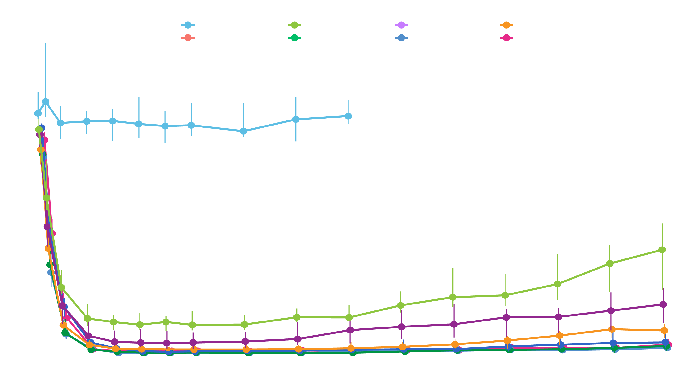
Median Percent Change in Lp(a) Over Time
Percent Change in Lipoprotein
Visit Day

Slide 9
Median Absolute Change from Baseline in Lp(a) at End of Follow-up
48 weeks for all Kylo-11 groups, 24 weeks for placebo
Median Absolute Change from Baseline (nmol/L)
9 mg
(n=8)
30 mg
(n=8)
75 mg
(n=7)
225 mg
(n=7)
450 mg
(n=8)
600 mg
(n=8)
225 mg
(n=8)
Cohort 7
Placebo
(n=14)

Slide 10
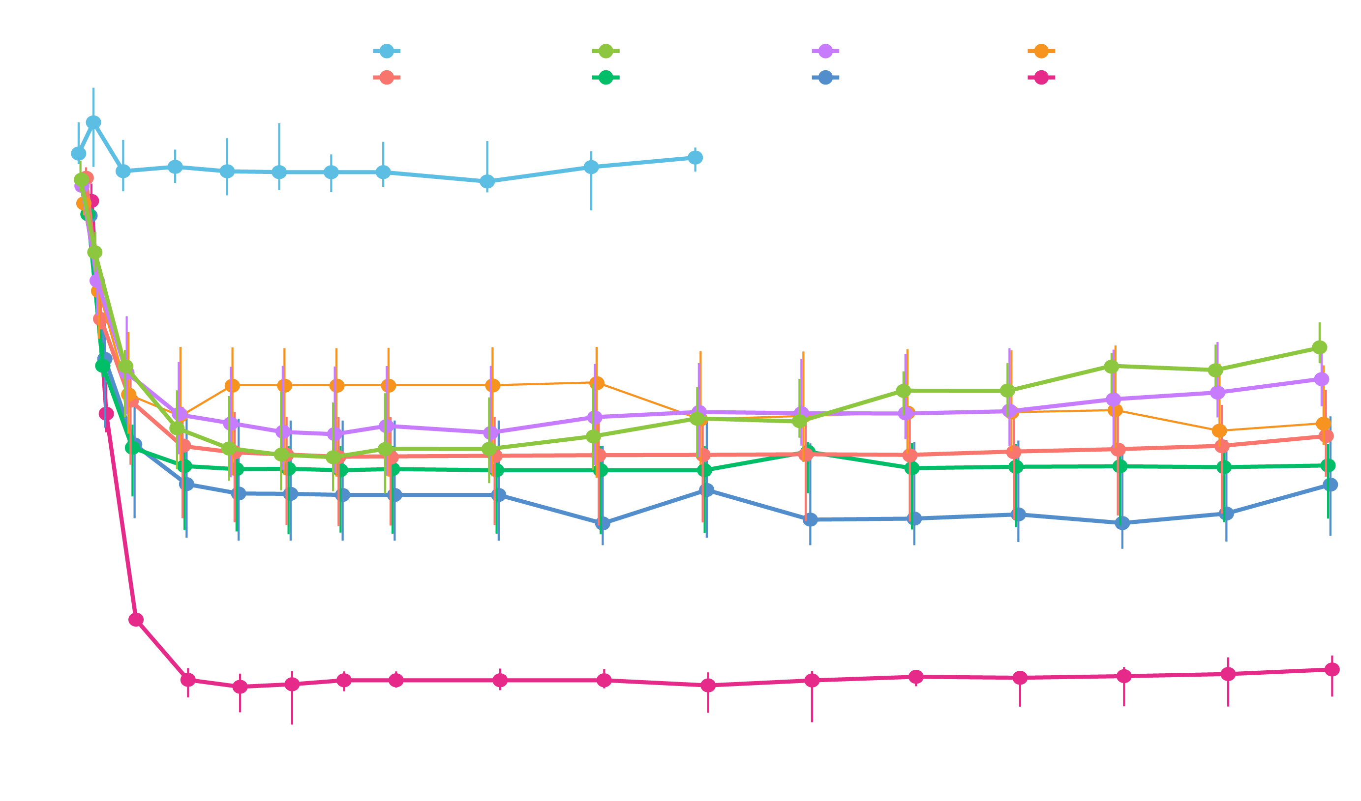
Median Absolute Change in Lp(a) Over Time
Absolute Change in Lipoprotein(a) nmol/L
-207.7
Visit Day

Slide 11
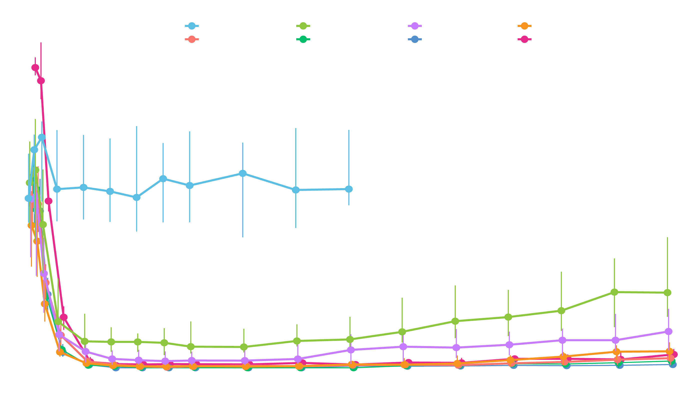
Median Observed Lp(a) Over Time
Cohort 7
Median (IQR) at baseline:
217.7 nmol/L (211.2 to 229.7)
Median (IQR) at 48 weeks:
10.5 nmol/L (3.7 to 18.1)
Observed Lipoprotein(a)
Visit Day

Slide 12

Individual Percent Changes in Lp(a) at End of Follow-up
Placebo
9mg
Kylo-11
30mg
Kylo-11
75mg
Kylo-11
225mg
Kylo-11
450mg
Kylo-11
600mg
Kylo-11
225mg
Kylo-11 (Cohort 7)
0
-25
Percent Change from Baseline (%)
-50
-75
-100

Slide 13
Limitations
This was a single-site phase 1 study with relatively young, otherwise healthy Chinese participants. Future studies should include broader populations by age, sex, race, ethnicity, and comorbidities.
Only a single dose was studied. Future studies should evaluate the safety, efficacy, and tolerance of sequential dosing, potentially on a yearly basis.
Ongoing cardiovascular outcome trials of multiple agents will inform the relationship between Lp(a) reduction and cardiovascular events independent of LDL-C lowering.

Slide 14
Conclusions
In a randomised, placebo-controlled, first-in-human phase 1 study in China, single, subcutaneous doses of Kylo-11 from 9 mg to 600 mg were tolerated through 48 weeks in participants with elevated baseline Lp(a) concentrations.
After single Kylo-11 doses of 225 mg or greater, sustained Lp(a) reductions exceeding 94% were observed through 48 weeks, including among participants with baseline Lp(a) > 200 nmol/L.
Findings support the study of Kylo-11 in larger trials, potentially with infrequent, annual dosing.

Slide 15
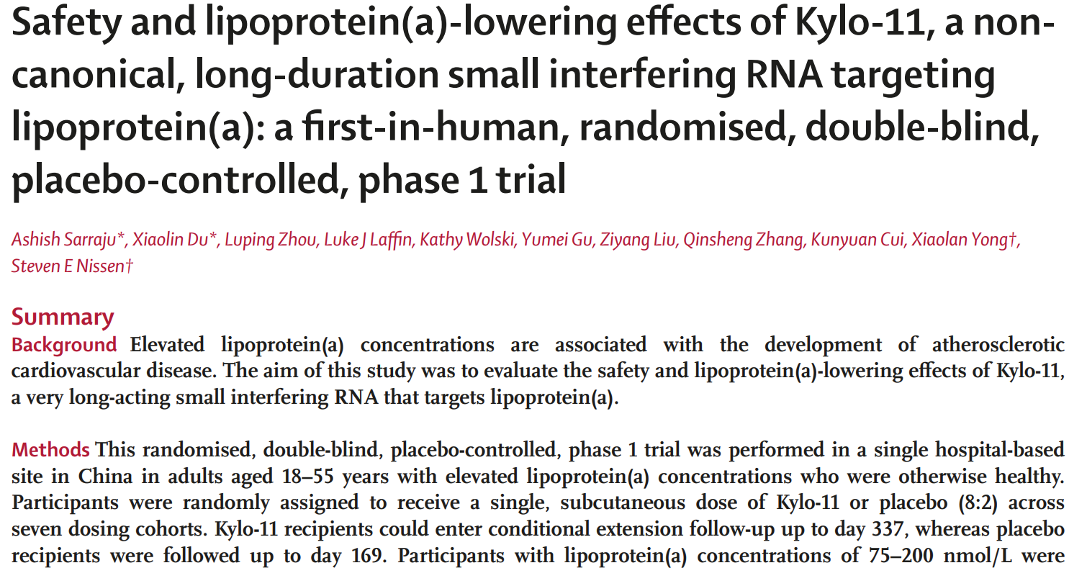

Manuscript accessible via the Lancet.com

Slide 16
Acknowledgements
Participants
Investigators and Site Staff
Manuscript Co-authors
C5Research Team
Kylonova

Slide 17
A Final Thought
Elevated lipoprotein(a) concentrations are present in one-fifth of the world’s population, representing a genetic driver for increased ASCVD risk but with no currently available pharmacologic therapies.
If ongoing cardiovascular outcome trials demonstrate that Lp(a) reduction improves ASCVD events, then long-acting, infrequently-dosed Lp(a)-lowering therapies could provide a practical strategy to address this prevalent source of residual risk.

