Slide 1
DIrect or Subacute Coronary angiography for Out of hospital cardiac arrest
DISCO Study
Rickard Lagedal, Ludvig Elfwen, Christian Juhl Terkelsen, Niels van Royen, Jonas Oldgren, John Bro-Jeppesen, Judith Bonnes, Per Nordberg, Lisette Okkels Jensen, Peter Lundgren, Felix Böhm, Tobias Cronberg, Stefan James, Sten Rubertsson
Presented by Sten Rubertsson, MD, PhD, Professor, EDIC, FCCM
Department of Surgical Sciences/Anaesthesiology and Intensive Care Medicine,
Uppsala University, Sweden on behalf of the DISCO study steering committee and investigators

Slide 2
Conflict of interest
No conflicts of interest to declare

Slide 3
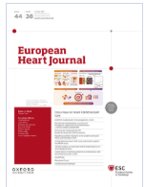
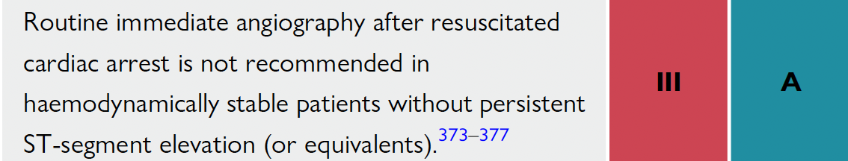
Background
The need and optimal time point of invasive management
for cardiac arrest patients with no ST segment elevation remain insufficiently investigated
ESC guidelines recommend a deferred rather than an immediate strategy for coronary angiography in resuscitated out-of-hospital cardiac arrest (OHCA) patients
Mainly based on neutral results from small-medium-sized randomized clinical trials, the PEARL (n=99), EMERGE (n=279), COACT (n=530) and TOMAHAWK (n=552) trials
2023 ESC ACS guidelines (European Heart Journal 2023;44:3720-826)
PEARL trial (Circulation. 2020;142:2002–2012)
EMERGE trial (JAMA Cardiol. 2022;7(7):700-707)
COACT trial (N Engl J Med 2019;380:1397-407)
TOMAHAWK trial (N Engl J Med 2021;385:2544-53)

Slide 4
Methods
Prospective Multicenter Randomized Controlled Trial-to investigate whether a strategy of immediate coronary angiography as compared to a deferred strategy improves 30-day survival in resuscitated OHCA patients without ST-elevation
A sample size of 1 006 patients was estimated to provide 80% power (α = .05) to detect a 20% relative improvement of 30-day survival rate from 45% to 54% by an immediate vs. deferred coronary angiography
(Am Heart J 2018;197:53-61.)

Slide 5
Methods
Inclusion criteria
Exclusion criteria
Witnessed, unconscious patients after out-of-hospital cardiac arrest
Return of spontaneous circulation (ROSC) for more than 20 minutes
Possibility to perform coronary angiography within 120 minutes after randomization
Patient under 18 years of age
Apparent non-cardiac etiology of cardiac arrest
Terminally ill patients
ST-elevation on the initial ECG
Pregnancy
Conscious patients with a Glasgow Coma Scale (GCS) of > 8

Slide 6
Methods-study interventions
Immediate coronary angiography
Performed within 120 minutes after randomization
If a PCI was performed revascularization was limited to the culprit lesion during the immediate angiography session according to a predefined protocol
Deferred coronary angiography
Not to be performed within 72 hours unless clinically indicated, i.e. hemodynamic instability, serious arrhythmia or new ST-elevation
If a PCI was indicated, revascularization was performed based on clinical guidelines

Slide 7
Endpoints
Primary endpoint-survival at 30 days
Secondary endpoints
-survival at 180 days
-survival with good neurological outcome at 30 and 180 days
defined as Modified Rankin Scale (mRS) score of 0-3
(No symptoms to moderate disability)
or Cerebral Performance Category (CPC) score of 1-2
(Good cerebral performance to moderate disability)

Slide 8
Baseline Characteristics
 | Deferred coronary angiography (N=502) | Immediate coronary angiography (N=504)
Country
Denmark | 230 (45.8%) | 214 (42.5%)
Netherlands | 127 (25.3%) | 144 (28.6%)
Sweden | 145 (28.9%) | 146 (29.0%)
Age, years
Median | 68 | 70
Sex
Male | 367 (73%) | 377 (75%)
Female | 135 (27%) | 127 (25%)

Slide 9
Baseline Characteristics
 | Deferred coronary angiography (N=502) | Immediate coronary angiography (N=504)
Bystander CPR | 421 (84%) | 428 (85%)
Shockable first rhythm | 309 (62%) | 311 (62%)
Time ROSC to ECG (minutes) Median (Q1, Q3) | 15 (6, 32) | 13 (5, 29)
Time CA to ROSC (minutes) Median (Q1, Q3) | 20 (13, 27) | 20 (13, 27)

Slide 10
Angiography Characteristics
 | Deferred coronary angiography (N=502) | Immediate coronary angiography (N=504)
Coronary angiography performed | 236 (47%) | 477 (95%)
 | Deferred coronary angiography (N=236) | Immediate coronary angiography (N=477)
Time CA to angio Median (Q1,Q,3) | 77 (27,136) Hrs | 122 (97,161) minutes
Angio within 120 minutes after randomisation
<=120 | 21 (9%) | 445 (93%)
>120 | 208 (88%) | 31 (6.5%)
Culprit lesion identified | 39 (16.5%) | 81 (17%)
PCI performed | 70 (30%) | 116 (24%)

Slide 11
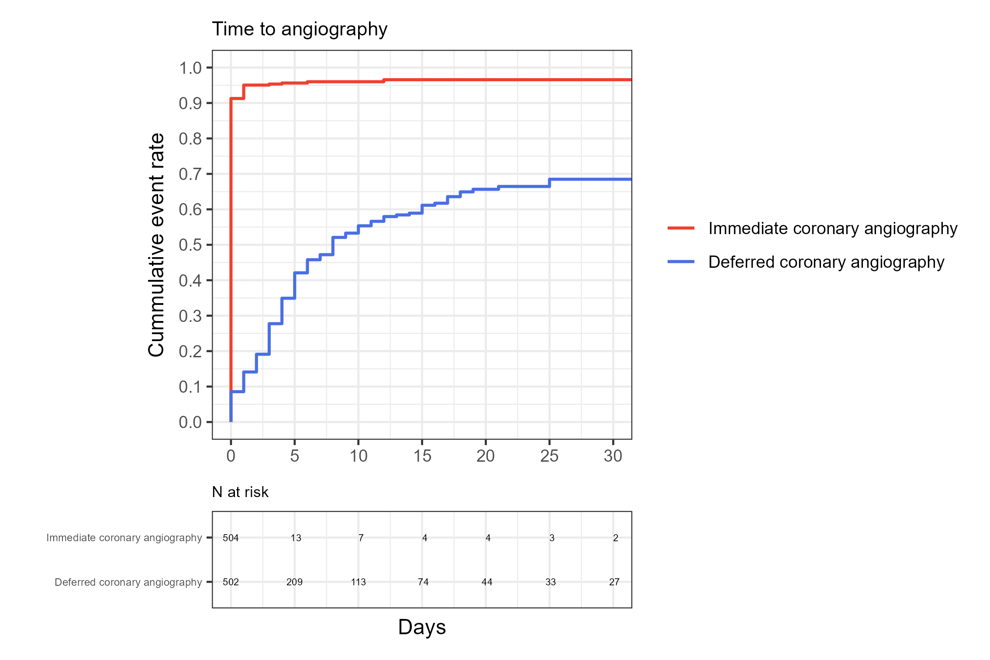
Time to coronary angiography

Slide 12
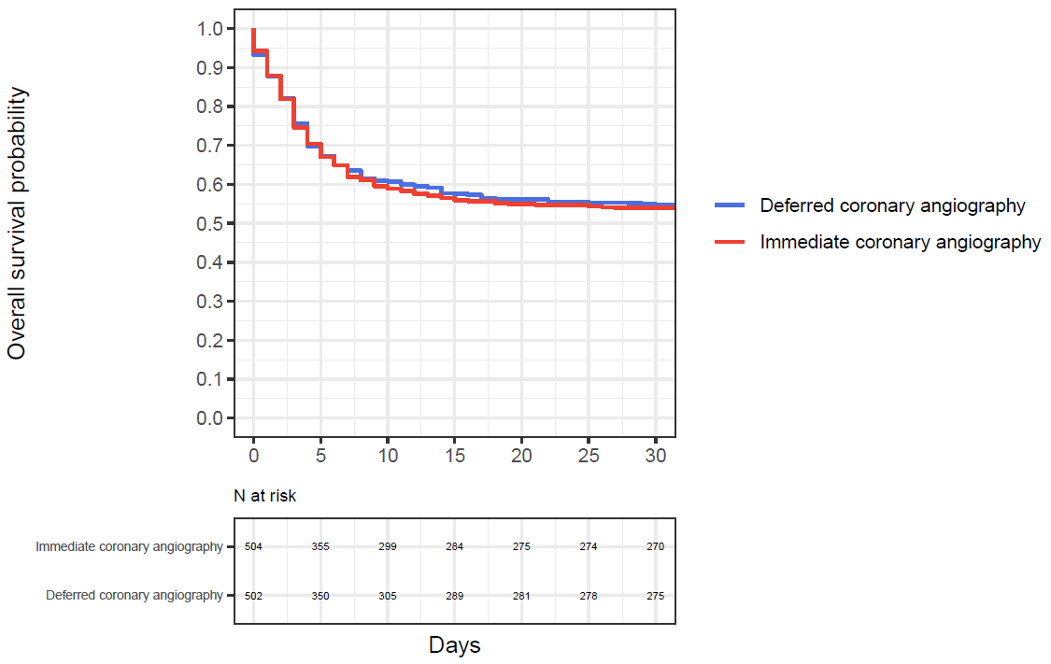
Primary outcome-30 day survival
30 day survival
54.6 % deferred
vs
53.6 % immediate
OR (95 % CI)
0.95 (0.74, 1.21)

Slide 13
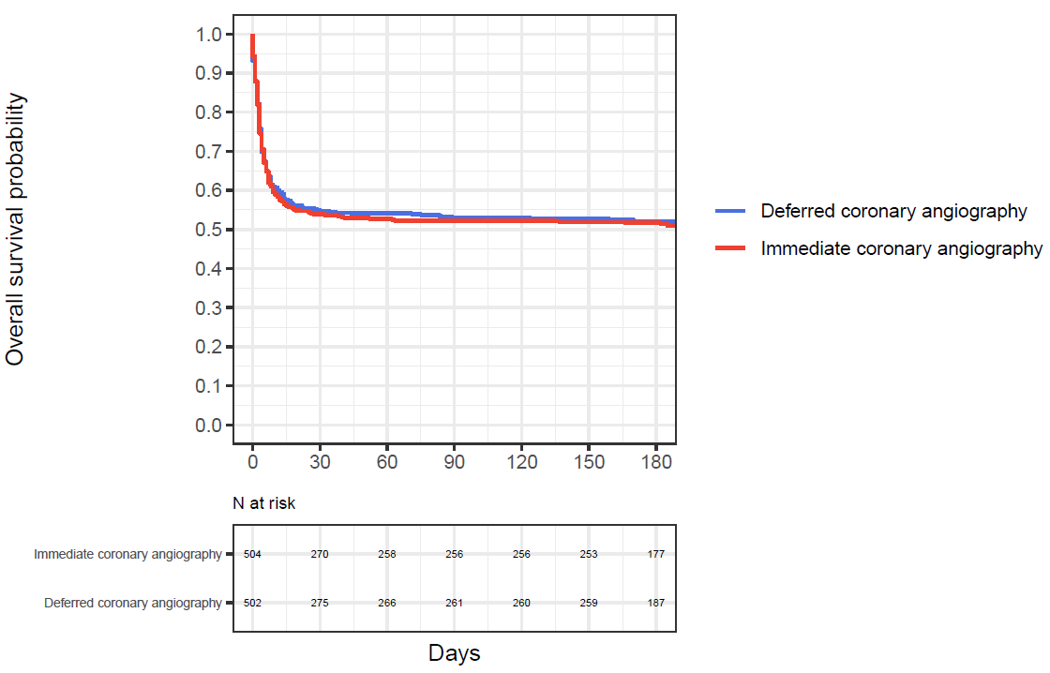
Secondary outcome-180 day survival
180 day survival
50.2 % deferred
vs
48.8 % immediate
OR (95 % CI)
0.93 (0.73, 1.20)

Slide 14
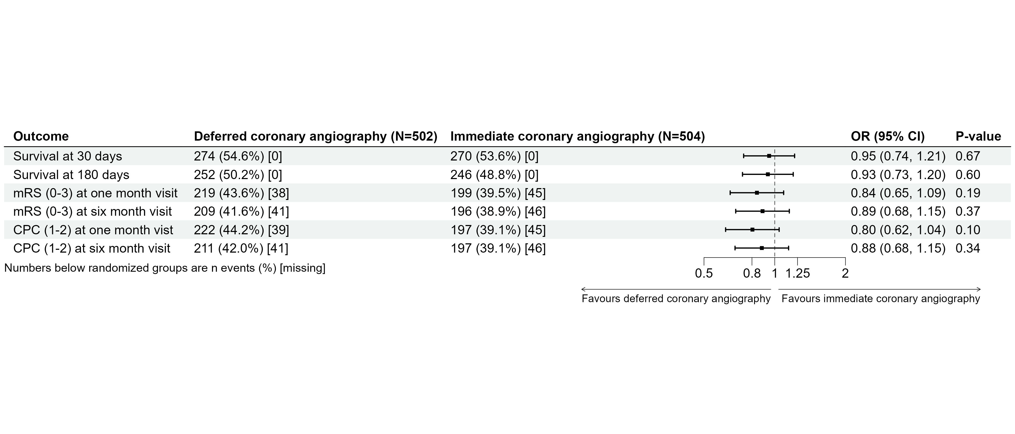
Survival and survival with good neurological outcome

Slide 15
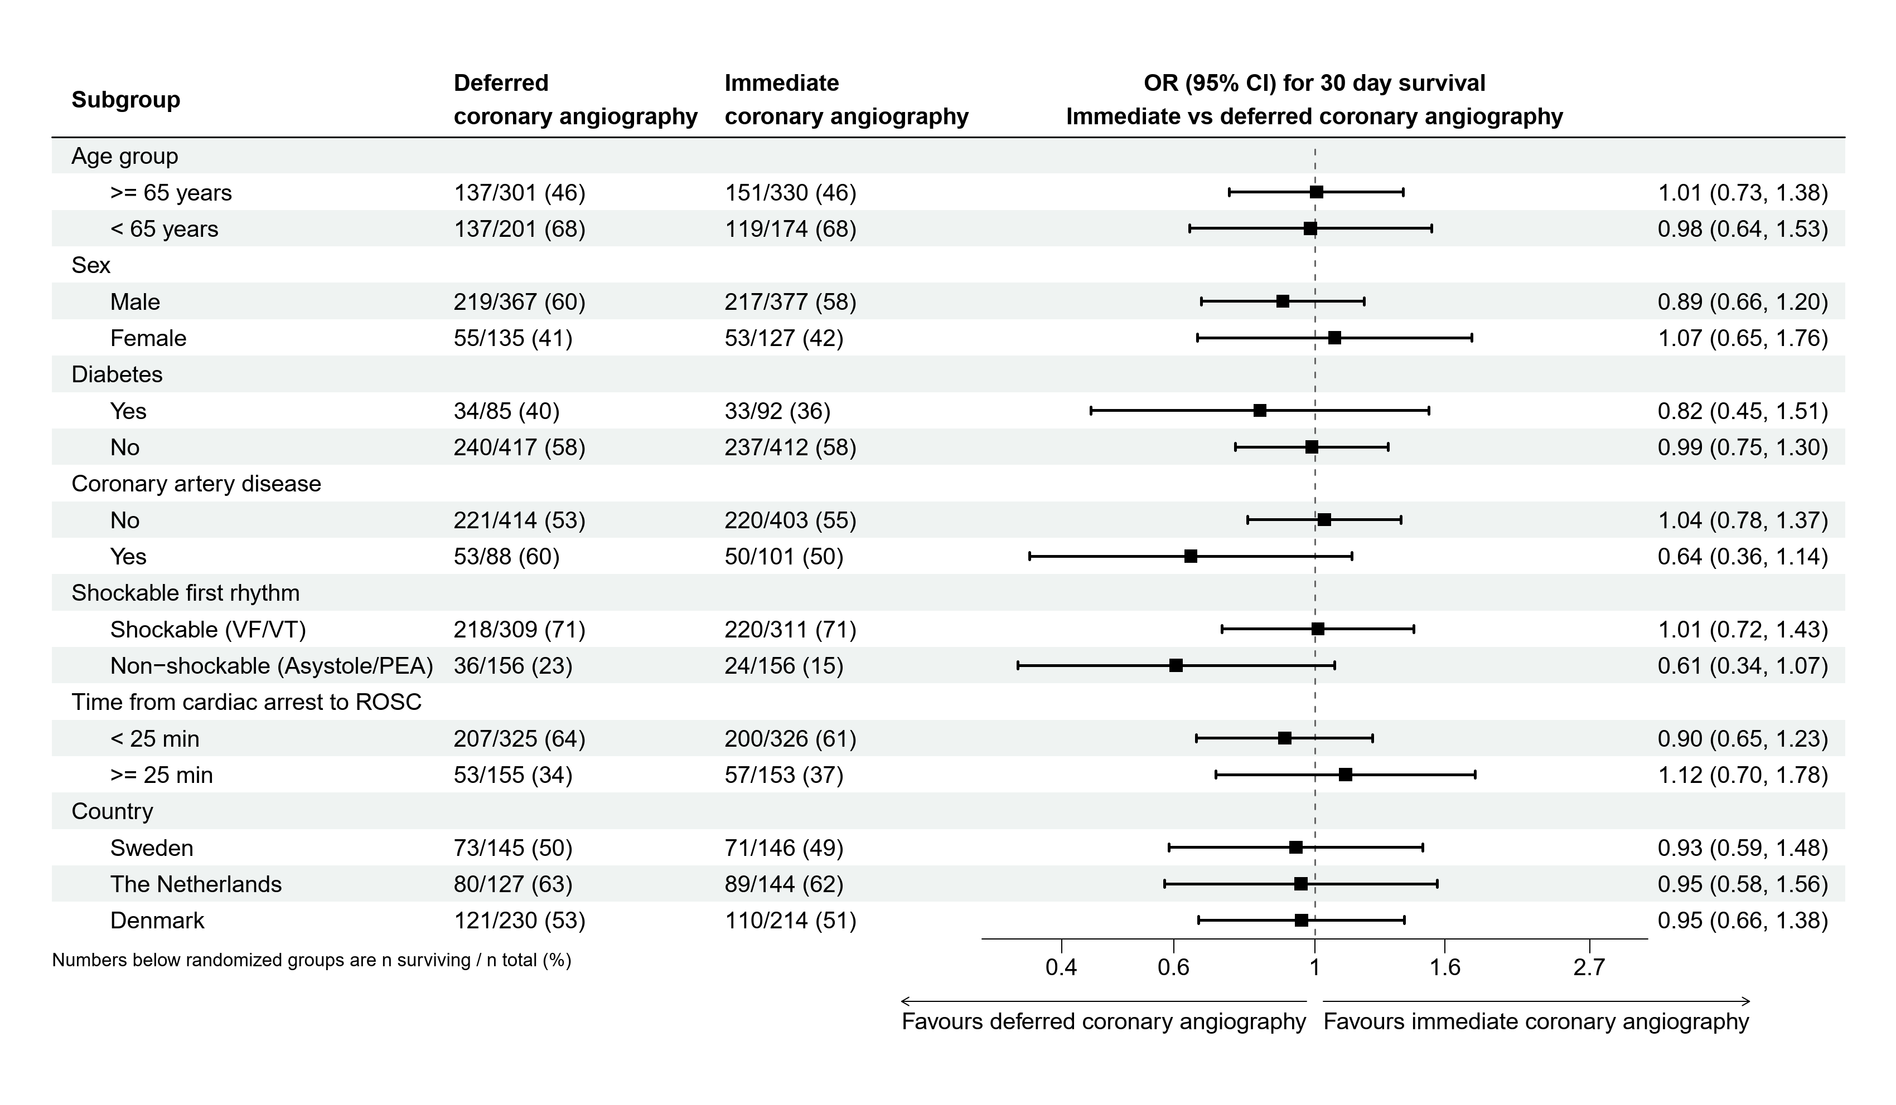
Subgroup analyses at 30 days

Slide 16
Conclusions and clinical implication
In patients successfully resuscitated after witnessed OHCA without ST-elevation on ECG immediate coronary angiography does not improve survival at 30 or 180 days
There was no difference in neurological outcome at 30 and 180 days
The study provides further support for current guideline recommendations against routine immediate coronary angiography in patients without ST-elevation after OHCA

Slide 17
Acknowledgement
Investigators
Denmark: Christian Juhl Terkelsen, John Bro-Jeppesen, Steffen Christensen, Pernille Thordahl Rohde, Troels Thim, Bent Roni Ranghøj Nielsen, Anders Grejs, Lisette Okkels Jensen, Henrik Schmidt & Kirstine Nørregaard Hansen
Netherlands: Niels van Royen, Judith Bonnes, A. el Barzouhi, R.L Anthonio, J. Henriques, Luuk Otterspoor, J. van Kuijk, R. Vandervleugel
Sweden: Stefan James, Jonas Oldgren, Rickard Lagedal, Ludvig Elfwen, Jacob Hollenberg, Leif Svensson, Felix Böhm, Per Nordberg, Liyew Desta, Jan van der Linden, Peter Lundgren, Oskar Angerås, Truls Råmunddal, Per Albertsson, Tobias Cronberg, Gisela Lilja
Coordinating study nurses: Joanna Wessbergh, Elin Söderman
Research nurses: Kerstin Höglund, Lisa Hellgren, Ola Friman, Gunilla Förstedt, Birgitta Welin-Berger, Kristina Kilsand, Liselotte Persson, Marie Thonander, Lina Håkansson
Uppsala Clinical Research Center: Biostatisticians, Ollie Östlund, Niclas Eriksson, Tatevik Lakic , Johan Lindbäck, Ulrika Andersson, Albert Nilsson, Rosa Baranzano, Projectcoordinator and monitor, Åsa Michelgård Palmquist, Data managementErika Nyberg, Åsa Eck
Sponsor: Uppsala University Sweden
Funding: Swedish Research Council, Swedish HeartLung Foundation, Laerdal Foundation for Acute Medicine

