Slide 1




EPIDAURUS
Escalated single Platelet Inhibition for one month plus Direct oral anticoagulation in patients with Atrial fibrillation and acUte coRonary syndrome undergoing percutaneoUS coronary intervention: A randomized-controlled trial
EPIDAURUS
K.D. Rizas, K. Mourouzis, K. Mayer, D. Rath, L. Villegas-Sierra, F. Korovesis, A. Polzin, C. Olivier, S. Maier, L. Bott-Fluegel, R. Wakili, I. Eitel, H. Thiele, U. Mansmann, S. Massberg
on behalf of the EPIDAURUS investigators
Munich, 29th August 2026
EPIDAURUS

Slide 2
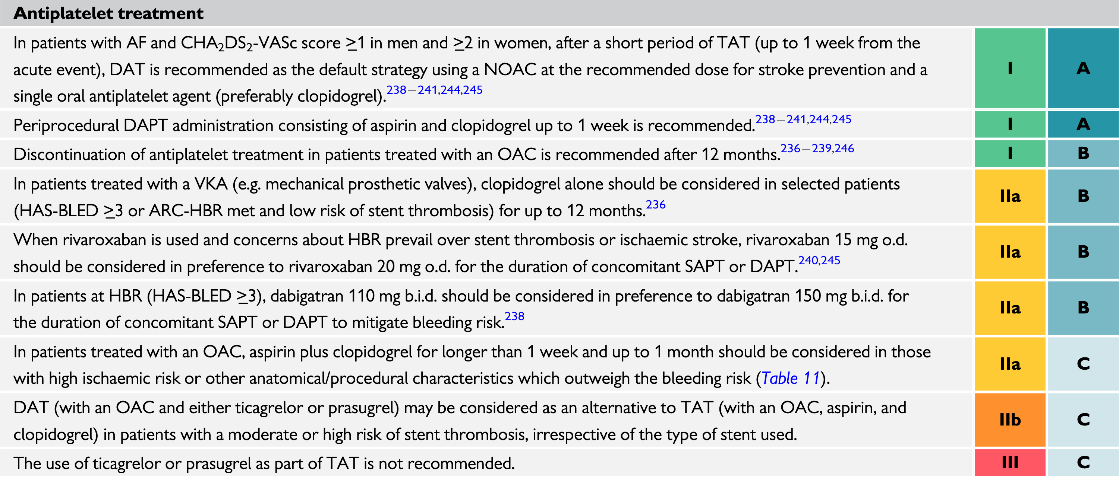
EPIDAURUS
Background
2020 and 2023 ESC Guidelines for the management of ACS

Slide 3
EPIDAURUS
Background
 | PIONEER AF-PCI ¹ | RE-DUAL PCI ² | ENTRUST-AF PCI ³ | AUGUSTUS ⁴
DOAC | Rivaroxaban | Dabigatran | Edoxaban | Apixaban
Patients, N | 2.124 | 2.725 | 1.506 | 4.614
Groups | 3 (open-label) | 3 (open-label) | 2 (open-label) | 4 (open/blinded)
Age (mean ± SD) | 70 ± 9 | 70 ± 9 | 70 ± 7 | 71 ± 7
NSTEMI/ STEMI, % | 30 % | 36 % | 39 % | 61 % (37 % PCI)
Follow-up, mo | 12 | 14 (mean) | 12 | 6
36% undergoing PCI due to NSTEM/STEMI
ISTH major bleeding | 0.56 (0.36 – 0.89) | 0.57 (0.43 – 0.76) | 0.94 (0.64 – 1.40) | 0.60 (0.44 – 0.81)*
¹ PIONEER AF-PCI, NEJM 2016; ² RE-DUAL PCI, NEJM 2017; ³ ENTRUST-AF PCI Lancet 2019; ⁴ AUGUSTUS, NEJM 2020
* DAT based on DOACs vs. TAT based on Vit.K antagonists 16.8% vs. 49.1%

Slide 4
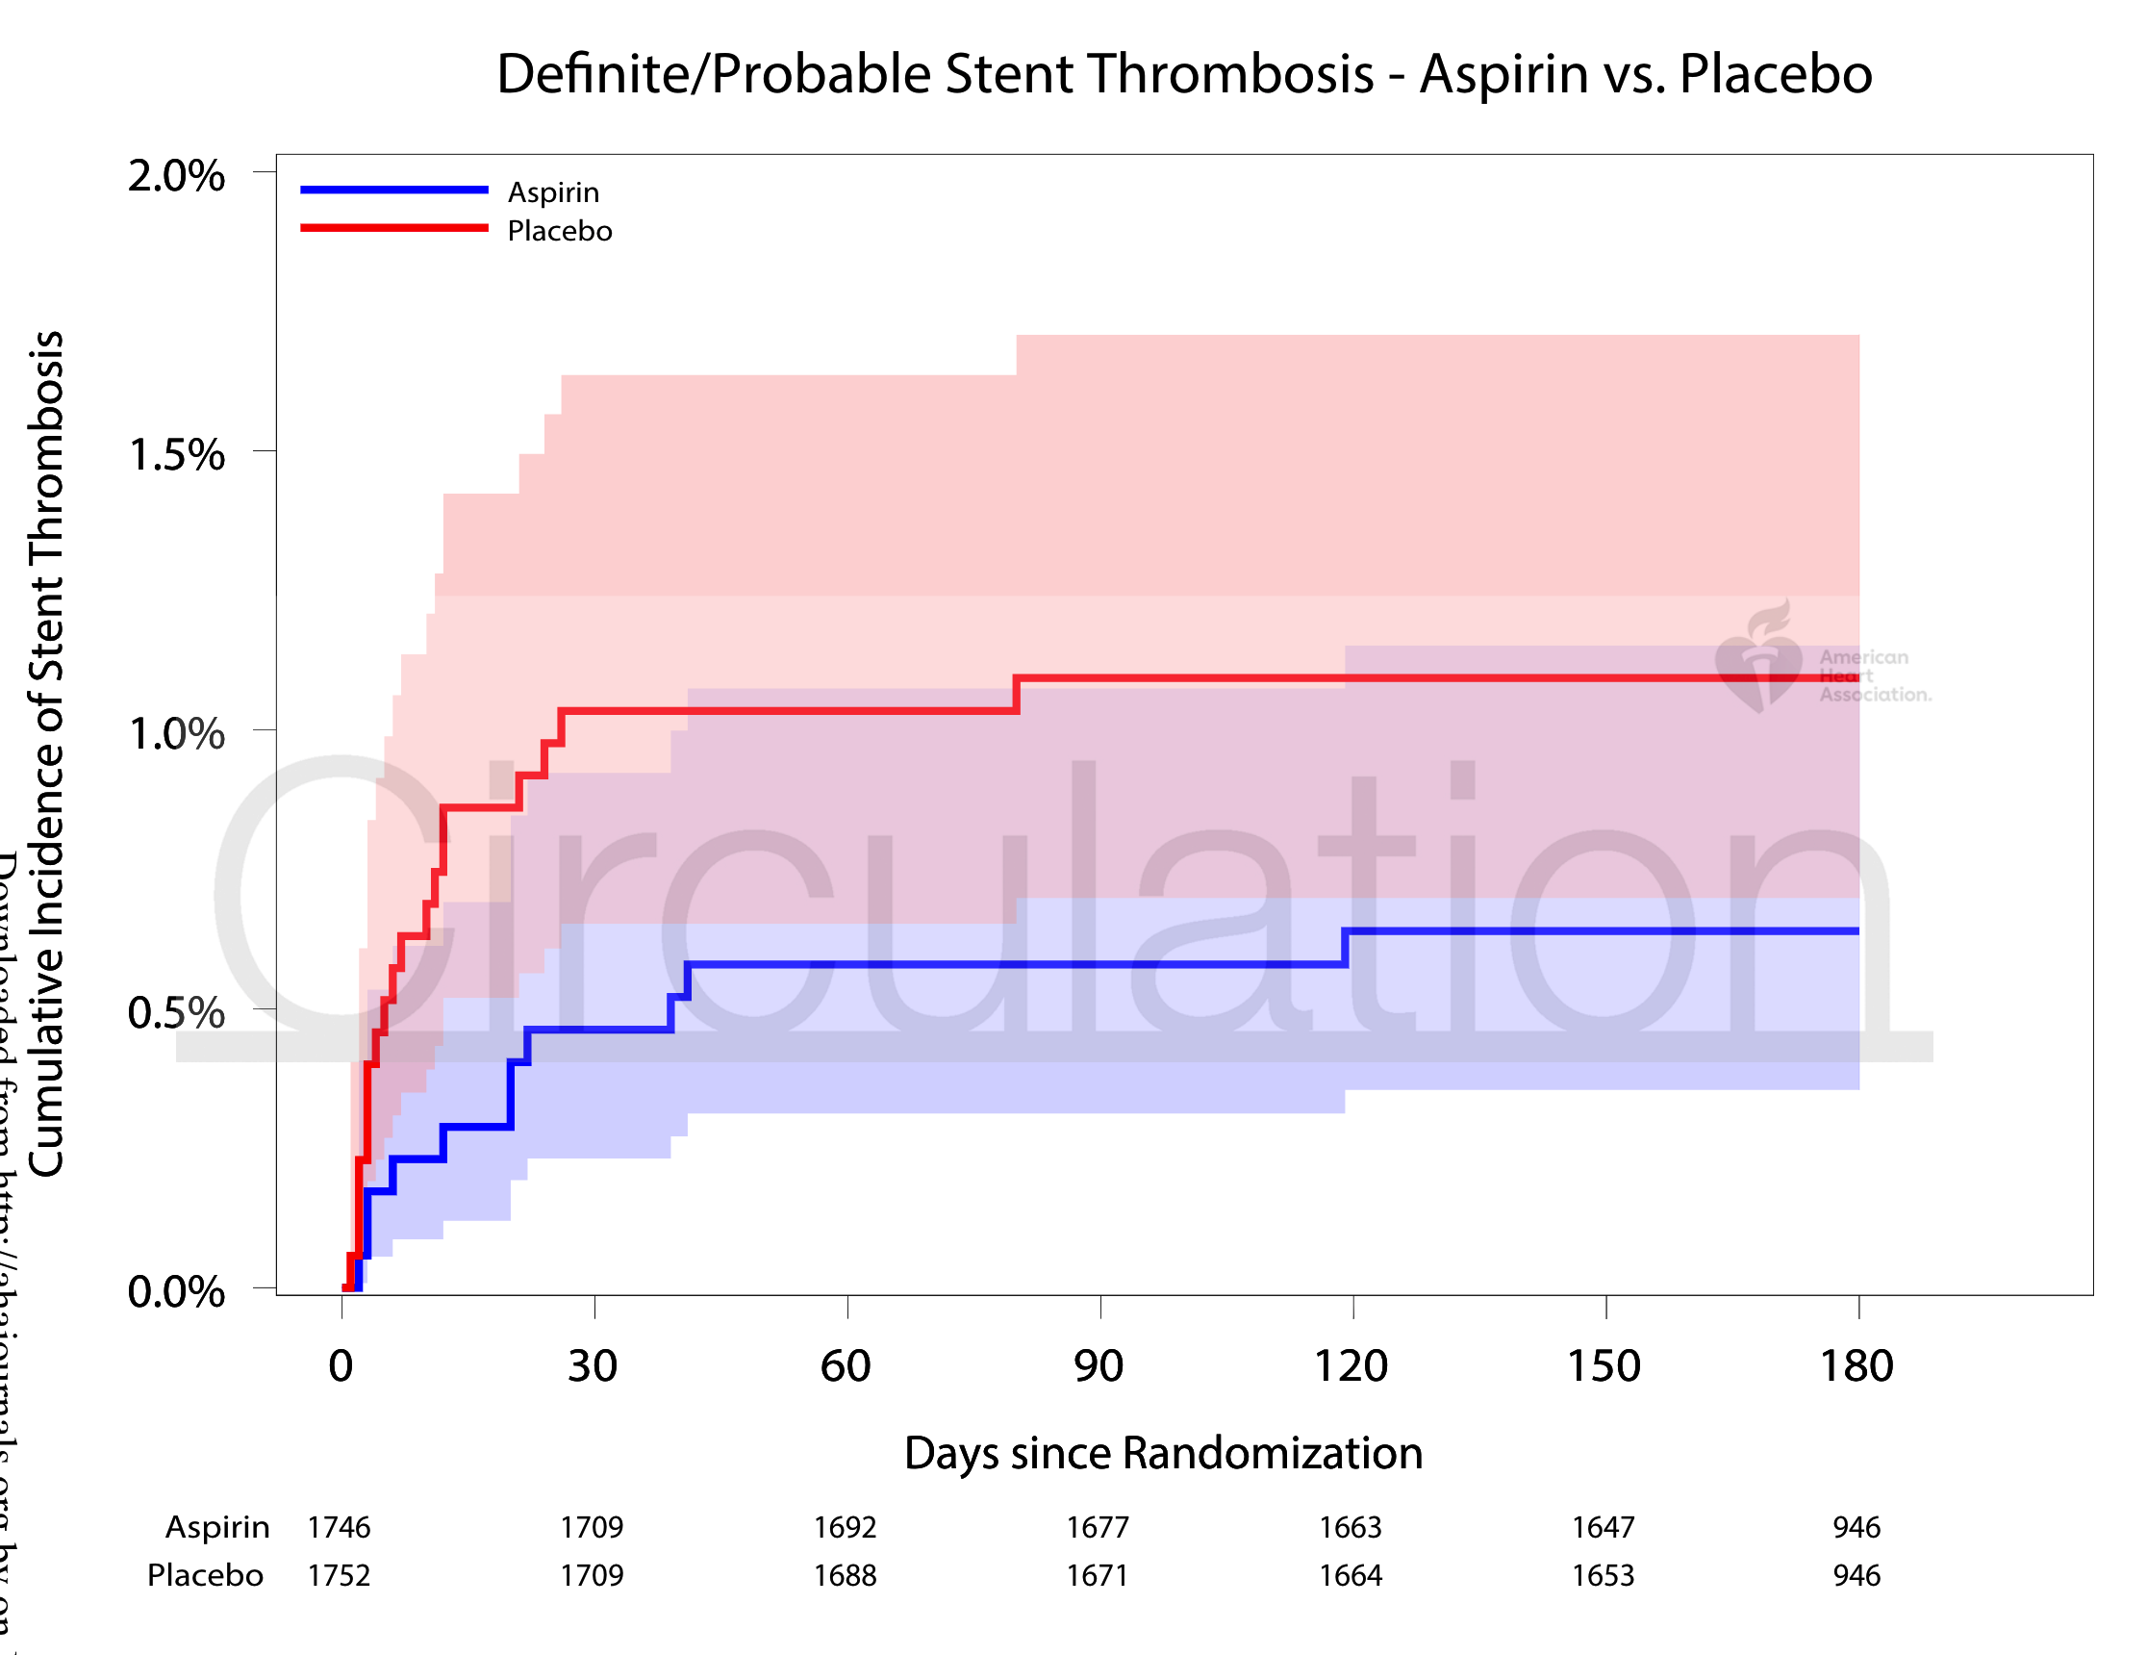
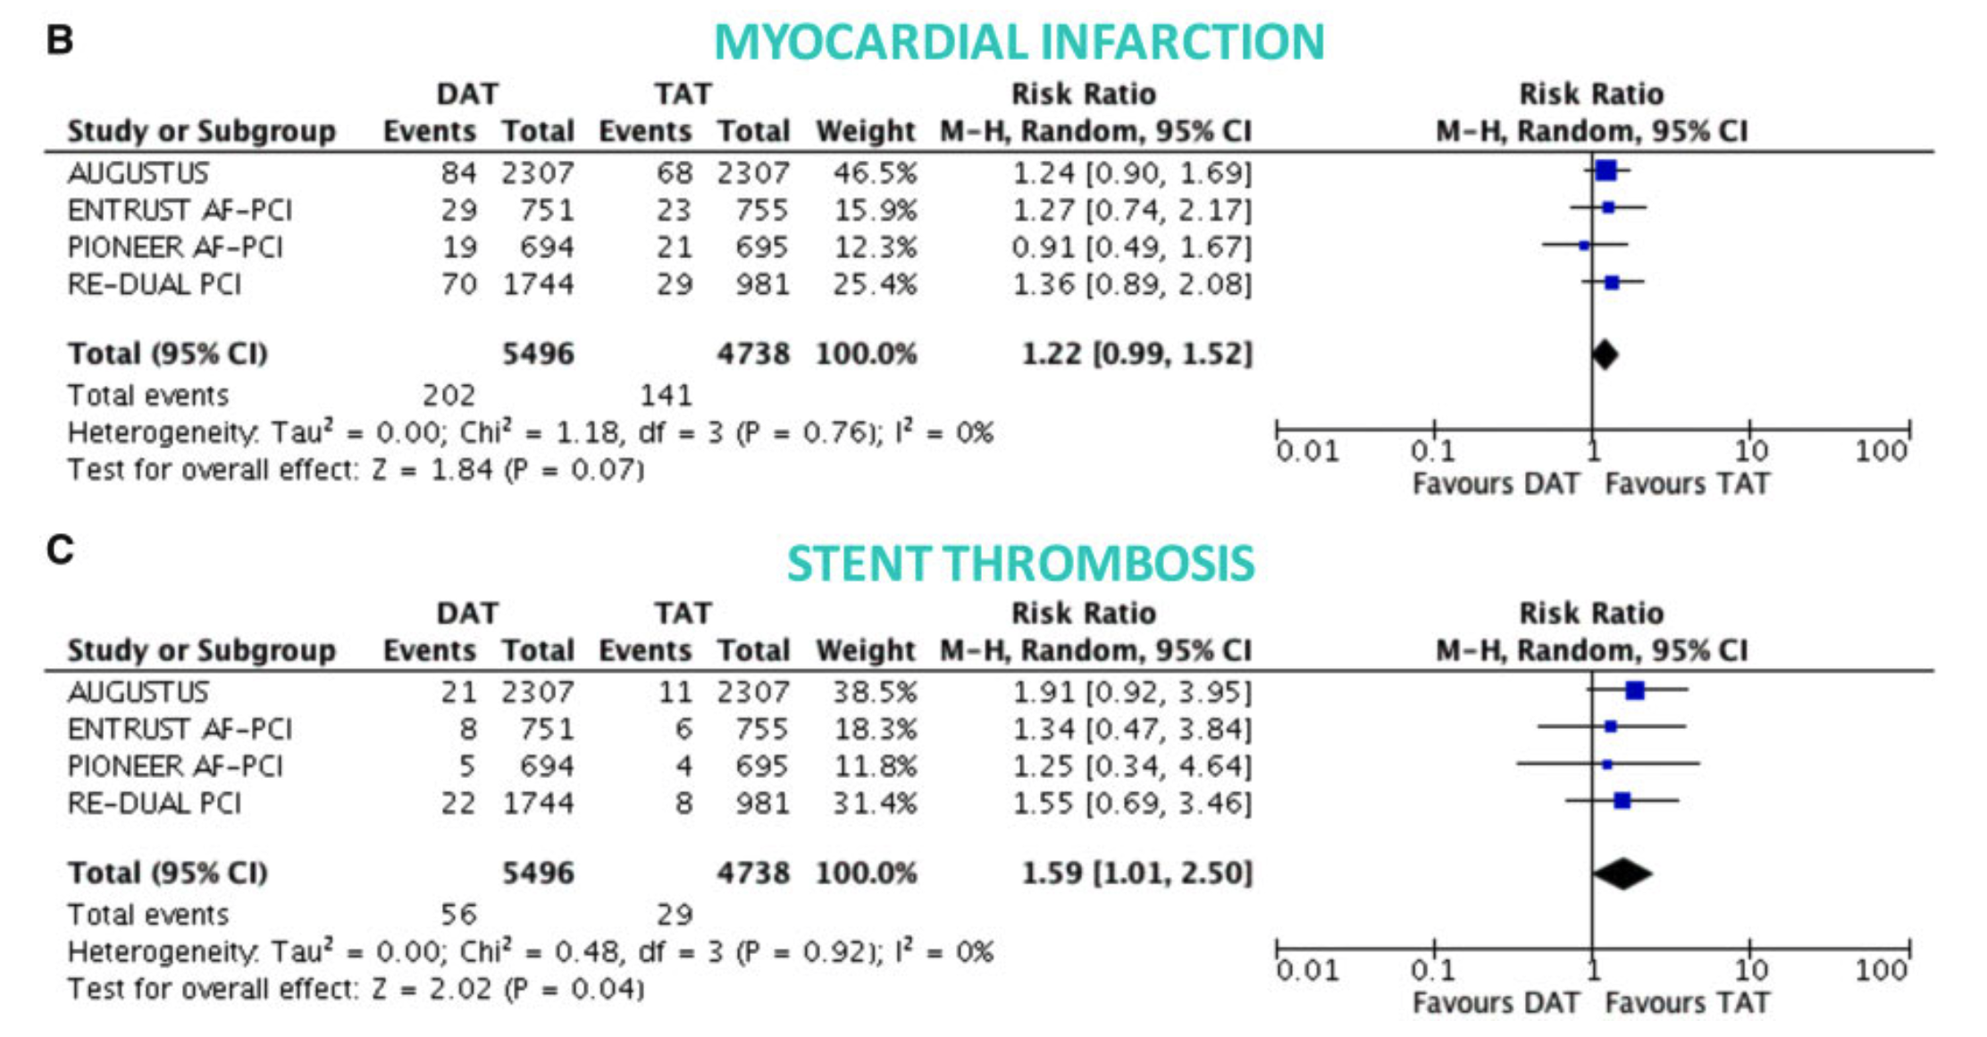
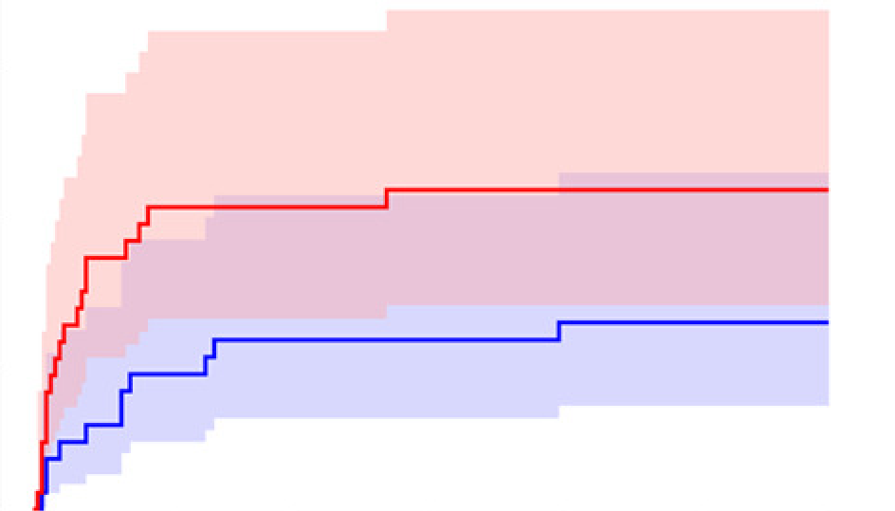
EPIDAURUS
Background
Gargiulo et al. Eur Heart J 2019
Lopes et al. Circulation 2020

Slide 5


EPIDAURUS
Background
2020 ESC Guidelines for the management of ACS in patients without STE
No recommendation due to limited evidence
2023 ESC Guidelines for the management of ACS

Slide 6
EPIDAURUS
Hypothesis
In patients with atrial fibrillation and acute coronary syndrome undergoing percutaneous coronary intervention, dual antithrombotic therapy (DAT) using oral factor Xa inhibitors plus potent P2Y12-inhibitors (prasugrel or ticagrelor) for one month, followed by clopidogrel could reduce ischemic events without a relevant increase in bleeding complications compared to standard in-hospital triple antithrombotic therapy (TAT) followed by DAT with direct factor Xa inhibitors plus clopidogrel.

Slide 7
EPIDAURUS
Study design
Investigator-initiated, randomized-controlled, open-label, parallel-group multicentre study
37 tertiary centres in Germany and Austria
Sponsor: Ludwig Maximilian University (LMU) hospital in Munich
Funded by Daiichi Sankyo Europe and the LMU university hospital
CRO: ISAResearch Center, TUM, Munich
Kiel
Rostock
Lübeck
Hannover
Bielefeld
Essen
Berlin
Paderborn
Düsseldorf
Hagen-Haspe
Leipzig
Bonn
Bad Nauheim
Dresden
Frankfurt
Mainz
Coburg
Mannheim
Nürnberg
Heidelberg
Straubing
Freiburg
Tübingen
Ingolstadt
Bad Krozingen
Dachau
Erding
Constance
Munich
Singen
Friedrichshafen
Innsbruck

Slide 8
EPIDAURUS
Study design
Inclusion criteria: Successful PCI due to NSTEM/STEMI and indication for OAC due to atrial fibrillation
Exclusion criteria: Contraindication for DOACs and contraindication for both Ticagrelor and Prasugrel
Experimental
DOAC + Prasugrel or Ticagrelor
After 1 month: DOAC + Clopidogrel
6 months
R
E
FU
Control
DOAC + Clopidogrel +
ASA (in-hospital)
N = 1,474
16.12.21
31.12.27
Initiation
of the trial
DOAC = Factor Xa inhibitors (Apixaban or Edoxaban or Rivaroxaban)
In the experimental arm switch from Prasugrel/Ticagrelor to Clopidogrel between days 27 - 33
End of
recruitment

Slide 9
EPIDAURUS
Primary endpoints of the trial: 6 weeks after randomization
Hierarchical testing
Efficacy: Ischemic events (ITT - FAS)
Death
Definite or probable stent thrombosis
Myocardial infarction (MI)
Ischemic stroke
Systemic thromboembolism
Urgent revascularization
Safety (modified ITT - PPS)
Death
BARC 3c bleeding
BARC 3b bleeding
BARC 3a bleeding
BARC 2 bleeding
Superiority
Non-inferiority
Non-inferiority delta 30%, WLR lower margin 0.77
Win-Loss-Ratio
ITT = intention-to-treat, FAS = full-analysis set
mITT = modified intention-to-treat, PPS = per-protocol set

Slide 10
EPIDAURUS
Secondary endpoints of the trial
Death, MI, Stent thrombosis, stroke, systemic thromboembolism, urgent revascularization
Death, MI, Stent thrombosis, stroke, systemic thromboembolism
Death, BARC ≥ 2 bleeding
BARC ≥ 2 bleeding
BARC ≥ 3 bleeding
Any bleeding
Time-to-event Cox-regression analysis
6-weeks and 6 months after randomization

Slide 11
EPIDAURUS
Study design
Experimental
DOAC + Prasugrel or Ticagrelor
After 1 month: DOAC + Clopidogrel
19.09.25
Trial stopped by the DSMB
6 months
R
E
FU
Control
DOAC + Clopidogrel +
ASA (in-hospital)
N = 1,474
16.12.21
31.12.27
Initiation
of the trial
DOAC = Factor Xa inhibitors (Apixaban or Edoxaban or Rivaroxaban)
In the experimental arm switch from Prasugrel/Ticagrelor to Clopidogrel between days 27 - 33
End of
recruitment

Slide 12
EPIDAURUS
Study design
Experimental
DOAC + Prasugrel or Ticagrelor
After 1 month: DOAC + Clopidogrel
N = 302
19.09.25
Trial stopped by the DSMB
6 months
R
E
FU
Control
DOAC + Clopidogrel +
ASA (in-hospital)
N = 300
N = 602
16.12.21
19.09.25
Initiation
of the trial
DOAC = Factor Xa inhibitors (Apixaban or Edoxaban or Rivaroxaban)
In the experimental arm switch from Prasugrel/Ticagrelor to Clopidogrel between days 27 - 33
End of
recruitment

Slide 13
EPIDAURUS
3rd regular DSMB meeting and decision to terminate the trial
”Based on the low likelihood of superiority of the experimental intervention along with the safety signal with an increased number of deaths, strokes, and bleedings in the experimental group the DSMB recommends termination of the trial.”
 | Deaths | Ischemic Strokes | Overall Strokes | Bleeding events | Myocardial infarction | Stent thrombosis | Urgent Revascular.
Experimental | 21 | 6 | 7 | 103 | 13 | 4 | 7
Control | 16 | 1 | 1 | 76 | 14 | 5 | 8
Unadjudicated events during the entire follow-up period at the time of the 3rd regular DSMB meeting.
No censoring was applied, some patients experienced more than one event.

Slide 14
EPIDAURUS
Results – Patients’ characteristics
Baseline characteristics | Experimental | Control
N | 302 | 300
Age, years (Q1-Q3) | 78 (71 – 83) | 78 (68 – 83)
Female sex, N (%) | 87 (29%) | 67 (22%)
STEMI, N (%) | 59 (20%) | 60 (20%)
HAS-BLED, score (Q1 – Q3) | 3 (3 – 3) | 3 (2 – 3)
CHA₂DS₂-VA, score (Q1 – Q3) | 4 (3 – 5) | 4 (3 – 4)
Transradial access, N (%) | 221 (73%) | 229 (76%)
Length of stents, mm (Q1 – Q3) | 28 (18 – 40) | 28 (18 – 44)

Slide 15
EPIDAURUS
Results – Win-Loss-Ratio 6 weeks after randomization
Win-Loss-Ratio: 1.19 (0.61 – 2.32; p = 0.610)
Death
Win-Loss-Ratio: 0.66 (0.39 - 1.11; p = 0.115)
10000
10000
p-non inferiority for WLR < 0.77: 0.713
BARC 3c bleeding
9,477 wins
6,214 wins
9000
BARC 3b bleeding
9000
BARC 3a bleeding
2,601
8000
BARC 2 bleeding
8000
7000
4,673 wins
5,556 wins
7000
Number of Wins
Number of Wins
6000
6000
1,445
5000
5000
2,448
1,437
4000
2,664
4000
2,668
Death
784
3000
3000
582
Stent thrombosis
2000
Myocardial infarction
2000
3,945
582
1,452
Ischemic stroke
2,982
1000
571
1000
568
Systemic thromboembolism
284
858
Urgent revascularization
0
Control
Experimental group
0
Control
Experimental group
Efficacy Endpoints (intention-to-treat)
Safety Endpoints (per-protocol)

Slide 16
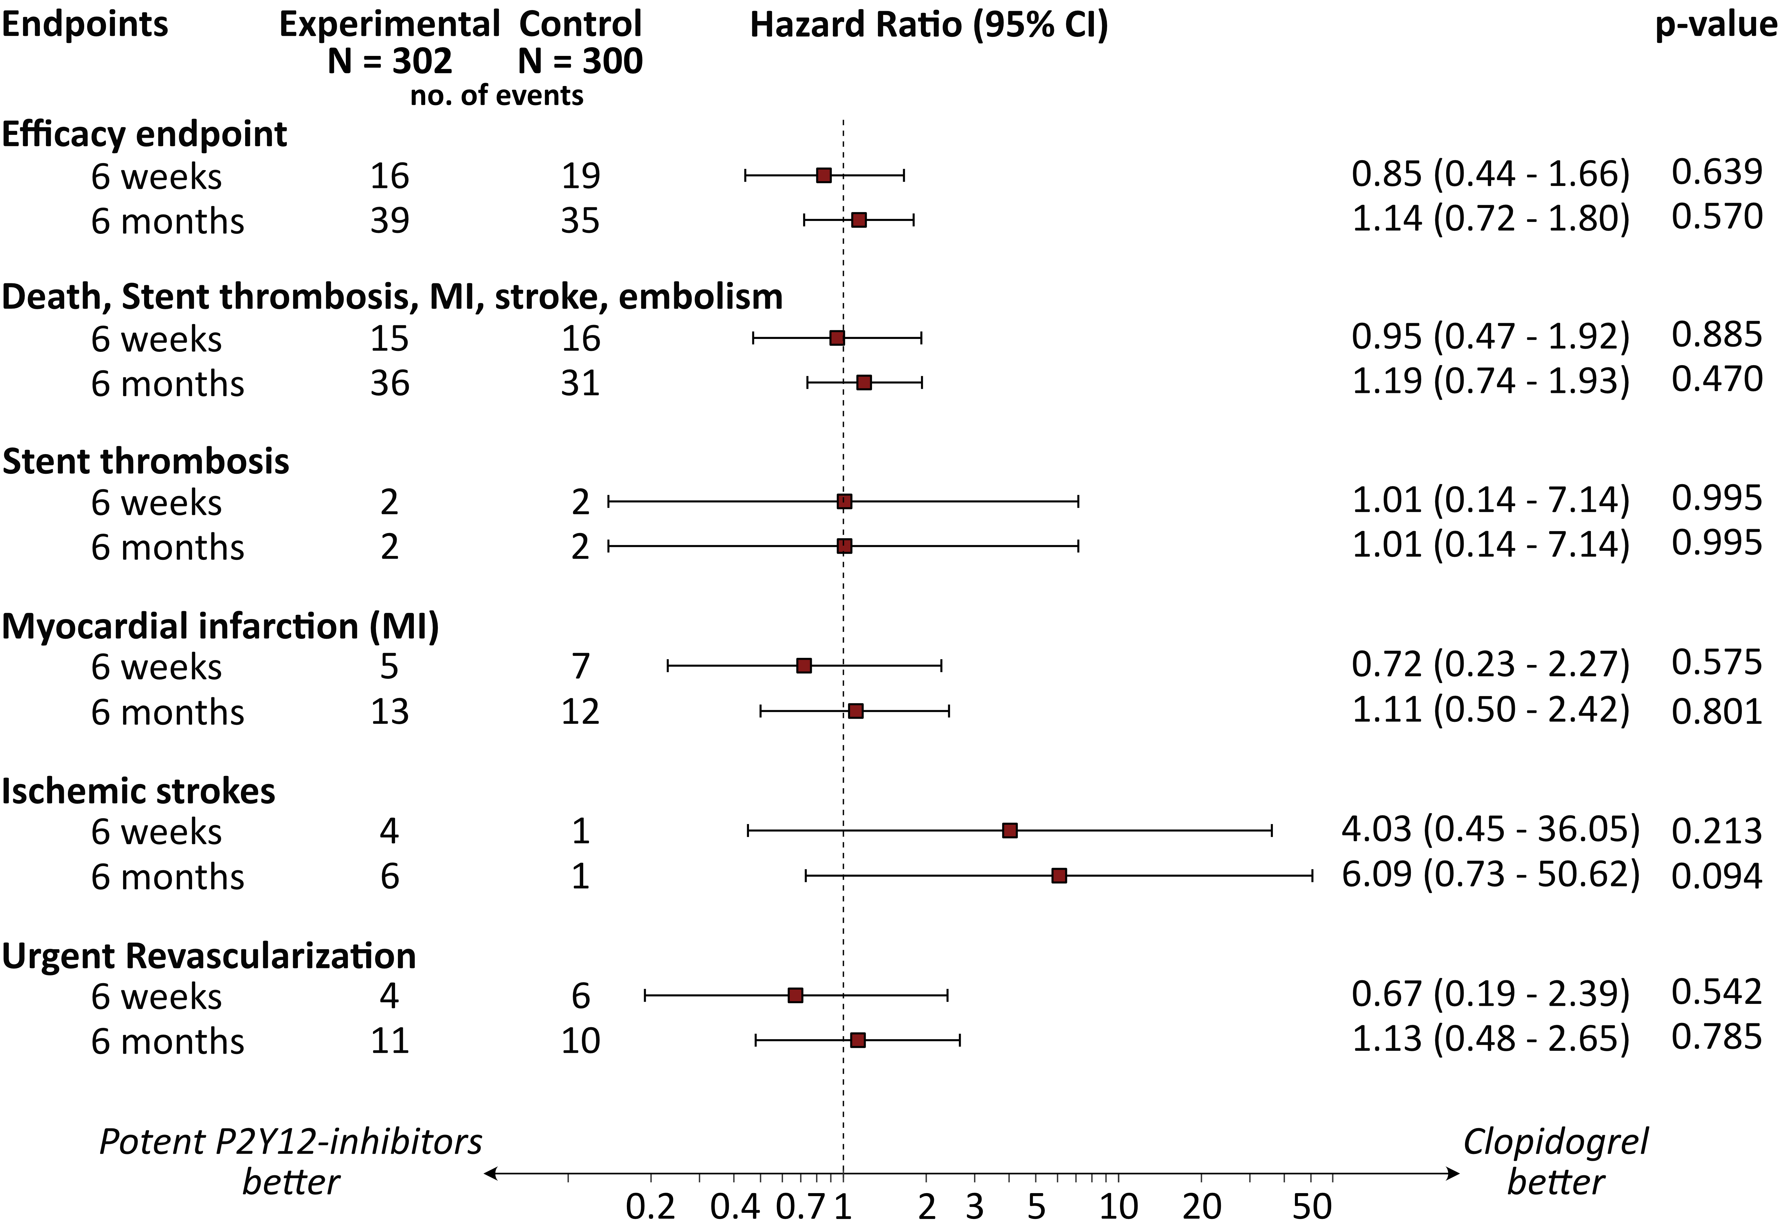
EPIDAURUS
Results – Time to event analyses
Efficacy Endpoints (intention-to-treat)

Slide 17
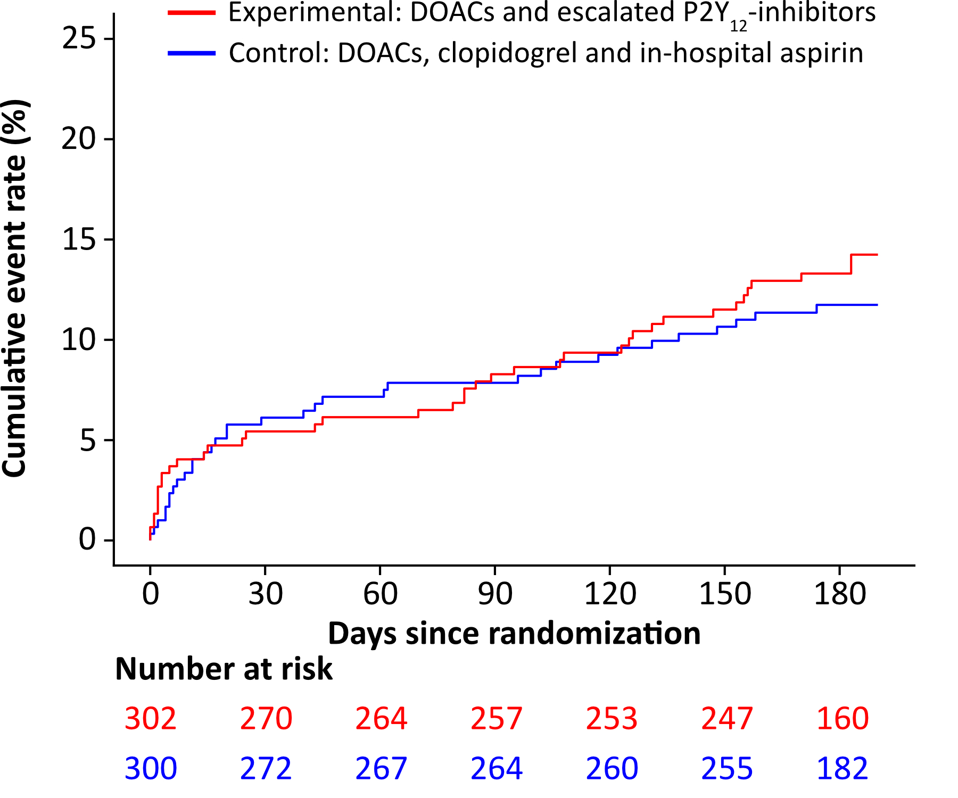
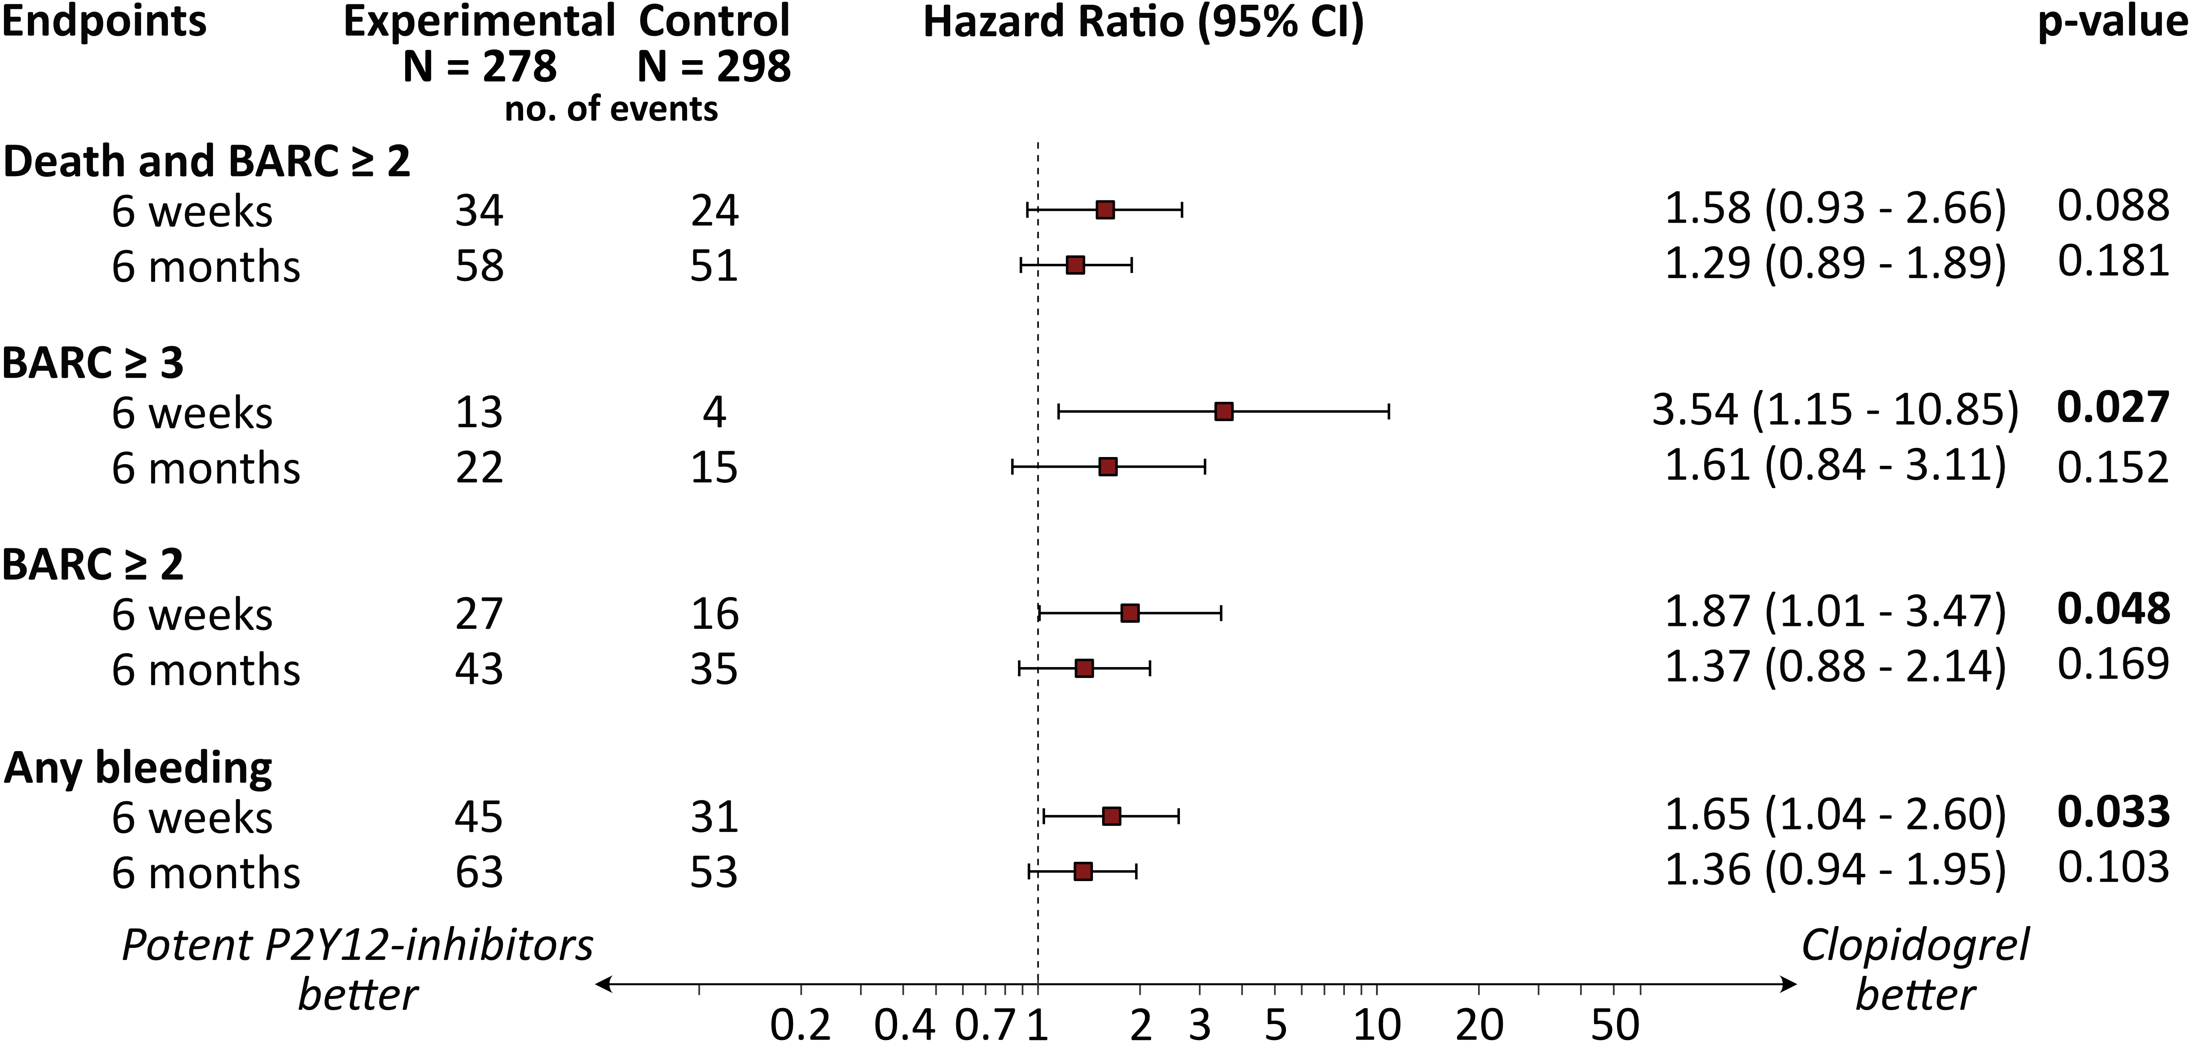
EPIDAURUS
Results – Time to event analyses
HR 0.85 (0.44 – 1.66); p = 0.639
6-weeks
Death, Stent thrombosis, MI, Stroke, Thromboembolism, Revascularization
6-months
HR 1.14 (0.72 – 1.80); p = 0.570
HR 2.18 (1.16 – 4.11); p =0.016
BARC ≥ 2
bleeding
Ischemic
complications
Efficacy Endpoints (intention-to-treat)
Safety Endpoints (per-protocol)

Slide 18
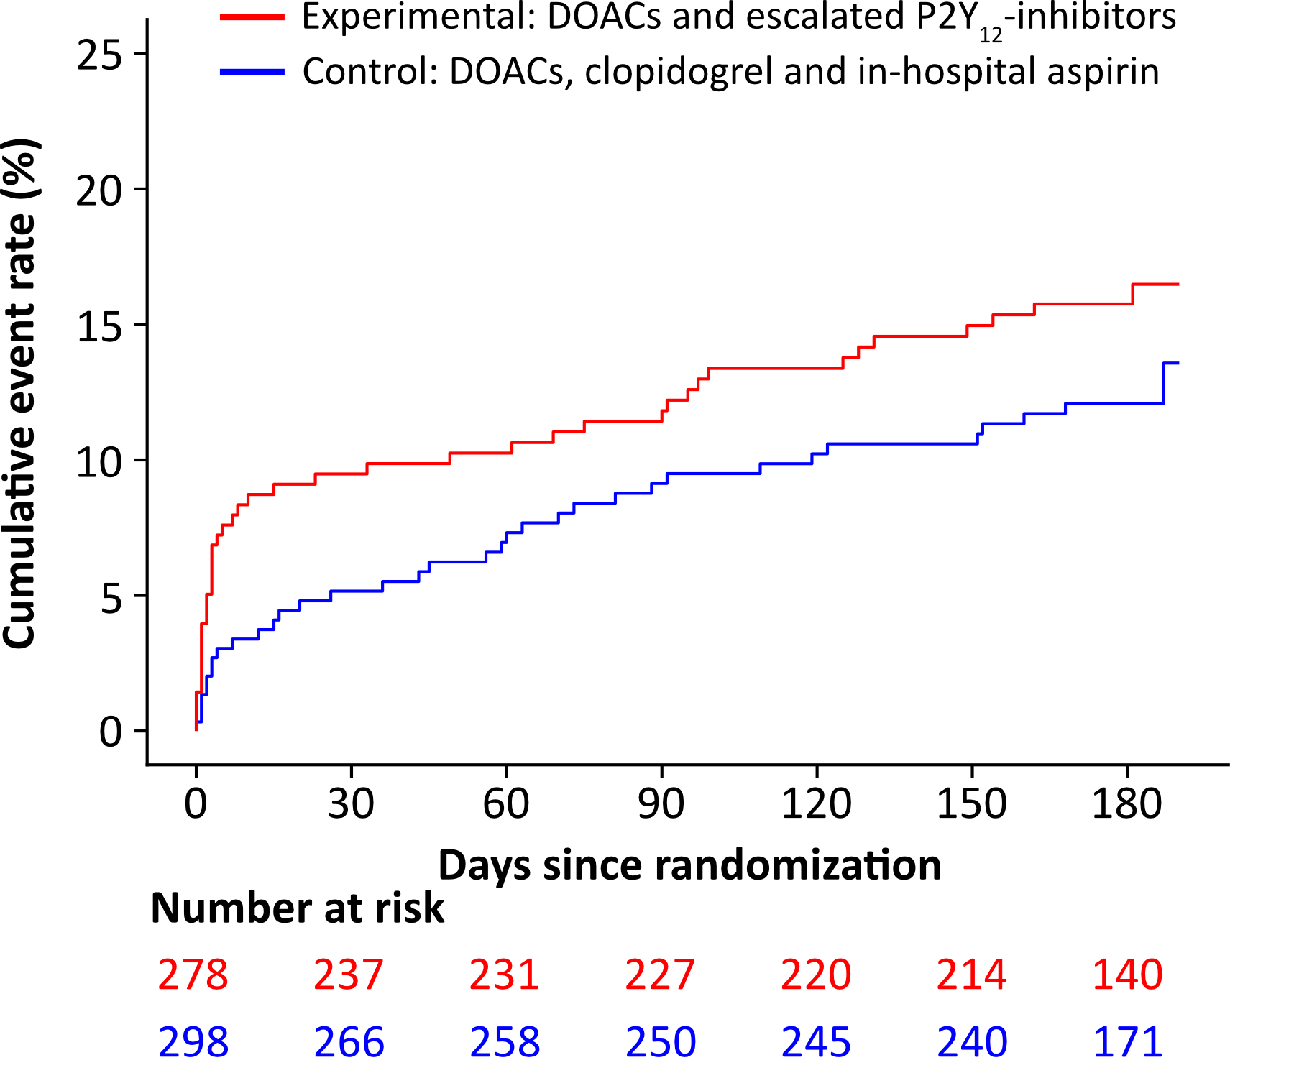
EPIDAURUS
Results – Time to event analyses
HR 0.85 (0.44 – 1.66); p = 0.639
HR 1.87 (1.01 – 3.47); p = 0.048
Intervention
Intervention
6-weeks
6-weeks
Death, Stent thrombosis, MI, Stroke, Thromboembolism, Revascularization
6-months
HR 1.14 (0.72 – 1.80); p = 0.570
6-months
HR 1.37 (0.88 – 2.14); p = 0.169
BARC ≥ 2 bleeding
Efficacy Endpoints (intention-to-treat)
Safety Endpoints (per-protocol)

Slide 19
EPIDAURUS
Main Limitations
Premature termination of the trial after recommendation of the DSMB.
Because of the hierarchical design of the trial and the fact that the first hypothesis was not met, all subsequent analyses remain secondary and hypothetical.
The selection of the escalated P2Y12-inhibitor (ticagrelor or prasugrel) and the DOAC (edoxaban, apixaban or rivaroxaban) was at the discretion of the treating physician.

Slide 20
EPIDAURUS
Conclusion
EPIDAURUS is the first randomized trial to date evaluating a strategy of intensified P2Y12-inhibition with prasugrel or ticagrelor in combination with a direct factor Xa inhibitor in patients with atrial fibrillation and acute coronary syndrome.
Within the limitations of premature termination there was a consistent signal that intensified P2Y12-inhibition was associated with a higher incidence of bleeding without evidence of a reduction in ischemic events.
The results of EPIDAURUS do not support the routine combination of DOACs with prasugrel or ticagrelor.

Slide 21
EPIDAURUS
Acknowledgments
EPIDAURUS investigators
Steering Committee members
  Prof. S. Massberg, Prof. K. Rizas, Prof. I. Eitel, Prof. T. Stiermaier, Prof. A. Kastrati, Prof. D. Sibbing, Prof. P. Kirchhof, Prof. C. Stellbrink, Prof. H. Thiele, Prof. U. Landmesser, PD M. Kollum
Data and Safety Monitoring Board members
  Prof. N. Marx, Prof. C. Meyer-Zürn, Prof. E. Charitos
Endpoint Adjudication Committee members
  Prof. B. Krämer, Prof. B. Huber, Dr. W. Hamm
Rostock
Kiel
Lübeck
Hannover
Bielefeld
Essen
Berlin
Paderborn
Düsseldorf
Hagen-Haspe
Leipzig
Bonn
Bad Nauheim
Dresden
Frankfurt
Mainz
Coburg
Mannheim
Nürnberg
Heidelberg
Straubing
Freiburg
Tübingen
Ingolstadt
Bad Krozingen
Dachau
Erding
Constance
Munich
Singen
Friedrichshafen
Innsbruck

Slide 22
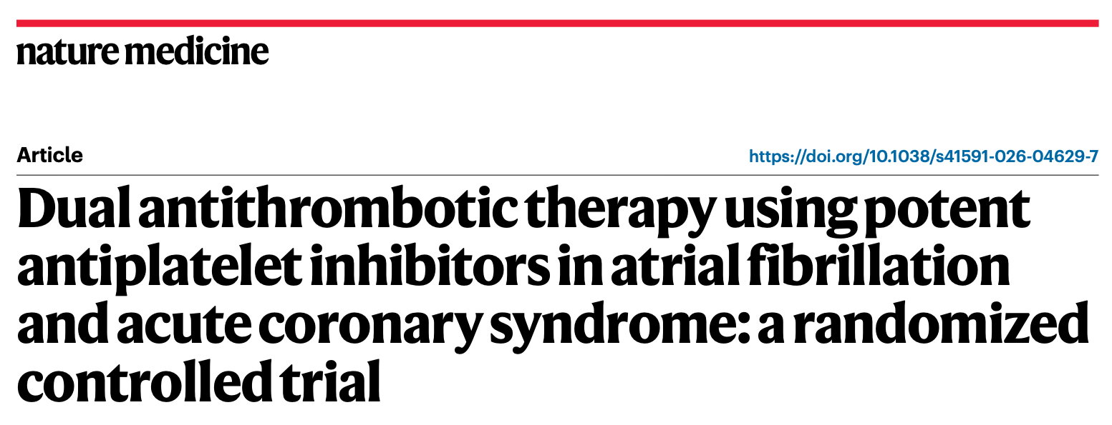

EPIDAURUS
Thank you for your attention.
13:00 CEST

