Slide 1

Virtual Integrated Reliable Transformative User-driven E-health System for Pacemakers and Implantable Cardioverter Defibrillators: two randomized clinical trials (VIRTUES PM and VIRTUES ICD)
Ratika Parkash MD MSc, George Wells, Amir Abdelwahab, Habib Khan, Laurence Sterns, Martin van Zyl, Isabelle Nault, Jean-Francois Sarrazin, Felix Ayala-Paredes, Felix Ayala-Valani, Marcio Sturmer, Maxime Ceran-la, Satish Raj, Bernard Thibault, Umjeet Jolly, William Chan, Stephen Duffett, Clarence Khoo, Satish -al, Samuel Sears, Kednapa Thavorn, Anthony Tang
On behalf of the Cardiovascular Network of Canada

Slide 2
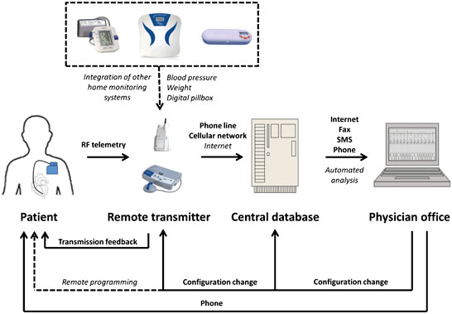
Background
The use of remote monitoring technology is non-uniform across geographies globally and the burden of remote monitoring transmissions is high due to the acuity of this population
Patients desire knowledge about their device
Digital solutions have been proposed to assist in workflows to ease clinic burden, improve efficiency while maintaining safety and reducing cost
Evidence around such solutions is generally lacking
Roka and Schoenfeld. J of Innovat in Cardiac Rhythm Management, 2 (2011), 381–393
Farkowski et al Europace 2025;27(7)
Kelly et al CJCO 2021;3:391-9

Slide 3
Study Design and Hypotheses
Randomized, multicenter, open-label, non-inferiority study with blinded endpoint adjudication performed in Canada
VIRTUES-PM – 13 sites
VIRTUES-ICD – 11 sites
1: A virtual E-health system (VIRTUES) in addition to remote monitoring will be non-inferior to standard of care in safety in follow up of patients with PMs
2: In addition, VIRTUES will be cost saving compared to standard of care
1: A virtual E-health system (VIRTUES) in addition to remote monitoring will be non-inferior to standard of care in both safety and efficacy in follow up of patients with ICDs
2: In addition, VIRTUES will be cost saving compared to standard of care

Slide 4
Intervention
Patient is enrolled into VIRTUES
The patient receives a username and password, downloads the app to a phone/tablet OR logs on to the website Virtuescare.app on a computer
The device clinic physician/provider reviews the transmission and sends back a green/yellow/red alert based on the findings in the transmission
Scheduled (every six months) or unscheduled remote transmissions are uploaded by the device clinic into the platform
The device clinic physician/provider reviews the transmission and sends back a green/yellow/red alert based on the findings in the transmission
At 18 months, the study is completed, the patient returns to standard of care
VIRTUES is a digital health platform securely built:
closed-system architecture hosted through ThinkOn, a Canadian-owned cloud provider and the only fully accredited Canadian sovereign cloud provider approved by the Federal Government
ThinkOn is certified to meet PIPEDA, HIPAA, GDPR, ISO 27001/27017/27018, SOC 2 Type II, and PCI standards.
PHIPA-compliant safeguards
ThinkOn’s Tier 3 Canadian data centres included Federal Secret-cleared environments with biometric access controls, video surveillance, redundant power and networking, and on-site operational security personnel

Slide 5
VIRTUES transmission
Communication guide
Green
Yellow
Red
Device is working well, no alerts, usual follow up is recommended
There is an issue with the device. The clinic will contact the patient on the next business day.
The patient should contact the clinic the same day the message is received.
Communication includes: device pacing, device battery longevity, alerts
Artificial intelligence used - extract:
battery longevity
Alerts
atrial or ventricular arrhythmia
lower limit for pacing
percentage pacing
For VIRTUES ICD only:
ICD shock
tachycardia detection for delivery of high voltage therapy

Slide 6
Standard of Care: VIRTUES-PM and VIRTUES-ICD
In clinic visits with or without remote monitoring
Both arms had standardized programming including automatic capture verification, minimization of ventricular pacing where appropriate, shock reduction programming for ICDs

Slide 7
Participants
VIRTUES-PM
VIRTUES-ICD
Inclusion criteria:
Medtronic or Abbott pacemaker capable of remote monitoring
More than 18 years of age
Exclusion criteria:
participation in a competing trial
unreliable automated capture verification if pacemaker-dependent
no access to a primary care provider
Inclusion criteria:
New or existing Medtronic, Abbott or Boston Scientific transvenous or subcutaneous ICD, with or without cardiac resynchronization therapy
More than 18 years of age
Exclusion criteria:
participation in a competing trial
unreliable automated capture verification if pacemaker-dependent
No access to a specialist
Currently being followed in a heart function clinic

Slide 8
Objectives
VIRTUES-PM
VIRTUES-ICD
1) Safety (a composite of time to death, stroke, cardiovascular or device-related hospitalizations)
2) Cost
Secondary outcome:
  Efficacy (the number of days from a clinically important event to a clinical decision (new onset atrial fibrillation >12 hours or with a rapid ventricular rate for ≥ 6 hours in a day, lead impedance out of range, low battery, need for device programming, or an alert due to an advisory)
Co-primary endpoints:
Safety (a composite of time to death, stroke, cardiovascular or device-related hospitalizations) and
Efficacy (the number of days from a clinically important event to a clinical decision (new onset atrial fibrillation >12 hours or with a rapid ventricular rate for ≥ 6 hours in a day, ICD shock, lead impedance out of range, low battery, excessive charge time, need for device programming, VT storm monitor zone or an alert due to an advisory)
Cost was a second primary endpoint

Slide 9
Sample Size
VIRTUES-PM
VIRTUES-ICD
Safety:
Based on the annual standard of care event rate of 13.5%*
Non-inferiority margin of 7%: HR 1.42
80% power at a 0.025 level
Sample size 836 participants including 5% crossover and 2.5% loss to follow up
Safety:
Based on the annual standard of care event rate of 10.4%**
Non-inferiority margin of 5%: HR=1.52
83% power at a 0.025 level
Efficacy:
Based on a median of 17.4 days from clinical event to clinical action***
Non-inferiority margin of 3.5 days or 20%
Power 96%
Total Power= (83%)(96%)=80%
Sample size 1146 participants including 5% crossover and 2.5% loss to follow up
Serial gate-keeping approach used for both, if non-inferiority was achieved, then alpha could be reserved for cost analysis
*Mabo et al EHJ 2012;33:1105-1111
**Varma et al Circulation 2010;122:325-322
***Crossley et al JACC 2011;57:1181-1189
Li Y, et al. Contemporary clinical trials. 2019;76:9-15

Slide 10
Follow up
Follow up was 18 months
All events were adjudicated by a blinded endpoint committee
A patient council informed the design, conduct and endpoints of the study

Slide 11
CONSORT diagrams
VIRTUES-PM
VIRTUES-ICD
848 randomised
1115 randomised
  428 assigned to VIRTUES
420 assigned to standard of care
562 assigned to VIRTUES
553 assigned to standard of care
18 discontinued treatment:
  12 patients withdrew
  6 patients lost to follow-up
  1 withdrew prior to baseline visit
8 discontinued treatment:
  2 patients withdrew
  6 patients lost to follow-up
18 discontinued treatment
16 patients withdrew
1 patient lost to follow-up
2 had cardiac transplant
15 discontinued treatment
12 patients withdrew
5 patients lost to follow-up
410 treatment ongoing
412 treatment ongoing
544 treatment ongoing
538 treatment ongoing
562 included in intention-to-treat analysis
553 included in intention-to-treat analysis
427 included in intention-to-treat analysis
420 included in intention-to-treat analysis
Notes:
^{Figure 1: Trial profile}
Please account for all dropouts, and supply in an editable format such as saved in a Powerpoint file.

Slide 12
Baseline Characteristics: VIRTUES-PM
Variables | VIRTUES PM N=427 | Standard of Care N=420
Age (years) mean ± SD | 70.7 ± 12.3 | 70.4 ± 12.4
Sex (Female) | 147(34.4) | 152 (36.2)
New York Heart Association Class II/ III/IV | 265 (27.0) | 126 (30.0)
Hypertension | 257 (60.2) | 234 (55.7)
Dyslipidemia | 212 (49.7) | 201(47.9)
Diabetes | 90 (21.8) | 86 (20.5)
Current Smoker | 28 (6.6) | 17 (4.1)
Stroke/transient ischemic attack | 91 (9.2) | 93 (9.6)
Chronic Obstructive Pulmonary Disease | 18 ( 4.2) | 14 (3.3)
Coronary Artery Disease | 82 (19.2) | 73 (17.4)
Peripheral Vascular Disease | 18 (4.2) | 14 (3.3)
Ejection Fraction, % (mean±SD) | 56.5 ± 9.1 | 57.1 ± 8.6
Frailty score >3 | 65 (15.2) | 53 (12.6)
Pacemaker dependent | 122 (28.6) | 119 (28.3)
Rural location (%) | 110 (25.7) | 76 (18.0)

Slide 13
Medications
Variables | VIRTUES-PM N=427 | Standard of Care N=420
Beta blocker | 161(37.7) | 155 (36.9)
Angiotensin Converting Enzyme inhibitor/Angiotensin II Recep-r Blocker/ARNI | 192(45.0) | 191(45.4)
Mineralocorticoid receptor antagonist | 46(10.8) | 22 (5.2)
Sodium Glucose LT2 inhibitor | 53(12.4) | 41(9.8)
Oral anticoagulation | 200(46.8) | 168(40.0)
Antiarrhythmic drug | 32(7.5) | 31(7.4)
Diuretic | 161(37.7) | 155 (36.9)

Slide 14
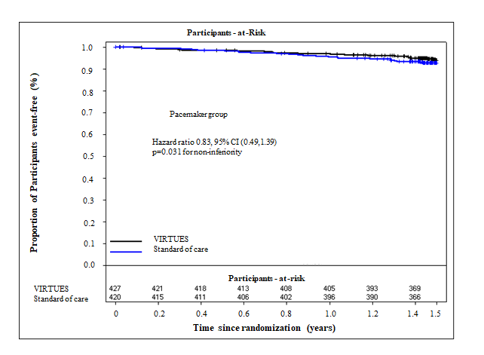
Primary Safety Outcome: VIRTUES-PM
Hazard ratio 0.83, 95% CI (0.49,1.39)
p=0.021 for non-inferiority

Slide 15
Safety outcomes
 | VIRTUES-PM n=427 | Standard of Care n=420 | Hazard Ratio 95% CI | P-value Non-inferiority
 | n (%) | n (%)
Safety | 26(6.1%) | 31(7.4%) | 0.83(0.49,1.39) 0.76(0.45,1.29)* | 0.0213 0.0101
Components of composite
Device related hospitalization | 0 | 2(0.48%)
Hospitalization due to a cardiovascular cause | 15(3.5%) | 21(5.0%)
Death | 12(2.8%) | 11(2.6%)
Stroke | 0 | 2(0.48%)
*prespecified adjusted analysis

Slide 16
Second Primary Objective: Cost Analysis
 | VIRTUES-PM (n=427) | SOC (n=420) | Adjusted Difference | P-Value
 | Adjusted Mean Cost (95% CI), CAD 2026
Cost - health care system
Remote device interrogation | $76 ($72 - $80) | $20 ($17 - $23) | $56 ($52 - $62) | <0.01
In-clinic device visit | $53 ($44 - $62) | $158 ($145 - $170) | -$105 (-$120 - -$90) | <0.01
Cost - patient and personal caregiver
Patient | $7 ($3 - $12) | $31 ($19 - $42) | -$23 (-$36 - -$11) | <0.01
Caregiver | $0 ($0 - $1) | $5 ($1 - $9) | -$5 (-$9 - $0) | 0.04
Total | $137 ($126 - $148) | $214 ($193 - $234) | -$77 (-$100 - -$54) | <0.01

Slide 17
Health Care Utilization in VIRTUES-PM: significant reduction
P=ns

Slide 18
Secondary outcome: Efficacy
VIRTUES N Time from event - clinical decision median (IQR) | Standard of care N Time from event - clinical decision median (IQR) | Difference in Medians 95% CI | P for non-inferiority
18 (4.2) 0 (0,3) | 12 (2.9) 3.25 (0, 102) | -3.25 (-1.5,1) | <0.001

Slide 19
Baseline Characteristics: VIRTUES-ICD
Variables | VIRTUES-ICD N=562 | Standard of Care N=553
Age (years) mean ± SD | 64.6 ± 11.5 | 64.8 ± 12.2
Sex (Female) | 121(21.5) | 116 (21.8)
New York Heart Association Class II/ III/IV | 210 (37.4) | 206 (37.3)
Hypertension | 287 (51.1) | 263 (47.6)
Dyslipidemia | 308 (54.8) | 278(50.3)
Diabetes | 181 (32.2) | 138 (25.0)
Current Smoker | 67 (11.9) | 45 (8.1)
Stroke/transient ischemic attack | 47 (8.4) | 52 (9.4)
Chronic Obstructive Pulmonary Disease | 43 (7.7) | 49 (8.9)
Coronary Artery Disease | 251 (44.7) | 240 (43.4)
Peripheral Vascular Disease | 26 (4.6) | 21 (3.8)
Ejection Fraction, % (mean±SD) | 41.8 ± 13.7 | 43.0 ± 13.5
Frailty score >3 | 90 (16.0) | 71 (12.8)
Rural location (%) | 153 (27.2) | 158 (28.6)
CRT-D | 165 (29.4) | 155 (28.0)
Secondary Prevention | 213 (37.9) | 222 (40.2)

Slide 20
Medications
Variables | VIRTUES-ICD N=562 | Standard of Care N=553
Beta blocker | 454(80.7) | 439 (79.4)
Angiotensin Converting Enzyme inhibitor/Angiotensin II Receptor Blocker/ARNI | 423 (75.3) | 393 (71.1)
Mineralocorticoid receptor antagonist | 408 (72.6) | 371 (67.1)
Sodium Glucose LT2 inhibitor | 209 (37.2) | 211 (38.2)
Oral anticoagulation | 252 (44.8) | 233 (42.1)
Antiarrhythmic drug | 170 (30.3) | 155 (28.0)
Diuretic | 195 (34.7) | 210 (38.0)

Slide 21
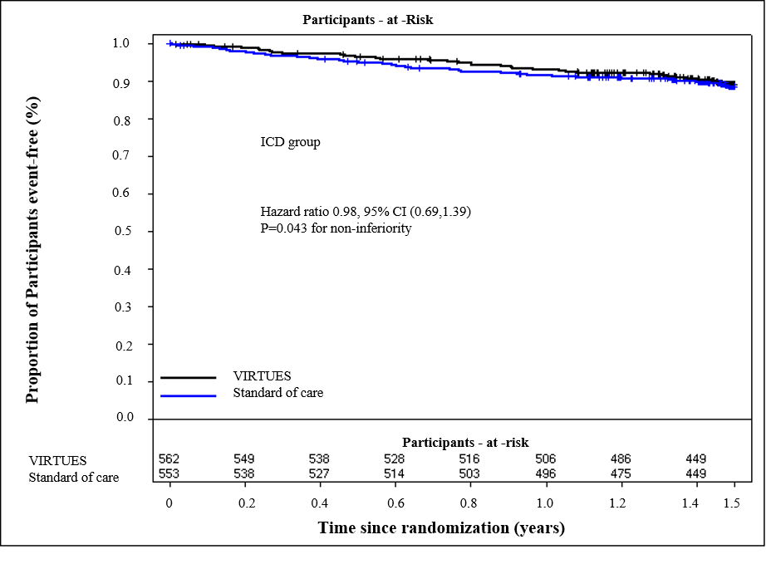
Primary Safety Outcome: VIRTUES-ICD
Hazard ratio 0.98, 95% CI (0.69,1.39)
p=0.007 for non-inferiority

Slide 22
Co-primary outcomes
 | VIRTUES-ICD n=562 | Standard of Care n=553 | Hazard Ratio 95% CI | P value for Non-inferiority
 | n (%) | n (%)
Safety | 62 (11.0) | 62 (11.2) | 0.98 (0.69 - 1.39) 0.90 (0.63 - 1.29)* | 0.007 0.002
 | N(%) Time from clinical event to decision (days) median (interquartile range) | N(%) Time from clinical event to decision (days) median (interquartile range) | Difference in Medians 95%CI
Efficacy | 73 (13.0) 2.00 (0,15) | 83 (15.0) 1.00 (0,8) | 1 (-1.24, 2.26) | <0.001
*prespecified adjusted analysis

Slide 23
Secondary Safety Outcomes – VIRTUES-ICD
Components of composite | VIRTUES-ICD n=562 | Standard of Care n=553 | Hazard Ratio 95% CI
Device related hospitalization | 3 (0.53) | 4 (0.72) | 0.73 (0.16 - 3.26)
Hospitalization due to a cardiovascular cause | 54 (9.6) | 51(9.2) | 1.03 (0.70 - 1.51)
Death | 18 (3.2) | 22 (4.0) | 0.81 (0.44 - 1.51)
Stroke | 1 (0.18) | 1 (0.18) | 0.99( 0.062 - 15.9)

Slide 24
Efficacy – Time from clinical event - clinical decision (days)
 | VIRTUES-ICD n=562 | Standard of Care n=553
 | N (%) median (interquartile range) | N (%) median (interquartile range)
Efficacy | 91 (9.2) 2.00(0,15) | 95( 9.8) 1.00(0,8)
new atrial tachyarrhythmia > 12 hours | 6 (1.1) 0.50(0,7.0) | 7 (1.3) 4.0(1.0,8.0)
rapid ventricular rate (≥120 bpm for ≥ 6 hrs AT/AF per day) | 3(0.53%) 57.0(0, 83.) | 2(0.36%) 2.50(1.00,4.00)
Lead impedance out of range | 4(0.71%) 0.50(0, 1.50) | 6(1.08%) 1.00(0,1.00)
Low battery | 2(0.36%) 31 (0,62) | 1(0.18%) 0
Need for device reprogramming | 10(1.78%) 0(0,1.00) | 16(2.89%) 0(0,1.50)
Advisory alert | 2 (0.20) 5.5(2.0,9.0) | 2 (0.21) 5.5(0,11.0)
ICD shock/ATP/VT storm or sustained VT > 30 seconds | 52 (9.3) 2.5(1,14.5) | 53 (9.6) 1.5(0,8.0)

Slide 25
Second Primary Objective: Cost Analysis
 | VIRTUES-ICD (n=562) | SOC (n=553) | Adjusted Difference | P-Value
 | Adjusted Mean Cost (95% CI), CAD 2026
Cost - health care system
Remote device interrogation | $201 ($190 - $211) | $161 ($152 - $170) | $40 ($26 - $53) | <0.01
In-clinic device visit | $67 ($58 - $77) | $144 ($133 - $154) | -$76 (-$90 - -$62) | <0.01
Cost - patient and personal caregiver | Cost - patient and personal caregiver
Patient | $14 ($9 - $19) | $50 ($39 - $61) | -$36 (-$48 - -$23) | <0.01
Caregiver | $3 ($0 - $6) | $7 ($1 - $14) | -$5 (-$12 - $3) | 0.23
Total | $286 ($269 - $302) | $363 ($340 - $385) | -$77 (-$105 - -$49) | <0.01

Slide 27
Quality of Life and Patient Satisfaction
No difference in SF-36 outcomes between the groups
N=668 (both VIRTUES PM and VIRTUES ICD combined):
VIRTUES Patient Satisfaction survey: median 4.0/5 on a Likert Scale indicating agreement

Slide 28
Limitations
This study was performed in a region where universal health care was available for all patients, with a single payer system
The event rates in VIRTUES-PM were lower than anticipated, however, relative margins were utilized to calculate non-inferiority to account for this
Cost savings were based on participant and health care system costs, full cost-effectiveness analyses for both studies are ongoing
The trials follow up was 18 months, the effect of cost savings may be underestimated

Slide 29
Conclusions
In these two randomized controlled trials of ICD and PM patients, a digital health platform (VIRTUES) in combination with remote monitoring was found to be as safe and as efficacious as standard of care
In addition, it was found to be more cost saving with a significant reduction in in-clinic visits, and in cost of travel for the patients themselves
The use of a digital health platform in combination with remote monitoring should be implemented globally to improve the care of the patients with CIEDs, decreasing cost for the health care system and patients with these devices

Slide 30
Acknowledgements
We would like to thank all the patients and their caregivers that participated in this study

