Slide 1


Effect on Oxidized Phospholipids of Lepodisiran, an Extended Duration siRNA Targeting Lipoprotein(a)
Steven E. Nissen MD MACC
Ann Marie Navar MD; John H. Krege MD; Wei Ni PhD; Julie St. John MS;
Stephen J. Nicholls MBBS, PhD; Xi Shen PhD; Kathy Wolski MPH; Laura F. Michael PhD
Study Sponsor:

Slide 2
Background
Lipoprotein(a) is a largely genetically determined causal risk factor for atherosclerotic cardiovascular disease and aortic stenosis.
Adverse effects are likely mediated in part by oxidized phospholipids bound to apolipoprotein(a) and apolipoprotein B.
Lepodisiran is a siRNA that produced ~95% time-averaged reduction in lipoprotein(a) sustained for a year after two doses
in a Phase 2 trial.
The effects of lepodisiran on oxidized phospholipids have not been previously described.

Slide 3
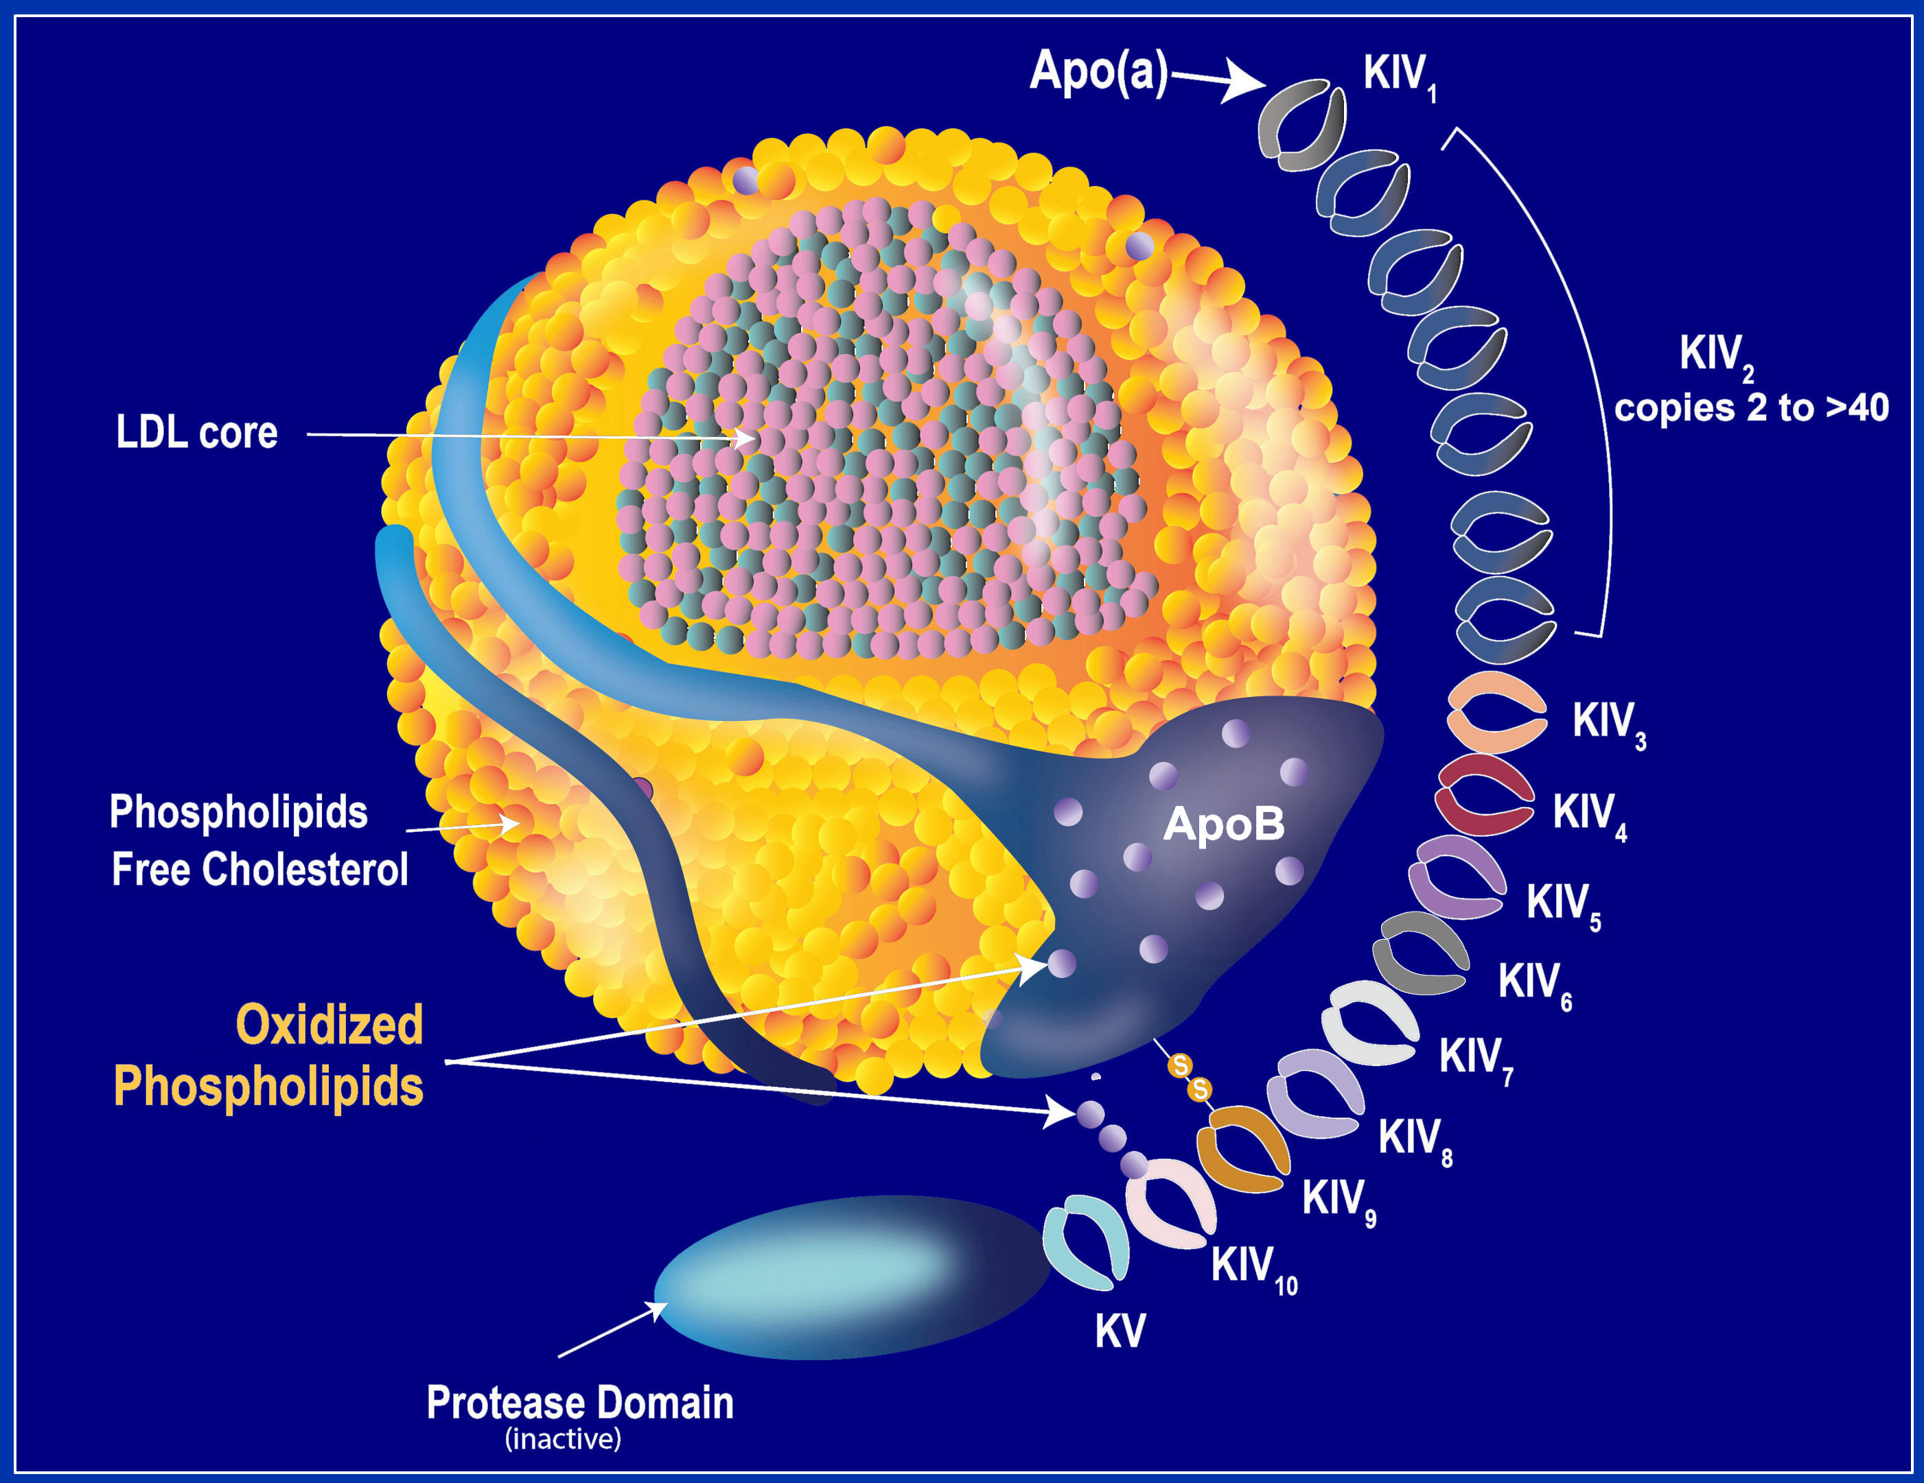
Structure of Lipoprotein(a) and Oxidized
Phospholipid Modifications

Slide 4
Current Post-Hoc Analysis
Included 213/320 participants at 66 global centers administered lepodisiran 16 mg, 96 mg or 400 mg at baseline and day 180.
At Days 240 and 360:
Placebo-adjusted percent change from baseline in oxidized phospholipids associated apo(a) and apoB.
Correlations between percent changes in lipoprotein(a) and oxidized phospholipids.
The relationship between changes in oxidized phospholipids
and biomarkers of systemic inflammation.

Slide 5
Selected Baseline Characteristics of Trial Participants
Characteristic | Placebo (n=59) | Lepodisiran 16 mg (n=31) | Lepodisiran 96 mg (n=65) | Lepodisiran 400 mg (n=58)
Mean Age (years) | 63.4 | 62.8 | 63.7 | 61.8
Female sex | 44% | 26% | 49% | 50%
White race | 90% | 87% | 85% | 79%
Lipoprotein(a), nmol/L | 244.6 | 252.1 | 261.9 | 246.1
LDL-Cholesterol, mg/dL | 74.6 | 73.5 | 78.1 | 81.0
OxPL-apo(a), nmol/L | 121.5 | 120.2 | 122.4 | 123.0
OxPL-ApoB, nmol/L | 29.4 | 26.7 | 27.4 | 28.1
hsCRP | 0.9 | 0.6 | 0.8 | 0.9

Slide 6
Placebo-Adjusted LS Mean Percent Changes in OxPLs
 | Lepodisiran 16 mg | Lepodisiran 96 mg | Lepodisiran 400mg
Percent Change in Oxidized Phospholipids Associated with Apo(a)
Day 240 | -21.9% | -65.1% | -94.2%
Day 360 | -23.7% | -41.6% | -80.7%
Percent Change in Oxidized Phospholipids Associated with ApoB
Day 240 | -39.5% | -76.9% | -88.5%
Day 360 | -30.6% | -57.1% | -79.9%

Slide 7
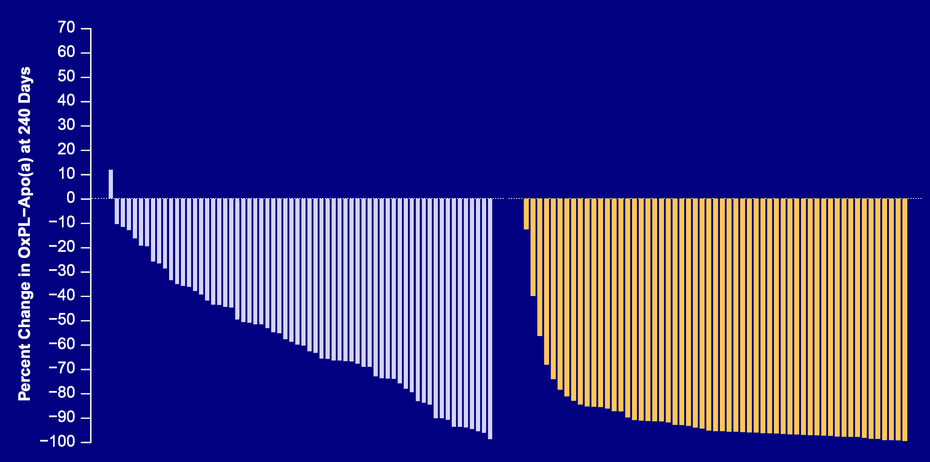
Waterfall Plots: Day 240 Percent Change in OxPL-Apo(a)
Lepodisiran 96 mg
Lepodisiran 400 mg

Slide 8
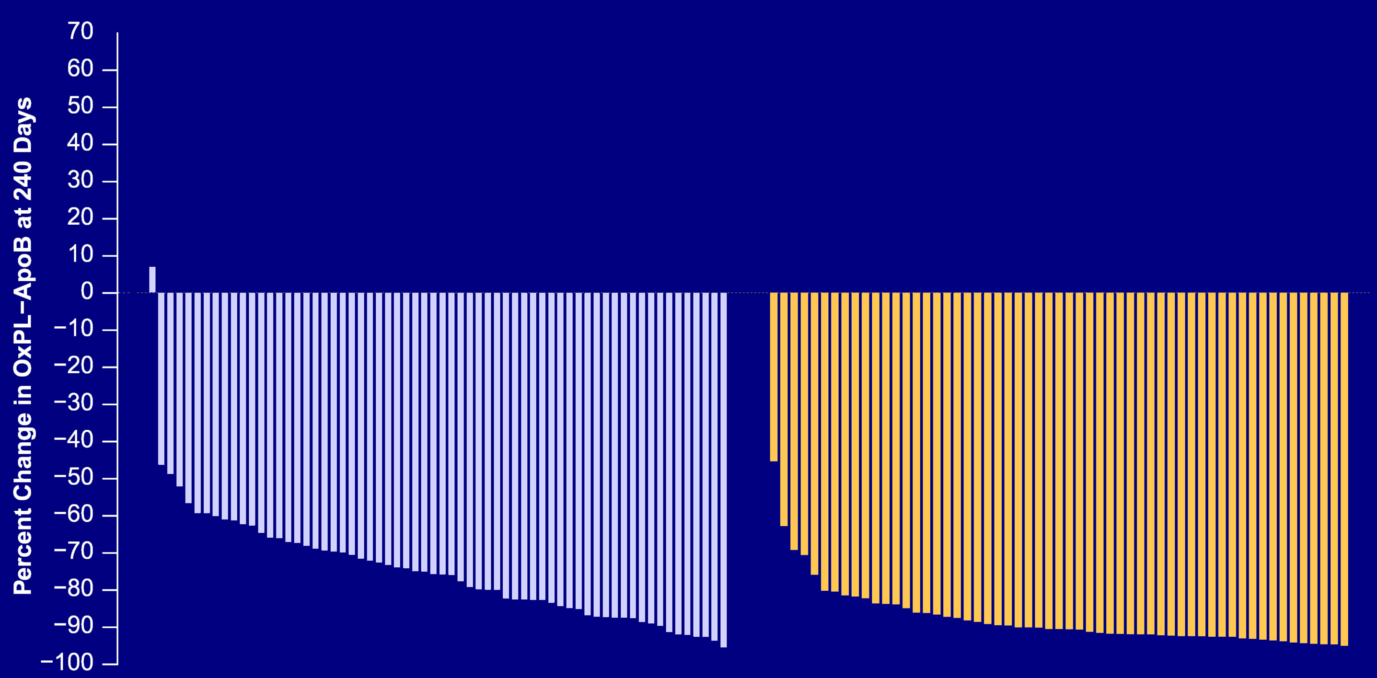
Waterfall Plots: Day 240 Percent Change in OxPL-ApoB
Lepodisiran 96 mg
Lepodisiran 400 mg

Slide 9
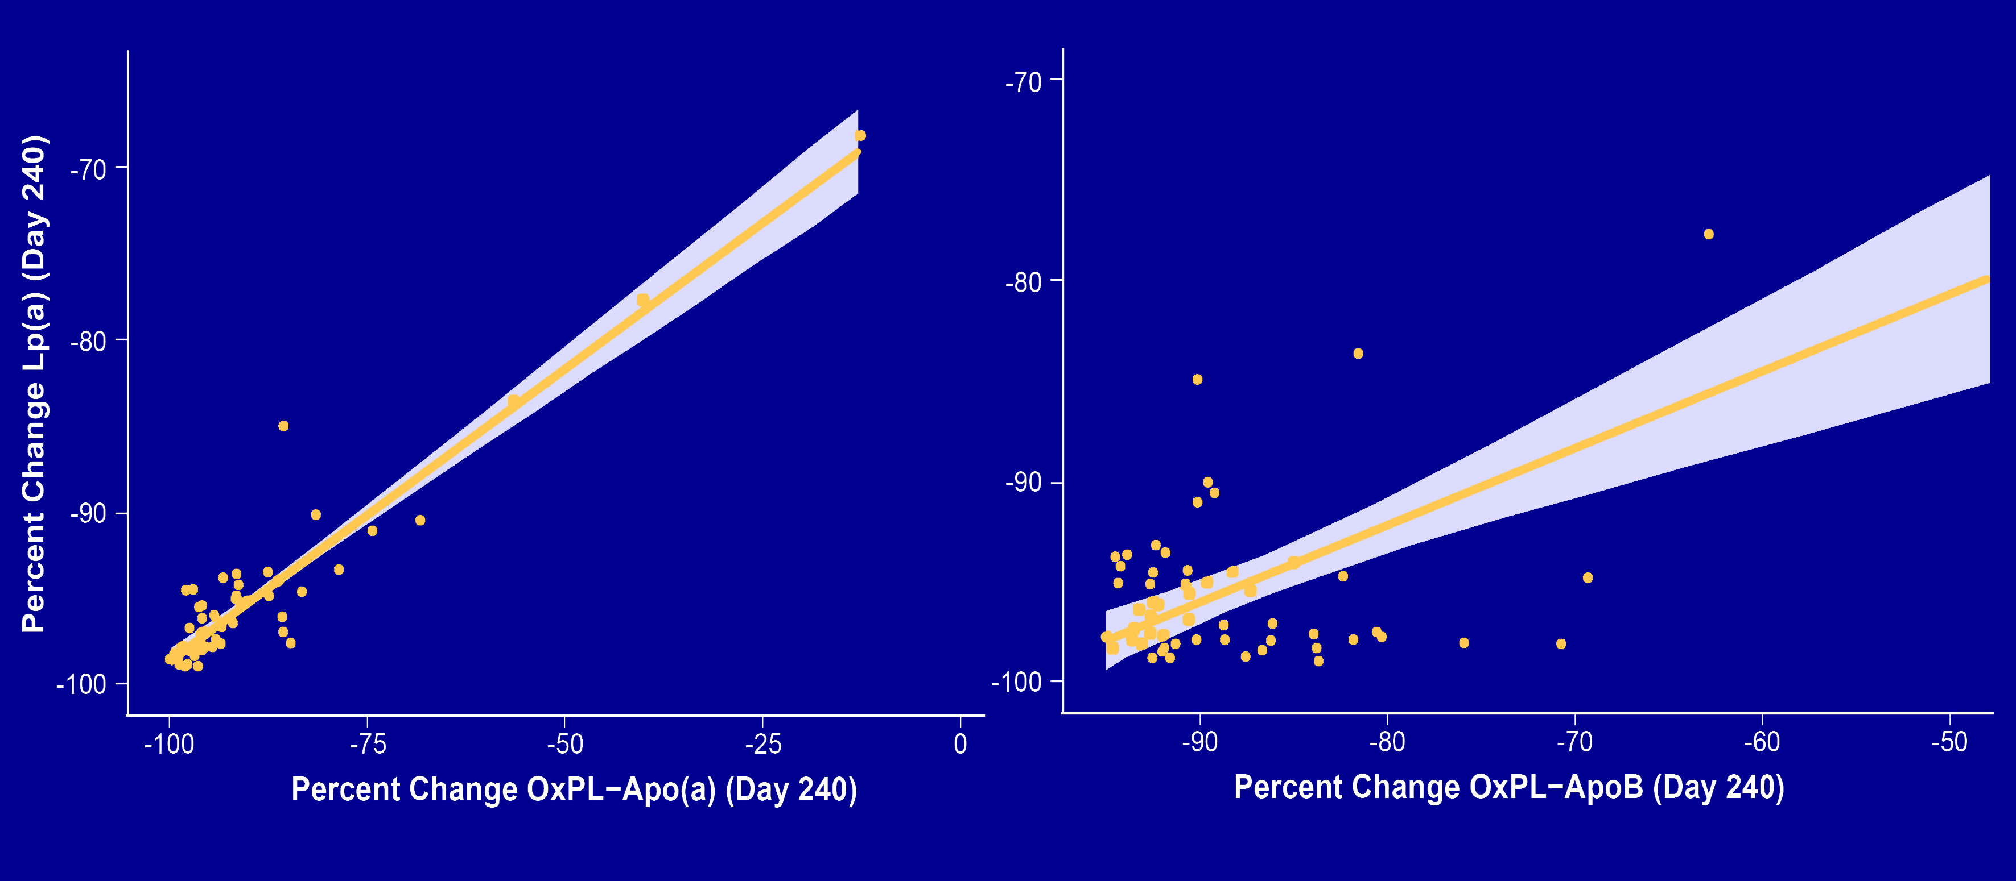
Day 240 Correlation: Percent Change in Lp(a) vs. OxPLs
OxPL- Apo(a)
OxPL- ApoB
r= 0.94
P<0.001
r= 0.62
p<0.001

Slide 10
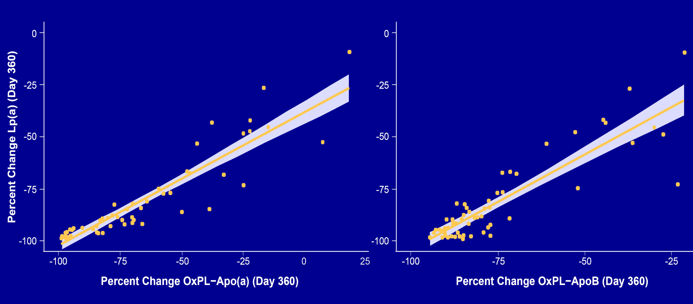
Day 360 Correlation: Percent Change in Lp(a) vs. OxPLs
OxPL- Apo(a)
OxPL- ApoB
r= 0.92
P<0.001
r= 0.88
p<0.001

Slide 11
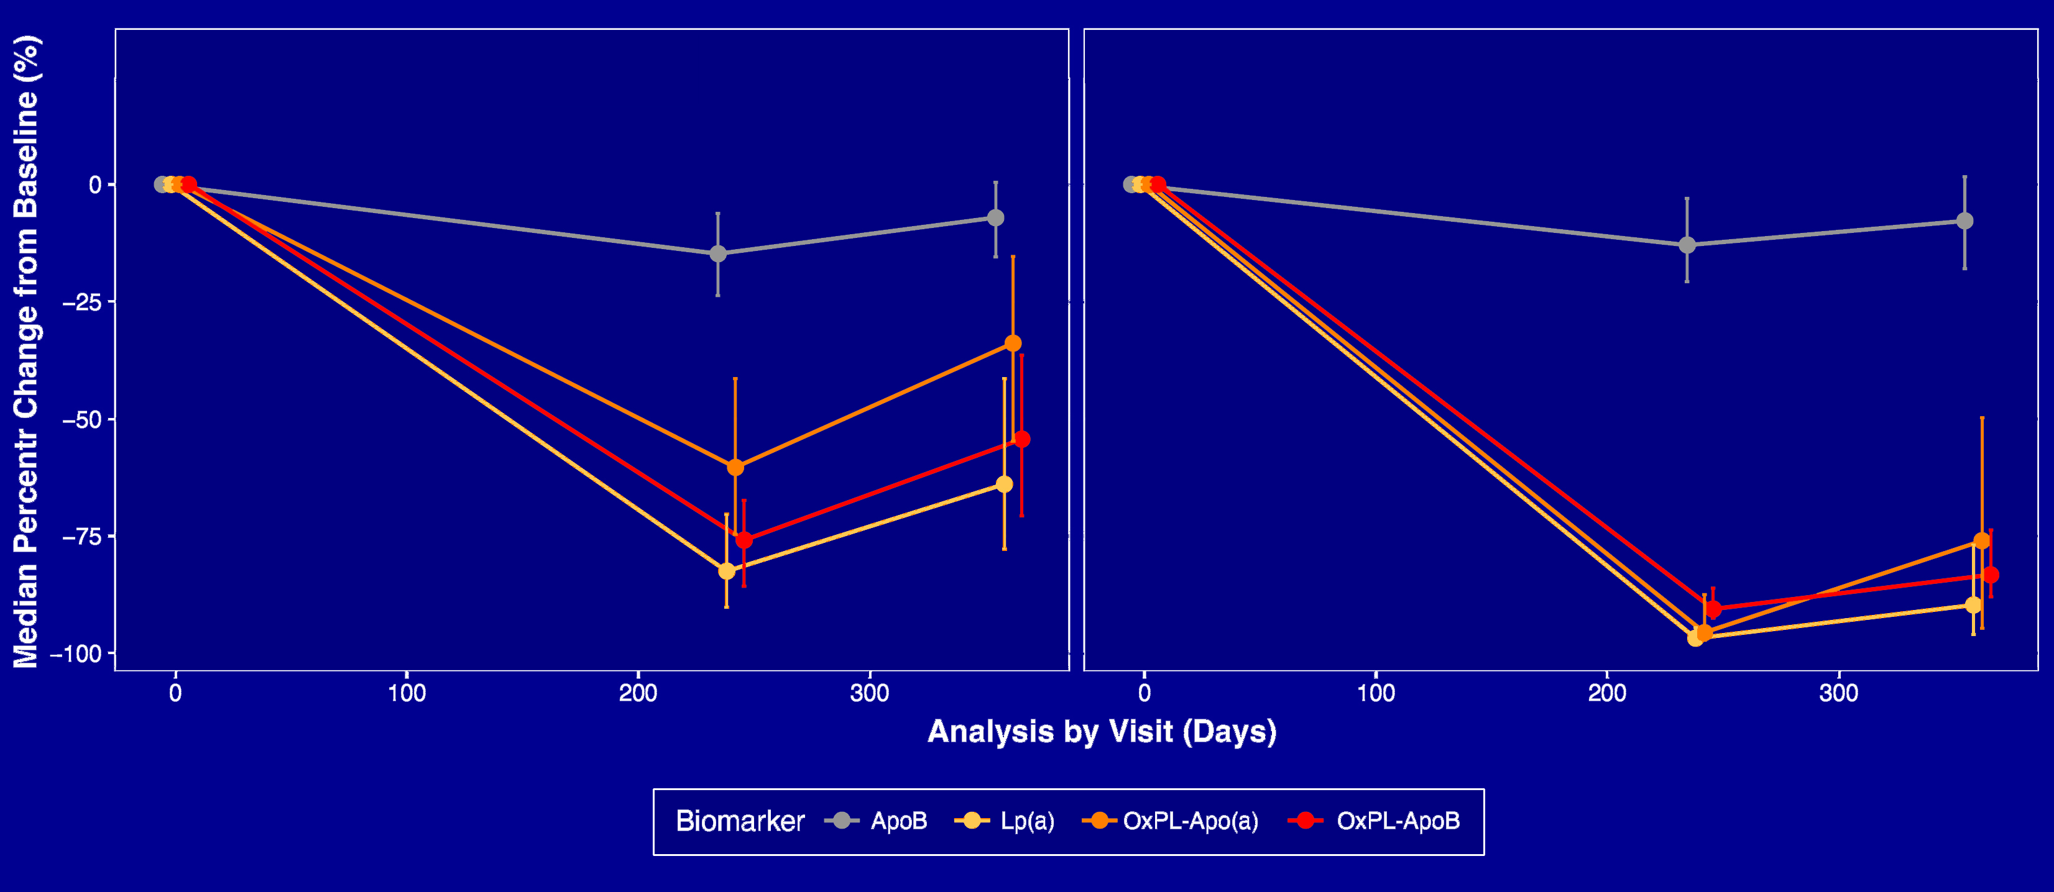
Trajectory: Changes in ApoB, Lipoprotein(a) and OxPLs
96 mg Dose Group
400 mg Dose Group

Slide 12
Limitations
This was a secondary post hoc analysis for a trial not primarily designed to assess changes in oxidized phospholipids.
The assays detect oxidized phosphatidylcholine, whether other particle-associated oxidized phospholipids contribute
to cardiovascular risk is unknown.
Ongoing cardiovascular outcomes trials of Lp(a) lowering therapies are required to determine whether changes in Lp(a) and OxPLs are correlated with reduced cardiovascular risk.

Slide 13
Conclusions
Subcutaneous administration of lepodisiran produced dose-dependent reductions in oxidized phospholipids associated with lipoprotein(a).
Reductions were most consistent at the highest studied dose,
400 mg.
Oxidized phospholipid reductions correlated closely with the reductions in lipoprotein(a).
These post hoc findings characterize pharmacodynamic target engagement and a possible mechanism for a therapeutic benefit of lepodisiran.

Slide 14
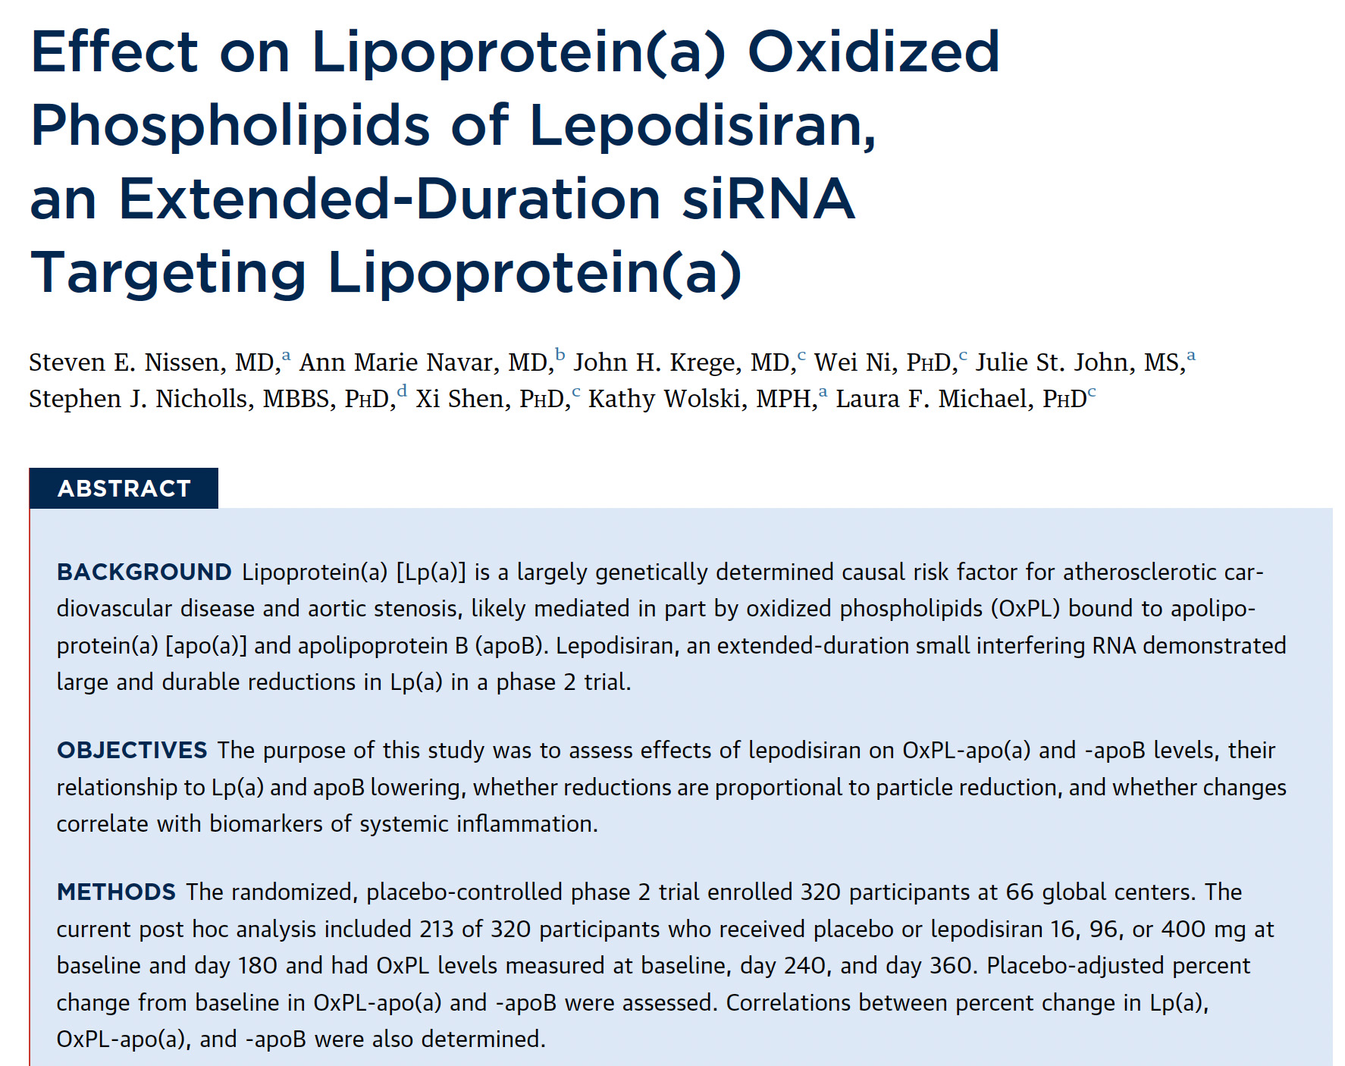


Slide 15
A Final Thought
Sixty years after the discovery of lipoprotein(a) the precise mechanisms by which this lipid particle causes cardiovascular morbidity and mortality remain elusive. Ongoing cardiovascular outcome trial should help clarify these important scientific issues.

