Slide 1
Anticoagulation for atrial fibrillation with intermediate stroke risk:
The SINGLE-AF trial
Boyoung Joung, MD, PhD on behalf of the SINGLE-AF investigators
Department of Cardiology, Severance Hospital, Yonsei University College of Medicine, Seoul, Korea
European Society of Cardiology Congress 2026 – Annual Scientific Session
Hot Line 1, August 28, 2026

Slide 2
Background
Oral anticoagulants for AF with intermediate stroke risk
(CHA₂DS₂-VASc of 1 for male or 2 for females)
2016 ESC
- Class IIa recommendation
2018 CHEST
- Strong recommendation
2019 AHA/ACC/HRS*
- Class IIb recommendation
*2023 Class IIa
When we designed the SINGLE-AF trial, recommendations for oral anticoagulation in patients with an intermediate stroke risk differed across international guidelines.
The Korean National Health Insurance Service (NHIS) reimbursed DOAC therapy for women with a CHA₂DS₂-VASc score of 2, but not for men with a score of 1.
Current guidelines now provide a Class IIa recommendation, stating that oral anticoagulation should be considered in these patients. However, this recommendation has been based primarily on observational evidence, and randomized trial data have been lacking.

Slide 3
Objective
The primary hypothesis was that DOAC therapy would lower the risk of net primary outcomes compared to no DOAC therapy in patients with intermediate stroke risk (CHA₂DS₂-VASc of 1 for male or 2 for females).
To investigate whether oral anticoagulation lowers adverse clinical events compared with no anticoagulation in patients with atrial fibrillation at intermediate stroke risk.

Slide 4
The efficacy and Safety of non-vItamiN K antaGonist oraL anticoagulants for intermEdiate stroke risk in patients with Atrial Fibrillation
SINGLE-AF Trial Design
Patients with AF and CHA₂DS₂-VA of 1 *
[CHA₂DS₂-VASc of 1 (male) or 2 (female)] (N=1,800)
Prospective multicenter RCT from 18 sites in Korea
Randomization
OAC
(N=900)
No OAC
(N=900)
Primary endpoint
composite of stroke, systemic embolism, major bleeding, or cardiovascular death at 2 years after randomization
SINGLE-AF ClinicalTrials.gov number, NCT04437654
Kim D, Joung B et al. Heart Rhythm O² 2026;7:545–551

Slide 5
Trial Organization
Participating Investigators (18 Sites in South Korea)
Boyoung Joung, Daehoon Kim, Hee Tae Yu, Tae-Hoon Kim, Jae-Sun Uhm, MD (Yonsei University), Il-Young Oh (Seoul Nat Bundal Hospital), Jaemin Shim (Korea University), Eue-Keun Choi (Seoul Nat University), Il-Young Oh (Seoul Nat Bundal Hospital), Jun Kim (Asan Medical Center), Young Soo Lee (Daegu Catholic University), Junbeom Park (Ewha Womans University), Jum-Suk Ko (Wonkwang University), Kyoung-Min Park (Samsung Medical Center), Jung-Hoon Sung (CHA University), Hyung Wook Park, MD (Chonnam National University), Hyung-Seob Park (Keimyung University), Jong-Youn Kim (Gangnam Severance Hospital), Ki-Woon Kang (ChungAng University), Dongmin Kim, MD (Dankook University), Jin-Kyu Park (Hanyang University), Dae-Hyeok Kim (Inha University), Jin-Bae Kim, MD (Kyung Hee University)
Executive Committee
Boyoung Joung (Trial PI) Daehoon Kim Hee Tae Yu Tae-Hoon Kim
Event Adjudication Committee
Sungjin Hong Jae-Hyuk Lee Sung Hwa Choi
Data & Safety Monitoring Board/Advisory members from PACEN /Statistical consultation
Jung Myung Lee Yeong-Min Lim Taehyun Hwang Seunghoon Cho
Jee-yoon Chae Min-joung Kim Song-hee Cho Hee-ju Ji Sung-Eun Lee
Tae-kyun Nam Kyung-soo Park Jinseob Kim (Zarathu)
Trial Funding Research grants from the Ministry of Health & Welfare, Republic of Korea (HC19C0130, RS-2026-25520638)
Samjin and Hanmi Pharm

Slide 6
Enrollment criteria
Inclusion criteria
Exclusion criteria
Patient with atrial fibrillation* 19 and 80 years
CHA₂DS₂-VASc score of 1 (male) or 2 (female)
Significant liver or renal disease
Requiring anticoagulation due to surgery with a mechanical prosthetic valve, moderate-to-severe mitral stenosis, or deep vein thrombosis
Significant structural heart disease (moderate-to-severe mitral regurgitation, severe valvular regurgitation or stenosis, DCMP, or HCMP)
Active malignancy
Pregnancy or breast-feeding
Life expectancy < 1 year
Refuse or enable to understand the written informed consent
* Atrial fibrillation was confirmed by an electrocardiogram (12-lead, multiple, or single leads). Atrial fibrillation was defined as documentation of atrial fibrillation on a standard 12-lead electrocardiogram or on a rhythm tracing lasting at least 30 seconds
DCMP, dilated cardiomyopathy, HCMP: Hypertrophic cardiomyopathy
Kim D, Joung B et al. Heart Rhythm O² 2026;7:545–551

Slide 7
Randomization and administration of study drug
Eligible patients were randomly assigned in a 1:1 ratio to either DOAC or no-OAC therapy
Standard-dose apixaban used
  5 mg twice daily as a standard dose
  Reduce dose to 2.5 mg orally 2 times a day for patients with any 2 of the following:
    Age 80 years or older
    Body weight 60 kg or less
    Serum creatinine 1.5 mg/dL (133 μmol/L) or higher
Standard-dose rivaroxaban used
  20-mg once daily as a standard dose
  15-mg once daily with dose-reduction criteria : CrCl <50 mL/min

Slide 8
Primary trial endpoint
Net adverse clinical event: defined as a composite of
  Stroke
  Systemic embolism
  Major bleeding (defined by the ISTH criteria)
  Cardiovascular death
  at 2 years after randomization

Slide 9
Secondary trial endpoints
Individual components of the primary outcome
  Stroke: Ischemic, Hemorrhagic
  Systemic embolism
  Major bleeding: Intracranial, Gastrointestinal, Other
  Cardiovascular death
  Clinically relevant non-major bleeding
  All-cause death
  Transient ischemic attack
  Myocardial infarction
  Hospitalization due to any causes

Slide 10
Statistical Considerations
Power Calculation (N = 1800)
Assuming a 2-year event rate of 2.0% in the OAC group, 4.5% in the no-OAC group
Statistical power of 80% to detect a absolute risk reduction of 2.5% in the primary outcome reduction (driven by the reduction of major bleeding) compared with no-OAC therapy at a significant level of 0.05
Statistical Analysis
Primary intention-to-treat analysis
Cumulative event rates calculated by Kaplan-Meier estimates and compared with log-rank test
Cox proportional hazard models
  Estimate the risk differences if proportional hazards assumption is not violated.
Sensitivity and subgroup analysis
  Per-protocol analysis (randomized groups without major protocol violations)
  Subgroup analysis for primary endpoint according to the prespecified clinical factors

Slide 11
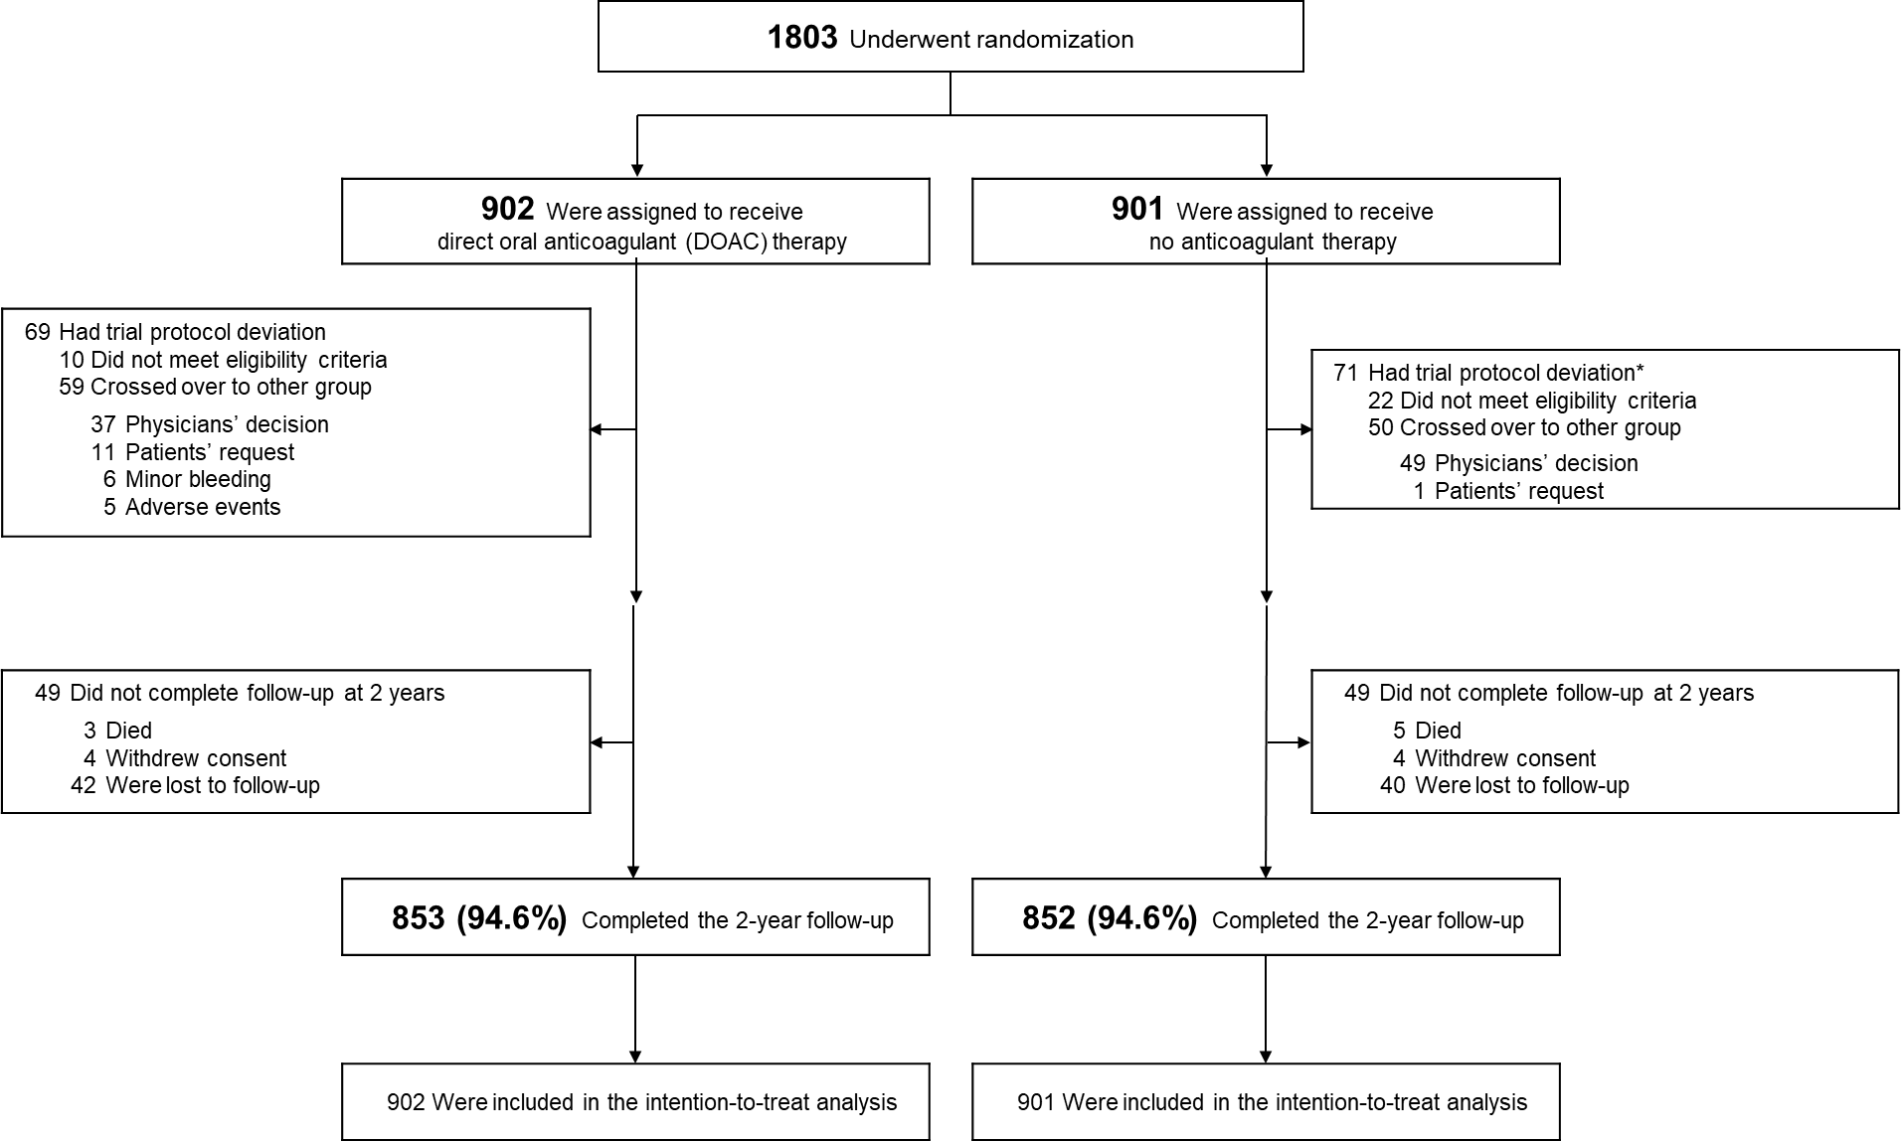
Patient Flow and Follow-up
(from July, 2020 through June, 2023)

Slide 12
Baseline Characteristics (1)
Characteristic | DOAC Therapy (N = 902) | No OAC Therapy (N = 901)
Age — yr | 60.7±7.8 | 60.0±8.1
Age ≥65 yr — no. (%) | 304 (33.7) | 282 (31.3)
Male sex — no. (%) | 682 (75.6) | 694 (77.0)
Paroxysmal AF — no. (%) | 636 (70.5) | 658 (73.0)
Non-paroxysmal AF — no. (%) | 266 (29.5) | 243 (27.0)
Median time since atrial fibrillation diagnosis (IQR) — mo | 21 (2–60) | 21 (2–58)
Medical history — no. (%)
Hypertension | 435 (48.2) | 482 (53.5)
Diabetes mellitus | 67 (7.4) | 70 (7.8)
Heart failure | 93 (10.3) | 72 (8.0)
Stroke or transient ischemic attack | 0 (0) | 2 (0.2)
Dyslipidemia | 224 (24.8) | 193 (21.4)
Myocardial infarction | 3 (0.3) | 2 (0.2)
Peripheral artery disease | 8 (0.9) | 4 (0.4)
Current drinking — no. (%) | 253 (28.0) | 265 (29.4)
Current smoking — no. (%) | 97 (10.8) | 123 (13.7)

Slide 13
Baseline Characteristics (2)
 | DOAC Therapy (N = 902) | No OAC Therapy (N = 901)
CHA₂DS₂-VASc score†
Mean | 1.3±0.5 | 1.3±0.5
Median (IQR) | 1 (1–1) | 1 (1–1)
CHA₂DS₂-VA score‡
Mean | 1.0±0.1 | 1.0±0.2
Median (IQR) | 1 (1–1) | 1 (1–1)
HAS-BLED score¶
Mean | 0.5±0.6 | 0.5±0.7
Median (IQR) | 0 (0–1) | 0 (0–1)
Blood pressure — mmHg
Systolic | 125.6±15.4 | 127.1±14.4
Diastolic | 76.6±12.4 | 77.2±11.8
Body mass index — kg/m²‖ | 25.2±3.2 | 25.3±3.2
Previous atrial fibrillation ablation — no. (%) | 266 (29.5) | 285 (31.6)
Previous cardioversion — no. (%) | 162 (18.0) | 137 (15.2)

Slide 14
Antithrombotic regimens after randomization
Study drug regimens after randomization | DOAC Therapy (N = 902) | No OAC Therapy (N = 901)
Direct oral anticoagulants | 902 (100.0)† | 50 (5.5)‡
Apixaban
5mg b.i.d | 608 (67.4) | 16 (1.8)
2.5mg b.i.d | 41 (4.5) | 1 (0.1)
Rivaroxaban
20mg q.d. | 127 (14.1) | 13 (1.4)
15mg q.d. | 125 (13.9) | 8 (0.9)
Dabigatran (150mg q.d.) | 1 (0.1) | 1 (0.1)
Edoxaban (60/30mg q.d.) | 0 (0) | 7 (0.8)/ 4 (0.4)
Full dose direct oral anticoagulants | 736 (81.6) | 2 (0.2)
Reduced dose direct oral anticoagulants | 166 (18.4) | 0 (0)
Fulfilling the dose reduction criteria | 1/166 (0.7) | -
Antiplatelet agents | 4 (0.4) | 329 (36.5)
Aspirin | 3 (0.3) | 305 (33.9)
Clopidogrel | 1 (0.1) | 27 (3.0)
Clinically indicated§ | 1/4 (25.0) | 33/329 (10.0)

Slide 15
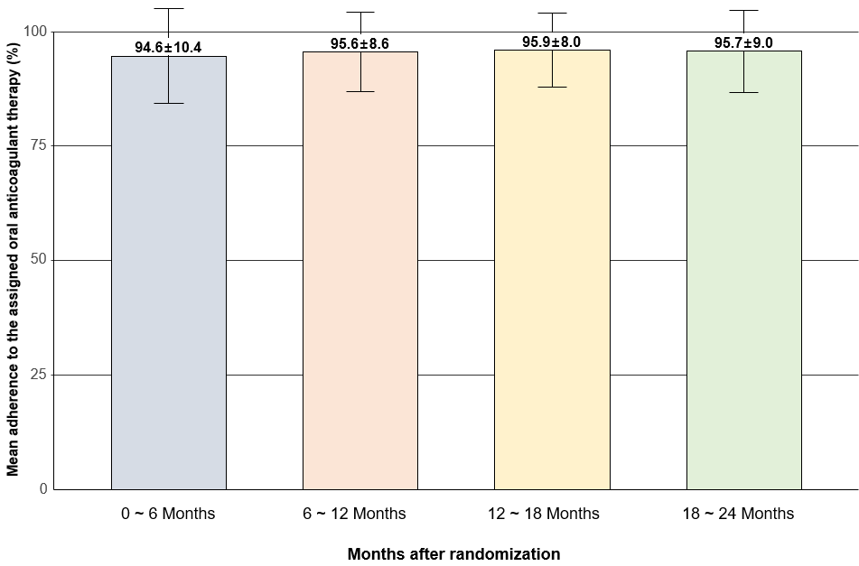
Rates of study drug adherence* during study period
* Adherence was assessed by pill count–based medication accountability at each follow-up visit.
Plus–minus values are means±SD.

Slide 16
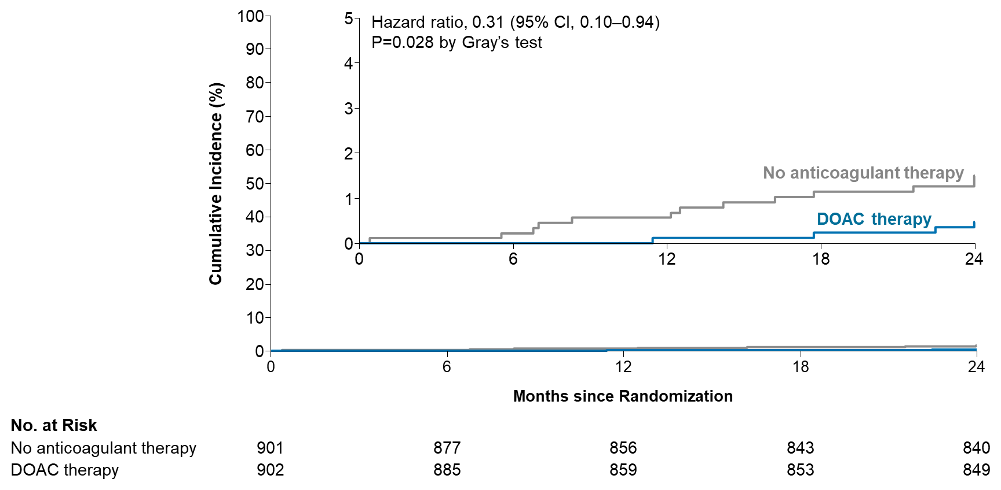
Primary Endpoint: Net adverse clinical event
Hazard ratio, 0.31 (95% CI, 0.10-0.94)
P=0.028 by Gray’s test
Absolute difference at 24 mo,
-1.0 percentage points (95% CI -2.0 to -0.1)
Cumulative incidence of a composite of
Stroke, Systemic embolism, Major bleeding or Cardiovascular death (%)
1.5%
0.5%

Slide 17
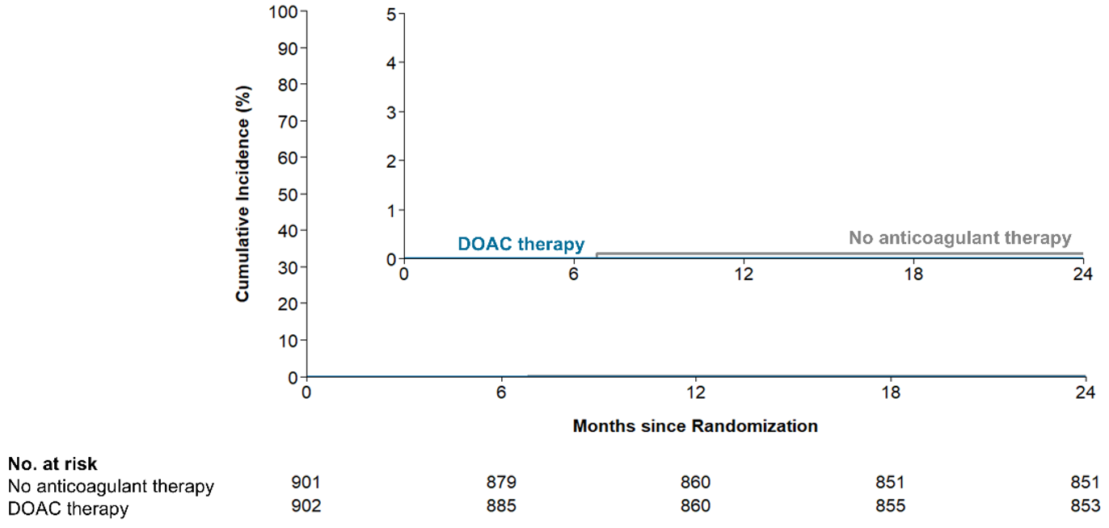
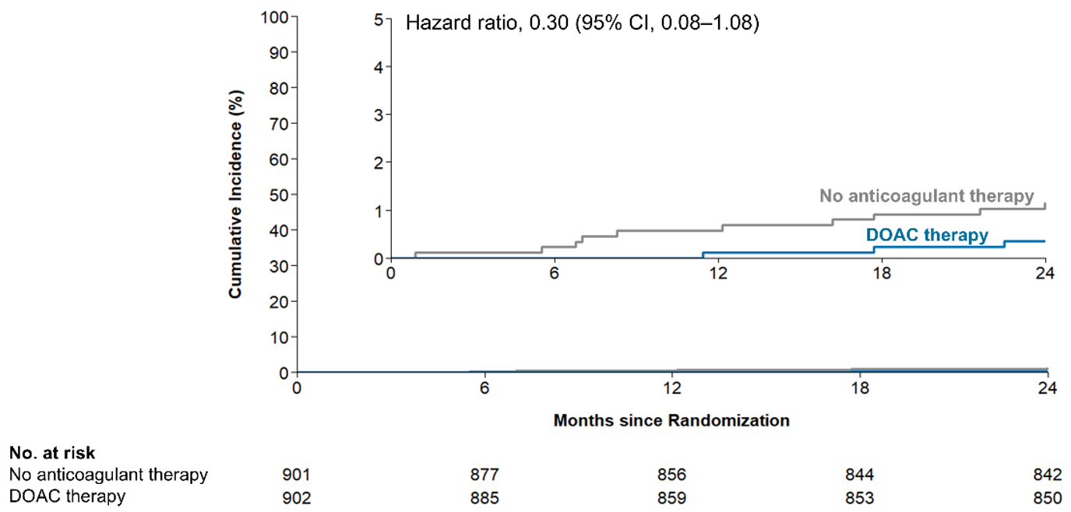
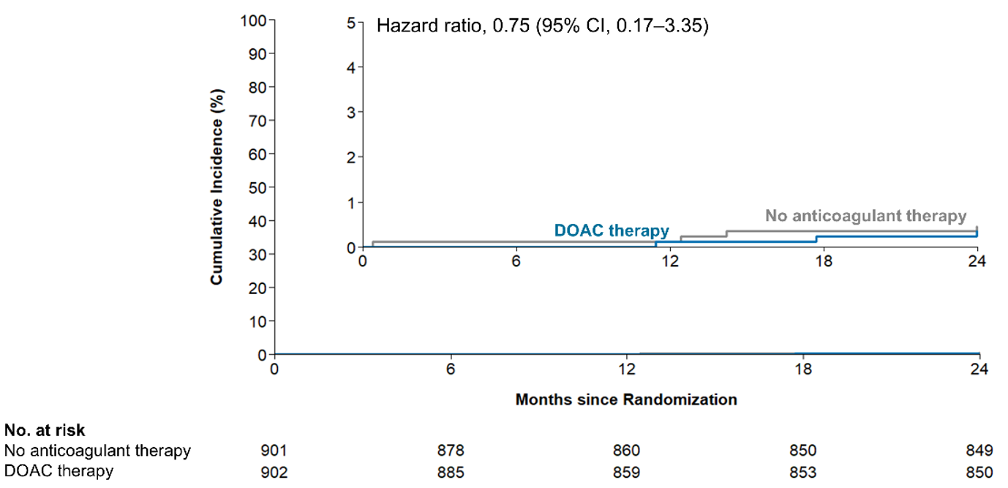
Key Secondary Endpoint
Systemic embolism
Stroke
0.1%
0%
1.1%
0.3%
Major bleeding
0.5%
0.3%

Slide 18
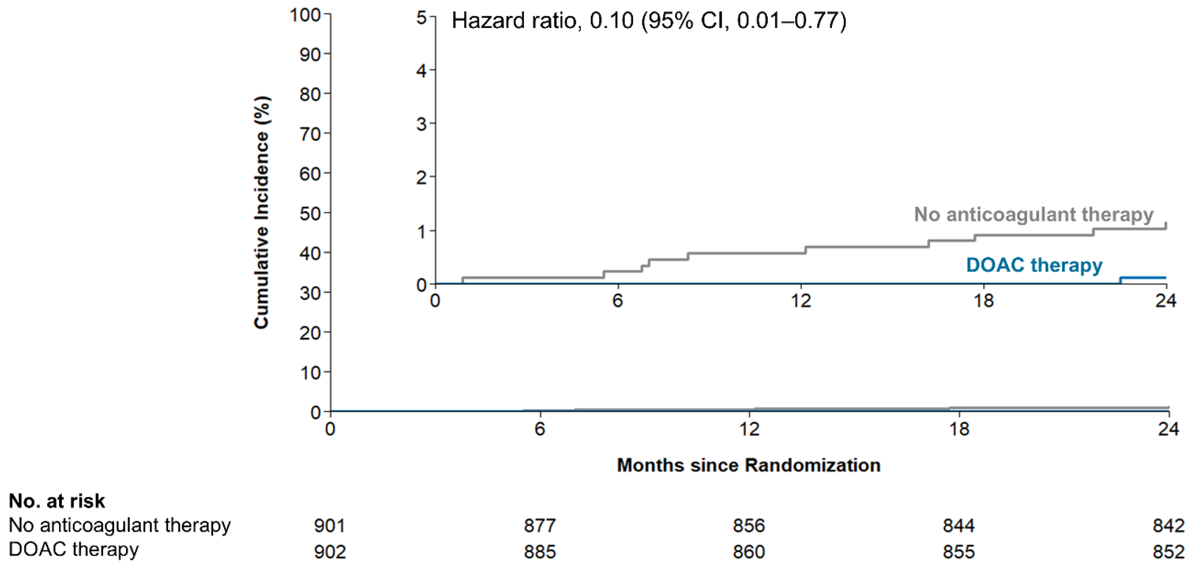
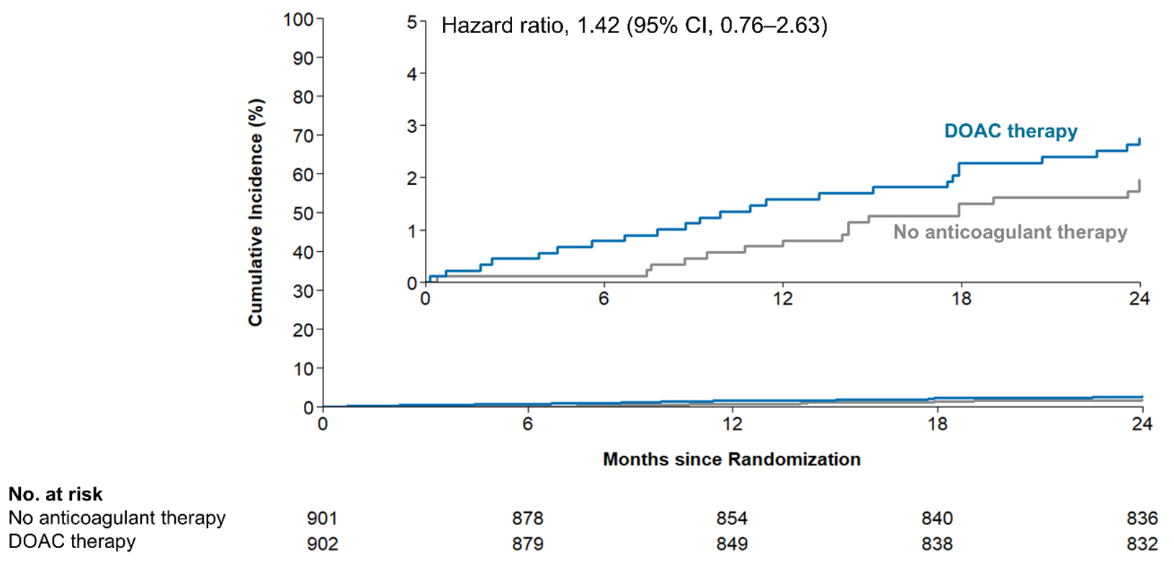
Exploratory post hoc end points
Ischemic stroke or systemic embolism
Major bleeding or CRNMB
2.7%
1.1%
2.0%
0.1%

Slide 19
Primary and Secondary Endpoints at 2 Years After Randomization
Outcome | DOAC Therapy (N = 902) | No OAC herapy (N = 901) |  | Difference, (95% CI) | Hazard Ratio (95% CI)
 | No. of patients (estimated %) |  |  | Percentage points
Primary composite endpoint
Stroke, systemic embolism, major bleeding, or cardiovascular death | 4 (0.5) |  | 13 (1.5) | -1.0 (-2.0 to -0.1) | 0.31 (0.10 to 0.94)
Secondary endpoints
Stroke | 3 (0.3) |  | 10 (1.1) | -0.8 (-1.6 to 0.0) | 0.30 (0.08 to 1.08)
Ischemic event | 1 (0.1) |  | 10 (1.1) | -1.0 (-1.8 to -0.3) | 0.10 (0.01 to 0.77)
Hemorrhagic event | 2 (0.2) |  | 0 | 0.2 (-0.1 to 0.6) | ND
Systemic embolism | 0 |  | 1 (0.1) | -0.1 (-0.3 to 0.1) | ND
Major bleeding¶ | 3 (0.3) |  | 4 (0.5) | -0.1 (-0.7 to 0.5) | 0.75 (0.17 to 3.35)
Intracranial hemorrhage‖ | 2 (0.2) |  | 1 (0.1) | 0.1 (-0.3 to 0.5) | 2.00 (0.18 to 22.05)
Gastrointestinal hemorrhage | 1 (0.1) |  | 2 (0.2) | -0.1 (-0.5 to 0.3) | 0.50 (0.05 to 5.51)
Fatal bleeding | 0 |  | 0 | ND | ND
Cardiovascular death | 0 |  | 0 | ND | ND
Clinically relevant nonmajor bleeding¶ | 22 (2.5) |  | 14 (1.6) | 0.9 (-0.4 to 2.2) | 1.58 (0.81 to 3.08)
Exploratory post hoc end points§
Ischemic stroke or systemic embolism** | 1 (0.1) |  | 10 (1.1) | -1.0 (-1.8 to -0.3) | 0.10 (0.01 to 0.77)
Major bleeding or clinically relevant nonmajor bleeding¶ | 24 (2.7) |  | 17 (2.0) | 0.8 (-0.6 to 2.2) | 1.42 (0.76 to 2.63)

Slide 20
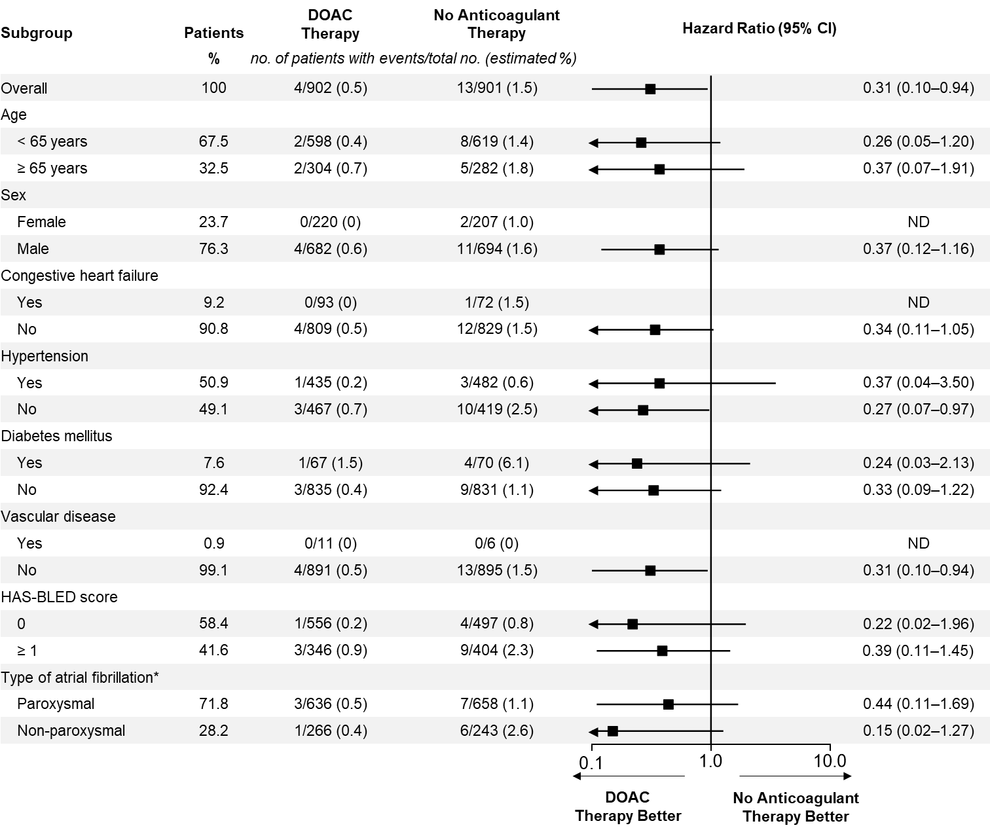
Prespecified Subgroup Analysis

Slide 21
Study Limitations
Open-label design that entailed a risk of reporting or ascertainment bias
The lower-than-anticipated primary end-point incidence
5.4% of patients in each group did not complete 2-year follow-up
Antiplatelet therapy was used in approximately one third of patients assigned to no anticoagulant therapy
The generalizability and producibility of our trial findings may be potentially limited
  East Asian Population
  Women were underrepresented

Slide 22
Conclusion
In the SINGLE-AF trial involving patients with atrial fibrillation at intermediate stroke risk,
DOAC therapy resulted in a lower risk of the composite of stroke, systemic embolism, major bleeding, or cardiovascular death than no anticoagulant therapy at 24 months.
Notes:
25. Summary
To summarize:
In this multicenter randomized trial, discontinuing oral anticoagulation in patients without AF recurrence after ablation resulted in a lower risk of the composite endpoint compared with continued anticoagulation.
The benefit was primarily due to a reduction in major bleeding events, while the risk of ischemic events remained similar between groups.

Slide 23
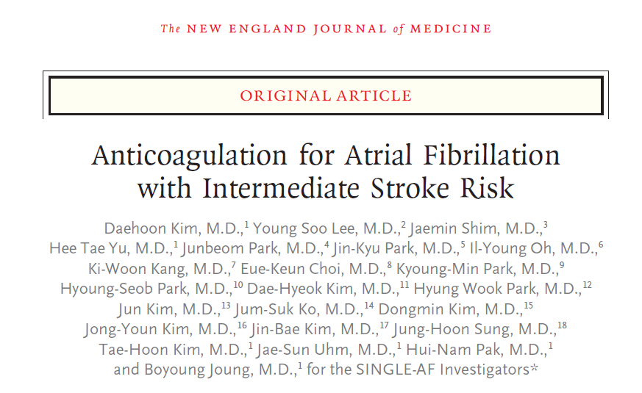
Further Details, simulataneously Published in NEJM
Notes:
“I’m happy to announce that this paper has just been published online in [JAMA] and is being made freely available during the meeting. You can access it via this QR code.”

Slide 24
Details of stroke events in the study participants
Stroke | DOAC therapy (N = 902) | No anticoagulant therapy (N = 901)
Classification
Ischemic | 1 (0.1) | 10 (1.1)
Hemorrhagic | 2 (0.2) | 0 (0)
Unspecified | 0 (0) | 0 (0)
Imaging modality used
Computed tomography | 3 (0.3) | 8 (0.9)
Magnetic resonance imaging | 2* (0.2) | 10 (1.1)
Etiology of ischemic stroke
Large-artery atherosclerosis | 0 (0) | 0 (0)
Cardioembolism | 1 (0.1)† | 8 (0.9)‡
Undetermined or other cause | 0 (0) | 2 (0.2)
By severity - Modified Rankin scale (mRS)§
Nondisabling (mRS 0 to 2) | 2 (0.2) | 8 (0.9)
Disabling or fatal (mRS 3 to 6) | 1 (0.1)¶ | 2 (0.2)‖
Fatal (mRS 6) | 0 (0) | 0 (0)

Slide 25
Details of major bleeding or CRNMB
Bleeding classification | DOAC therapy (N = 902) | No anticoagulant therapy (N = 901)
By severity (ISTH criteria)
Major bleeding | 3 (0.3) | 4 (0.4)
CRNMB | 22 (2.4) | 14 (1.6)
By severity (BARC criteria)
BARC 2 | 22 (2.4) | 14 (1.6)
BARC 3a | 1 (0.1) | 2 (0.2)
BARC 3b | 0 (0) | 1 (0.1)
BARC 3c | 3 (0.3) | 1 (0.1)
By site (Major bleeding by ISTH criteria)
Intracranial hemorrhage | 2 (0.2) | 1 (0.1)
Gastrointestinal bleeding | 1 (0.1) | 2 (0.2)
Other | 0 (0) | 1 (0.1)
By site (CRNMB by ISTH criteria)
Gastrointestinal bleeding | 3 (0.3) | 3 (0.3)
Genitourinary bleeding | 9 (1.0) | 6 (0.7)
Respiratory tract bleeding | 2 (0.2) | 2 (0.2)
Others | 8 (0.9) | 3 (0.3)
By each criterion of ISTH major bleeding
Fatal bleeding | 0 (0) | 0 (0)
Symptomatic bleeding in a critical area or organ | 2 (0.2)* | 1 (0.1)*
Bleeding causing a fall in hemoglobin level of 2 g/dL (1.24 mmol/L) or more, or leading to transfusion of 2 or more units of whole blood or red cells. | 1 (0.1)† | 3 (0.7)‡
Transfusion | 1 (0.1)† | 1 (0.1)§

