Slide 1
Outcomes of Intracoronary AAV1/SERCA2a Gene Therapy in Patients With Heart Failure With Preserved Ejection Fraction: 12-Month Results From the MUSIC-HFpEF Phase 1b Trial
Marat Fudim, MD, MHS on behalf of the MUSIC HFPEF investigators
Duke University

Slide 2
Disclosures
Study Funded by Medera Biopharmaceutical
M. Fudim is a consultant to Medera
J. Rudy, C. Chan, R. Li, J. Guerero are current employees or consultants of Medera
R. Li & R.J. Hajjar are co-founders of Medera
All other authors report no relevant conflict of interest

Slide 3
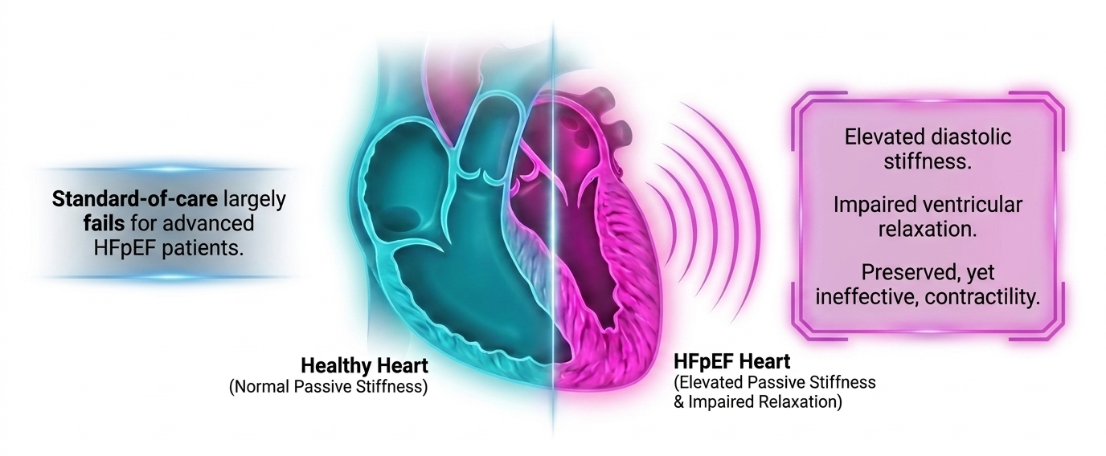
Heart Failure with Preserved Ejection Fraction (HFpEF)

Slide 4
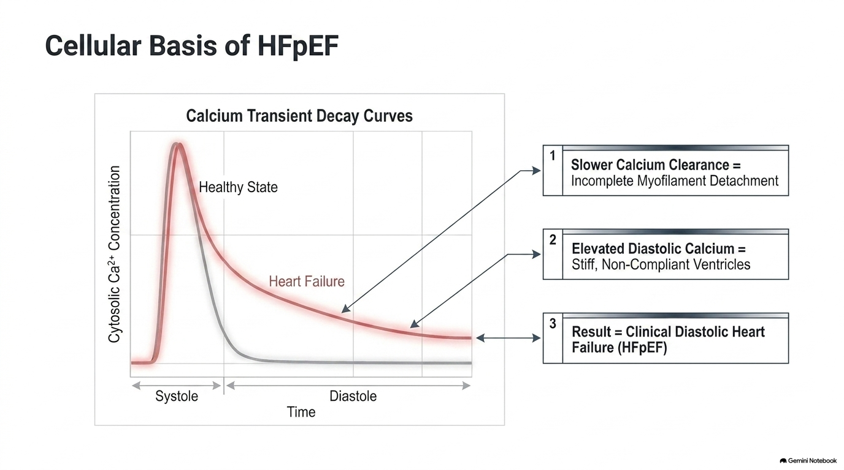
Cellular Basis of HFpEF
SERCA2a-Mediated Cardiac Relaxation
Ca²⁺
Ca²⁺
RyR
SERCA2a
Ca²⁺
Ca²⁺
Ca²⁺
Ca²⁺
PLN
P
Ca²⁺
PLN
SERCA2a

Slide 5
Phase 1b Clinical Trial of AAV1.SERRCA2a (HFpEF) Completed Enrollment
  Screening & NAB Testing
  Intracoronary Delivery of SRD-002
  6 & 12 Month
  Endpoints
  Long-term Follow-up
  Five Years Post-intervention
Cohort A (n=5)
1st dose (3E13 vg)
  Efficacy Endpoints Change from Baseline:
Cardiovascular events
All cause mortality
Patients
Enrollment
PCWP at rest & exercise 6MWT KCCQ LA volume | NT-proBNP Troponin Tau NYHA
Cohort B (n=5)
High dose (4.5E13 vg)
Inclusion Criteria:
Adults with HFpEF
NYHA II or III on SOC treatment
LVEF >50%
PCWP >15mmHg or >25mmHg on exercise
Current Status: 5 Cohort A patients dosed & completed 12- month f/u. 5 Cohort B patients have been dosed.
Exclusion Criteria:
Anti-AAV1 NAB ≤50% inhibition at 1:4
Cardiac surgery or intervention in last 3 months

Slide 6
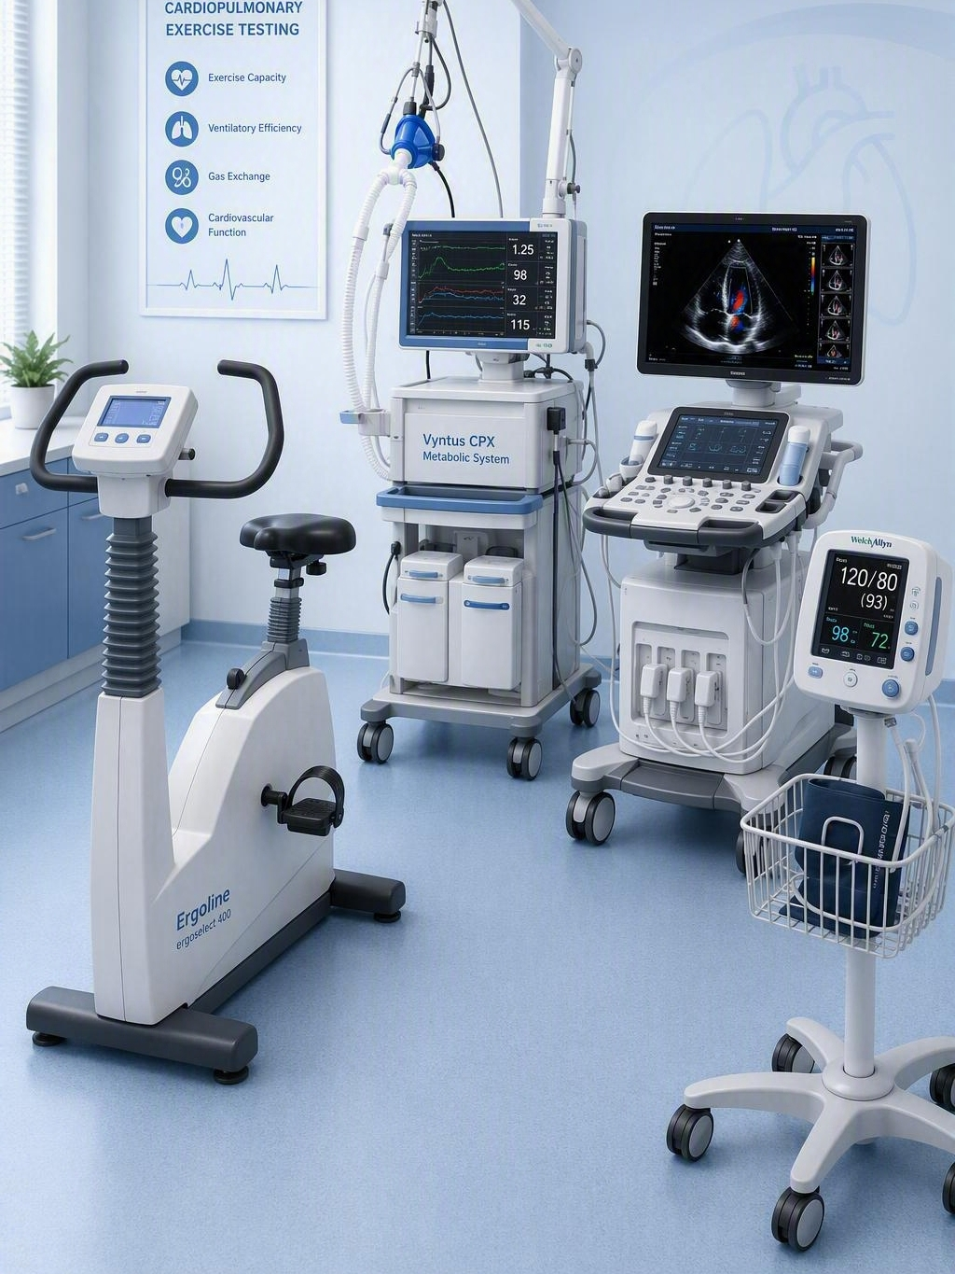
Hemodynamic Measurements
Echo
Swan Ganz & Arterial Line
Metabolic Cart
Ergometer
6

Slide 7
Low and High-Dose Cohort Patient Baseline Measurements
Baseline Parameters | 3x10¹³ vg Cohort (n = 5) | 4.5x10¹³ vg Cohort (n = 5) | All Cohorts (n = 10)
Mean Age in Years (SD) | 73.8 (7.1) | 68.6 (12.7) | 71.2 (10.1)
Sex – n (%) Male Female | 2 (40%) 3 (60%) | 0 (0%) 5 (100%) | 2 (20%) 8 (80%)
Race – n (%) White Black / African American | 4 (80%) 1 (20%) | 5 (100%) 0 (0%) | 9 (90%) 1 (10%)
LVEF % | ≥50% (all patients) | ≥50% (all patients) | ≥50% (all patients)
Heart Rate in Beats/Min – Mean (SD) | 70.6 (5.5) | 64.4 (7.4) | 67.5 (7.0)
Systolic Blood Pressure in mmHg – Mean (SD) | 115.0 (21.0) | 116.2 (13.0) | 115.6 (16.5)
Creatinine in mg/dL – Mean (SD) | 1.138 (0.463) | 0.884 (0.224) | 1.011 (0.368)
BMI in kg/m² – Mean (SD) | 32.3 (6.9) | 27.7 (5.9) | 30.0 (6.6)
Key Co-morbidities Atrial Fibrillation Chronic Kidney Disease Type 2 Diabetes | 2 (40%) 1 (20%) 2 (40%) | 4 (80%) 0 (0%) 0 (0%) | 6 (60%) 1 (10%) 2 (20%)

Slide 8
Hemodynamic Data
%) | ID | CO @ Rest & Peak (L/min) |  |  | PCWP @ Rest & Peak (mmHg, % change) |  |  | PCWP/CO @ Peak (mmHg*min/L absolute change) |  |  | mPAP @ Rest & Peak (mmHg, absolute change) |  |  | PVR @ Rest (mmHg*min/L, % change)
 |  | Baseline | 6 mos | 12 mos | Baseline | 6 mos | 12 mos | Baseline | 6 mos | 12 mos | Baseline | 6 mos | 12 mos | Baseline | 6 mos | 12 mos
Low Dose (3x10¹³ vg) | 119-3001 | 6 15^{90W} | 5 12^{110W} | 6.5 13.8^{90W} | 13.3 22.7^{90W} | 8.0 (-40.0%) 22.0^{110W} (-3.0%) | 10.0 (-25.0%) 23.0^{90W} (+1.5%) | 1.5 | 1.8 (+0.3) | 1.7 (+0.2) | 18.0 47.0^{90W} | 22.0 (+4.0) 46.0^{110W} (-1.0) | 20.0 (+2.0) 47.0^{90W} (0.0) | 0.8 | 2.8 (+259.7%) | 1.5 (+97.7%)
 | 119-3003 | 4 11^{70W} | 3.2 8.8^{70W} | 5.1 8.9^{80W} | 7.0 22.0^{70W} | 4.7 (-33.3%) 9.7^{70W} (-56.0%) | 4.0 (-42.9%) 10.0^{80W} (-54.5%) | 2.0 | 1.1 (-0.9) | 1.1 (-0.9) | 18.0 30.0^{70W} | 14.0 (-4.0) 20.0^{70W} (-10.0) | 8.0 (-10.0) 19.0^{80W} (-11.0) | 2.8 | 2.9 (+6.0%) | 0.8 (-71.5%)
 | 119-3004 | 5 11^{70W} | 5.4 9.1^{80W} | 4.9 9.1^{70W} | 20.7 24.7^{70W} | 11.0 (-46.8%) 25.0^{80W} (+1.3%) | 11.0 (-46.8%) 20.0^{70W} (-18.9%) | 2.2 | 2.7 (+0.5) | 2.2 (0.0) | 34.0 40.0^{70W} | 20.0 (-14.0) 39.0^{80W} (-1.0) | 18.0 (-16.0) 35.0^{70W} (-5.0) | 2.7 | 1.7 (-37.5%) | 1.4 (-46.4%)
 | 119-3008 | 5 11^{80W} | 5.6 10.6^{90W} | 4.6 9.8^{80W} | 8.3 30.0^{80W} | 15.0 (+80.1%) 32.0^{90W} (+6.7%) | 11.0 (+32.1%) 25.0^{80W} (-16.7%) | 2.7 | 3.0 (+0.3) | 2.6 (-0.2) | 18.0 42.0^{80W} | 25.0 (+7.0) 50.0^{90W} (+8.0) | 20.0 (+2.0) 51.0^{80W} (+9.0) | 1.9 | 1.8 (-7.7%) | 2.0 (+1.2%)
 | 108-3011 | 5.7 13.6^{45W} | 7.6 16^{50W} | 5 13^{55W} | 9.0 41.3^{45W} | 6.0 (-33.3%) 40.3^{50W} (-2.4%) | 3.7 (-59.2%) 23.3^{55W} (-43.6%) | 3.0 | 2.5 (-0.5) | 1.8 (-1.2) | 18.0 52.0^{45W} | 14.0 (-4.0) 60.0^{50W} (+8.0) | 14.0 (-4.0) 37.0^{55W} (-15.0) | 1.6 | 1.1 (-33.3%) | 2.1 (+30.8%)
High Dose (4.5x10¹³ vg) | 119-3011 | 4.5 7.7^{80W} | 5.8 9.2^{80W} | 5.3 7.5^{60W} | 11.0 28.0^{80W} | 11.0 (0.0%) 24.0^{80W} (-14.3%) | 3.0 (-72.7%) 20.0^{60W} (-28.6%) | 3.6 | 2.6 (-1.0) | 2.7 (-1.0) | 20.0 43.0^{80W} | 17.0 (-3.0) 42.0^{80W} (-1.0) | 13.0 (-7.0) 31.0^{60W} (-12.0) | 2.0 | 1.0 (-48.3%) | 1.9 (-5.7%)
 | 119-3013 | 4.5 7.5^{60W} | 5.1 7.1^{60W} | 4.2 7.3^{60W} | 8.0 23.0^{60W} | 3.0 (-62.5%) 8.0^{60W} (-65.2%) | 4.0 (-50.0%) 13.0^{60W} (-43.5%) | 3.1 | 1.1 (-1.9) | 1.8 (-1.3) | 17.0 29.0^{60W} | 14.0 (-3.0) 18.0^{60W} (-11.0) | 12.0 (-5.0) 21.0^{60W} (-8.0) | 2.0 | 2.2 (+7.8%) | 1.9 (-4.8%)
 | 119-3015 | 5.2 11.2^{70W} | 5.2 11.5^{70W} | 5.1 10.3^{70W} | 15.0 25.0^{70W} | 8.0 (-46.7%) 22.0^{70W} (-12.0%) | 13.0 (-13.3%) 30.0^{70W} (+20.0%) | 2.2 | 1.9 (-0.3) | 2.9 (+0.7) | 20.0 32.0^{70W} | 14.0 (-6.0) 30.0^{70W} (-2.0) | 17.0 (-3.0) 41.0^{70W} (+9.0) | 1.0 | 1.2 (+20.0%) | 0.8 (-18.4%)
 | 119-3017 | 6.2 9.9^{80W} | 6.2 11.2^{80W} |  | 12.0 28.0^{80W} | 3.0 (-75.0%) 23.0^{80W} (-17.9%) |  | 2.8 | 2.1 (-0.8) |  | 17.0 32.0^{80W} | 11.0 (-6.0) 30.0^{80W} (-2.0) |  | 0.8 | 1.3 (+60.0%)
 | 108-3015 | 6.1 7.1^{40W} | 7.1 NA |  | 16.7 48.0^{40W} | 20.7 (+24.0%) 47.7^{25W} (-0.7%) |  | 6.8 | NA |  | 32.0 72.0^{40W} | 41.0 (+9.0) 66.0^{25W} (-6.0) |  | 2.5 3.4^{40W} | NA
Clinically Meaningful Changes:
PCWP decrease >20% or <15 mmHg @ rest & <25mmHg @ peak exercise
PCWP/CO decrease from >2 to <2 or PCWP/CO decrease >0.5
mPAP @ rest or @ peak exercise decrease >5 mmHg
PVR decrease >20% or from >2 to <2
Abbreviations:
CO: Cardiac Output
PCWP: Pulmonary Capillary Wedge Pressure
mPAP: Mean Pulmonary Artery Pressure
PVR: Pulmonary Vascular Resistance
Improvement
Represents normalized PCWP levels
Stabilization
Worsening

Slide 9
Change in PCWP from baseline at 6 and 12 months post gene transfer in low and high dose cohorts
High dose led to faster and stronger response vs. low dose
Potential for sustained disease modification, with greater reduction in PCWP from 6 to 12 mos in both cohorts
Consistent safety observed with no immunogenicity, liver enzyme abnormalities or other treatment-related SAEs
% Change in Mean PCWP from Baseline*
(n = 5)
(n = 5)
(n = 5)
(n = 3)
Rest
Peak Exercise
To date, 80% (8/10) of patients achieved normalized filling pressure in 6 – 12 mos
Note: PCWP = Pulmonary Capillary Wedge Pressure. Peak exercise ranged from 50W – 110W in the low-dose cohort at 6 mos and 55W – 90W at 12 mos. Peak exercise ranged from 25W – 80W in the high-dose cohort at 6 mos and 60W – 70W at 12 mos.

Slide 10
PCWP Improvement in Concordance with Other Hemodynamic Endpoints (All Patients)
PCWP @ Peak Exercise
Pulmonary Vascular Resistance @ Rest
Greater improvement in PH patients (PVR ≥2 mmHg*min/L)
(n = 4)
(n = 4)
(n = 3)
HFpEF Threshold
PH
Threshold
(n = 10)
(n = 10)
(n = 8)

Slide 11
SRD-002 Phase 1/2a HFpEF Data: HFpEF Symptoms and Function
 | ID | NYHA Classification |  |  | KCCQ (points, absolute change)
 |  | Baseline | 6 mos | 12 mos | Baseline | 6 mos | 12 mos
Low Dose (3x10¹³ vg) | 119-3001 | III | II | II | 40 | 49 (+9) | 52 (+12)
 | 119-3003 | III | II | II | 25 | 35 (+10) | 41 (+16)
 | 119-3004 | III | II | II | 23 | 42 (+19) | 73 (+50)
 | 119-3008 | III | II | II | 21 | 30 (+9) | 46 (+25)
 | 108-3011 | II | II | II | 54 | 54 (0) | 64 (+10)
High Dose (4.5x10¹³ vg) | 119-3011 | III | III | III | 38 | 29 (-9) | 32 (-6)
 | 119-3013 | III | II | II | 70 | 61 (-9) | 97 (+27)
 | 119-3015 | II | II | II | 61 | 58 (-3) | 70 (+9)
 | 119-3017 | II | II |  | 35 | 84 (+49)
 | 108-3015 | II | II |  | 73 | 59 (-14)
Clinically Meaningful Changes:
NYHA decrease ≥1 point
KCCQ >5 points
Abbreviations:
NYHA: New York Heart Association Functional Class
KCCQ: Kansas City Cardiomyopathy Questionnaire
Improvement
Stabilization
Worsening

Slide 12
AAV1.SERCA2a Efficacy in GLP-1 vs. Non-GLP-1 Patients
Based on the data below, GLP-1 did not seem to play a role in efficacy in the Phase 1/2a HFpEF trial
PCWP @ Peak Exercise
% of Patients Improving >1 NYHA
KCCQ
+21 points
+2 points
-38.0%
-23.8%
Clinically meaningful PCWP reduction (>20%) in GLP-1 &
non-GLP-1 patients
More non-GLP-1 patients showed improvement in NYHA
Greater KCCQ improvement in
non-GLP-1 patients

Slide 13
SRD-002 Phase 1/2a HFpEF Data: Exercise Capacity and Cardiac Biomarkers
 | ID | 6MWT (m, absolute change) |  |  | Peak VO₂ (mL/kg/min, absolute change) |  |  | NT-proBNP (pg/mL, % change)
 |  | Baseline | 6 mos | 12 mos | Baseline | 6 mos | 12 mos | Baseline | 6 mos | 12 mos
Low Dose (3x10¹³ vg) | 119-3001 | 380 | 377 (-3) | 383 (+3) | 17.0 | 20.0 (+3.0) | 17.0 (0.0) | 60 | 77 (+28.3%) | 154 (+156.7%)
 | 119-3003 | 323 | 320 (-4) | 299 (-24) | 16.0 | 13.8 (-2.2) | 13.7 (-2.3) | <50 | 56 (+12.0%) | 51 (+2.0%)
 | 119-3004 | 406 | 416 (+10) | 373 (-33) | 18.0 | 16.2 (-1.8) | 17.8 (-0.2) | 595 | 228 (-61.7%) | 324 (-45.5%)
 | 119-3008 | 185 | 304 (+119) | 248 (+63) | 13.3 | 11.4 (-1.9) | 14.7 (+1.4) | 569 | 649 (+14.1%) | 649 (+14.1%)
 | 108-3011 | 399 | 450 (+51) | 461 (+62) | 9.4 | 10.9 (+1.5) | 11.0 (+1.6) | <50 | 119 (+138.0%) | 54 (+8.0%)
High Dose (4.5x10¹³ vg) | 119-3011 | 324 | 285 (-39) | 260 (-64) | 11.3 | 12.5 (+1.2) | 10.8 (-0.5) | 754 | 1,277 (+69.4%) | 913 (+21.1%)
 | 119-3013 | 471 | 463 (-8) | 506 (+35) | 17.6 | 19.1 (+1.5) | 18.1 (+0.5) | <50 | <50 (0.0%) | <50 (0.0%)
 | 119-3015 | 435 | 343 (-92) | 365 (-70) | 13.1 | 14.3 (+1.2) | 13.7 (+0.6) | 98 | 61 (-37.8%) | 129 (+31.6%)
 | 119-3017 | 412 | 420 (+8) |  | 15.8 | 18.7 (+2.9) |  | 222 | 165 (-25.7%)
 | 108-3015 | 290 | NA |  | 7.4 | 6.1 (-1.3) |  | 675 | 947 (+40.3%)
Clinically Meaningful Changes:
6MWT increase ≥30 meters
Peak VO₂ increase >1 mL/kg/min
NT-proBNP decrease >35%
Abbreviations:
6MWT: 6 Minute Walk Test
VO2: Oxygen Consumption
NT-proBNP: N-terminal Pro B-type Natriuretic Peptide
Improvement
Stabilization
Worsening

Slide 14
AAV1.SERCA2a Phase 1/2a HFpEF Safety Data
Across 10 treated patients, AAV1.SERCA2a demonstrated a favorable safety profile with no deaths, no treatment discontinuations and no treatment-related SAEs
Treatment-emergent AEs (TEAEs) were largely mild and consistent with the underlying HF population
There were no signals of cardiac toxicity, hepatotoxicity or systemic inflammatory response, supporting the tolerability of SRD-002 at both dose levels
Category | Cohort 1 3x10¹³ vg (n = 5) | Cohort 2 4.5x10¹³ vg (n = 5) | Overall (n = 10)
Any TEAE, n (%) [events] | 5 (100.0%) [25] | 4 (80.0%) [15] | 9 (90.0%) [40]
Grade 1 | 5 (100.0%) [18] | 4 (80.0%) [11] | 9 (90.0%) [29]
Grade 2 | 3 (60.0%) [5] | 3 (60.0%) [4] | 6 (60.0%) [9]
Grade 3 (Severe) | 2 (40.0%) [2] | 0 | 2 (20.0%) [2]
Treatment-related TEAE | 2 (40.0%) [2] | 0 | 2 (20.0%) [2]
Serious TEAE, n (%) [events] | 1 (20.0%) [1] | 0 | 1 (10.0%) [1]
Leading to Death | 0 | 0 | 0
Treatment-related Serious TEAE | 0 | 0 | 0
Predefined Dose-limiting Toxicity | 0 | 0 | 0
Grade 3+ Liver Enzyme Elevation | 0 | 0 | 0
Notes:
Same table for hi dose? At least slide 4 summary eg 100% PCWP normalisation

Slide 15
Summary
Consistent improvement in cardiac filling pressures, with durable reductions in resting and exercise PCWP through 12 months, supporting target engagement and restoration of calcium handling.
Concordant improvements across multiple physiological measures, including pulmonary vascular resistance, left ventricular relaxation, and patient-reported outcomes, consistent with a biologically meaningful treatment effect.
Favorable safety profile, with no treatment-related serious adverse events, no dose-limiting toxicities, no clinically significant hepatotoxicity, and no evidence of clinically meaningful immunogenicity.
The higher dose (4.5 × 10¹³ vg) demonstrated earlier and greater hemodynamic improvement while maintaining a comparable safety profile.

Slide 16
Conclusions
These first-in-human Phase 1b results provide compelling proof-of-concept that intracoronary AAV1.SERCA2a gene therapy can safely restore a key mechanism underlying HFpEF and produce durable physiological improvements.
Findings support advancement to a randomized Phase 2b/3 trial to confirm clinical efficacy and establish AAV1.SERCA2a as a potential one-time therapy for patients with HFpEF.

