Slide 1
DANISH-CRT: Targeted LV lead placement for biventricular pacing for heart failure
a national, multicentre, double-blind, randomised controlled trial (NCT03280862)
The trial was supported by grants from the Novo Nordisk Foundation, the Danish Heart Foundation, the Danish Pacemaker and ICD Registry, and Independent Research Fund Denmark
Jens Cosedis Nielsen
Department of Cardiology, Aarhus University Hospital, Aarhus, Denmark
August 31st, 2026 HOTLINE 10

Slide 2
DANISH-CRT investigators
Affiliations
Department of Cardiology, Aarhus University Hospital
Department of Clinical Medicine, Aarhus University
Department of Cardiology, Copenhagen University Hospital – Rigshospitalet
Department of Clinical Medicine, Faculty of Health and Medical Sciences, University of Copenhagen
Department of Cardiology, Odense University Hospital
Department of Cardiology, Aalborg University Hospital
Department of Clinical Medicine, Aalborg University
Department of Cardiology, Copenhagen University Hospital - Herlev and Gentofte
Department of Radiology, Copenhagen University Hospital – Rigshospitalet
Department of Health Science and Technology, Aalborg University
Research Data and Biostatistics, Aalborg University Hospital
all Denmark.
Jens Cosedis Nielsen (PI)
Jesper Hastrup Svendsen
Jens Brock Johansen
Jacob Moesgaard Larsen
Charlotte Ellen Larroudé
Steen Hvitfeldt Poulsen
Hans Eiskjær
Bjarne Linde Nørgaard
Niels Risum
Lars Køber
Jens Kristensen
Kristian Øvrehus
Anders Munck Sommer
Morten Schou
Peter Søgaard
Mikael Kjær Poulsen
Klaus F. Kofoed
Thomas Fritz Hansen
Claus Graff
Regitze Gyldenholm Skals
Maria Hee Jung Park Frausing
Emil Anton Frandsen
Jesper Møller Jensen
Michael Vinther
Henrik Kjærulf Jensen
Jens Haarbo
Tomas Zaremba
Mindaugas Viezelis
Berit Philbert
Jakob Hjort
Christian Gerdes
Mads Brix Kronborg (Co-PI)
For the DANISH-CRT Trial Investigators

Slide 3
Background and aim
Background
  A considerable proportion of patients treated with CRT has no measurable benefit of CRT
  Observational studies show better outcomes in patients with late electrical activation at site of LV lead
  Small RCTs indicate better outcomes targeting the LV lead at latest activation in CS
Hypothesis and aim
  We aimed to test the hypothesis that targeting the left ventricular lead at the site of the latest electrical activation in the coronary sinus branches improves outcomes measured as time to death or unplanned hospitalization for heart failure in patients with an indication for cardiac resynchronization therapy.

Slide 4
Methods
Investigator-initiated, double-blind, randomized controlled, superiority trial
All five Danish university centres performing CRT implantation
Primary outcome was composite of time to death or first unplanned HF-hospitalization
80% power to detect 25% difference in the primary endpoint between treatment groups. At least 264 primary outcome events were required for the study to be conclusive. With expected attrition rate <10%, we planned including 1,000 patients
Intention-to-treat analysis

Slide 5
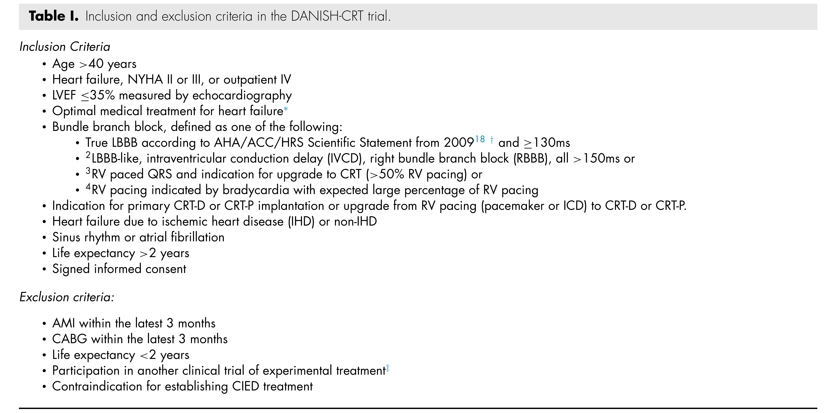
Inclusion and exclusion criteria

Slide 6
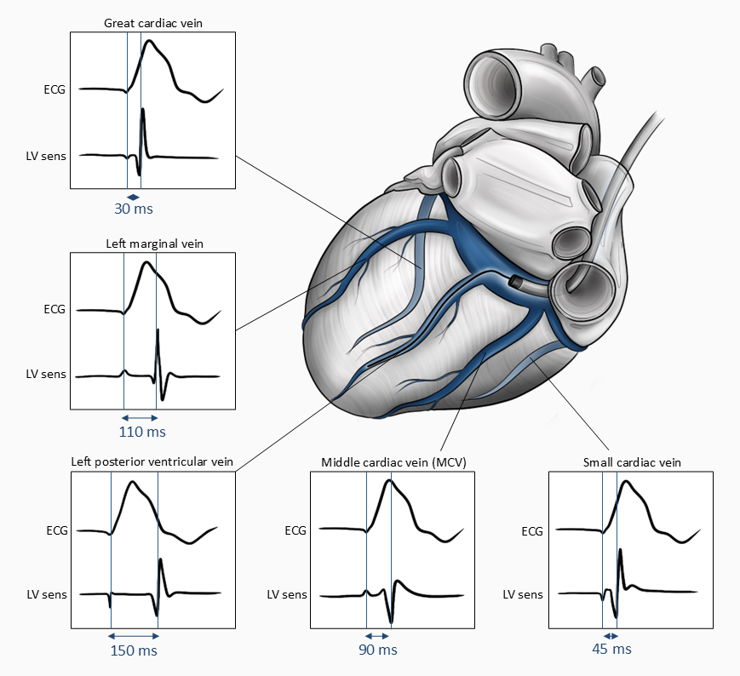
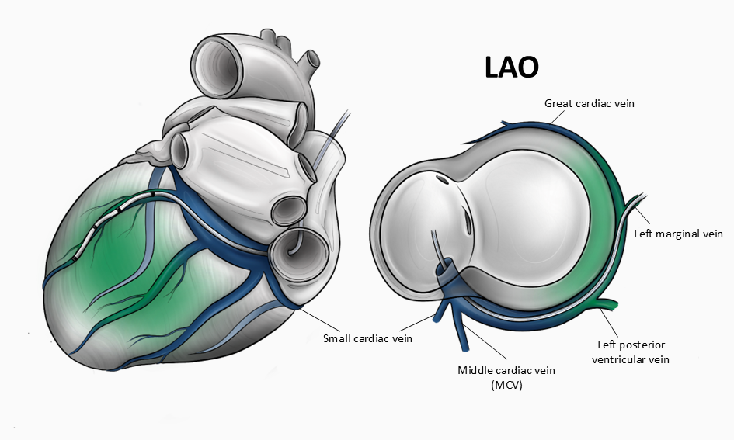
Intervention Group
Control Group

Slide 7
Baseline characteristics
 | Intervention (N=499) | Control (N=501)
Median age (IQR) – years | 73 (65, 78) | 72 (63, 77)
Female sex – no. (%) | 130 (26%) | 125 (25%)
Median QRS (IQR) - msec | 164 (158, 180) | 166 (158, 180)
Mean LVEF (SD) - % | 27 (6) | 27 (6)
Mean LVEDV (SD) - ml | 187 (73) | 190 (64)
Mean LVESV(SD) - ml | 138 (62) | 140 (54)
NYHA class – no. (%) II III IV | 279 (56.1%) 216 (43.5%) 2 (0.4%) | 286 (57.1%) 206 (41.1%) 9 (1.8%)
HF aetiology– no. (%) Ischaemic heart disease Non-ischaemic DCM | 221 (44.6%) 271 (54.4%) | 193 (38.8%) 284 (56.8%)
Preexisting PM or ICD – no. (%) | 174 (34.9%) | 174 (34.7%)
Indication for CRT– no. (%) LBBB with QRS≥130 msec Other BBB with QRS>150 msec Paced QRS and need for RV pacing Indication for pacing and low LVEF | 336 (67.3%) 43 (8.6%) 111 (22.2%) 9 (1.8%) | 342 (68.3%) 41 (8.2%) 111 (22.2%) 7 (1.4%)
Medication – no. (%) ACE-inhibitor, AT-II blocker, or ARNI Betablocker Mineralocorticoid receptor blocker SGLT2-inhibitor Diuretics | 465 (93.2%) 434 (87.0%) 349 (69.9%) 194 (47.5%) 345 (69.3%) | 475 (95.0%) 429 (85.8%) 337 (67.5%) 191 (46.5%) 326 (65.2%)
Median Nt-Pro BNP (IQR) – ng/l | 1,259 (574.5, 2,672) | 1,260 (487, 2,666)

Slide 8
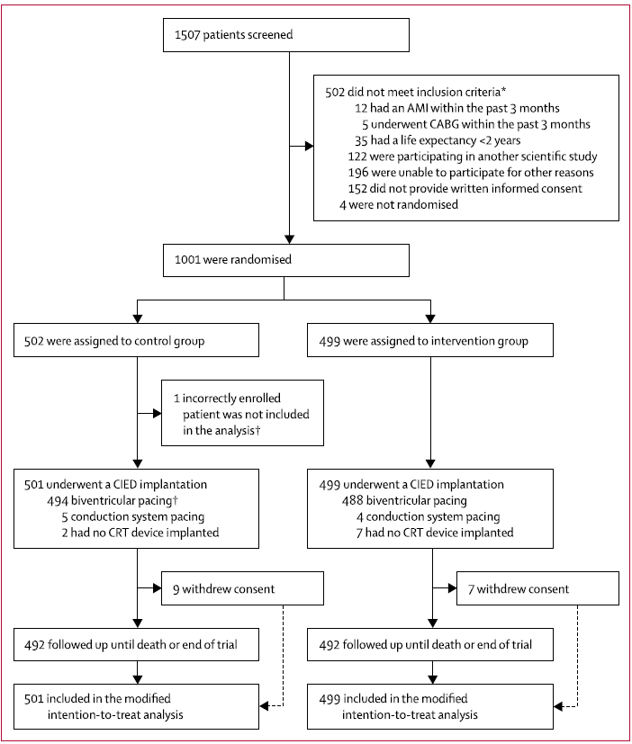
Patient flow

Slide 9
Results
Procedural data
 | Intervention (N=499) | Control (N=501)
Median number of coronary sinus branches mapped (IQR) - no. | 3 (2, 4) | 0
Left ventricular lead placed: – no. (%) In latest electrically activated CS branch At latest electrically activated site | 414 (83.0) 389 (78.0) | NA NA
Median activation delay on LV pacing site from RV sensing/pacing (IQR) – msec. | 137 (118, 160) | 130 (108, 153)
Median procedure duration (IQR) – minutes. | 100 (85, 130) | 81 (63, 120)
Median fluoroscopy duration (IQR) – minutes. | 22 (15, 30) | 15 (9, 25)
Median radiation dose (IQR) – Gycm² | 19 (12, 33) | 14 (8, 30)

Slide 10
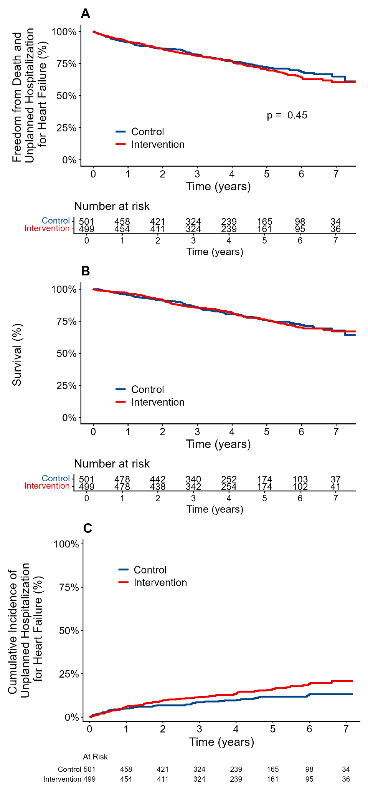
Freedom from
Results
Death or Unplanned Hospitalization for Heart Failure
HR (95% CI) 1.10 (0.86-1.39)
p = 0.45
Median follow-up
45.8 months

Slide 11
Results
Unplanned Hospitalization for Heart Failure
Survival

Slide 12
Results
Clinical outcomes
No. of patients (%) | Intervention (N=499) | Control (N=501) | Hazard ratio (95% CI)
Death or unplanned hospitalization for HF Death Cardiovascular death Sudden cardiac death Unplanned hospitalization for heart failure Atrial fibrillation | 139 (27.9%) 113 (22.6%) 82 (16.4%) 32 (6.4%) 77 (15.4%) 48 (9.6%) | 128 (25.5%) 110 (22.0%) 67 (13.4%) 36 (7.2%) 53 (10.6%) 34 (6.8%) | 1.10 (0.86-1.39) 1.03 (0.79-1.34) 1.23 (0.89-1.70) 0.90 (0.56-1.44) 1.47 (1.03-2.08) 1.44 (0.93-2.23)

Slide 13
Results
6-month outcomes
 | Intervention | Control
Mean left ventricular ejection fraction (SD) - % | 41 (10) | 41(10)
Mean absolute increase in LVEF from baseline (SD) - % | 14 (9) | 14 (9)
Mean Six-Minute Walk Test distance (SD) – m. | 436 (107) | 432 (113)
Mean change in KCCQ-12 CSS score from baseline (SD) | 12 (17) | 11 (18)
NYHA class – no. (%) I II III IV | 167 (35.3%) 262 (55.4%) 43 (9.1%) 1 (0.2%) | 154 (32.2%) 282 (58.9%) 41 (8.6%) 2 (0.4%)

Slide 14
Results
Complications
 | Intervention | Control | Risk ratio with 95% CI | p-value
Total patients with any complication, n (%) Patients with major complications, n (%) Total patients with lead-related complications, n (%) Patients with lead-related complications including perforations, n (%) Patients with left ventricular lead-related complications, n (%) | 71 (14%) 59 (12%) 34 (7%) 39 (8%) 15 (3%) | 64 (13%) 50 (10%) 23 (5%) 26 (5%) 6 (1%) | 1.11 (0.81-1.52) 1.18 (0.83-1.69) 1.48 (0.89-2.48) 1.51 (0.93-2.44) 2.51 (0.98-6.42) | 0.50 0.35 0.13 0.09 0.05

Slide 15
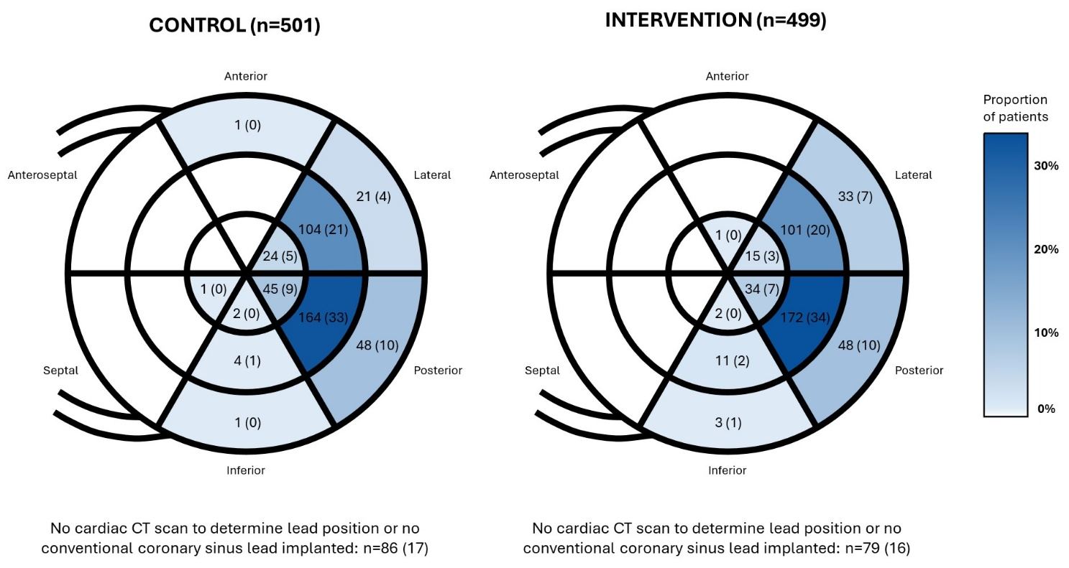
Left ventricular lead tip placement in post implant cardiac CT scan

Slide 16
Conclusion
In patients with HF and prolonged QRS, targeted placement of the left ventricular pacing lead at site of latest electrical activation did not reduce the risk of the composite endpoint of death or unplanned hospitalization for heart failure compared with conventional placement of the lead in a posterolateral, non-apical position.

Slide 17
Perspectives
Our findings do not support routine electrical mapping to guide left ventricular lead placement in contemporary CRT practice
It is unlikely that other mapping strategies for targeted LV lead placement will be more successful
The excellent clinical response to CRT observed in this trial could be used for benchmarking when assessing upcoming trials on novel CRT-modalities

Slide 18
Thank you
To patients and implanters
Study nurses and coordinators in the participating centres, study coordinator Henriette Holmberg, BSc, research nurse and study coordinator Lotte Lindskow, BSN, echo technician Bente Mortensen, and radiographer Kamilla Bech Pedersen for their extraordinary efforts in completing this trial
Professor Susanne S. Pedersen, who was responsible for the patient-reported outcomes program in the trial
Members of the trial Data Safety Monitoring Board Professor Hans Erik Bøtker, MD, DMSc, PhD (chair), and Professor Kenneth Egstrup, MD, DMSc,
Members of our Endpoint Committee, Professor Kristian Thygesen, MD, DMSc, Professor Michael Mæng, MD, PhD, and Associate Professor Jan Ravkilde, MD, DMSc
The trial was supported by grants from the Novo Nordisk Foundation (NNF17OC0029148), the Danish Heart Foundation (17- R116-A7405-22046 and 21-R151-A9920-22199), the Danish Pacemaker and ICD Registry, and Independent Research Fund Denmark (5283-00034B)

Slide 19
