Slide 1


Hydralazine-Isosorbide Dinitrate in HFrEF
A Prespecified Trial-Level Meta-Analysis
Jawad Haider Butt, MD, PhD
Department of Cardiology, Rigshospitalet, Copenhagen University Hospital, Denmark
On behalf of the H-HeFT Committees and Investigators
Notes:
Dear chairmen, dear colleagues, good morning.
With the results from H-HeFT in mind, I will now step back and look at the bigger picture
What does the total evidence show for H-ISDN in HFrEF?
To address this, we conducted a prespecified trial-level meta-analysis.

Slide 2
Disclosures
Advisory board honoraria: Abbott, AstraZeneca, Bayer
Consultant honoraria: AstraZeneca, Novartis, Bayer
Travel grants: AstraZeneca, Bayer, Boehringer Ingelheim, MSD

Slide 3
Introduction: H-ISDN in HFrEF
Current guidelines for the management of HFrEF recommend H-ISDN in patients:
  self-identified as black, in NYHA class III/IV, receiving foundational medical therapy
  unable to tolerate ACEi/ARB/ARNI
V-HeFT I (1986)
A-HeFT (2004)
Trend towards a reduction in mortality
- Only men
- RASi and BB not standard-of-care therapy
Reduction in mortality and HF hospitalization
- Only self-identified black individuals
- Stopped early for benefit
Notes:
H-ISDN is already recommended in current HFrEF guidelines. However, this treatment is currently recommended only in 2 specific situations.
In patients who…
These recommendations are predominantly based on 2 RCTs.
Both trials were conducted in selected populations.
As such, these results may not be generalizable to a broader, contemporary HFrEF population

Slide 4
Introduction: H-ISDN in HFrEF
H-HeFT was designed to extend the evidence to a distinct, contemporary population, but was not powered for mortality
Together, the three trials cover complementary HFrEF populations across the spectrum of disease severity and patient profiles
Pooling the trials increases statistical power to assess treatment effects

Slide 5
Objective
In a prespecified meta-analysis of placebo-controlled RCTs, we estimated the effects of H-ISDN on mortality and HF hospitalizations in chronic HFrEF
Meta-analysis planned and registered with PROSPERO (CRD420261402397) prior to database lock of H-HeFT.
Notes:
Consequently, we examined the totality of evidence of the effects of H-ISDN on mortality and HF hospitalizations in patients with chronic HFrEF
Importantly, this meta-analysis was prespecified and registered with PROSPERO prior to database lock of H-HeFT.

Slide 6
Eligibility criteria
Key inclusion criterion
Key exclusion criteria
RCTs investigating the effects of H-ISDN vs placebo on morbidity and mortality in chronic HF and predominantly reduced LVEF
RCTs conducted exclusively in acute decompensated HF or HFpEF
RCTs including < 100 participants

Slide 7
Prespecified outcomes
All-cause death
Primary endpoint
CV death
Secondary endpoints
First HF hospitalization
First HF hospitalization or all-cause death
Data retrieved from primary trial reports, secondary publications, and publicly available regulatory documents.
Notes:
Data on outcomes were retrieved from primary trial reports, secondary publications, and publicly available regulatory documents.

Slide 8
RCTs included in meta-analysis
 | V-HeFT I N=459* | A-HeFT N=1050 | H-HeFT N=592
Enrollment period | 1980-1985 | 2001-2004 | 2018-2025
Sites | 11 VA hospitals in US | 161 centers in US | 23 centers in Denmark
Key inclusion criteria | Male sex Cardiothoracic ratio >0.55 or LV dimension >2.7cm/m² or LVEF <45% Reduced exercise tolerance Symptoms despite treatment with digitalis glycosides and diuretics …… | Self-identified black race LVEF <35% or LVEF <45% with LV dimension >2.9cm/m² (or >6.5 cm) NYHA class III–IV Standard HF therapy, including ACEi/ARB, BB, digoxin, spironolactone, and diuretics | Non-African descent LVEF <40% and NT-proBNP >350pg/mL … NYHA class II-IV Foundational HF therapy, including ACEi/ARB/ARNI, BB, MRA, SGLT2i, ICD, and CRT
Mean follow-up | 2.3 years | 10 months | 3.7 years
Target daily dose | ISDN:160 mg; H: 300 mg | ISDN: 120 mg; H: 225 mg | ISDN: 120 mg; H: 225 mg
Primary outcome | All-cause death | Composite score based on all-cause death, HF hospitalization, and change in QoL | Composite of death, HF hospitalization, urgent outpatient visit, heart transplantation, or LVAD implantation
*V-HeFT I characteristics are shown for the H-ISDN and placebo arms only, as the prazosin group (N=183) was excluded in this meta-analysis.
Notes:
Our search identified 3 RCTs
Span more than 4 decades
Complementary populations
V-HeFT I enrolled only men on digoxin and diuretics
A-HeFT enrolled only self-identified Black patients predominantly in NYHA 3 treated with a RAS-inhibitor, beta-blocker, MRA
H-HeFT enrolled patients of non-African-descent predominantly in NYHA 2 on foundational medical therapy
Substantial variation in mean follow-up from 10 mo. to 3,7 years

Slide 9
Main results:
Fixed-effect models
Notes:
I wil now share the primary results of this meta-analysis of H-ISDN in chronic HFrEF
Main results were based on fixed-effect models with inverse-variance weighting.

Slide 10
Primary outcome
Notes:
A hazard ratio was reported for all 3 trials

Slide 11
Effect of H-ISDN on all-cause death
 | No. with event / no. of patients |  |  |  | Hazard ratio
Trial | H-ISDN | Placebo |  |  | (95% CI)
V-HeFT I | 72/186 (38.7%) | 120/273 (44.0%) |  |  | 0.78 (0.58-1.04)
A-HeFT | 32/518 (6.2%) | 54/532 (10.2%) |  |  | 0.57 (0.37-0.88)
H-HeFT | 57/294 (19.4%) | 72/298 (24.2%) |  |  | 0.72 (0.51-1.02)
Overall |  |  |  |  | 0.71 (0.58-0.87)
Test for overall treatment effect: p=0.001
Heterogeneity: I²=0.0%
Test for heterogeneity of effect: p=0.51
0.35 0.50 0.75 1.00 1.50
Favors H-ISDN Favors placebo
Between-trial heterogeneity was assessed with Cochran’s Q test
Notes:
H-ISDN, compared with placebo, significantly reduced the risk of all-cause death with 29%.
The estimates were remarkably similar with no evidence of heterogeneity across trials

Slide 12
Secondary outcomes
Notes:
For all secondary endpoints, hazard ratios were only reported for A-HeFT and H-HeFT.
Therefore, in the primary analysis, only these 2 trials were meta-analyzed

Slide 13
Effect of H-ISDN on CV death
 | No. with event / no. of patients |  |  |  | Hazard ratio
Trial | H-ISDN | Placebo |  |  | (95% CI)
A-HeFT | 26/518 (5.0%) | 45/532 (8.5%) |  |  | 0.56 (0.35-0.90)
H-HeFT | 37/294 (12.6%) | 45/298 (15.1%) |  |  | 0.74 (0.48-1.15)
Overall |  |  |  |  | 0.65 (0.47-0.90)
Test for overall treatment effect: p=0.009
Heterogeneity: I²=0.0%
Test for heterogeneity of effect: p=0.40
0.35 0.50 0.75 1.00 1.50
Favors H-ISDN Favors placebo
Between-trial heterogeneity was assessed with Cochran’s Q test
Notes:
H-ISDN significantly reduced the risk of CV death with 35%, with no evidence of heterogeneity across trials.

Slide 14
Effect of H-ISDN on first HF hospitalization
 | No. with event / no. of patients |  |  |  | Hazard ratio
Trial | H-ISDN | Placebo |  |  | (95% CI)
A-HeFT | 85/518 (16.4%) | 130/532 (24.4%) |  |  | 0.61 (0.46-0.80)
H-HeFT | 48/294 (16.3%) | 45/298 (15.1%) |  |  | 0.99 (0.66-1.48)
Overall |  |  |  |  | 0.71 (0.56-0.89)
Test for overall treatment effect: p=0.003
Heterogeneity: I²=72.5%
Test for heterogeneity of effect: p=0.06
0.35 0.50 0.75 1.00 1.50
Favors H-ISDN Favors placebo
Between-trial heterogeneity was assessed with Cochran’s Q test
Notes:
In contrast, although H-ISDN reduced the risk of first HF hospitalization with almost 30%...
there was substantial between-trial heterogeneity, with a beneficial effect in A-HeFT and none in H-HeFT.

Slide 15
Effect of H-ISDN on first HF hospitalization
or all-cause death
 | No. with event / no. of patients |  |  |  | Hazard ratio
Trial | H-ISDN | Placebo |  |  | (95% CI)
A-HeFT | 108/518 (20.8%) | 158/532 (29.7%) |  |  | 0.63 (0.49-0.81)
H-HeFT | 85/294 (28.9%) | 89/298 (29.9%) |  |  | 0.88 (0.65-1.18)
Overall |  |  |  |  | 0.72 (0.60-0.88)
Test for overall treatment effect: p=0.001
Heterogeneity: I²=63.8%
Test for heterogeneity of effect: p=0.10
0.35 0.50 0.75 1.00 1.50
Favors H-ISDN Favors placebo
Between-trial heterogeneity was assessed with Cochran’s Q test
Notes:
Likewise, although H-ISDN reduced the risk of a composite of first HF hospitalization or death, there was substantial between-trial heterogeneity.

Slide 16
Sensitivity analyses:
Random-effects models
Notes:
As a sensitivity analysis, we conducted random-effects meta-analyses to try and account for the between-trial heterogeneity observed

Slide 17
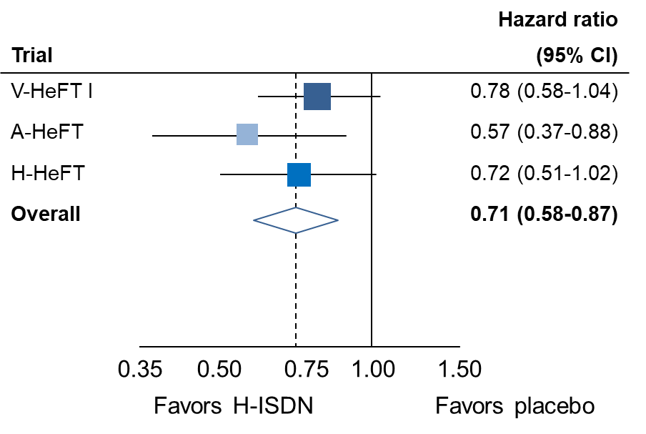
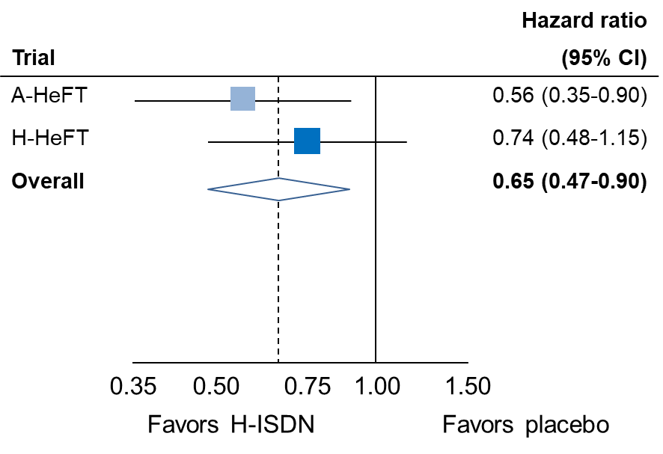
Effect of H-ISDN on all-cause and CV death
All-cause death
CV death
Notes:
For both all-cause and CV death, there was no evidence of heterogeneity between trials.
As a result, the random effects meta-analysis produced essentially similar estimates.

Slide 18
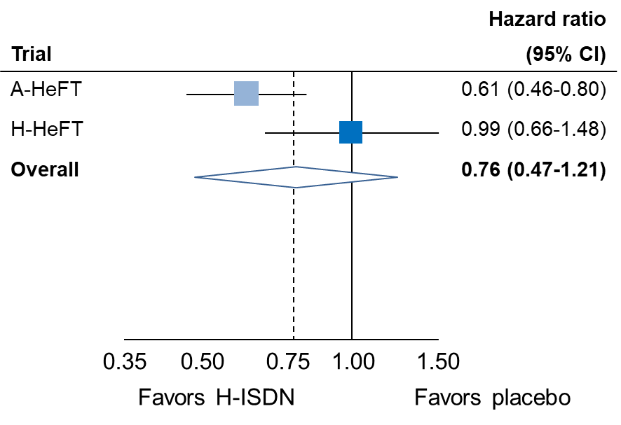
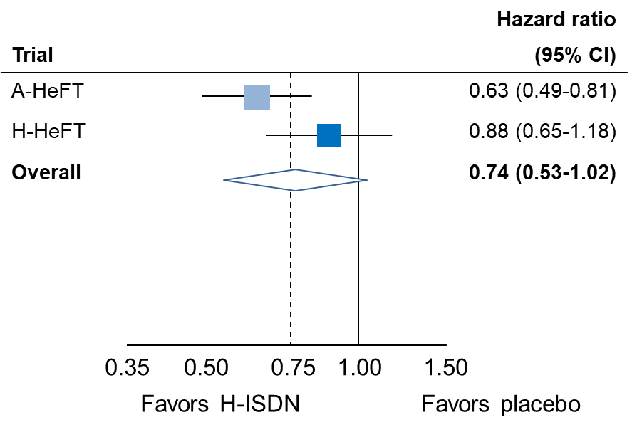
Effect of H-ISDN on HF hospitalization-related outcomes
First HF hospitalization
First HF hospitalization
or all-cause death
Notes:
However, when accounting for the substantial between-trial heterogeneity for first HF hospitalization or the composite outcome
H-ISDN no longer significantly reduced the risk of these outcomes, although a trend remained

Slide 19
Sensitivity analyses:
Mantel-Haenszel method
Notes:
In V-HeFT I, no hazard ratio was reported for secondary outcomes; only number of events were reported.
Therefore we conducted meta-analyses using the Mantel-Haenzel method to be able to include the raw data from V-HeFT I.

Slide 20
Effect of H-ISDN on all-cause death
 | No. with event / no. of patients |  |  |  | Risk ratio
Trial | H-ISDN | Placebo |  |  | (95% CI)
V-HeFT I | 72/186 (38.7%) | 120/273 (44.0%) |  |  | 0.91 (0.71-1.17)
A-HeFT | 32/518 (6.2%) | 54/532 (10.2%) |  |  | 0.63 (0.41-0.96)
H-HeFT | 57/294 (19.4%) | 72/298 (24.2%) |  |  | 0.83 (0.61-1.14)
Overall |  |  |  |  | 0.82 (0.69-0.98)
Test for overall treatment effect: p=0.03
Heterogeneity: I²=10.4%
Test for heterogeneity of effect: p=0.33
0.35 0.50 0.75 1.00 1.50
Favors H-ISDN Favors placebo
Between-trial heterogeneity was assessed with Cochran’s Q test
Notes:
In this analysis, H-ISDN still reduced the risk of all-cause death

Slide 21
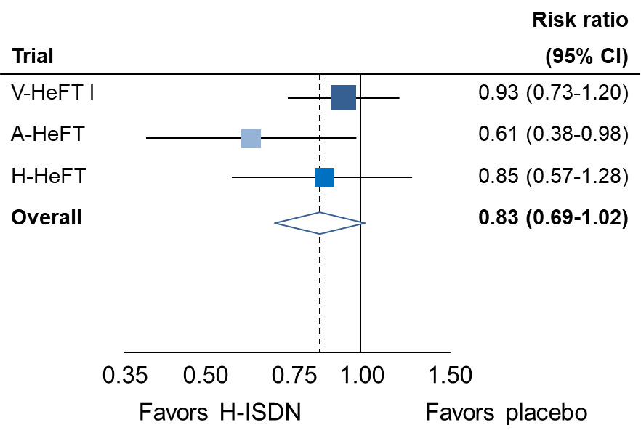
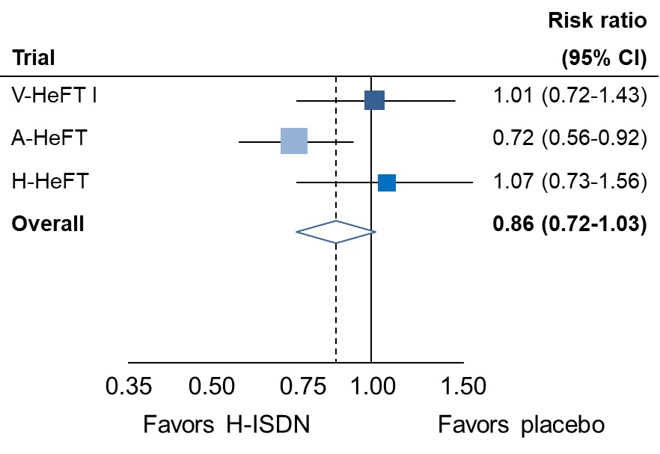
Effect of H-ISDN on CV death and first HF hospitalization
CV death
First HF hospitalization
Notes:
Although there was a clear trend, H-ISDN no longer significantly reduced the risk of CV death or the risk of first HF hospitalization

Slide 22
Conclusions: H-ISDN in HFrEF
In chronic HFrEF, H-ISDN was associated with a reduction in all-cause death and CV death
H-ISDN was associated with a reduction in HF hospitalizations in fixed-effect but not random-effects models, reflecting substantial between-trial heterogeneity
Notes:
Although H-ISDN was associated with a reduction in HF hospitalization in fixed effect models, this was not the case in random-effects models, and this reflects the substantial heterogeneity between trials

Slide 23
Perspectives: H-ISDN in HFrEF
High treatment discontinuation rates of H-ISDN on top of FMT – tolerability warrants close attention in clinical practice
H-HeFT: Possible mortality benefit after 2 years, but high early treatment discontinuation rate and no effect on HF hospitalization – chance finding?
A-HeFT: Unusually large mortality benefit – early stopping may inflate observed effect size
Substantial differences in key eligibility criteria, duration of follow-up, and background HF therapy across trials – are the quantitative estimates valid?
Notes:
I’ll end with a few perspectives for discussion
1) Overall discontinuation rates were high, especially on top of modern FMT, and this highlights the importance of close monitoring of the treatment in clinical practice.
2) H-HeFT: Raises the question of whether the mortality finding is a chance finding. However, estimates for mortality were remarkebly similar across trials.
3) A-HeFT: Stopping the trial early for benefit may have inflated the effect size. This matters because A-HeFT drove much of the observed benefit of H-ISDN in this
4) This raises the question of how much weight we should place on pooled quantitative estimates from this and other recently conducted meta-analyses in HFrEF.
Thank you for your attention

