Slide 1


CRIB
Cardiovascular Research
Institute Basel
Safety and efficacy of the 0/1-hour pathway for myocardial infarction in the emergency department:
an international, pragmatic, stepped-wedge, cluster-randomised, controlled trial
Jasper Boeddinghaus*, Paolo Bima*, Luca Crisanti, Dagmar I Keller, Ksenija Slankamenac, Michael Christ, Philipp Schuetz, Andrea Wiencierz, Ivo Strebel, Julia Reinhardt, Iryna Vyshnevska, Tzu-Ying Tsao, Maria Pia Ruggieri, Stephan Steuer, Òscar Miró, Veli-Pekka Harjola, Fulvio Morello, Peiman Nazerian, Dominik Roth, José Luis Zamorano, Deborah Erica Gannon, Jason Pott, Ben Bloom, Rafique Zubaid, Richina Bicette, Andreea Cuculici, Héctor Bueno, Juan Sanchis, Felix Mahfoud, Mohammed OA Abubakr, Hyun Suk Yang, Christian Mueller, for the PRESC1SE-MI investigators#
Christian Mueller MD FESC
Professor of Cardiology
Cardiovascular Research Institute Basel (CRIB), Switzerland
Saturday, August 29th, 2026

Slide 2
Declaration of interest
The PRESC1SE-MI trial was funded by the Swiss National Science Foundation, the Swiss Heart Foundation, the University Hospital Basel, the University of Basel, the Foundation for Cardiovascular Research Basel, Fondazione Ricerca Molinette, Idorsia, and Roche
Research grants from Innosuisse, Abbott, Astra Zeneca, Beckman Coulter, Biomerieux, Boehringer Ingelheim, Mindray, MSD, Novartis, Novo-Nordisk, Ortho Clinical Diagnostics, Quidel, SpinChip, Upstream, and Sphingotec, all paid to the institution
Speaker/consulting honoraria from Abbott, Astra Zeneca, Bayer, Boehringer Ingelheim, BMS, Daiichi Sankyo, Eli Lilly, Idorsia, MSD, Novartis, Novo Nordisk, Roche, Sanofi, Siemens, and SpinChip, all paid to the institution

Slide 3
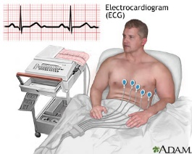

Background: Acute chest pain in the ED
>30 million patients per year worldwide
12-lead ECG
1st blood draw
2nd blood draw
2nd blood draw
0h 1h 2h 3h 4h 5h 6h 7h
cTn cTn
0/3h pathway: hs-cTn hs-cTn
(ESC 2011)
Safe +, ED length of stay⬇
in early adopting hospitals
2) Late adopting hospital?
0/1h pathway: hs-cTn
hs-cTn
(ESC 2015/2020/2023)
Collet JP, et al. Eur Heart J. 2021;42:1289-1367.

Slide 4

Methods: 0/3h versus 0/1h
0/3h:
0/1h:
Cut-offs are assay-specific
Used with all available hs-cTnT/I assays
Using uniform or sex-specific URL

Slide 5
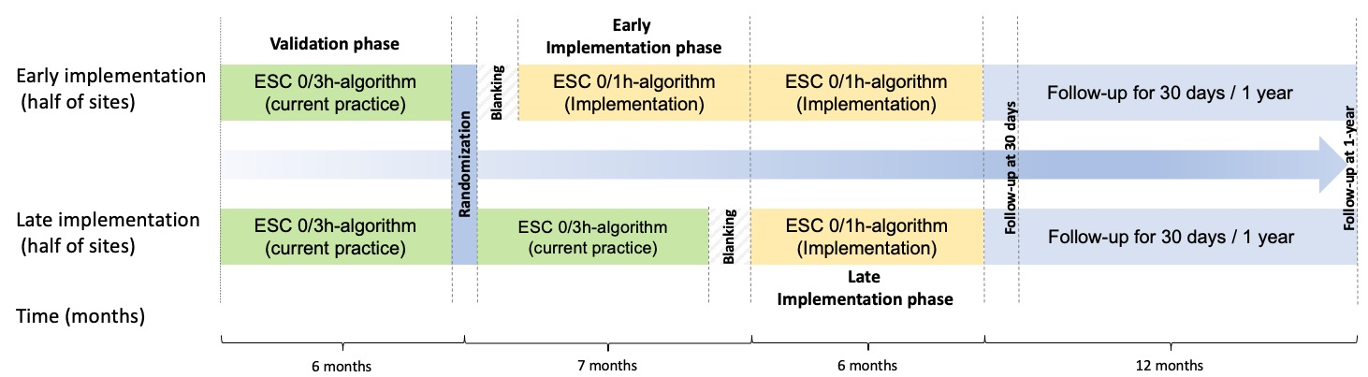

Methods: Implementation of 0/1h in late adopting hospitals
Co-Primary endpoints:
Safety: Death or new type 1 MI at 30d
Efficacy: ED length of stay
Stepped-wedge cluster-randomised controlled trial
19/20 hospitals were eligible, 10 countries
Designed to test the non-inferiority of the 0/1-hour pathway for safety and its
superiority for efficacy across diverse healthcare systems. The non-inferiority
margin was set at 1·3 for the adjusted odds ratio (OR)

Slide 6

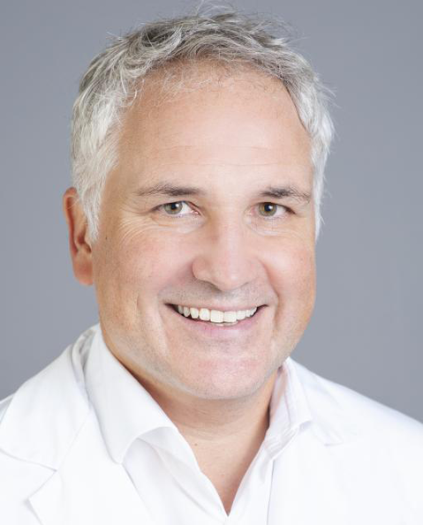
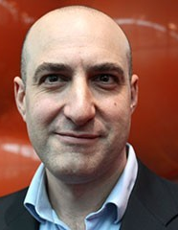





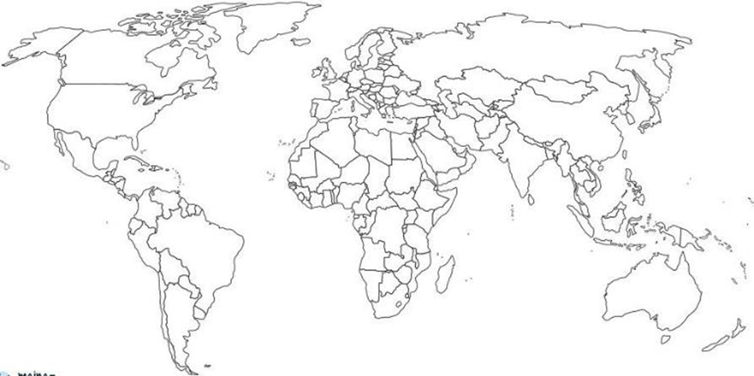


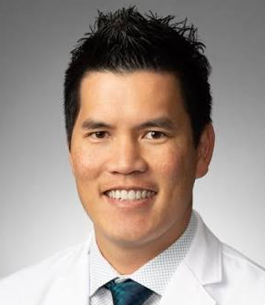





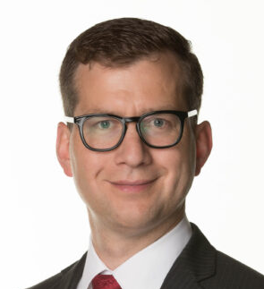


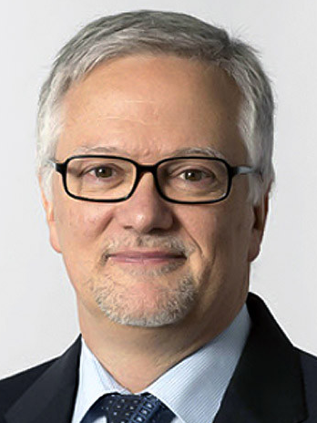
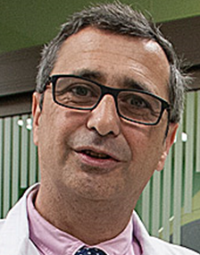
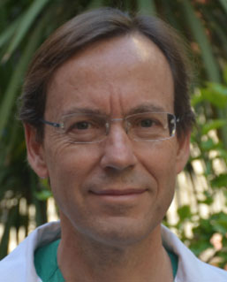
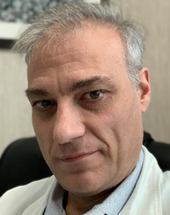
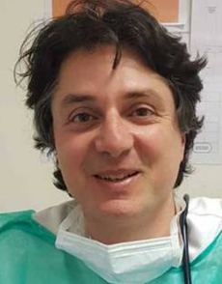
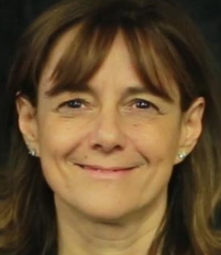
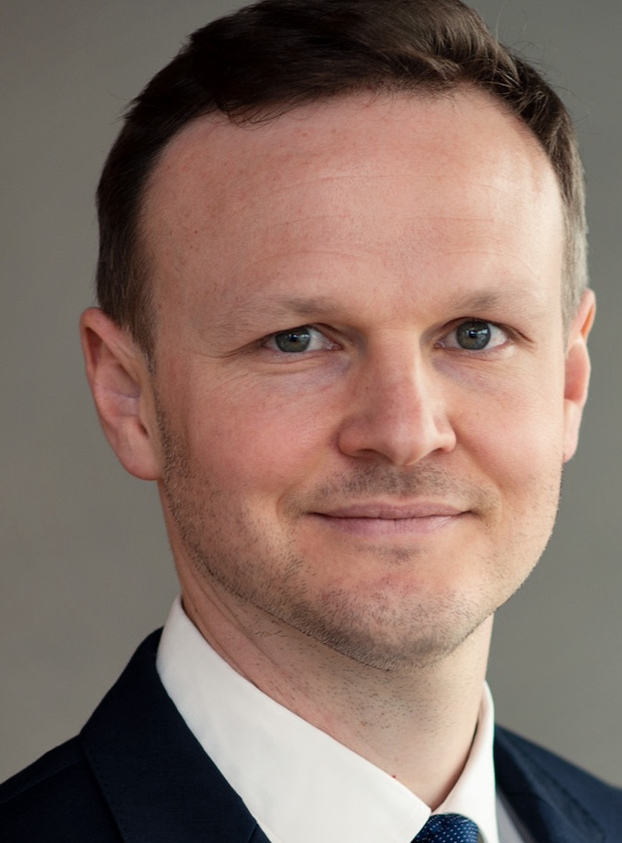
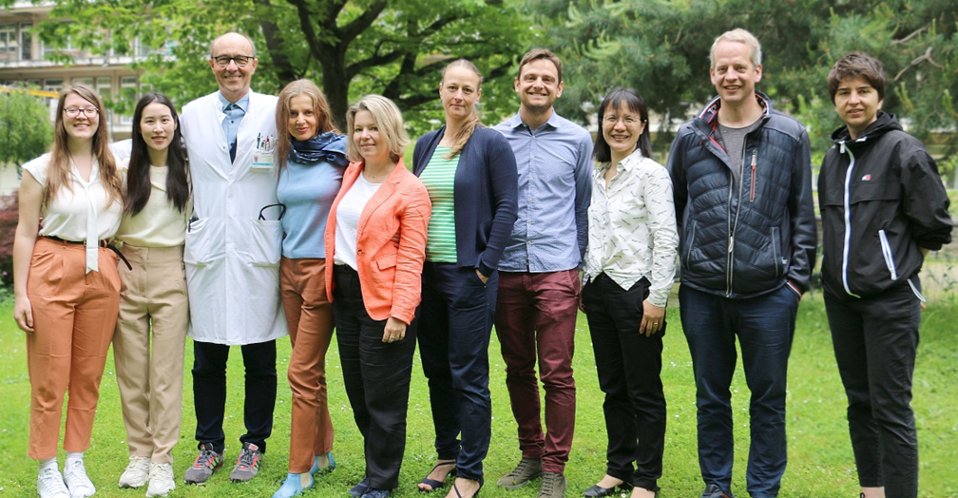

PRESC1SE-MI Study Centres
Dr. M. Abubakr,
Treliske
Prof. P. Schütz,
Aarau
Dr. B. Bloom,
London
Prof. M. Christ,
Lucerne
Prof. D. Keller,
Zürich
Dr. K. Slankamenac,
Zürich
Prof. V.P. Harjola,
Helsinki
Prof. D. Roth,
Vienna
Approved by local ethics committees for most (16/19) hospitals without the need for study-specific IC → allowing inclusion of all consecutive patients regardless of time of presentation/other barriers.
Dr. S. Steuer,
Basel
Dr. A. Cuculici,
Bucharest
Dr. J. Young,
Houston
Dr. R. Bicette,
Houston
DSMB
Prof. H.S. Yang,
Seoul
Dr. Andrea Wiencierz
Prof. J. Zamorano,
Madrid
Dr. E. Gannon,
Brisbane
Prof. H. Bueno,
Madrid
Prof. O. Miro,
Barcelona
Prof. J. S. Forés,
Valencia
Prof. E. Lupia,
Torino
Dr. P. Nazarian,
Florence
Dr. M. Ruggieri, Rome

Slide 7
Methods: Implementation of 0/1h in late adopting hospitals
Inclusion Criteria:
Age ≥18 years
Presenting to ED with acute non-traumatic chest pain & suspected myocardial infarction
Exclusion Criteria:
Cardiac arrest, cardiogenic shock
Chronic dialysis
Non-residents
Presentation to ED <30 days
Assumptions for sample size calculation:
20 hospitals (14 large, 6 small)
Death/new type 1 MI 3%
Median ED length of stay 5.3h
Intra-class correlations 0.03 and 0.50
Power 90%
Sample size ≥52156

Slide 8
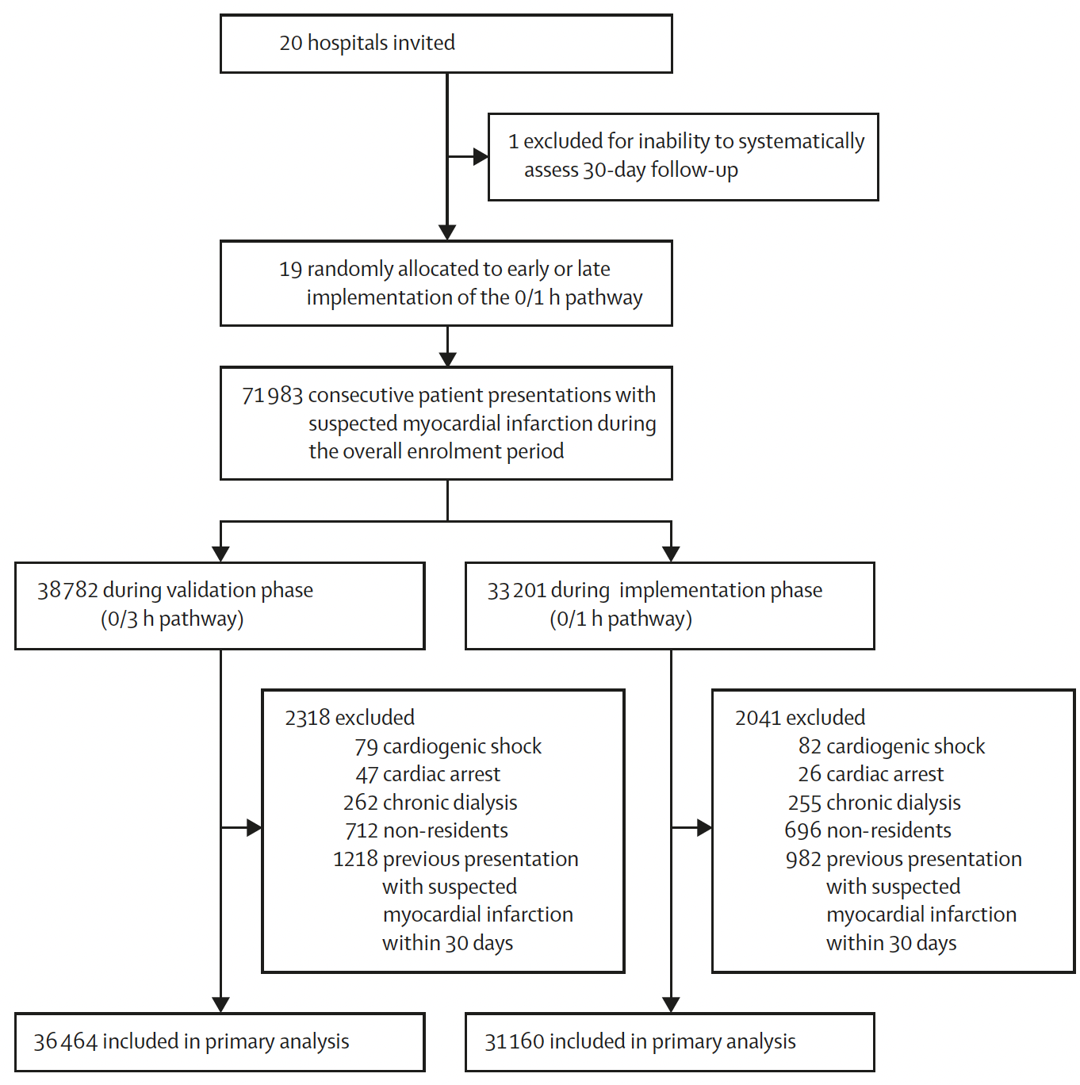
Results:

Slide 9
Results:
Characteristics of the Patient Presentations at Baseline | 0/3h pathway (n=36464) | 0/1h pathway (n=31160)
Age, years | 59 (46-73) | 59 (46-73)
Sex
Female | 16272 (45%) | 13682 (44%)
Male | 20192 (55%) | 17478 (56%)
Medical history
Brought in by ambulance | 11522 (35%) | 7997 (31%)
Known coronary artery disease | 7782 (23%) | 5971 (21%)
Previous myocardial infarction | 5017 (14%) | 3905 (13%)
Blood pressure, mm Hg
Systolic | 141 (27) | 140 (24)
Diastolic | 82 (15) | 81 (15)
Ischemia on electrocardiogram | 4615 (13%) | 3634 (12%)
Index event myocardial infarction | 3215 (8·8%) | 2640 (8·5%)
Cardiac troponin assay type
hs-TnT | 14602 (40%) | 15064 (48%)
hs-TnI | 21862 (60%) | 16096 (52%)
Upper-reference-limit
uniform | 18398 (50%) | 17897 (57%)
sex-specific | 18066 (50%) | 13263 (43%)

Slide 10
Results: Implementation of 0/1h pathway
Second hs-cTn measurement:
0/3h pathway group
in 15305 patient presentations (42%)
median 190 min (IQR 153–252) after 0h
After randomisation to the 0/1h pathway, one site was unable to implement the 1h
blood draw due to shortage of nurses but remained in the intention-to-treat analysis
0/1h pathway group
in 18829 patient presentations (60%)
median 86 min (IQR 62–143) after 0h
~ 2h↓

Slide 11
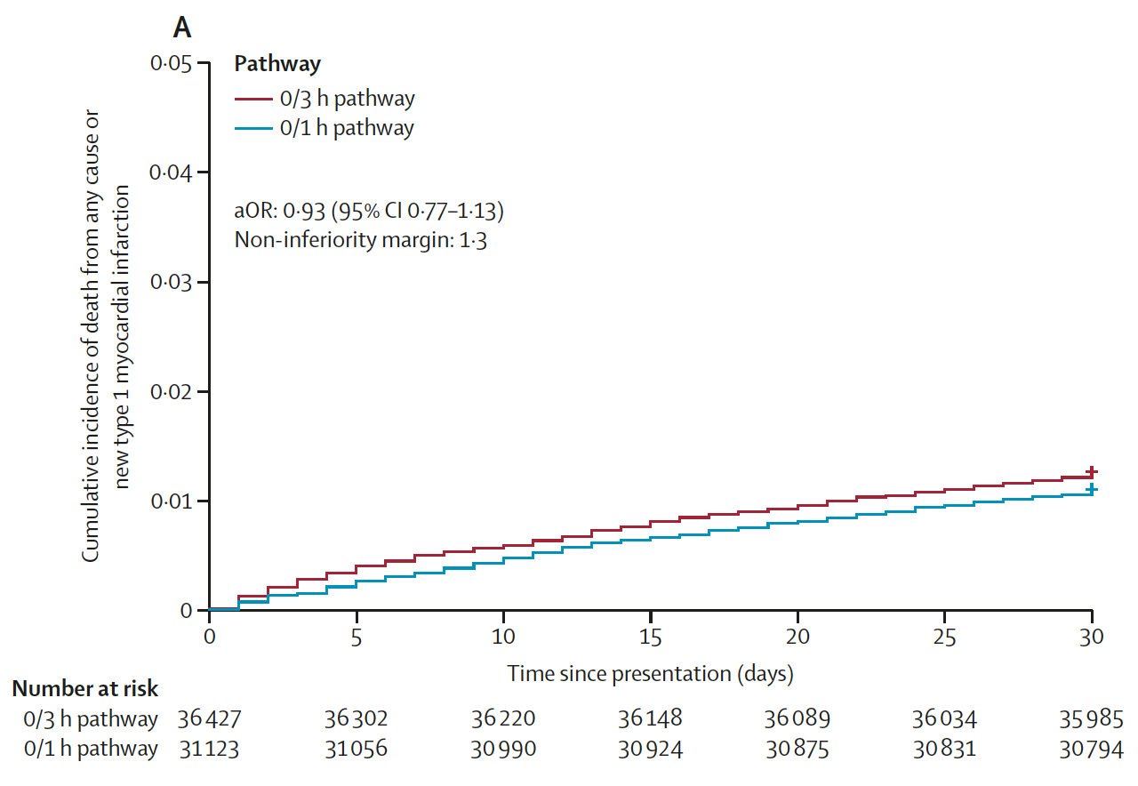
Results: Safety of the 0/1h pathway
Divergence in the direction of
both components:
Non-inferiority p=0·00038
Death from any cause:
0/3h: 1·1% 0/1h: 0·8%
adjusted OR 0·84 (95%CI 0·67-1·06))
New type 1 MI:
0/3h: 0·2% 0/1h: 0·3%
adjusted OR 1·55 (95%CI 1·07-2·24)

Slide 12
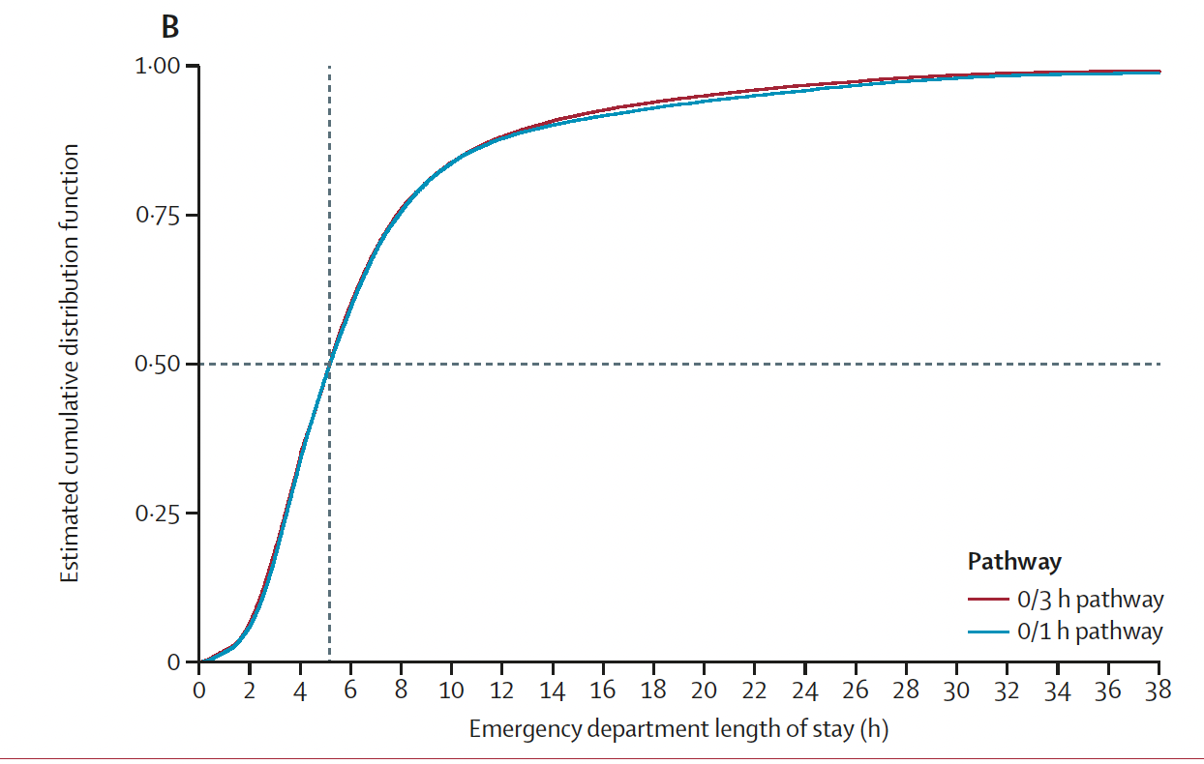
Results: Efficacy the 0/1h pathway
0/3h: median 309 min (IQR 203-470)
0/1h: median 309 min (IQR 207-474)
ratio of adjusted median time 1.00 (95% CI 0·97-1·02), p=0·65)

Slide 13
Results Subgroup Analyses: Implementation of 0/1h
Safety
Efficacy

Slide 14
Strengths & Limitations: Implementation of 0/1h
Strengths:
Large sample size; diversity of represented countries & healthcare systems & hs-cTn assays
24/7 enrolment; an informed consent process that minimized selection bias
Care delivered by routine clinical teams; blinded outcome adjudication
Limitations:
After randomisation to the 0/1h pathway, one large site was unable to implement the 1h blood draw due to shortage of nurses
Protocol deviations due to missing or incorrect timing of the 1h blood draw were common
Event rate was lower than anticipated (1·2% vs 3%)

Slide 15
Summary: Implementation of 0/1h
1) This pragmatic trial conducted in late-adopting hospitals across various countries
and healthcare systems showed that implementation of the 0/1h pathway
was non-inferior to the 0/3h pathway with respect to death from any cause
or new type 1 myocardial infarction within 30 days
2) but, despite availability 2nd hs-cTn ~2h earlier, did not result in shorter ED length of stay
3) Physician/Nurse workload ➔ availability of hs-cTn result as rate-limiting step;
Diagnosis versus subsequent local workflow
4) Divergence in death from any cause vs new type 1 MI, and reduction in women and
patients without known CAD requires further study
5) Healthcare providers should be aware of the challenges and implementation
barriers when considering adopting rapid pathways in clinical practice

Slide 16
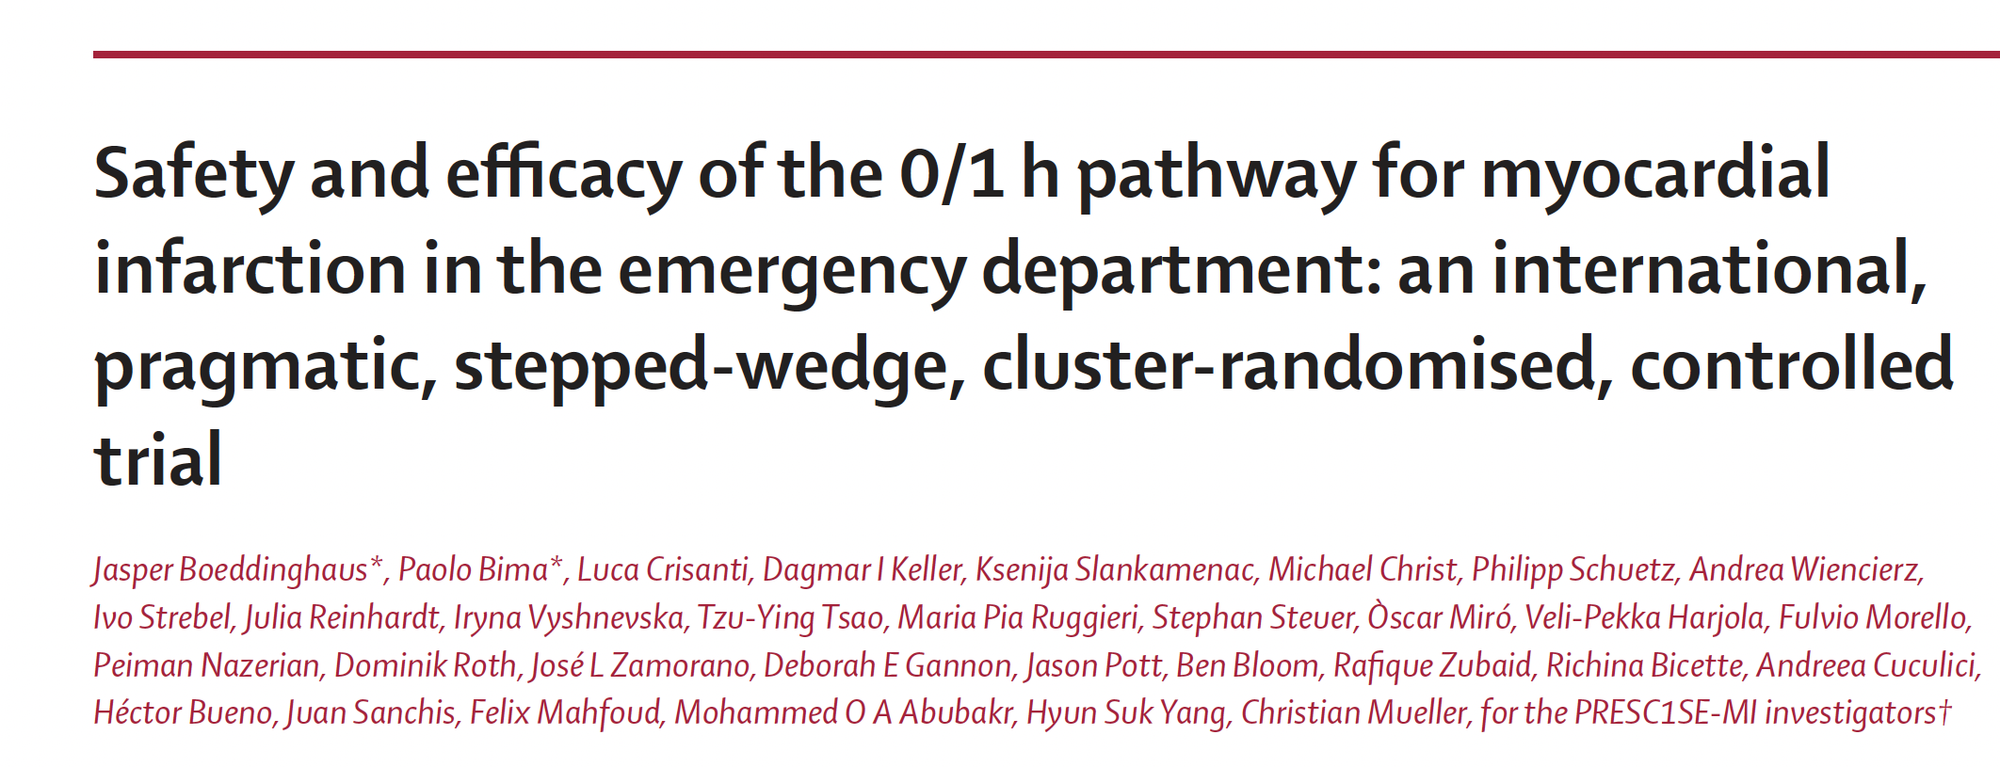
Publication

