Slide 1

Functional Coronary Angiography to Indicate and Guide Revascularization in STEMI Patients with Multivessel Disease
The AIR-STEMI trial
Simone Biscaglia, MD
University Hospital of Ferrara (Italy)
on behalf of the AIR-STEMI trial Investigators
Notes:
Dear Chairpersons, dear colleagues, it is a great honor to present the main results of the AIR-STEMI trial on behalf of all the investigators. These are my disclosures.
[Target time: approximately 0:15]

Slide 2

Background
Complete revascularization is the gold standard in MI with MVD, but the best way to achieve it remains to be determined¹.
Angiography may lead to overtreatment of nonculprit lesions with low risk of adverse events²
Physiology can refine lesion selection, but wire-based physiology can be cumbersome in STEMI setting and previous trials showed conflicting results^{3,4}
1. Lancet. 2025;406:2772-2781. 2. J Am Coll Cardiol. 2020;76:1277-1286. 3. N Engl J Med. 2021;385:297-308. 4. Eur Heart J. 2023;44:473-484.
Notes:
Complete revascularization is the standard of care in myocardial infarction with multivessel disease, but the optimal way to select nonculprit lesions remains uncertain. Angiography may lead to overtreatment, while wire-based physiology can be cumbersome during the STEMI pathway. Functional coronary angiography may offer a practical and more selective alternative.
[Target time: approximately 0:30]

Slide 3
Research question
In patients with STEMI and multivessel disease after successful culprit-lesion PCI, does functional coronary angiography–guided complete revascularization reduce major cardiovascular events compared with conventional angiography-guided complete revascularization? ¹
1. Erriquez A, Am Heart J. 2025;284:71-80
Notes:
We therefore asked whether complete revascularization guided by functional coronary angiography could reduce major cardiovascular events compared with conventional angiography-guided complete revascularization after successful culprit-lesion PCI.
[Target time: approximately 0:20]

Slide 4

















Organization
Investigator-initiated, multicenter, prospective, superiority, randomized trial¹
Countries: Italy Pakistan
21 centers
Study PI:
Simone Biscaglia
Study Chair:
Gianluca Campo
Executive Committee: Abdul Hakeem, Giulia Bugani, Francesca Mantovani, Giampaolo Niccoli, Iginio Colaiori, Elisabetta Moscarella, Rocco Vergallo, Alberto Polimeni, Domenico D’Amario, Giulia Masiero
CEC:
Rita Pavasini, Raffaele Piccolo
DSMB:
Matteo Tebaldi, Antonio M. Leone
Core Lab:
Andrea Erriquez
ARO (University Hospital of Ferrara):
Veronica Lodolini, Alice Santoni, Martina Viola,
Elisa Mosele, Chiara Manzalini
Stats: Donato Martella
Sponsor:
Supporters:
Ricerca Finalizzata 2021
GR-2021-12372516
1. Erriquez A, Am Heart J. 2025;284:71-80
Notes:
AIR-STEMI was an investigator-initiated, prospective, randomized superiority trial conducted at 21 centers in Italy and Pakistan, with independent event adjudication, safety monitoring, and a central physiology core laboratory.
[Target time: approximately 0:20]

Slide 5

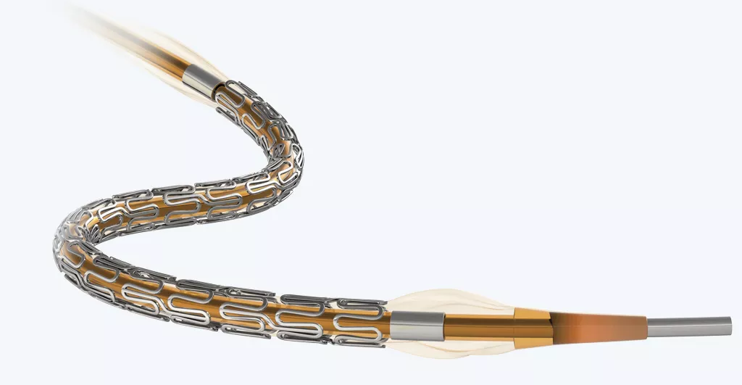
Study design
Inclusion criteria
Pts hospitalized for STEMI with indication to primary PCI
Exclusion criteria
STEMI
MVD
Successful PPCI
Multivessel disease at coronary artery angiography
Culprit lesion clearly identifiable and successfully treated
R
Physiology-guided Complete Revascularization
Angiography-guided Complete Revascularization
BP-SES Supraflex Cruz recommended
Primary endpoint: median follow-up 17.9 months (IQR 12-24 months)
We estimated that 9% of patients in the angiography group would experience a primary outcome event. Assuming a relative risk reduction of 35% with the physiology-guided strategy, we calculated that a sample of 1718 patients would provide 80% power to detect a significant between-group difference at a two-sided alpha level of 0.05. To account for an anticipated 5% attrition rate, the target sample size was increased to at least 1800 patients
Sample Size
1. Erriquez A, Am Heart J. 2025;284:71-80
Notes:
Patients with STEMI, successful culprit-lesion PCI, and at least one 50% nonculprit stenosis in a vessel of at least 2.5 millimeters were randomized one-to-one within 48 hours. Complete revascularization, guided either by functional coronary angiography or conventional angiography, had to be achieved during the index hospitalization. The target sample was at least 1,800 patients, and the primary analysis was performed at a median follow-up of 17.9 months.
[Target time: approximately 0:40]

Slide 6
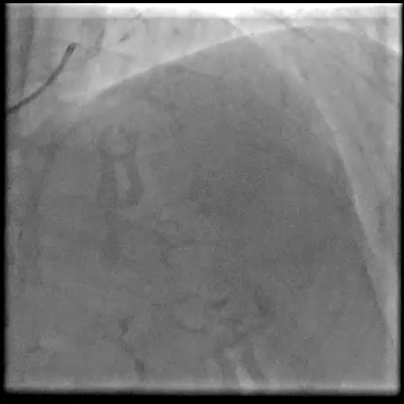
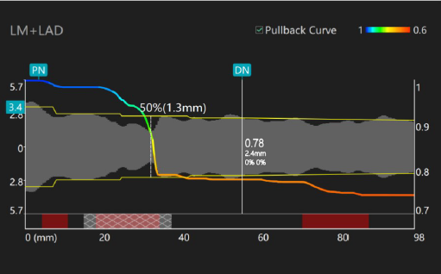
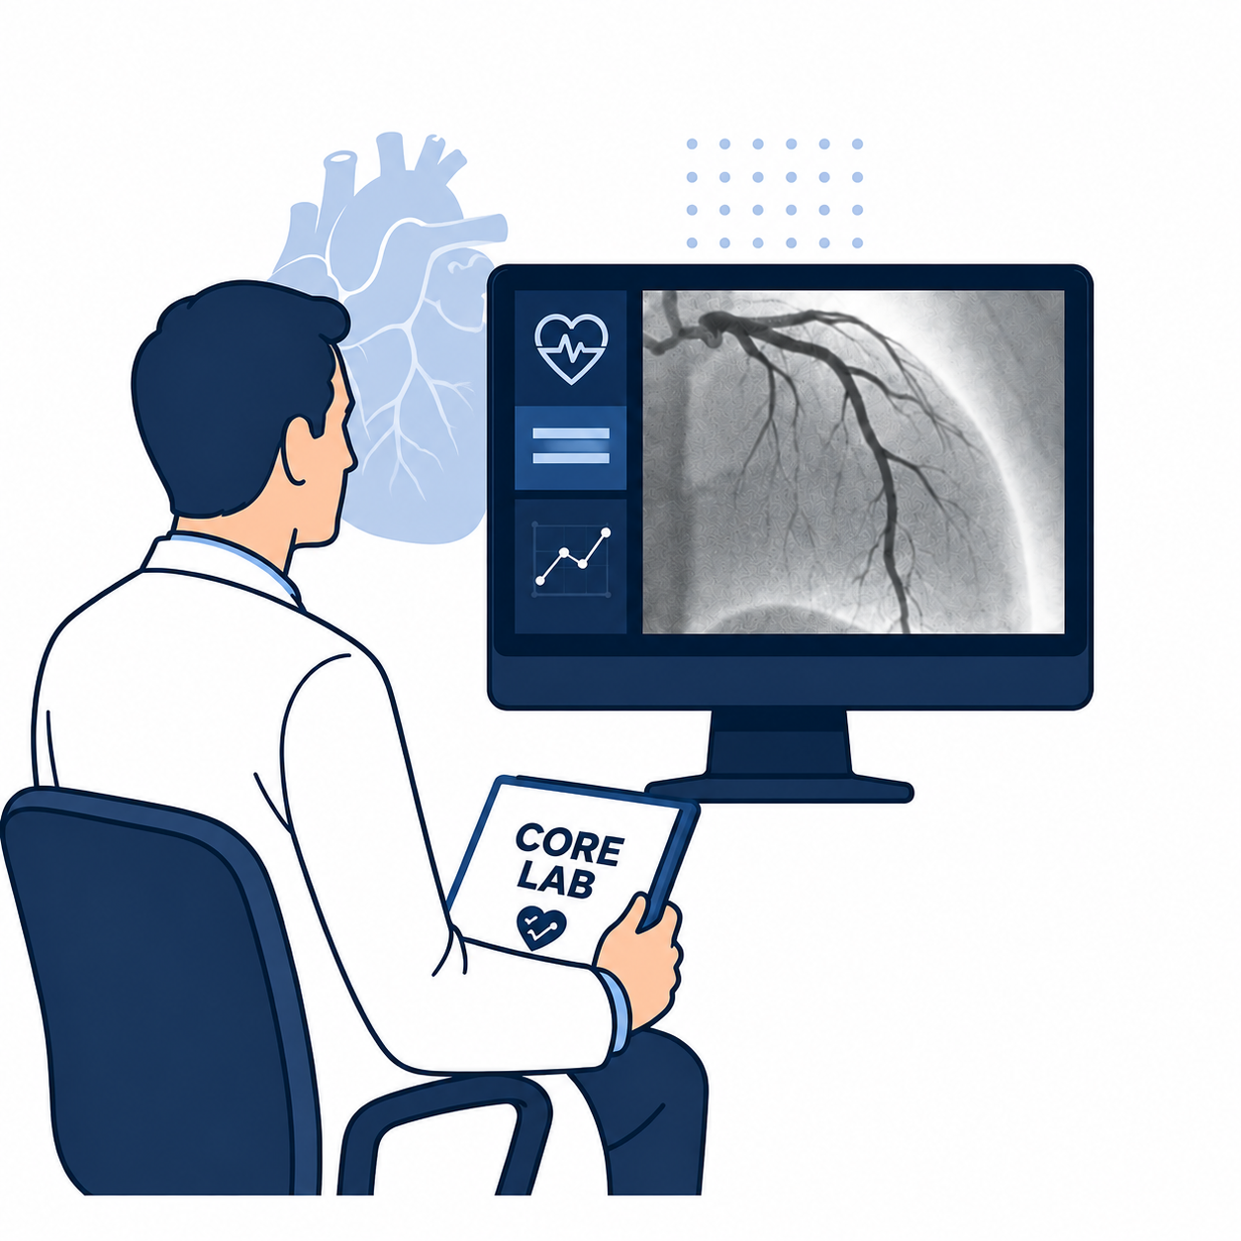
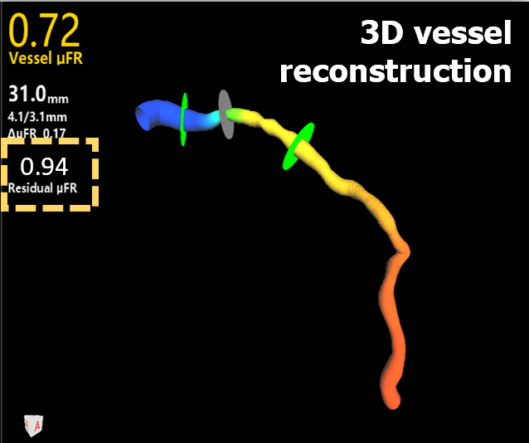
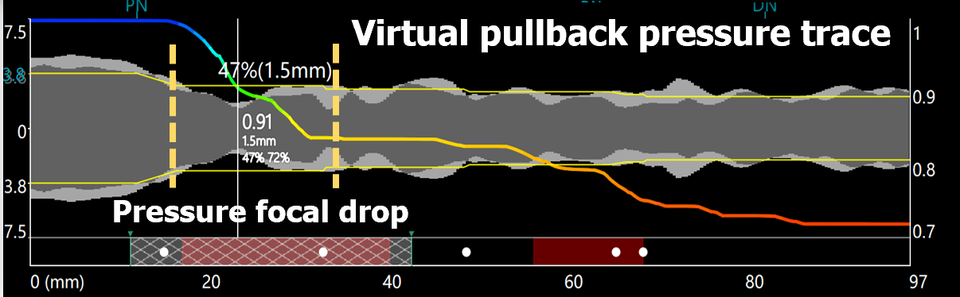
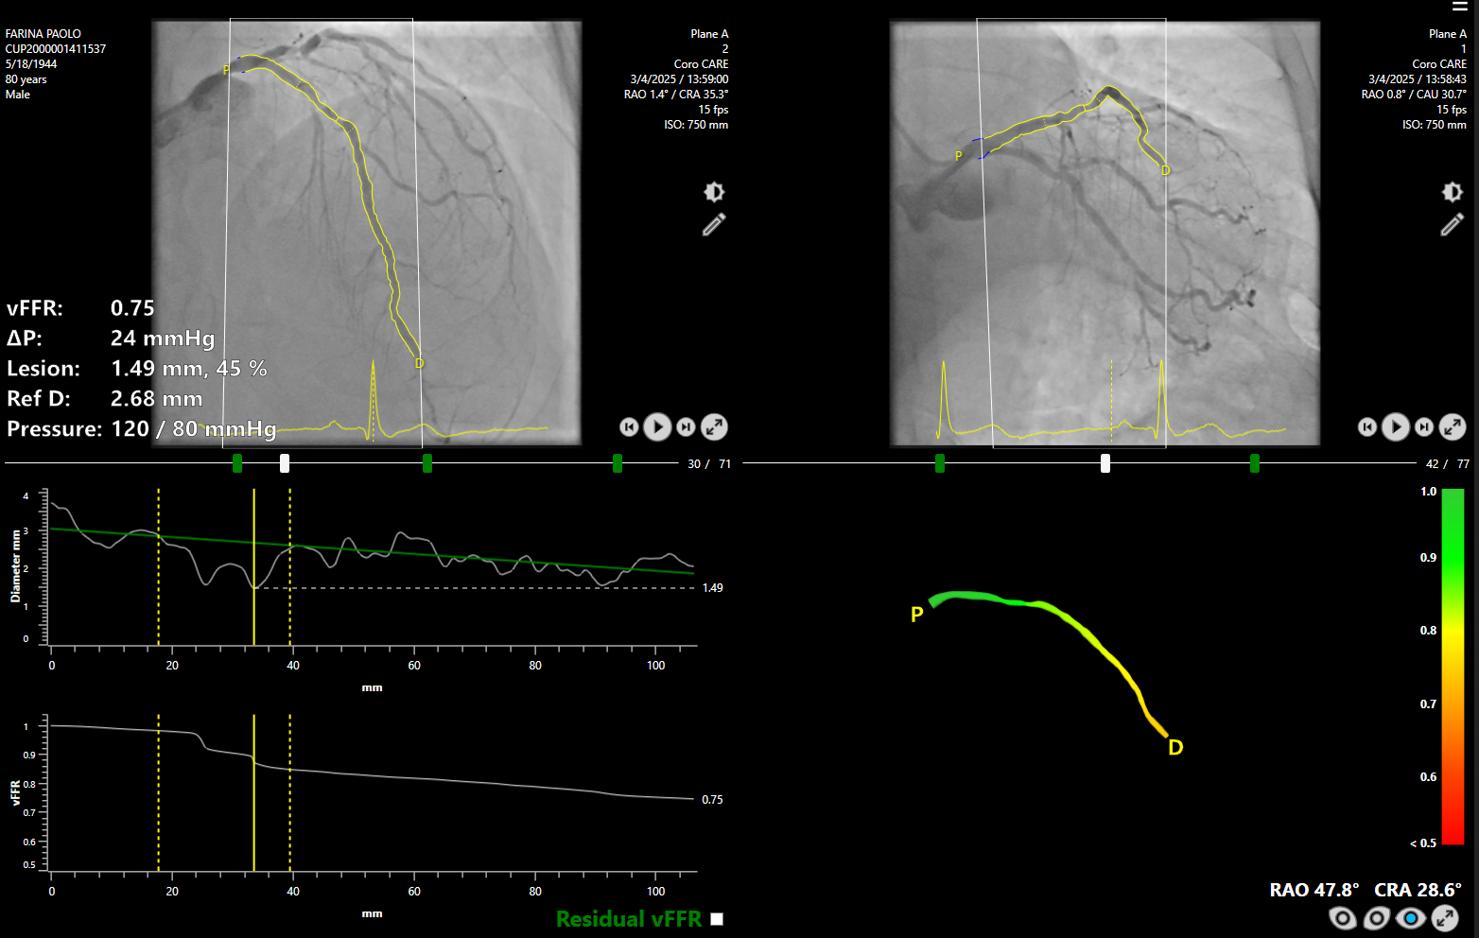
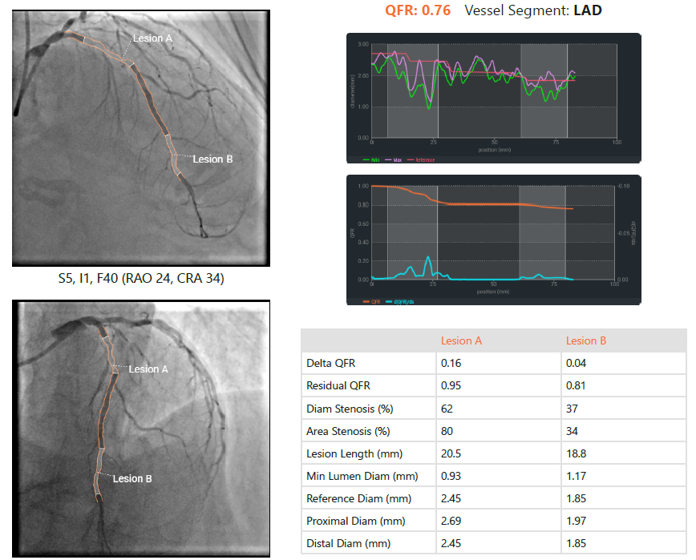

Functional Coronary Angiography¹
Angiography-guided
PCI of all nonculprit lesions with %DS ≥50%
During the index or staged procedure (index hospitalization)
Central Core Lab – Functional Coronary Angiography
Positive angio-derived FFR → PCI
Nonculprit lesion
Murray law-based QFR (Pulse)
Distal single point FFR value
Longitudinal pattern of disease
Procedural plan / treatment indication
Vessel FFR (Pie Medical)
Physiology-guided
Negative angio-derived FFR → OMT
Quantitative Flow Ratio (Medis)
1. Erriquez A, Am Heart J. 2025;284:71-80
Notes:
In the angiography-guided group, all nonculprit lesions with at least 50 percent diameter stenosis were treated. In the physiology-guided group, the angiographic images already acquired during the procedure were used to reconstruct the vessel and estimate an angiography-derived FFR, without routinely crossing each lesion with a pressure wire or administering hyperemic drugs. The central core laboratory provided the distal FFR value together with the longitudinal pattern of disease. A value of 0.80 or less indicated PCI; a value above 0.80 led to deferral and optimal medical therapy. For positive vessels, the pullback curve was also used to plan where and how to treat. The goal was therefore not incomplete revascularization, but functionally complete and more precise revascularization.
[Target time: approximately 1:10]

Slide 7
Endpoints¹
Primary
Death, any MI, CVA, or ID-revascularization
Key secondary
Cardiovascular death or MI
Safety
CA-AKI or BARC type 3-5 bleeding
1. Erriquez A, Am Heart J. 2025;284:71-80
Notes:
The primary endpoint was all-cause death, myocardial infarction, cerebrovascular accident, or ischemia-driven revascularization. The key secondary endpoint was cardiovascular death or myocardial infarction. The safety endpoint was contrast-associated acute kidney injury or BARC type 3-to-5 bleeding.
[Target time: approximately 0:25]

Slide 8
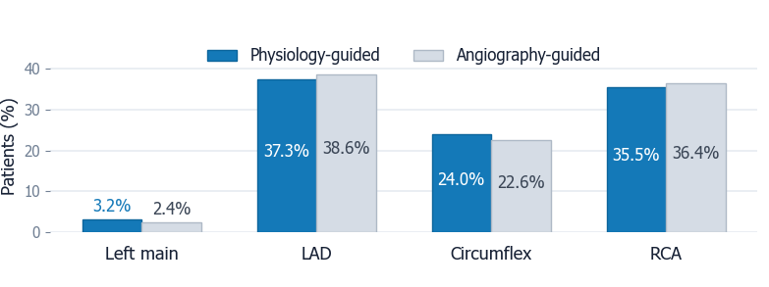
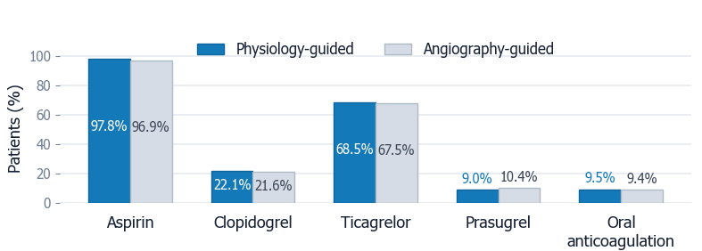
Baseline Characteristics*
Culprit vessel
Characteristic | Physiology (N=913) | Angiography (N=910)
Age (IQR) – yr | 67 (58-76) | 66 (57-75)
Female sex | 223 (24.4) | 208 (22.9)
Comorbidities
Hypertension | 638 (69.9) | 614 (67.5)
Diabetes | 195 (21.4) | 205 (22.5)
Current smoker | 292 (32.0) | 278 (30.5)
Prior MI | 87 (9.5) | 98 (10.8)
eGFR <60 ml/min | 116 (12.7) | 127 (14.0)
PAD | 100 (11.0) | 106 (11.6)
Clinical presentation
Cardiac arrest | 34 (3.7) | 32 (3.5)
Killip ≥2 | 192 (21.0) | 171 (18.8)
Antithrombotic therapy
* Total number of patients included n=1823
Notes:
We randomized 1,823 patients: 913 to physiology guidance and 910 to angiography guidance. Baseline characteristics were well balanced; median age was 66 years, 24 percent were women, and approximately 22 percent had diabetes.
[Target time: approximately 0:25]

Slide 9
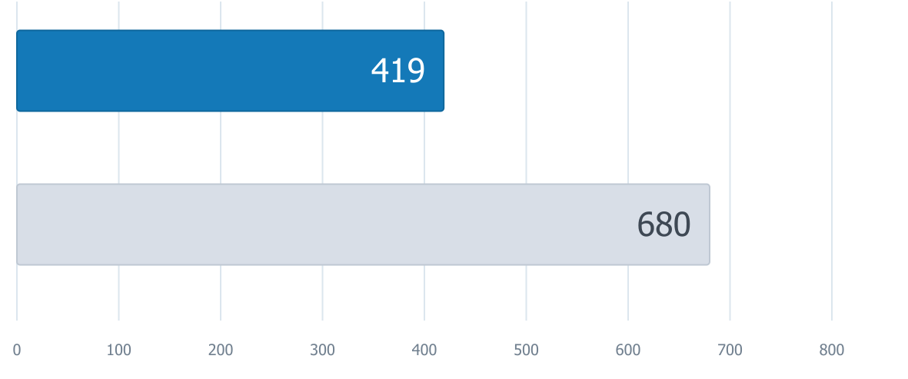
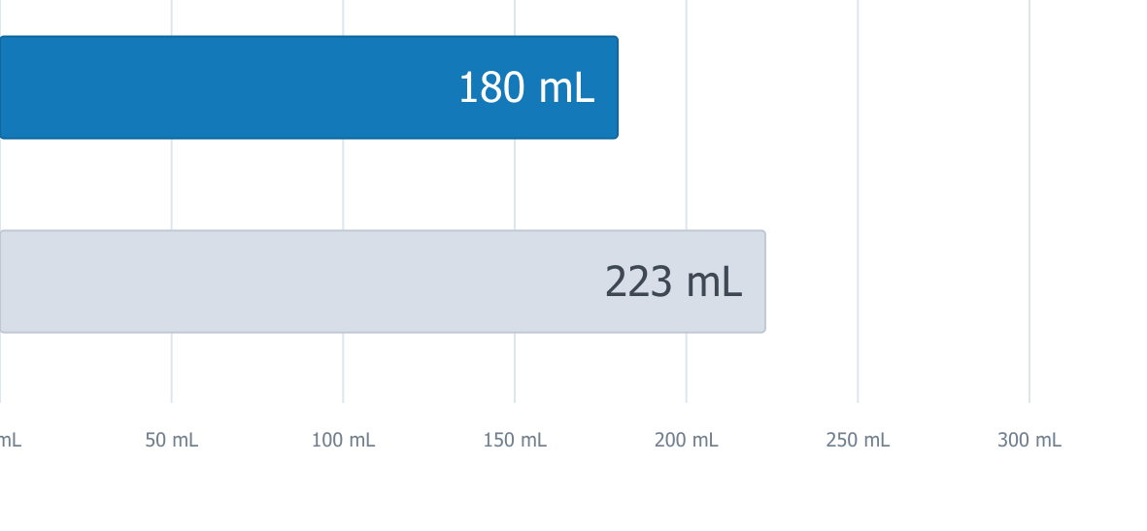

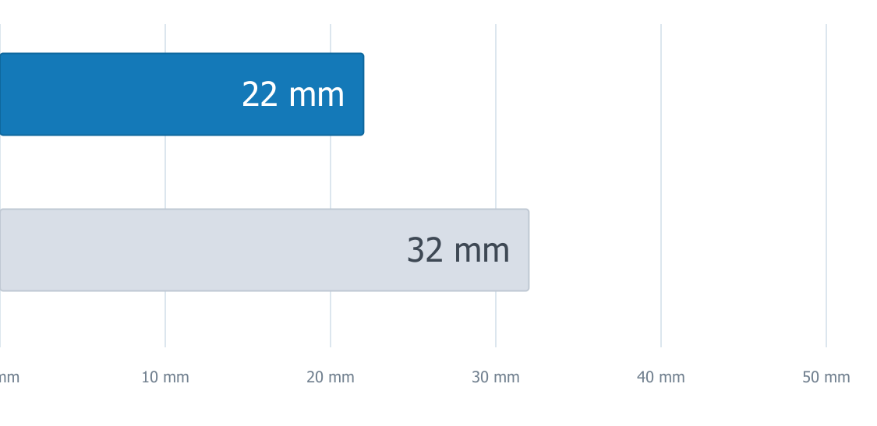
Procedural Data*
Staged procedures
Contrast use
Physio
Characteristic | Physiology (N=913) | Angiography (N=910)
Index procedures | 913 | 910
Staged procedures | 419 | 680
Nonculprit vessel
Total number | 1147 | 1128
LAD | 479 (41.7) | 473 (41.9)
Circumflex | 352 (30.6) | 342 (30.3)
RCA | 316 (27.5) | 313 (27.7)
RVD (mm) | 3.0 (2.7-3.3) | 127 (2.7-3.3)
%DS | 80 (72-87) | 79 (72-86)
Functional evaluation
Angio-derived FFR | 1132 (98.7) | ---
Wire-based FFR | 15 (1.3) | ---
Angio
NCV treated
Stent length
Physio
Angio
Staged procedures
Contrast use
NCVs treated
Total stent length
-38.4%
-19.3%
-45.3%
-31.2%
* Total number of vessels included (culprit+non culprit) n=4098
Notes:
The procedural findings show the practical impact of physiology. Functional coronary angiography was feasible in 98.6 percent of nonculprit vessels. Although all vessels were angiographically eligible, only 51.4 percent were functionally important. Consequently, 51.9 percent underwent PCI in the physiology group, compared with 94.9 percent in the angiography group. This translated into 38.4 percent fewer staged procedures, 19.3 percent less contrast, 45.3 percent fewer nonculprit vessels treated, and 31.2 percent less total stent length. Median contrast volume fell from 223 to 180 milliliters. Thus, physiology avoided treatment in nearly half of the nonculprit vessels and substantially reduced procedural burden, contrast exposure, and implanted metal, while still pursuing functionally complete revascularization.
[Target time: approximately 1:10]

Slide 10
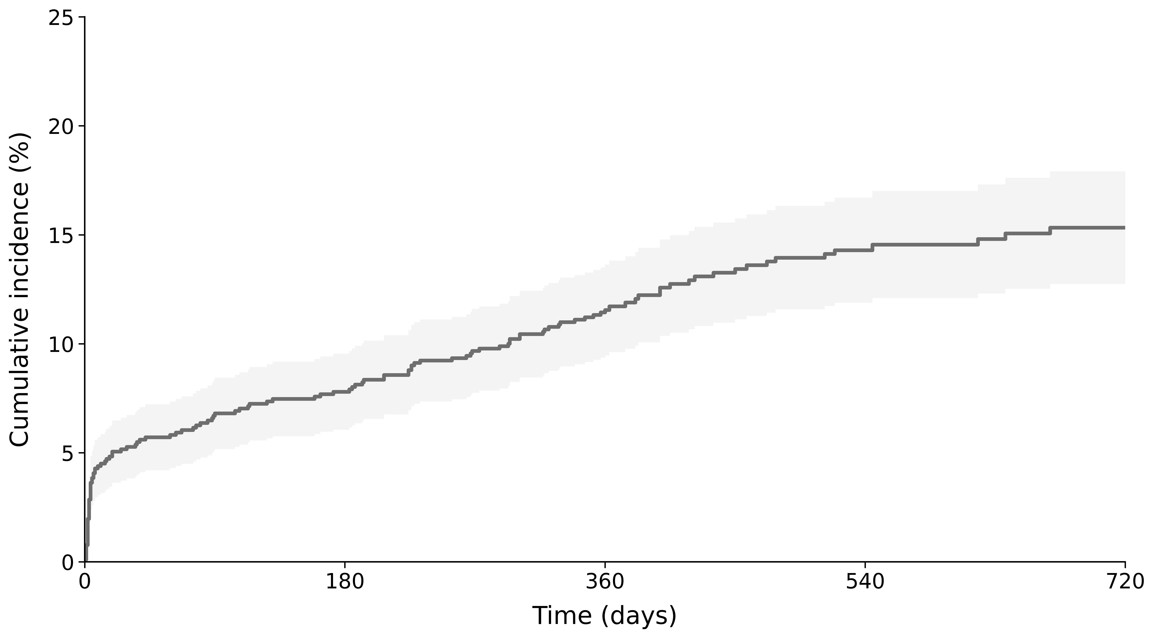
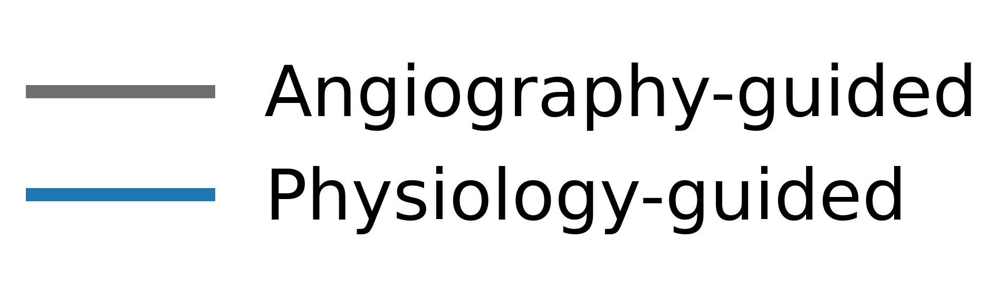
(death, CVA, MI, id-revasc)
Primary Endpoint
13.7%
Notes:
We now come to the primary endpoint. In the angiography-guided group, death, myocardial infarction, cerebrovascular accident, or ischemia-driven revascularization occurred in 13.7 percent of patients.
[Target time: approximately 0:20]

Slide 11
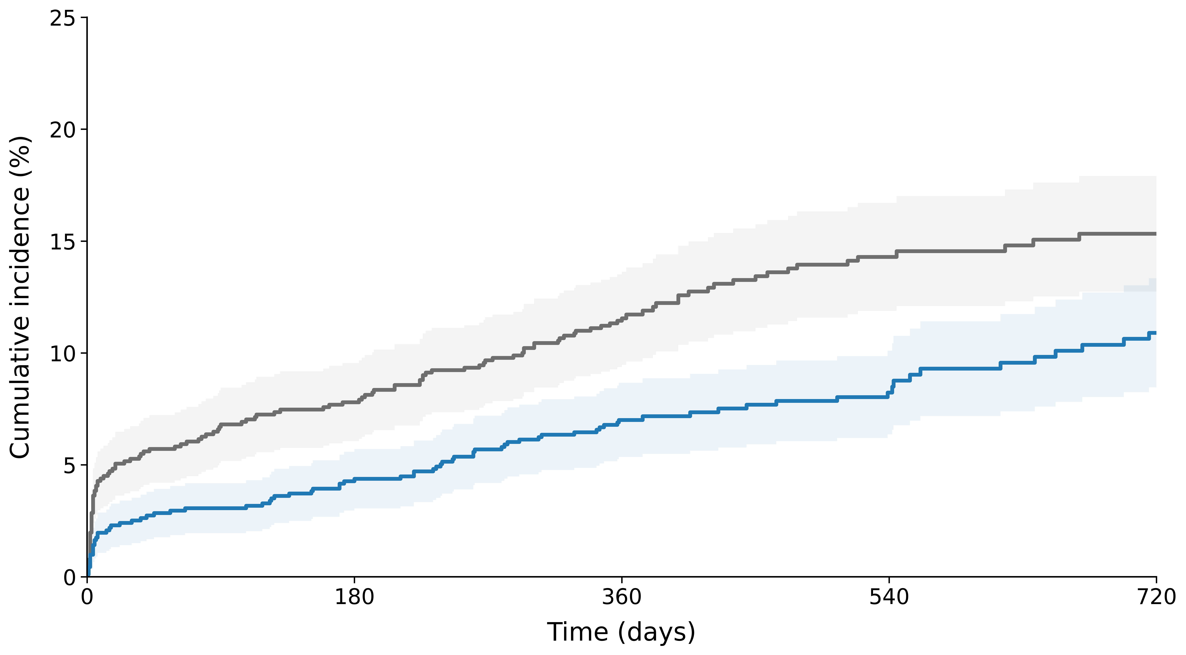
(death, CVA, MI, id-revasc)
Primary Endpoint
HR 0.62 (95%CI 0.47-0.83)
13.7%
8.9%
P<0.001
Notes:
In the physiology-guided group, the primary endpoint occurred in 8.9 percent, compared with 13.7 percent with angiography guidance. The hazard ratio was 0.62, with a 95 percent confidence interval from 0.47 to 0.83 and a P value below 0.001. This represents a 38 percent relative reduction, an absolute reduction of 4.8 percentage points, and a number needed to treat of 21.
[Target time: approximately 0:45]

Slide 12
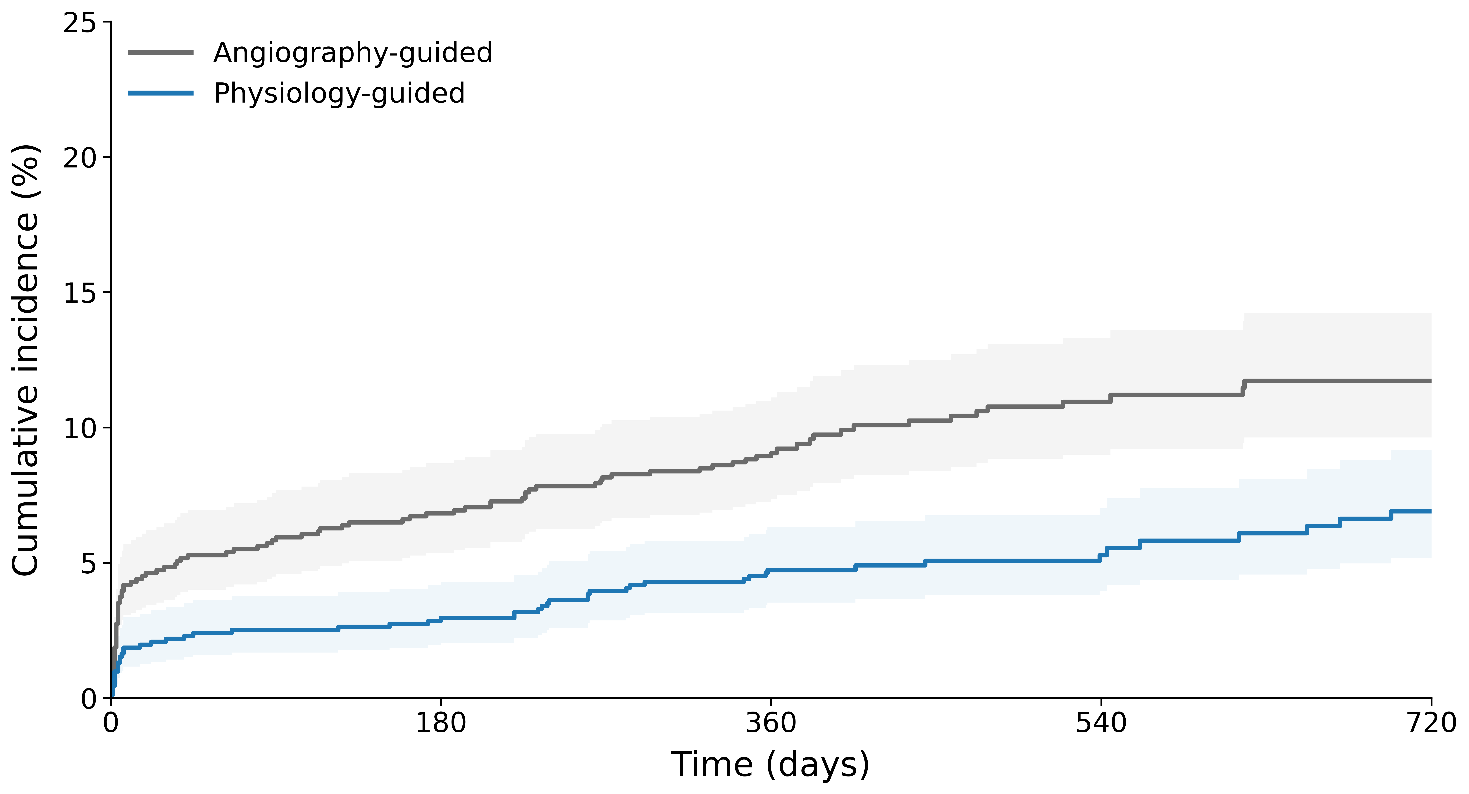
Secondary Endpoints
EP1 excluding MI type 4a
CV death or MI
P=0.001
P<0.001
HR 0.67 (95%CI 0.50-0.92)
HR 0.52 (95%CI 0.37-0.73)
Notes:
The benefit remained significant when type 4a myocardial infarction was excluded, with a hazard ratio of 0.67. More importantly, cardiovascular death or myocardial infarction occurred in 5.7 percent with physiology guidance and 10.5 percent with angiography guidance, corresponding to a hazard ratio of 0.52. The effect therefore extended to hard cardiovascular events.
[Target time: approximately 0:40]

Slide 13
Secondary Endpoints
Outcome | Physiology (N=913) | Angiography (N=910)
 | no. (%) | no. (%) | HR (95% CI) | P value
Death | 36 (3.9) | 46 (5.1) | 0.77 (0.50-1.20) | 0.250
Cardiovascular death | 20 (2.2) | 31 (3.4) | 0.64 (0.36-1.12) | 0.120
Myocardial infarction | 35 (3.8) | 73 (8.0) | 0.47 (0.31-0.70) | <0.001
Procedure-related | 15 (1.6) | 33 (3.6) | 0.45 (0.24-0.83) | 0.010
Spontaneous | 21 (2.3) | 45 (5.0) | 0.46 (0.27-0.77) | 0.003
ID-revascularization | 29 (3.2) | 47 (5.2) | 0.61 (0.38-0.97) | 0.037
Cerebrovascular accident | 3 (0.3) | 4 (0.4) | 0.75 (0.17-3.35) | 0.710
Safety outcome* | 42 (4.6) | 65 (7.1) | 0.63 (0.43-0.93) | 0.020
Contrast-associated acute kidney injury | 20 (2.2) | 36 (4.0) | 0.55 (0.32-0.94) | 0.031
BARC 3-5 bleeding | 23 (2.5) | 33 (3.6) | 0.69 (0.41-1.18) | 0.170
*Composite of contrast-associated acute kidney injury, BARC 3-5
Notes:
Myocardial infarction was reduced from 8.0 to 3.8 percent, with a hazard ratio of 0.47, and both procedure-related and spontaneous myocardial infarction were significantly lower. Ischemia-driven revascularization was also reduced. Importantly, a less extensive procedure did not trade efficacy for safety: the composite of contrast-associated acute kidney injury or major bleeding occurred in 4.6 percent with physiology guidance and 7.1 percent with angiography guidance, with a hazard ratio of 0.63. Contrast-associated acute kidney injury itself was significantly reduced. Secondary endpoints should be interpreted acknowledging that confidence intervals were not adjusted for multiplicity.
[Target time: approximately 0:55]

Slide 14
Limitations
Open-label design
ID-revascularization in the primary endpoint
Relative contribution of each component to the observed benefit cannot be determined
Central core laboratory assessment might limit generalizability
Notes:
The trial was open label, although events were adjudicated by an independent blinded committee. Ischemia-driven revascularization was included in the primary endpoint, but the reduction in cardiovascular death or myocardial infarction supports the clinical relevance of the findings. Finally, the individual contribution of lesion selection, reduced procedural burden, and virtual PCI planning cannot be separated, and core-laboratory assessment may limit immediate generalizability.
[Target time: approximately 0:35]

Slide 15
Conclusions
Among patients with STEMI and multivessel coronary artery disease, a strategy of complete revascularization guided by functional coronary angiography reduced:
a composite of death, MI, CVA, or ID-revasc
cardiovascular death or MI
Notes:
In conclusion, functional coronary angiography-guided complete revascularization reduced the primary composite endpoint and cardiovascular death or myocardial infarction compared with angiography guidance. It also avoided PCI in nearly half of nonculprit vessels and reduced contrast, stent burden, and the safety endpoint. AIR-STEMI therefore supports functional coronary angiography as precision medicine: treating the vessels that need treatment, avoiding unnecessary procedures, and reducing cardiovascular events.
[Target time: approximately 0:45]

Slide 16

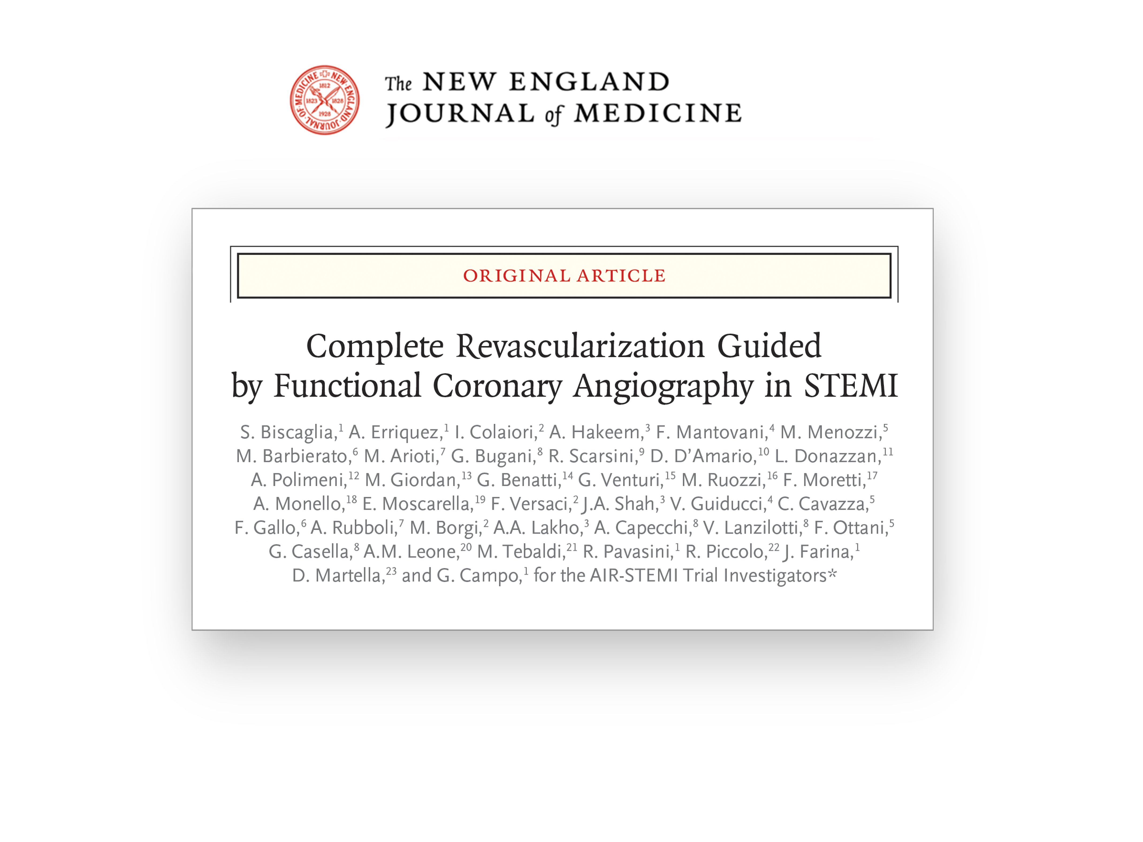

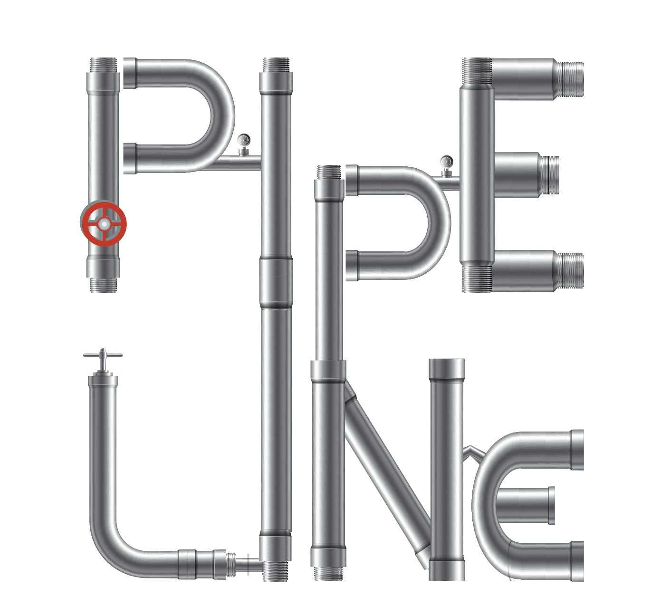




From FIRE to AIR-STEMI: an extraordinary scientific journey and, above all, an adventure of friendship. Our deepest gratitude to all the patients, investigators, and colleagues who made it possible.
Notes:
Before closing, I would like to acknowledge that, from FIRE to AIR-STEMI, this has been an extraordinary scientific journey and, above all, an adventure of friendship. My deepest gratitude goes to all the patients, investigators, and colleagues who made it possible. The AIR-STEMI results have been simultaneously published in the New England Journal of Medicine and can be accessed by scanning the QR code or through the NEJM website. Thank you very much for your attention.
[Target time: approximately 0:40]

