Slide 1




RSVpreF vaccine for preventing
cardiorespiratory hospitalisations in Adults
Professor Tor Biering-Sørensen, MD, MSc, MPH, PhD
On behalf of the whole DAN-RSV trial group:
Mats C. Højbjerg Lassen; Sine H. Christensen; Marat Yafasov; Manan Pareek; Niklas Dyrby Johansen; Abby E. Rudolph; Carmen Rodriguez-Tenreiro-Sánchez,; Kristoffer Grundtvig Skaarup; Daniel Modin; Brian L. Claggett; Carsten S. Larsen; Lykke Larsen; Lothar Wiese; Michael Dalager-Pedersen; Matias G. Lindholm; Anne Marie R. Jensen; Maria Dons; Katrine F. Bernholm; Filip S. Davidovski; Lisa Steen Duus; Camilla I. Ottosen; Anne B. Nielsen; Julie H. Borchsenius; Caroline Espersen; Guldas Köse; Frederik H. Fussing; Ingrid T. Lenz; Jacob Christensen; Jakob Ø. Simonsen; Majid Afzal; Katja V. Bartholdy; Adam C. F. Langhoff; Lars Køber; Scott D. Solomon; Jens Ulrik Stæhr Jensen; Cyril Jean-Marie Martel; Iago Giné-Vázquez; Carmen Duran-Parrondo; Marta Piñeiro-Sotelo; Martín Cribeiro-González; Mónica Conde-Pájaro; Susana Mirás-Carballal; Juan-Manuel González-Pérez; Bradford D. Gessner; Negar Aliabadi; Claudia Schwarz; Mette Skovdal; Lawrence H. Moulton; Pingping Zhang; Vanessa López-Gómez; Sabrina Welsh, MPH; Laura Anatale-Tardiff; Alejandro Cane; Kyla Hayford; Federico Martinón-Torres; Elizabeth Begier; Tor Biering-Sørensen

Slide 2
Disclosures
Dr. Tor Biering-Sørensen: Research grants from MSD/Merck, Moderna, Bayer, Novartis, Pfizer, Sanofi Pasteur, GSK, Novo Nordisk, AstraZeneca, Boston Scientific and GE Healthcare, consulting fees from AstraZeneca, MSD/Merck, Novo Nordisk, IQVIA, Parexel, Amgen, CSL Seqirus, GSK and Sanofi Pasteur, and lecture fees from ALK-Abelló, Moderna, Pfizer, AstraZeneca, Bayer, Novartis, Sanofi Pasteur, GE healthcare and GSK
The DAN-RSV trial was funded by Pfizer Inc.

Slide 3
Background
Respiratory syncytial virus (RSV) can cause serious illness in older adults and those with chronic conditions¹
While the most frequent complications are pulmonary, observational studies suggest RSV may also contribute to cardiovascular morbidity and mortality²⁻⁴
The bivalent RSV prefusion F (RSVpreF) vaccine has been shown to prevent RSV-related respiratory tract illness⁵
The DAN-RSV trial was designed to evaluate the effectiveness of RSVpreF vaccination against severe clinical outcomes in a large pragmatic randomized trial using routinely collected health data^{6,7}
⁴Lassen MCH, et al. J Am Coll Cardiol. 2025;85(14):1504-1507
⁵Walsh EE, et al. N Engl J Med. 2023;388(16):1465-1477
⁶Lassen MCH , et al. Am Heart J. 2026;291:14-25.
⁷Lassen MCH , et al. Am Heart J. 2026;300:107497
¹Wyffels V, et al. Adv Ther 2020;37(3):1203-17
²Ivey KS, et al. J Am Coll Cardiol. 2018;71(14):1574-1583
³Woodruff RC, et al. JAMA Intern Med. 2024;184(6):602-611

Slide 4
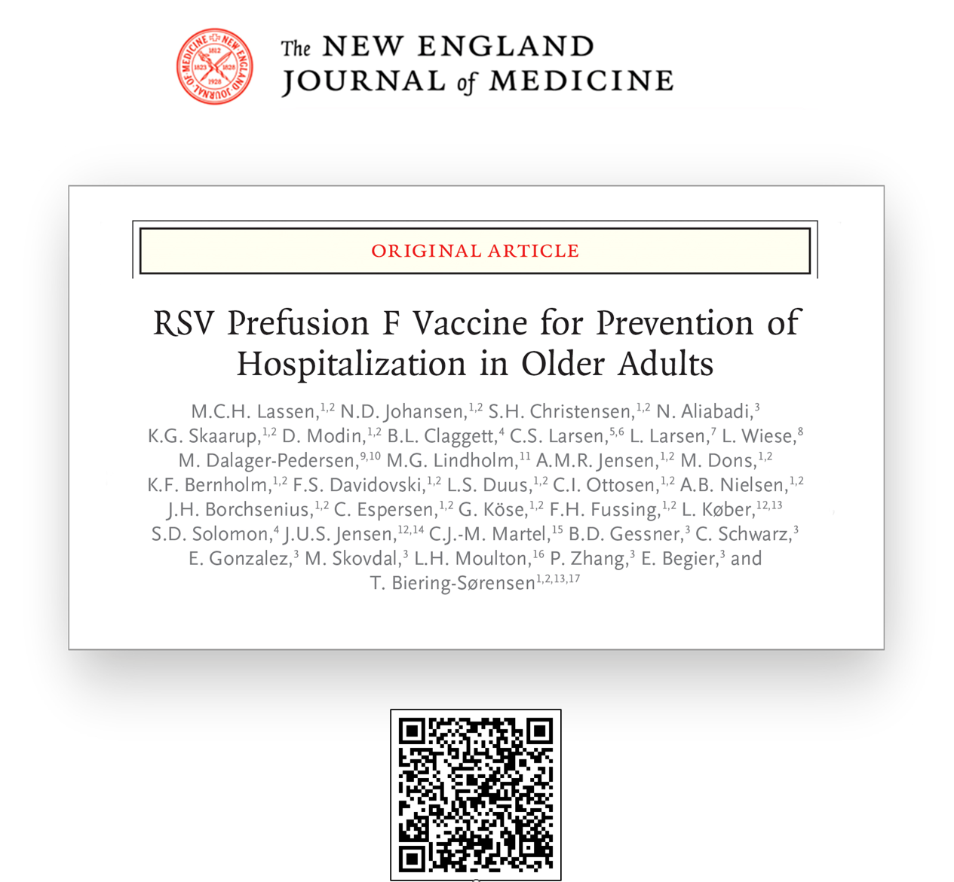
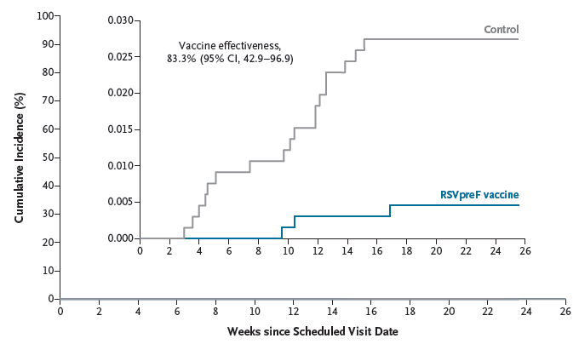
 | RSVpreF group n = 65,642 | Control group n = 65,634 | Vaccine effectiveness (95% CI) | P-value | NNV
Endpoint | No. of events
Primary endpoint
Hospitalization for RSV-related respiratory tract disease | 3 | 18 | 83.3% (42.9% to 96.9%) | 0.007 | 1818
Secondary endpoints
Hospitalization for RSV-related lower respiratory tract disease | 1 | 12 | 91.7% (43.7% to 99.8%) | 0.009 | 2500
Hospitalization for any respiratory tract disease | 284 | 335 | 15.2% (0.5% to 27.9%) | 0.041 | 535
RSV-related hospitalization (ICD-10 codes) | 1 | 8 | 87.5% (6.8% to 99.7%) |  | 4000
Hospitalization for RSV-related cardiorespiratory disease | 3 | 19 | 84.2% (46.4% to 97.0%) |  | 1695
Hospitalization for any cardiorespiratory disease | 715 | 794 | 9.9% (0.3% to 18.7%) |  | 345
Hospitalization for any lower respiratory tract disease | 236 | 298 | 20.8% (5.8% to 33.6%) |  | 440
Hospitalization for any cause | 3526 | 3598 | 2.0% (-2.7% to 6.5%)
All-cause mortality | 146 | 120 | -21.7% (-56.1% to 5.1%)
Lassen MCH , et al. N Engl J Med. 2026; 394(2):138-151.
Notes:
- The primary results from the trial as initially designed were reported last year at this conference. The trial randomized approximately 131000 individuals and found that among adults 60 years of age or older in Denmark, RSVpreF vaccination significantly reduced the incidence of RSV-related respiratory tract disease hospitalization as compared to no vaccine, corresponding to a vaccine effectiveness of 83.3%.¹⁴

Slide 5


RSV Seasons
2024
2025
2026
2 season vaccine effectiveness estimates: NH 24/25 and 25/26
1st season vaccine effectiveness estimates for expanded age eligibility and expanded geographic enrollment
131K
Denmark
Season: 2024/25
Age ≥60 years
332K
513K
50K
Denmark + Galicia, Spain
Season: 2025/26
Age ≥18 years
Denmark + Galicia, Spain
Seasons: 2024/25 + 2025/26
Age ≥18 years
Notes:
- A prespecified core objective of the DAN-RSV trial, was to estimate RSVpreF vaccine effectiveness against RSV-related hospitalization outcomes during a second RSV season after vaccination. These results will be presented here.
- Furthermore, due to fewer RSV-related endpoint events occurring during the first season and the EU extension of the indication of the vaccine for individuals 18 year and above, enrolment was expanded to include individuals 18 years and older and to include individuals from Galicia Spain as well.
- 1st season vaccine effectiveness estimates for expanded age eligibility and expanded geographic enrollment will also be presented here.

Slide 6
Objectives
To assess the vaccine effectiveness of the RSVpreF vaccine against RSV-related hospitalization outcomes during a second RSV season after vaccination.
To assess the vaccine effectiveness of the RSVpreF vaccine against RSV-related hospitalization outcomes for everyone 18 years of age or older across an expanded geographic area.

Slide 7
Methods
The extended DAN-RSV trial was a pragmatic, registry-based, open-label, individually randomized trial conducted during the 2024/2025 and 2025/2026 Northern Hemisphere winter season
Planned sample size:
Up to 690000 participants
Inclusion criteria:
Age ≥18 years
Signed informed consent
No formal exclusion criteria
Lassen MCH , et al. Am Heart J. 2026;291:14-25.
Lassen MCH , et al. Am Heart J. 2026;300:107497

Slide 8
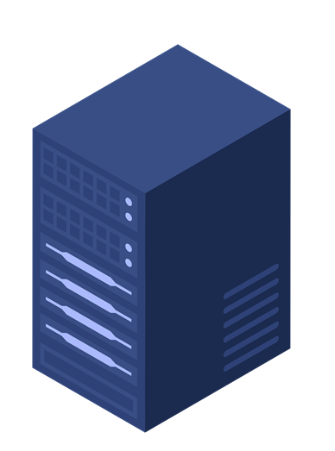

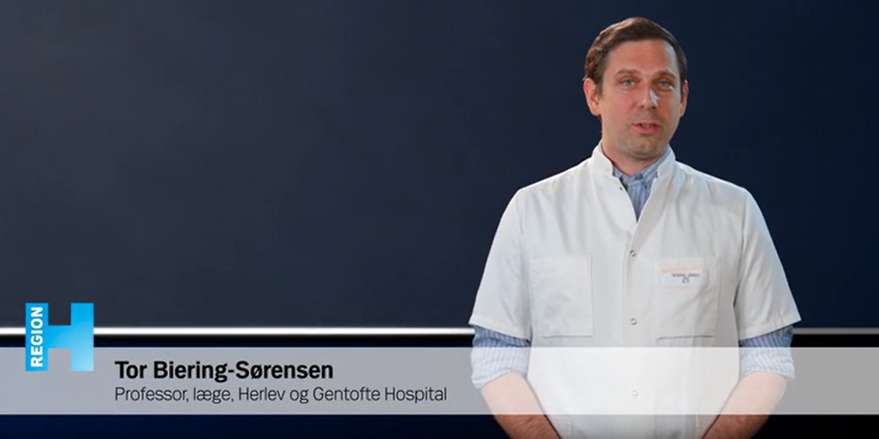
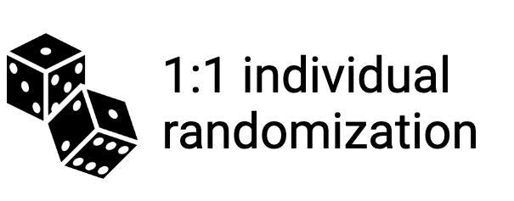


~ 4,500,000 invites sent
Lassen MCH , et al. Am Heart J. 2026;291:14-25.
Lassen MCH , et al. Am Heart J. 2026;300:107497
Notes:
NÅR FÆRDIG:
In Galicia, Spain written informed consent was obtained in person at the trial visit, and participants were randomly assigned immediately thereafter.

Slide 9
Endpoints
Participants were followed for clinical outcomes from 14 days after initially booked trial visit until May 31 the following year
Primary endpoint:
Hospitalization for RSV-related respiratory tract disease
Key Secondary endpoints:
Hospitalization for RSV-related lower respiratory tract disease
Hospitalization for any respiratory tract disease
Additional Secondary endpoints:
Hospitalization for RSV-related cardiorespiratory disease
Hospitalization for any cardiorespiratory disease
Hospitalization for any lower respiratory tract disease
Hospitalization for any cause
All-cause death

Slide 10
Statistical analysis
Vaccine effectiveness (VE) for each endpoint was calculated as 1 minus the incidence rate ratio of the outcome between the RSVpreF group and the control group, expressed as a percentage
VE = relative risk reduction
A VE of 100% indicates complete protection and 0% indicates no effect of the vaccine
All analyses are based on the intention-to-treat principle
Because no statistical adjustment was made for the repeated analysis of participants included in the original report, the present analyses should be considered descriptive

Slide 11
RSV Seasons
2024
2025
2026
2 season vaccine effectiveness estimates: NH 24/25 and 25/26
1st season vaccine effectiveness estimates for expanded age eligibility and expanded geographic enrollment
131K
Denmark
Season: 2024/25
Age ≥60 years
332K
513K
50K
Denmark + Galicia, Spain
Season: 2025/26
Age ≥18 years
Denmark + Galicia, Spain
Seasons: 2024/25 + 2025/26
Age ≥18 years

Slide 12
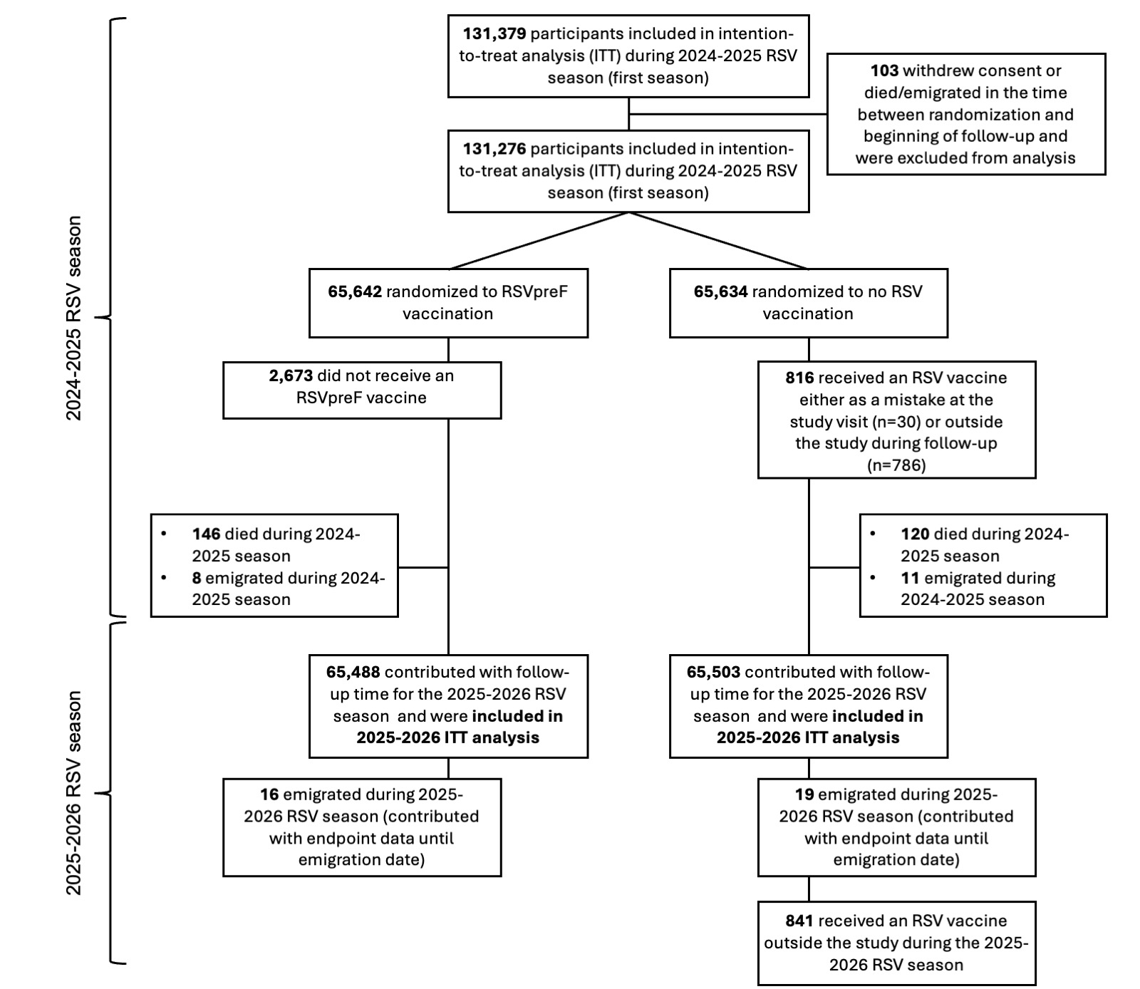
Study flow
Concordance between the assigned trial group and the intervention received was 95.9% in the RSVpreF group (2673 never showed up to get the vaccine) and >99.9% in the control group (30 controls received an RSVpreF at trial visit in error)
266 participants died and 19 emigrated during the 2024-2025 RSV season. The remaining 130,991 participants (65,488 in the RSVpreF group and 65,503 in the control group) contributed follow-up during the second RSV season (2025-2026)
786 (1.2%) controls bought an RSV vaccine outside the trial during during the first follow-up season and an additional 841 (1.3%) during the second season.

Slide 13
Baseline characteristics
Characteristic | RSVpreF vaccine group n = 65,488 | No vaccine (control) group n = 65,503
Age, mean (SD) | 69.4 (6.5) | 69.4 (6.5)
Male sex, n (%) | 32,819 (50.1%) | 32,992 (50.4%)
Chronic cardiovascular disease, n (%) | 14,302 (21.8%) | 14,237 (21.7%)
Ischemic heart disease, n (%) | 4873 (7.4%) | 4836 (7.4%)
Heart failure, n (%) | 1498 (2.3%) | 1445 (2.2%)
Atrial fibrillation, n (%) | 5111 (7.9%) | 4957 (7.6%)
Cerebrovascular disease, n (%) | 2276 (3.5%) | 2375 (3.6%)
Hypertension, n (%) | 9770 (14.9%) | 9874 (15.1%)
Diabetes, n (%) | 7150 (10.9%) | 7221 (11.0%)
Chronic lung disease, n (%) | 4776 (7.3%) | 4775 (7.3%)
Chronic obstructive pulmonary disease, n (%) | 1686 (2.6%) | 1658 (2.5%)
Chronic kidney disease, n (%) | 6605 (10.1%) | 6673 (10.2%)
Cancer, n (%) | 7498 (11.4%) | 7502 (11.5%)
Immunodeficiency, n (%) | 2582 (3.9%) | 2548 (3.9%)

Slide 14
Primary and secondary endpoints
 | Second season |  |  | Across first and second season (combined)
 | RSVpreF group n = 65,642 | Control group n = 65,634 | Vaccine effectiveness (95% CI) | RSVpreF group n = 65,642 | Control group n = 65,634 | Vaccine effectiveness (95% CI)
Endpoint | No. of events |  |  | No. of events
Primary endpoint
Hospitalization for RSV-related respiratory tract disease | 7 | 16 | 56.2% (-12.4% to 84.8%) | 10 | 34 | 70.6% (39.1% to 87.0%)
Secondary endpoints
Hospitalization for RSV-related lower respiratory tract disease | 4 | 13 | 69.2% (0.4% to 92.7%) | 5 | 25 | 80.0% (46.8% to 94.0%)
Hospitalization for any respiratory tract disease | 651 | 645 | -1.0% (-12.8% to 9.6%) | 884 | 938 | 5.8% (-3.4% to 14.1%)
RSV-related hospitalization (ICD-10 codes) | 5 | 7 | 28.6% (-161.5% to 82.1%) | 6 | 15 | 60.0% (-9.1% to 87.3%)
Hospitalization for RSV-related cardiorespiratory disease | 8 | 16 | 50.0% (-23.9% to 81.5%) | 11 | 35 | 68.6% (36.7% to 85.6%)
Hospitalization for any cardiorespiratory disease | 1726 | 1755 | 1.6% (-5.2% to 8.0%) | 2313 | 2418 | 4.4% (-1.2% to 9.7%)
Hospitalization for any lower respiratory tract disease | 582 | 578 | -0.7% (-13.2% to 10.4%) | 774 | 839 | 7.8% (-1.8% to 16.5%)
Hospitalization for any cause | 7884 | 7841 | -0.6% (-3.8% to 2.5%) | 10,301 | 10,334 | 0.4% (-2.4% to 3.1%)
All-cause mortality | 504 | 466 | -8.2% (-23.0% to 4.8%) | 650 | 587 | -10.8% (-24.1% to 1.1%)
Notes:
- VE estimates were attenuated for all endpoints assessed during the second season as compared to the first season especially for the all-cause outcomes.
- Across both seasons combined, estimated vaccine effectiveness against the RSV specific outcomes were attenuated but the RSVPreF vaccine was associated with lower incidence of most of the RSV specific endpoints but not associated with lower incidences for the all-cause endpoints across two seasons.

Slide 15
RSV Seasons
2024
2025
2026
2 season vaccine effectiveness estimates: NH 24/25 and 25/26
1st season vaccine effectiveness estimates for expanded age eligibility and expanded geographic enrollment
131K
Denmark
Season: 2024/25
Age ≥60 years
332K
513K
50K
Denmark + Galicia, Spain
Season: 2025/26
Age ≥18 years
Denmark + Galicia, Spain
Seasons: 2024/25 + 2025/26
Age ≥18 years

Slide 16
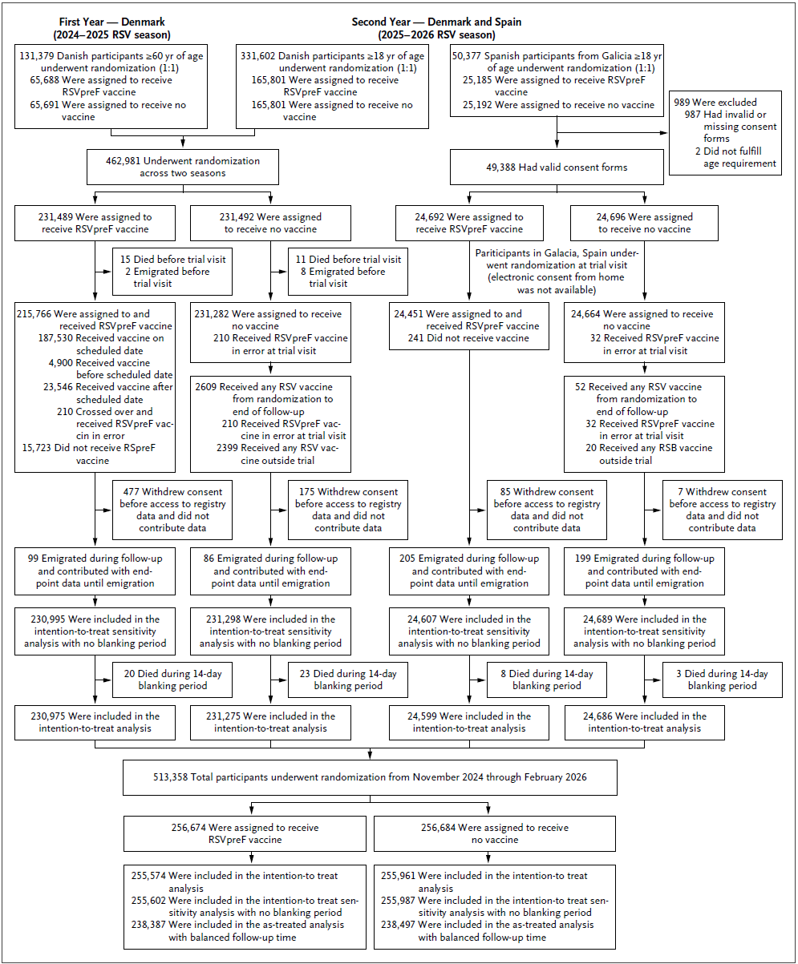
Study flow
Concordance between the assigned trial group and the intervention received was 93.8% in the RSVpreF group (15,964 [6.2%] never showed up to get the vaccine) and >99.9% in the control group (254 controls received an RSVpreF at trial visit in error)
2407 (0.9%) controls bought an RSV vaccine outside the trial during follow-up

Slide 17
Baseline characteristics
Characteristic | RSVpreF vaccine group n = 255,574 | No vaccine (control) group n = 255,961
Age, mean (SD) | 61.5 (14.4) | 61.5 (14.4)
Female sex, n (%) | 138,055 (54.0%) | 138,382 (54.1%)
Chronic cardiovascular disease, n (%) | 41,534 (16.3%) | 41,520 (16.2%)
Ischemic heart disease, n (%) | 13,297 (5.2%) | 13,275 (5.2%)
Heart failure, n (%) | 4711 (1.8%) | 4,640 (1.8%)
Atrial fibrillation, n (%) | 13,452 (5.3%) | 13,353 (5.2%)
Cerebrovascular disease, n (%) | 7184 (2.8%) | 7270 (2.8%)
Hypertension, n (%) | 28,392 (11.1%) | 28,426 (11.1%)
Chronic lung disease, n (%) | 17,386 (6.8%) | 17,443 (6.8%)
Chronic obstructive pulmonary disease, n (%) | 5652 (2.2%) | 5690 (2.2%)
Cancer, n (%) | 22,267 (8.7%) | 22,087 (8.6%)
Immunodeficiency, n (%) | 9488 (3.7%) | 9398 (3.7%)

Slide 18
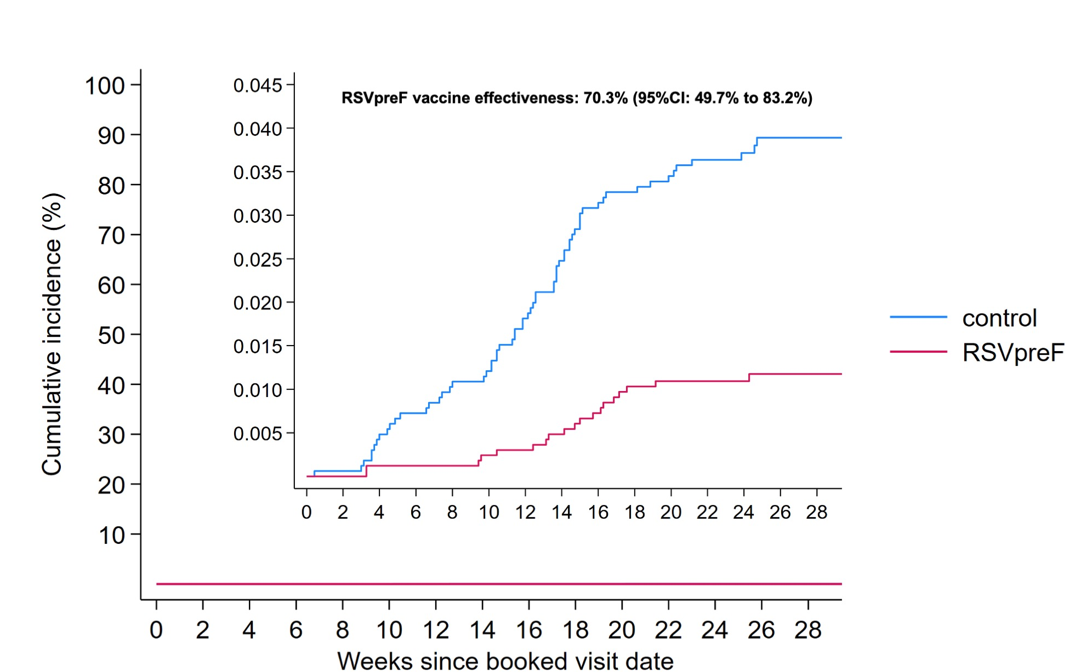
Primary endpoint
Hospitalization for RSV-related respiratory tract disease (primary endpoint)
Control (64 events)
RSVpreF (19 events)

Slide 19
Primary and secondary endpoints
 | RSVpreF group n = 255,574 | Control group n = 255,961 | Vaccine effectiveness (95% CI)
Endpoint | No. of events
Primary endpoint
Hospitalization for RSV-related respiratory tract disease | 19 | 64 | 70.3% (49.7% to 83.2%)
Secondary endpoints
Hospitalization for RSV-related lower respiratory tract disease | 13 | 45 | 71.1% (45.4% to 85.7%)
Hospitalization for any respiratory tract disease | 1295 | 1396 | 7.1% (-0.3% to 13.9%)
RSV-related hospitalization (ICD-10 codes) | 7 | 28 | 75.0% (41.3% to 90.8%)
Hospitalization for RSV-related cardiorespiratory disease | 20 | 67 | 70.0% (50.1% to 82.8%)
Hospitalization for any cardiorespiratory disease | 2704 | 2889 | 6.2% (1.2% to 11.1%)
Hospitalization for any lower respiratory tract disease | 1108 | 1208 | 8.1% (0.2% to 15.4%)
Hospitalization for any cause | 13,470 | 13,675 | 1.3% (-1.1% to 3.7%)
All-cause mortality | 610 | 623 | 1.9% (-9.9% to 12.4%)
Notes:
RSVpreF vaccination was associated with a lower incidence of all RSV- related endpoint events, as well as all-cause lower respiratory tract disease and cardiorespiratory hospitalizations as compared to no vaccination.

Slide 20
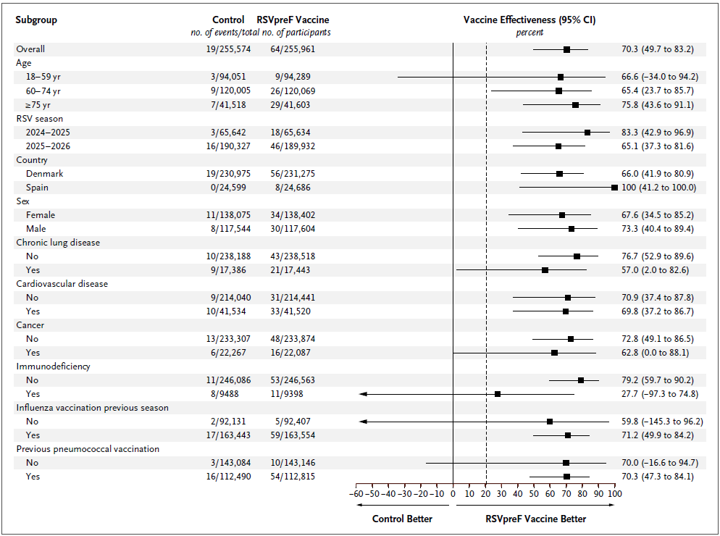
Subgroups
The effect was consistent across all pre-specified subgroups

Slide 21
Safety/adverse events
 | RSVpreF group n = 240,479 | Control group n = 271,890
Event | No. of participants (%)
Any serious adverse event (SAE) | 4814 (2.0%) | 6052 (2.2%)
Any cardiovascular SAE | 697 (0.3%) | 834 (0.3%)
Any respiratory SAE | 457 (0.2%) | 519 (0.2%)
Any gastro-intestinal SAE | 507 (0.2%) | 605 (0.2%)
Any neurological SAE | 150 (0.1%) | 154 (0.1%)
Any cancer-related SAE | 228 (0.1%) | 270 (0.1%)
Any infection-related SAE | 144 (0.1%) | 188 (0.1%)
Any injury-related SAE | 585 (0.2%) | 764 (0.3%)
Fatal SAE | 75 (<0.1%) | 124 (<0.1%)
Any serious adverse reaction | 21 (<0.1%) | N/A
Guillain–Barré syndrome | 5 (<0.1%) | 0
Notes:
-The rate of serious adverse events was low and similar in both groups.
-GBS occurred amongst 5 in the vaccine group which is of consisted magnitude as other safety surveillance data.

Slide 22
Conclusion
Among adults 60 years of age or older, RSVpreF vaccination was associated with protection against hospitalization for RSV-related respiratory tract disease across two RSV seasons.
Among adults 18 years of age or older, recruited from two European geographies, the RSVpreF vaccine was associated with a lower incidence of RSV-related respiratory tract disease hospitalization as compared to no vaccine during the first RSV season.
There were no apparent differences in estimated vaccine effectiveness between consecutive winter seasons, between country of enrollment, or across younger and older adults.

Slide 23
Acknowledgements
SPONSOR/CENTRAL TRIAL SITE – HERLEV AND
GENTOFTE HOSPITAL
Tor Biering-Sørensen (Chief Investigator)
Mats C. Højbjerg Lassen (Coordinating Investigator)
Sine H. Christensen
Marat Yafasov
Manan Pareek
Niklas Dyrby Johansen
Daniel Modin
Kristoffer G. Skaarup
Anne Marie Jensen
Maria Dons
Katrine F. Bernholm
Filip S. Davidovski
Lisa S. Duus
Camilla I. Ottosen
Anne B. Nielsen
Julie H. Borchsenius
Caroline Espersen
Güldas Köse
Frederik H. Fussing
Ingrid T. Lenz
Jacob Christensen
Jakob Ø. Simonsen
Majid Afzal
Katja V. Bartholdy
Adam C. F. Langhoff
DANSKE LÆGERS VACCINATIONS SERVICE
Carsten Schade Larsen (Principal Investigator)
Andrew Paulsen
Daniel Anderson
Helena Consortini Hobel
All vaccination personel
XMEDICUS
Mads K. Johnsen
PFIZER INC
Elizabeth Begier
Negar Aliabadi
Abby E. Rudolph
Claudia Schwarz
Elisa Gonzalez
Mette Skovdal
Pingping Zhang
Lawrence Moulton
Bradford Gessner
Vanessa López-Gómez
Sabrina Welsh
Laura Anatale-Tardiff
Alejandro Cane
Kyla Hayford
STATENS SERUM INSTITUT
Cyril Jean-Marie Martel
STUDY GROUP
Scott D. Solomon
Brian L. Claggett
Lykke Larsen
Lothar Wiese
Michael Dalager-Pedersen
Matias G. Lindholm
Lars Køber
Jens Ulrik Stæhr Jensen
GALICIAN TEAM
Federico Martinón-Torres (Principal Investigator)
Iago Giné-Vázquez
Carmen Duran-Parrondo
Marta Piñeiro-Sotelo
Martín Cribeiro-González
Martín Cribeiro-González
Susana Mirás-Carballal
Juan-Manuel González-Pérez
Carmen Rodriguez-Tenreiro-Sánchez
GALFLU trial team
THE DANISH HEALTH DATA
AUTHORITY
ALL STUDY PARTICIPANTS
Contact: tor.biering@gmail.com / @TorBiering / @CTCPR_

Slide 24
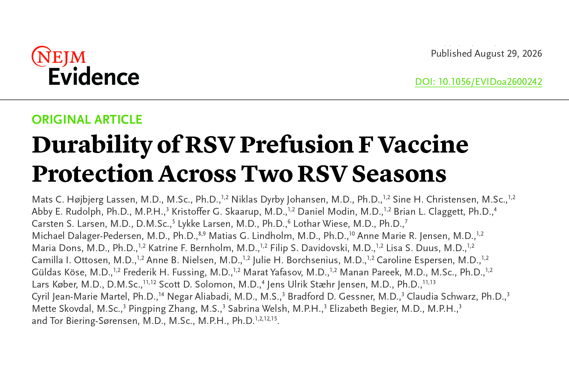
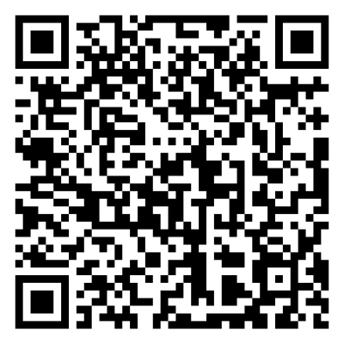
Notes:
Reserved for sim pubs

Slide 25
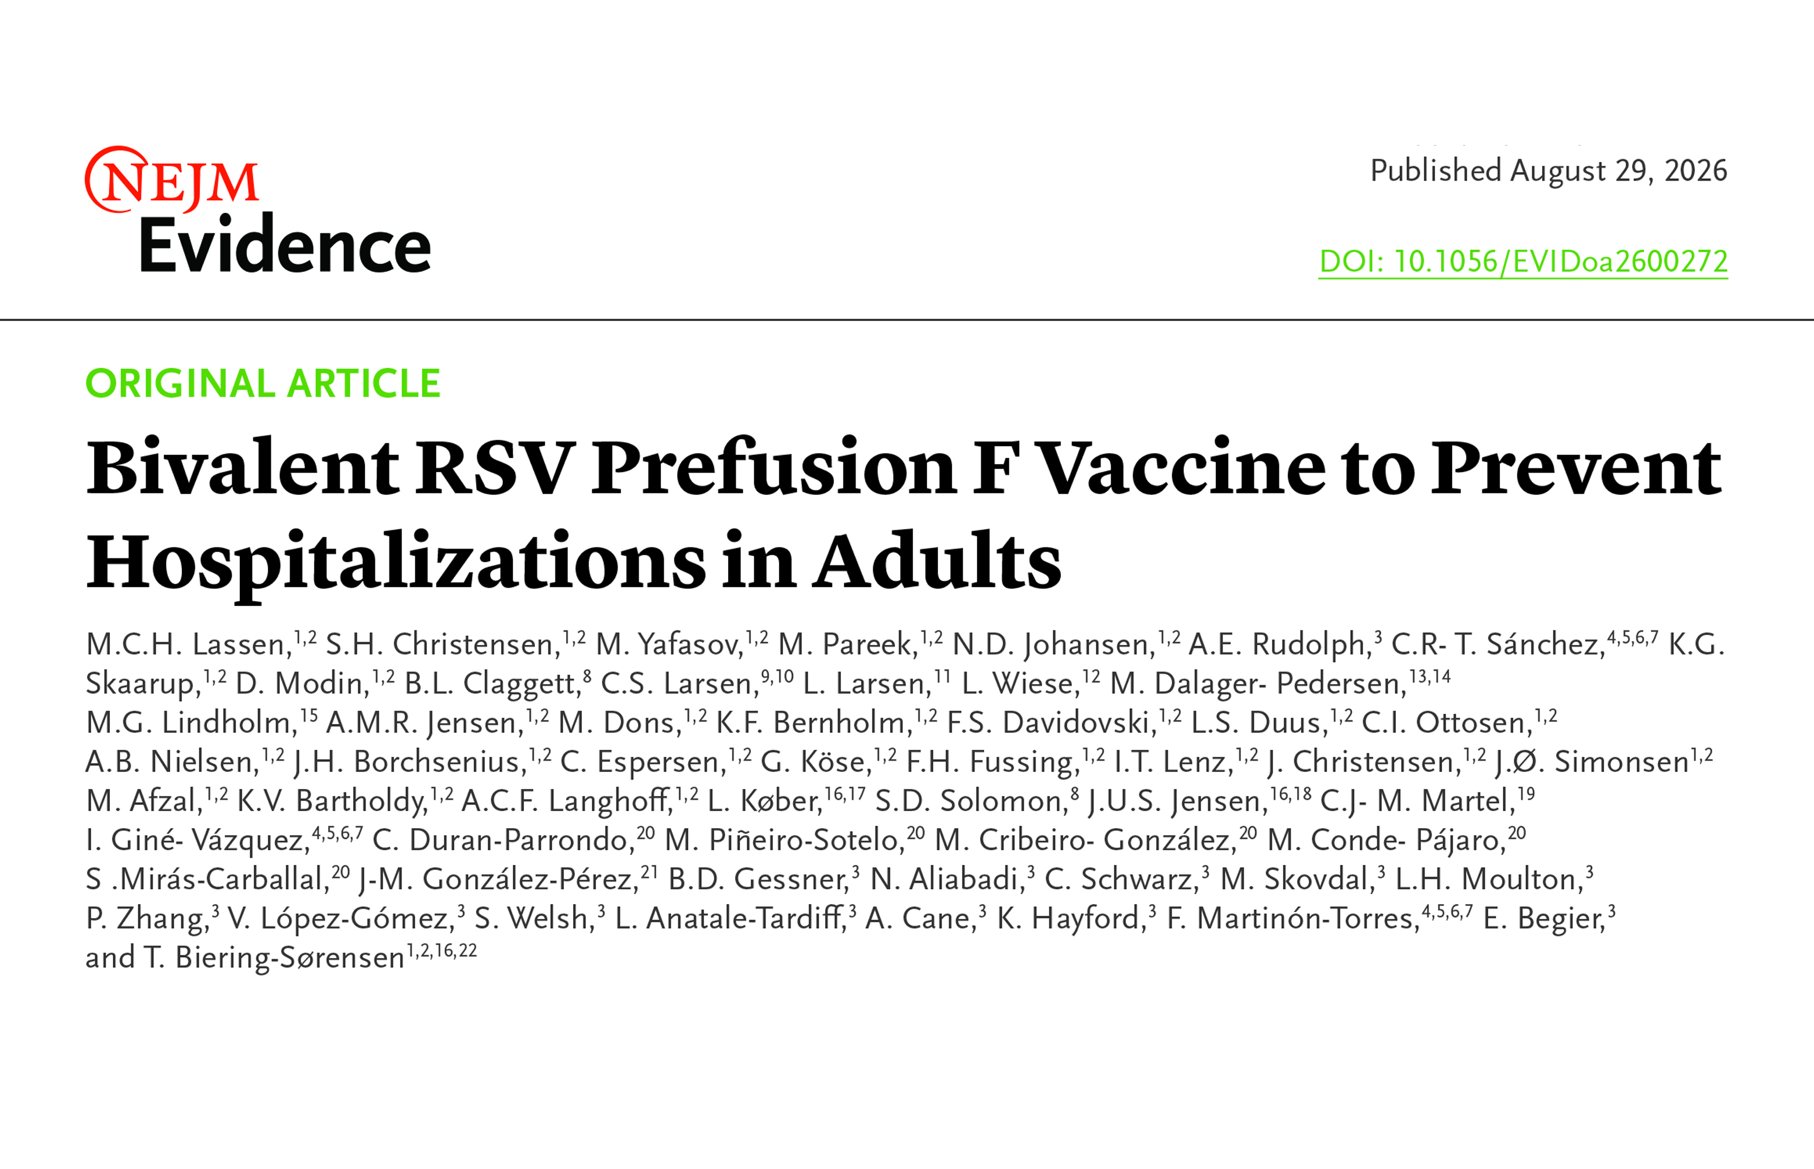
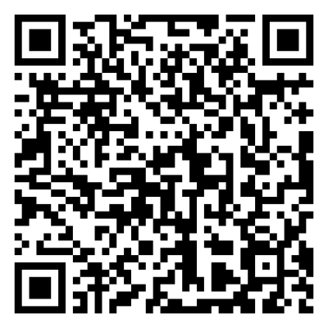
Notes:
Reserved for sim pubs

Slide 26
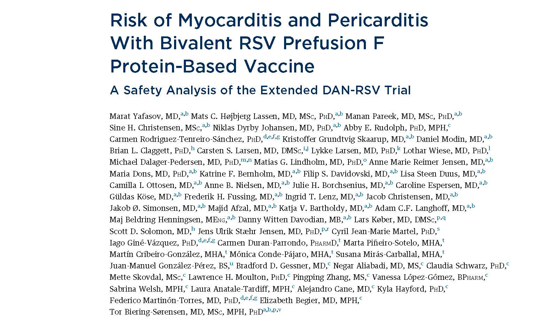
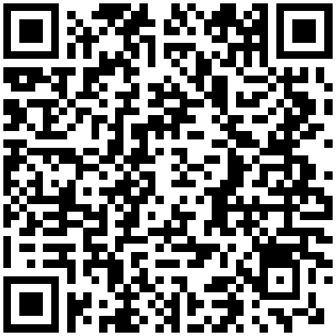

Simultaneously published in JACC

Slide 27
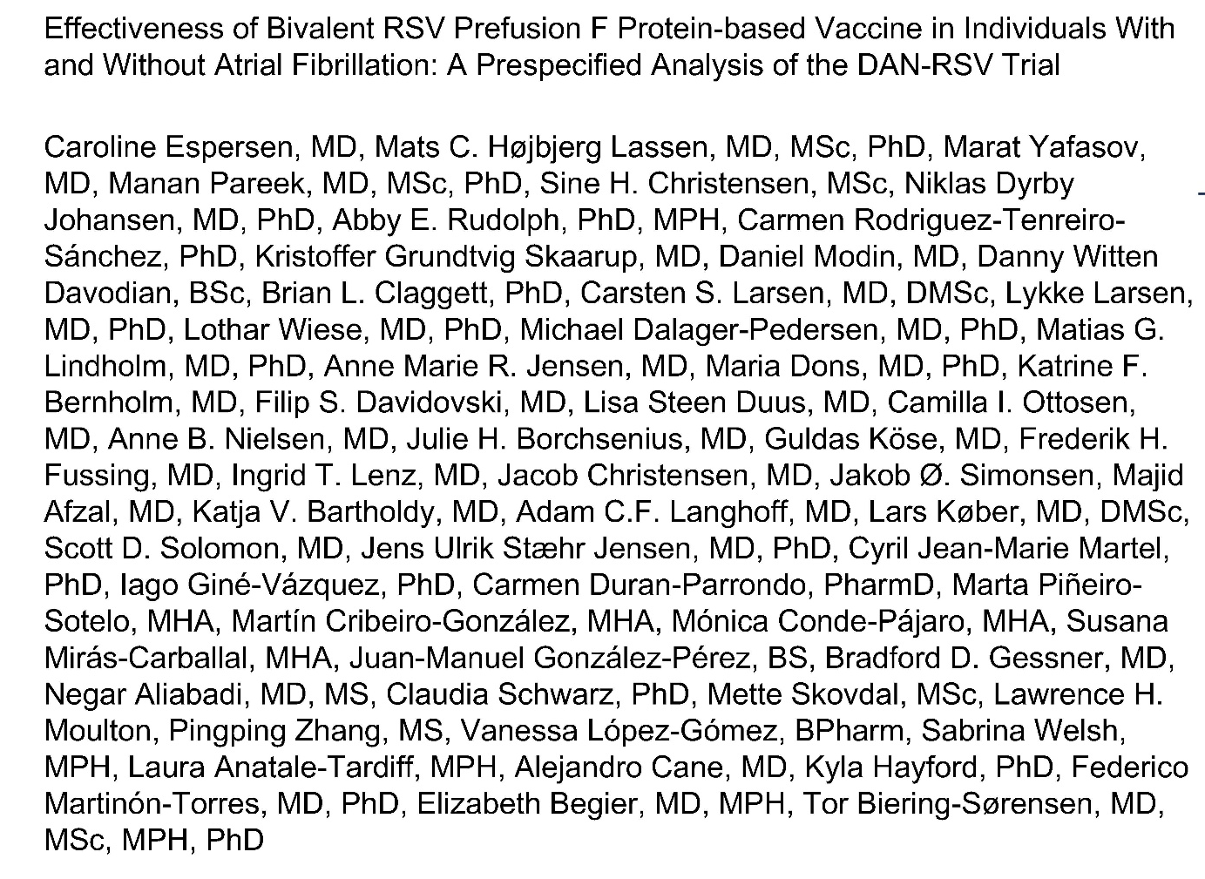

Simultaneously published in JACC

Slide 28

