Slide 1

Advancing Cath Lab Results with FFRangio Coronary Physiology Assessment:
The ALL-RISE Randomized Trial
Ajay J. Kirtane MD, SM
Director of Columbia Interventional Cardiovascular Care and Professor of Medicine at Columbia University Irving Medical Center / New York-Presbyterian Hospital
on behalf of the ALL-RISE Study Investigators
Notes:
On behalf of our entire investigational team, it is a true privilege to be able to present to you the results of the ALL-RISE randomized trial here at ACC.26.

Slide 2
Financial Conflict of Interest Disclosure
Dr. Kirtane reports Institutional funding to Columbia University and/or Cardiovascular Research Foundation from Abbott Vascular, Amgen, Bolt Medical, Boston Scientific, CathWorks, Concept Medical, Cordis, Idorsia, Janssen, Magenta Medical, Medtronic, Neurotronic, Philips, ReCor Medical, Supira, and Teleflex. In addition to research grants, institutional funding includes fees paid to Columbia University and/or Cardiovascular Research Foundation for consulting and/or speaking engagements in which Dr. Kirtane controlled the content. Personal: Equity options in Airiver, Aeroflow, Bolt Medical, Lumen Medical, Roon, Tonic Medical; consulting from Sonivie; Travel Expenses/Meals from Abbott Vascular, Acist, Abiomed, Amgen, Angiodynamics, Biotronik, Boston Scientific, CathWorks, Chiesi, Concept Medical, Edwards Lifesciences, Kiniksa Pharmaceuticals, Medtronic, Novartis, Janssen, Philips, ReCor Medical, Shockwave, and Supira.

Slide 3
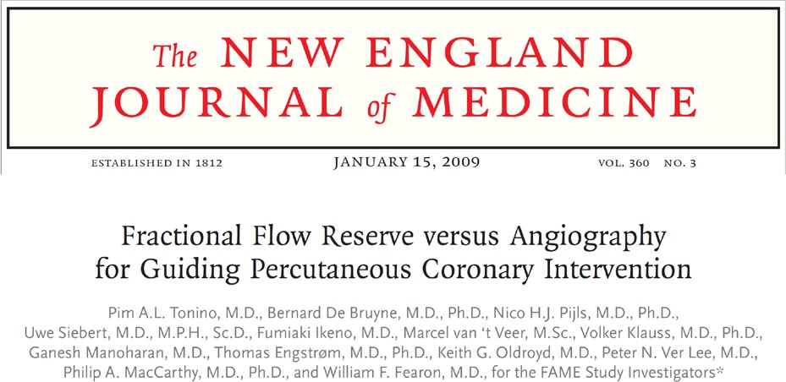
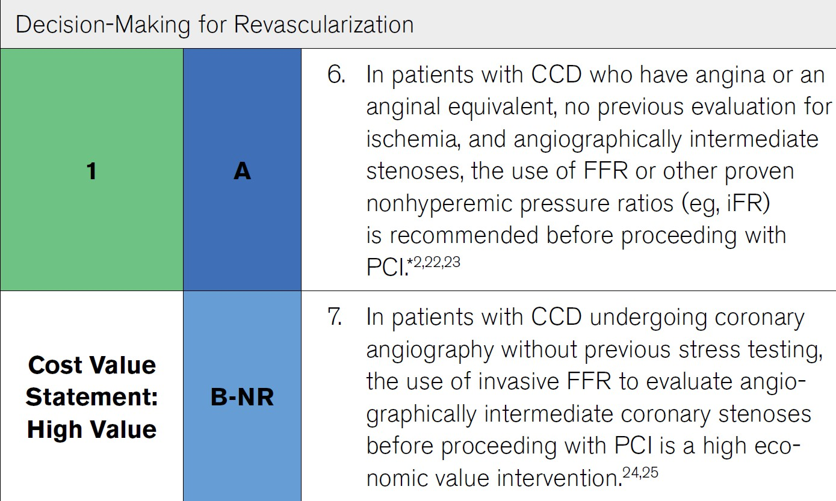
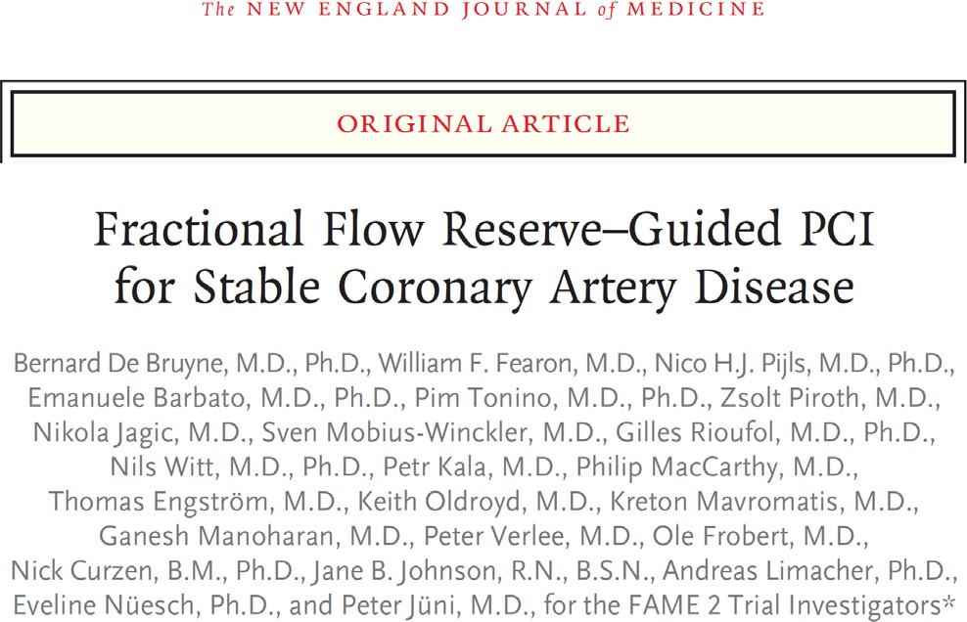
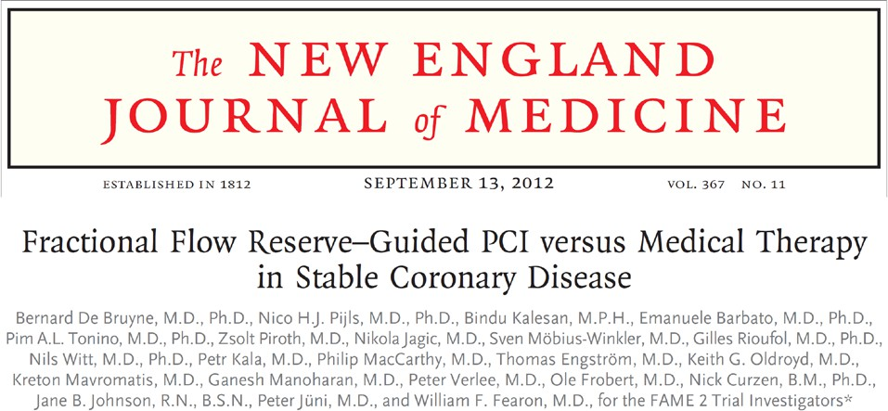
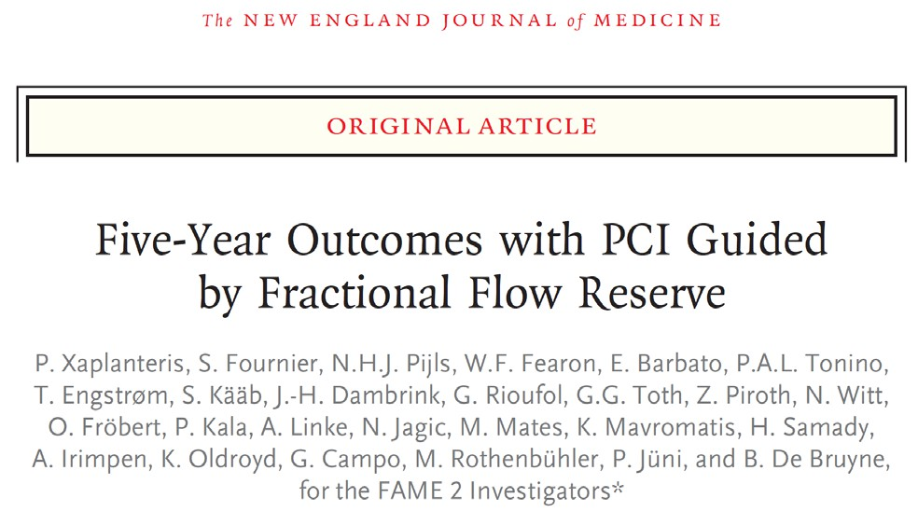
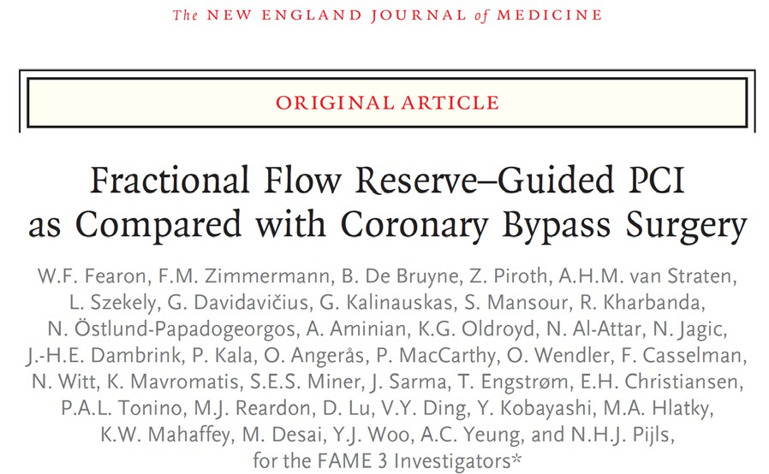
Coronary Physiology: IA High Value Indication in ACC/AHA Guidelines
Virani et al 2023
Notes:
Abundant Class IA evidence has demonstrated both the clinical utility and the economic value of coronary physiologic testing to guide revascularization decisions in the cath lab.

Slide 4

And Yet… Physiology is Underutilized in the Cath Lab
Clinical Inertia
Pressure wire-based physiology
(Class IA)
Procedural Time and Cost
Workflow / Measurement Complexity
Small Risk of Complications
Notes:
And yet, like many other guideline-endorsed practices, coronary physiology is underutilized. This may be in part due to clinical intertia, but there is no question that the workflow of having to put up a guiding catheter, open a new wire, anticoagulate, equalize pressures, advance the wire, and make measurements – sometimes after giving adenosine – takes time and effort and can cause rare but real complications.
As a result of these issues… to be honest… we just don’t do physiology as much as we should.

Slide 5
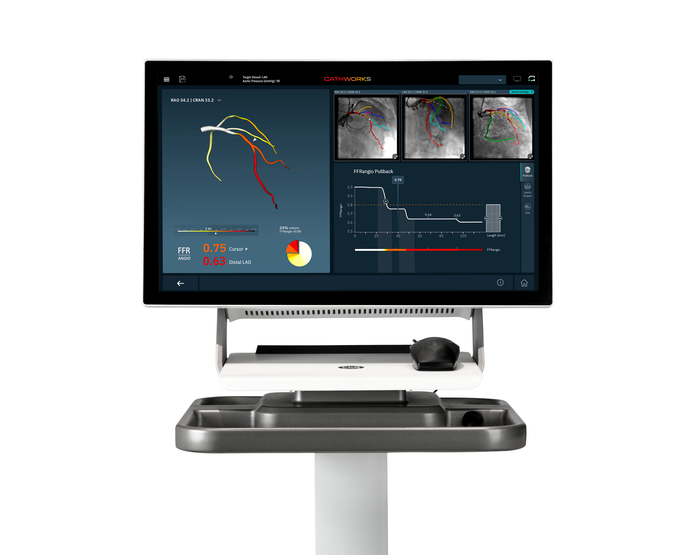
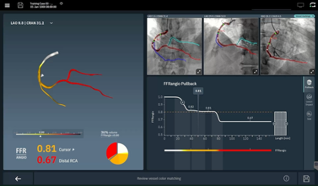
CathWorks FFRangio® System
Console receives routine angiograms
Combines AI/Computer Vision to build 3D coronary model, MD verifies
Applies ”Resistance Flow” algorithm
Provides comprehensive multi-vessel coronary physiology without further procedural manipulation
FDA-Approved and validated vs. FFR
CathWorks FFRangio System is a Registered Trademark of CathWorks.
Notes:
There are ways to use computer software in the cath lab to derive detailed lesion-based physiology without any procedural manipulation or need for hyperemia. FFRangio is a technology that receives routine angio images and combines AI and computational science, to trace coronary vessels and create a 3D model.
After a physician confirms the adequacy of the vessel contours, a resistance flow algorithm is applied. This allows derivation of FFR values at all points along the coronary tree, in multiple vessels.
The measurement of FFRangio using this tool has been validated against wire-based FFR in multiple clinical studies, but there have been limited clinical outcomes data comparing treatment based upon this approach to treatment based upon a pressure wire. Because of this, many physicians just aren’t sure if FFRAngio is as good as the pressure wire.

Slide 6
Study Objective
To test whether FFRangio is comparable to conventional pressure wire-based assessment of intermediate lesions being considered for PCI
Notes:
ALL-RISE was designed to test exactly this simple question: whether FFRangio is comparable to conventional pressure wire-based assessment of intermediate lesions being considered for PCI.

Slide 7
Study Design
~1924 patients to be enrolled in up to 60 sites globally
Key Inclusion Criteria:
CCS/NSTEACS patients w/ 50-90% lesion(s) deemed appropriate for both FFRangio and pressure wire assessment
Declare lesion(s) for assessment
1:1
Stratified by FFR/NHPR & Presentation
FFRangio-guided
Pressure wire-guided
Key Exclusion Criteria:
STEMI in the last 72 hours, CABG with patent grafts to the study vessel(s), or those in whom CABG was being considered
FFRangio
≤0.80
FFRangio
>0.80
FFR ≤0.80
NHPR ≤0.89
FFR >0.80
NHPR >0.89
PCI
Defer
PCI
Defer
Primary Endpoint: 1-year MACE
(All-cause death, MI, or unplanned clinically-driven revascularization)
Funded by CathWorks; ClinicalTrials.gov number NCT05893498
Notes:
We powered this randomized trial of >1900 patients with a primary endpoint of one-year MACE, defined as the composite of all-cause death, MI, or unplanned clinically driven revasc. Key inclusion criteria were CCS/NSTEACS patients w/lesion(s) 50-90% severity deemed appropriate for physiologic assessment​ to guide decision-making for PCI.
Patients were randomized to FFRAngio-guided treatment or Pressure wire-guided treatment. Randomization was stratified by presentation acuity and whether the investigator planned to use FFR or a non-hyperemic index if randomized to the pressure wire study arm. Performance of PCI was based upon conventional thresholds.
Beyond clinical endpoints, we additionally carefully measured procedural parameters including overall procedure time, time measure the physiology, contrast volume, and fluoroscopy time.

Slide 8
Study Organization
Chairs
M. Leon (Executive Chair), A. Kirtane (Study Chair and Global Principal Investigator)
Global Co-Principal Investigators
W. Fearon, A. Jeremias
Steering Committee
M. Leon, A. Kirtane, W. Fearon, A. Jeremias, R. Al-Lamee, G. Witberg, D. Cohen, R. Yeh, R. Sharma, A. Kaki
Data & Safety Monitoring Board
S. King (Chair), M. Khan, T. Collier
Clinical Events Committee
S. Brener (Chair), E. Osborn (Co-Chair), B. Uretsky, B. Peterson, J. Weinberger, D. Engel, O. Dogan, H. Vefali
Study Oversight, Data Coordinating Center, Angiographic Core Lab
A. Popma, J. Ungarten, J. Thompson, D. Zhao, O. Dressler, J. Popma
Sponsor: CathWorks (Newport Beach, CA); ClinicalTrials.gov number NCT05893498
Notes:
I want to take a moment to acknowledge all of our study leadership especially Marty Leon for trusting Bill Fearon, me, and others to lead this study, as well as all of our PI’s, study coordinators, and most importantly, the patients that participated in the trial.

Slide 9
43 US Study Sites
Medstar Union (Wang)
Medstar WHC (Hashim)
Inova (Batchelor)
Tidal Health (Hearne)
Beth Israel Deaconess (Yeh)
Ascension St. John (Kaki)
Carle Foundation (Moussa)
MN Heart Inst-Abbott NW (Sandoval)
Mercy (Whitbeck)
Columbia Univ (McEntegart)
NYU Langone (Razzouk)
Cornell-NY Presbyterian (Wong)
St. Francis Hosp.(Shlofmitz)
Northwell (Kim)
NYP Brooklyn Methodist (Kobayashi)
Ellis Hospital (Garg)
VA-Long Beach (Seto)
VA-Palo Alto (Fearon)
Stanford (Fearon)
UCSD (Mahmud)
USC (Matthews)
St. Joseph (Buhari)
Kaiser Perm-SF (Manthripragada)
UCLA (Parikh)
Valley, Health-Ridgewood NJ (Tayal)
Morristown MC (Safirstein)
Mountainside MC (Patel)
Lehigh Valley Hosp (Singh)
Upenn (Kolansky)
The Christ Hosp. (Garcia)
St. Elizabeth-Edgewood (Brar)
Mt. Carmel (Buschur)
Ascension Via Christ St. Francis-Wichita (Chehab)
Kansas Heart Inst.-Wichita (Chehab)
BSW-Heart Hospital (Al-Azizi)
HCA San Antonio Methodist (Thukral)
CRA North Mississippi (Blossom)
TCAVI (Khuddus)
Tallahassee Res. Inst (Rengifo)
Tampa General-USF (Bezerra)
JFK (Rothenberg)
HCA Florida Northside (Jabbar)
Archbold Memorial (Sizemore)
St. Elizabeth HC-Edgewood, KY (Brar)

Slide 10
16 International Sites
2 sites in Israel
8 sites in Japan
6 sites in EU
Imperial College of London (Al-Lamee)
Musgrove Park Hospital (Sahebjalal)
Essex Cardiothoracic Center (Keeble)
Rabin MC (Levi)
HaSharon MC (Greenberg)
Sakakibara Heart Institute (Nanasato)
Chibanishi General Hospital (Misumi)
NTT Medical Center (Warisawa)
Kobe University (Otake)
Gifu Heart Center (Matsuo)
Mie University (Kurita)
Ichinomiya Nishi Hospital (Dan)
Fukuyama Hosp. (Kikuta)
Hopitaux Universitaires Geneve (Iglesias)
CHUV Lausanne (Fournier)
HFR Fribourg (Arroyo)
ISRAEL
JAPAN
EUROPE

Slide 11
Top 10 Enrolling Sites
Rabin Medical Center, Petach Tikva, Israel | Amos Levi | 146 Patients
Ascension Via Christi Hospitals Wichita, Wichita, KS | Bassem Chehab | 138 Patients
Northwell Health, New York, NY | Michael Kim | 117 Patients
Kobe University Hospital, Hyogo, Japan | Hiromasa Otake | 101 Patients
The Valley Hospital, Ridgewood, NJ | Rajiv Tayal | 83 Patients
Stanford University, Stanford, CA | William Fearon | 79 Patients
Mie University Hospital, Mie, Japan | Tairo Kurita | 77 Patients
Gifu Heart Center, Gifu, Japan | Matsuo Hitoshi | 65 Patients
Ichinomiyanishi Hospital, Aichi, Japan | Kazuhiro Dan | 63 Patients
Columbia/New York-Presbyterian Hospital, New York, NY | Margaret B. McEntegart | 61 Patients
Notes:
This was a multinational effort with enrollments in the United States, Japan, Israel, Switzerland, and the UK. Our top 10 enrolling sites are shown on this slide.

Slide 12
Sample Size and Power
Primary hypothesis: non-inferiority of FFRangio vs. pressure-wire for 1-year MACE
Non-inferiority margin: 3.5% (absolute risk difference)
One-sided alpha: 0.025
Assumptions (for 1:1 randomization)
Estimated MACE rate: 7.5% in both FFRangio and pressure-wire arms
Attrition rate: 5%
>80% power at 1924 randomized patients
Notes:
The study was powered to demonstrate non-inferiority of FFRangio-guided treatment compared with pressure wire assessment. We estimated a 1-year MACE rate of 7.5% in both groups, with an absolute non-inferiority margin of 3.5%. We picked a sample size that would provide >80% power for the trial.

Slide 13
Study Flow
4,704 signed informed consent and assessed for eligibility
2,771 were excluded
2,530 did not meet the inclusion criteria
274 met General Exclusion criteria
194 met Angiographic exclusion criteria
1,930 randomized
FFRangio-guided treatment (N=965)
Received allocated intervention (n=949)
Did not receive allocated intervention (n=16)
Allocation
Pressure wire-guided treatment (N=965)
Received allocated intervention (n=941)
Did not receive allocated intervention (n=24)
Subjects discontinued early: 4.6% (n=44)
Voluntarily withdrew or by investigator (n=12)
Lost to follow-up (n=31)
Others (n=1)
Subjects discontinued early: 3.4% (n=33)
Voluntarily withdrew or by investigator (n=14)
Lost to follow-up (n=15)
Others (n=4)
Follow-Up
Analyzed (N=965)
Analysis
Analyzed (N=965)
Notes:
We ultimately enrolled a total of 1,930 patients, equally allocated to both strategies, and clinical follow-up at one year was >95%. Adherence to the study protocol was generally excellent.

Slide 14
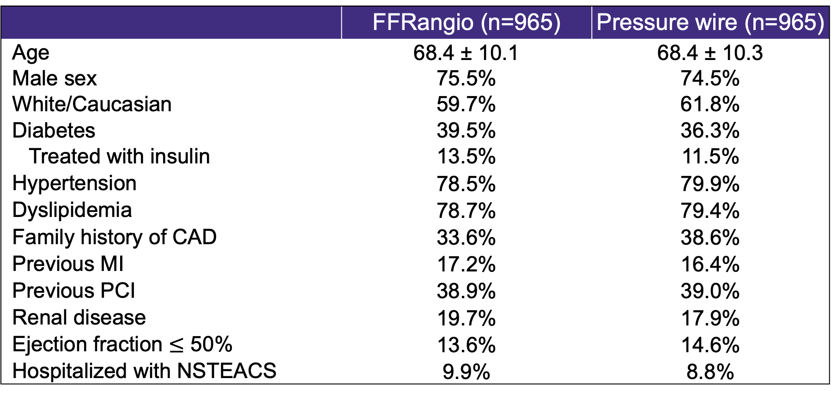
Baseline Clinical Characteristics
 | FFRangio (n=965) | Pressure wire (n=965)
Age | 68.4 ± 10.1 | 68.4 ± 10.3
Male sex | 75.5% | 74.5%
White/Caucasian | 59.7% | 61.8%
Diabetes | 39.5% | 36.3%
Treated with insulin | 13.5% | 11.5%
Hypertension | 78.5% | 79.9%
Dyslipidemia | 78.7% | 79.4%
Family history of CAD | 33.6% | 38.6%
Previous MI | 17.2% | 16.4%
Previous PCI | 38.9% | 39.0%
Renal disease | 19.7% | 17.9%
Ejection fraction $≤$ 50% | 13.6% | 14.6%
Hospitalized with NSTEACS | 9.9% | 8.8%
Notes:
Baseline characteristics were well-balanced across study arms
The mean age of patients enrolled was 68 years
Almost 40% had diabetes
90% of patients presented with chronic coronary syndromes

Slide 15
Lesion Level Characteristics
 | FFRangio (n=965) | Pressure wire (n=965)
Total number of study lesions | 1288 | 1248
LAD | 635 (49.3%) | 624 (50.0%)
LCX | 277 (21.5%) | 261 (20.9%)
RCA | 376 (29.2%) | 363 (29.1%)
Reference vessel diameter - mm | 2.9 ± 0.6 | 2.9 ± 0.6
Pre-procedure diameter stenosis (%) | 54.5 ± 12.0 | 54.5 ± 12.0
Lesion length (IQR) – mm | 12.0 [8.0, 19.1] | 12.5 [8.0, 18.8]
Successful physiologic assessment | 1269 (98.5%) | 1230 (98.6%)
FFRangio value | 0.81 ± 0.12 | n/a
FFR value | n/a | 0.84 ± 0.10
NHPR value | n/a | 0.89 ± 0.11
FFRangio/FFR ≤0.80 or NHPR ≤0.89 | 545 (43.0%) | 454 (37.0%)
Total study lesions undergoing PCI | 571 (44.3%) | 442 (35.4%)
Intravascular imaging use (for PCI) | 280 (49.0%) | 231 (52.3%)
Notes:
Of the lesions declared as study lesions, 50% were in the LAD.
Physiologic assessment was successful in more than 98% of lesions in both arms.
The average FFRangio value was 0.81 and the average pressure wire-based FFR was 0.84 – or for non-hyperemic indexes 0.89. To contextualize this, all of these values are close to decision-making thresholds, in a sense validating our investigators’ clinical thinking in these cases, to interrogate intermediate lesions.
Based upon these values, 43% of lesions in the FFRangio arm had a value below the treatment threshold, and PCI was performed in 44%.
In the pressure wire arm, 37% of lesions had a value below the treatment threshold and correspondingly 35% underwent PCI.

Slide 16
Procedural Characteristics (Patient Level)
 | FFRangio (n=965) Median [25%,75%] | Pressure wire (n=965) Median [25%,75%] | Difference [25,75%]
Physiology assessment (min) | 6.0 [4.0, 10.0] | 8.0 [5.0, 15.0] | -2.0* [-3.0, -2.0]
Total contrast volume (mL) | 100.0 [52, 145] | 105.0 [72,150] | -14.0* [-20.0,-10.0]
Total fluoroscopy time (min) | 9.0 [5.0, 17.0] | 12.0 [8.0, 20.0] | -3.0* [-3.0,-2.0]
Total Procedure time (min) | 39.0 [21.0, 62.0] | 42.0 [29.0, 60.0] | -5.0* [-7.0,-3.0]
*Hodges–Lehmann estimator for risk differences (median of all pairwise differences between groups)
Notes:
Here are the procedural characteristics in both arms.
The time it took to perform the physiology assessment was shorter with FFRAngio than with the pressure wire.
Calculation of FFRAngio took a median of 6 minutes (with no further procedural manipulation).
With pressure wire-based assessment which employed all the procedural steps I previously described, the physiologic assessments took 8 minutes.
Total contrast volume and fluoroscopy times were lower with FFRangio than pressure wire assessment, and despite a slightly higher rate of PCI in that arm, the overall procedure time was actually lower with FFRangio-based treatment with a median between-group difference of 5 minutes saved per procedure.

Slide 17
Primary Endpoint: 1-Year MACE
10
HR (95% CI): 0.98 (0.70-1.39)
P_{non-inferiority} = 0.0008
Pressure wire
7.1%
FFRangio
6.9%
MACE (%)
5
0
0
2
4
6
8
10
12
Months since Randomization
Number at risk
FFRangio-guided strategy
965
947
907
864*
Pressure wire-guided strategy
965
940
906
859*
MACE: All-cause death, MI, or unplanned clinically-driven revascularization
*12-month number at risk includes all subjects with follow-up in the 12-month visit window (days 335-395)
Notes:
But beyond procedural differences which are important for workflow, the primary endpoint of the study was a clinical one, shown in this slide.
First, the incidence of death, MI, or unplanned revascularization with pressure wire based treatment was 7.1%.
With FFRangio it was 6.9%.
Examination of the Kaplan-Meier curves demonstrates that the two arms are virtually superimposable for this endpoint, with a p for non-inferiority of 0.0008.

Slide 18
Primary Endpoint: 1-Year MACE
FFRangio
(N=965)
6.9%
Pressure wire (N=965)
7.1%
Non-inferiority p-value
0.0008
Rate Difference: -0.2%
Upper Bound of 1-sided 97.5% CI: 2.1%
Margin:
3.5%
FFRangio met non-inferiority to pressure wire-based assessment
-5.0 | -4.0 | -3.0 | -2.0 | -1.0 | 0.0 | 1.0 | 2.0 | 3.0 | 4.0 | 5.0
Favors FFRangio
Favors Wire
Notes:
This is an illustration of the non-inferiority testing; The upper bound of the confidence interval for the difference in event rates was 2.1%, which is well below the pre-specified margin of 3.5%, confirming non-inferiority.

Slide 19
Secondary Clinical Endpoints: Death, MI
10
10
8
8
HR (95% CI):
0.65 (0.34-1.25)
HR (95% CI):
1.16 (0.63-2.14)
MI (%)
Death (%)
6
6
4
FFRangio
4
Pressure wire
2.3%
2.5%
2
2
Pressure wire
FFRangio
2.1%
1.6%
0
0
1
6
12
1
6
12
Months since Randomization
Months since Randomization
Number at risk
Number at risk
FFRangio
965
955
927
904*
FFRangio
965
949
919
891*
Pressure
wire
965
950
929
905*
Pressure
wire
965
942
916
884*
*12-month number at risk includes all subjects with follow-up in the 12-month visit window (days 335-395)
Notes:
Shown here are the curves for the individual components of this endpoint with no appreciable differences seen for death or for myocardial infarction.

Slide 20
Unplanned Clinically-Driven Revascularization
10
HR (95% CI)
0.90 (0.58-1.40)
8
Pressure wire
6
Revascularization (%)
4.6%
4
FFRangio
2
4.1%
0
1
6
12
Months since Randomization
Number at risk
FFRangio
965
950
910
869*
Pressure wire
965
942
908
865*
*12-month number at risk includes all subjects with follow-up in the 12-month visit window (days 335-395)
Notes:
Finally, there was no observed differences in early or late revascularization between the two treatment groups.

Slide 21
Prespecified Subgroups: 1-Year MACE
Subgroup
N
FFRangio
Pressure wire
Hazard Ratio [95% Confidence Interval]
MACE Rate % (n)
Age
1930
> 65
1201
7.7% (44)
7.2% (41)
1.11 [0.72, 1.70]
<=65
729
5.4% (20)
7.0% (24)
0.79 [0.43, 1.42]
Diabetes
1926
Present
730
8.6% (32)
8.5% (28)
1.05 [0.63, 1.74]
Absent
1196
5.8% (32)
6.4% (37)
0.91 [0.57, 1.46]
Study Vessel Based on Physiology Assessment
1922
LAD
1136
5.2% (29)
8.3% (44)
0.64 [0.40, 1.03]
Non-LAD
786
9.3% (35)
5.5% (21)
1.70 [0.99, 2.92]
Presence of Bifurcation Lesions
1921
Present
456
6.6% (15)
10.2% (22)
0.64 [0.33, 1.23]
Absent
1465
7.0% (49)
6.3% (43)
1.16 [0.77, 1.75]
Renal Insufficiency
1888
GFR < 60 mL/min
355
9.4% (17)
9.2% (15)
1.07 [0.53, 2.13]
GFR >= 60 mL/min
1533
6.3% (46)
6.9% (50)
0.93 [0.63, 1.39]
Type of Conventional Pressure Wire Assessment
1930
FFR Strata
982
4.8% (23)
7.7% (36)
0.61 [0.36, 1.03]
NHPR Strata
948
9.0% (41)
6.7% (29)
1.48 [0.92, 2.38]
Clinical Presentation
1930
Acute Coronary Syndrome
181
8.1% (7)
9.7% (8)
0.75 [0.27, 2.06]
Chronic Coronary Syndrome
1749
6.7% (57)
6.9% (57)
1.01 [0.70, 1.46]
Study Lesion(s) Treatment Decision
1922
PCI on Any Study Lesion(s)
850
5.9% (27)
8.5% (30)
0.73 [0.43, 1.23]
No PCI on Any Study Lesion(s)
1072
7.8% (37)
6.3% (35)
1.24 [0.78, 1.97]
Hazard ratio (95% CI) from Cox model with treatment, subgroup, and their interaction.
0
1
2
3
FFRangio Better
Pressure wire Better
Notes:
Here are the primary endpoint results stratified by key subgroups. The trial results are overall consistent across these strata with two nominal qualitative interactions: first by LAD lesion location, and second by stated intent to perform hyperemic vs. non-hyperemic assessment using a pressure wire. In both of these groups, FFRangio had nominally lower event rates. However, given that the confidence intervals are wide and that these comparisons were not powered, play of chance may be the most likely explanation for these findings.

Slide 22
Clinical Outcomes at 1 Year
 | FFRangio (n=965) | Pressure wire (n=965) | Hazard Ratio (95% CI) | P value
Primary Endpoint
Death, MI, or Unplanned CI-Revasc | 64 (6.9%) | 65 (7.1%) | 0.98 (0.70, 1.39) | 0.0008*
Secondary Endpoints
Death | 22 (2.3%) | 19 (2.1%) | 1.16 (0.63, 2.14)
Cardiac death | 9 (1.0%) | 7 (0.7%) | 1.29 (0.48, 3.46)
Myocardial infarction | 15 (1.6%) | 23 (2.5%) | 0.65 (0.34, 1.25)
Spontaneous | 12 (1.3%) | 20 (2.2%) | 0.60 (0.29, 1.22)
Procedural | 3 (0.3%) | 3 (0.3%) | 1.00 (0.20, 4.94)
Unplanned clinically-indicated revasc | 37 (4.1%) | 41 (4.6%) | 0.90 (0.58, 1.40)
PCI | 32 (3.5%) | 39 (4.4%) | 0.82 (0.51, 1.30)
Coronary bypass surgery | 5 (0.6%) | 4 (0.5%) | 1.26 (0.34, 4.68)
Definite/probable stent thrombosis | 2 (0.2%) | 4 (0.5%) | 0.50 (0.09, 2.72)
Safety Endpoints
BARC 3-5 Bleeding | 7 (0.7%) | 14 (1.5%) | 0.50 (0.20, 1.23)
Acute kidney injury | 0 (0.0%) | 1 (0.1%) | n/a
*Non-inferiority p-value
Notes:
Other 1-year endpoints are shown in this slide demonstrating similar outcomes between groups for a variety of efficacy and safety events. Interestingly, the rate of bleeding was half in the FFRAngio group compared with the pressure wire, although the overall rates were low.

Slide 23
Trial Limitations
Coronary anatomy had to be amenable to both pressure wire-based and FFRangio-based physiology measurements
Majority of patients included in the trial had CCS/no biomarker elevation; CABG patients were excluded
Trial-group assignment was unblinded
FFRAngio was compared was to a mixed control group of FFR/NHPR, though this is representative of current clinical use of pressure wire-based physiology, and randomization was stratified
Notes:
There are several limitations of this trial
Although the inclusion criteria were broad, coronary anatomy had to be amenable to both pressure-wire–based and FFRangio-based measurements
The majority of patients included had chronic syndromes or no biomarker elevation, and patients with prior CABG (or those being considered for CABG) were excluded
Trial-group assignment was unblinded which could have impacted in-lab and follow-up care
FFRAngio was compared was to a mixed control group of FFR/NHPR, though this IS representative of current clinical use of pressure wire-based physiology, and randomization was stratified based upon this choice

Slide 24
Conclusions
FFRangio is a software-based tool that derives coronary physiology from a routine angiogram with physician oversight
In this RCT powered to assess treatment guided by FFRangio compared with pressure wire (reference standard), we observed:
Similar 1-yr MACE (6.9% vs. 7.1%), meeting non-inferiority
Shorter time to calculate FFRangio vs. pressure wire-based physiology (without the need for additional procedural manipulation)
Shorter overall procedural and fluoroscopy times with lower contrast volume, despite a slightly higher rate of PCI
Notes:
In summary:
FFRangio is a software-based tool that derives coronary physiology from a routine angiogram with physician oversight
In this RCT powered to assess treatment guided by FFRangio compared with pressure wire (reference standard), we observed:
Similar 1-yr MACE, meeting non-inferiority
Shorter time to calculate FFRangio vs. pressure wire-based physiology (and without additional procedural manipulation)
Shorter overall procedural and fluoroscopy times with lower contrast volume, despite a slightly higher rate of PCI

Slide 25
Clinical Implications
These data support the routine use of FFRangio to guide treatment of intermediate lesions in the cath lab, with a simplified workflow over the current standard (pressure wire assessment)
We hope this will help facilitate increased use of coronary physiology concordant with guidelines!
Notes:
These data support the routine use of FFRangio to guide treatment of intermediate lesions in the cath lab, with a simplified workflow over the current standard of pressure wire assessment
We hope this will help facilitate increased use of coronary physiology concordant with guidelines!

Slide 26
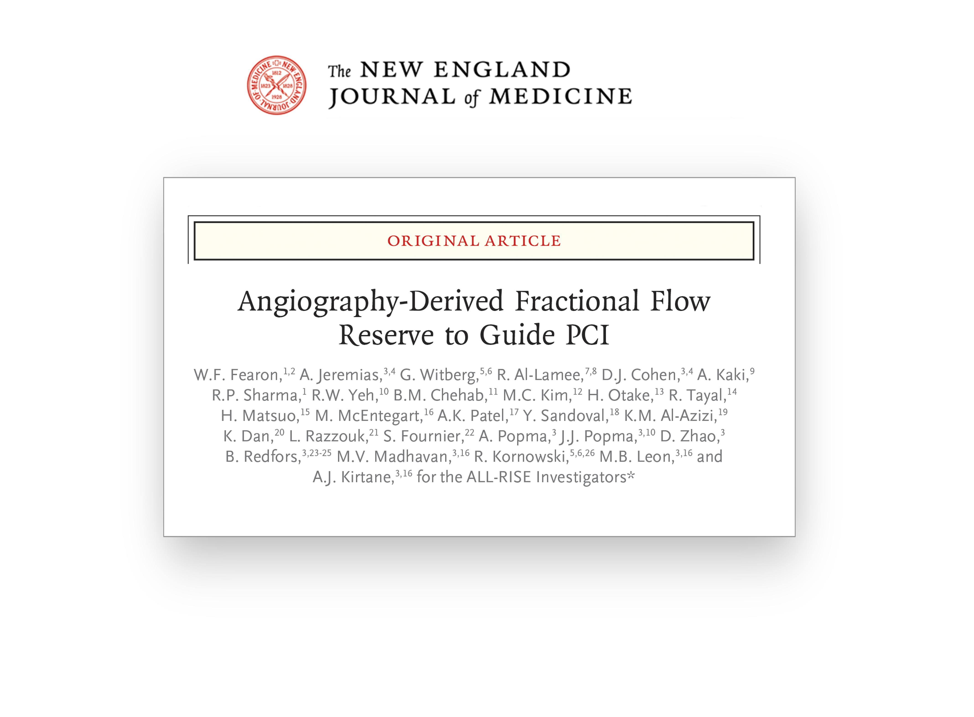


Slide 27


