Slide 1
Top 10 Take Home Messages of the ACC/AHA/Multisociety Dyslipidemia Guideline
Roger S. Blumenthal, MD; Chair
Pamela B. Morris, MD; Vice-Chair

Slide 2



The Jordan & Pippen of Preventive Cardiology – Drs. Grundy & Stone

Slide 3


AHA/ACC Guideline on the Management of Blood Cholesterol
October 28, 2024, Kick-off Meeting
Roger S. Blumenthal, MD; Chair
Pamela B. Morris, MD; Vice-Chair

Slide 4
Rationale: The Simple Version
TIME—>7 years since the ‘18 GL
FDA approval of 3 new non-statin therapies—NOT included in 2018 GL
Bempedoic acid, Inclisiran, Evinacumab
Results of CVOT with bempedoic acid in patients with statin intolerance
ASCVD & High-risk primary prevention
CVOT findings NOT available at time of ‘22 ACC ECDP on Non-statin Therapies
Availability of new improved risk calculator (PREVENT)

Slide 5
Top Take-Home Messages
Treat dyslipidemia earlier to reduce lifelong risk of prolonged exposure to atherogenic lipoproteins. Health behavior counseling to support lifestyle optimization should start in youth, with early consideration of pharmacoRx in youth with familial hypercholesterolemia (FH) & in young adulthood in individuals with low-density lipoprotein-cholesterol (LDL-C) ≥160 mg/dL or a strong family history of premature ASCVD.

Slide 6
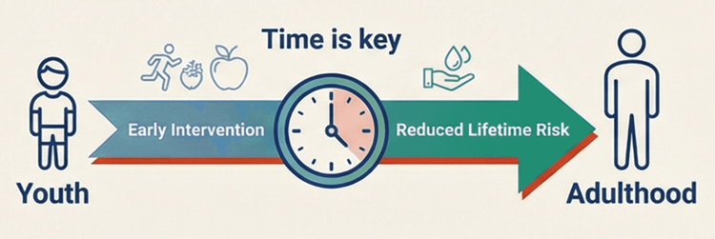

Start Earlier: Reduce Lifetime Exposure to LDL-C
1
Start Statin Therapy for:
All Adults with HeFH
Age ≥30:
LDL-C ≥160 mg/dL OR
Strong family history of premature ASCVD OR
High 30-year risk of ASCVD
Treat these groups early even if 10y risk is low to prevent long-term exposure to high LDL-C
Notes:
Begin health behavior counseling in youth

Slide 7
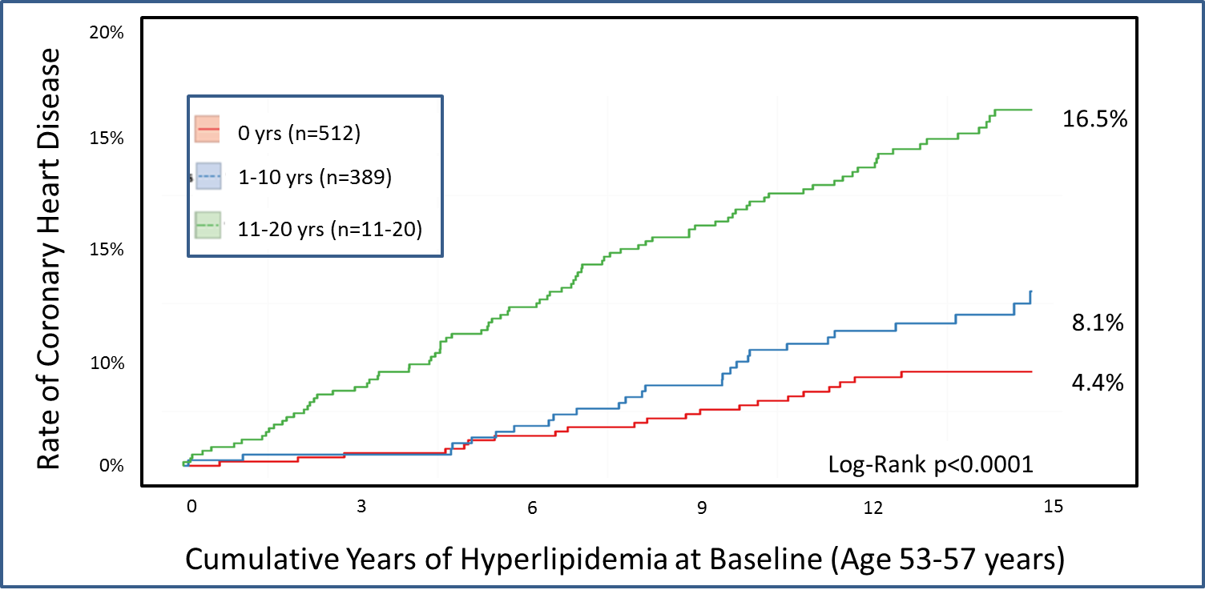
Prolonged Exposure to High Cholesterol Increases Heart Disease Risk (Framingham Offspring)
Navar AM, Peterson ED et al. Circulation. 2015
Notes:
Framingham Offspring Cohort data to identify adults without incident CVD up to ~55 years of age (n=1478); explored association between duration of moderate hyperlipidemia (non-HDL-C≥160 mg/dL) in early adulthood & subsequent CHD.
Relationship between duration of exposure to elevated LDL-C (“hyperlipidemia”) by age 55 & cumulative risk of developing CHD.
Red Line (0 years of hyperlipidemia): Lowest risk (≈4.4%)
Blue Line (1–10 years of hyperlipidemia): Intermediate risk (≈8.1%)
Green Line (11–20 years of hyperlipidemia): Highest risk (≈16.5%)
The figure demonstrates a dose–response relationship between cumulative duration of elevated LDL-C and CHD risk.

Slide 8
Top Take-Home Messages
Use more contemporary AHA Predicting Risk of CVD EVENTs (PREVENT™) equations instead of older Pooled Cohort Equations (PCE) for 10- and 30-yr risk assessment to guide lipid-lowering therapy (LLT) in primary prevention in adults aged 30 to 79 yrs. Use the “CPR” Model: A) Calculate 10-year ASCVD risk; B) Personalize estimated risk to specific patient by considering factors not included in PREVENT-ASCVD equations; & C) possibly Reclassify with selective use of coronary artery calcium (CAC) & Reassess Rx recommendations.

Slide 9
Use PREVENT-ASCVD for Risk Assessment
2a
Calculate Risk (if no ASCVD or FH)
10-yr ASCVD risk if age 30-79
30-yr ASCVD risk if age 30-59
Personalize risk assessment
Evaluate Risk Enhancers
CAC if intermediate risk or LLT decision uncertain
Reassess need for LLT
PCE risk estimates were known to over-estimate 10-year risk. PREVENT-ASCVD 10-y risk estimates are generally lower than PCE results. Approximate equivalent ranges for PCE and PREVENT ASCVD are shown here:
10-yr risk Category | PCE | PREVENT ASCVD
Low | <5% | <3%
Borderline | 5-<7.5% | 3-<5%
Intermediate | 7.5-<20% | 5-<10%
High | ≥20% | >10%

Slide 10
ASCVD Risk Enhancers to Guide
Primary Prevention Risk Assessment
2b
ASCVD Risk Enhancers
Demographic, Genetic and Family History | Family history of premature ASCVD Sibling or parent <55y if M, <65y if F
 | Higher risk ancestry South Asian, Filipino
 | High polygenic risk
Clinical Conditions that Increase ASCVD Risk | Chronic inflammatory diseases Systemic lupus, inflammatory arthritis, psoriasis
 | CKM Syndrome
 | Reproductive risk markers Early menopause (<45 y), preeclampsia, gestational DM
Biomarkers | hsCRP ≥2 mg/L on >1 measurement
 | Elevated TGs ≥150 mg/dL fasting, ≥175 mg/dL nonfasting
 | Persistently elevated LDL-C (≥160 mg/dL) , non-HDL-C (≥190 mg/dL) or ApoB (≥120 mg/dL)
 | Lp(a) ≥125 nmol/L or ≥50 mg/dL
If present, risk enhancers favor statin therapy in borderline to intermediate risk individuals (10-year ASCVD risk 3-<10%)

Slide 11
Top Take-Home Messages
LDL-lowering Rx can be considered in adults for primary prevention of ASCVD with a 10-yr PREVENT-ASCVD risk estimate of 3% to <5% (borderline risk) & should be considered for those at 5% to <10% (intermediate risk) 10-year risk after a clinician–patient discussion.

Slide 12
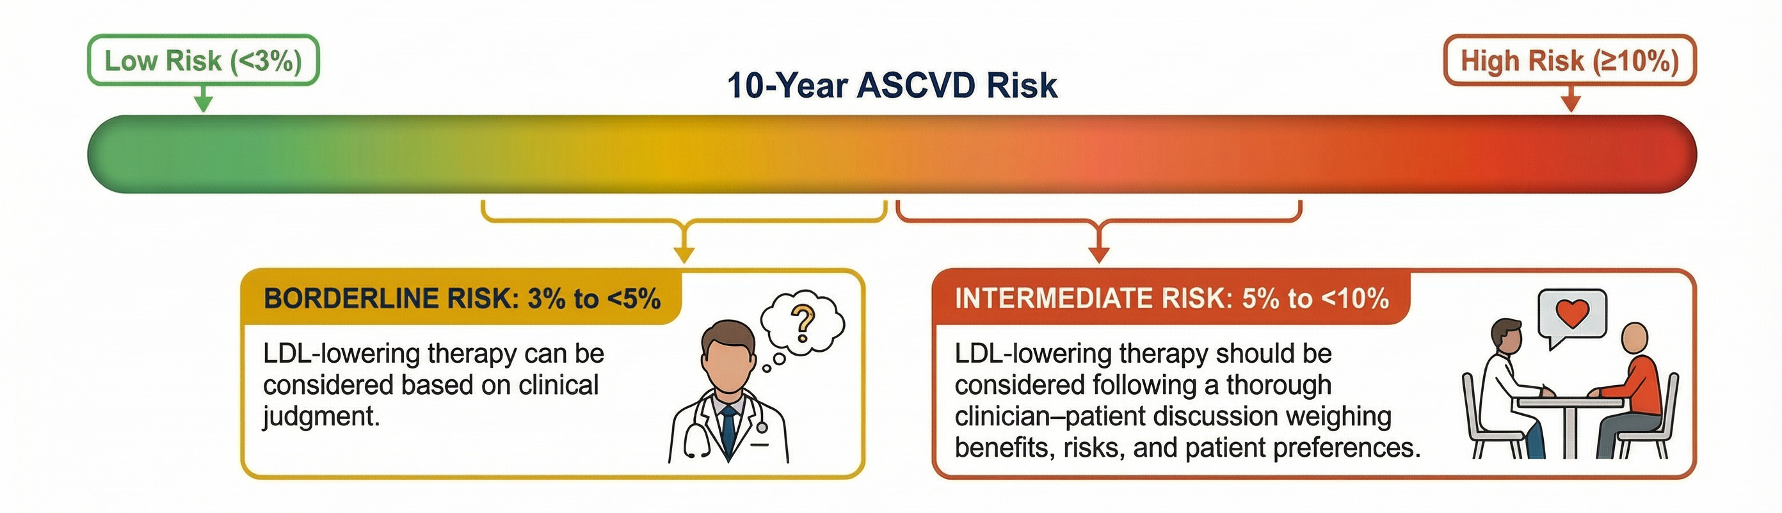
LDL-Lowering in Primary Prevention: Risk-Guided Decision Making
3
Based on 10-Year PREVENT-ASCVD Risk Estimates

Slide 13
Top Take-Home Messages
LDL-C & non–HDL-C Rx goals are back to guide LLT. Percentage reduction in LDL-C remains a priority for all individuals as well, with goal for % reduction depending on the level of ASCVD risk.

Slide 14
LDL-C & Non-HDL-C Goals are Back + ApoB Goals are Included
4/5
 | Patient Examples | LDL-C mg/dL | Non-HDL-C mg/dL | ApoB mg/dL
Borderline to Intermediate Risk | 3-<5% or 5-<10% 10y ASCVD Risk <3% 10y ASCVD risk + (LDL-C ≥160 mg/dL or Fam Hx or 30y risk ≥10%) T2DM without ASCVD or Risk Factors CAC 1-99 or mild incidental CAC | <100 | <130 | <90
High Risk | >10% 10-yr ASCVD Risk T2DM + Risk Factors HeFH without ASCVD CAC ≥100 – 999 AU Moderate to severe incidental CAC | <70 | <100 | <70
Very High Risk | ASCVD (optional if not very-high risk) CAC ≥1000 AU (optional if ≥300 AU) | <55 | <85 | <55
Notes:
Friedewald LDL-C formula replaced by an updated calculator for LDL-C: (Martin/Hopkins or Sampson/NIH)

Slide 15
Top Take-Home Messages
Apolipoprotein B (ApoB) testing can be useful to improve risk assessment & guide Rx once LDL-C & non–HDL-C goals are met, particularly in those with elevated triglycerides (TG) (>200 mg/dL), diabetes, or low achieved LDL-C (<70 mg/dL). ApoB measurement helps identify adults with residual elevated lipoprotein-related risk that may be underestimated by standard lipid profile alone & may be useful in the diagnosis of specific lipid & lipoprotein disorders.

Slide 16
Use ApoB to Assess
Residual Lipid-Related Risk
5
Consider ApoB when
LDL-C & non-HDL-C goals are met, especially in patients with:
Cardiovascular-Kidney-Metabolic syndrome
Diabetes
TG ≥200 mg/dL
If ApoB above goal, Rx should be intensified
About ApoB:
All atherogenic lipoproteins have a single apoB100 protein. ApoB reflects the total # of atherogenic lipoproteins. ApoB is not affected by fasting.

Slide 17
Top Take-Home Messages
Lipoprotein(a) [Lp(a)] should be measured at least once to identify those individuals at higher risk of ASCVD. It is a risk-enhancer at levels ≥125 nmol/L (50 mg/dL), which is associated with about a 1.4-fold increased ASCVD risk, & values ≥250 nmol/L (100 mg/dL) are associated with ≥2-fold higher estimated risk. The presence of elevated Lp(a) should be an indication for more intensified LDL-C lowering & management of other risk factors.

Slide 18
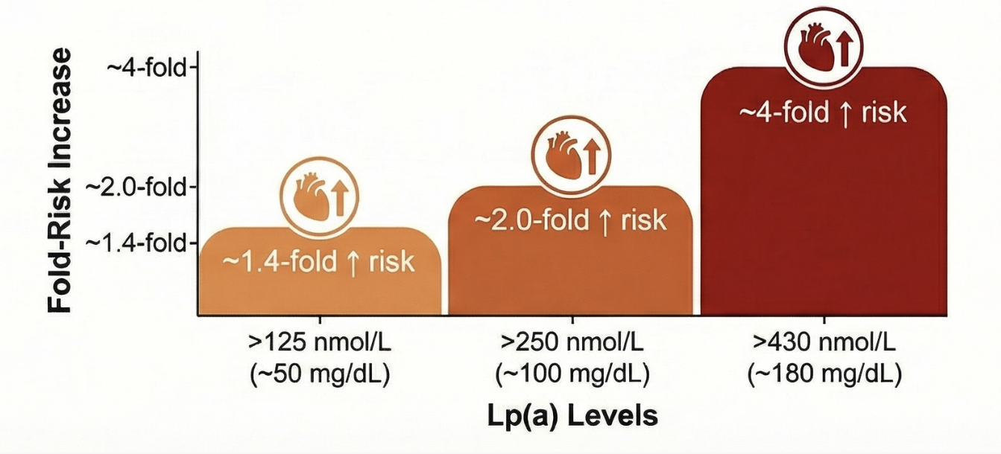
6
Measure Lp(a) Once in All Adults
Increased ASCVD Risk By Lp(a) Levels
About Lp(a):
Lp(a) particles consist of an LDL particle bound to an apo(a) protein. Lp(a) levels largely genetically determined & mostly stable over a lifetime. Repeat testing generally not needed.
If Lp(a) is elevated, LDL-C lowering should be intensified and other ASCVD risk factors aggressively controlled

Slide 19
Top Take-Home Messages
Coronary artery calcium (CAC) scoring in men at least 40 yrs of age & women at least 45 yrs of age can improve risk assessment & guide LDL-C + non–HDL-C goals. Both the absolute amount of CAC & the corresponding standardized percentile (based on age, sex, & race) have prognostic importance & help to reclassify risk in adults.

Slide 20
CAC Score Guided Rx of
Subclinical Atherosclerosis
7
0 AU
1-99 AU or 75th %ile
100-299 AU
300-999 AU
1000 AU
CAC Scoring Recommended if Borderline (3-<5%) or intermediate (5-<10%) 10y ASCVD Risk in Men ≥40, Women ≥45 y.o.
LDL-C goal <70 mg/dL, optional <55 mg/dL
LDL-C goal <55 mg/dL
LDL-C goal <70 mg/dL
LDL-C goal <100 mg/dL
Incidental CAC on a nongated CT scan can also be used to guide therapy. If mild, LDL-C goal <100 mg/dL. If moderate or severe, LDL-C goal is <70 mg/dL. Absence of incidental CAC should not be used to defer Rx given the low negative predictive value of nongated scans.
May defer LLT if not high risk: no DM, FH, tobacco use, family history of premature ASCVD, or LDL-C ≥190 mg/dL. Repeat CAC in 3-7 yr.
Notes:
Incidental CAC on a nongated CT scan can also be used to guide therapy. If mild, LDL-C goal <100 mg/dL. If moderate or severe, LDL-C goal is <70 mg/dL. Absence of incidental CAC should not be used to defer therapy given the low negative predictive value of nongated scans; a formal CAC score should be done.

Slide 21
Top Take-Home Messages
LDL-lowering Rx is recommended for primary prevention in adults aged 40 to 75 years with diabetes, chronic kidney disease stage 3 or 4, or human immunodeficiency virus, regardless of LDL-C level. After age 75 yrs, LDL-C–lowering pharmacoRx can be considered in conjunction with lifestyle interventions to reduce ASCVD risk.

Slide 22
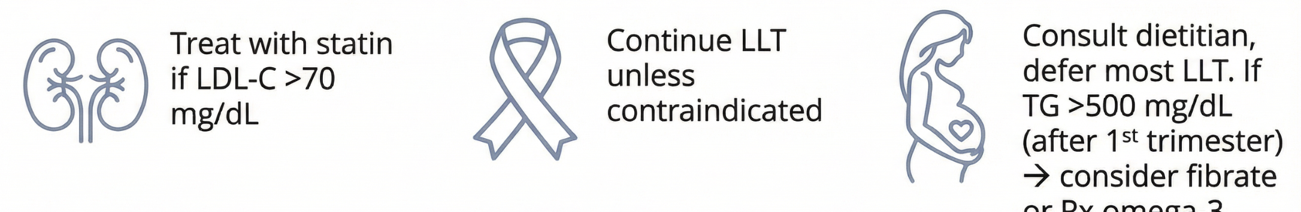

8
Special Considerations in Therapy
Cancer
Pregnancy
CKD
Stage 3-4
All Ages
HIV
Age ≥40
Diabetes
Age ≥40
Consult a dietitian and defer most LLT
If TG are >500 mg/dL (after 1st trimester), consider fibrate
or omega-3 FA
Continue LLT unless contraindicated
Statin Therapy Recommended if LDL-C ≥70 mg/dL

Slide 23
Top Take-Home Messages
In secondary prevention, a goal of LDL-C <55 mg/dL (1.4 mmol/L) & non–HDL-C <85 mg/dL (2.2 mmol/L) is recommended for those at very high risk of ASCVD events. Although a smaller number of patients with ASCVD not at very high risk have an LDL-C goal of at least <70 mg/dL, the majority of those with a history of ASCVD events will likely qualify for an LDL-C goal of <55 mg/dL.

Slide 24

Primary & a half vs. Secondary Prevention
Is there sufficient evidence for a distinction between “ASCVD not at very high risk” & “ASCVD at very high risk”?
Should these categories be collapsed or maintained?
Is there a level of CAC that corresponds to risk c/w established ASCVD?
Inclusion of bempedoic acid & inclisiran in Rx algorithms
Thresholds/goals of Rx—lower? For whom?

Slide 25
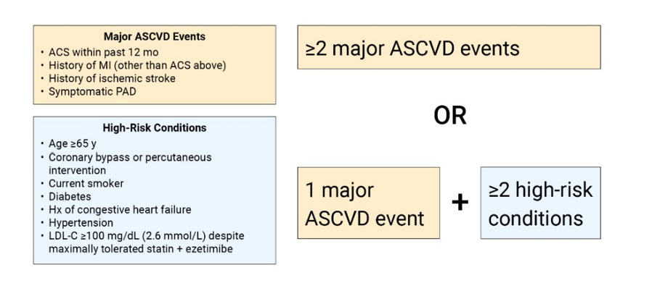
9
Lipid Goals in Established ASCVD
LDL-C <55 mg/dL &
Non-HDL-C <85 mg/dL &
ApoB <55 mg/dL
Very High Risk ASCVD
Optional Goal for Not Very High Risk
LDL-C <70 mg/dL &
Non-HDL-C <100 mg/dL &
ApoB <70 mg/dL
All Other ASCVD
The majority of patients with established ASCVD are Very High Risk
Notes:
<70 mg/dL if clinical ASCVD
<55 mg/dL

Slide 26
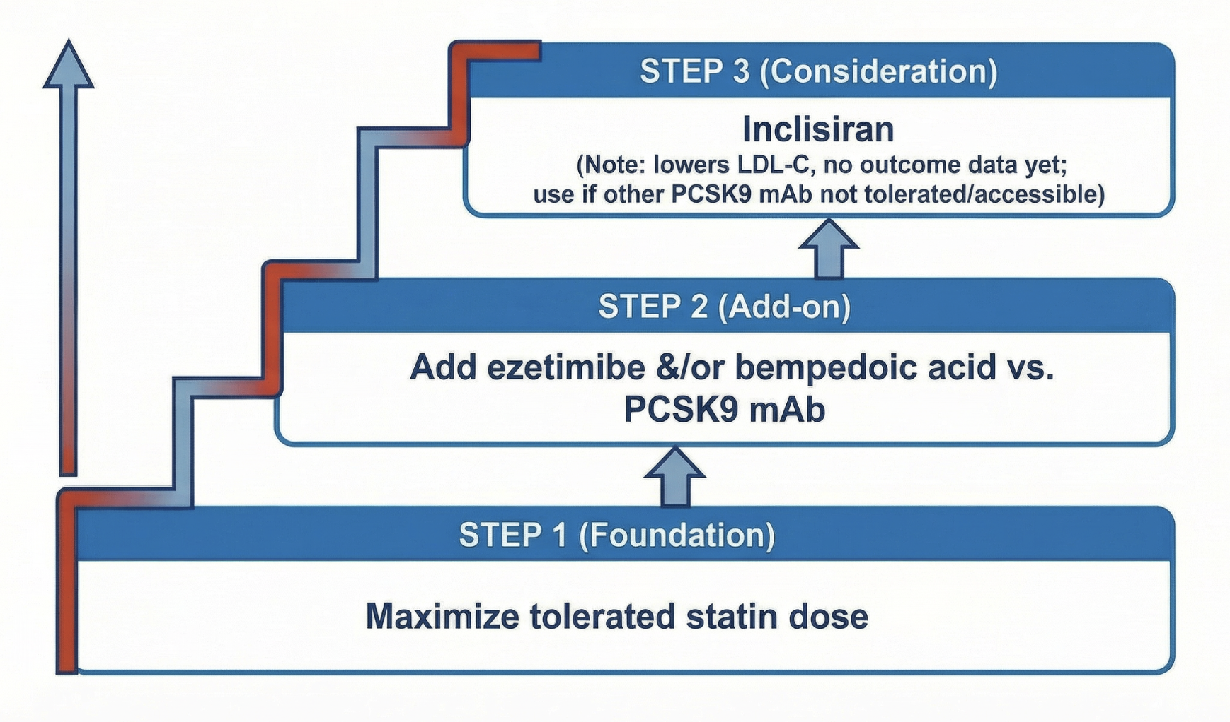
Lipid-Lowering Therapy
Beyond Statins
9

Slide 27
Top Take-Home Messages
In patients with persistently elevated TG, statin therapy remains the foundation of pharmacoRx as an adjunct to lifestyle intervention to reduce ASCVD risk. Treatment for prevention of pancreatitis may also include TG-lowering therapies, especially in individuals with TG levels ≥1000 mg/dL (11.3 mmol/L).

Slide 28
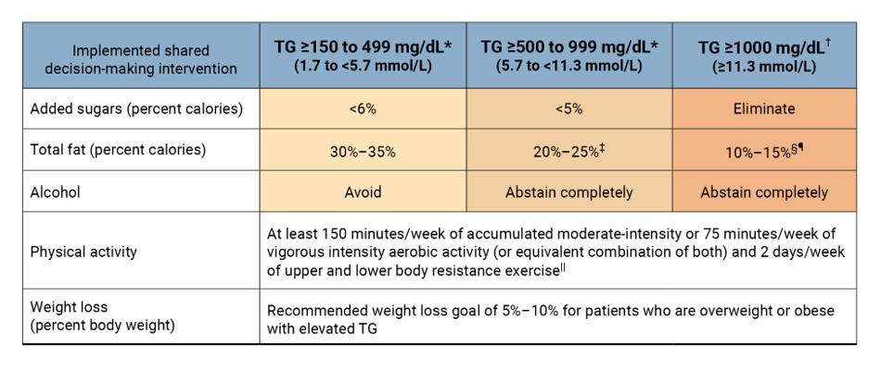
Dietary Interventions for Hypertriglyceridemia
10a
Lifestyle is 1st Line for All With Elevated TGs:
>5% weight loss, >150 min/week moderate intensity activity

Slide 29
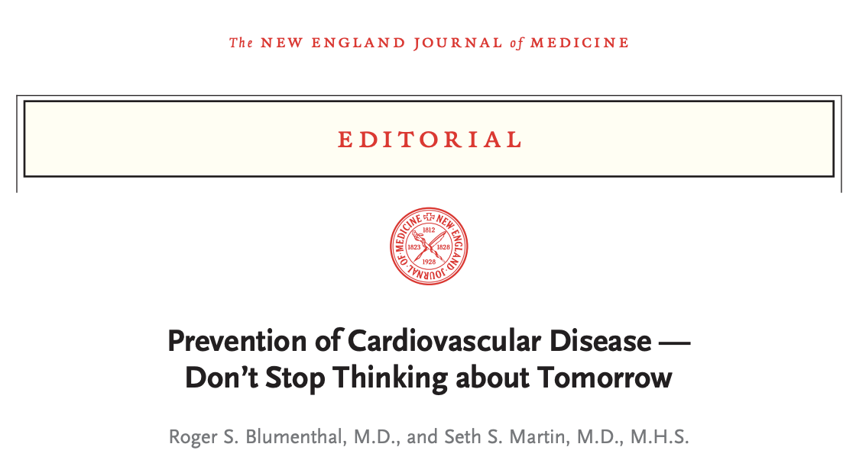





…Clinicians should stress that the best way to avoid CVD is to follow the AHA’s Life’s Essential 8 construct, since tomorrow will soon be here.
Blumenthal RS, Martin SS. Prevention of Cardiovascular Disease - Don't Stop Thinking about Tomorrow. N Engl J Med. 2024 Aug 31.

