Slide 1
Adaptive AI for CV Adjudication: Adjudication Across Different Definitions in the ODYSSEY OUTCOMES and EUCLID Trials
Sreek Vemulapalli, MD
Associate Professor of Medicine with Tenure, Duke University SOM
Director, Cardiovascular Imaging, DUHS
Duke Clinical Research Institute
Duke-Margolis Institute for Health Policy

Slide 2
Disclosures
Grants / Contracts: American College of Cardiology, American Heart Association, Food and Drug Administration, National Institutes of Health (R01 and UG3/UH3), Cytokinetics, Edwards Lifesciences, Abbott
Advisory / Consulting: Edwards Lifesciences, Medtronic, Abbott, Astra Zeneca, Boehringer-Ingelheim, Veralox Therapeutics

Slide 3
Background
Clinical event adjudication is the gold standard for identifying CV events in clinical trials
Costly, time consuming, variable Across CEC Groups
Previous efforts at AI for CEC have:
Derived separate models for each CV event type
No demonstrated ability to adapt to new definitions or endpoints across trials

Slide 4
Objectives
Develop and train an AI algorithm to perform clinical endpoint adjudication that can:
Extend to new endpoints
Extend to new trials
Compare algorithm performance to GPT 4.0 and hybrid adjudication (AI + human)
Re-estimate a trial’s primary endpoint using AI-CEC

Slide 5

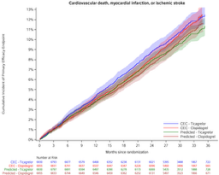




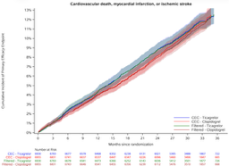



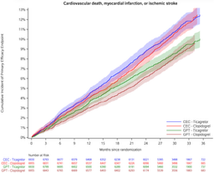

Study Design
DEVELOPMENT PIPELINE
STRATEGY COMPARISON
EUCLID PRIMARY ENDPOINT REPLICATION
Kaplan–Meier cumulative incidence: CV Death, MI, or Ischemic Stroke
TRAINING DATA
ADAPT-CEC
ODYSSEY OUTCOMES
Automated AI adjudication: no human review in the loop
CEC: HR 1.02 (0.93–1.13), p=0.65
ADAPT-CEC
Source trial providing labeled clinical narratives for supervised learning
Trained on:
Predicted: HR 0.98 (0.88–1.09), p=0.74
MI
Stroke
VS
ALGORITHM
ADAPT-CEC Model
Hybrid ADAPT-CEC + Human
CEC: HR 1.02 (0.93–1.13), p=0.65
Model trained on labeled events to classify endpoints
Hybrid ADAPT-CEC + Human
AI pre-screening with expert review on uncertain cases
Hybrid: HR 1.04 (0.94–1.15), p=0.44
VALIDATION · EUCLID
Adjudication of New Events
VS
Applied under new definitions to four endpoint categories
CEC: HR 1.02 (0.93–1.13), p=0.65
GPT-4
GPT-4
MI (new definition)
CV Death (new event)
Large language model zero-shot adjudication
Stroke (new definition)
Bleeding (new event)
GPT-4: HR 1.06 (0.95–1.19), p=0.29
Step 1
Step 2
Step 3

Slide 6
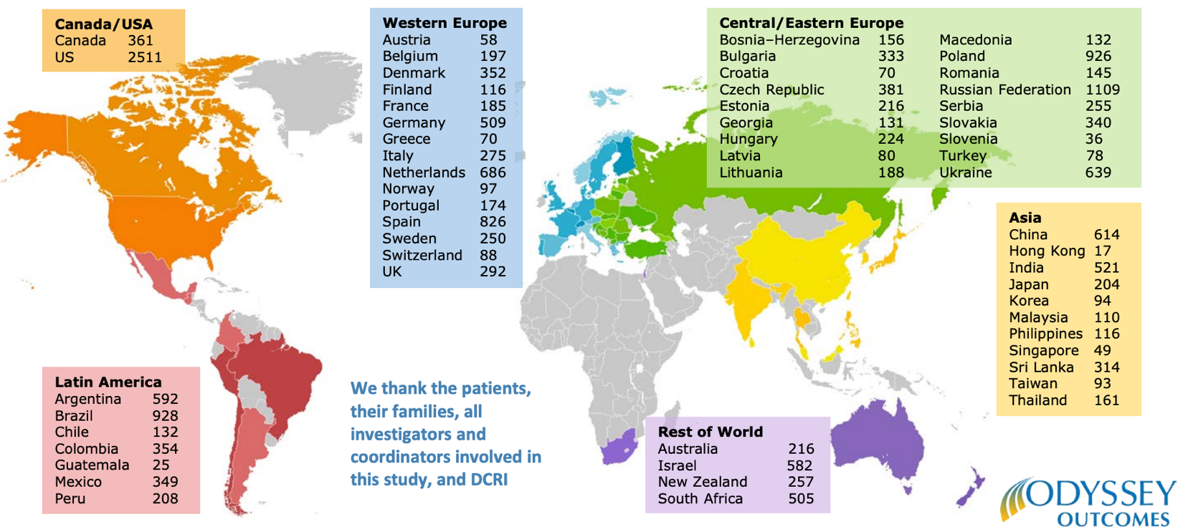
ODYSSEY OUTCOMES
18,924 patients randomized at 1315 sites in 57 countries, Nov 2, 2012-Nov11,2017
Steg et al. ACC 2018

Slide 7
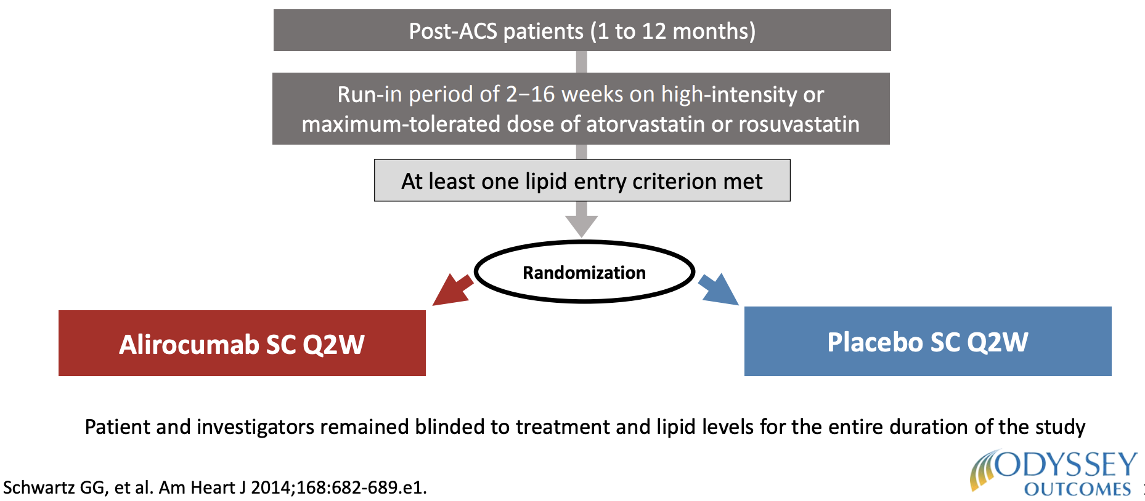
Treatment Assignment
Steg et al. ACC 2018

Slide 8
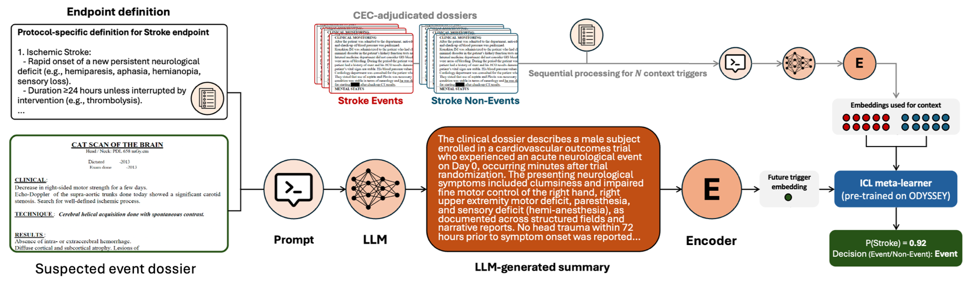
ADAPT-CEC Methods

Slide 9
ADAPT-CEC Methods

Slide 10
ADAPT-CEC Methods

Slide 11
Study Design
DEVELOPMENT PIPELINE
STRATEGY COMPARISON
EUCLID PRIMARY ENDPOINT REPLICATION
Kaplan–Meier cumulative incidence: CV Death, MI, or Ischemic Stroke
TRAINING DATA
ADAPT-CEC
ODYSSEY OUTCOMES
Automated AI adjudication: no human review in the loop
CEC: HR 1.02 (0.93–1.13), p=0.65
ADAPT-CEC
Source trial providing labeled clinical narratives for supervised learning
Trained on:
Predicted: HR 0.98 (0.88–1.09), p=0.74
MI
Stroke
VS
ALGORITHM
ADAPT-CEC Model
Hybrid ADAPT-CEC + Human
CEC: HR 1.02 (0.93–1.13), p=0.65
Model trained on labeled events to classify endpoints
Hybrid ADAPT-CEC + Human
AI pre-screening with expert review on uncertain cases
Hybrid: HR 1.04 (0.94–1.15), p=0.44
VALIDATION · EUCLID
Adjudication of New Events
VS
Applied under new definitions to four endpoint categories
CEC: HR 1.02 (0.93–1.13), p=0.65
GPT-4
GPT-4
MI (new definition)
CV Death (new event)
Large language model zero-shot adjudication
Stroke (new definition)
Bleeding (new event)
GPT-4: HR 1.06 (0.95–1.19), p=0.29
Step 1
Step 2
Step 3

Slide 12
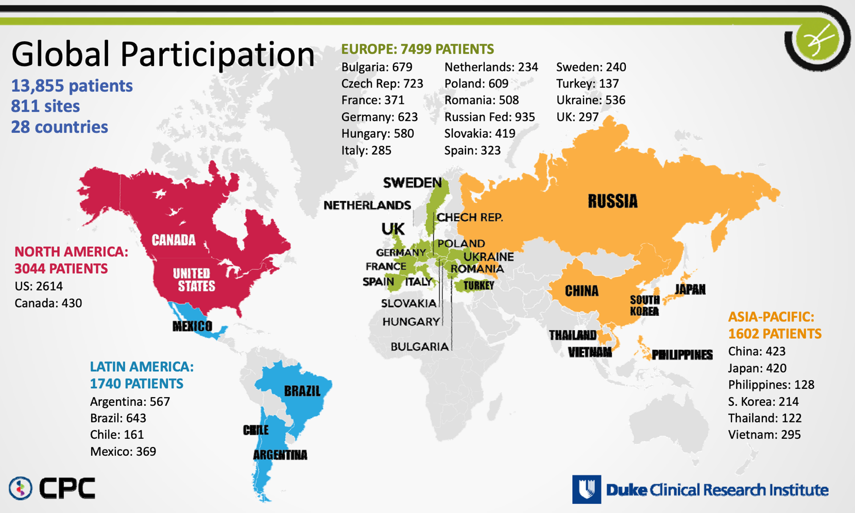
Global Participation
13,855 patients / 811 sites / 28 countries
Patel et al. AHA 2016

Slide 13
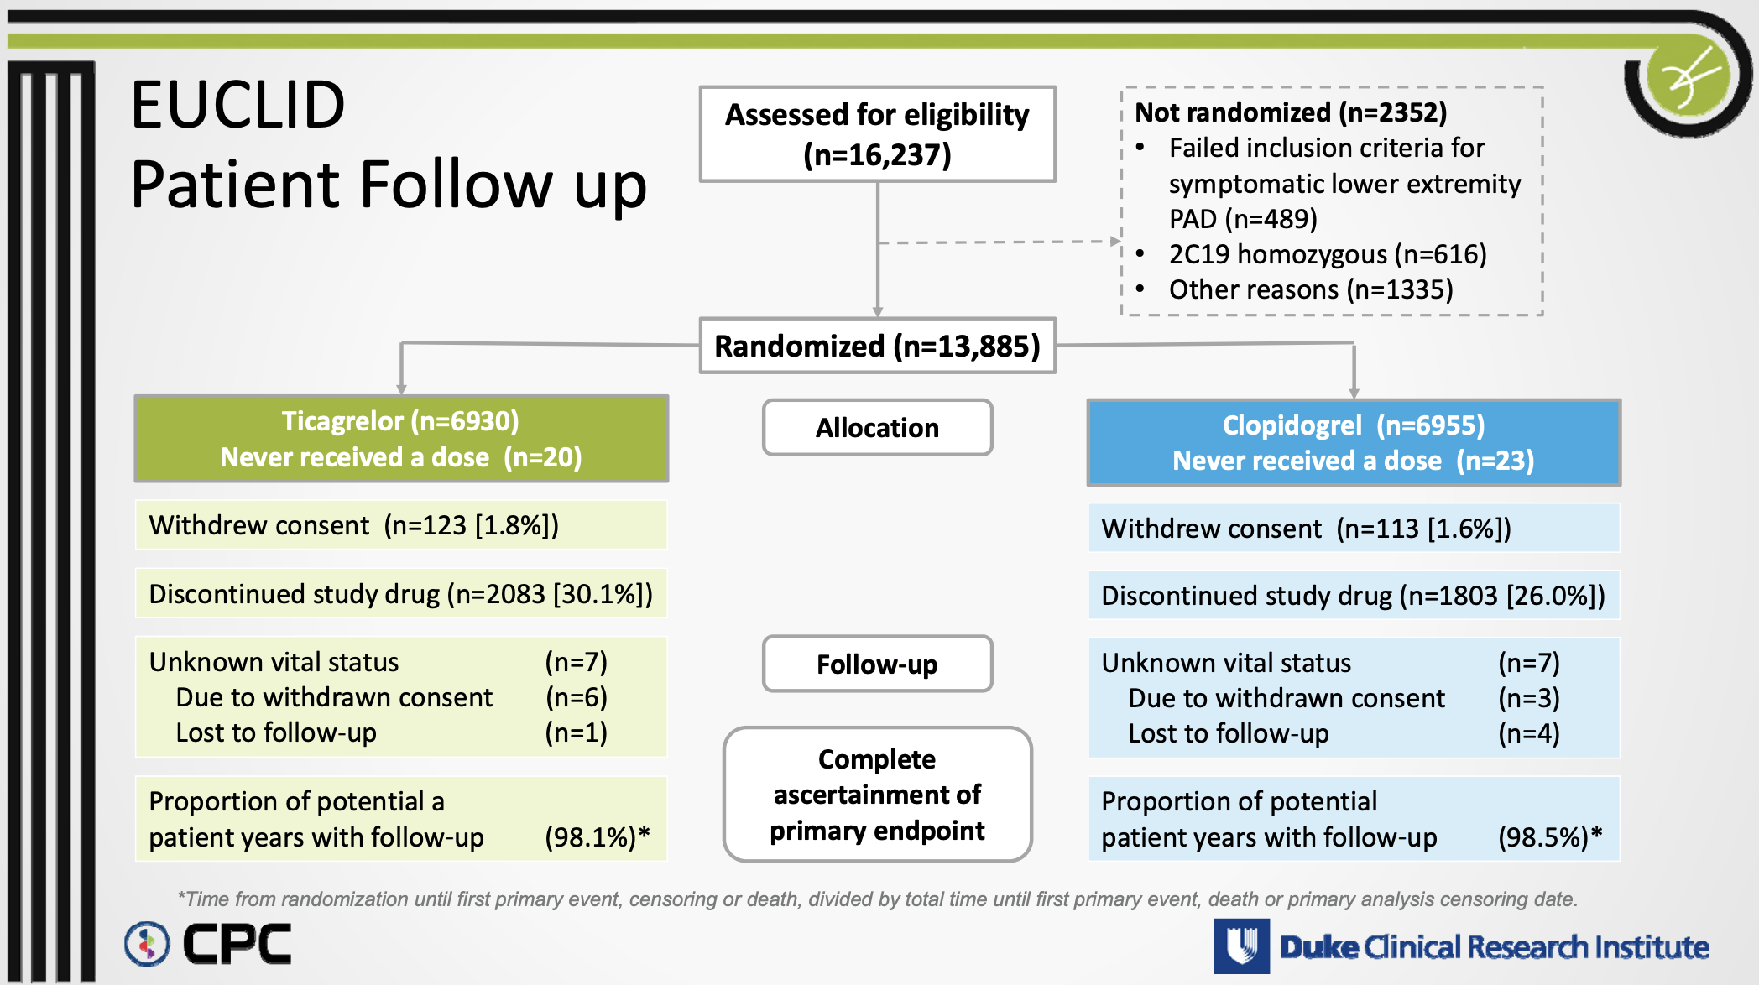
EUCLID
Patient Follow up
Patel et al. AHA 2016

Slide 14
Adaptation to New Definitions / Endpoints

Slide 15
Adaptation to New Definitions / Endpoints

Slide 16
Adaptation to New Definitions / Endpoints

Slide 17
Study Design
DEVELOPMENT PIPELINE
STRATEGY COMPARISON
EUCLID PRIMARY ENDPOINT REPLICATION
Kaplan–Meier cumulative incidence: CV Death, MI, or Ischemic Stroke
TRAINING DATA
ADAPT-CEC
ODYSSEY OUTCOMES
Automated AI adjudication: no human review in the loop
CEC: HR 1.02 (0.93–1.13), p=0.65
ADAPT-CEC
Source trial providing labeled clinical narratives for supervised learning
Trained on:
Predicted: HR 0.98 (0.88–1.09), p=0.74
MI
Stroke
VS
ALGORITHM
ADAPT-CEC Model
Hybrid ADAPT-CEC + Human
CEC: HR 1.02 (0.93–1.13), p=0.65
Model trained on labeled events to classify endpoints
Hybrid ADAPT-CEC + Human
AI pre-screening with expert review on uncertain cases
Hybrid: HR 1.04 (0.94–1.15), p=0.44
VALIDATION · EUCLID
Adjudication of New Events
VS
Applied under new definitions to four endpoint categories
CEC: HR 1.02 (0.93–1.13), p=0.65
GPT-4
GPT-4
MI (new definition)
CV Death (new event)
Large language model zero-shot adjudication
Stroke (new definition)
Bleeding (new event)
GPT-4: HR 1.06 (0.95–1.19), p=0.29
Step 1
Step 2
Step 3

Slide 18
Step 2: ADAPT-CEC in New Definitions in EUCLID
Endpoint | Metric | ADAPT-CEC Adaptive Training Size=20 (95% CI) | Hybrid ADAPT-CEC – Human Adjudication 30% Filtered (95% CI) | GPT4o (95% CI) | p-value (ADAPT vs. GPT)
MI | F1 | 0.731 (0.709–0.752) | 0.795 (0.771-0.818) | 0.697 (0.669–0.725) | 0.031
 | PPV | 0.635 (0.607–0.663) | 0.701 (0.669-0.733) | 0.821 (0.791–0.851) | 0.000
 | TPR | 0.859 (0.836–0.883) | 0.917 (0.894 – 0.983) | 0.606 (0.572–0.639) | 0.000
 | AUC | 0.825 (0.807–0.842)
 | AUPRC | 0.715 (0.678–0.750)
 | ECE | 0.066 (0.050–0.082)
Stroke | F1 | 0.780 (0.745–0.813) | 0.821 (0.783 – 0.857) | 0.812 (0.780–0.842) | 0.048
 | PPV | 0.754 (0.709–0.796) | 0.829 (0.780 – 0.877) | 0.787 (0.745–0.828) | 0.035
 | TPR | 0.809 (0.765–0.849) | 0.812 (0.762 – 0.860) | 0.838 (0.798–0.876) | 0.231
 | AUC | 0.800 (0.764–0.834)
 | AUPRC | 0.793 (0.741–0.843)
 | ECE | 0.083 (0.057–0.111)
Notes:
F1 score balances positive predictive value and sensitivity
ECE = expected calibration error
< 0.01Excellent calibration0.01 – 0.03Very good / well‑calibrated0.03 – 0.05Acceptable, mild miscalibration0.05 – 0.10Poor calibration> 0.10Severe miscalibration

Slide 19
ADAPT-CEC and Type I vs. Type II MI
Endpoint | Metric | ALL MI TYPES vs. No Event | TYPE 1 MI vs. TYPE 2 MI | Difference ALL MI TYPES vs. No Event - TYPE1 vs TYPE2 | p-value
 |  | ADAPT-CEC Ctxt=20 (95% CI) | ADAPT-CEC Ctxt=20 (95% CI)
MI | Accuracy | 0.760 (0.742–0.778) | 0.739 (0.708–0.770) | +0.021 | 0.241
 | F1 | 0.731 (0.709–0.752) | 0.759 (0.725–0.789) | -0.028 | 0.161
 | PPV | 0.635 (0.607–0.663) | 0.819 (0.780–0.856) | -0.184 | 0.000
 | TPR | 0.859 (0.836–0.883) | 0.706 (0.665–0.747) | +0.153 | 0.000
 | AUC | 0.825 (0.807–0.842) | 0.786 (0.752–0.818) | +0.039 | 0.038
 | AUPRC | 0.715 (0.678–0.750) | 0.848 (0.813–0.880) | -0.135 | 0.000
 | ECE | 0.066 (0.050–0.082) | 0.085 (0.067–0.119) | -0.023 | 0.091
Notes:
F1 score balances positive predictive value and sensitivity

Slide 20
Step 2: ADAPT-CEC in New Endpoints in EUCLID
Endpoint | Metric | ADAPT-CEC Adaptive Training Size=20 (95% CI) | Hybrid ADAPT-CEC – Human Adjudication 30% Filtered (95% CI) | GPT4o (95% CI) | p-value (ADAPT vs. GPT)
CV Death | F1 | 0.873 (0.854–0.891) | 0.940 (0.925 – 0.955) | 0.862 (0.842–0.882) | 0.295
 | PPV | 0.891 (0.867–0.913) | 0.931 (0.909 – 0.953) | 0.954 (0.936–0.970) | 0.000
 | TPR | 0.857 (0.830–0.882) | 0.949 (0.929 – 0.967) | 0.787 (0.757–0.817) | 0.000
 | AUC | 0.919 (0.903–0.934)
 | AUPRC | 0.937 (0.920–0.952)
 | ECE | 0.088 (0.071–0.106)
Bleeding | F1 | 0.780 (0.745–0.813) | 0.833 (0.819 – 0.846) | 0.564 (0.546–0.581) | 0.000
 | PPV | 0.754 (0.709–0.796) | 0.951 (0.939 – 0.961) | 0.707 (0.686–0.727) | 0.000
 | TPR | 0.809 (0.765–0.849) | 0.741 (0.721 – 0.760) | 0.468 (0.449–0.487) | 0.000
 | AUC | 0.800 (0.764–0.834)
 | AUPRC | 0.793 (0.741–0.843)
 | ECE | 0.083 (0.057–0.111)

Slide 21
Study Design
DEVELOPMENT PIPELINE
STRATEGY COMPARISON
EUCLID PRIMARY ENDPOINT REPLICATION
Kaplan–Meier cumulative incidence: CV Death, MI, or Ischemic Stroke
TRAINING DATA
ADAPT-CEC
ODYSSEY OUTCOMES
Automated AI adjudication: no human review in the loop
CEC: HR 1.02 (0.93–1.13), p=0.65
ADAPT-CEC
Source trial providing labeled clinical narratives for supervised learning
Trained on:
Predicted: HR 0.98 (0.88–1.09), p=0.74
MI
Stroke
VS
ALGORITHM
ADAPT-CEC Model
Hybrid ADAPT-CEC + Human
CEC: HR 1.02 (0.93–1.13), p=0.65
Model trained on labeled events to classify endpoints
Hybrid ADAPT-CEC + Human
AI pre-screening with expert review on uncertain cases
Hybrid: HR 1.04 (0.94–1.15), p=0.44
VALIDATION · EUCLID
Adjudication of New Events
VS
Applied under new definitions to four endpoint categories
CEC: HR 1.02 (0.93–1.13), p=0.65
GPT-4
GPT-4
MI (new definition)
CV Death (new event)
Large language model zero-shot adjudication
Stroke (new definition)
Bleeding (new event)
GPT-4: HR 1.06 (0.95–1.19), p=0.29
Step 1
Step 2
Step 3

Slide 22
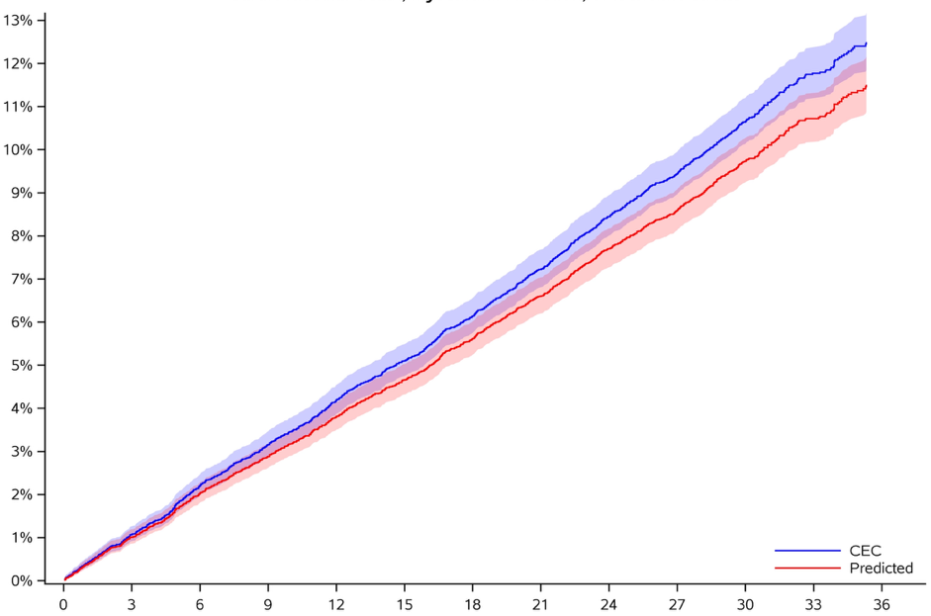
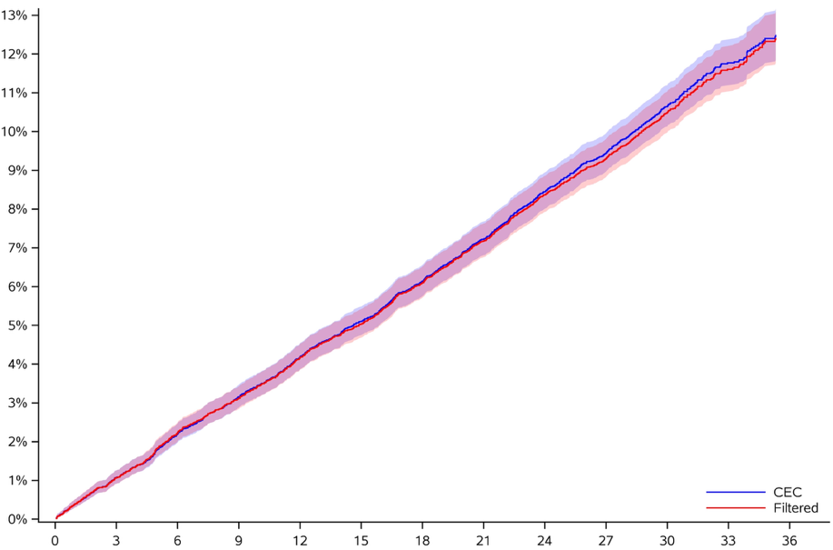
Step 3: EUCLID 1º Endpoint Cumulative Incidence
Months Since Randomization
CV Death, MI, Stroke
CEC
ADAPT-CEC
CEC
ADAPT-CEC
13885
13885
13624
13630
13418
13435
13216
13243
13005
13043
12799
12849
12585
12640
12357
12425
12117
12200
10855
10932
6984
7035
3714
3754
1387
1399
13885
13885
13624
13624
13418
13421
13216
13227
13005
13014
12799
12821
12585
12608
12357
12382
12117
12148
10855
10888
6984
7011
3714
3734
1387
1394
ADAPT-CEC
HYBRID

Slide 23
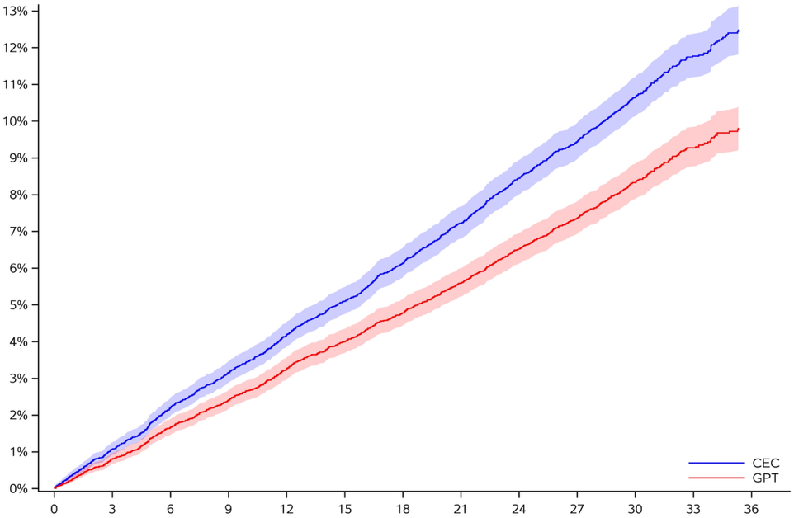
Step 3: EUCLID 1º Endpoint Cumulative Incidence
Months Since Randomization
CV Death, MI, Stroke
CEC
ADAPT-CEC
CEC
GPT
13885
13885
13624
13630
13418
13435
13216
13243
13005
13043
12799
12849
12585
12640
12357
12425
12117
12200
10855
10932
6984
7035
3714
3754
1387
1399
13885
13885
13624
13642
13418
13460
13216
13271
13005
13077
12799
12883
12585
12691
12357
12484
12117
12268
10855
10999
6984
7088
3714
3783
1387
1420
ADAPT-CEC
GPT

Slide 24
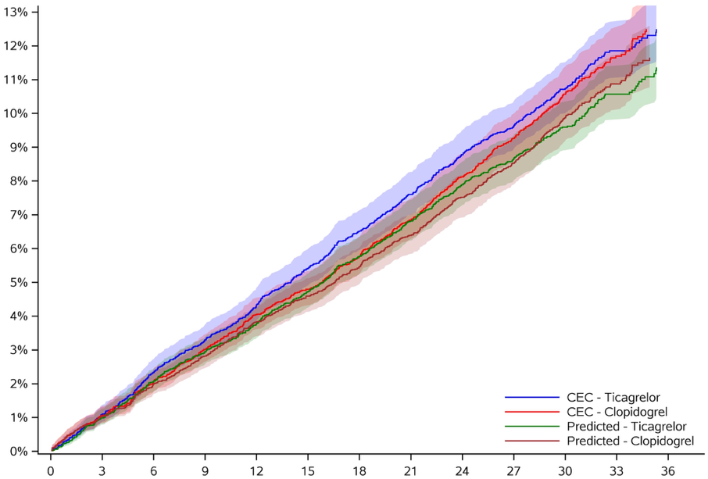
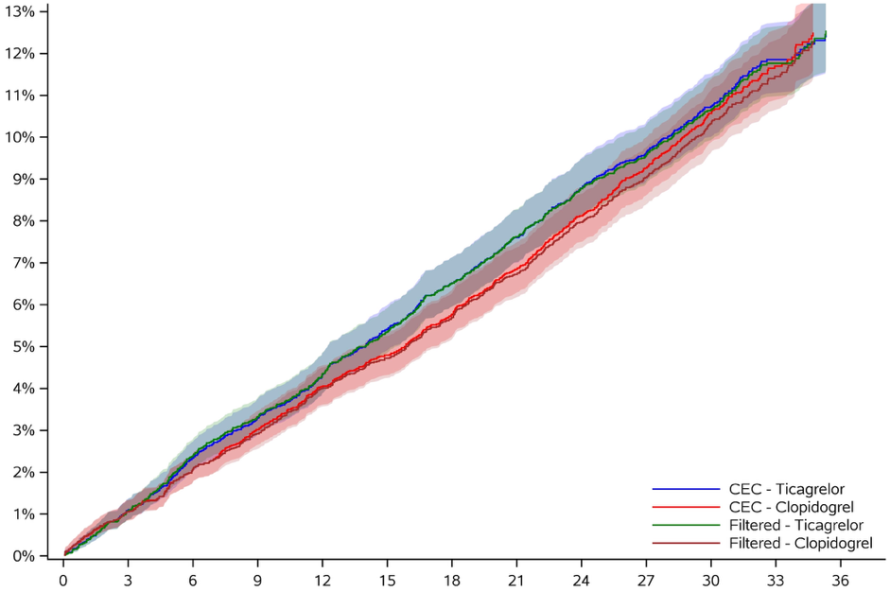
Step 3: EUCLID 1º Endpoint Treatment Effect
Months Since Randomization
CEC: HR 1.02 (0.93–1.13), p=0.65
CEC: HR 1.02 (0.93–1.13), p=0.65
CV Death, MI, Stroke
ADAPT-CEC: HR 0.98 (0.88–1.09), p=0.74
Hybrid: HR 1.04 (0.94–1.15), p=0.44
CEC – Ticagrelor
CEC – Clopidogrel
ADAPT-CEC – Ticagrelor
ADAPT-CEC - Clopidogrel
CEC – Ticagrelor
CEC – Clopidogrel
Hybrid – Ticagrelor
Hybrid - Clopidogrel
6930
6955
6930
6955
6793
6831
6797
6833
6677
6741
6691
6744
6579
6637
6594
6649
6468
6537
6497
6546
6352
6447
6390
6459
6238
6347
6278
6362
6131
6226
6173
6252
6021
6096
6069
6131
5395
5460
5435
5497
3488
3496
3512
3523
1867
1847
1888
1866
722
665
728
671
6930
6955
6930
6955
6793
6831
6793
6831
6677
6741
6678
6743
6579
6637
6581
6646
6468
6537
6473
6541
6352
6447
6366
6455
6238
6347
6252
6356
6131
6226
6143
6239
6021
6096
6036
6112
5395
5460
5412
5476
3488
3496
3501
3510
1867
1847
1877
1857
722
665
726
668
ADAPT-CEC
HYBRID

Slide 25
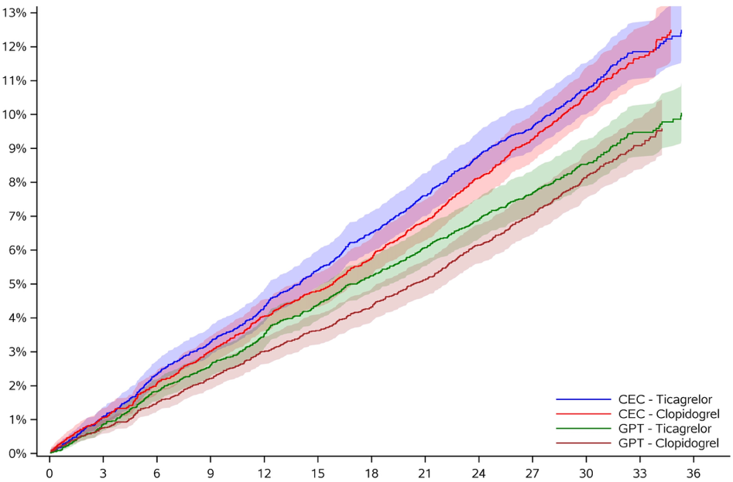
EUCLID 1º Endpoint Treatment Effect
Months Since Randomization
CEC: HR 1.02 (0.93–1.13), p=0.65
CEC: HR 1.02 (0.93–1.13), p=0.65
CV Death, MI, Stroke
ADAPT-CEC: HR 0.98 (0.88–1.09), p=0.74
GPT-4: HR 1.06 (0.95–1.19), p=0.29
CEC – Ticagrelor
CEC – Clopidogrel
ADAPT-CEC – Ticagrelor
ADAPT-CEC - Clopidogrel
CEC – Ticagrelor
CEC – Clopidogrel
GPT – Ticagrelor
GPT - Clopidogrel
6930
6955
6930
6955
6793
6831
6797
6833
6677
6741
6691
6744
6579
6637
6594
6649
6468
6537
6497
6546
6352
6447
6390
6459
6238
6347
6278
6362
6131
6226
6173
6252
6021
6096
6069
6131
5395
5460
5435
5497
3488
3496
3512
3523
1867
1847
1888
1866
722
665
728
671
6930
6955
6930
6955
6793
6831
6799
6843
6677
6741
6695
6765
6579
6637
6602
6669
6468
6537
6500
6577
6352
6447
6390
6493
6238
6347
6289
6402
6131
6226
6191
6293
6021
6096
6094
6174
5395
5460
5460
5539
3488
3496
3532
3556
1867
1847
1900
1883
722
665
737
683
ADAPT-CEC
GPT

Slide 26
Limitations
Further work will be needed to validate ADAPT-CEC on other endpoints
2. ADAPT-CEC uses an LLM to summarize an event dossier, making it susceptible to changes in the underlying LLM
3. Performance across event types was not uniform
Training and Validation performed on adjudications at a single ARO
5. Analyses were retrospective and prospective assessment of AI-CEC will be needed

Slide 27
Conclusions
A single AI algorithm trained on a single trial can, after brief adaptation:
identify the same events with a new definition
Identify new events
Validated in the EUCLID Trial
ADAPT-CEC alone or as a hybrid strategy with human adjudication reproduced the EUCLID primary endpoint and effect size
Further prospective studies are needed to determine how adaptive AI adjudication can be implemented in future trials.

Slide 28



Adaptive AI for Cardiovascular Event Adjudication: Cardiovascular Event Adjudication Across Different Definitions in the ODYSSEY OUTCOMES and EUCLID Trials
Sreekanth Vemulapalli, Karla Pena Guerra, Daniel Wojdyla, W. Schuyler Jones, Kenneth W. Mahaffey, Robert A. Harrington, Philippe Gabriel Steg, Gregory G. Schwartz, Manesh R. Patel, Renato D. Lopes and Ricardo Henao
CIRCULATION. 2026; [PUBLISHED ONLINE AHEAD OF PRINT]. DOI: 10.1161/CIRCULATIONAHA.126.080072

Slide 29
STEP 3: 1º EUCLID Endpoint Components
Model / Outcome | Events |  | Non-Events |  | Percent |  | Sens | Spec | PPV |  | NPV
 | Right | Wrong | Right | Wrong | Right | Wrong
ADAPT-CEC
CV death | 575 | 131 | 13114 | 65 | 98.6 | 1.4 | 81.4 | 99.5 | 89.8 |  | 99.0
MI | 564 | 119 | 13138 | 64 | 98.7 | 1.3 | 82.6 | 99.5 | 89.8 |  | 99.1
Stroke | 266 | 34 | 13553 | 32 | 99.5 | 0.5 | 88.7 | 99.8 | 89.3 |  | 99.7
Hybrid ADAPT-CEC and Human Adjudication
CV death | 680 | 26 | 13141 | 38 | 99.5 | 0.5 | 96.3 | 99.7 |  | 94.7 | 99.8
MI | 655 | 28 | 13158 | 44 | 99.5 | 0.5 | 95.9 | 99.7 |  | 93.7 | 99.8
Stroke | 272 | 28 | 13569 | 16 | 99.7 | 0.3 | 90.7 | 99.9 |  | 94.4 | 99.8
GPT 4.0
CV death | 556 | 150 | 13150 | 29 | 98.7 | 1.3 | 78.8 | 99.8 |  | 95.0 | 98.9
MI | 444 | 239 | 13176 | 26 | 98.1 | 1.9 | 65.0 | 99.8 |  | 94.5 | 98.2
Stroke | 251 | 49 | 13555 | 30 | 99.4 | 0.6 | 83.7 | 99.8 |  | 89.3 | 99.6

