Slide 1
LONG-TERM SURVIVAL BENEFITS AND DISEASE STABILIZATION WITH ACORAMIDIS IN PATIENTS WITH TRANSTHYRETIN AMYLOID CARDIOMYOPATHY (ATTR-CM)
Prem Soman, Julian D. Gillmore, Hugh Goodman, Francesco Cappelli, Lily K. Stern, Martha Grogan, Laura Obici, Kunal Bhatt, Sarah A. M. Cuddy, Kuangnan Xiong, Xiaofan Cao, Maria Lucia Pecoraro, Leonid Katz, Jonathan C. Fox, Keyur Shah, Justin L. Grodin, Kevin M. Alexander, and Richard K. Cheng
Presenter: Prem Soman, University of Pittsburgh Medical Center, Pittsburgh, PA, USA
Acknowledgments
The authors would like to thank the patients who participated in the ATTRibute-CM trial and its open-label extension, their families, and their caregivers
The authors would also like to thank the ATTRibute-CM investigators and study center staff
Under the guidance of the authors, medical writing assistance was provided by Oxford PharmaGenesis, which was funded by BridgeBio Pharma, Inc. Editorial support and critical review were provided by Dana Walters, PhD, and Shweta Rane, PhD, CMPP, BCMAS, of BridgeBio Pharma, Inc.
Presented on March 30, at the American College of Cardiology (ACC) 75th Annual Scientific Session & Expo, March 28–30, 2026, New Orleans, LA, USA

Slide 2
INTRODUCTION
ATTR-CM is characterized by destabilization of TTR and aggregation of amyloid fibrils in the heart, leading to progressive heart failure, impaired quality of life, CV hospitalizations, and death^{1,2}
Acoramidis, an oral TTR stabilizer that achieves near-complete (≥ 90%) TTR stabilization, is approved in the USA, Europe, Japan, and the UK for the treatment of ATTR-CM³
In the phase 3 ATTRibute-CMª study, acoramidis treatment reduced the risk of ACM or first CVH versus placebo at Month 30, with evidence of an effect observed as early as Month 3^{4,5}
The clinical benefit of acoramidis was sustained through Month 42 (OLE^{b} Month 12), resulting in a 36% and 45% risk reduction^{c} in ACM and CVM respectively.^{6,7}
OBJECTIVE:
Assess long-term efficacy and safety of acoramidis through Month 54 of ATTRibute-CM and OLE
ªClinical trial number: NCT03860935. ^{b}Clinical trial number: NCT04988386. ^{c}Risk reduction was calculated as 1 − HR, where the HR was estimated using a stratified Cox proportional hazards model, and is expressed as a percentage.
ACM, all-cause mortality; ATTR-CM, transthyretin amyloid cardiomyopathy; CVH, cardiovascular hospitalization; CVM, cardiovascular-related mortality; HR, hazard ratio; NT-proBNP, N-terminal pro-B-type natriuretic peptide; OLE, open-label extension; TTR, transthyretin.
1. Ruberg FL, et al. JAMA. 2024;331(9):778-791; 2. Lane T, et al. Circulation. 2019;140(1):16-26. 3. Judge DP, et al. J Am Coll Cardiol. 2019;74(3):285-295; 4. BridgeBio Pharma, Inc. Prescribing Information, Attruby (acoramidis). FDA, 2024. Accessed January 12, 2026. www.accessdata.fda.gov/drugsatfda_docs/label/2024/216540s000lbl.pdf; 4. Gillmore JD, et al. N Eng J Med. 2024;390(2):132-142; 5. Judge DP, et al. J Am Coll Cardiol. 2025;85(10):1003-1014. 6. Judge DP, et al. Circulation. 2025;151(9):601-611. 7. Masri A, et al. J Am Coll Cardiol. 2025;7(3):282-293.

Slide 3
PRESPECIFIED OUTCOME ANALYSIS OF ATTRibute-CM AND ITS OPEN-LABEL EXTENSION (OLE)
ATTRibute-CM (30 Months)
OLE
Analysis Through Month 54
Time to ACM
Time to CVM
Change from baseline in NT-proBNP and sTTR
Safety
Completed Month 30 and invited to enroll in the OLE (n = 438)
89% met eligibility criteria and elected to enroll in the OLE (n = 389)
800 mg acoramidis HCl BID
n = 421
800 mg acoramidis HCl BID
Start of OLEª (n = 263)
Continuous acoramidis (M54 treatment ongoing: n = 221)​
2
Randomization
R
Placebo BID
n = 211
800 mg acoramidis HCl BID
Start of OLEª (n = 126)
Placebo-to- acoramidis​ (M54 treatment ongoing: n = 72)
1
ACM and CVM events were adjudicated by an independent data monitoring committee^{b}
Tafamidis usage allowed after Month 12
I: 12.5%
II: 70.4%
Concomitant tafamidis usage not allowed in the OLE
Month:
0
30
42
54
RCT primary endpoint
ªThe FAS included the mITT population in ATTRibute-CM, which was defined as all participants who were randomized to acoramidis or placebo, received at least one dose of acoramidis or placebo, had at least one efficacy evaluation after baseline, and had a baseline estimated glomerular filtration rate of ≥ 30 mL/min/1.73 m². ^{b}Adjudicated by an independent and blinded clinical events committee who were unaware of prior treatment assignment when adjudicating events occurring before and after ATTRibute-CM unblinding. ACM, all-cause mortality; BID, twice daily; CVM, cardiovascular-related mortality; FAS, full analysis set; mITT, modified intention-to-treat; NT-proBNP, N-terminal pro-B-type natriuretic peptide; OLE, open-label extension; RCT, randomized controlled trial; sTTR, serum transthyretin.

Slide 4
Patient characteristics at entry into the OLE
Baseline Demographic/Characteristic | Continuous Acoramidis (n = 263) | Placebo-to-Acoramidis (n = 126)
Age, years, mean (SD) | 78.8 (6.5) | 79.7 (6.3)
Sex, male, n (%) | 244 (92.8) | 115 (91.3)
Wild-type ATTR-CM,ª n (%) | 242 (92.0) | 120 (95.2)
NYHA functional class, n (%)
I or II | 216 (82.1) | 79 (62.7)
III | 44 (16.7) | 45 (35.7)
IV | 3 (1.1) | 1 (0.8)
6MWD,^{b} m, mean (SD) | 363.9 (125.7) | 315.2 (119.0)
NT-proBNP,^{c} pg/mL, median (Q1–Q3) | 2094 (1247–3566) | 2905 (1624–5166)
sTTR, mg/dL,^{d} mean (SD) | 32.8 (6.2) | 25.5 (6.5)
KCCQ-OS score, mean (SD) | 70.9 (22.0) | 64.6 (23.3)
History of AF,^{e} yes, n (%) | 220 (83.7) | 103 (81.7)
Placebo-to-Acoramidis participants had more advanced disease than Continuous Acoramidis participants
Data are shown for the OLE FAS, which included participants who were enrolled in the OLE and received at least one dose of open-label acoramidis treatment.
Values are the last non-missing assessment values measured before the first open-label acoramidis dose.
ªTTR genotype was reported at randomization. ^{b}Continuous acoramidis, n = 248; placebo-to-acoramidis, n = 114. ^{c}Continuous acoramidis, n = 257; placebo-to-acoramidis, n = 125. ^{d}Continuous acoramidis, n = 258; placebo-to-acoramidis, n = 123. ^{e}History of AF was defined as the presence of any of the following: (1) a documented medical history of AF at baseline (at randomization in ATTRibute-CM), which also included a prior AF-related procedure (eg, ablation or cardioversion) or use of anticoagulation specifically noted to be for the indication of AF; or (2) evidence of AF on electrocardiograms obtained at baseline. 6MWD, 6-minute walk distance; AF, atrial fibrillation, FAS, full analysis set; KCCQ-OS, Kansas City Cardiomyopathy Questionnaire Overall Summary; NT-proBNP, N-terminal pro-B-type natriuretic peptide; NYHA, New York Heart Association; OLE, open-label extension; Q, quartile; SD, standard deviation; sTTR, serum transthyretin; TTR, transthyretin.

Slide 5
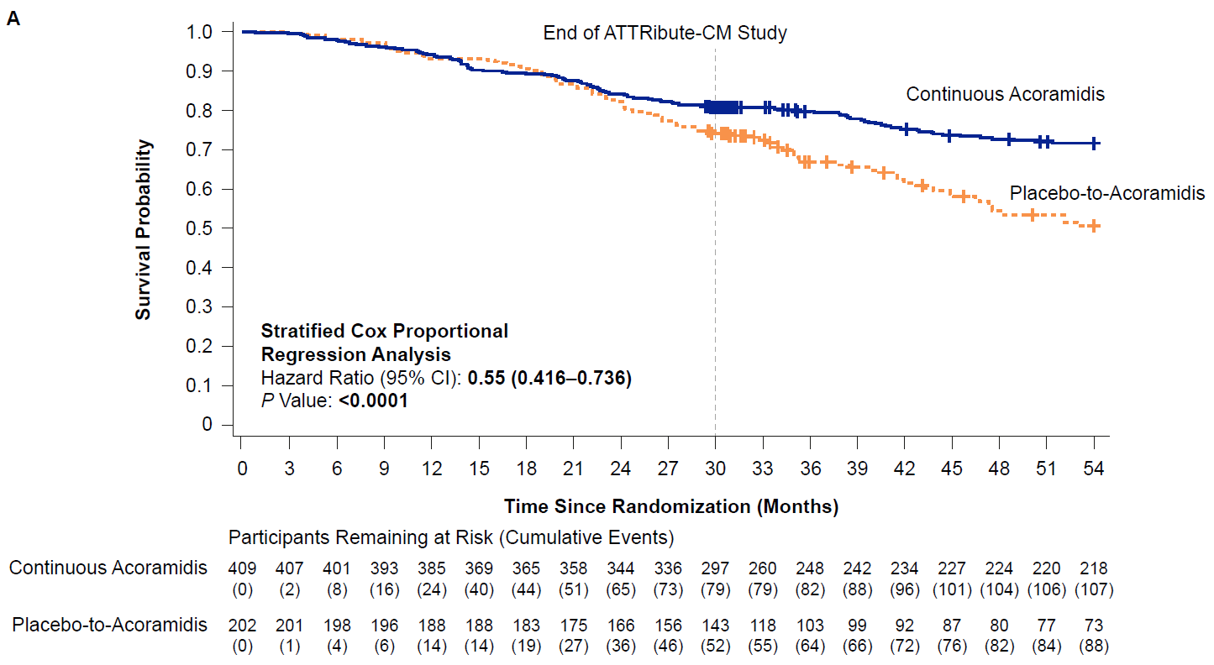
CONTINUOUS ACORAMIDIS REDUCED THE RISK OF ACM THROUGH MONTH 54 BY 45%
End of ATTRibute-CM (double-blind portion)
 | Acoramidis (n = 409)​ª | Placebo (n = 202)​ª
Participants with ACM,^{b} n (%) | 107 (26.2) | 88 (43.6)
Risk reduction^{c} | 45%
Hazard ratio^{d} (95% CI)​ | 0.55 (0.42, 0.74)
p value | < 0.0001​
ªAfter 30 months of ATTRibute-CM, of the mITT population, 258 participants continued to receive acoramidis and 122 participants switched from placebo to acoramidis after transitioning to the OLE. ^{b}ACM was defined as death from any cause, receipt of a heart transplant, or receipt of an implanted cardiac mechanical assist device. ^{c}Risk reduction was calculated as 1 − HR, where the HR was estimated using a stratified Cox proportional hazards model, and is expressed as a percentage. ^{d}Analyses were performed using a stratified Cox proportional hazards model that included treatment group as an explanatory factor and baseline 6MWD as a covariate. The model was stratified by the randomization factors of genotype, NT-proBNP, and estimated glomerular filtration rate as recorded at randomization. 6MWD, 6-minute walk distance; ACM, all-cause mortality; CI, confidence interval; mITT, modified intention-to-treat; NT-proBNP, N-terminal pro-B-type natriuretic peptide; OLE, open-label extension.
5

Slide 6
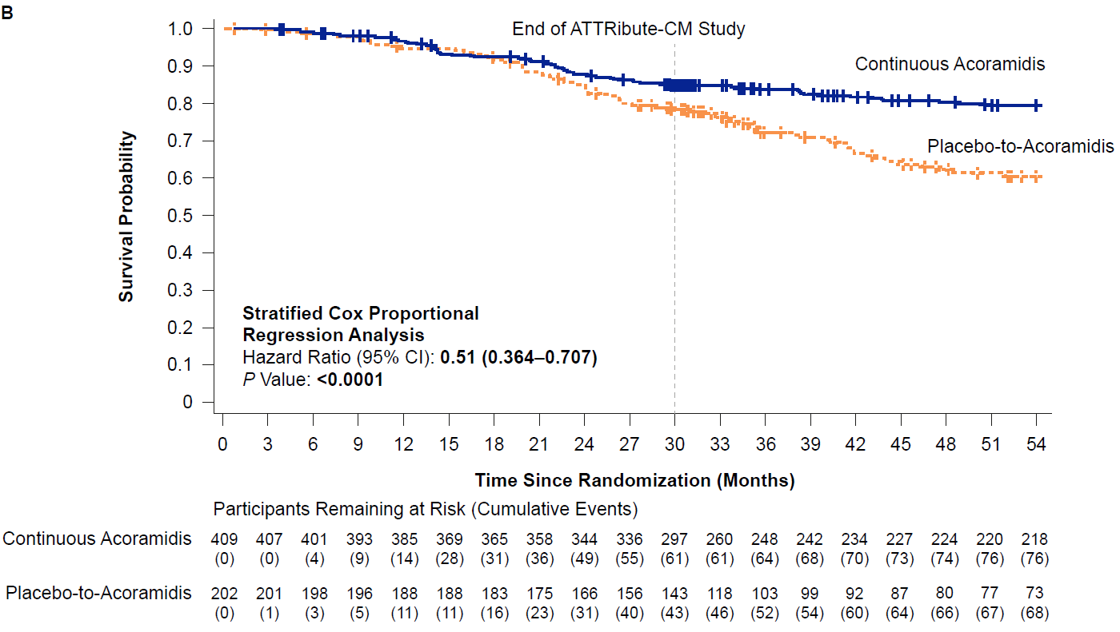
CONTINUOUS ACORAMIDIS REDUCED THE RISK OF CVM THROUGH MONTH 54 BY 49%
End of ATTRibute-CM (double-blind portion)
 | Acoramidis (n = 409)​ª | Placebo (n = 202)​ª
Participants with CVM,^{b} n (%) | 76 (18.6) | 68 (33.7)
Risk reduction^{c} | 49%
Hazard ratio^{d​} (95% CI) | 0.51 (0.36, 0.71)
p value | < 0.0001​
ªAfter 30 months of ATTRibute-CM, of the mITT population, 258 participants continued to receive acoramidis and 122 participants switched from placebo to acoramidis after transitioning to the OLE. ^{b}CVM was defined as any death adjudicated as cardiovascular or of undetermined cause. ^{c}Risk reduction was calculated as 1 − HR, where the HR was estimated using a stratified Cox proportional hazards model, and is expressed as a percentage. ^{d}Analyses were performed using a stratified Cox proportional hazards model that included treatment group as an explanatory factor and baseline 6MWD as a covariate. The model was stratified by the randomization factors of genotype, NT-proBNP, and estimated glomerular filtration rate as recorded at randomization. 6MWD, 6-minute walk distance; CI, confidence interval; CVM, cardiovascular-related mortality; mITT, modified intention-to-treat; NT-proBNP, N-terminal pro-B-type natriuretic peptide; OLE, open-label extension.
6

Slide 7
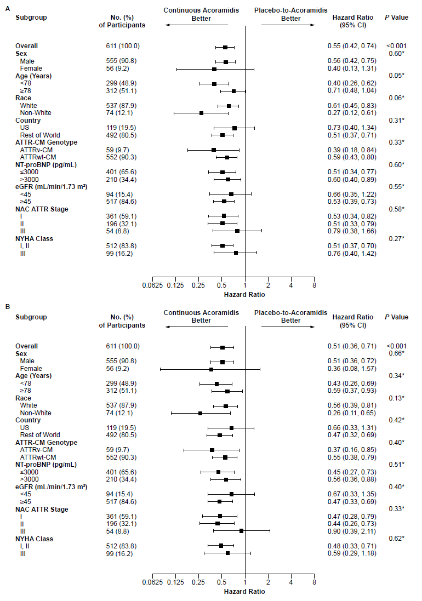
TREATMENT EFFECT ON ACM AND CVM CONSISTENTLY FAVORED CONTINUOUS ACORAMIDIS ACROSS KEY PATIENT SUBGROUPS
ACM
CVM
ACM was defined as death from any cause, receipt of a heart transplant, or receipt of an implanted cardiac mechanical assist device. CVM was defined as any death adjudicated as cardiovascular or of undetermined cause. NAC ATTR stage I was defined as NT-proBNP ≤ 3000 pg/mL and eGFR ≥ 45 mL/min/1.73 m²; stage III was defined as NT-proBNP > 3000 pg/mL and eGFR < 45 mL/min/1.73 m²; the remainder were categorized as stage II when both NT-proBNP and eGFR were not missing. Hazard ratios were estimated using a stratified Cox proportional hazards model with terms for treatment, baseline 6MWD, subgroup of interest, and subgroup × treatment interaction. Stratification factors included genotype, NT-proBNP level, and eGFR from the interactive voice/web response system. If the subgroup variable was a stratification factor, it was removed from the stratification list. p values marked with * correspond to tests of the subgroup × treatment interaction. The horizontal axes use a log scale. 6MWD, 6-minute walk distance; ACM, all-cause mortality; ATTR, transthyretin amyloidosis; ATTR-CM, transthyretin amyloid cardiomyopathy; ATTRv-CM, variant transthyretin amyloid cardiomyopathy; ATTRwt-CM, wild-type transthyretin amyloid cardiomyopathy; CI, confidence interval; CVM, cardiovascular-related mortality; NT-proBNP, N-terminal pro-B-type natriuretic peptide; eGFR, estimated glomerular filtration rate; NAC, National Amyloidosis Centre; NYHA, New York Heart Association.
7

Slide 8
CONTINUOUS ACORAMIDIS SHOWED DURABLE BENEFIT ON ACM AND CVM THROUGH MONTH 54
ACM
CVM
M30
M42
M54
M30
M42
M54
23%
29%
36%
45%
45%
49%
Risk Reduction
ªRisk reduction was calculated as 1 − HR, where the HR was estimated using a stratified Cox proportional hazards model, and is expressed as a percentage.
ACM, all-cause mortality; CVM, cardiovascular-related mortality; HR, hazard ratio.
1. Judge DP, et al. J Am Coll Cardiol. 2025;85(10):1003-1014. 2. Judge DP, et al. Circulation. 2025;151(9):601-611. 3. Ambardekar A, et al. Amyloid J Protein Fold Disord. 2024;31(Suppl 1):S119. 4. Masri A, et al. J Am Coll Cardiol. 2025;7(3):282-293.

Slide 9
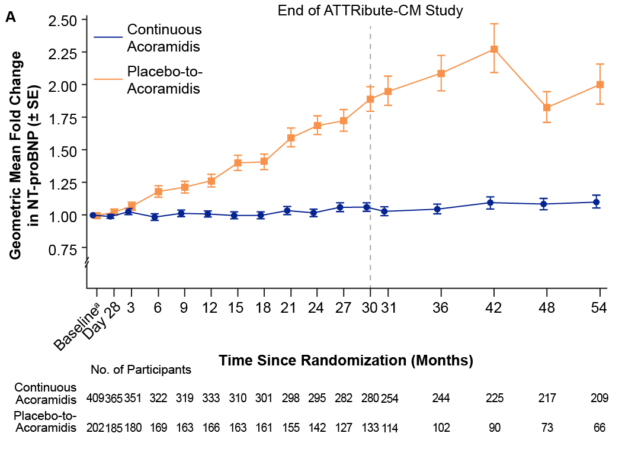
CONTINUOUS ACORAMIDIS STABILIZED NT-proBNP CONCENTRATIONS THROUGH MONTH 54
End of ATTRibute-CM (double-blind portion)
Placebo-to-Acoramidis
Geometric Mean Fold Change in NT-proBNP (± SE)
Continuous Acoramidis
ªBaseline values are the last non-missing assessment values obtained before initiation of treatment in ATTRibute-CM. The dotted blue line at Month 12 indicates the point after which tafamidis was permitted during the original ATTRibute-CM study. The dashed gray vertical line indicates the end of the ATTRibute-CM study, after which all participants in the OLE received acoramidis. NT-proBNP, N-terminal pro-B-type natriuretic peptide; OLE, open-label extension; SE, standard error.
9

Slide 10
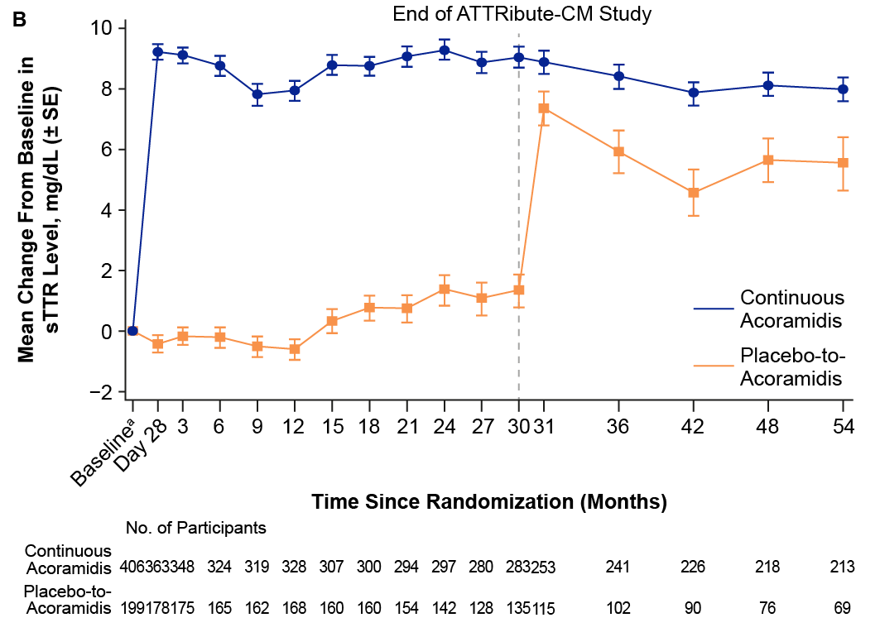
ACORAMIDIS SHOWED SUSTAINED INCREASE IN sTTR THROUGH MONTH 54
End of ATTRibute-CM (double-blind portion)
Continuous Acoramidis
Mean Change From Baseline in sTTR Level, mg/dL (± SE)
Placebo-to-Acoramidis
ªBaseline values are the last non-missing assessment values obtained before initiation of treatment in ATTRibute-CM. The dotted blue line at Month 12 indicates the point after which tafamidis was permitted during the original ATTRibute-CM study. The dashed gray vertical line indicates the end of the ATTRibute-CM study, after which all participants in the OLE received acoramidis. OLE, open-label extension; SE, standard error; sTTR, serum transthyretin.
10

Slide 11
ACORAMIDIS WAS WELL TOLERATED THROUGH MONTH 54
Summary of Adverse Events (AE) During the OLE Period (Month 30–54)
Participants With One or More Event(s), nª (%) | Continuous Acoramidis (n = 263) | Placebo-to-Acoramidis (n = 126) | Overall (N = 389)
Any Treatment-emergent AE^{b} TEAE with fatal outcome TEAE leading to study drug discontinuation | 248 (94.3) 27 (10.3) 7 (2.7) | 119 (94.4) 38 (30.2) 3 (2.4) | 367 (94.3) 65 (16.7) 10 (2.6)
Any treatment-emergent SAE^{b} | 126 (47.9) | 75 (59.5) | 201 (51.7)
Any treatment-related TEAE^{b} | 4 (1.5) | 6 (4.8) | 10 (2.6)
Severe TEAE^{c} | 90 (34.2) | 62 (49.2) | 152 (39.1)
ªn is the number of participants who experienced an event. ^{b}An AE was considered an open-label acoramidis TEAE if the AE was not present before the first dose of open-label acoramidis or if it was present but increased in severity during the open-label acoramidis treatment-emergent period. ^{c}Severity as assessed by the investigator. AE, adverse event; OLE, open-label extension; SAE, serious adverse event; TEAE, treatment-emergent adverse event.

Slide 12
CONCLUSIONS
Early and continuous acoramidis treatment provided durable reductions in ACM and CVM through Month 54
Long-term effect on survival consistently favored continuous acoramidis across key patient subgroups, with no evidence of heterogeneity in treatment effect
Continuous acoramidis stabilized NT-proBNP concentrations and led to a sustained increased sTTR concentrations through Month 54
Acoramidis was well tolerated through Month 54
Limitations: The open‑label extension design - combined with enrolment only of participants who elected to continue beyond the double‑blind phase - introduces inherent uncertainty and potential selection bias that may affect interpretation of long‑term outcomes
These findings demonstrate the long-term, durable clinical benefits and safety/tolerability of early and continuous acoramidis in patients with ATTR-CM, and underscore the importance of early diagnosis and treatment
ACM, all-cause mortality; ATTR-CM, transthyretin amyloid cardiomyopathy; CVM, cardiovascular-related mortality; sTTR, serum transthyretin.

Slide 13


Soman P, Cuddy SAM, Gillmore JD, et al
Long-Term Durability of Acoramidis Efficacy in Transthyretin Amyloid Cardiomyopathy
Open-Label Extension of the ATTRibute-CM Randomized Clinical Trial
Published Online March 30, 2026
ACC.26

