Slide 1

Lung Impedance-Guided Therapy Reduces Heart Failure Hospitalizations and Mortality in Heart Failure Patients with Preserved Ejection Fraction: Randomized IMPEDANCE-HFpEF Trial
Michael Kleiner Shochat, MD, B.Sc., PhD, FACC
Marat Fudim, MD, MHS • Simcha Meisel, MD, PhD • Co-investigators.
Heart Failure Institute, Hillel Yaffe Medical Center • Technion – Israel Institute of Technology
ACC Annual Scientific Sessions 2026 New Orleans, Louisiana • March 29, 2026

Slide 2

Pulmonary Congestion Drives Heart Failure Hospitalizations
• Pulmonary congestion is the main driver of Heart Failure hospitalizations
• Congestion develops days–weeks before symptoms
• There are no simple and direct methods to measure lung fluid changes

Slide 3
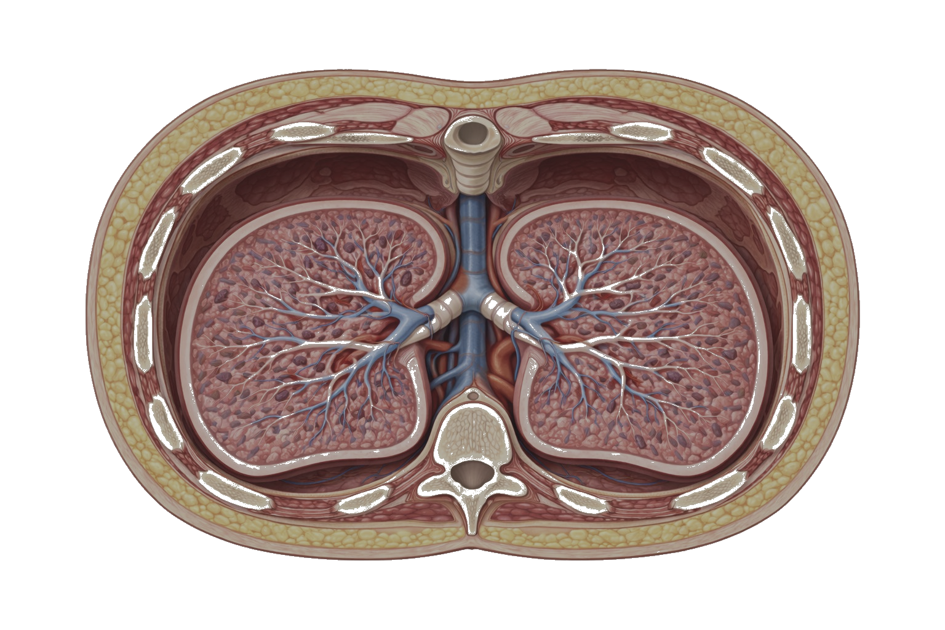
Why Traditional Impedance Monitoring Failed?
Lung impedance signal is small especially at preclinical stage of lung edema
Chest wall electrical “Noise” is 10–20× larger
Transthoracic impedance measures both lung and chest wall
Chest Wall “Noise” signal
Calculation of Chest Wall “Noise” signal
"Noise"
Impedance
front
R
R
L
L
R
L
Lung Impedance
Transthoracic Impedance
"Noise"
Impedance
back
Chest Wall “Noise” signal
Calculation of Chest Wall “Noise” signal
Traditional Impedance
CardioSet Technology
CardioSet measures and subtracts chest wall noise, isolating the pure lung impedance signal
Direct and highly sensitive measurement of lung fluid changes is first necessity for successful treatment

Slide 4
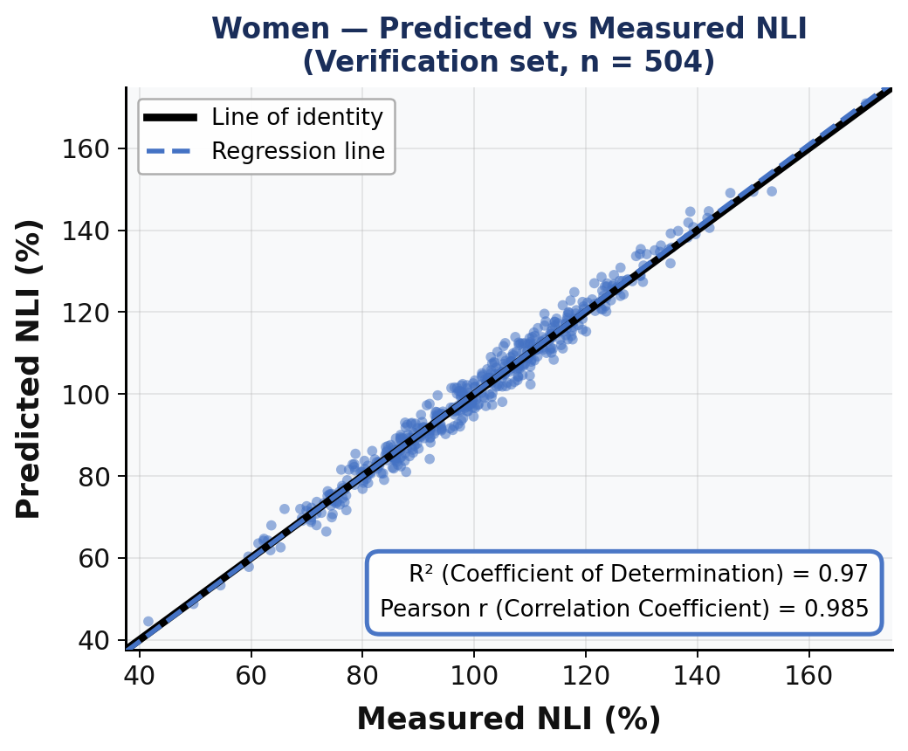
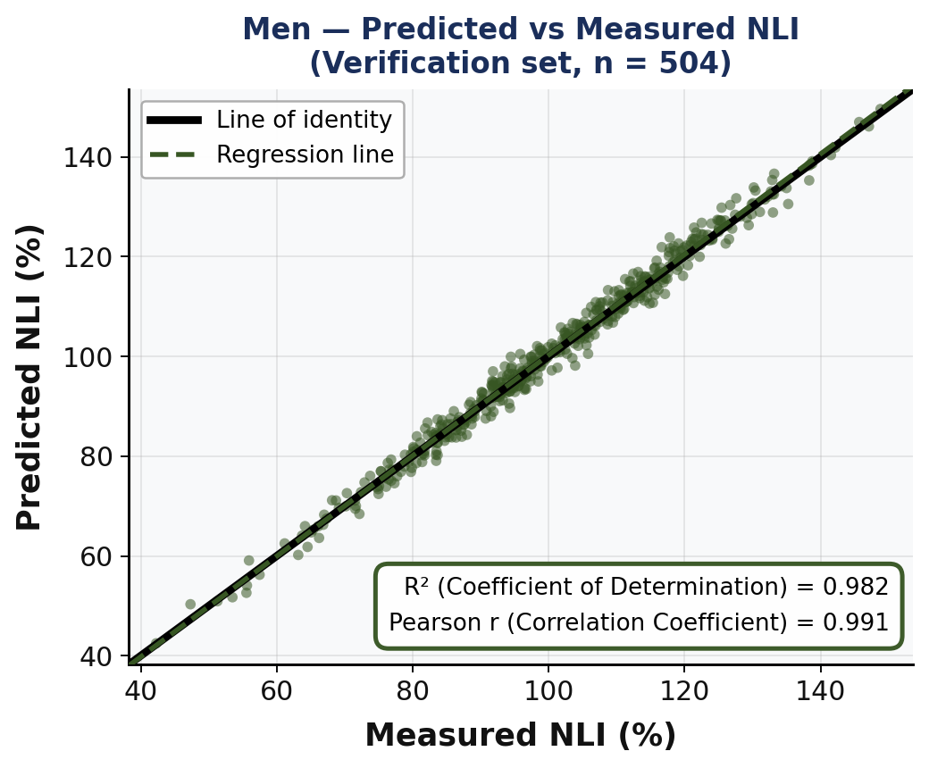
Normal Lung Impedance (NLI) Prediction Model — Validation Performance
■ What is NLI? Each patient has a unique normal (“dry") lung impedance.
Heart Failure patients usually have some degree of lung edema, therefore,
the ability to calculate NLI enables quantification of pulmonary congestion at each clinical visit
A model for calculation of individual NLI was developed.
■ Predictors: 14 key anthropometric, clinical, and device-derived variables.
■ Method: Gradient Boosting (GB) machine learning algorithm.
■ Study Design N = 4,058 volunteers without heart disease (2,029 women + 2,029 men). 75% used to build the model and 25% independent verification set for women and men separately.
■ Model performance was assessed using Bland–Altman analysis and predicted vs. measured comparisons.
95%
Prediction Accuracy (≤5% error)
Women
96.0%
Prediction Accuracy (≤5% error)
Men
98.8%
Ability to calculate NLI is the second necessity for successful treatment

Slide 5
Lung Impedance-Guided Diuretic Titration Protocol
LIR%
Deterioration
Improvement
0%
LIR = 0% = Normal (“dry”) lung
“Zone”: Interstitial Edema
GREEN From Normal to Interstitial Congestion
No titration needed
↓ Diuretic Mandatory
-18%
Increasing of pulmonary Edema
“Zone”: Transition of Interstitial to Alveolar Edema
↑ Diuretic Recommended
Decreasing of pulmonary Edema
↓ Diuretic Recommended
-24%
“Zone”: Alveolar Edema
RED
Mild,
Moderate,
Severe
Alveolar Congestion
↑ Diuretic Mandatory
-60%
Lung Impedance Ratio (LIR) = Fluid Index = [(LI current - LI dry-calculated)/ LI dry-calculated]*100 (in percent)

Slide 6
Study Design & Baseline Characteristics (Results 1)
Study Design
Protocol & Follow-up
Single-blind, single-center RCT (NCT02661841). 150 HFpEF patients randomized 1:1 to LI-guided therapy or usual care.
Eligibility: HF hospitalization/ED visit within prior year • LVEF >50% • NYHA class I–IV • NT-proBNP ≥300 pg/mL (SR) or ≥900 pg/mL (AF)
Monthly outpatient HF clinic visits with clinical, laboratory, and lung impedance assessments; measurements were also obtained at each HF hospitalization (admission and discharge).
Mean follow-up: 38.4 ± 22.8 months
Baseline Characteristics: Groups were well matched (all p = NS)
Parameter
LI-Guided (n=75)
Control (n=75)
Age (years)
Female sex (%)
BMI (kg/m²)
LVEF (%)
NYHA Class (mean)
Chronic AF/Flutter (%)
Hypertension (%)
Chronic Renal Failure (%)
eGFR (mL/min/1.73m²)
NT-proBNP, median [IQR] (pg/mL)
LIR (% from normal), median [IQR]
75.5 ± 8.9
62.7%
33.7 ± 7.0
59.9 ± 6.2
2.8 ± 0.8
41.3%
90.7%
22.7%
61.2 ± 18.2
1245 [468–2324]
−22.3 [−28.8 to −17.4]
75.7 ± 8.1
61.3%
34.4 ± 6.0
60.6 ± 6.4
2.8 ± 0.7
40.0%
93.3%
22.7%
63.2 ± 21.4
1205 [486–2227]
−22.0 [−28.4 to −11.7]

Slide 7
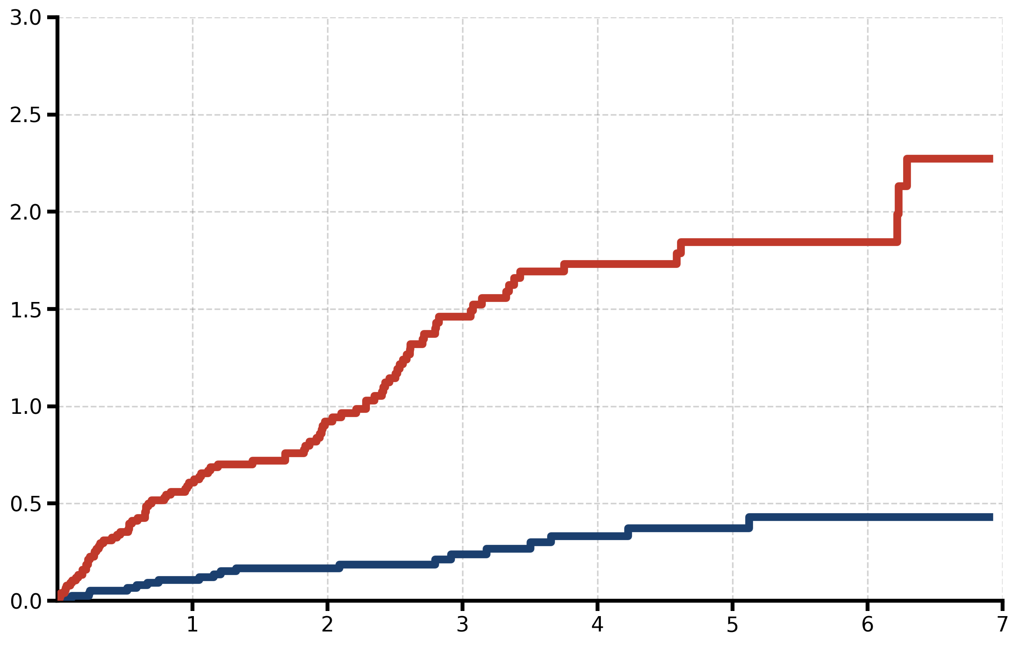
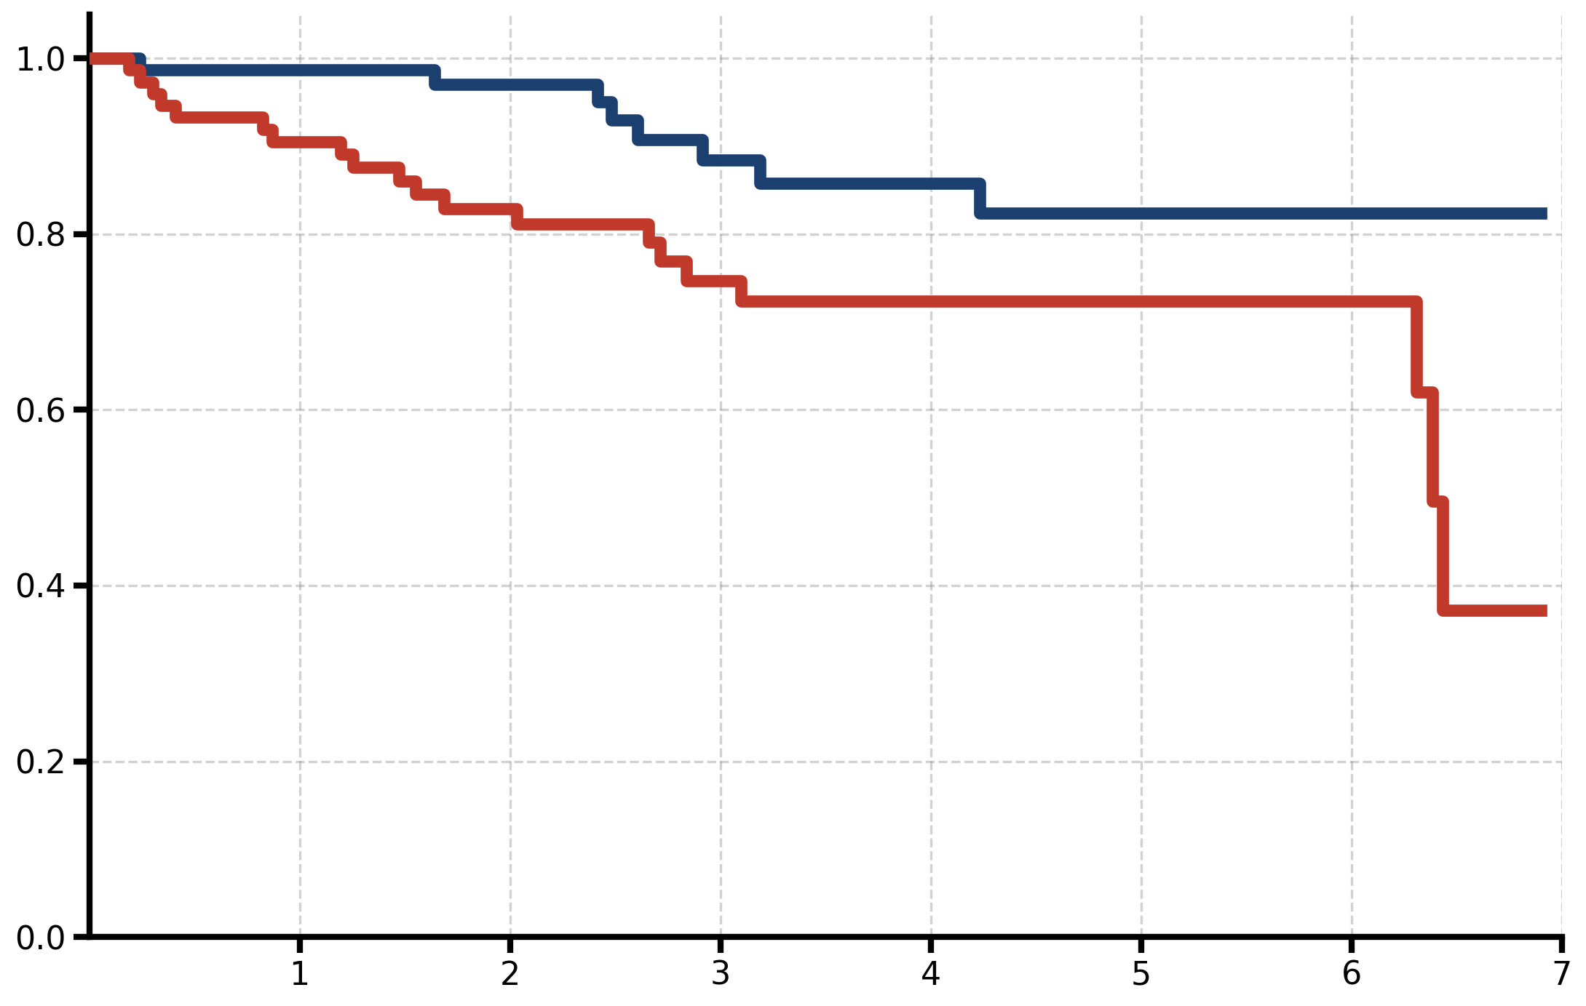
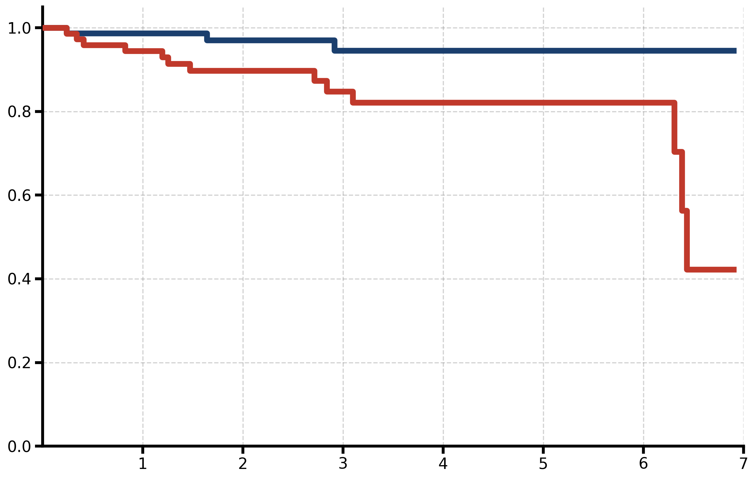
Cumulative Clinical Outcomes: LI-Guided Therapy vs Control (Results 2)
Heart Failure Hospitalizations (Anderson-Gill analysis)
LI-Guided Group
1 year:
HR=0.28, p < 0.01
7 year:
HR=0.19, p < 0.01
Control Group
Mean Cumulative Function
HF Hospitalizations Reduced by 81%
Follow Up (Years)
All-Cause Mortality (Kaplan-Meier analysis, p-log-rank)
Heart Failure–Related Mortality (Kaplan-Meier analysis, p-log-rank)
Heart Failure Related Mortality Reduced by 81%
All-Cause Mortality Reduced by 65%
1 year:
HR=0.14, p = 0.06
7-year follow-up:
HR=0.35, p < 0.01
1 year:
HR = 0.24, p = 0.2
7-year follow-up:
HR = 0.19, p < 0.01
Follow Up (Years)
Follow Up (Years)

Slide 8
Up- and Down- Titration of Diuretic Therapy (Results 3)
LIR = 0 = (normal =“dry” lung)
0%
Control Group LIR = -2.3%
161 Down-Titrations in Control Group. Level of lung congestion at Down-Titration: median LIR = -2.3% (IQR: -4.1 to 0.2)
P < 0.01
× 5.0
811 Down-Titrations in LI-guided Group. Level of lung congestion at Down-Titration: median LIR = -13.7% (IQR: -11.7 to -15.3)
LI-guided Group. LIR = -13.7%
-18%
1,873 Up-Titrations in LI-guided Group. Level of lung congestion at Up-Titration: median LIR = -20.8% (IQR: -19.3 to -26.6)
LIR = -20.8%
-24%
Degree of lung congestion in compare to normal status in %
× 1.8
P < 0.01
1,049 Up-Titrations in Control Group. Level of lung congestion at Up-Titration: median LIR = -35.4% (IQR: -30.2 to -42.4)
LIR = -35.4%
Exacerbation
Up-Titration
Up and Down-titrations of diuretic drugs were earlier in LI-Guided Group
Improvement
Down-Titration
-60%

Slide 9
LI-Guided Therapy Kept Patients in Therapeutic Range Nearly Twice as Long (Results 4)
Zone Definition
Time in Therapeutic Range (TTR)
0%
p < 0.01
Zone of
Over-Diuresis
−5%
100%
Therapeutic
Range
75%
Degree of lung congestion vs. normal state (%)
50%
−30%
Buffer Zone
−35%
25%
Zone of HF
Hospitalizations
0%
LI-Guided Group
Median: 96.6%
(IQR 89.5–100)
Control Group
Median: 50.0%
(IQR 21.6–73.9)
−60%

Slide 10
Mechanism of Benefit: Adjustment Efficacy vs. Precision Timing (Results 5)
★ Key Finding: Diuretic adjustments were equally effective in both groups after up-titration— superior outcomes resulted from earlier and more precise timing of interventions rather than differences in treatment efficacy.
LI-Guided (median [IQR])
Control (median [IQR])
Treatment Response After Up-Titration
-10%
LIR Trajectory Preceding Hospitalization
p = 0.63
p = 0.63
-20%
Faster deterioration detected in LI-Guided group
−27.3%
-30%
p = 0.21
−31.2%
ΔLIR = −17.1%, p = 0.05
Lung Impedance Ratio — LIR (%)
-40%
ΔLIR = −12.8%, p = 0.05
−41.1%
p = 0.76
Similar efficacy in both groups
−42.2%
-50%
-60%
1 Month Before Hospitalization
At Admission

Slide 11
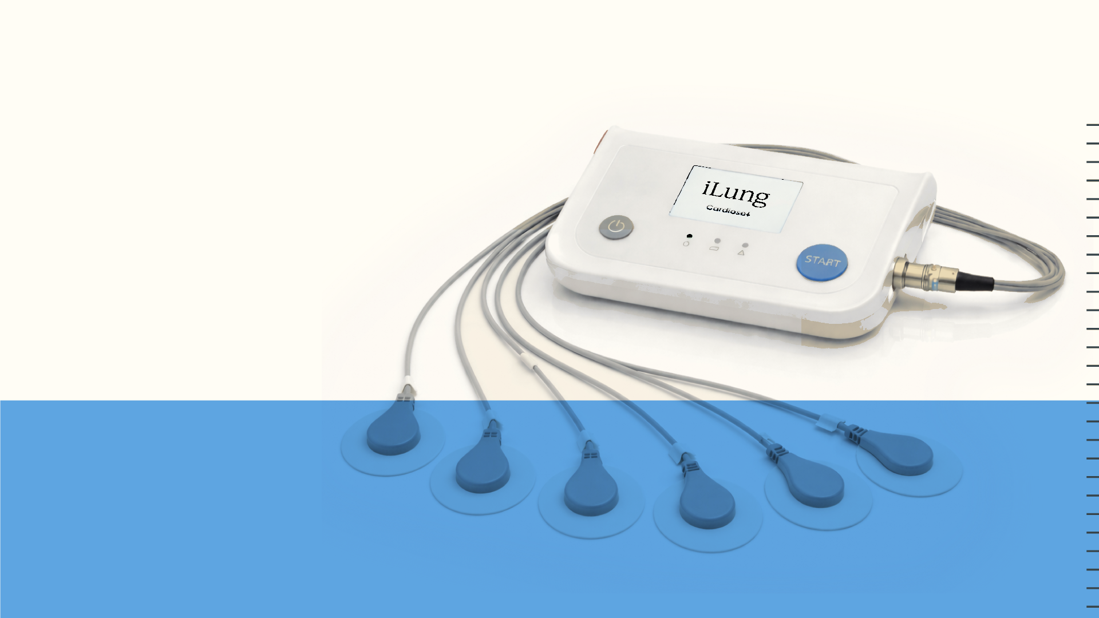
Conclusions: In patients with HFpEF, LI-guided management significantly :
• Reduces HF hospitalizations
• Reduces all-cause mortality
• Reduces HF-related mortality
These benefits are driven by earlier detection and correction of pulmonary congestion
Lung Impedance monitoring is non-invasive, simple, and scalable
Direct monitoring of pulmonary congestion may redefine HFpEF management
Thank you very much

Slide 12




Commercialization
Ready for
Commercialization
Commercialization
Ready for
Ready for
Non-invasive Congestion Monitoring.
Commercialization
Ready for

