Slide 1



A Prospective Multicenter Registry
To Define Coronary Vasomotor Disorders in Ischemia With Nonobstructive Coronary Arteries:
Primary Results Of DISCOVER INOCA
Samit Shah MD, PhD
on behalf of the investigators
@samitshahMD

Slide 2

Disclosures
Samit Shah:
Institutional research support: Abbott Vascular
Consulting: Abbott Vascular, Edwards Lifesciences, Medtronic, and Philips, Shockwave Medical, and Vahaticor
2

Slide 3
Background
Ischemia with nonobstructive coronary arteries (INOCA) and angina with nonobstructive coronary arteries (ANOCA) occur in up to 30-50% of patients undergoing coronary angiography¹
Affected patients experience significant morbidity, including recurrent chest pain, impaired functional capacity, reduced quality of life, increased healthcare utilization, and possibly increased long-term mortality
The impact of nonobstructive atherosclerotic coronary artery disease has has not been well characterized in a contemporary study of INOCA
¹Samuels et al., 2023;82(12):1245-1263
3

Slide 4
Background
Recent guidelines² recommend invasive coronary function testing to determine the cause of symptoms in patients with INOCA including:
Measurement of Coronary Flow Reserve & Microvascular Resistance
Provocative Testing with Acetylcholine
However, adoption of coronary function testing remains limited due to uncertainty regarding the diagnostic yield, procedural safety, and prognostic impact of INOCA
To address these gaps, we designed DISCOVER INOCA, a prospective multi-center registry of patients undergoing invasive coronary function testing
²Gulati et al., Circulation 2021;144(22):e368-e454
4

Slide 5
Study Organization
1. Sponsor | Yale Cardiovascular Research Group
2. Funding | Investigator-initiated research grant to Yale University from Abbott Vascular. The funding source was not involved in the design or implementation of the study.
3. Steering Committee | Alexandra Lansky MD (Chair), Samit Shah MD PhD, Timothy Henry MD, Amir Lerman MD, Jeffrey Moses MD, Megha Prasad MD, Jennifer Tremmel MD, Bruce Samuels MD
4. Core Laboratory | Yale Cardiovascular Research Group Imaging Core Laboratories
5

Slide 6



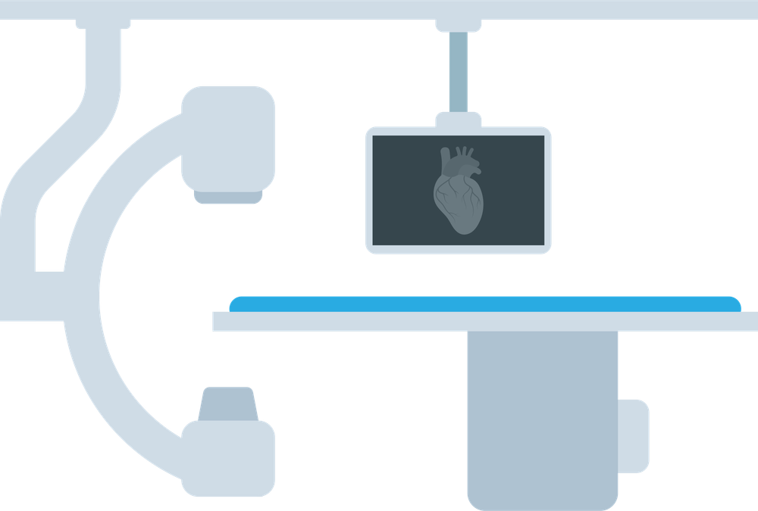
Study Design
Investigator initiated, prospective, multi-center registry
30-days
6 Months
12 Months
Annually to 5 years
Referred for Coronary Angiography
(Clinically Indicated)
Baseline
Symptoms
SAQ
EQ-5D-5L
GAD-7, PHQ-8
Medications
Index Procedure
Angiography
Acetylcholine Testing
Bolus Thermodilution
Intravascular Imaging (IVUS or OCT)
Post-Procedure
Diagnosis
Adverse Events
Medications
Follow-up
Symptoms
SAQ
EQ-5D-5L
GAD-7, PHQ-8
Medications
Primary Endpoint: Prevalence of each INOCA physiologic phenotype
Secondary Endpoint: Major adverse cardiovascular events (MACE), defined as a composite of cardiovascular death, myocardial infarction, hospitalization for cardiovascular causes, or coronary revascularization at a follow-up of 30-days
6

Slide 7
Eligibility
Key Inclusion Criteria:
1. The patient has suspected ischemic heart disease and is referred for coronary angiography
2. The patient has no obstructive coronary artery disease (CAD) as defined by:
Angiographically normal coronary arteries
Non-obstructive CAD with angiographic stenosis < 50% or ≥ 50 but < 70% with FFR ≥ 0.81 or RFR ≥ 0.90
Key Exclusion Criteria:
1. Any myocardial infarction at index presentation or within 90 days prior to enrollment (INOCA, not MINOCA)
2. Prior percutaneous coronary intervention
3. Prior coronary artery bypass graft surgery
4. History of cardiomyopathy (e.g., LVEF < 50%, HCM, amyloid)
5. Severe valvular heart disease or pulmonary hypertension
6. Renal insufficiency with eGFR < 30
7

Slide 8
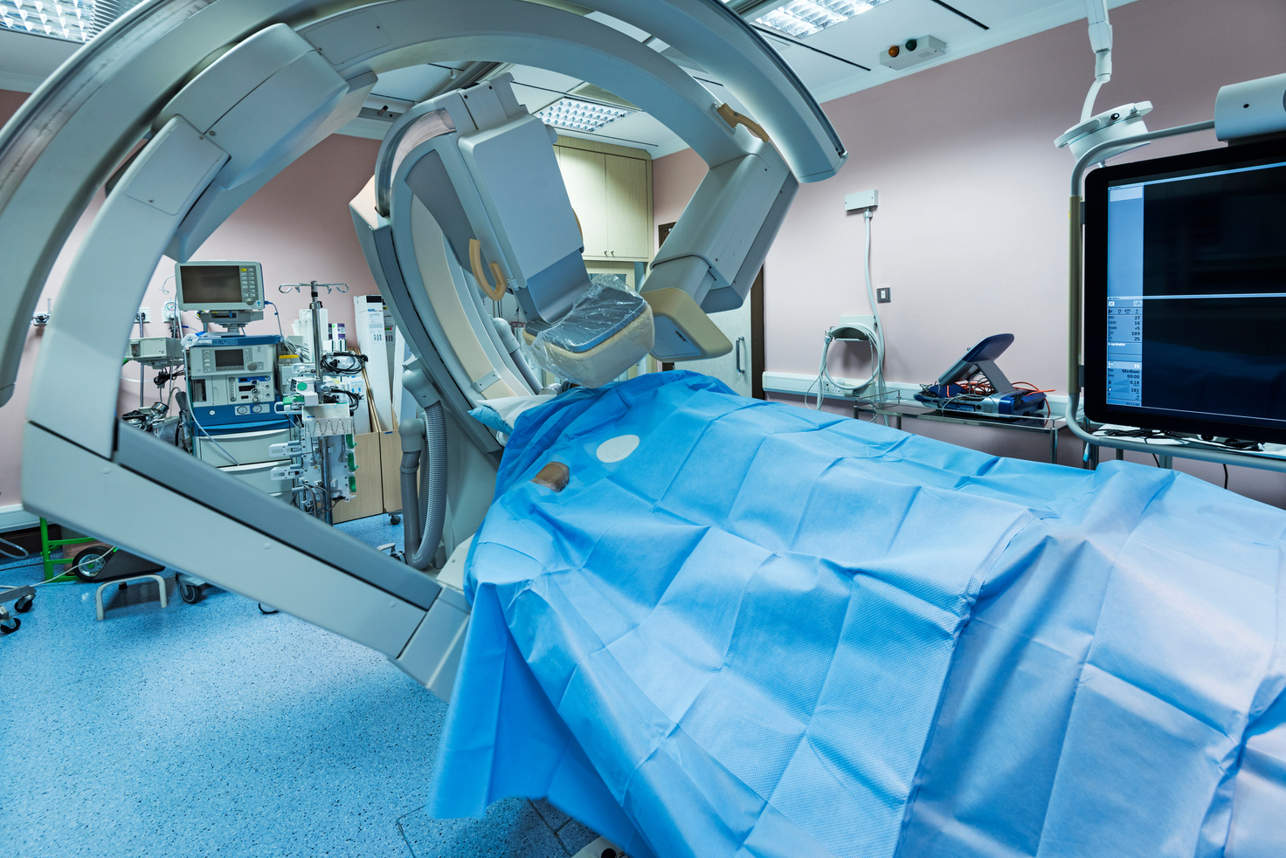
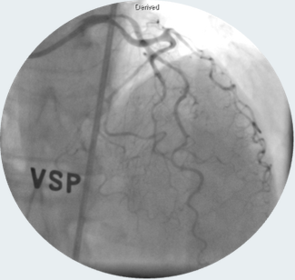
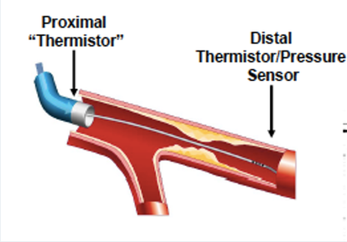
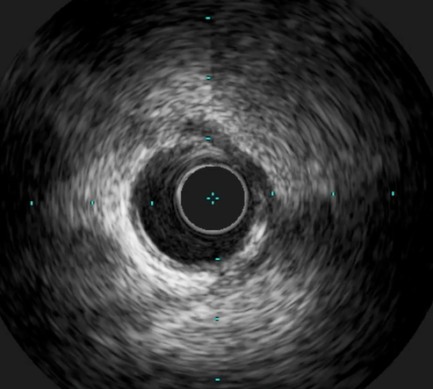
Index Procedure
Coronary
Angiography
Acetylcholine
Testing
Bolus
Thermodilution
Intravascular
Imaging
Core Lab
Acetylcholine Testing: Bolus injection or micro-catheter infusion
Target Vessel: Clinically indicated or the left anterior descending artery
Intravascular Imaging: Intravascular ultrasound (IVUS) or optical coherence tomography (OCT)
Additional testing such as dobutamine challenge for myocardial bridging at the discretion of the operator
8

Slide 9
Enrollment
Screening
Excluded:
5 Not meeting inclusion criteria
Baseline Assessment
Angiographic Exclusion:
33 Not meeting angiographic eligibility criteria
Angiographic Inclusion: 500/500
Coronary Angiogram
Index Procedure:
Acetylcholine Provocation 497/500
RFR/FFR 498/500
CFR/IMR 498/500
Intravascular Imaging 482/500
>99%
Completed
Physiology
Testing
>96%
Completed
Intravascular
Imaging
Follow-up Assessments
9

Slide 10
Enrollment by Site
Site | Site Name | Site Investigator | Site Enrollment (N) | % of Total Enrollment
1 | Yale University, Connecticut | Samit Shah, MD PhD | 176 | 35%
2 | The Christ Hospital, Ohio | Timothy Henry, MD | 82 | 16%
3 | Thomas Jefferson University Hospital, Pennsylvania | Michael Savage, MD | 5 | 1%
4 | Columbia University Irving Medical Center, New York | Partha Sardar, MD | 25 | 5%
5 | NYU Langone Health, New York | Nathaniel Smilowitz, MD | 30 | 6%
6 | New York-Presbyterian – Brooklyn Methodist Hospital, New York | Yuhei Kobayashi, MD | 15 | 3%
7 | Northeast Georgia Medical Center, Georgia | Olga Toleva, MD & Glen Henry, MD | 86 | 17%
8 | Stanford University Medical Center, California | Jennifer Tremmel, MD | 70 | 14%
9 | University of California Los Angeles Medical Center, California | Rushi Parikh, MD | 14 | 3%
10

Slide 11
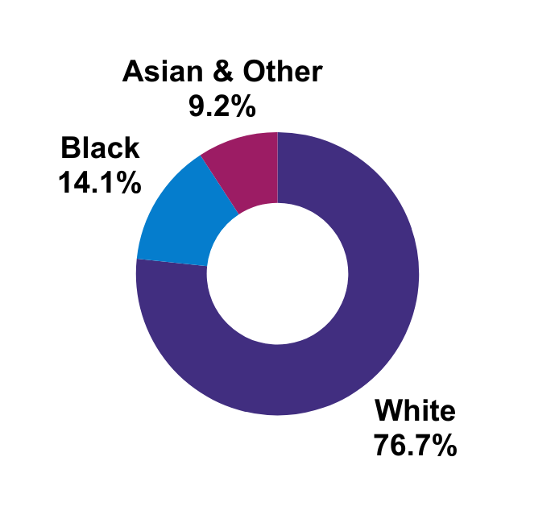
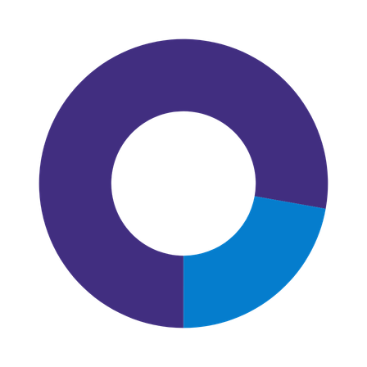
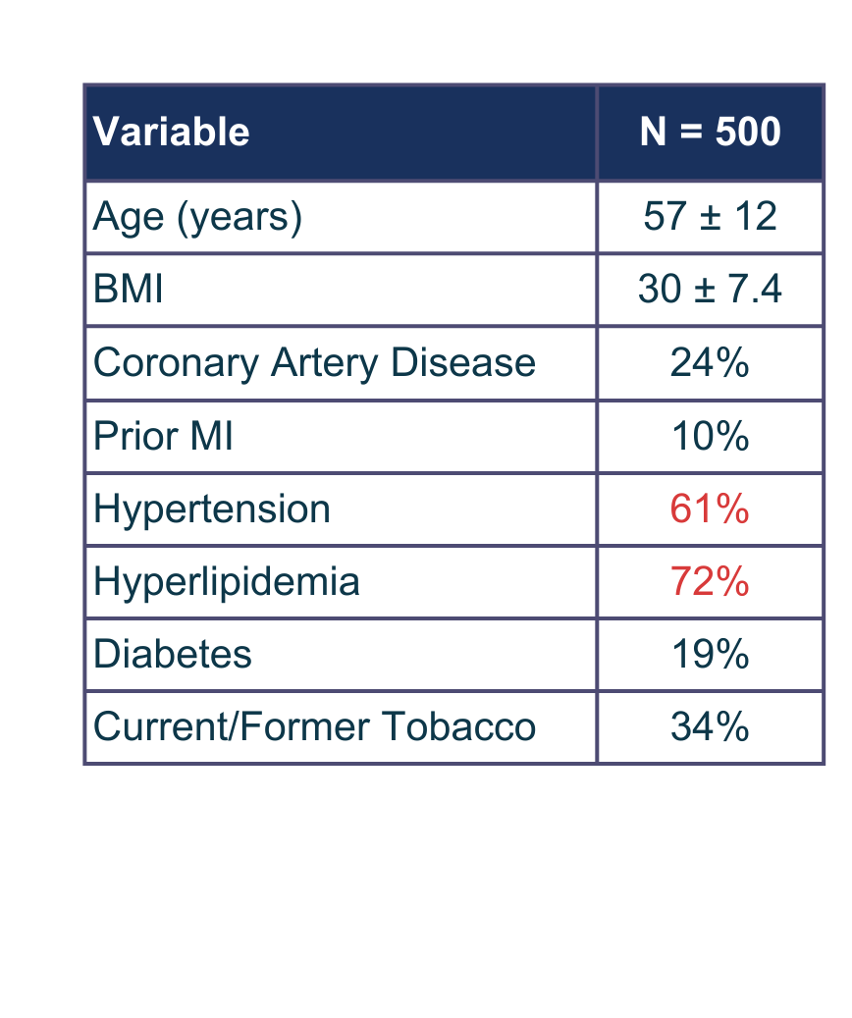
Baseline Characteristics
Sex
Race & Ethnicity
Female 78%
Male 22%
10.2% Hispanic
11

Slide 12
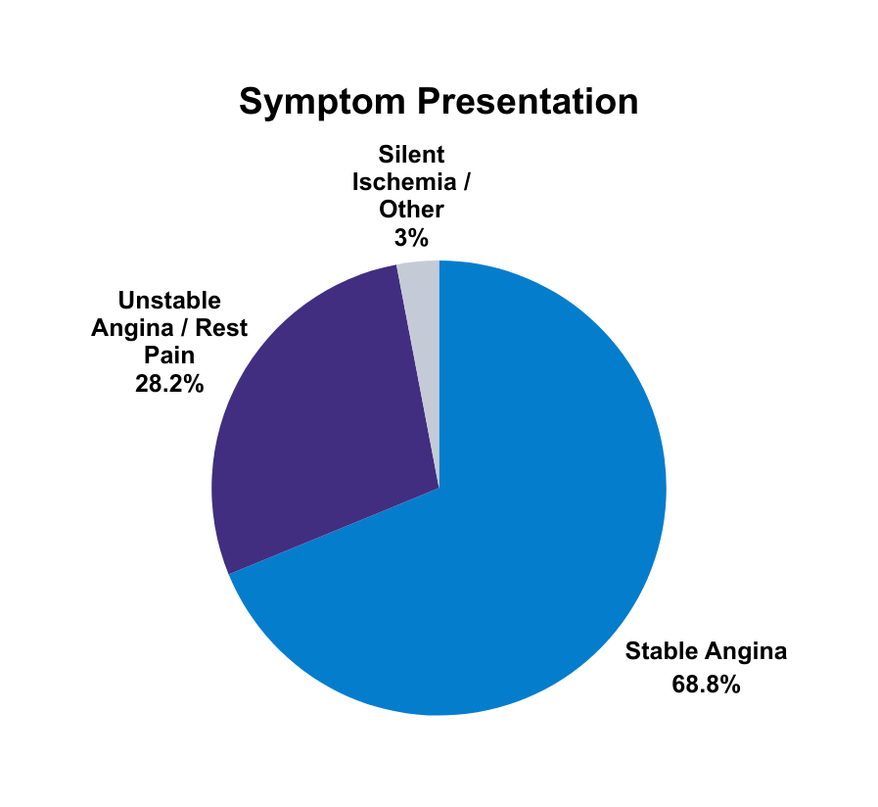
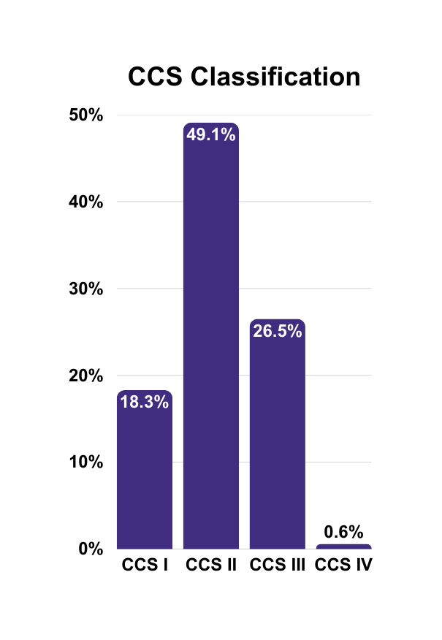
Symptom Burden
SAQ
Summary Score
53.5
40.0
66.5
Median with IQR
EQ-5D-5L
Visual Analogue Scale
70
50.0
80.0
Median with IQR
12

Slide 13
Procedural Characteristics
Procedural Characteristics
Radial Access | 50%
Femoral Access | 46%
Radial to Femoral Transition | 4%
Duration (minutes) | 61 ± 18
Guide catheter size (6Fr) | 97%
Contrast Volume (mL) | 113 ± 46
LVEDP (mmHg) | 13 ± 7
Procedural Findings
Normal Coronary Arteries | 45%
Non-obstructive Coronary Artery Disease | 55%
Myocardial Bridge (Angiographic) | 33%
LVEDP (mmHg) | 13.4 ± 6.9
Right Dominance | 87%
Coronary Flow Reserve (CFR) | 3.6 (IQR 2.6, 4.7)
Index of Microcirculatory Resistance (IMR) | 18.0 (IQR 12.0, 26.0)
13

Slide 14
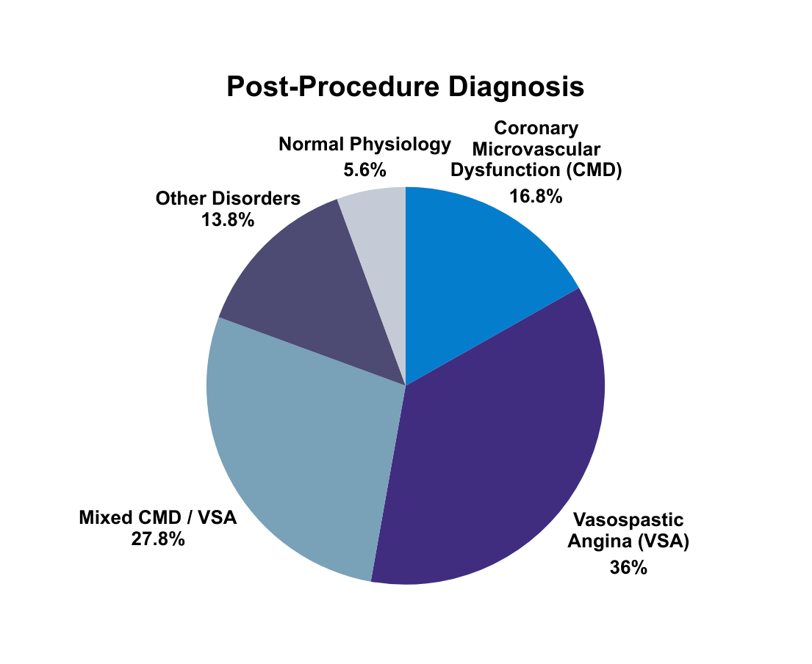
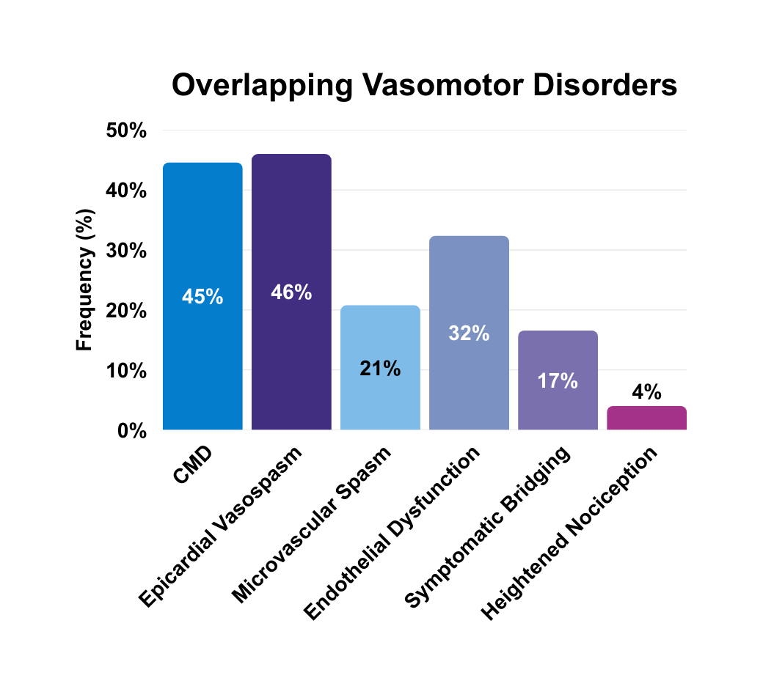
Primary Endpoint: Diagnosis
14

Slide 15
Primary Endpoint: Diagnosis
94%
89%
Diagnosis of a Coronary
Vasomotor Disorder
Change from Pre-Procedure
“Empiric” Diagnosis
15

Slide 16





Secondary Endpoint: MACE
N = 500
Procedural Serious Adverse Events
Guide Catheter Dissection: 0.4%
Death: 0.2%
Stroke: 0.2% (Transient)
Vascular Access Complication: 0.7%
30-Day Adverse Events
Myocardial Infarction: 0.7%
Spontaneous: 0.2%
Procedure-Related: 0.5%
Hospitalization for Chest Pain: 0.9%
1.4%
1.8%
2.8%
Procedural
SAE
30-Day
MACE
30-Day
Chest Pain
16

Slide 17
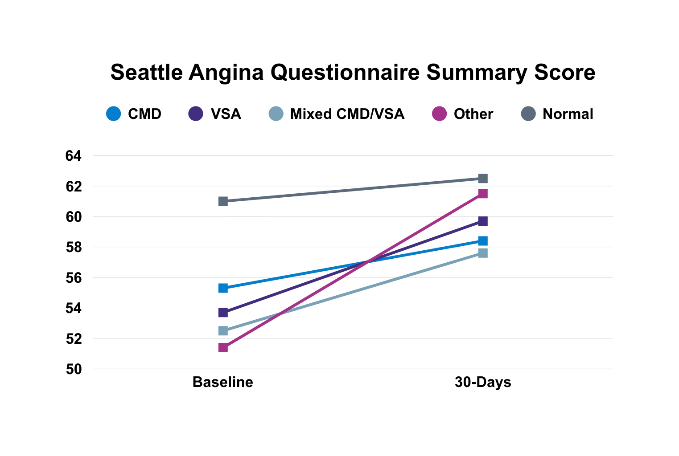
30-Day Change in Symptoms
Other 51.4 ⟶ 61.5, p <0.001
VSA 53.7 ⟶ 59.7, p <0.001
17

Slide 18
Conclusions
In this prospective multicenter U.S. registry of symptomatic INOCA patients, standardized invasive coronary function testing identified a coronary vasomotor disorder in 94%, and reclassified the pre-procedure diagnosis in 89%
Coronary function testing had a favorable safety profile with 1.4% procedure-related serious adverse events and less than 1.8% 30-day MACE
These findings support routine use of comprehensive invasive coronary function testing to identify vasomotor disorders and guide medical therapy in symptomatic patients with INOCA
Long-term follow-up is ongoing
18

Slide 19
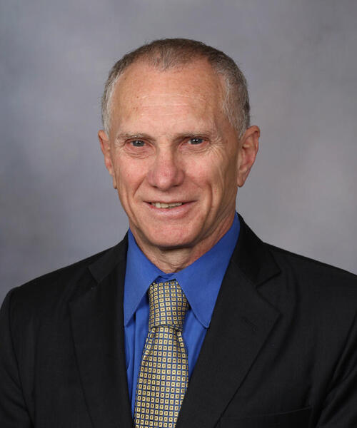
Acknowledgments
The steering committee and investigators would like to dedicate this study to the late Dr. Amir Lerman (Mayo Clinic), who has transformed our understanding of ischemic heart disease
19

Slide 20
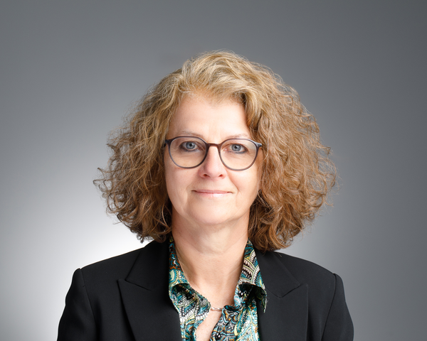
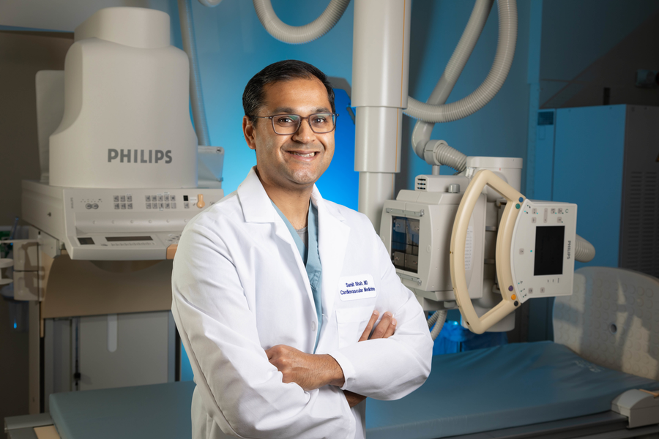
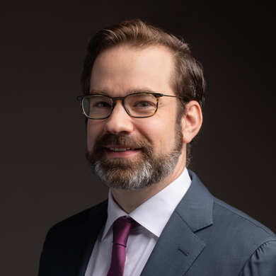
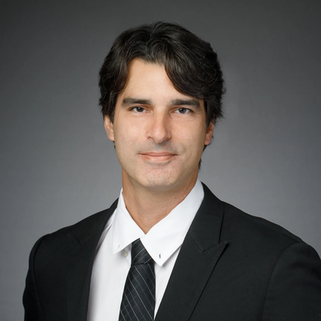
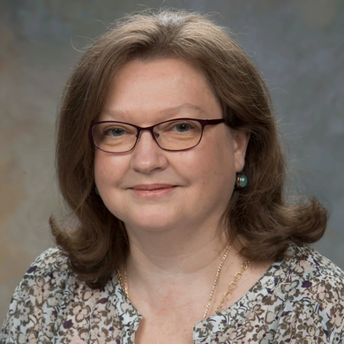
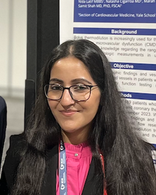
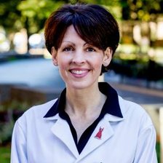
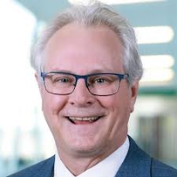
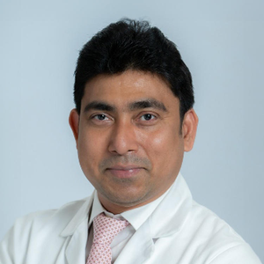
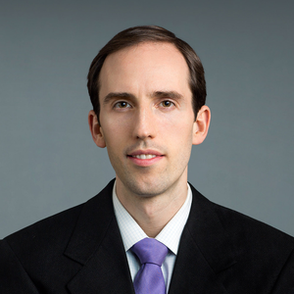
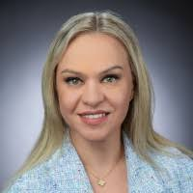
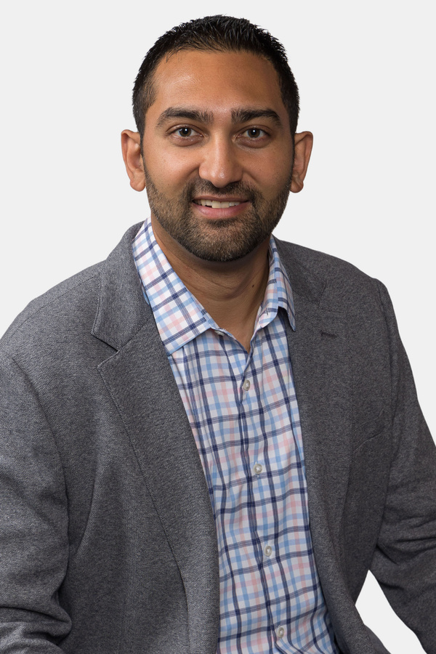
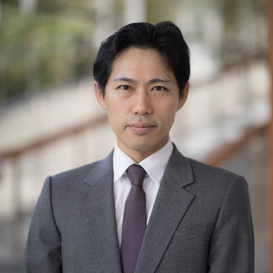

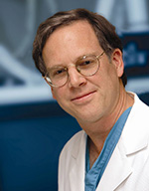
Study Team
Principal Investigators
Yale Cardiovascular Research Group
Cody Pietras
Executive Director
Dr. Daniel Chamie
Physiology & Imaging
Core Lab
Dr. Ecaterina Cristea
Angiographic
Core Lab
Dr. Nida Latif
Call Center
Dr. Alexandra Lansky
Yale University
Dr. Samit Shah
Yale University
Site Investigators
Dr. Jennifer Tremmel
Stanford University
Palo Alto, CA
Dr. Tim Henry
Christ Hospital
Cincinnati, OH
Dr. Partha Sardar
Columbia University
New York, NY
Dr. Nat Smilowitz
New York University
New York, NY
Dr. Olga Toleva
Northeast Georgia
Gainesville, GA
Dr. Rushi Parikh
UCLA
Los Angeles, CA
Dr. Yuhei Kobayashi
New York Methodist
Brooklyn, NY
Dr. Samit Shah
Yale University
New Haven, CT
Dr. Michael Savage
Thomas Jefferson
Philadelphia, PA
20

