Slide 1
Controlled trial of High-risk coronary Intervention with Percutaneous left ventricular unloading (CHIP-BCIS3)
Divaka Perera MD FRCP
Professor of Cardiology, King’s College London
Interventional Cardiologist, Guy’s & St Thomas’ Hospital
@divaka_perera

Slide 2
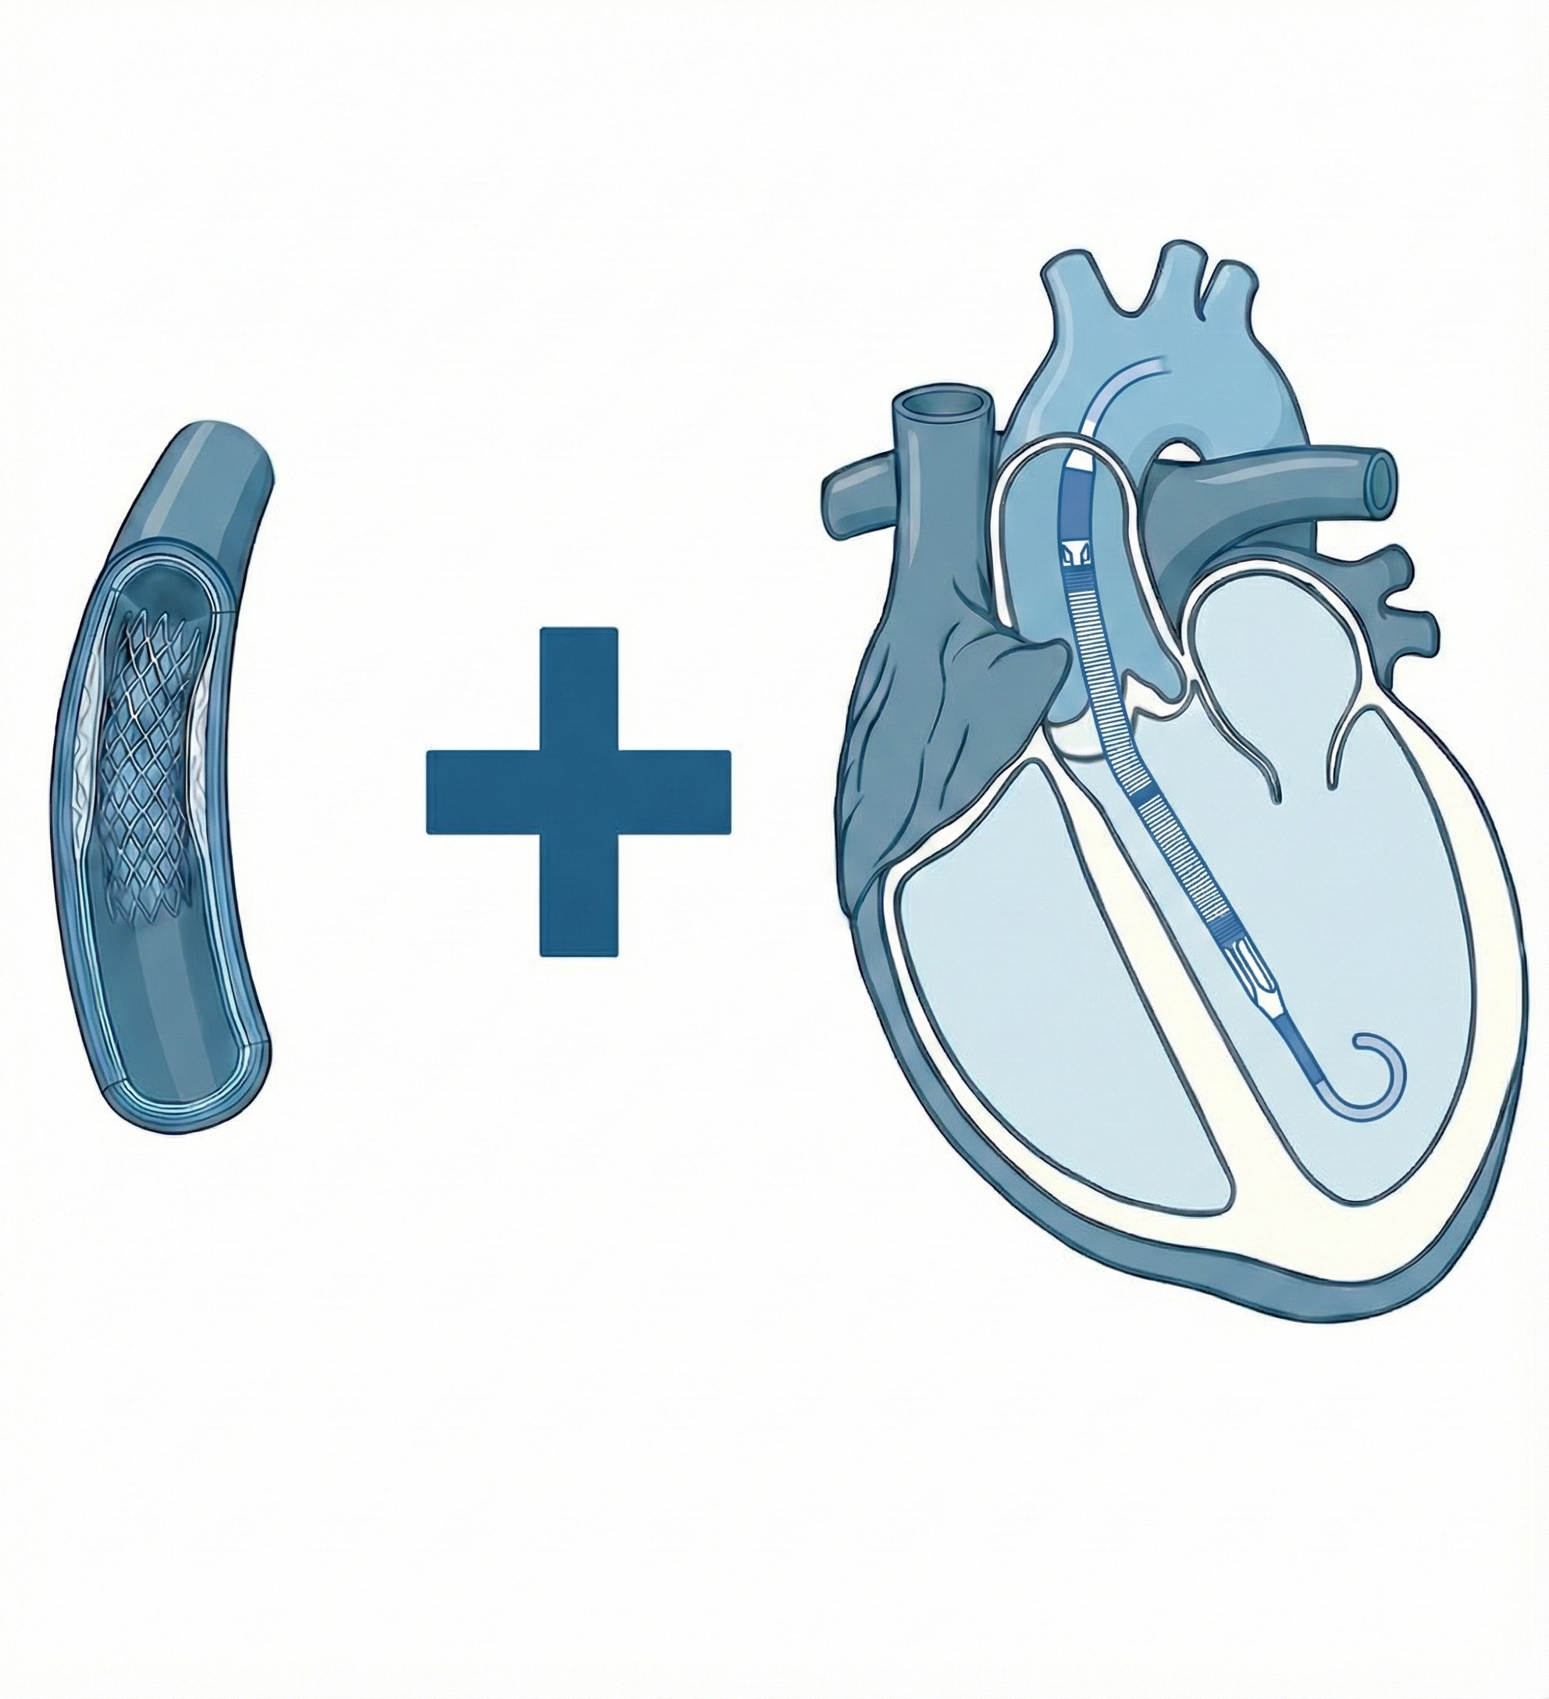
LV dysfunction
at outset
?
Ischaemic
Cascade
Decreased
Cardiac Output
Decreased
Perfusion
Worsening
LV Function
SHOCK
@divaka_perera

Slide 3






PROTECT 2
NICE guidance
FDA Approval
CHIP-BCIS3
#ACC2026
2008
2012
2016
2020
2024
2028
PROTECTED PCI: a timeline

Slide 4
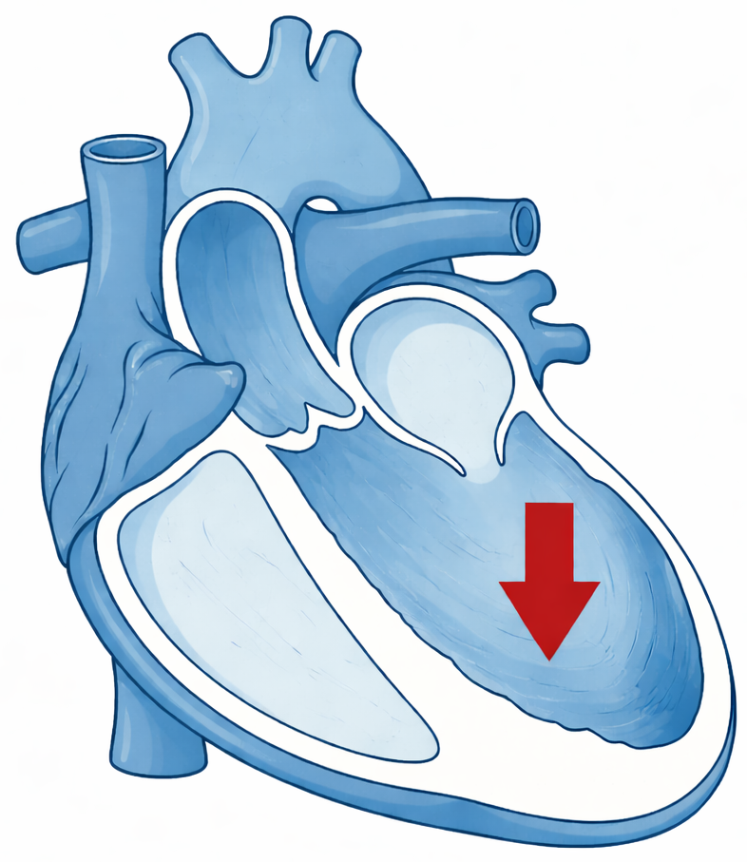
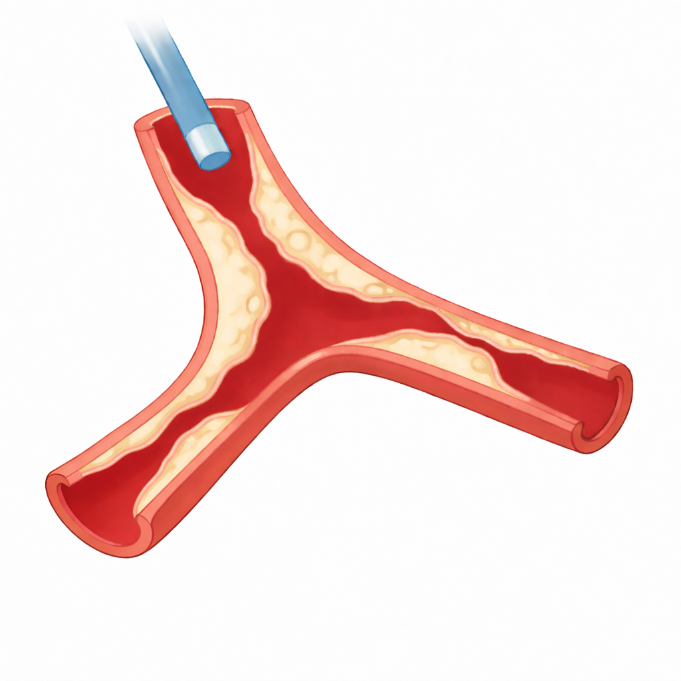
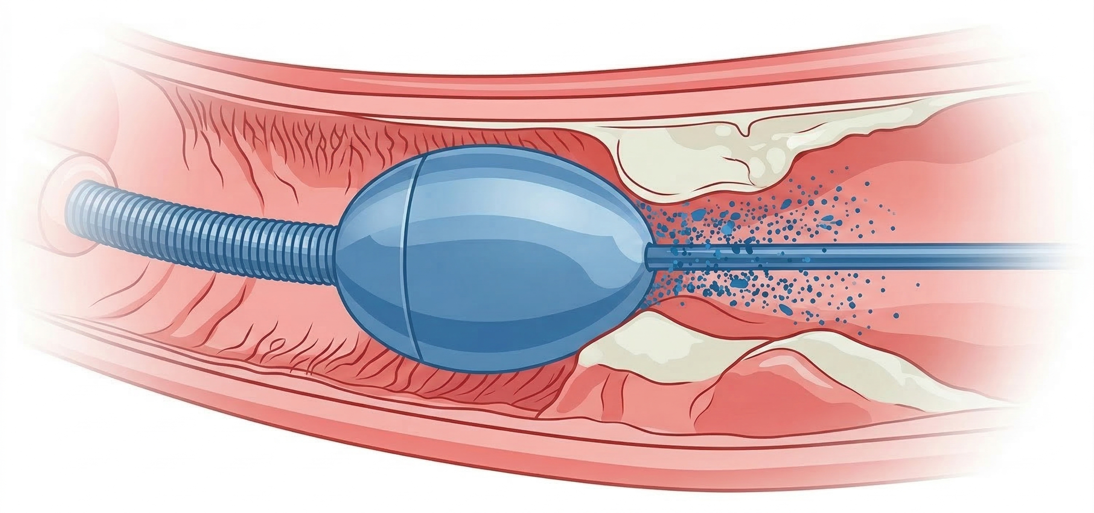
Target Population
Severe LV systolic dysfunction
LVEF ≤35%
+
Extensive coronary disease
BCIS-Jeopardy Score ≥8/12
+
Complex planned PCI
LMS PCI (involving bifurcation/ left dominant/ occluded RCA)
Multi-vessel calcium modification
Retrograde CTO

Slide 5


Micro-Axial Flow Pump
Randomize
Standard Care

Slide 6
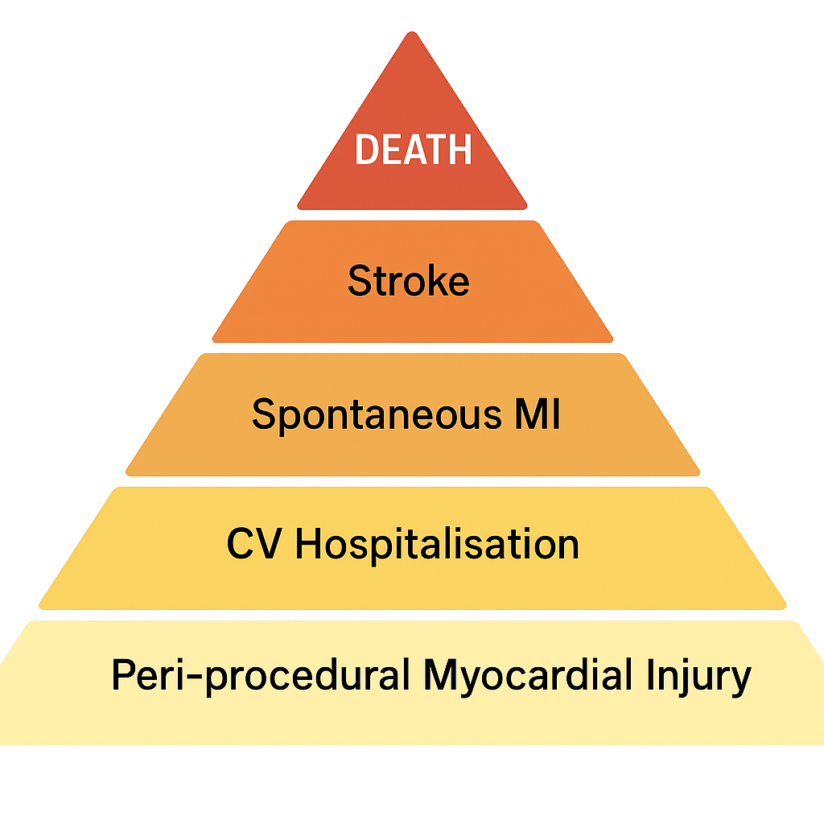
Primary Hierarchical Composite Outcome
Major Secondary Outcomes
Time to …
All-cause Death
Cardiovascular Death
First Disabling Stroke
First Spontaneous MI
First CV Hospitalisation
Frequency of …
Peri-procedural myocardial injury
Completeness of Revascularisation

Slide 7

Pairwise Comparison
A1, A2, … A150
B1, B2, … B150
Total Wins
for Micro-Axial Flow Pump
Total Wins
for Standard Care

Slide 8
Power Calculation
Total Wins
for Micro-Axial Flow Pump
A1, A2, … A150
B1, B2, … B150
Win Ratio =
Total Wins
for Standard Care
300 patients: 85% power (α=0.05) to detect a Win Ratio of at least 1.6
Predicted event rates: all-cause death 10% year 1 (then 4% pa); stroke 2% year 1 (then 1% pa)
spontaneous MI 4% year 1 (then 2% pa); CV hospitalization 20% pa; PPMI rate 20%

Slide 9
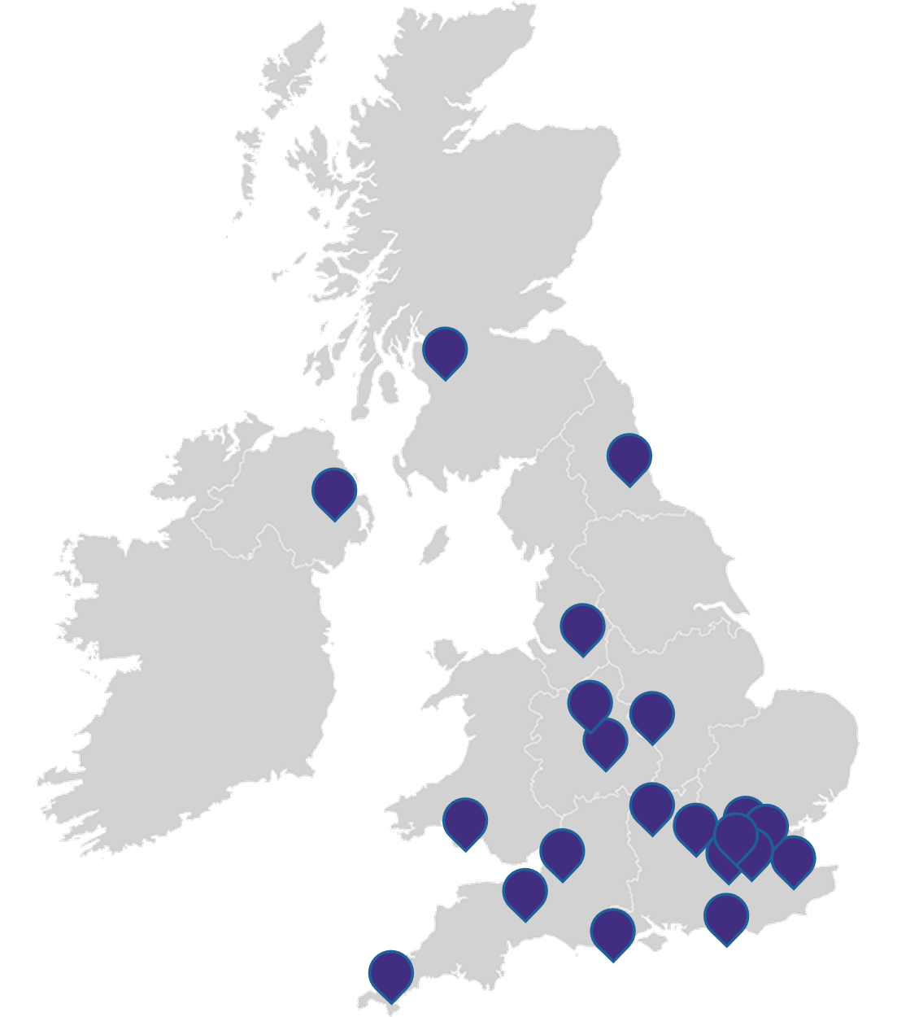
n=300
Randomized
August 2021 to December 2024
21 Centres in the United Kingdom
Micro-Axial Flow Pump
n=148
Standard Care
n=152
Median FU 22 months
(IQR 17 to 30 months)
100% complete FU at 12 months
Median FU 22 months
(IQR 15 to 30 months)
100% complete FU at 12 months

Slide 10



Characteristics at Randomization
83% Male
85% Caucasian, 12% S. Asian
Mean age 73 yrs
LVEF 27%
(IQR 20 to 32)
Core Laboratory
BCIS-JS 12
(IQR 10 to 12)
Syntax Score 38
(IQR 30 to 47)
76% Acute Coronary Syndrome
Planned procedure
LMS PCI 72%
Cal. mod 81%
CTO PCI 27%
42% CCS 3/4 Angina
46% NYHA III/IV

Slide 11
Elective mAFP (Impella CP)
97%
0%
Elective IABP
0%
0%
Bailout mAFP (Impella CP)
0%
0.7%
Bailout IABP
0.7%
5.3%
Received planned PCI
100%
99%
Single-stage PCI
93%
82%
PCI in two or more stages
7%
18%
Notes:
4 participants in the Elective Unloading group did not receive a pLVAD
Two had unexpectedly severe obstructive disease that precluded implant
One suffered a spontaneous CFA occlusion after randomisation that precluded implant
One had a vascular complication during insertion
One participant in the No Planned MCS group died before receiving planned PCI.

Slide 12
Pre-procedure CT planning
71%
66%
Major Bleeding
10.8%
7.3%
BARC 3a
7.4%
4.6%
BARC 3b
2.7%
2.6%
BARC 4
0.7%
0%
Vascular Complication
16.9%
10.6%
Minor
15.5%
9.9%
Major
1.4%
0.7%
Notes:
4 participants in the Elective Unloading group did not receive a pLVAD
Two had unexpectedly severe obstructive disease that precluded implant
One suffered a spontaneous CFA occlusion after randomisation that precluded implant
One had a vascular complication during insertion
One participant in the No Planned MCS group died before receiving planned PCI.

Slide 13
Primary Outcome

Slide 14



mAFP
SC
16.4% wins
23.4% wins
1. All-cause Death
80/300 participants had died at a median of 22 months

Slide 15
Primary hierarchical composite outcome
Hierarchy:
43.0% wins
for Standard Care
1. All-cause Death
2. Stroke
3. Spontaneous MI
36.6% wins
for mAFP
4. CV Hospitalization
5. Myocardial Injury
Wins for mAFP
Win Ratio =
= 0.85 (95% CI 0.63 to 1.15)
Wins for Standard Care
All cause death was the most decisive tier of the hierarchy

Slide 16
Major Secondary Outcomes

Slide 17
All-cause Death
HR 1.54 (95% CI 0.99 to 2.41); p=0.054
mAFP
Standard care
32.6%
23.4%
80/300 participants had died at a median of 22 months

Slide 18
Cardiovascular Death
HR 1.91 (95% CI 1.11 to 3.30); p=0.018
mAFP
Standard care
26.7%
14.5%
56/80 deaths at 22 months were of cardiovascular causes

Slide 19
Spontaneous Myocardial Infarction
HR 0.64 (95% CI 0.28 to 1.47); p=0.289
mAFP
Standard care
12.4%
6.8%

Slide 20
Cardiovascular Hospitalization
HR 1.19 (95% CI 0.72 to 1.98); p=0.487
mAFP
Standard care
24.5%
21.0%

Slide 21
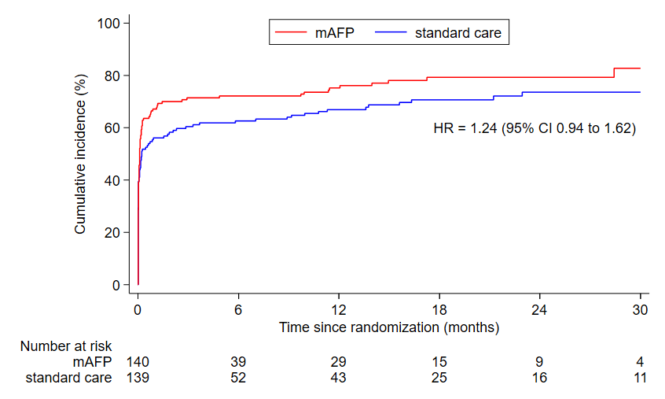
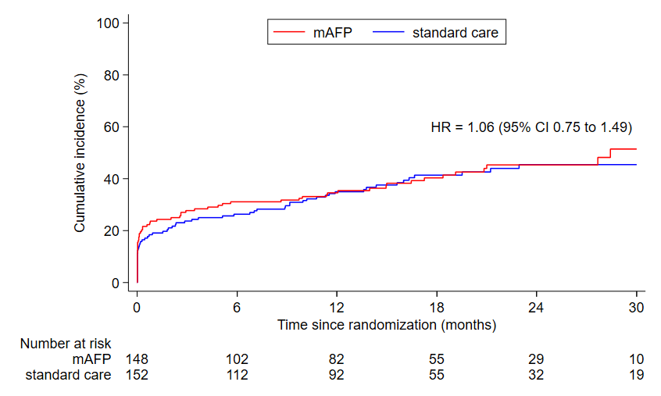
Sensitivity Analysis: Composite Outcome (TTFE)
All-cause death, stroke, spontaneous MI, CV hospitalization or peri-procedural myocardial injury
All-cause death, stroke, spontaneous MI or CV hospitalization
ppMI occurred in 62% mAFP versus 50% standard care patients
RR 1.23 (95% CI 0.99–1.54; p=0.06)

Slide 22
Completeness of Revascularisation
Core laboratory-adjudicated
BCIS-JS at randomization
12
12
Syntax Score at randomization
38
38
Change in BCIS-JS after INDEX PCI
60%
50%
Residual Syntax Score after INDEX PCI
14
15
Change in BCIS-JS after FINAL PCI
67%
67%
Residual Syntax Score after FINAL PCI
14
13
Notes:
4 participants in the Elective Unloading group did not receive a pLVAD
Two had unexpectedly severe obstructive disease that precluded implant
One suffered a spontaneous CFA occlusion after randomisation that precluded implant
One had a vascular complication during insertion
One participant in the No Planned MCS group died before receiving planned PCI.

Slide 23
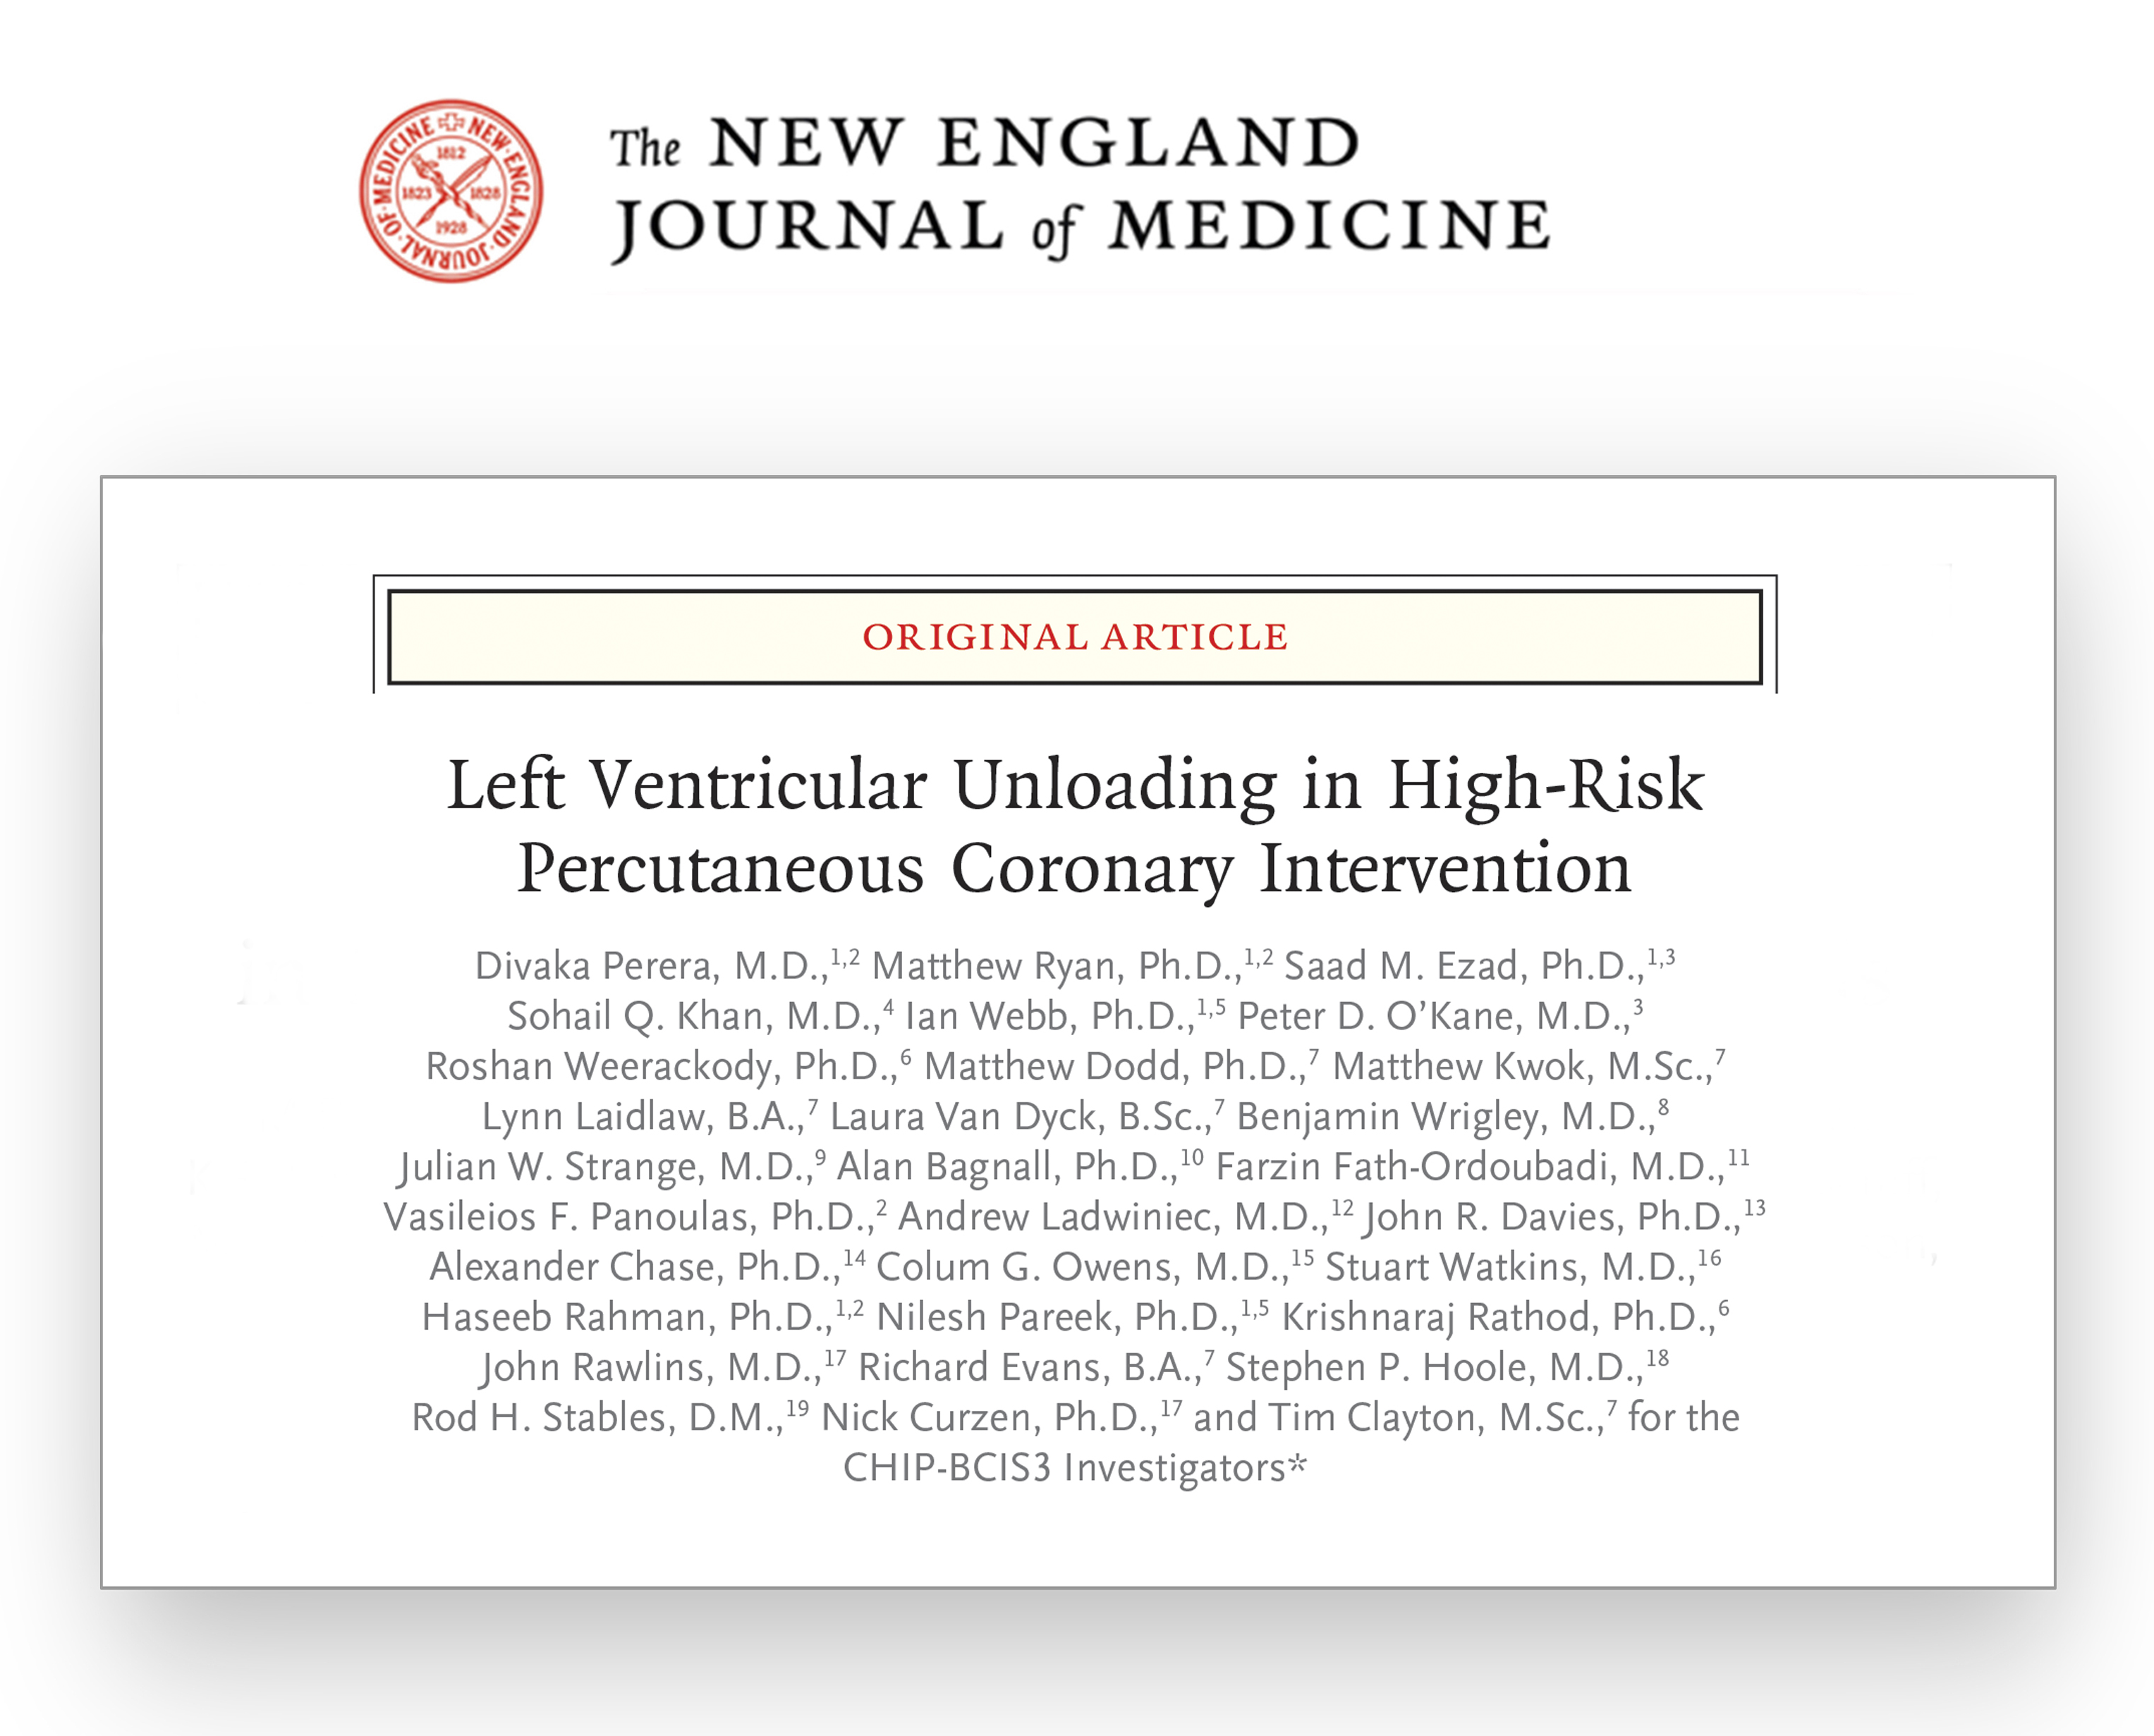

CHIP-BCIS3 trial criteria prospectively identified patients at high risk of death and major morbidity following PCI
A Micro Axial Flow Pump did not reduce major adverse clinical outcomes in patients with severe LV dysfunction undergoing complex PCI
There was an excess of death due to cardiovascular causes in patients who received PCI with a Micro Axial Flow Pump
@divaka_perera

Slide 24
Funder
National Institute for Health & Care Research (UK)
Trial Steering Committee
Chair: Nick Curzen
Sponsor
King’s College London
Data Safety Monitoring Committee
Chair: Rod Stables
Clinical Trials Unit
LSHTM
Chief Investigator
Divaka Perera
Snr Statistician
Tim Clayton
The Patients
who selflessly volunteered
Clinical Events Committee
Chair: Steve Hoole
Recruiting Centers
Thank You!

