Slide 1


Effect of Early Financial Support on Medication Adherence Among Low-Income Patients Following Heart Failure Hospitalization
The FUND-HF Pilot Trial
Ambarish Pandey, MD, MSCS Associate Professor of Internal Medicine Divisions of Cardiology and Geriatrics Medical Director, HFpEF Program Principal Investigator, Cardiometabolic Research Unit UT Southwestern Medical Center, Dallas, TX

Slide 2
Presenter Disclosures
Ambarish Pandey reports the following:
  Research Support: National Institute of Health, American Heart Association, Applied Therapeutics, Roche, Ultromics, Gilead Sciences, Bayer, and AstraZeneca.
  Honoraria as an Advisor, Consultant, or Speaker: Tricog Health Inc, Lilly, Rivus, Roche Diagnostics, Axon Therapies, Edward Lifesciences, Science37, Novo Nordisk, Bayer, Medical AI, Astra Zeneca, Baylor Scott and White Research Institute, Boehringer Ingelheim, iRhythm Technologies, Tourmaline Bio, Merck, Sarfez Pharmaceuticals, Ultromics, Kardigan, Tenax Pharma, Alnylam, Abbott, Kilele Health, Anumana, Acorai, Novartis, Antlia Biosciences.
This trial was funded through institutional research support to the Study PI.

Slide 3
Background
Heart failure (HF) hospitalization carries a high risk of 30-day readmission and mortality, disproportionately affecting socioeconomically disadvantaged patients
Adverse social determinants of health (SDOH), such as food insecurity, housing instability, transportation barriers, and cost-related non-adherence, drive these disparities
Care coordination trials (CONNECT-HF, PACT-HF) and single-domain financial interventions (MI-FREEE, ARTEMIS) have not improved clinical outcomes
Socioeconomic barriers are multidimensional; unrestricted financial support during the post-discharge period remains unexplored
Abbreviations: HF – heart failure, SDOH – social determinants of health
Notes:
Heart failure (HF) hospitalization carries a high risk of 30-day readmission and mortality, disproportionately affecting socioeconomically disadvantaged patients.
Adverse social determinants of health (SDOH) such as food insecurity, housing instability, transportation barriers, and cost-related non-adherence are among the key drivers of these disparities.
Socioeconomic barriers to post-discharge recovery are multidimensional, and single-domain interventions targeting health care navigation or medication affordability alone have shown mixed results
Whether unrestricted, financial support interventions that directly address socioeconomic needs can improve postdischarge outcomes following HF hospitalization remains unexplored.

Slide 4

Study Objectives
To evaluate the feasibility and effects of early post-discharge financial support ($500) vs. control among low-income patients with HFrEF and adverse SDOH on:
Medication adherence by therapeutic drug monitoring at 1 month
Health-related quality of life (KCCQ-OSS) at 1 month
Safety (substance use, psychological stress)
Abbreviations: HFrEF – heart failure with reduced ejection fraction, SDOH – social determinants of health, KCCQ-OSS – Kansas City Cardiomyopathy Questionnaire Overall Summary Score
Notes:
The FUND-HF trial was designed to evaluate the feasibility and effects of early post-discharge financial support among low-income patients with HFrEF focusing on outcomes of Medication adherence, quality of life, and assess for any unintended safety consequences of the intervention.

Slide 5
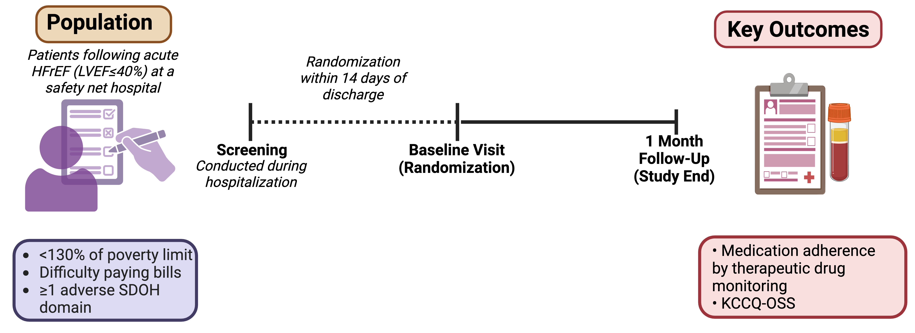
Study Design
Open-label, single-center RCT in Dallas, TX (June 2023 – April 2025)
Abbreviations: LVEF – left ventricular ejection fraction, KCCQ – Kansas City Cardiomyopathy Questionnaire, FPL – federal poverty limit, SDOH – social determinants of health
Notes:
This was an open-label, single-center RCT conducted at Parkland Memorial Hospital in Dallas — a large urban safety-net hospital — from June 2023 through April 2025. We enrolled patients with HFrEF, LVEF 40% or below, who were screened during hospitalization and randomized within 14 days of discharge.
Follow-up was at one month and the key outcomes of interest were medication adherence, assessed by TDM and quality of life, assessed by KCCQ/

Slide 6









Adverse SDOH Burden
Eligible participants had income < 130% of the federal poverty limit, difficulty paying bills, and ≥1 additional SDOH across the following domains:
Cost-Related
Nonadherence
Low Social
Support
Housing
Instability
Interpersonal
Violence
Unemployment
Household
Crowding
Food Insecurity
Transportation Barriers
Discrimination
Notes:
Eligible patients had their household income below 130% of the federal poverty level, self-reported difficulty paying bills, and at least one additional adverse SDOH domain.

Slide 7
Key Outcomes
Medication Adherence by Therapeutic Drug Monitoring (TDM)
Serum levels measured at 1 month via LC-MS/MS
Testable medications: metoprolol, spironolactone, furosemide, amlodipine, hydralazine, nifedipine, prazosin
  Expressed as a proportion of tested meds with detectable levels (0 to 1)
  Categorized as complete (all detected), partial (some detected), non-adherent (none detected)
Also assessed for HF GDMT specifically (metoprolol, spironolactone)
Health-Related Quality of Life - KCCQ-OSS at 1 month
All-cause and HF hospitalization adjudicated by chart review
Safety- Urine drug screen at 1 month and Perceived Stress Scale (PSS-10)
Abbreviations: TDM – therapeutic drug monitoring; LC-MS/MS – liquid chromatography tandem mass spectrometry, HF –heart failure, GDMT – guideline directed medical therapy
Notes:
Medication adherence was measured using serum drug monitoring testing for seven cardiac meds that included HF GDMT medications— metoprolol and spironolactone, as shown here. Adherence was expressed as a proportion of tested medication with detectable levels, and participants were categorized as fully ahdrenent, partially adherent, or nonadherent. QoL was assessed using the KCCQ-OSS, and hospitalization events were captured at follow-up through chart review.
Safety assessment was done by urine drug screen and assessing the perceived stress burden.

Slide 8
Intervention
Financial Support
$500 on a prepaid debit card at randomization
  80% of the reported monthly income for the study population
Single disbursement, no spending restrictions
Debit card payment or cash withdrawal permitted
No guidance on fund utilization
Control
Usual post-discharge care
Equivalent $500 provided at 1-month follow-up completion
Notes:
At randomization, participants in the financial support arm received $500 on a prepaid debit card with no restrictions or guidance on how to spend it. Cash withdrawal was allowed.
The financial support represented 80% of the median reported monthly income for the study population.
The control arm received usual post-discharge care and an equivalent $500 payment only after completing the end-of-the study 1-month follow up visit,

Slide 9
Statistical Analysis
Per-protocol (adherence, patient-reported outcomes); intention-to-treat (clinical outcomes)
TDM adherence (continuous): binomial GLM, presented as estimated marginal means
TDM adherence (categorical): modified Poisson regression, presented as risk ratios
KCCQ-OSS: baseline-adjusted ANCOVA, presented as least-squares mean differences
Hospitalizations: negative binomial regression with person-time offset, rate ratios per 100 person-months
Notes:
Adherence outcomes were analyzed per protocol using binomial and Poisson regression models.
KCCQ outcome was analyzed using ANCOVA adjusted for baseline
Hospitalization rates were analysed on an intention-to-treat basis using negative binomial regression with a person-time offset.

Slide 10
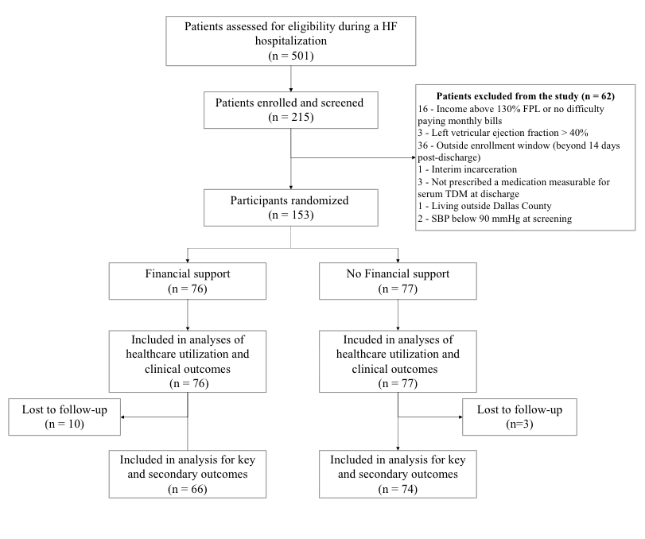
Study Cohort
Notes:
153 participants were randomized on a 1:1 basis to the financial support vs. control group.
Loss to follow-up was low overall at 8%, but was unequal across the two arms with 13% in the financial support arm versus 4% in the control arm.
The final analysis for adherence and QOL outcomes included 66 participants in the financial support arm and 74 participants in the control arm

Slide 11
Baseline Characteristics
 | Financial Support (n=76) | Control (n=77)
Age (mean, y) | 53 | 53
Male sex, % | 78 | 74
Black race, % | 65 | 81
Hispanic ethnicity, % | 18 | 12
Self-reported monthly income (median, $) | $840 | $400
Self-reported monthly income of $0, % | 37 | 42
Uninsured, % | 51 | 57
County Indigent Health Program, % | 34 | 36
LVEF (median, %) | 26 | 25
Admission NT-proBNP (median, pg/mL) | 3648 | 3775
Prescribed quadruple GDMT, % | 53 | 62
Baseline KCCQ-OSS (median) | 39 | 39
Low self-reported adherence, % | 59 | 57
Abbreviations: LVEF – left ventricular ejection fraction, GDMT – guideline directed medical therapy, KCCQ-OSS – Kansas City Cardiomyopathy Questionnaire Overall Summary Score
Notes:
The baseline characteristics of the study participants across the two groups are shown here. A high proportion of participants were of self-reported black race, the median monthly income was low, with 40% reporting a median income of 0 dollars. Over half of the participants were uninsured.
Self-reported adherence was also low at ~58% across both groups.

Slide 12
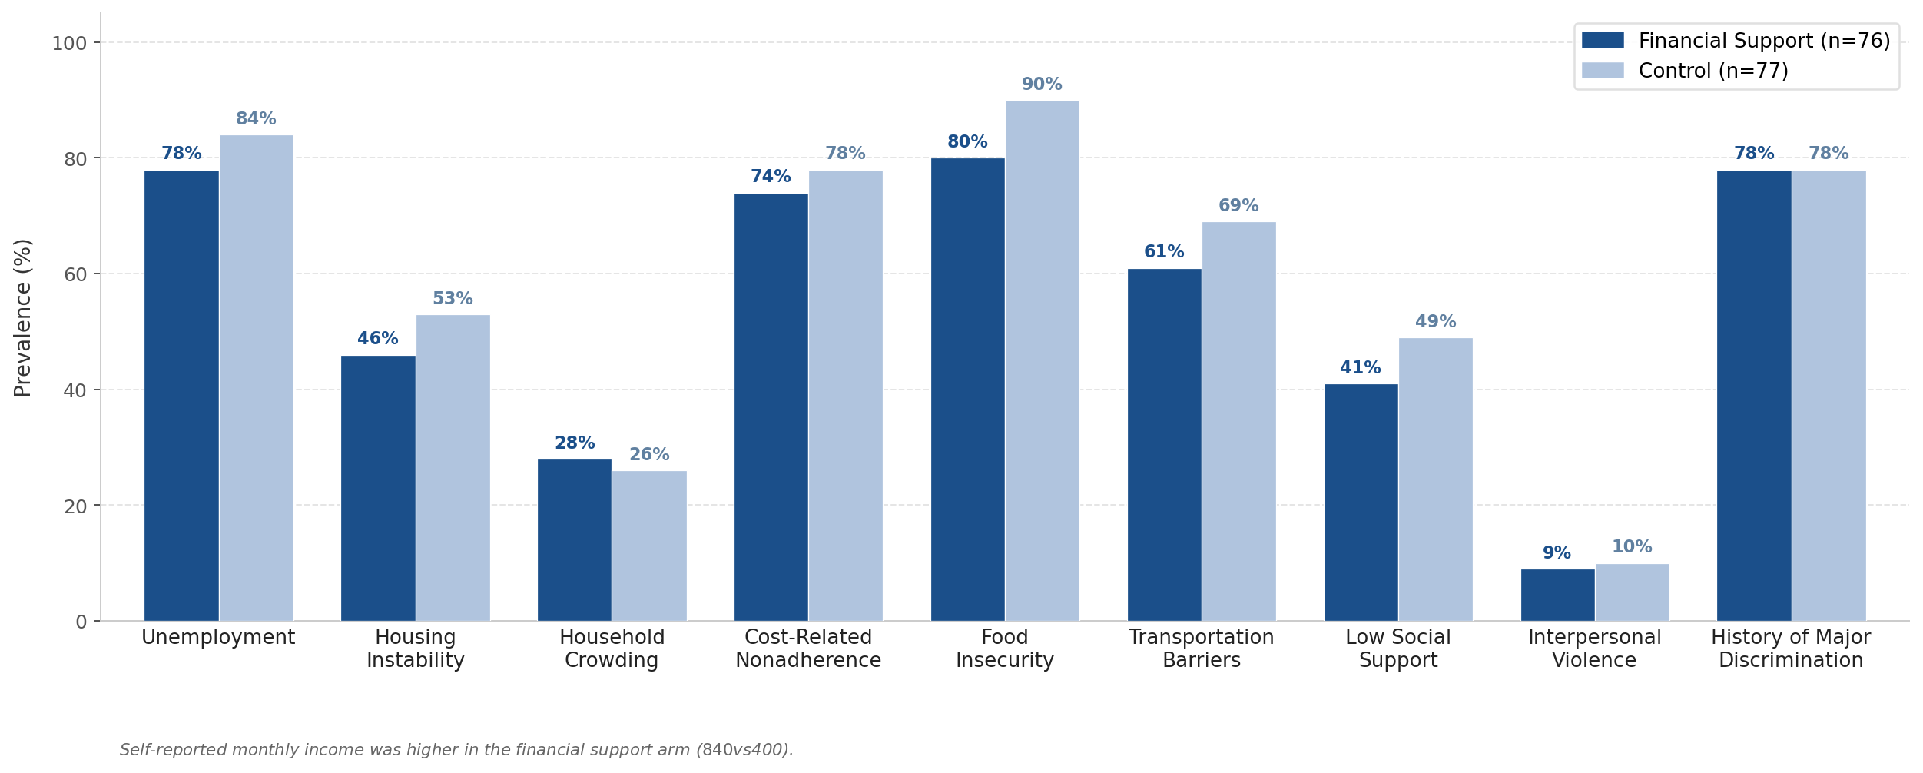
Burden of Adverse SDOH
Median total SDOH domains/participant = 5 in both groups
Notes:
Both groups had a median of five adverse SDOH domains per participant at baseline. Unemployment affected >75% of participants, housing instability was present in up to 50%, Cost-related nonadherence was present in over 75%, and Food insecurity affected 80 to 90% of participants.

Slide 13
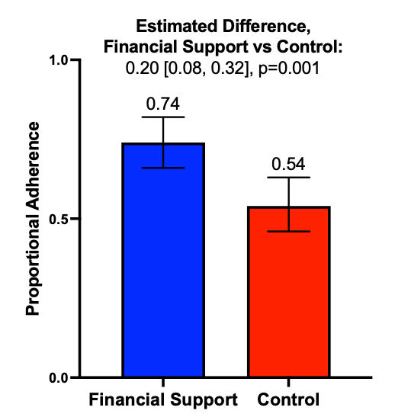
Adherence at 1 Month by TDM
Proportional adherence estimated as the proportion of tested medications with detectable serum levels using binomial regression with estimated marginal means. Error bars represent 95% confidence intervals.
Abbreviations: TDM – therapeutic drug monitoring
Notes:
Coming to the primary outcome. At 1-month follow-up, proportional TDM adherence — the fraction of tested medications with detectable serum levels — was significantly greater in the financial support arm than in the control arm, with a 20-percentage-point absolute difference

Slide 14
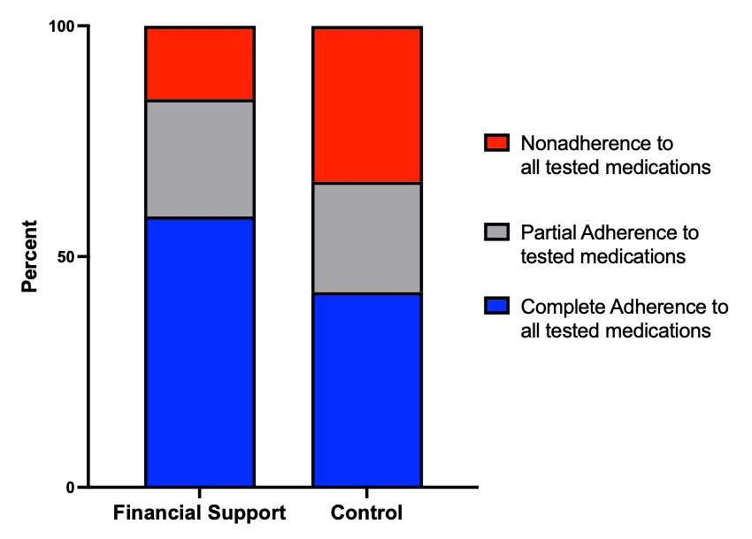
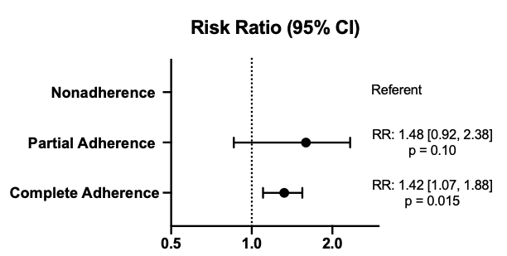
Adherence at 1 Month by TDM
15.9%
32.4%
25.4%
23.9%
58.7%
42.3%
Complete adherence: all tested medications detected (proportion=1.0). Partial adherence: at least one but not all detected (proportion >0 to <1.0). Nonadherence: no tested medications detected (proportion=0, referent). Risk ratios estimated using modified Poisson regression with robust standard errors.
Abbreviations: TDM – therapeutic drug monitoring, CI – confidence interval, RR – risk ratio
Notes:
Looking at categorical adherence, 58.7% of the financial support arm achieved complete adherence to all tested medications— compared to only 42.3% of controls. Nonadherence was nearly halved at 15.9% in the financial support arm versus 32.4% in the control arm. When analysed using a Poisson regression model, the financial support arm had 42% higher probability of complete adherence which was statistically significant.

Slide 15
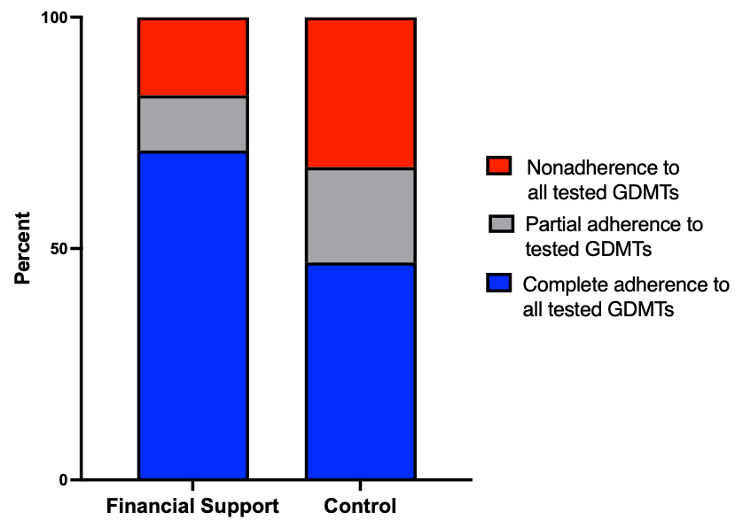
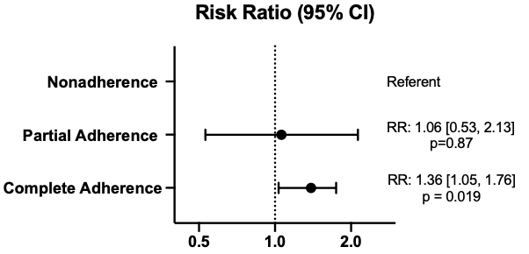
Adherence to GDMT at 1 Month by TDM
16.9%
11.9%
32.4%
20.6%
71.2%
47.1%
Complete adherence: all tested medications detected (proportion=1.0). Partial adherence: at least one but not all detected (proportion >0 to <1.0). Nonadherence: no tested medications detected (proportion=0, referent). Risk ratios estimated using modified Poisson regression with robust standard errors.
Abbreviations: TDM – therapeutic drug monitoring, CI – confidence interval, RR – risk ratio
Notes:
Similar pattern of greater adherence in favor of the financial support intervention was noted for HF GDMT of metoprolol and spironolactone. Complete adherence to tested GDMT was achieved by 71.2% of the financial support arm versus 47.1% of controls — a risk ratio of 1.36 in favor of the financial support intervention. Nonadherence to both GDMTs was rare in the intervention arm (6.9%), compared with 32.4% in controls.

Slide 16
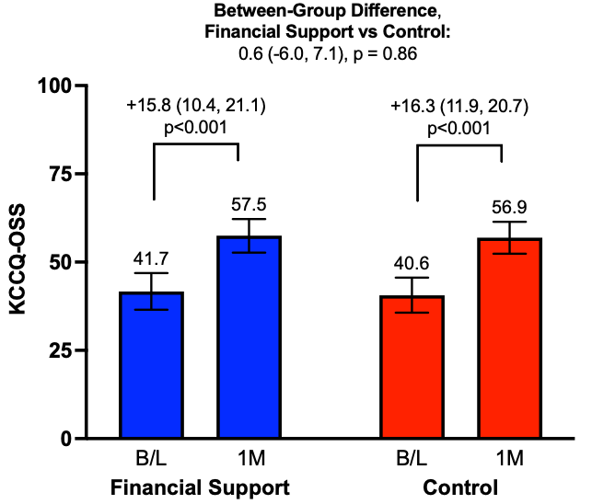
KCCQ-OSS at 1 Month
Health-related quality of life assessed by Kansas City Cardiomyopathy Questionnaire Overall Summary Score (0–100; higher = better). Bars represent baseline (B/L) and 1-month (1M) values. Within-group changes estimated using paired comparisons; between-group difference estimated using linear regression adjusted for baseline KCCQ-OSS, reported as least-squares mean difference (95% CI). Error bars represent 95% confidence intervals.
Abbreviations: B/L – baseline, 1M – 1 month< KCCQ-OSS – Kansas City Cardiomyopathy Questionnaire Overall Summary Score
Notes:
In terms of quality of life, significant improvement in QOL was noted in both groups — by about 16 points —with no meaningful between-group difference

Slide 17
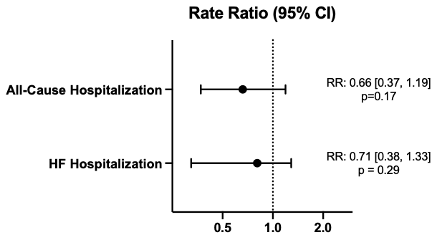
All-Cause & HF Hospitalization
All-Cause Hospitalization:
  Financial Support: 24.3 events per 100 PM
  Control: 36.6 events per 100 PM
HF Hospitalization:
  Financial support: 21.8 events per 100 PM
  Control: 30.5 events per 100 PM
Event rates calculated as events per 100 person-months using negative binomial regression with person-time offset to account for varying follow-up durations. All-cause hospitalization includes any inpatient admission; HF hospitalization defined as admission with primary or first secondary diagnosis of heart failure. Rate ratios expressed as financial support vs control.
Abbreviations: PM – person months, RR – rate ratio
Notes:
All-cause hospitalization rates were numerically lower at 24.3 events per 100 person-months in the financial support arm versus 36.6 in controls, with a rate ratio of 0.66 that was not significant. Similar pattern was also noted for HF hospitalization with a numerically lower HF hospitalization rates in the finanacial support arm vs. control arm that did not achieve statistical significance.

Slide 18
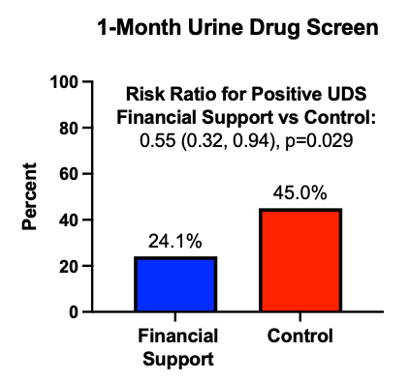
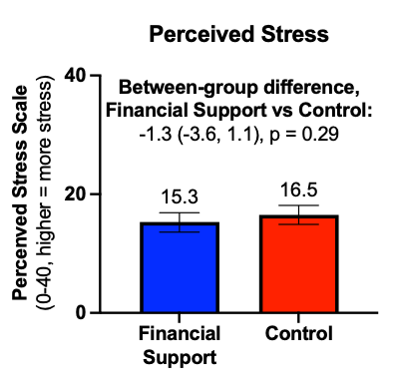
Safety Outcomes
Urine drug screen positivity compared using modified Poisson regression with robust standard errors, reported as risk ratio (95% CI). Perceived stress assessed by the Perceived Stress Scale (PSS-10; range 0–40, higher = greater stress) using linear regression adjusted for baseline values, reported as least-squares means (95% CI).
Abbreviations: UDS – urine drug screen
Notes:
In terms of safety outcomes, the unrestricted financial support did not lead to an increase in recreational drug use but was rather associated with a significant reduction in the risk of a positive UDS test on follow-up as shown in the bar plot on you right. Percieved stress scores on follow up were not different between the two groups

Slide 19
Key Findings and Implications
Among low-income patients with HFrEF and adverse SDOH, early financial support ($500 vs. control):
IMPROVED MEDICATION ADHERENCE
SAFETY & SUBSTANCE USE
TDM adherence: 20% absolute improvement (0.74 vs 0.54, p=0.001).
Consistent for GDMT (metoprolol, spironolactone) TDM additionally.
Lower proportion with positive urine drug screen in the financial support arm.
No increase in psychological distress (K10, PSS-10) in either arm.
QoL & CLINICAL OUTCOMES
NEXT STEPS
KCCQ-OSS: No between-group difference Both groups improved substantially from low baseline.
All-cause hospitalization: numerically lower (RR: 0.66, p=0.17) but not statistically significant.
Larger multicenter RCT powered for clinical endpoints.
Sustained financial support (up to 6 months).
Extended follow-up (up to 12 months) for clinical events, HRQOL, and TDM durability.
Notes:
In conclusion, among low-income patients with HFrEF and multidimensional adverse SDOH burden, early financial support resulted in significant improvement in medication adherence at 4-week follow-up. QOL improved meaningfully in both groups with no significant between-group differences, while the risk of all-cause hospitalization was numerically lower in the financial support arm.
The intervention had no unintended safety consequences with a significantly lower rate of positive drug screen in the financial support arm and no worsening in psychological stress in either group.
These findings establish the feasibility and proof of concept for early financial support as a meaningful strategy to improve HF care in this vulnerable population , and provide the evidence base for a definitive multicenter trial evaluating adherence durability and clinical outcomes.

Slide 20
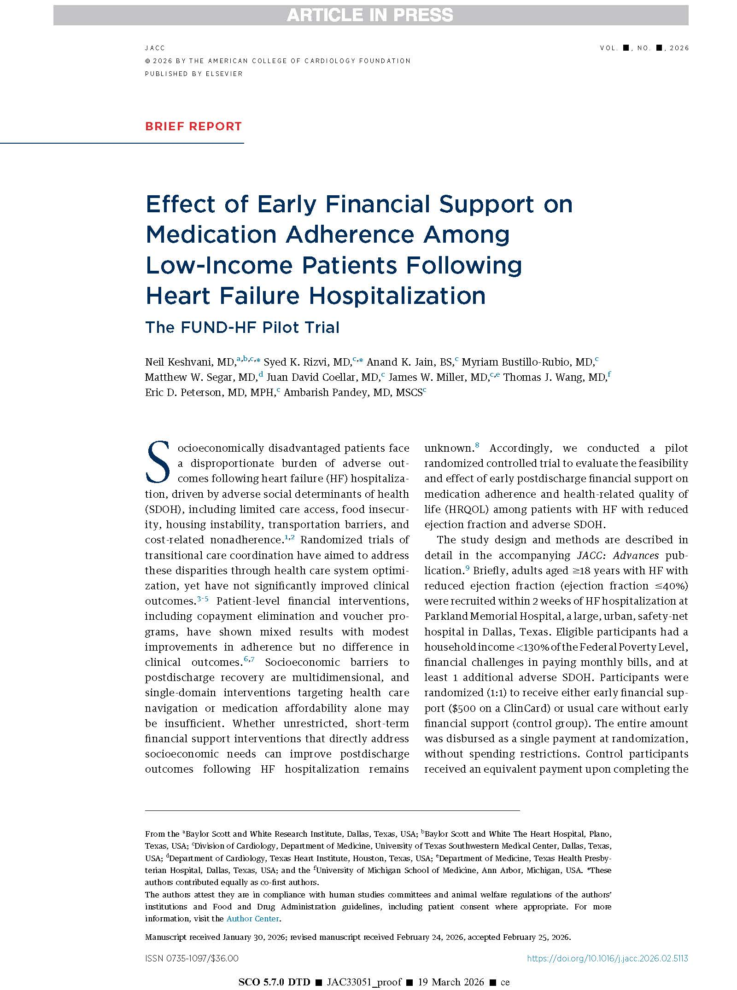
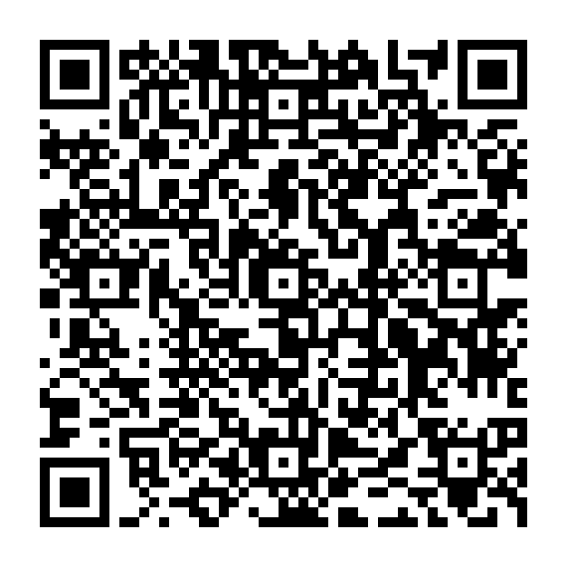

Simultaneously published in JACC
March 30th,1:15 PM
Notes:
The full results of the FUND-HF trial were published simulatnsouly with this presentation in JACC and can be accessed using the QR code here.

