Slide 1


Cardiorenal Outcomes: Tirzepatide vs. Dulaglutide
in Patients with Diabetes and Cardiovascular Disease
Steven E. Nissen MD MACC
On behalf of the SURPASS CVOT investigators
Study Sponsor:

Slide 2
Academic Executive Committee
Stephen J Nicholls and David D’Alessio (Co-Chairs)
Deepak L. Bhatt
John B. Buse
Stefano Del Prato
Steven E. Kahn
A. Michael Lincoff
Darren K. McGuire
Michael A. Nauck
Steven E. Nissen
Naveed Sattar
Bernard Zinman
Sophia Zoungas

Slide 3
Background
GLP-1 agonists reduce major adverse cardiovascular and renal outcomes in patients with ASCVD and diabetes, obesity or CKD.
Tirzepatide targets both GLP-1 and GIP receptors with added benefits on weight, glycemic control and biomarkers associated with adverse cardiorenal outcomes.
SURPASS CVOT was the first large outcome trial of an incretin-based therapy with an active control arm, showing:
  Tirzepatide, was noninferior (P<0.001) to the GLP-1 agonist dulaglutide for a 3-component composite of CV death, MI, or stroke.

Slide 4
Current Analysis
In SURPASS CVOT, dulaglutide was chosen as the comparator because it reduced cardiovascular events in the REWIND trial and was available in a visibly identical injector to tirzepatide.
In SURPASS CVOT, outcomes for more comprehensive range
of major adverse cardiorenal end points have not been reported.
The current study is a secondary post hoc analysis that includes a broader range of major sources of morbidity and mortality
in patients with diabetes and ASCVD.

Slide 5
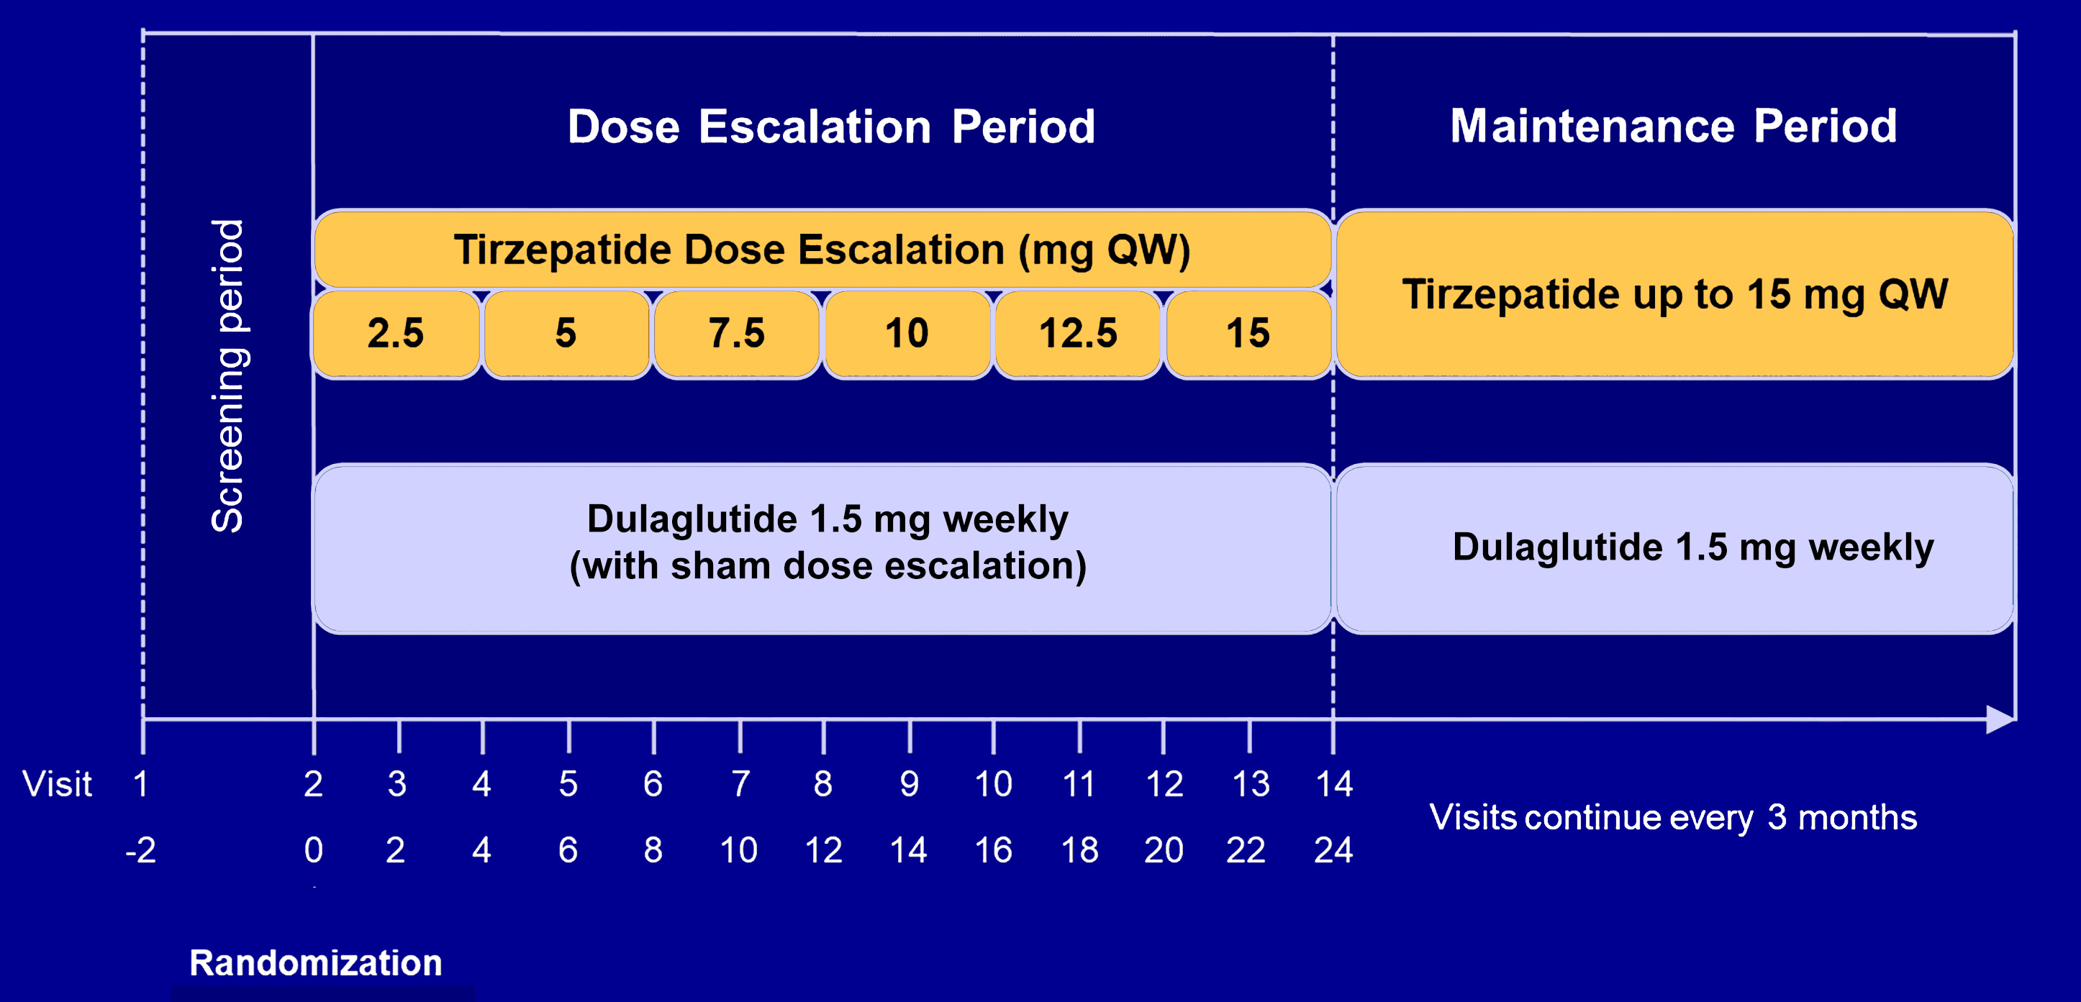
SURPASS CVOT: Trial Design
*
*Maximum tolerated dose

Slide 6
End Points for Current Analysis
Primary end point: 6-component cardiorenal outcomes:
  1) All-cause mortality
  2) Myocardial infarction
  3) Stroke
Sensitivity analyses:
  5 component end point (omitting adverse renal outcomes)
  4-component end point (omitting renal and heart failure outcomes)
  4) Coronary revascularization
  5) Hospitalization for heart failure
  6) Adverse renal outcomes

Slide 7
Selected Baseline Characteristics: Patients with Events
 | Tirzepatide (n=6586) |  | Dulaglutide (n=6579)
Characteristic | With Event N=1559 | Without event N=5027 | With Event N=1803 | Without event N=4776
Mean Age (years) | 66.0 | 63.4 | 65.8 | 63.5
Female sex | 21.0% | 31.1% | 23.1% | 31.6%
Weight (kg) | 93.4 | 92.4 | 93.8 | 92.0
eGFR (mL/min/1.73 m²) | 69.7 | 81.2 | 71.7 | 82.1
Median UACR (mg/g) | 46 | 19 | 46 | 18
Microalbuminuria | 40.4 | 29.4 | 42.5 | 28.0
Hemoglobin A1c (%) | 8.5 | 8.4 | 8.4 | 8.4
Prior CHF (%) | 27.0 | 17.7 | 28.6 | 17.9

Slide 8
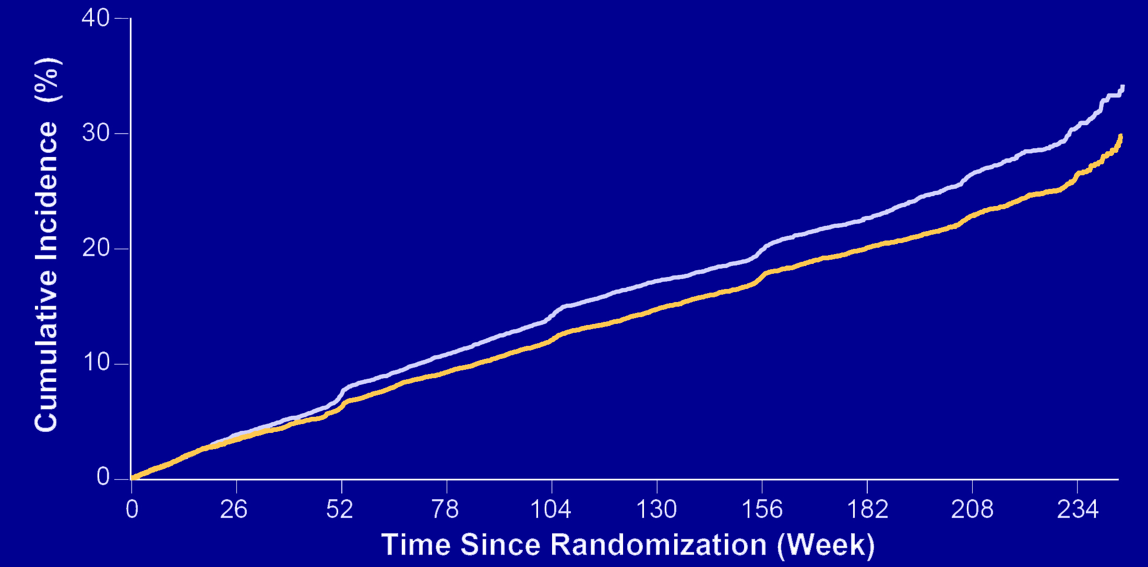
Tirzepatide vs. Dulaglutide: 6-Component Outcome
HR 0.84
(95% CI 0.79 – 0.90)
P<0.001
Dulaglutide
Tirzepatide

Slide 9
Results: Six Major Cardiorenal Adverse Outcomes
 | Tirzepatide % | Dulaglutide % | HR (95% CI) | P value
6-component composite | 23.7 | 27.4 | 0.84 (0.79-0.90) | <0.001
End point components
All-cause mortality | 8.6 | 10.2 | 0.84 (0.75-0.94)
Myocardial infarction | 4.7 | 5.4 | 0.86 (0.74-1.00)
Stroke | 3.5 | 3.8 | 0.91 (0.76-1.09)
Coronary revascularization | 8.0 | 9.4 | 0.84 (0.75-0.95)
Heart failure hospitalization | 3.0 | 3.1 | 0.96 (0.79-1.17)
Composite renal end point | 4.9 | 6.1 | 0.79 (0.68-0.91)

Slide 10
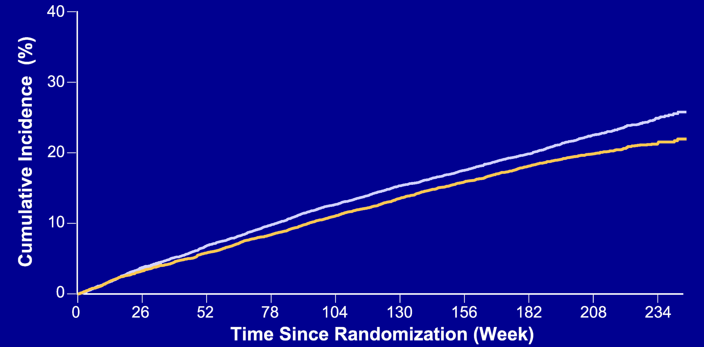
Tirzepatide vs. Dulaglutide: 5-Component Outcome
Sensitivity analysis:
Omitting renal events
HR 0.86
(95% CI 0.80 – 0.93)
P<0.001
Dulaglutide
Tirzepatide

Slide 11
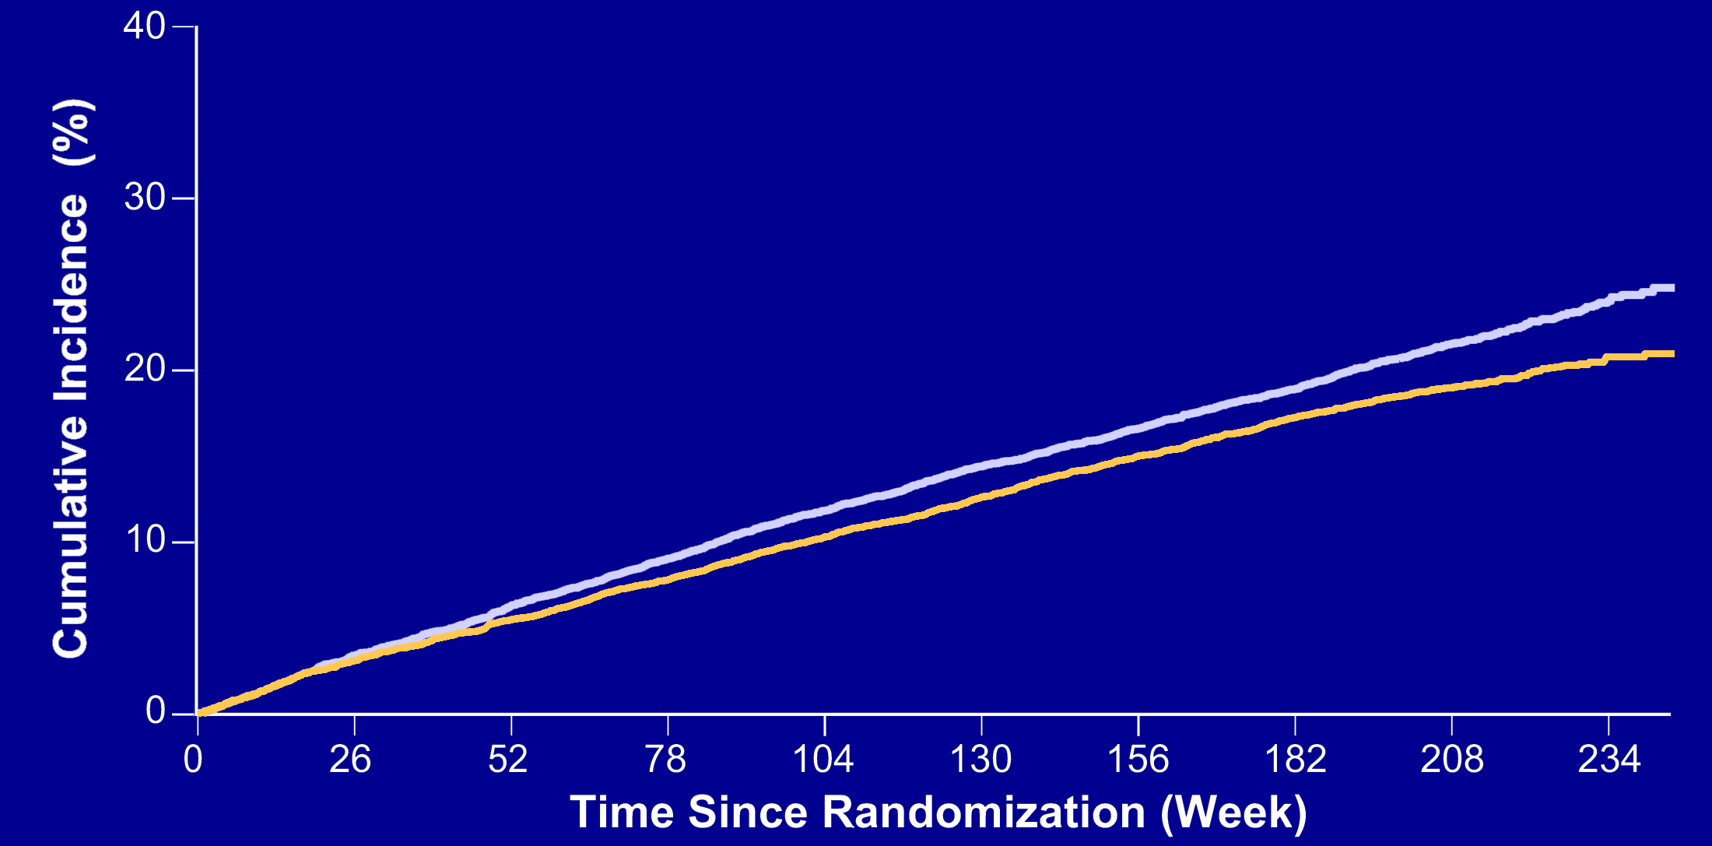
Tirzepatide vs. Dulaglutide: 4-Component Outcome
Sensitivity analysis:
Omitting renal
and heart failure events
HR 0.86
(95% CI 0.80 – 0.93)
P<0.001
Dulaglutide
Tirzepatide

Slide 12
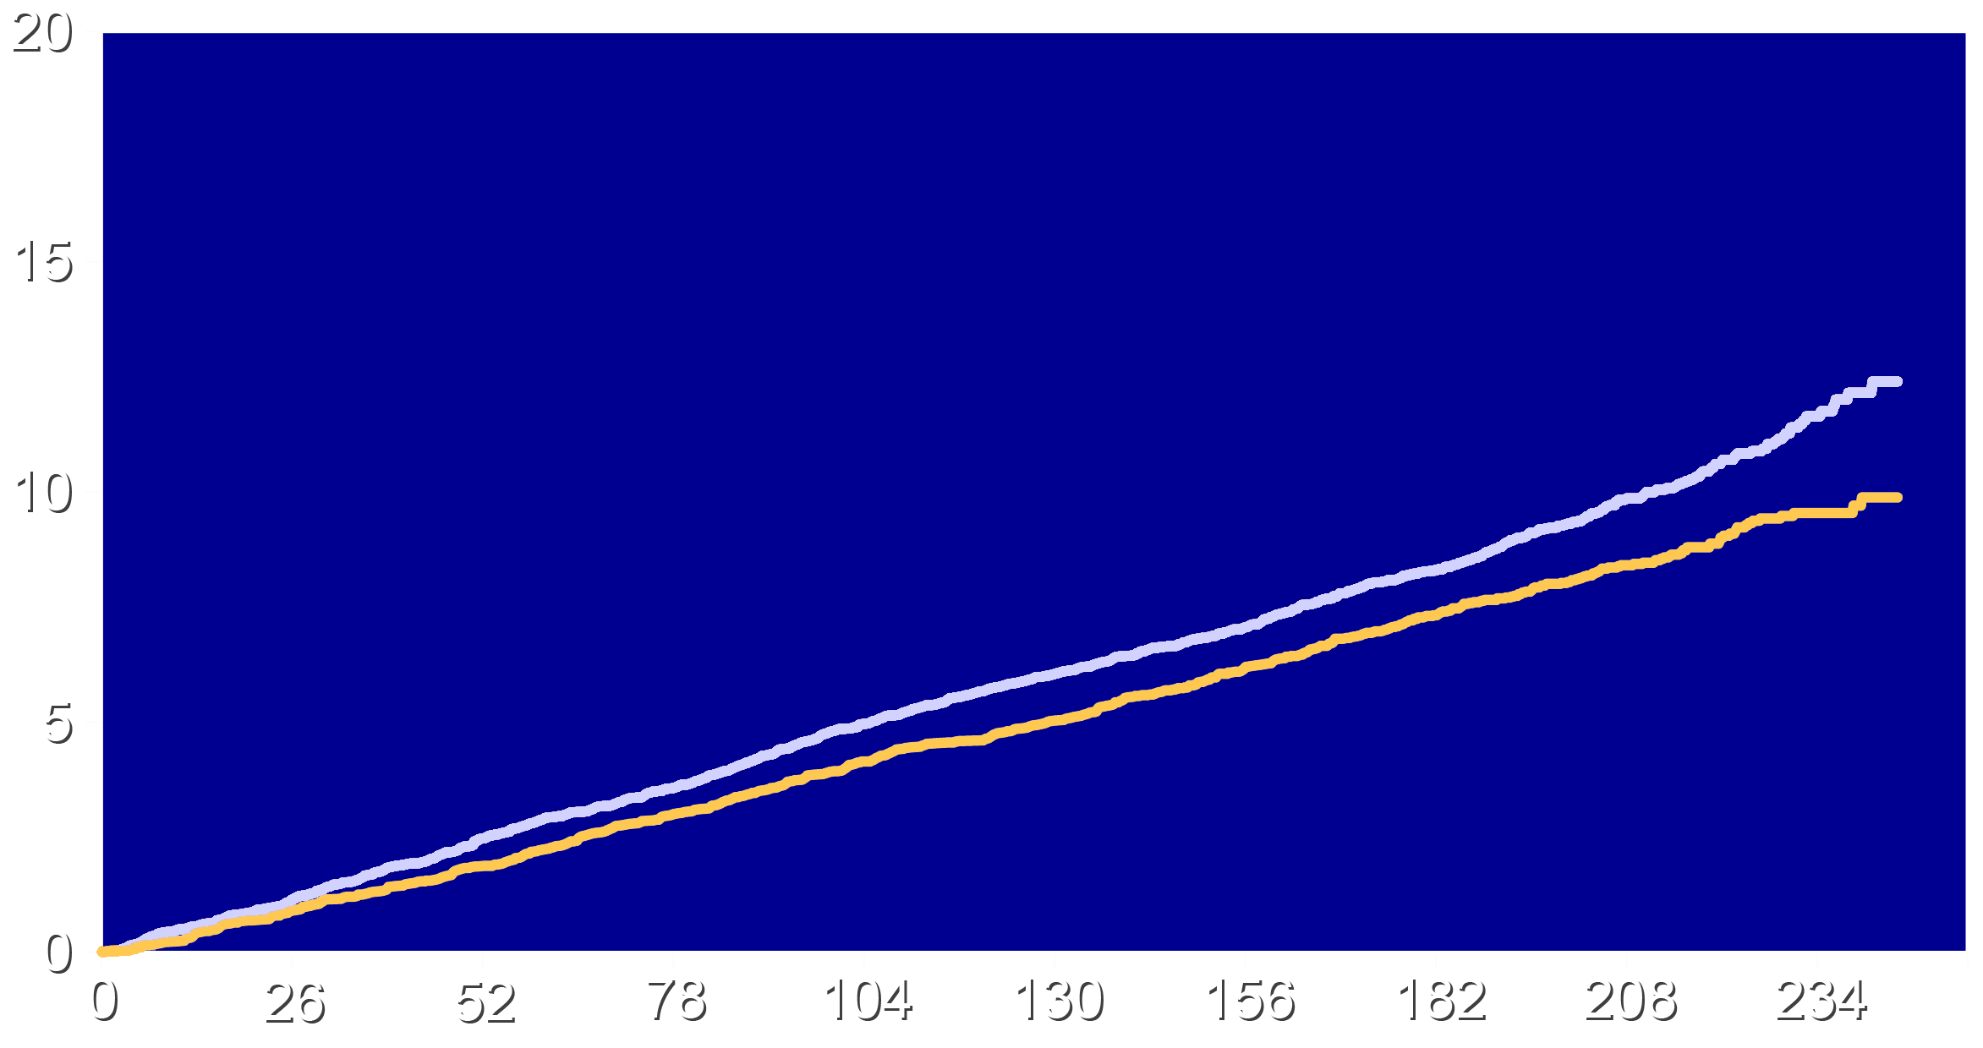
All-Cause Mortality: Major Driver of Improved Outcomes
HR 0.84
(95% CI 0.75 – 0.94)
P<0.001
Dulaglutide
Cumulative Incidence (%)
Tirzepatide
Time Since Randomization (week)

Slide 13
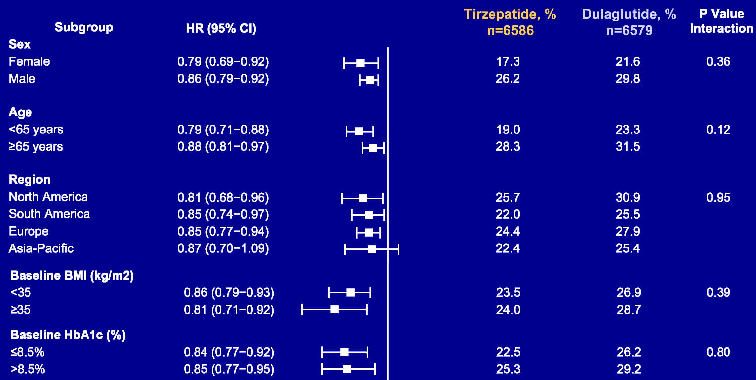
Selected Subgroups: 6-component Cardiorenal End Point
Tirzepatide
better
Dulaglutide
better

Slide 14
Most Common Investigator-Reported Adverse Effects
Most Common Adverse Events | Tirzepatide N=6647 | Dulaglutide N=6647
Any treatment emergent adverse event | 89.6% | 88.7%
Serious treatment emergent adverse event | 31.8% | 31.9%
Adverse event leading to drug discontinuation | 13.2% | 10.1%
Gastrointestinal disorders | 42.5% | 35.9%
Urinary tract infection | 7.1% | 7.5%
Dizziness | 7.0% | 6.2%
Arthralgias | 6.2% | 6.4%
Hypotension | 5.9% | 3.3%

Slide 15
Limitations
This was a secondary post hoc analysis for a trial with a narrower 3-component primary end point. Such analyses benefit from knowledge about the outcomes in the primary trial.
However, each of the components of the current study were prespecified and most were centrally adjudicated.
The broader end point resulted in approximately double the number of events which yielded much greater statistical power.
These patients were high risk for a cardiovascular event. Results may not apply to lower risk populations.

Slide 16
Conclusions
In patients with diabetes and ASCVD, tirzepatide, compared with dulaglutide, was associated with a lower incidence
of a broad 6-component cardiorenal end point that included:
  All-cause mortality
  Myocardial infarction
  Stroke
  Coronary revascularization
  Heart failure
  Adverse renal outcomes.

Slide 17
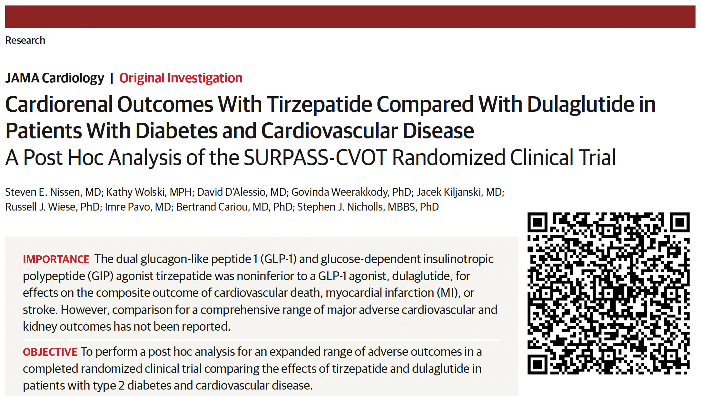

Slide 18
A Final Thought
Highly efficacious incretin therapies for diabetes and obesity are now available with additional drugs in development. These treatments offer a wide range
of benefits for patients and represent a new paradigm for reduction in multiple cardiorenal adverse outcomes.

