Slide 1
The STEMI Door to Unload Trial (STEMI-DTU)
Gregg W. Stone MD
Icahn School of Medicine, Mount Sinai Hospital, NY, NY
On behalf of the STEMI-DTU Steering Committee and Investigators
This presentation includes discussion of investigational or unapproved uses of Impella that have not been approved by the U.S. Food and Drug Administration.
The presentation is intended for scientific exchange and educational purposes only.

Slide 2
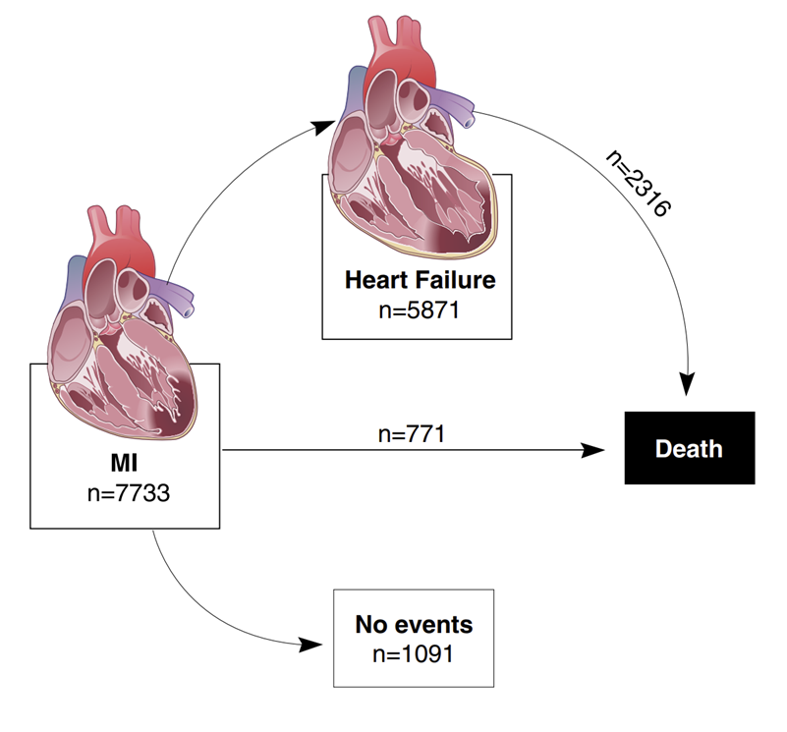
Heart Attacks Lead to Heart Failure: Age >65 with 1st Acute MI
Despite timely reperfusion:
10% In-hospital mortality
34% In-hospital HF
76% HF within 5 years
For every 5% increase in infarct size,
1-year mortality and 1-year HF hospitalization increases by 20%
Larger infarcts and higher 1-year mortality/HF hospitalization with Anterior vs Non-anterior STEMI
76%
39%
10%
in-hospital mortality
14%
Ezekowtiz and McAlister et al JACC 2009
Stone and Udelson et al JACC 2019
DeWaha and Stone et al JAHA 2024
Notes:
Heart attacks lead to heart failure. This is especially evident for patients over the age of 65 with their first acute MI. Despite timely reperfusion….

Slide 3
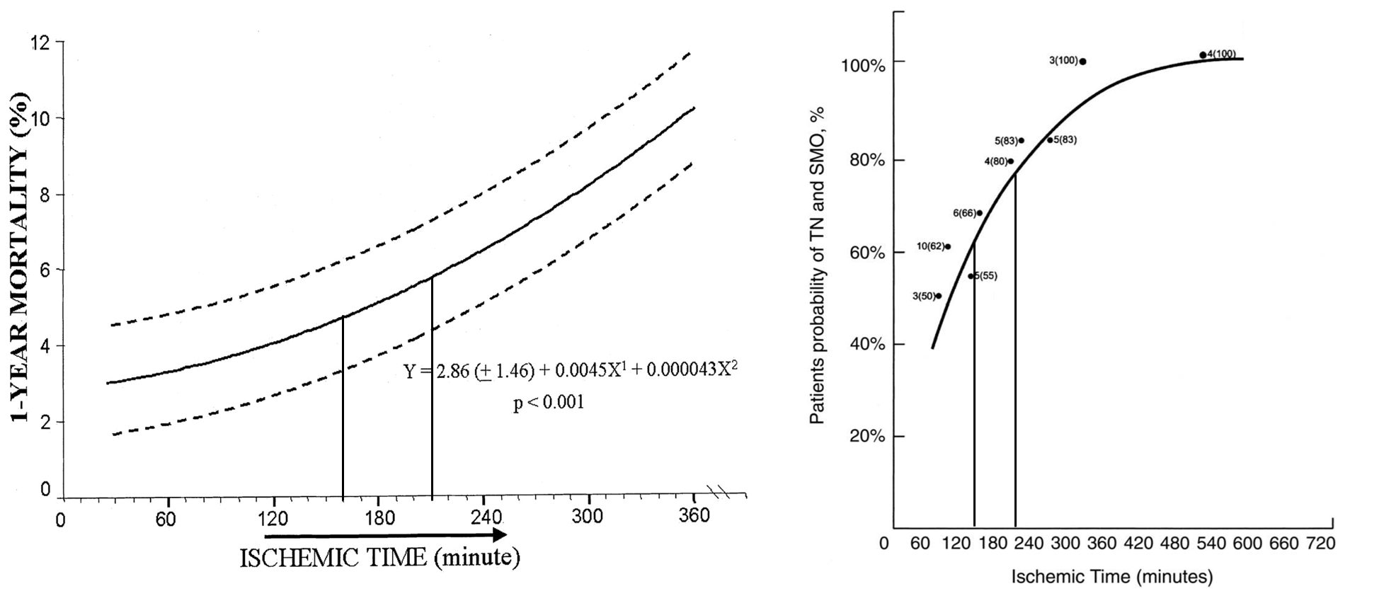
Time is Myocardium
Ischemic Time Correlates with Mortality and Infarct Size
Patients probability of Troponin
1-Year Mortality %
Ischemic Time (minutes)
Ischemic Time (minutes)
DeLuca and Antman et al Circulation 2004
Tarantini and lliceto et al JACC 2005
Notes:
The mantra that Time is Muscle is most directly evident when looking at total ischemic time from symptom onset to reperfusion, which is directly associated with mortality and infarct size (as measured by troponin levels in this report by Tarantini and colleagues in 2005).

Slide 4
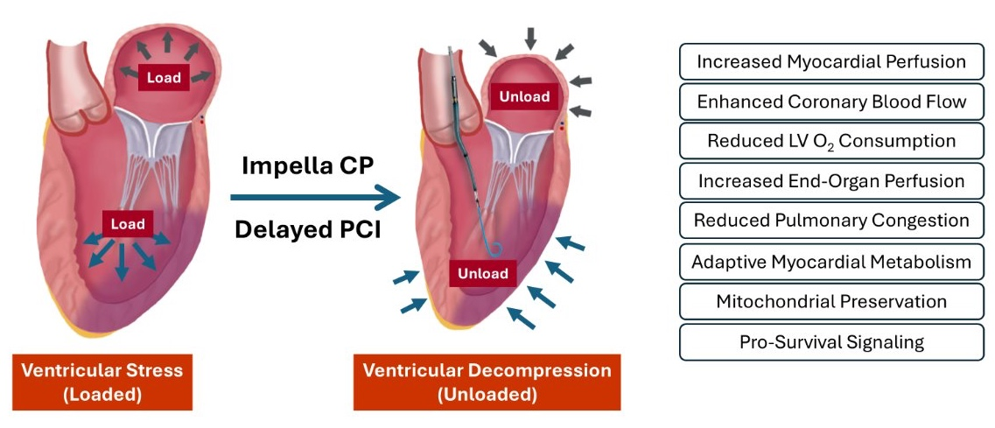
Five Decades of Preclinical Testing has Shown that LV Unloading Reduces Myocardial Ischemia & Promotes Cardioprotective Signaling
Impella
Pre-PCI
DeLaria and Bernstein et al J Thor Card Surg 1974; Laschinger and Spencer et al Arch Surg 1983;
Meyns et al. J Am Coll Cardiol 2003; Archour, Smalling et al CCI 2005; Tieluo, Griffith, et al JATS 2016;
Saku, Sunagawa et al Circ HF 2018; Esposito ML et al. JACC 2018; Watanabe, Ishikawa et al JAHA 2018;
Kapur NK et al. Circulation 2019
Notes:
Since the early 1970’s extensive preclinical data supports the concept that reducing left ventricular wall stress and workload (known as LV unloading) reduces myocardial ischemic and promotes cardioprotective signaling. These mechanisms are illustrated on the right and include enhanced myocardial perfusion, reduced oxygen consumption, and alterations in myocardial biology that limit both ischemic and reperfusion injury. These studies became more translationally relevant with the introduction of Impella – rapidly deployable percutaneous LV unloading technology.

Slide 5
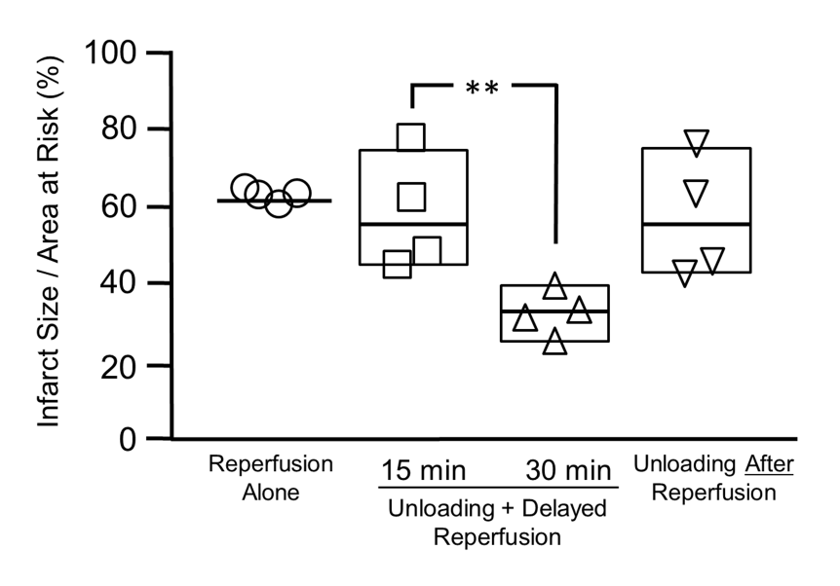
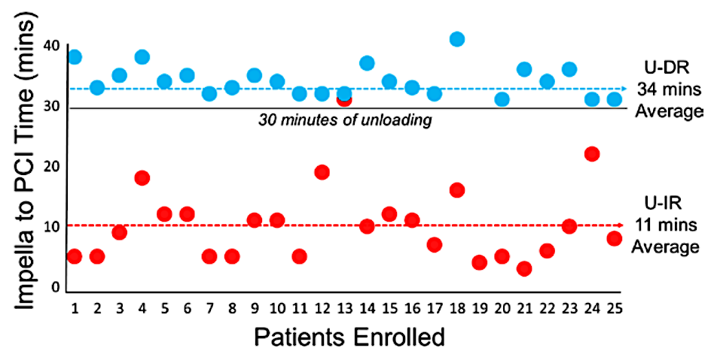
Bench to Bedside Translation of the Door-to-Unload Paradigm
LV Unloading Plus Delayed PCI Reduces Infarct Size
30 Minutes of LV Unloading Before PCI Optimize Myocardial Salvage
STEMI-DTU Pilot Trial Confirms
Feasibility of LV Unloading + Delayed PCI
Esposito and Kapur et al. JACC 2018;72:501-14
Kapur and O'Neill et al. Circulation 2019;139:337-46
Notes:
The translation from bench to bedside of the Door to LV unloading paradigm became more evident when a preclinical study in 2018 illustrated that optimal reductions in infarct size were achieved when LV unloading was combined with a 30 minute delay to reperfusion – a period of mechanical pre-conditioning of the myocardium. The challenge was translating these preclinical protocols to clinical trials. For this reason the STEMI-DTU pilot study was performed and showed feasibility of Impella unloading plus delayed reperfusion compared to Impella unloading and immediate PCI in patients with anterior STEMI. These reports supported the development of the STEMI-DTU pivotal trial.

Slide 6
STEMI-DTU Randomized Controlled Trial
Acute anterior STEMI without cardiogenic shock
Patients meeting all clinical inclusion and no exclusion criteria
Iliofemoral angiogram and LV-gram (with LVEDP measurement)
To rule out Impella CP contraindication and rule-in likely PCI indication
R
Stratified by site and symptom onset to hospital arrival ≤3 vs. >3 hrs
Treatment arm
Control arm
Impella CP Impella plus a protocolized
≥30-minute delay before PCI
4-24 hours Impella CP support
Immediate coronary angiography + PCI
Follow-Up
3-5-day echo and cardiac MRI
30-day clinical safety evaluation
90-day echo
6-month cardiac MRI for LV function and clinical evaluation
12-, 18-, 24-, 36-, 48- and 60-month clinical evaluation
Clinicaltrials.gov NCT03947619
Kapur NK et al. Am Heart J. 2022;254:122-32
Notes:
The STEMI-DTU Trial design is illustrated here. Enrollment involved a rigorous screening, consent, and randomization sequence that included performance of a femoral angiogram, LV gram, and assessment of LV wall motion prior to randomization in the cath lab. After randomization, patients received either an Impella CP or immediate PCI. In the treatment arm, Impella support was combined with a 30 minute protocolized delay before PCI – this has NEVER been attempted before and represents a highly innovative aspect of the procedure given that any delay to PCI should increased infarct size. The Impella device was left in place for a minimum of 4 hours and needed to be removed in the cath lab within 24 hours. 3-5 days later a CMR was performed for infarct size assessment. Patients will be followed for up to 5 years.

Slide 7
Key Eligibility Criteria
Clinical inclusion criteria
Age 18-85 years
First MI, 1-6 hours after chest pain onset
Acute anterior STEMI with ≥2 mm STE in ≥2 anterior leads or ≥4 mm STE in V1-V4 AND anterior wall motion abnormality noted on contrast LV gram or echocardiogram
Indicated for primary PCI
Signed informed consent
Iliofemoral and LV angiographic inclusion criteria (Pre-randomization)
Anterior wall motion abnormality
No vascular contraindications to Impella CP
Clinical exclusion criteria
Unwitnessed cardiac arrest OR ≥30 minutes of CPR prior OR any cardiac arrest with neurologic impairment
Cardiogenic shock or acute cardiac mechanical complication
Inferior STEMI or RV infarction
Contraindication to Impella CP
Prior coronary angiogram or fibrinolysis or MCS for this admission
Prior HF or severe Ao valve ds/interv
Prior CABG or LAD-PCI
Notes:
Inclusion criteria are shown here. The population was focused on anterior STEMI without cardiogenic shock.

Slide 8
Study Endpoints
Primary effectiveness endpoint
Infarct size on day 3-5 cardiac MRI (%LV mass)
Key powered secondary effectiveness endpoint
Hierarchical composite (win ratio), of (in order)
CV death at ≥12 months
Cardiogenic shock at ≥24 hours from enrollment
LVAD or heart transplant at ≥12 months
Heart failure at ≥12 months
ICD or CRT placement at ≥12 months
Infarct size on day 3-5 cardiac MRI (%LV mass)
Key secondary safety endpoint
All patients with Impella attempted/implanted only (vs. prespecified performance goal)
Device- or procedure-related major bleeding or major vascular complications at 30 days
Notes:
The study endpoints are shown here. As a mechanistic study, the primary endpoint is infarct size normalized to total LV mass. The powered secondary endpoint is a hierarchical composite anchored by infarct size. The key secondary safety endpoint is device or procedure related major bleeding or vascular complications at 30 days.

Slide 9
Power Analysis
Primary effectiveness endpoint
Assumptions
5% mean difference in infarct size between groups
15% SD in both groups
26% attrition (non-acquired or non-analyzable CMR images)
2-sample t-test at a 2-sided α=0.05 (normality met)
516 randomized pts provides 90% power
Key secondary safety endpoint (Impella group only)
Performance goal of 26.5%
Exact binomial test
516 randomized pts provides >95% power
Notes:
The study was powered to achieve 90% power with 516 patients.

Slide 10
Patient Enrollment
4,519 subjects screened at 70 sites in the
US, Germany, Italy, Switzerland, UK and Canada
between Dec 12, 2019 and Sep 3, 2024
Randomized
N=527 at 55 sites
Ineligible N=3,884
1,187 (30.6%) Inclusion 4: Patient presents to the hospital between 1-5(6) hours of Ischemic pain onset
738 (19.0%) Exclusion 5: Inferior STEMI or suspected right ventricular failure
556 (14.3%) Inclusion 3: Acute anterior STEMI with ≥ 2mm in 2 or more contiguous anterior leads or ≥ 4mm
510 (13.1%) Inclusion 2: First myocardial infarction
376 (9.7%) Inclusion 1: Age 18-80(85) years
Treatment
N=262 (ITT)
Control
N=265 (ITT)
Evaluable CMR
N=220
Evaluable CMR
N=223
Enrolled
N=635 at 66 sites
30-day follow up
N=245
30-day follow up
N=237
Roll-in Subjects N=108
Randomized
N=527 at 55 sites
12-month follow up
N=234
12-month follow up
N=225
Notes:
Over 4,500 patients were screened over a 5 year period through the COVID pandemic in 6 countries across 66 sites. The ITT population was 527 subjects with 262 and 265 in the treatment and control arms respectively.

Slide 11
Baseline Characteristics
 | Treatment N=262 | Control N=265
Age, years | 60 ± 11 | 62 ± 11
Male | 209 (79.8%) | 208 (78.5%)
Body mass index, kg/m² | 28.6 ± 5.3 | 28.3 ± 5.0
Race: White/Caucasian | 209/241 (86.7%) | 222/243 (91.4%)
Geography
United States | 179 (68.3%) | 185 (69.8%)
Europe | 80 (30.5%) | 77 (29.1%)
Canada | 3 (1.2%) | 3 (1.1%)
Medical history
Hypertension (drug treated) | 99/254 (39.0%) | 104/258 (40.3%)
Current nicotine use | 73/248 (29.4%) | 84/256 (32.8%)
Dyslipidemia (drug treated) | 50/257 (19.5%) | 61/259 (23.6%)
Diabetes mellitus | 56/262 (21.4%) | 55/262 (21.0%)
 | Treatment N=262 | Control N=265
At presentation
Blood pressure, mmHg
Systolic | 143 ± 25 | 142 ± 25
Diastolic | 90 ± 16 | 87 ± 16
Mean arterial pressure, mmHg | 108 ± 18 | 106 ± 18
Heart rate, beats/min | 80 ± 18 | 81 ± 19
Anterior ST-segment elev sum, mm | 9.6 ± 6.7 | 9.7 ± 6.2
Cath lab, pre-PCI
Arterial lactate, mmol/L | 2.0 ± 1.3 | 2.1 ± 1.0
LVEDP, mm Hg | 26 ± 10 | 24 ± 9
LVEF, % | 46 ± 10 | 46 ± 11
Notes:
Baseline characteristics illustrate a typical anterior stemi population. Notably, however, we were surprised to see the hypertensive nature of patients with a mean arterial pressure approaching 110 mmHg. This is important because high afterload can negative impact the ability of a rotary flow pump to unload the left ventricle. Patients also had mean lactate levels around 2.0 and high LVEDPs – suggested we enrolled the correct population.

Slide 12
Procedural Characteristics
 | Treatment N=262 | Control N=265 | p-value
PCI access site, radial | 53 (20.2%) | 43 (16.2%) | 0.23
Culprit lesion: Left anterior descending | 249/254 (98.0%) | 253/259 (97.7%) | 0.88
Pre-PCI pressures | (After pump Insertion)
Aortic diastolic pressure, mmHg | 86.6 ± 18.0 | 77.3 ± 18.5 | <0.0001
Coronary perfusion pressure (ADP-LVEDP), mmHg | 61.4 ± 19.3 | 52.5 ± 18.7 | 0.0005
Core laboratory angiographic assessments
Pre-PCI TIMI flow, culprit vessel |  |  | 0.004
0/1 | 142/254 (55.9%) | 179/258 (69.4%)
2/3 | 112/254 (44.1%) | 79/258 (30.6%)
2 | 55/254 (21.7%) | 29/258 (11.2%)
3 | 57/254 (22.4%) | 50/258 (19.4%)
Post-PCI TIMI flow, culprit vessel |  |  | 0.63
0/1 | 2/247 (0.8%) | 2/248 (0.8%)
2 | 35/247 (14.2%) | 41/248 (16.5%)
3 | 210/247 (85.0%) | 205/248 (82.7%)
Notes:
Some key procedural characteristics are shown here. Radial access for PCI was only observed in 16-20% due to the protocol requirement for a femoral angiogram in all patients. 98% of patients had a culprit lesion in the LAD. After initiation of the Impella pump, aortic diastolic pressure and coronary perfusion pressure was significantly increased compared to the control arm. Notably, after 30 minutes of Impella support, more patients achieved TIMI 2/3 flow before PCI in the treatment arm compared to controls, which may reflect the combination of increased coronary perfusion pressure and exposure to anticoagulation for 30 minutes before PCI.

Slide 13
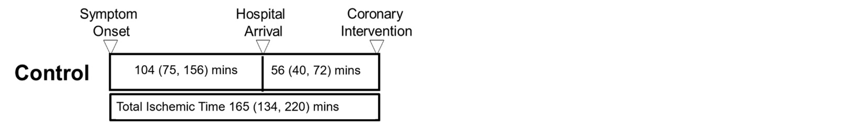
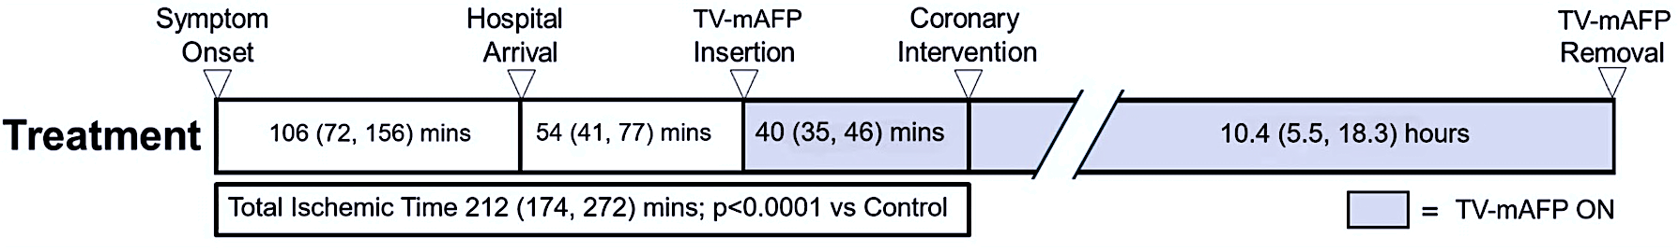
Total Ischemic Time and Door-to-Balloon Time
Control
Treatment
Median 47 minutes longer Total Ischemic Time (p<0.0001)
Median 42 minutes longer Door-to-Balloon time (p<0.0001)
Zero bail-out PCI during the protocolized ≥30 mins waiting period under TV-mAFP support
Notes:
As mentioned, this was a highly ambitious study protocol, especially within the high pressure environment of anterior STEMI where timing is critical. Both the treatment and control arms had nearly identical symptom onset to first device timing. In the treatment arm, the protocolized delay to PCI led to a 47 minute increase in total ischemic time and 42 minute increase in door to balloon time compared to controls. Notably, operators were allowed to bailout to PCI during this delay to PCI period. Zero bailouts were observed, suggesting patient stability while on LV support before PCI. Impella pumps stayed in place for an average of 10 hours as per protocol. Based on these timing elements and consistent with what we knew about door to balloon and total ischemic time, one would expect an increase in infarct size in the treatment arm.

Slide 14
Acknowledgements
Steering Committee
William O’Neill, MD NPI
Norman Mangner, Prof. Dr. Med NPI
Gregg W Stone, MD
James Udelson, MD
Jeffrey Moses, MD
Navin K Kapur MD*
  Regional PI Leads
  Nima Aghili, MD
  Alaide Chieffo, Prof. Dr. Med
  Haroon Faraz, MD
  Sanjit Jolly, MD
  Samuel McElwee, MD
  Raja A. Nazir, MD
  Contributors
  Richard Karas, MD PhD
  Daniel Burkhoff, MD PhD
STEMI DTU Study Patients
STEMI DTU Site Investigators
STEMI DTU Research Coordinators
Cardiovascular Research Foundation
ECG Core Lab (Director: Jose Dizon, MD)
Angiographic Core Lab (Director: Bjorn Redfors, MD)
DSMB (Chair: Jeffrey, Marshall, MD)
CEC (Chair: Steven Marx, MD)
  Yale Core Lab
  Directors: Alexandra Lansky, MD; Lissa Sugeng, MD
  Perceptive Imaging CMR Analysis
  Central Reader (Yuchi Han, MD)
  Duke Core Lab
  Director: Raymond Kim, MD
  J&J MedTech Heart Recovery
  Clinical Affairs
  Medical Affairs
* Employee of J&J MedTech as of April 2025

Slide 15
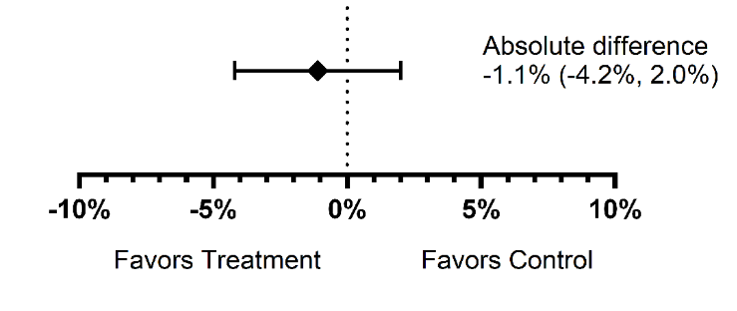
Primary Endpoint: Infarct Size (%LVM)
ITT
Absolute Difference
-1.1% (-4.2%, 2.0%)
Intent-to-Treat Population | Treatment | Control | p-value
Mean ± SD, % | 30.8 ± 16.2 | 31.9 ± 16.9 | 0.50
Median (IQR), % | 31.8 (19.4, 43.5) | 31.9 (19.7, 43.4) | 0.51
Notes:
The primary endpoint is shown here. Impella plus delayed PCI did not reduce infarct size compared to the control arm. An absolute reduction of 1.1% was observed in the treatment arm. Notably, despite the increase in total ischemic time and delayed PCI, no increase in infarct size observed.

Slide 16
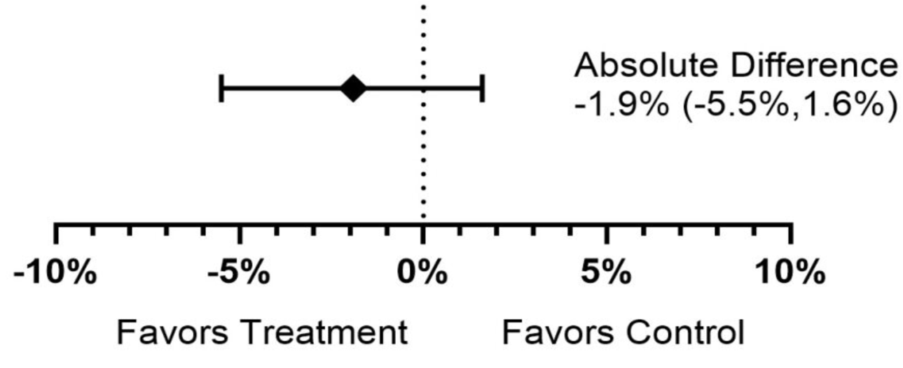
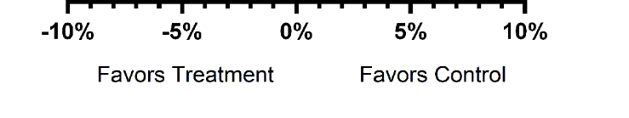
Primary Endpoint: Infarct Size (%LVM)
Absolute Difference
-1.9% (-5.5%, 1.6%)
Per-Protocol
Per-Protocol Population | Treatment N=153 | Control N=170 | p-value
Mean ± SD, % | 31.8 ± 16 | 33.7 ± 16 | 0.28
Median (IQR), % | 32.4 (21.3, 44.1) | 36.1 (22.3, 45.4) | 0.26
Per-protocol = Included ITT subset with no major protocol violations and either:
(a) randomized to TV-mAFP and received treatment including ≥30 mins delay prior to PCI and TV-mAFP support for ≥4 hours or (b) were randomized to the control group and received PCI only.
Excluded subjects having cardiogenic shock prior to enrollment (based on pre-PCI lactate and hemodynamics)
Notes:
In the per protocol population, the absolute reduction in infarct size increased to 1.9%, but remained non-statistically significant.

Slide 17
Key Powered Secondary Effectiveness Endpoint
Treatment group compared with control group |  | Wins | Ties | Losses | % of decisions
Level 1. | Cardiovascular mortality (including undetermined causes) | 3,230 | 64,011 | 2,189 | 7.8%
Level 2. | Time-to-first cardiogenic shock (≥24 hours after enrollment)* | 2 | 63,234 | 775 | 1.2%
Level 3. | Time to first LVAD or heart transplantation | 0 | 63,234 | 0 | 0%
Level 4a. | Total heart failure-related hospitalizations or urgent care visits | 2,075 | 58,645 | 2,514 | 7.3%
Level 4b. | Time to first heart failure hospitalization or urgent care visit | 33 | 58,579 | 33 | 0.1%
Level 5. | Time to first ICD/CRT | 1,394 | 55,448 | 1,737 | 5.3%
Level 6. | IS (%LVM) at 3-5 days | 21,878 | 13,254 | 20,316 | 76.1%
Final |  | 28,612 | 13,254 | 27,564 | 80.9%
Win ratio (95% CI) |  | 1.04 (0.84, 1.28) p=0.73
*Impella use for ≥24 hour were adjudicated as cardiogenic shock irrespective of hemodynamic status
Notes:
The win ratio is shown here and as expected was non-significant given the neutral primary endpoint.

Slide 18


All-Cause Mortality
Cardiovascular Mortality
30 days HR 0.33 (95% CI 0.09-1.22); p=0.08
365 days HR 0.76 (95% CI 0.33-1.73); p=0.51
30 days HR 0.33 (95% CI 0.09-1.22); p=0.08
365 days HR 0.74 (95% CI 0.31-1.75); p=0.49
5.1%
4.7%
4.0%
3.6%
Number at Risk
Number at Risk
Control
Control
Treatment
Treatment
Notes:
At one year, all cause and CV mortality were not different between groups despite early separation of the curves at 30 days.

Slide 19
Additional Effectiveness Endpoints
12-month outcomes (non-hierarchical) | Treatment N=262 | Control N=265 | HR (95% CI)* | p-value
All-cause death | 10 (4.0%) | 13 (5.1%) | 0.76 (0.33, 1.73) | 0.51
Cardiovascular death | 9 (3.6%) | 12 (4.7%) | 0.74 (0.31, 1.75) | 0.49
Cardiogenic shock <24 hours* | 16 (6.1%) | 14 (5.3%) | - | 0.68
Cardiogenic shock ≥24 hours** | 6 (2.3%) | 1 (0.4%) | 5.98 (0.72, 49.65) | 0.16
HFH or urgent care visit | 12 (4.9%) | 10 (4.1%) | 1.18 (0.51, 2.73) | 0.70
Heart failure hospitalization | 12 (4.9%) | 10 (4.1%) | 1.18 (0.51, 2.73) | 0.70
HF-related urgent care visit | 0 (0%) | 0 (0%) | - | -
Acute kidney injury (30 days) | 26 (10.0%) | 15 (5.8%) | 1.79 (0.95, 3.34) | 0.07
Renal failure requiring dialysis | 6 (2.3%) | 3 (1.2%) | 2.00 (0.50, 8.01) | 0.32
Myocardial infarction | 4 (1.6%) | 2 (0.9%) | 1.97 (0.36, 10.77) | 0.42
ICD or CRT placement | 10 (4.1%) | 7 (3.0%) | 1.41 (0.54, 3.70) | 0.49
*All rates are time-to-first event n (%) except cardiogenic shock <24 hrs which is a simple proportion
**Impella use ≥24 hour were adjudicated as cardiogenic shock irrespective of hemodynamic status
Notes:
Additional effectiveness endpoints are shown here. None were significant.

Slide 20
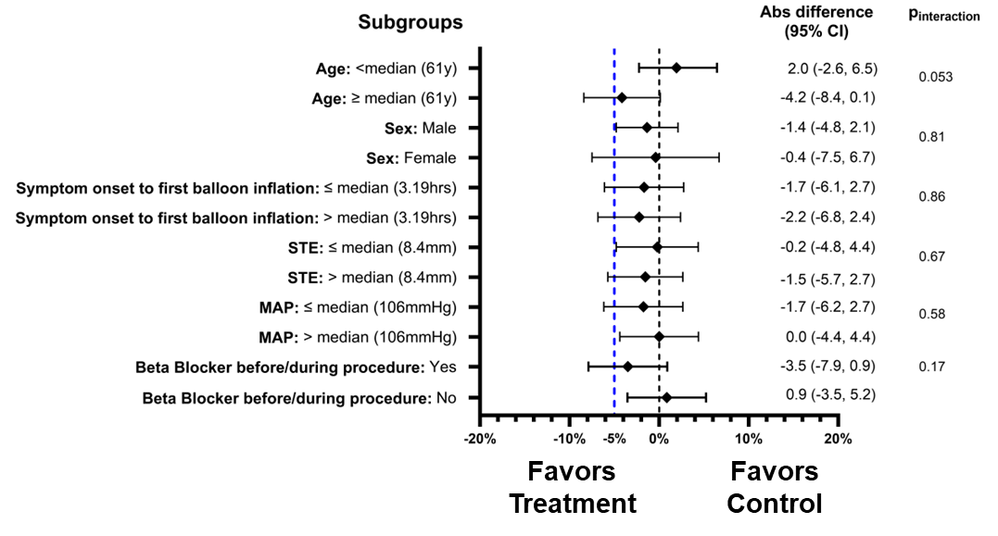
Key Pre-Specified Subgroup Analyses: Infarct Size
Notes:
In the pre-specified subgroups, Age over 61 was associated with a 4% reduction in infarct size compared to patients under the age of 61 with an interaction p-value of 0.05. We also observed that patents receiving a beta-blocker in the setting of hypertension also had a 3.5% reduction in infarct size, but this remained non-significant.

Slide 21
Key Secondary Safety Endpoint
Post-hoc analysis (ITT Population) | Treatment N=262 | Control N=265
All major bleeding or vascular complication | 89 (34.0%) | 16 (6.0%)
Access-site related | 83 (31.7%) | 6 (2.3%)
Non-access-site related | 5 (1.9%) | 10 (3.8%)
BARC 3 | 88 (33.6%) | 16 (6.0%)
BARC 3a | 47 (17.9%) | 5 (1.9%)
BARC 3b | 43 (16.4%) | 11 (4.2%)
BARC 3c | 0 (0%) | 1 (0.4%)
BARC 4 | 0 (0%) | 0 (0%)
BARC 5 | 1 (0.4%) | 0 (0%)
Blood transfusion | 27 (10.3%) | 8 (3.0%)
Major vascular complications | 13 (5.0%) | 5 (1.9%)
Device-related major bleeding (BARC 3-5)
or major vascular complications (30-day)
Safety Population
Performance goal 26.5%
p=0.95
N=80/260
Safety population = all subjects in whom a TV-mAFP insertion was attempted during the index procedure.
Notes:
For the safety endpoint, the treatment arm did not meet it’s pre-specified performance goal. 30.8% of patients experienced a device-related major bleed or major vascular complication. The majority of these bleeding events were BARC 3A and 3B bleeds with a large proportion being access site hematomas.
Left schematic: Device related major bleeding/vascular events in the safety population 30.8%
Right table: All major bleeding/vascular events in ITT population 34%

Slide 22
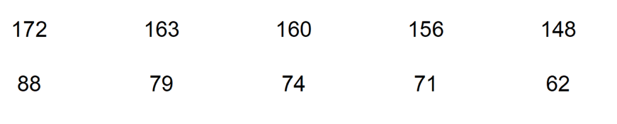
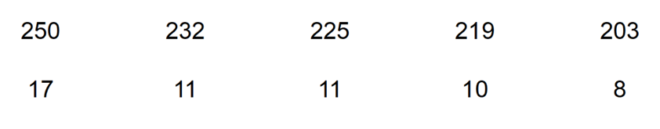
Relationship Between Mortality and
Major Bleeding and Vascular Complications
Treatment arm
Control arm
HR 2.46 (95% CI 0.75-8.06)
HR 12.74 (95% CI 4.03-40.27)
p_{interaction}
0.046
No major bleeding or vascular complications
All-cause mortality
No major bleeding or vascular complications
All-cause mortality
Major bleeding or vascular complications
Major bleeding or vascular complications
31.6%
7.4%
3.0%
2.9%
Days from Randomization
Days from Randomization
Number at Risk
Number at Risk
No major bleeding or vascular complications
No major bleeding or vascular complications
Major bleeding or vascular complications
Major bleeding or vascular complications
Notes:
Notably, major bleeding or vascular complications did not correlate with increased mortality and a lower event rate was observed compared to patients experiencing major bleeding or vascular complications in the control arm.

Slide 23
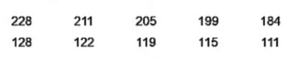
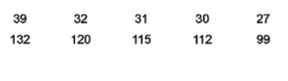
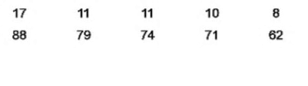
Mortality Impact of Bleeding and Vascular Complications
No Bleeding and Vascular Complications
Any Bleeding and Vascular Complications
Major Bleeding and Vascular Complications
HR 1.05 (95% CI 0.25-4.42)
HR 0.32 (95% CI 0.11-0.87)
HR 0.19 (95% CI 0.06-0.63)
31.6%
18.4%
2.4%
6.4%
7.4%
2.3%
Number at Risk
Number at Risk
Number at Risk
Control
Control
Control
Treatment
Treatment
Treatment
Notes:
These mortality curves highlight the observations around bleeding and mortality between the treatment and control arms.

Slide 24
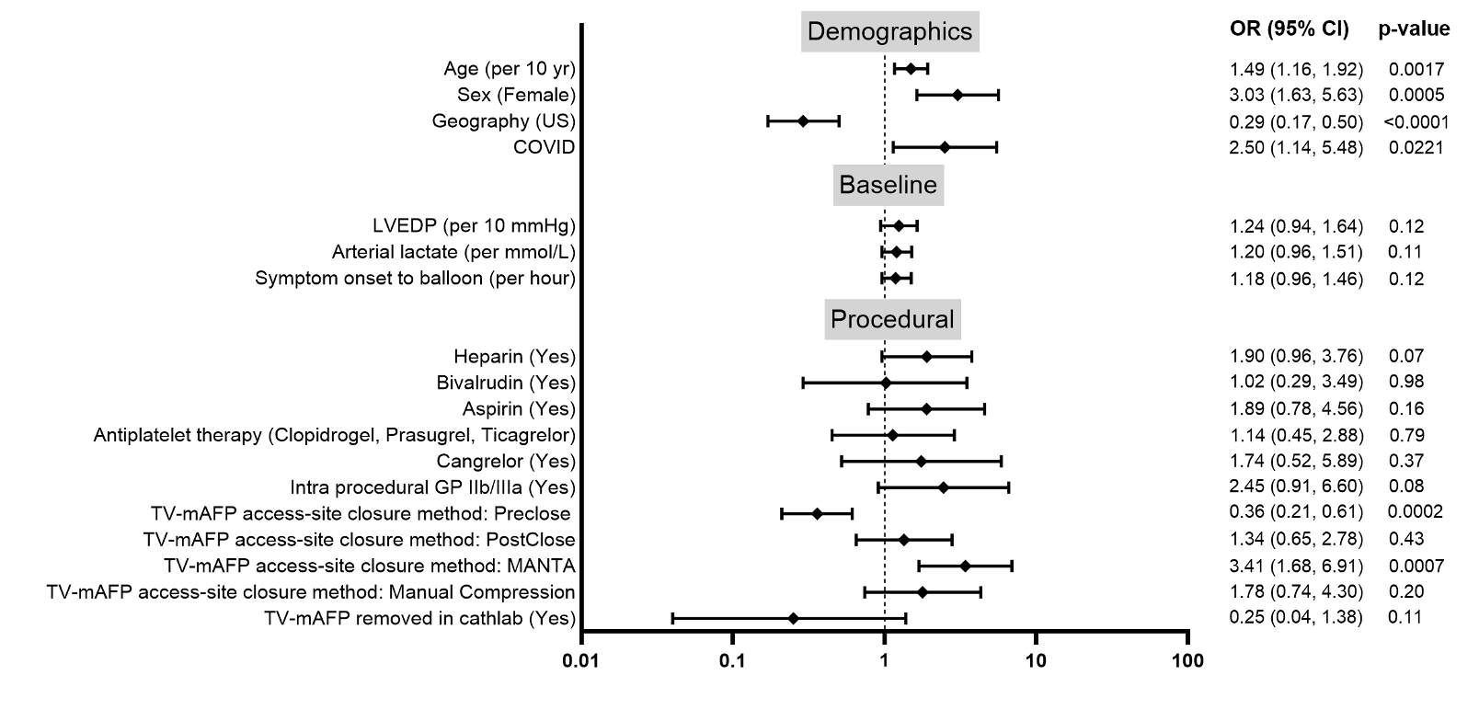
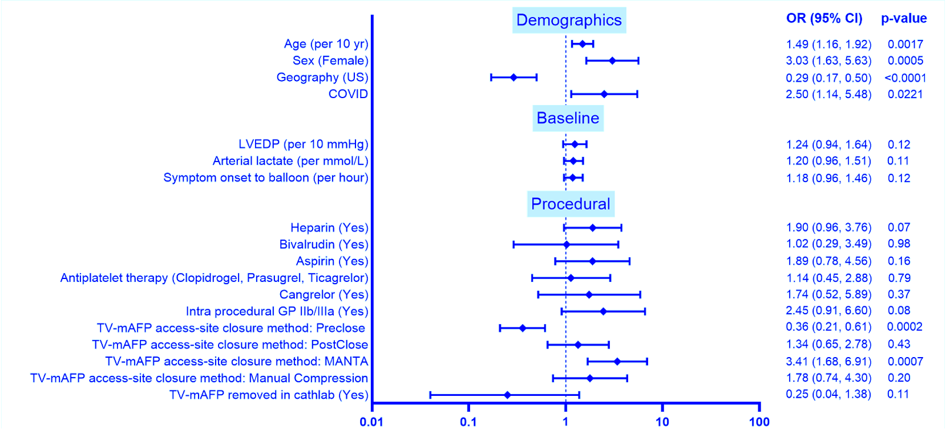
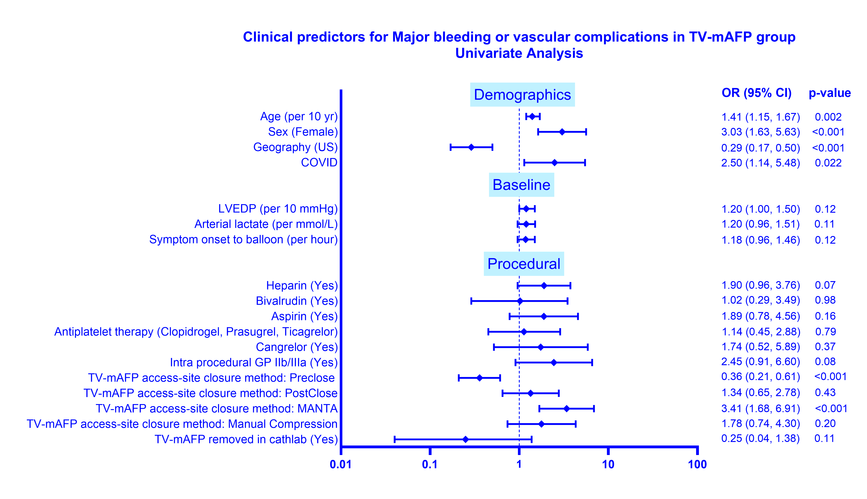
New Insights: Predictors* of Major Bleeding & Vascular Complications in the Treatment Arm
*Univariate analysis
Notes:
As we dig deeper into the bleeding observations, we are seeing that in the US, patients experienced significantly lower bleeding rates with an odds ratio of 0.29 compared to OUS populations. US rate was 23% vs OUS rate of 49% (more than double outside the US). We are also seeing that use of GP2B/3A drugs and closure techniques may be important determinants of bleed risk with a significant disparity between pre-closure vs Manta as closure methods, favoring the use of pre-closure. (Technique is as important as the Technology).

Slide 25
Limitations
High rate of femoral artery access (protocol-driven)
Higher than expected SBP (~143 mmHg) may have decreased Impella efficacy
STEMI-DTU was not designed to elucidate the mechanisms of infarct size nor was the trial powered for clinical outcomes
Longer than expected Impella dwell times with anticoagulation (mean 14 hours) and suboptimal closure techniques may have contributed to bleeding complications
Notes:
Limitations of the study are shown here and include higher femoral access, a hypertensive patient population, the fact that the trial was not powered for clinical outcomes, and the longer than expected dwell times for an Impella after PCI.

Slide 26
Conclusions
The combination of Impella CP plus a 30-minute delay to PCI did not reduce infarct size compared with immediate PCI in patients with anterior STEMI without shock
Infarct size was not increased despite a substantial delay to reperfusion after initiating LV support (median 47 mins)
Major bleeding or vascular complications occurred more frequently in the treatment group when compared with a prespecified performance goal or the control group
Notes:
In conclusion…. The trial is now published in JACC.

Slide 27

Future Directions
Future potential studies in the STEMI-DTU Program will incorporate insights from subgroup analysis and may combine Impella with adjunct pharmacotherapy (including BP lowering) to optimize loading conditions before PCI to reduce infarct size and improve outcomes in high-risk patients with STEMI
Notes:
As we take in the learnings from the STEMI-DTU pivotal trial , we are excited to continue advancing the science of LV unloading with a future study that will likely combine drug and device therapy to optimize conditions to reduce ischemia and reperfusion injury. Too many patients develop heart failure after a heart attack and the DTU paradigm will remain committed to reducing infarct size and improving outcomes for heart attack patients worldwide.
Thank you

Slide 28
Appendix

Slide 29
Investigators and Research Coordinators
Samuel McElwee
Carey Kimmelstiel
Haroon Faraz
David Manly
Zackery George
Pablo Rengifo-Moreno
John Katopodis
Thomas Noel
Nima Aghili
Niranjan Reddy
Raja Nazir
Mark Bieniarz
Raymond Yau
Chris Metzger
Gaurav Rana
Sanjit Jolly
Norman Mangner
Felix Woitek
Alaide Chieffo
Peter Nordbeck
Ralf Westenfeld
Amin Polzin
Matthias Bossard
Florum Cuculi
Marco Spaziano
David Wohns
Ryan Madder
Rajinder Marok
J. Stewart Collins
Kevin Wolschleger
Marwan Jumean
Sachin Kumar
Marwan Jumean
Jeffrey Fowler
Ashley Lee
Conrad Smith
Catalin Toma
Phillip Smith
Ali Ebrahimi
Madhura Myla
Firas Al Solaiman
Darryl Prime
Gregory Von Mering
Mouhamed Amr Sabouni
Mustafa Ahmed
Gregory Von Mering
Jason Moreland
Chalak Berzingi
Ramesh Daggubati
Chalak Berzingi
Perwaiz Meraj
Rajiv Jauhar
Terek Hammad
Farshad Forouzandeh
Steven Filby
Jun Li
Carl Gillombardo
Michael Cunningham
Mohammed Osman
Hiram Bezerra
Paul Poommipanit
Najeeb Osman
Michael Yin
Nicolas Ruiz
Noah Haroin
Mohamad El-Zaru
Mir Basir
Gerald Koenig
Mohammad Alqarqaz
Tiberio Frisoli
Mohammad Zaidan
Brian O'Neill
Akshay Khandelwal
Arka Chatterjee
Deepak Acharya
Exequiel Pineda
Michel Corban
Creig Hoover
Pranaychandra Vaidya
Jeffrey Hirst
Jeffrey Hirst
Asad Rizvi
Immad Sadiq
Graham Parker
Joseph Henderson
Atul Chawla
Mark Tannenbaum
David McAllister
Magdi Ghali
Daniel Shivapour
Vijay Iyer
Kinan Dilal
David Ziotnick
Ramesh Mazhari
Christian Nagy
Salvatore Mannino
Scott McKee
Thomas Lalonde
Amir Kaki
Theodore Schreiber
Mark Ricciardi
Justin Levisay
Jonathan Rosenberg
Jorge Alvarez
Abelardo Martinez Rumayor
Nandish Thukral
Stanley Zimmerman
Kamran Muhammad
Eugene Ichinose
Wayne Leimbach
Gregory Johnsen
Deepak Talreja
Paul Lavigne
Matthew Summers
Siddharth Wayangankar
Salil Patel
David Anderson
Mohammad Massoomi
Samuel Horr
Andrew Goodman
Craig Thompson
Louai Razzouk
Homam Ibrahim
Andres Vargas
William Dixon
David Halpin
John Altman
Ashwin Murthy
Regina Lee
Abdallah Bitar
Lawrence Lazar
Ziwar Karabatak
Brian Schwartz
Ajay Reddivari
Tim Trageser
Robert Maholic
Michael Huang
Ramzan Zakir
Ashok Chaudhary
Aditya Mehra
Vandan Upadhyaya
Stacey Clegg
Geoffrey Kunz
Pabitra Saha
Mark Aziz
Thomas Helton
Marc Mayhew
Oliver Abela
James Smith
Octavio Cosme
Sharif Halim
Robert Federici
Aamer Rehmen
Adam Banks
Guilherme Marin
Kayvan Ellini
Guilherme Marin
Patrick Hall
Michael Cryer
Rebecca Chester
David Rizik
Rebecca Chester
Calvin Lui
Lang Lin
Parag Patel
Raj Baljepally
Patrick Hu
Mark Goodwin
Sami Hayek
Fahed Bitar
Avinash Khitri
Frank Lin
Neil Wimmer
Erin Fender
Michael Tsang
Nicholas Valettas
Derek So
Aun-Yeong Chong
Marco Barzallo
Sudhir Mungee
Kunal Brahmbhatt
Ankitkumar Patel
Michele Voeltz
Allison Dupont
Fredy El Sakr
Abdul Hafiz
Tony DeMartini
Mohsin Salih
Bryan Har
Juan Russo
Stephan Haußig
Ephraim Winzer
Stephanie Jellinghaus
Peter Sick
Robert Höllriegel
Georg Ende
Birgit Markus
Georgios Chatzis
Italo Porto
Paolo Archetti
Filippo Russo
Giulia Ghizzoni
Alessandro Belletti
Barbara Bellini
Domitilla Gentile
Ghizzoni Giulia
Jürgen Leick
Tobias Krause
Nikos Werner
Florian Bönner
Florian Bönner
Christian Schulze
Sven Möbius-Winkler
Vasileios Panoulas
Adrian Attinger
Tienush Rassaf
Fadi Al-Rashid
Amir-Abbas Mahabadi
Antonio Colombo
Antonio Mangieri
Ottavia Cozzi
Damiano Regazzoli
Holger Sigusch
Akos Juhasz
Peter Bergmann
Alexander Schmid
Flavio Ribichini
Gabriele Pesarini
Aurora Trevisanello

Slide 30
Study Population Characteristics
Characteristic | DanGer (AMI-CS) | PROTECT II (HR-PCI) | PROTECT III (HR-PCI) | STEMI-DTU (DTU+Delayed PCI)
Patient population | STEMI + cardiogenic shock | Elective high-risk & complex PCI |  | First anterior STEMI, non-shock
Impella use | On-label (AMI-CS) | On-label (HR-PCI) |  | Investigational (DTU+Intentional Delay)
Guideline, Level of Evidence | Class IIa | Class IIb, RCT + Prospective Registry |  | Investigational, RCT
Treatment strategy | Impella + PCI | Impella + PCI | Impella + PCI | Impella + delayed PCI (~40–45 min)
Mean age | ~67–68 yrs | ~67 yrs | ~69 yrs | 61 ± 11 yrs
Blood pressure | Hypotensive 84/55 mmHg (shock) | Normotensive (non-shock) | Normotensive MAP ~88 mmHg (non-shock) | Hypertensive 142/89 mmHg (non-shock)
Baseline lactate | 4.5 mmol/L | Not routinely reported | Not routinely reported | ~2.0 mmol/L
Mean LVEF | 25% | ~27% | ~23% | 46%
Impella Support Duration | 60 hrs (median) | Procedural only | 1.6 hrs (median) | 14 hrs (mean)
Hemodynamic phenotype | Shock (low BP, high lactate) | Stable low EF | Stable low EF | Hypertensive STEMI (high afterload)
DanGer Shock Trial — NEJM 2024 (Møller et al.)
PROTECT II — Circulation 2012 (O’Neill et al.)
PROTECT III, PROTECT II-like — American Heart Journal 2022 (O’Neill et al.)
STEMI-DTU — JACC 2026 (Kapur et al.)

Slide 31
Procedural Characteristics
 | Treatment N=262 | Control N=265 | p-value
PCI access site, radial | 53 (20.2%) | 43 (16.2%) | 0.23
PCI access site, femoral | 207 (79.0%) | 222 (83.8%) | 0.16
Femoral single-access | 192 (73.3%)
Culprit lesion location, core lab |  |  | 0.88
Left anterior descending | 249/254 (98.0%) | 253/259 (97.7%)
Proximal | 114/254 (44.9%) | 116/259 (44.8%)
Mid | 132/254 (52.0%) | 134/259 (51.7%)
Distal | 3/254 (1.2%) | 3/259 (1.2%)
Other (first diagonal branch, LM, right, etc.) | 5/254 (2.0%) | 5/259 (1.9%)
PCI performed | 256 (97.7%) | 252 (95.1%) | 0.11
Thrombectomy | 46 (17.6%) | 56 (21.1%) | 0.30
PCI not performed | 6 (2.3%) | 13 (4.9%) | 0.11
CABG instead | 3 (1.2%) | 5 (1.9%)
Technical limitations | - | 3 (1.1%)
No culprit lesion identified | 3 (1.2%) | 5 (1.9%)
Non-culprit lesions treated during the index PCI | 21 (8.0%) | 21 (7.9%) | 0.97
Staged PCI procedure after CMR | 19 (7.3%) | 30 (11.3%) | 0.11

Slide 32
Pre-specified Subgroup Analyses: Infarct Size
Favors Treatment
Favors Control

Slide 33
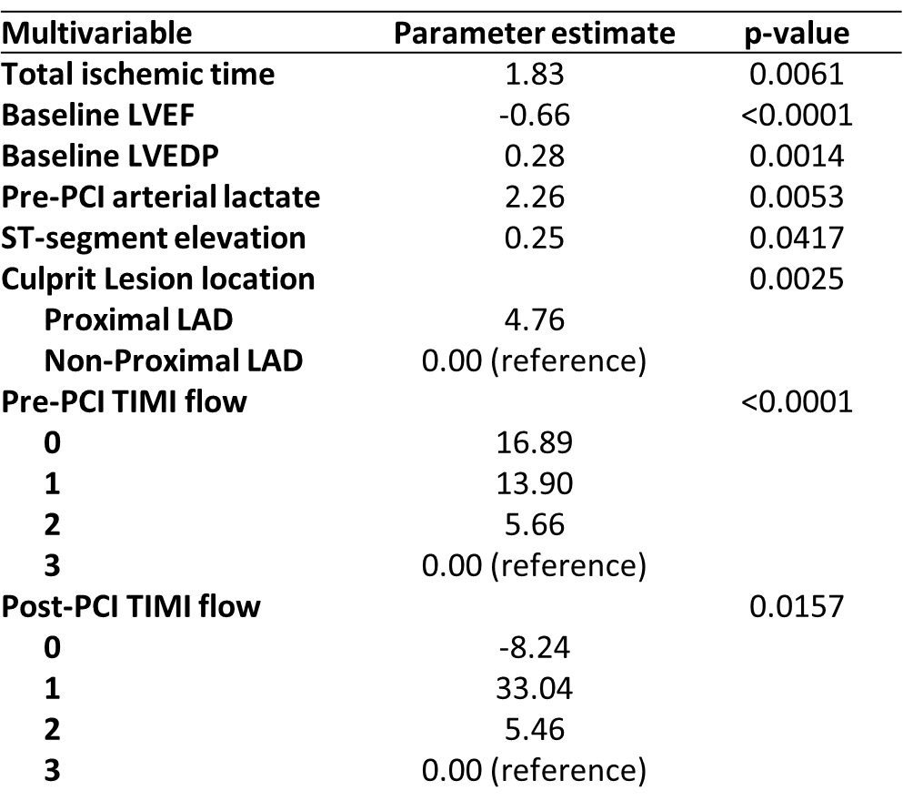
New Insights: Clinical Predictors of IS/LVM in Total Cohort
Other variables that were not significant predictors of IS/LVM were Age, Sex, COVID, Diabetes, Geography, SBP, Heart rate, Door to balloon, Symptom onset to arrival, Beta blocker use before/during PCI and randomization assignment, LVEDP, LVEF, LAD, Left anterior descending artery.

Slide 34
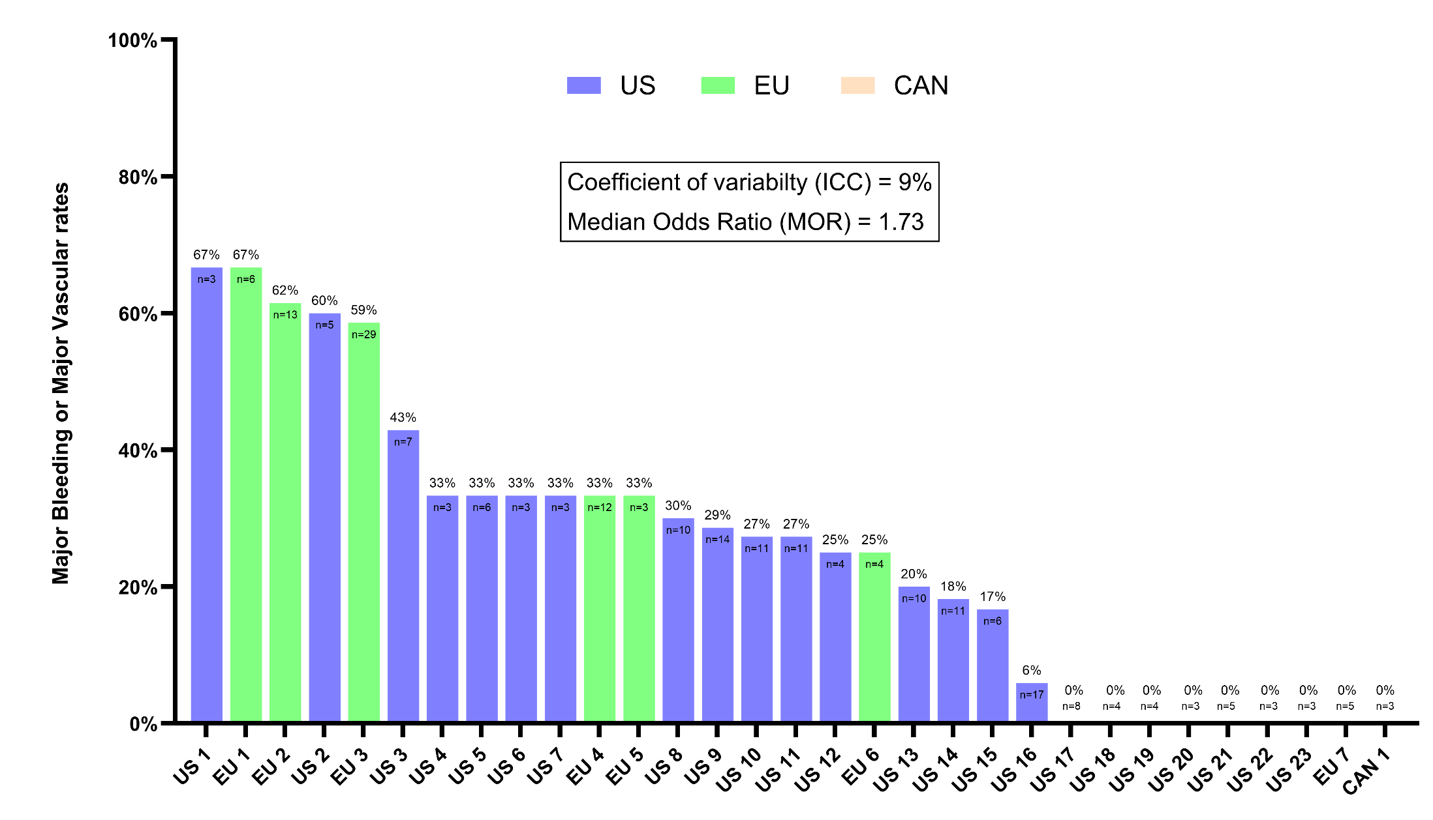
Variability in Major Bleeding and Vascular Complications between Sites and Geography
Safety Population – Impella Treated Only
Intraclass Correlation Coefficient (ICC) = 9%
Median Odds Ratio* = 1.73 [95% CI: 1.24, 2.54]
Major Bleeding or Major Vascular Complications
Sites with ≥ 3 Impella randomized subjects
* Median Odds Ratio shows that the variations are not likely due to chance

Slide 35
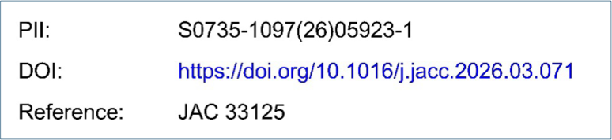
Left Ventricular Unloading in
Anterior STEMI without Shock
The STEMI Door to Unload (DTU)
Randomized Controlled Trial
Navin K. Kapur, MD; Norman Mangner, MD; Nima Aghili, MD; Haroon Faraz, MD; Samuel McElwee, MD; Raja Nazir, MD; Alaide Chieffo, MD; Sanjit Jolly, MD; Mark Bieniarz, MD; Florim Cuculi, MD; Zachary George, MD; John Katopodis, MD; David Manly, MD; Chris Metzger, MD; Thomas Noel, MD; Amin Polzin, MD; Gaurav Rana, MD; Pablo Rengifo-Moreno, MD; Ralf Westenfeld, MD; Matthias Bossard, MD; Peter Nordbeck, MD; Niranjan Reddy, MD; Felix Woitek, MD; Raymond Yau, MD; Carie Facemire, PhD; Ashish Parikh, PhD; Yonghong Gao, PhD; Hamza Awad, MD PhD; Jeremy Moretz, PharmD; Geoffrey Christanday, MA; Poornima Sood, MD; Seth Bilazarian, MD; Charles A. Simonton, MD; Yuchi Han, MD; Steven O. Marx, MD; Daniel Burkhoff, MD PhD; James Udelson, MD; Jeffrey Moses, MD; Carey Kimmelstiel, MD; Richard Karas, MD PhD; Gregg W. Stone, MD; and William O’Neill, MD

