Slide 1
Advancing Cath Lab Results with FFRangio Coronary Physiology Assessment:
The ALL-RISE Randomized Trial
Ajay J. Kirtane MD, SM
Director of Columbia Interventional Cardiovascular Care and Professor of Medicine at Columbia University Irving Medical Center / New York-Presbyterian Hospital
on behalf of the ALL-RISE Study Investigators
Notes:
Minor tweaks made

Slide 2
Financial Conflict of Interest Disclosure
Dr. Kirtane reports Institutional funding to Columbia University and/or Cardiovascular Research Foundation from Abbott Vascular, Amgen, Bolt Medical, Boston Scientific, CathWorks, Concept Medical, Cordis, Idorsia, Janssen, Magenta Medical, Medtronic, Neurotronic, Philips, ReCor Medical, Supira, and Teleflex. In addition to research grants, institutional funding includes fees paid to Columbia University and/or Cardiovascular Research Foundation for consulting and/or speaking engagements in which Dr. Kirtane controlled the content. Personal: Equity options in Airiver, Aeroflow, Bolt Medical, Lumen Medical, Roon, Tonic Medical; consulting from Sonivie; Travel Expenses/Meals from Abbott Vascular, Acist, Abiomed, Amgen, Angiodynamics, Biotronik, Boston Scientific, CathWorks, Chiesi, Concept Medical, Edwards Lifesciences, Kiniksa Pharmaceuticals, Medtronic, Novartis, Janssen, Philips, ReCor Medical, Shockwave, and Supira.

Slide 3

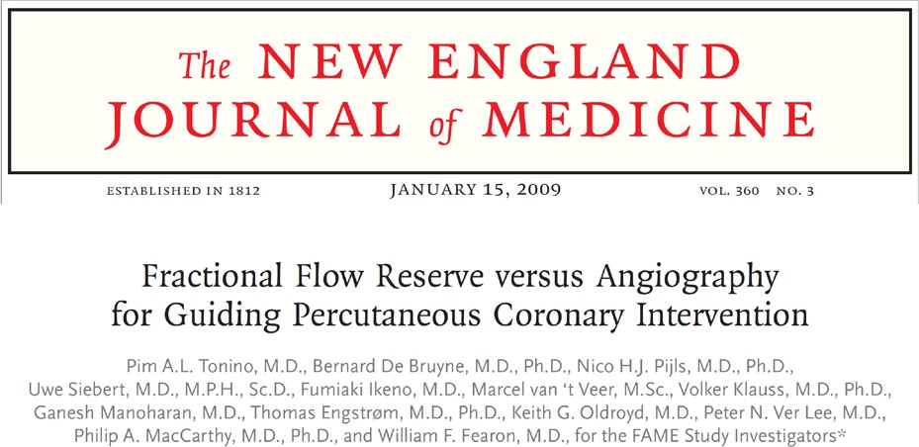
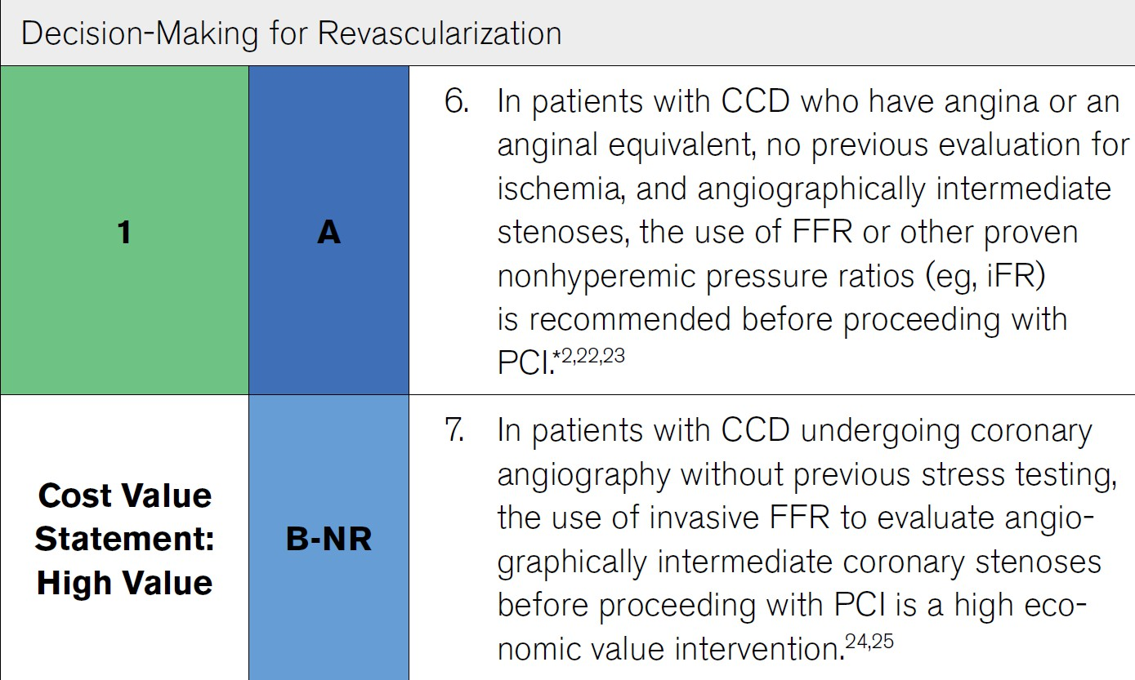
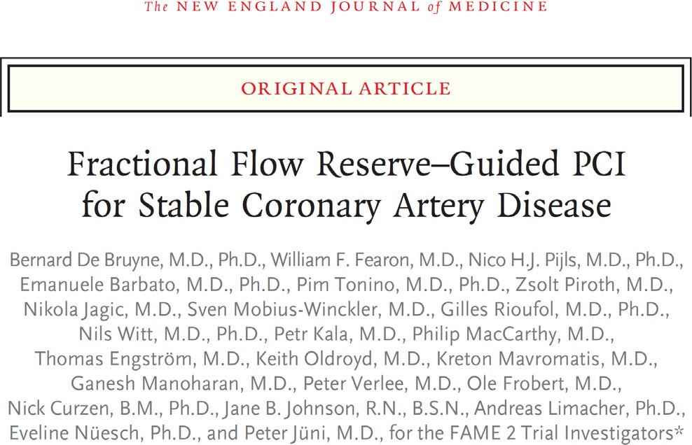
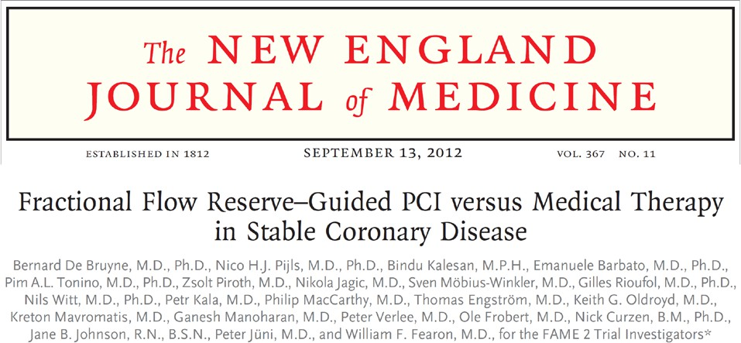
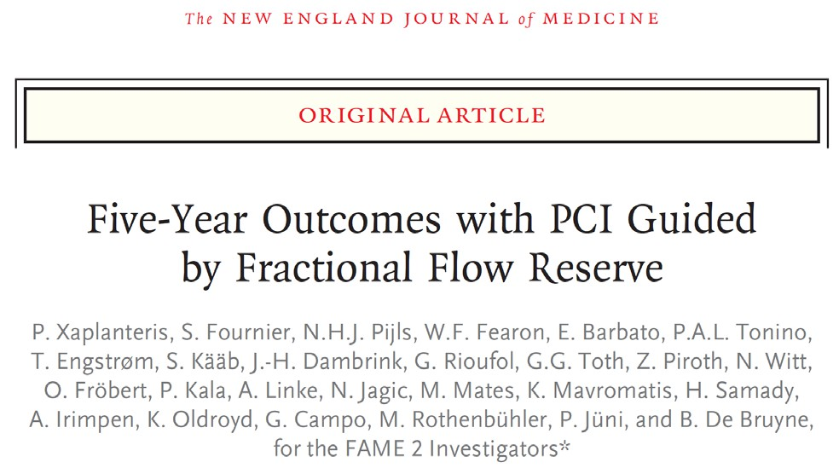
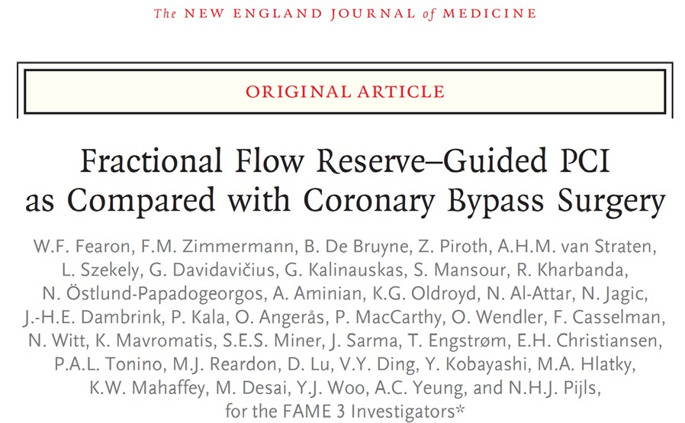
Coronary Physiology is Integral to Optimal PCI IA High Value Indication in ACC/AHA Guidelines
Virani et al 2023

Slide 4

And Yet… Physiology is Underutilized in the Cath Lab
Clinical Inertia
Pressure Wire-based Physiology
(Class IA)
Procedural Time and Cost
Workflow / Measurement Complexity
Small Risk of Complications

Slide 5
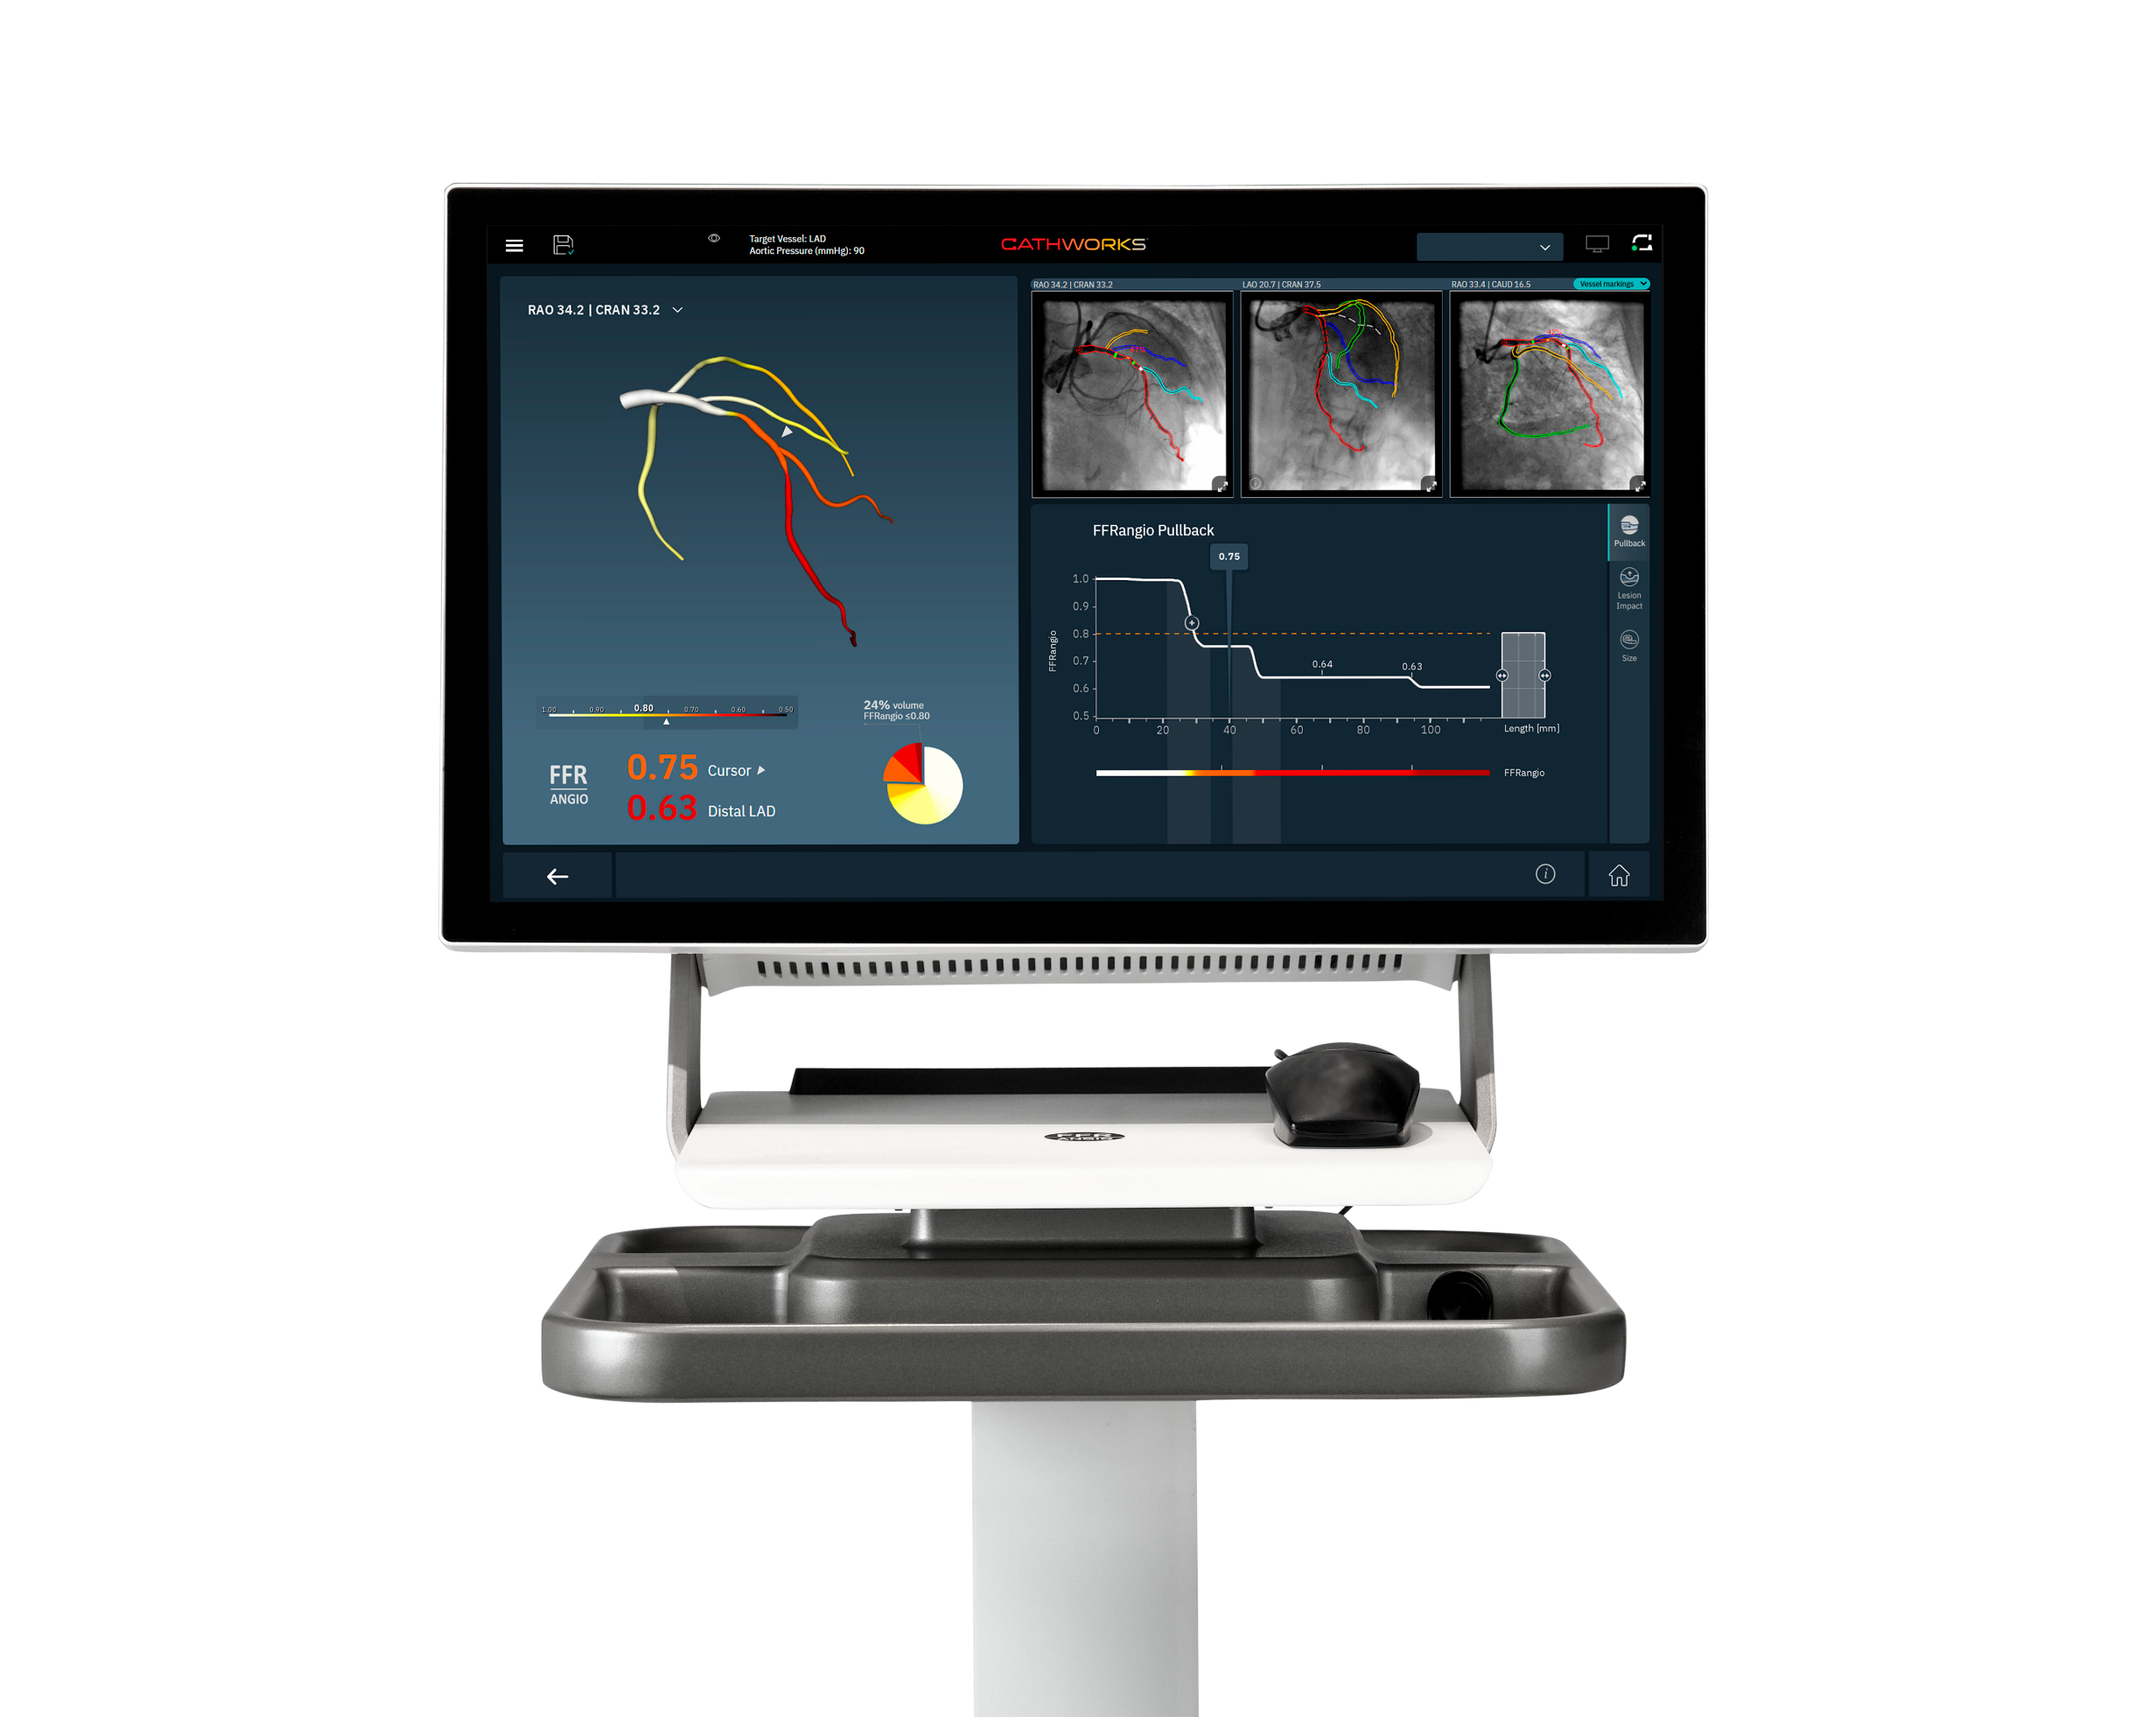
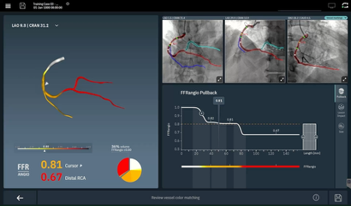
CathWorks FFRangio® System
Console receives routine angiograms
Combines AI/Computer Vision to build 3D coronary model, MD verifies
Applies ”Resistance Flow” algorithm
Provides comprehensive multi-vessel coronary physiology without further procedural manipulation
FDA-Approved and validated vs. FFR
For presentation purposes, playing at 4x speed
Actual time to run this case is 1 minute and 43 seconds
CathWorks FFRangio System is a Registered Trademark of CathWorks.

Slide 6
Study Objective
To test whether FFRangio is comparable to conventional pressure wire-based assessment of intermediate lesions being considered for PCI

Slide 7
Study Design
~1924 patients to be enrolled in up to 60 sites globally
Key Inclusion Criteria:
CCS/NSTEACS patients w/ 50-90% lesion(s) deemed appropriate for both FFRangio and pressure wire assessment
Declare lesion(s) for assessment
1:1
Stratified by FFR/NHPR & Presentation
FFRangio-guided
Pressure wire-guided
Key Exclusion Criteria:
STEMI in the last 72 hours, CABG with patent grafts to the study vessel(s), or those whom CABG was being considered
FFRangio
≤0.80
FFRangio
>0.80
FFR ≤0.80
NHPR ≤0.89
FFR >0.80
NHPR >0.89
PCI
Defer
PCI
Defer
Primary Endpoint: 1-year MACE
(All-cause death, MI, or unplanned clinically-driven revascularization)
Funded by CathWorks; ClinicalTrials.gov number NCT05893498

Slide 8
Study Organization
Chairs
M. Leon (Executive Chair), A. Kirtane (Study Chair and Global Principal Investigator)
Global Co-Principal Investigators
W. Fearon, A. Jeremias
Steering Committee
M. Leon, A. Kirtane, W. Fearon, A. Jeremias, R. Al-Lamee, G. Witberg, D. Cohen, R. Yeh, R. Sharma, A. Kaki
Data & Safety Monitoring Board
S. King (Chair), M. Khan, T. Collier
Clinical Events Committee
S. Brener (Chair), E. Osborn (Co-Chair), B. Uretsky, B. Peterson, J. Weinberger, D. Engel, O. Dogan, H. Vefali
Study Oversight, Data Coordinating Center, Angiographic Core Lab
A. Popma, J. Ungarten, J. Thompson, D. Zhao, O. Dressler, J. Popma
Sponsor: CathWorks (Newport Beach, CA); ClinicalTrials.gov number NCT05893498

Slide 9
43 US Study Sites
Medstar Union (Wang)
Medstar WHC (Hashim)
Inova (Batchelor)
Tidal Health (Hearne)
Beth Israel Deaconess (Yeh)
Ascension St. John (Kaki)
Carle Foundation (Moussa)
MN Heart Inst-Abbott NW (Sandoval)
Mercy (Whitbeck)
Columbia Univ (McEntegart)
NYU Langone (Razzouk)
Cornell-NY Presbyterian (Wong)
St. Francis Hosp.(Shlofmitz)
Northwell (Kim)
NYP Brooklyn Methodist (Kobayashi)
Ellis Hospital (Garg)
VA-Long Beach (Seto)
VA-Palo Alto (Fearon)
Stanford (Fearon)
UCSD (Mahmud)
USC (Matthews)
St. Joseph (Buhari)
Kaiser Perm-SF (Manthripragada)
UCLA (Parikh)
Valley, Health-Ridgewood NJ (Tayal)
Morristown MC (Safirstein)
Mountainside MC (Patel)
Lehigh Valley Hosp (Singh)
Upenn (Kolansky)
The Christ Hosp. (Garcia)
St. Elizabeth-Edgewood (Brar)
Mt. Carmel (Buschur)
Ascension Via Christ St. Francis-Wichita (Chehab)
Kansas Heart Inst.-Wichita (Chehab)
BSW-Heart Hospital (Al-Azizi)
HCA San Antonio Methodist (Thukral)
CRA North Mississippi (Blossom)
TCAVI (Khuddus)
Tallahassee Res. Inst (Rengifo)
Tampa General-USF (Bezerra)
JFK (Rothenberg)
HCA Florida Northside (Jabbar)
Archbold Memorial (Sizemore)
St. Elizabeth HC-Edgewood, KY (Brar)

Slide 10
16 International Sites
2 sites in Israel
8 sites in Japan
6 sites in EU
Imperial College of London (Al-Lamee)
Musgrove Park Hospital (Sahebjalal)
Essex Cardiothoracic Center (Keeble)
Rabin MC (Levi)
HaSharon MC (Greenberg)
Sakakibara Heart Institute (Nanasato)
Chibanishi General Hospital (Misumi)
NTT Medical Center (Warisawa)
Kobe University (Otake)
Gifu Heart Center (Matsuo)
Mie University (Kurita)
Ichinomiya Nishi Hospital (Dan)
Fukuyama Hosp. (Kikuta)
Hopitaux Universitaires Geneve (Iglesias)
CHUV Lausanne (Fournier)
HFR Fribourg (Arroyo)
ISRAEL
JAPAN
EUROPE

Slide 11
Top 10 Enrolling Sites
Rabin Medical Center, Petach Tikva, Israel | Amos Levi | 146 Patients
Ascension Via Christi Hospitals Wichita, Wichita, KS | Bassem Chehab | 138 Patients
Northwell Health, New York, NY | Michael Kim | 117 Patients
Kobe University Hospital, Hyogo, Japan | Hiromasa Otake | 101 Patients
The Valley Hospital, Ridgewood, NJ | Rajiv Tayal | 83 Patients
Stanford University, Stanford, CA | William Fearon | 79 Patients
Mie University Hospital, Mie, Japan | Tairo Kurita | 77 Patients
Gifu Heart Center, Gifu, Japan | Matsuo Hitoshi | 65 Patients
Ichinomiyanishi Hospital, Aichi, Japan | Kazuhiro Dan | 63 Patients
Columbia/New York-Presbyterian Hospital, New York, NY | Margaret B. McEntegart | 61 Patients

Slide 12
Sample Size and Power
Primary hypothesis: non-inferiority of FFRangio vs. pressure-wire for 1-year MACE
Non-inferiority margin: 3.5% (absolute risk difference)
One-sided alpha: 0.025
Assumptions (for 1:1 randomization)
Estimated MACE rate: 7.5% in both FFRangio and pressure-wire arms
Attrition rate: 5%
>80% power at 1924 randomized patients

Slide 13
Study Flow
4,704 signed informed consent and assessed for eligibility
2,771 were excluded
2,530 did not meet the inclusion criteria
274 met General Exclusion criteria
194 met Angiographic exclusion criteria
1,930 randomized
Pressure Wire-guided Control Group (N=965)
Received allocated intervention (n=934)
Did not receive allocated intervention (n=31)
Allocation
Pressure Wire-guided Control Group (N=965)
Received allocated intervention (n=934)
Did not receive allocated intervention (n=31)
Subjects discontinued early: 4.6% (n=44)
Voluntarily withdrew or by investigator (n=12)
Lost to follow-up (n=31)
Others (n=1)
Subjects discontinued early: 3.4% (n=33)
Voluntarily withdrew or by investigator (n=14)
Lost to follow-up (n=15)
Others (n=4)
Follow-Up
Analyzed (N=965)
Analysis
Analyzed (N=965)

Slide 14
Baseline Clinical Characteristics
 | FFRangio (n=965) | Pressure Wire (n=965)
Age | 68.4 ± 10.1 | 68.4 ± 10.3
Male sex | 75.5% | 74.5%
White/Caucasian | 59.7% | 61.8%
Diabetes | 39.5% | 36.3%
Treated with insulin | 13.5% | 11.5%
Hypertension | 78.5% | 79.9%
Dyslipidemia | 78.7% | 79.4%
Family history of CAD | 33.6% | 38.6%
Previous MI | 17.2% | 16.4%
Previous PCI | 38.9% | 39.0%
Renal disease | 19.7% | 17.9%
 | 13.6% | 14.6%
Hospitalized with NSTEACS | 9.9% | 8.8%

Slide 15
Procedural & Angiographic Characteristics (Lesion Level)
 | FFRangio (n=965) | Pressure Wire (n=965)
Total number of study lesions | 1288 | 1248
LAD | 635 (49.3%) | 624 (50.0%)
LCX | 277 (21.5%) | 261 (20.9%)
RCA | 376 (29.2%) | 363 (29.1%)
Reference vessel diameter - mm | 2.9 ± 0.6 | 2.9 ± 0.6
Pre-procedure diameter stenosis (%) | 54.5 ± 12.0 | 54.5 ± 12.0
Lesion length (IQR) – mm | 12.0 [8.0, 19.1] | 12.5 [8.0, 18.8]
Successful physiologic assessment | 1269 (98.5%) | 1230 (98.6%)
FFRangio value | 0.81 ± 0.12 | n/a
FFR value | n/a | 0.84 ± 0.10
NHPR value | n/a | 0.89 ± 0.11
FFRangio/FFR ≤0.80 or NHPR ≤0.89 | 545 (43.0%) | 454 (37.0%)
Total study lesions undergoing PCI | 571 (44.3%) | 442 (35.4%)
Intravascular imaging use (for PCI) | 280 (49.0%) | 231 (52.3%)

Slide 16
Procedural Characteristics (Patient Level)
 | FFRangio (n=965) Median [25%,75%] | Pressure Wire (n=965) Median [25%,75%] | Difference [25,75%]
Contrast volume (mL) | 100.0 [52, 145] | 105.0 [72,150] | -14.0* [-20.0,-10.0]
Fluoroscopy time (min) | 9.0 [5.0, 17.0] | 12.0 [8.0, 20.0] | -3.0* [-3.0,-2.0]
Procedure duration (min) | 39.0 [21.0, 62.0] | 42.0 [29.0, 60.0] | -5.0* [-7.0,-3.0]
Physiology assessment (min) | 6.0 [4.0, 10.0] | 8.0 [5.0, 15.0] | -2.0* [-3.0, -2.0]
*Hodges–Lehmann estimator for risk differences (median of all pairwise differences between groups)

Slide 17
Primary Endpoint: 1-Year MACE
10
HR (95% CI): 0.98 (0.70-1.39)
P_{non-inferiority} = 0.0008
Pressure Wire
7.1%
FFRangio
6.9%
MACE (%)
5
0
0
2
4
6
8
10
12
Months since Randomization
Number at risk
FFRangio-guided strategy
965
947
907
864*
Pressure Wire-guided strategy
965
940
906
859*
MACE: All-cause death, MI, or unplanned clinically-driven revascularization
*12-month number at risk includes all subjects with follow-up in the 12-month visit window (days 335-395)

Slide 18
Primary Endpoint: 1-Year MACE
FFRangio
(N=965)
6.9%
Pressure Wire (N=965)
7.1%
Non-inferiority p-value
0.0008
Rate Difference -0.2
Upper Bound of 1-sided 97.5% CI 2.1
Margin:
3.5%
FFRangio met non-inferiority to pressure wire-based assessment
-5.0 | -4.0 | -3.0 | -2.0 | -1.0 | 0.0 | 1.0 | 2.0 | 3.0 | 4.0 | 5.0
Favors FFRangio
Favors Wire

Slide 19
Secondary Clinical Endpoints: Death, MI
10
10
8
8
HR (95% CI):
1.16 (0.63-2.14)
HR (95% CI):
0.65 (0.34-1.25)
Death (%)
MI(%)
6
6
4
FFRangio
4
Pressure Wire
2.3%
2.5%
2
2
Pressure Wire
FFRangio
2.1%
1.6%
0
0
1
6
12
1
6
12
Months since Randomization
Months since Randomization
Number at risk
Number at risk
FFRangio
965
955
927
904*
FFRangio
965
949
919
891*
Pressure
wire
965
950
929
905*
Pressure
wire
965
942
916
884*
*12-month number at risk includes all subjects with follow-up in the 12-month visit window (days 335-395)

Slide 20
Unplanned Clinically-Driven Revascularization
12
10
HR (95% CI)
0.90 (0.58-1.40)
8
Pressure Wire
6
Revascularization (%)
4.6%
4
FFRangio
2
4.1%
0
1
6
12
Months since Randomization
Number at risk
FFRangio
965
950
910
869*
Pressure Wire
965
942
908
865*
*12-month number at risk includes all subjects with follow-up in the 12-month visit window (days 335-395)

Slide 21
Prespecified Subgroups: 1-Year MACE
Subgroup
N
FFRangio
Pressure Wire
Hazard Ratio [95% Confidence Interval]
MACE Rate % (n)
Age
1930
> 65
1201
7.7% (44)
7.2% (41)
1.11 [0.72, 1.70]
<=65
729
5.4% (20)
7.0% (24)
0.79 [0.43, 1.42]
Diabetes
1926
Present
730
8.6% (32)
8.5% (28)
1.05 [0.63, 1.74]
Absent
1196
5.8% (32)
6.4% (37)
0.91 [0.57, 1.46]
Study Vessel Based on Physiology Assessment
1922
LAD
1136
5.2% (29)
8.3% (44)
0.64 [0.40, 1.03]
Non-LAD
786
9.3% (35)
5.5% (21)
1.70 [0.99, 2.92]
Presence of Bifurcation Lesions
1921
Present
456
6.6% (15)
10.2% (22)
0.64 [0.33, 1.23]
Absent
1465
7.0% (49)
6.3% (43)
1.16 [0.77, 1.75]
Renal Insufficiency
1888
GFR < 60 mL/min
355
9.4% (17)
9.2% (15)
1.07 [0.53, 2.13]
GFR >= 60 mL/min
1533
6.3% (46)
6.9% (50)
0.93 [0.63, 1.39]
Type of Conventional Pressure Wire Assessment
1930
FFR Strata
982
4.8% (23)
7.7% (36)
0.61 [0.36, 1.03]
NHPR Strata
948
9.0% (41)
6.7% (29)
1.48 [0.92, 2.38]
Clinical Presentation
1930
Acute Coronary Syndrome
181
8.1% (7)
9.7% (8)
0.75 [0.27, 2.06]
Chronic Coronary Syndrome
1749
6.7% (57)
6.9% (57)
1.01 [0.70, 1.46]
Study Lesion(s) Treatment Decision
1922
PCI on Any Study Lesion(s)
850
5.9% (27)
8.5% (30)
0.73 [0.43, 1.23]
No PCI on Any Study Lesion(s)
1072
7.8% (37)
6.3% (35)
1.24 [0.78, 1.97]
Hazard ratio (95% CI) from Cox model with treatment, subgroup, and their interaction.
0
1
2
3
FFRangio Better
Pressure Wire Better

Slide 22
Clinical Outcomes at 1 Year and Peri-procedural Complications at 30 Days
 | FFRangio (n=965) | Pressure Wire (n=965) | Hazard Ratio (95% CI) | P value
Primary Endpoint
Death, MI, or Unplanned CI-Revasc | 64 (6.9%) | 65 (7.1%) | 0.98 (0.70, 1.39) | 0.0008*
Secondary Endpoints
Death | 22 (2.3%) | 19 (2.1%) | 1.16 (0.63, 2.14)
Cardiac death | 9 (1.0%) | 7 (0.7%) | 1.29 (0.48, 3.46)
Myocardial infarction | 15 (1.6%) | 23 (2.5%) | 0.65 (0.34, 1.25)
Spontaneous | 12 (1.3%) | 20 (2.2%) | 0.60 (0.29, 1.22)
Procedural | 3 (0.3%) | 3 (0.3%) | 1.00 (0.20, 4.94)
Unplanned clinically-indicated revasc | 37 (4.1%) | 41 (4.6%) | 0.90 (0.58, 1.40)
PCI | 32 (3.5%) | 39 (4.4%) | 0.82 (0.51, 1.30)
Coronary bypass surgery | 5 (0.6%) | 4 (0.5%) | 1.26 (0.34, 4.68)
Definite/probable stent thrombosis | 2 (0.2%) | 4 (0.5%) | 0.50 (0.09, 2.72)
Safety Endpoints
Stroke at 30 Days | 5 (0.5%) | 2 (0.2%) | 2.49 (0.48, 12.83)
BARC type 3-5 bleeding | 7 (0.7%) | 14 (1.5%) | 0.50 (0.20, 1.23)
Major bleeding at 30 Days | 3 (0.3%) | 9 (0.9%) | 0.33 (0.09, 1.22)
Acute kidney injury | 0 (0.0%) | 1 (0.1%) | n/a
*Non-inferiority p-value

Slide 23
Trial Limitations
Coronary anatomy had to be amenable to both pressure wire–based and FFRangio-based physiology measurements
Majority of patients included in the trial had CCS/no biomarker elevation; CABG patients were excluded
Trial-group assignment was unblinded
Comparison to a mixed comparison group of both FFR/NHPR, although this is representative of the current clinical use of pressure wire-based physiology and randomization was stratified

Slide 24
Conclusions
FFRangio is a software-based tool that derives coronary physiologic measurements from a routine angiogram with physician oversight
In this RCT powered to assess the performance of FFRangio compared with pressure wire (the reference standard), we observed:
Similar 1-yr MACE (6.9% vs. 7.1%), meeting non-inferiority
Shorter time to calculate FFRangio vs. pressure wire-based physiology (without additional procedural manipulation)
Shorter overall procedural and fluoroscopy times with lower contrast volume despite a slightly higher rate of PCI

Slide 25
Clinical Implications
These data support the routine use of FFRangio to guide the treatment of intermediate lesions in the cath lab, with workflow improvements that should facilitate increased use of coronary physiology concordant with guidelines

Slide 26
Now Available in The New England Journal of Medicine

Slide 27


