Slide 1

Groceries for Black Residents of Boston to Stop Hypertension among Adults with Treated Hypertension (GoFreshRx)
Stephen P Juraschek, MD PhD
Associate Professor of Medicine & Nutrition
Beth Israel Deaconess Medical Center, Harvard Medical School, Harvard T. H. Chan School of Public Health
@spjuraschek

Slide 2





Disclosures
This trial was supported by the National Institutes of Minority Health and Health Disparities R01MD016068
This work was conducted with support from UM1TR004408 award through Harvard Catalyst, The Harvard Clinical and Translational Science Center (National Center for Advancing Translational Sciences, National Institutes of Health), and financial contributions from Harvard University and its affiliated academic healthcare centers.

Slide 3
Context
Black adults are the largest group treated for hypertension in the U.S. and have the highest rates of uncontrolled hypertension
Need for solutions beyond pharmacologic therapy to lower blood pressure
The DASH diet is especially efficacious among Black adults, but was not tested in a population treated for hypertension

Slide 4
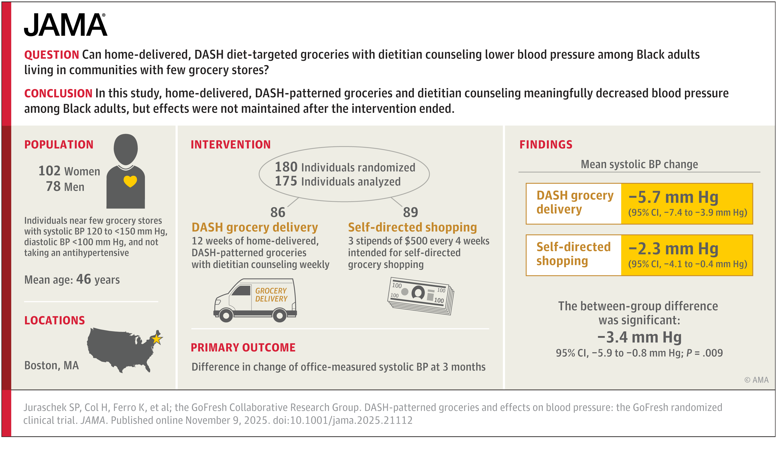

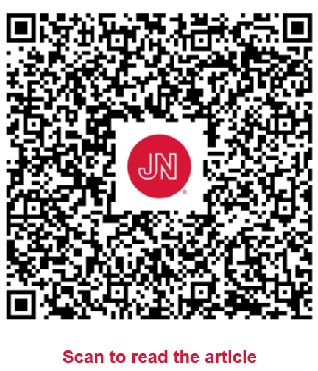
GoFresh Trial

Slide 5

GoFreshRx Randomized Clinical Trial
Groceries for Black Residents of Boston to Stop Hypertension among Adults with Treated Hypertension

Slide 6
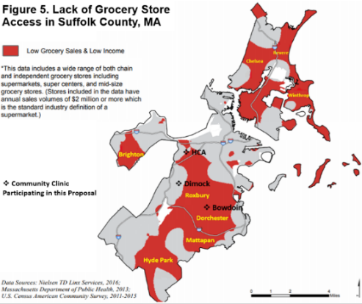
Objective
Determine whether a nutrient-based, grocery ordering strategy modeled after the DASH diet might lower BP among Black adults treated for hypertension and living in Boston communities with few grocery stores and lower income

Slide 7
Population
Inclusion:
Self-identified Black or African American
Age 18 years or older
Stable antihypertensive medication use over the past 6 months
Resident of a Boston-area healthy food priority area (or “food desert”):
Brighton, Chelsea, Dorchester, East Boston, Everett, Hyde Park, Jamaica Plain, Malden, Mattapan, Revere, Roslindale, Roxbury, or Winthrop
Systolic blood pressure of 120 to <150 mm Hg and diastolic blood pressure <100 mm Hg
Have access to refrigeration, cooking appliances, and Wi-Fi/cellular service
Exclusion:
Diabetes, stage 4 or 5 chronic kidney disease, hyperkalemia
Families with more than 6 adults at dinner time

Slide 8
One of Two 12-week Interventions
Daily Nutrient Targets | GoFresh Diet
Sodium (mg/day) | <2300 mg/d (2100 kcal)
Potassium (mg/day) | >4700 mg/d (2100 kcal)
Saturated fat | 7% of total energy (~15 g/day)
Ratios
Na/kcal | <1.1
K/kcal | >2.2
K/Na | >2.0
Active Intervention: Home-delivered, DASH-patterned groceries, tailored to caloric needs and ordered weekly with dietitian counseling
or
Comparator: 3 $500 stipends, 1 provided every 4 weeks for self-directed grocery shopping
Weekly Goals*
≥28 servings of fruit & vegetable
≥14 low-fat dairy
28-41 oz. meat
36-49 servings of grains
4-5 servings of nuts, seeds, legumes
*For a 2100 kcal/day diet

Slide 9
Design Schematic

Slide 10
Outcomes
Primary Outcome: Office measured systolic blood pressure
Secondary outcomes:
Diastolic blood pressure
Body mass index (BMI)
Hemoglobin A1c
LDL-cholesterol
Diet adherence was measured by 24-hour urine collection and 24-hour diet recall
Measures performed at baseline, 3 months (post-intervention), and 6 months (3 months after the intervention ended)

Slide 11
CONSORT
Community-dwelling adults assessed for eligibility
N = 5,676
Main Exclusions:
No antihypertensive medication use
Diabetes
Lost Interest/Contact
Exclusionary medications
Ineligible BP
Randomized
N = 176
DASH Groceries
N = 89
Self-Directed
N = 87
Drop Out
N = 1
Drop Out
N = 1
3-Month Analysis
N = 88
3-Month Analysis
N = 85
Main reasons for not contributing to analysis were BPs obtained outside the protocol time window or visit non-attendance
6-Month Analysis
N = 85
6-Month Analysis
N = 81

Slide 12
Demographic Information of Randomized Participants
 | DASH Groceries Group, N=89 | Self-Directed Group, N=87
 | Mean (SD) or N (%) or Median (25th, 75th) | Mean (SD) or N (%) or Median (25th, 75th)
Age (years), mean (SD) | 60.2 (11.7) | 60.1 (11.4)
Female Sex | 72 (81) | 70 (80)
Black or African American | 89 (100) | 87 (100)
Hispanic or Latino | 3 (3) | 5 (6)
Household Income
<$30,000 | 23 (26) | 28 (32)
$30,000 to $59,999 | 18 (20) | 19 (22)
≥$60,000 | 33 (37) | 34 (39)
Unsure/Prefer not to answer | 15 (17) | 6 (7)
Family Size, median (25th, 75th) | 2.0 (1.0, 3.0) | 2.0 (1.5, 3.0)
Systolic BP (mm Hg), mean (SD) | 130.9 (7.0) | 130.1 (7.1)
Diastolic BP (mm Hg), mean (SD) | 77.8 (8.9) | 77.8 (9.0)
BMI (kg/m²), mean (SD) | 32.2 (5.7) | 32.1 (6.3)
Hemoglobin A1c (%), mean (SD) | 5.6 (0.4) | 5.6 (0.4)
LDL-cholesterol, mean (SD) | 120.8 (32.7) | 114.8 (36.8)
Abbreviations: BP, blood pressure; BMI, body mass index; LDL, low density lipoprotein; SD, standard deviation

Slide 13
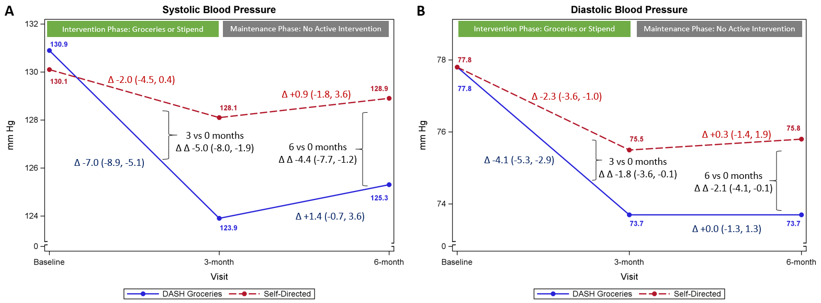
Primary Outcome: Difference in 3-month vs Baseline SBP

Slide 14
Secondary Outcome: Difference in 3-month vs Baseline

Slide 15
Secondary Contrast: Difference in 6-month vs Baseline

Slide 16
Adherence: 24-hr Urine
Outcome | Assignment | BL Mean (SE) | 3M – BL β (95% CI) or P | 6M – BL β (95% CI) or P
Urine Potassium, mg/24 hr N*=179, 172, 164 | SDG | 1810 (97) | 11 (-171, 194) | -38 (-244, 169)
 | DASH | 1777 (62) | 220 (60, 381) | 38 (-128, 205)
 | DASH minus SDG |  | 209 (-34, 452) | 76 (-190, 342)
 | P |  | 0.092 | 0.58
Urine Sodium, mg/24 hr N*=179, 172, 164 | SDG | 2961 (181) | -206 (-607, 195) | -82 (-465, 301)
 | DASH | 2802 (129) | -587 (-911, -264) | -126 (-488, 236)
 | DASH minus SDG |  | -381 (-896, 134) | -45 (-572, 482)
 | P |  | 0.15 | 0.87
Urine Potassium/Sodium Ratio N*=179, 172, 164 | SDG | 0.43 (0.03) | 0.03 (-0.04, 0.09) | -0.01 (-0.07, 0.05)
 | DASH | 0.43 (0.02) | 0.22 (0.15, 0.30) | 0.04 (-0.03, 0.10)
 | DASH minus SDG |  | 0.20 (0.09, 0.30) | 0.04 (-0.05, 0.13)
 | P |  | <0.001 | 0.34
Change values were generated via generalized estimating equations (exchangeable correlation structure, normal family, identity link, robust variance estimator). Diets were compared with the visit-by-assignment interaction. *N of participants contributing measurements at baseline, 3 months, and 6 months Abbreviations: CI, confidence interval; DASH, Dietary Approaches to Stop Hypertension or grocery intervention group; SDG, self-directed group; SE, standard error

Slide 17
Adherence: 24-hr Recall
Outcome | Assignment | BL Mean (SE) | 3M – BL β (95% CI) or P | 6M – BL β (95% CI) or P
Saturated fat (24-hr recall), g/24 hr N*=179, 171, 168 | SDG | 23.6 (1.6) | -1.9 (-5.2, 1.3) | -1.1 (-4.8, 2.5)
 | DASH | 26.0 (2.1) | -8.0 (-12.2, -3.8) | -6.6 (-10.9, -2.4)
 | DASH minus SDG |  | -6.1 (-11.4, -0.8) | -5.5 (-11.1, 0.1)
 | P |  | 0.024 | 0.054
DASH Diet Index (24-hr recall), points** N*=179, 171, 168 | SDG | 3.99 (0.17) | -0.03 (-0.40, 0.34) | -0.09 (-0.46, 0.27)
 | DASH | 3.58 (0.14) | 1.14 (0.73, 1.55) | 0.58 (0.22, 0.93)
 | DASH minus SDG |  | 1.17 (0.61, 1.72) | 0.67 (0.16, 1.18)
 | P |  | <0.001 | 0.011
Change values were generated via generalized estimating equations (exchangeable correlation structure, normal family, identity link, robust variance estimator). Diets were compared with the visit-by-assignment interaction. *N of participants contributing measurements at baseline, 3 months, and 6 months **DASH index: 1 is lowest DASH adherence, while 11 is highest DASH adherence. Abbreviations: CI, confidence interval; DASH, Dietary Approaches to Stop Hypertension or grocery intervention group; SDG, self-directed group; SE, standard error

Slide 18
Secondary Outcomes
Outcome | Assignment | BL Mean (SE) | 3M – BL β (95% CI) or P | 6M – BL β (95% CI) or P
Serum LDLc, mg/dL N*=179, 175, 165 | SDG | 114.8 (3.9) | -1.8 (-7.0, 3.4) | -5.5 (-10.5, -0.6)
 | DASH | 120.8 (3.4) | -8.8 (-12.8, -4.9) | -9.2 (-14.1, -4.4)
 | DASH minus SDG |  | -7.0 (-13.6, -0.5) | -3.7 (-10.6, 3.2)
 | P |  | 0.035 | 0.30
BMI, kg/m² N*=180, 175, 167 | SDG | 32.15 (0.67) | -0.15 (-0.32, 0.01) | -0.31 (-0.59, -0.03)
 | DASH | 32.25 (0.60) | -0.25 (-0.49, -0.01) | -0.22 (-0.45, 0.01)
 | DASH minus SDG |  | -0.10 (-0.39, 0.19) | 0.09 (-0.27, 0.45)
 | P |  | 0.50 | 0.63
HbA1c (whole blood), % N*=180, 175, 169 | SDG | 5.63 (0.04) | 0.06 (0.02, 0.10) | 0.06 (0.02, 0.10)
 | DASH | 5.65 (0.04) | 0.05 (0.01, 0.08) | 0.01 (-0.02, 0.05)
 | DASH minus SDG |  | -0.02 (-0.07, 0.04) | -0.04 (-0.10, 0.01)
 | P |  | 0.59 | 0.12
Change values were generated via generalized estimating equations (exchangeable correlation structure, normal family, identity link, robust variance estimator). Diets were compared with the visit-by-assignment interaction. *N of participants contributing measurements at baseline, 3 months, and 6 months Abbreviations: BMI, body mass index; CI, confidence interval; DASH, Dietary Approaches to Stop Hypertension or grocery intervention group; HbA1c, hemoglobin A1c; LDLc, low density lipoprotein cholesterol; SDG, self-directed group; SE, standard error

Slide 19
Limitations
Did not examine isolated factors of the intervention (dietitian counselling, groceries)
Median cost was $212/week per household (vs $146/week at baseline; median size 2 adults)
$500 stipend may have been more or less valuable than the groceries
Urban setting
Did not include diabetes, severe kidney disease

Slide 20
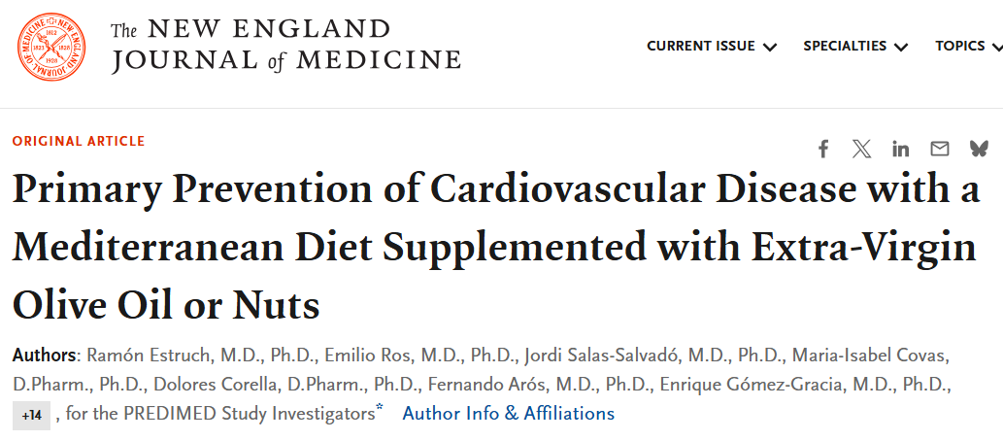
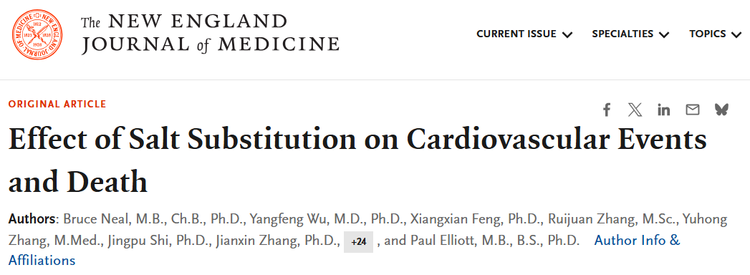
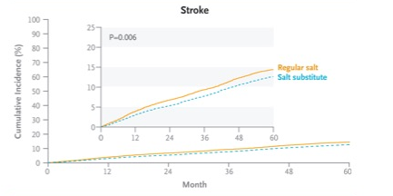
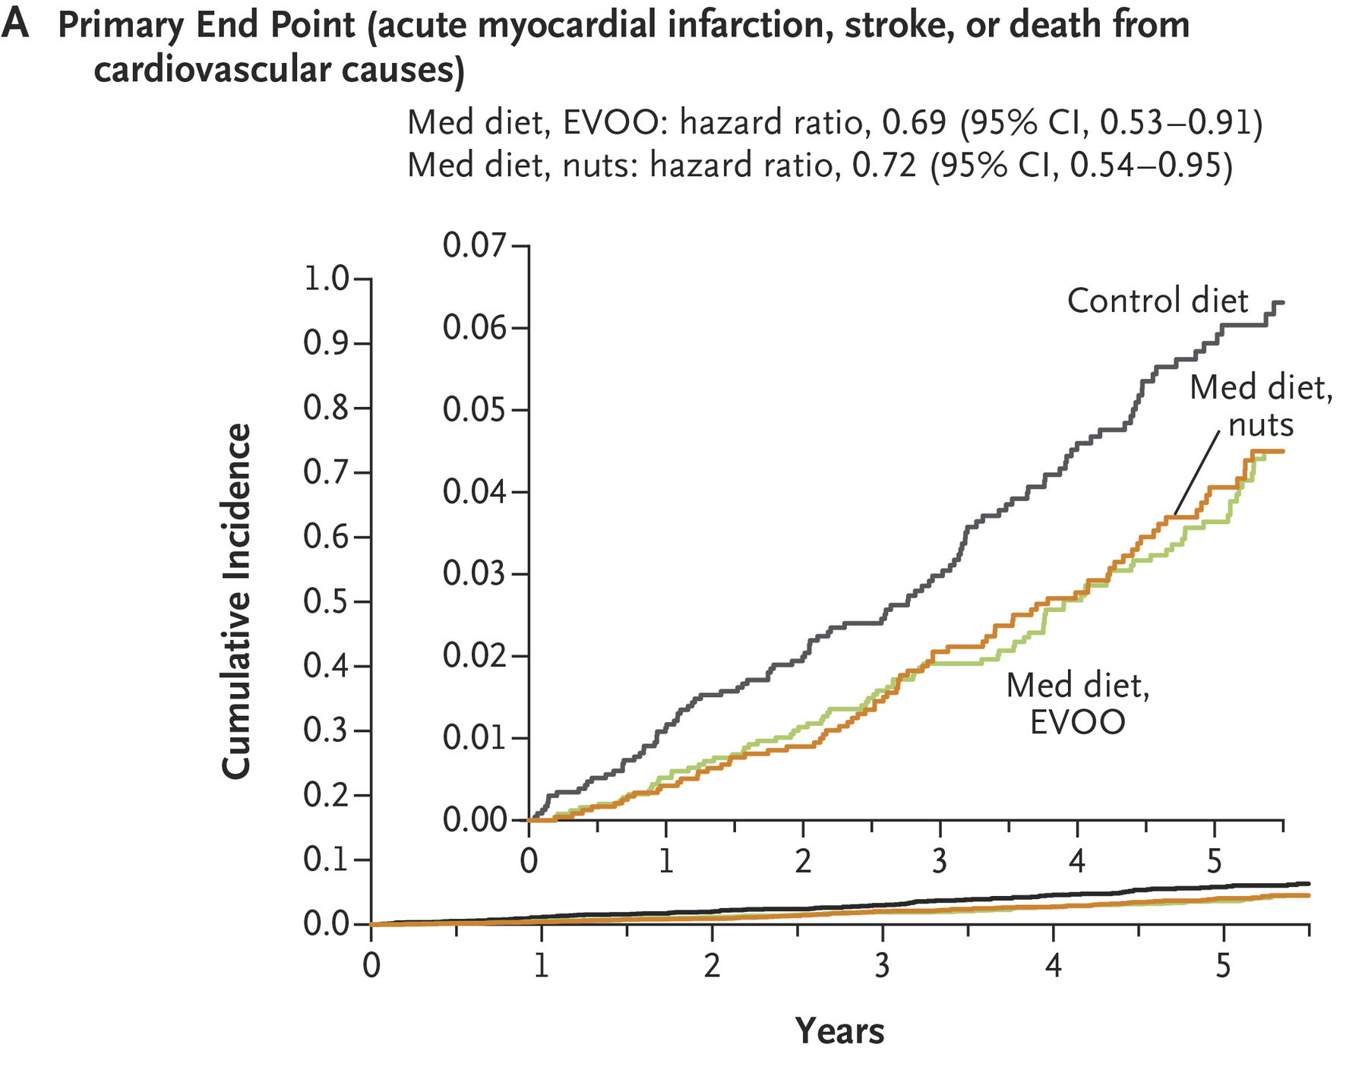
Public Health Context
Systolic Blood Pressure
GoFreshRx: -5.0 mm Hg (GoFresh: -3.4 mm Hg)
SSaSS: -3.3 mm Hg
LDL-cholesterol
GoFreshRx: -7.0 mg/dL (GoFresh: - 8.0 mg/dL)
PREDIMED: -5.8 mg/dL

Slide 21
Contextualizing with GoFresh
GoFreshRx
Compared to GoFresh, GoFresh Rx:
Sustained BP effects
Potential explanations:
Population differences:
Age: 60 (Rx) vs 46 yrs
Female: 80% (Rx) vs 55%
Motivation?
More feedback: we observed more medication titrations
GoFresh

Slide 22
Conclusions
Compared to similar monetary compensation, 3-months of DASH-patterned groceries ordered with dietitian counseling and home-delivered to Black residents with treated hypertension, living in Boston communities with fewer grocery stores:
Reduced SBP, DBP, and LDL-cholesterol
Improved intake of potassium relative to sodium
Blood pressure benefits were partially sustained after the intervention ended
The intervention had a stronger effect on potassium/sodium ratio rather than either component, allowing greater flexibility in choice
Potential for greater cost-effectiveness over time

Slide 23
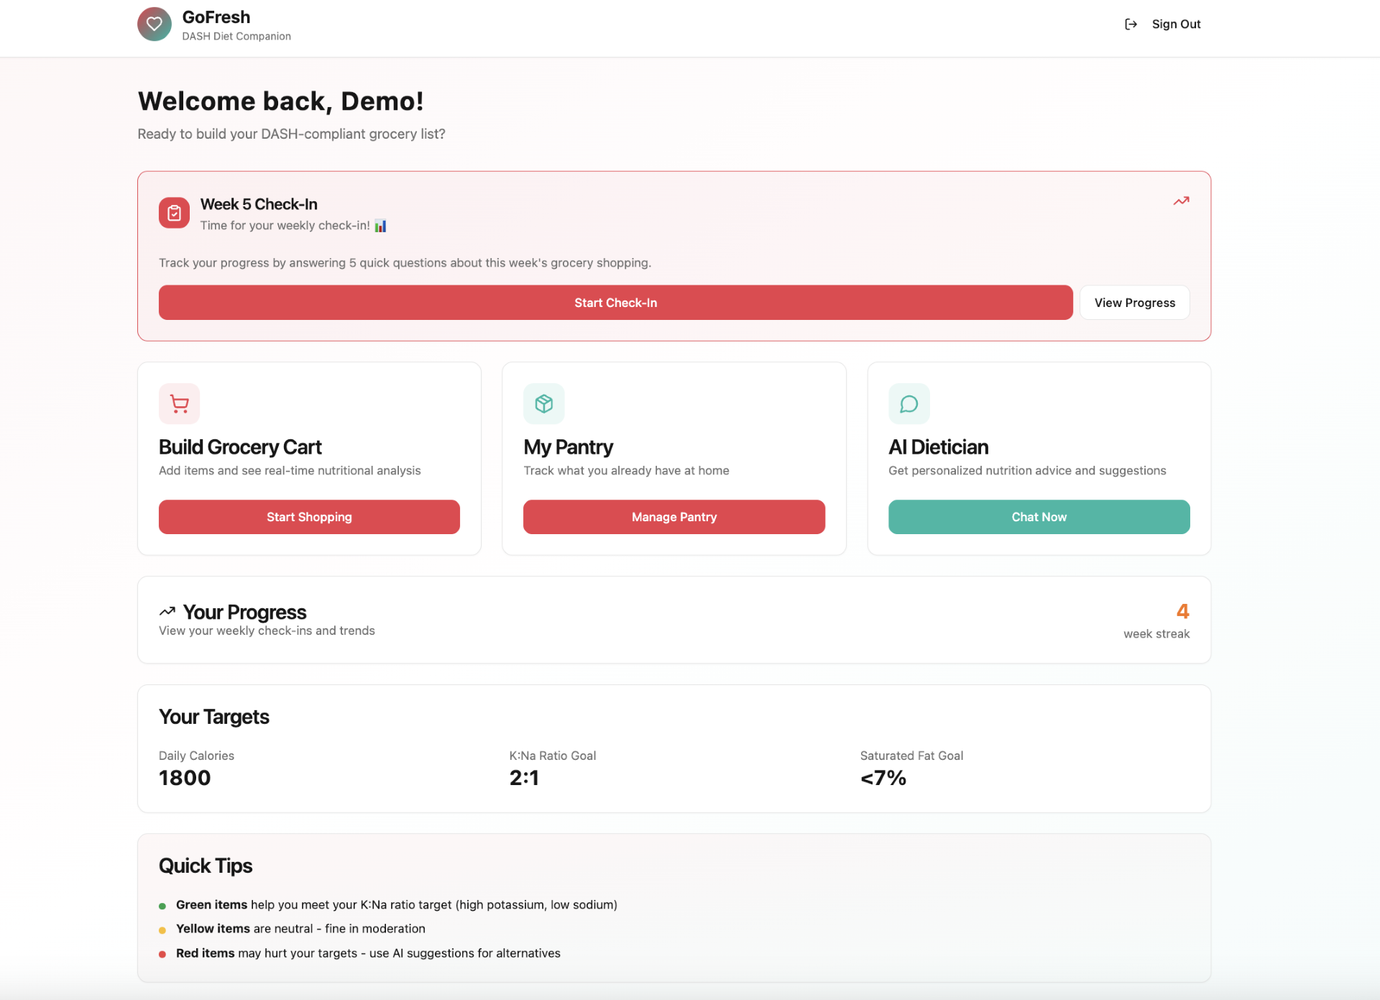


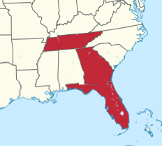
Future directions
GoFresh Southeast
Active! GoFresh Southeast (www.gofreshsoutheast.org)
Expanding our reach to new urban and rural communities across the Southeast U.S (FL, GA, and TN)
2. GoFreshWorld
International Consortium focused on developing universal standards in healthy grocery shopping to prevent CVD
Initial partners: Argentina, Australia, Canada, Ghana, Netherlands, South Korea, Vietnam, United Kingdom (looking to grow!)
3. App Development & Scalability
Actively seeking partnerships with innovators to create a GoFresh app to automate food ordering and delivery logistics
Integrates nutrition facts, GoFresh principles, and participant preferences
Designed to make the model sustainable, efficient, and scalable nationwide

Slide 24
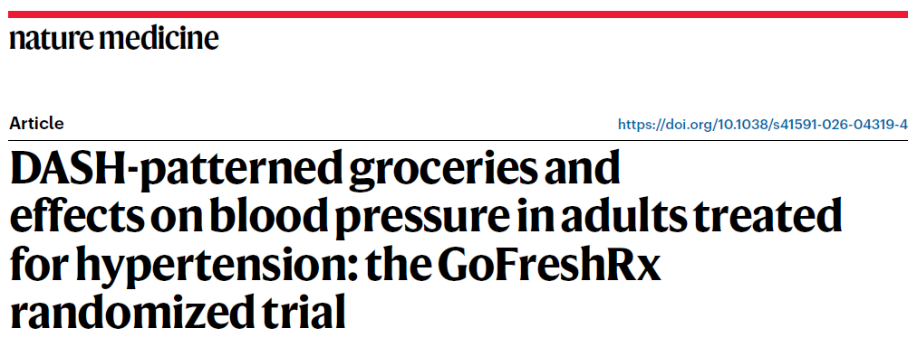
Read More!

Slide 25

On behalf of GoFreshRx,
Thank you

Slide 26
Acknowledgments
Steering Committee
Edgar Miller III, MD PhD (Johns Hopkins University)
Deidra Crews, MD ScM (Johns Hopkins University)
Anika Hines, PhD MPH (Virginia Commonwealth University)
Stephanie Fitzpatrick, PhD (Northwell Health)
Dietary Advisory Committee
Katherine McManus, MS RD (Brigham and Women’s Hospital)
Xiaoran Liu, PhD MSc (Rush University)
Sarah Couch, PhD RD (University of Cincinnati)
Amaris Williams, PhD (Ohio State University)
Data Safety Monitoring Board
Jessica Yeh, PhD (Johns Hopkins University; Chair)
Don Wesson, MD MBA (Texas A&M College of Medicine)
LaPrincess Brewer, MD MPH (Mayo Clinic)
Kimberlee Gauvreau, ScD (Boston Children’s Hospital)
Community Advisory Committee
Samantha Taylor (co-chair) (Executive Director of Bowdoin Street Health Center)
Christine Sinclair MA MS RD (Registered Dietitian, Stop & Shop)
Earlene Avalón (Teaching Professor, Northeastern University)
Ed Gaskin (Executive Director of Greater Grove Hall Main Streets)
Sabrina Vixama (Chef, Business Owner)
Tiffany Marshall (Media Team, Boston Renegades)
Current Students
Medical Students (HMS): Benjamin Grobman, Mansi Totwani, Christian Rivera, Katie Williams, Grace Lee, Jose Carranza Celis, Katie Gao
Undergraduates: Kathleen Timolien (UMASS), Carolina Aponte (Northeastern)
Prior Students
Noelle Castilla-Ojo, MD (Brigham & Women’s Hospital), Tola Ibikunle, MD (Mayo Clinic)
Team
Hannah Col, Kayla Ferro, Ruth-Alma Turkson-Ocran, Jennifer Cluett, Roger Davis, Kristen Kraemer, Kathy McManus, Kenneth Mukamal, Emily Aidoo, Fredrick Larbi Kwapong, Marian Budu, Dhrumil Patil, Sarah Nartey, Jacqueline Michetti, Sofia Allison, Manfred Mate-Kole, Jingyi Cao, Reva Seager

