Slide 1


Prehospital Heparin Administration In Patients with STEMI Undergoing Primary PCI – HEPARIN STEMI
Misa Fister, Marko Noc, Peter Radsel,
Matjaz Bunc, Danilo Franco, Tomaz Goslar
misa.fister@kclj.si

Slide 2
CONFLICT OF INTEREST
NONE

Slide 3
BACKGROUND
Patient with STEMI → primary PCI
Patent infarct related artery (IRA) at initial CAG is associated with smaller infarct size and improved prognosis
Several agents (UFH, bivalirudin, GP llb/llla ± thrombolysis, P2Y12) have been investigated to facilitate IRA reperfusion with mixed success and often associated with increased bleeding
Notes:
Timely PCI is nowadays the preffered reperfusion strategy in STEMI.
Patients who have a patent IRA at their initial CAG, have a smaller infarct size and improved prognosis.
Several agents have been tested to faciliate IRA reperfusion with mixed success, and they were often associated with increased bleeding.

Slide 4
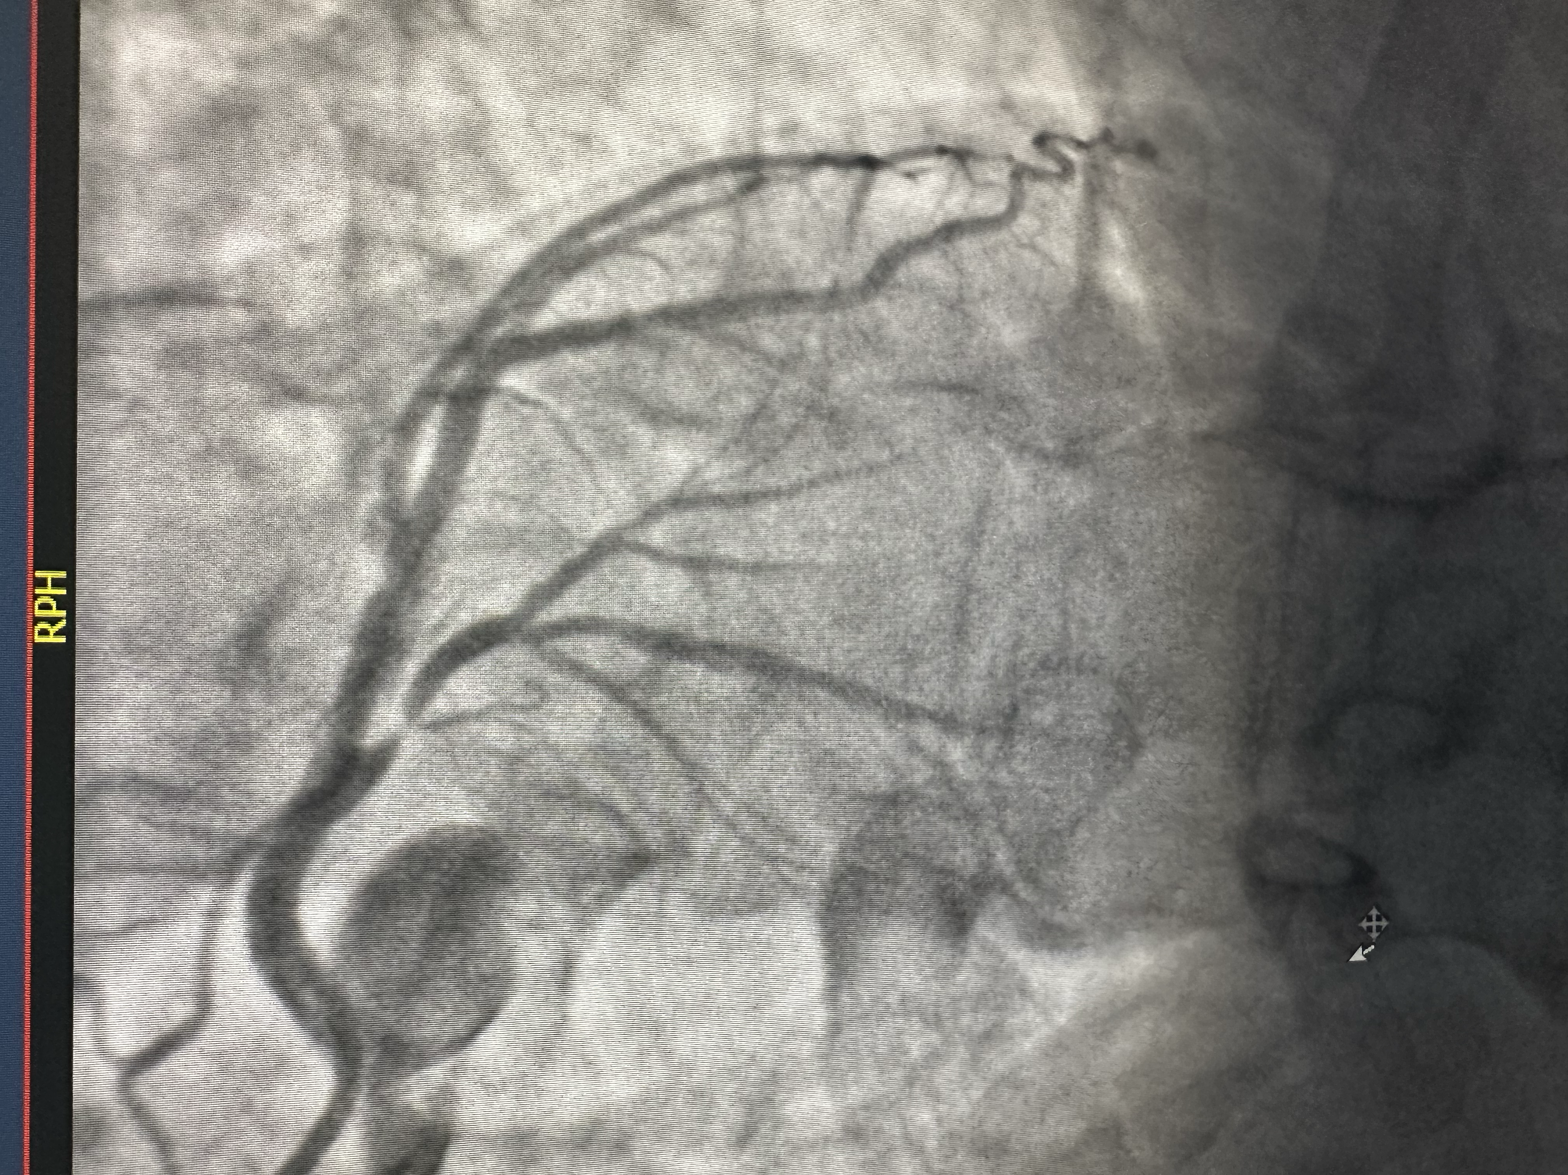
Can a bolus of UFH at prehospital FMC increase IRA patency without excess bleeding?
💉
🩸
Notes:
There is a lack of consensus about giving heparin at the first medical contact. Therefore, the objective of our study was to investigate whether a bolus of heparin at prehospital FMC could increase IRA patency without the excess bleeding

Slide 5
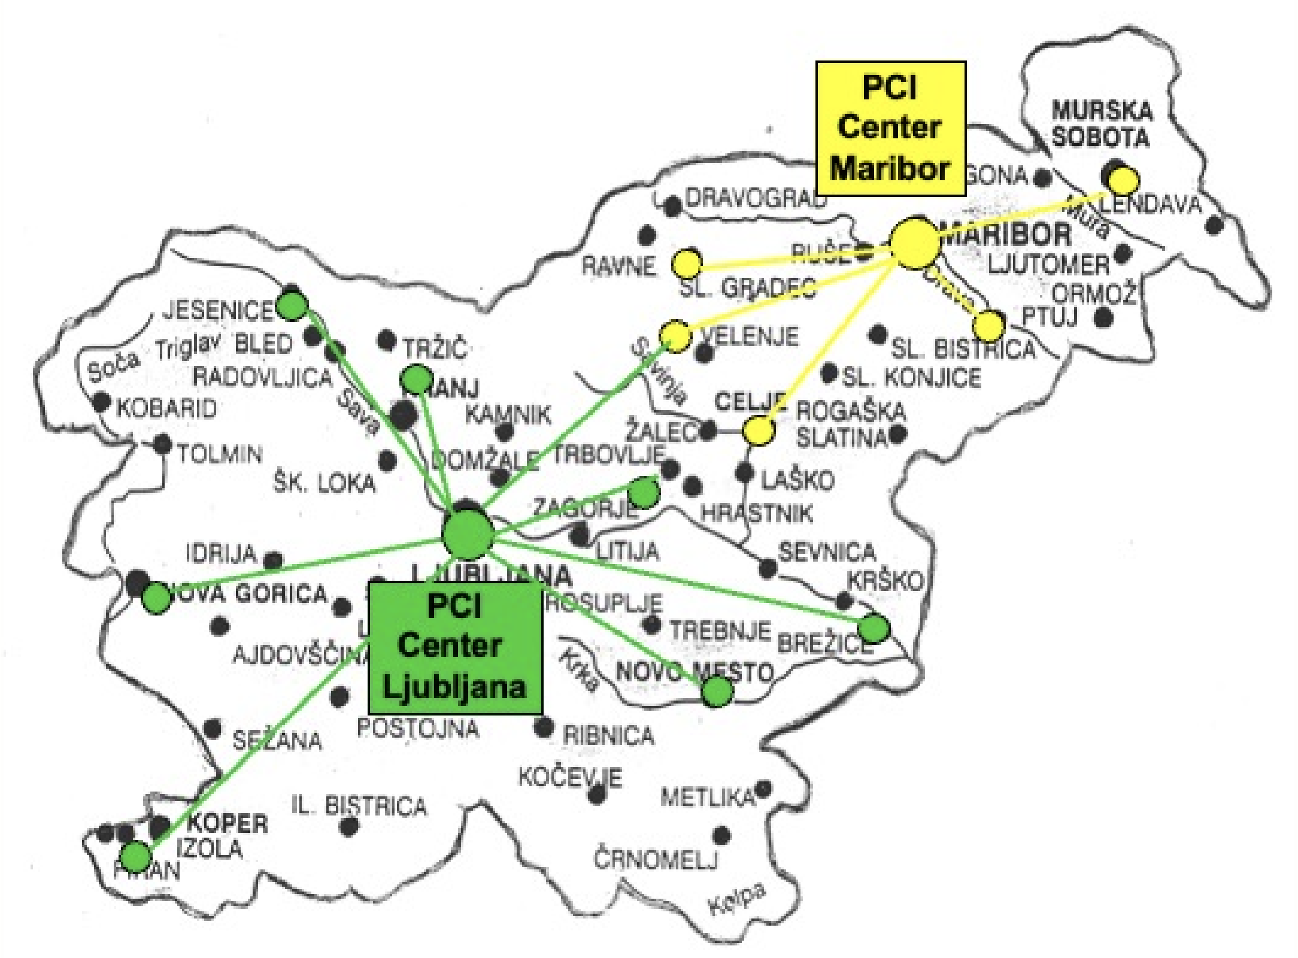
MAP OF SLOVENIA
Notes:
Although this was a single center study, our university hospital covers up to 70% of population of our country for primary PCI.
In addition, in our emergency medical system, the first prehospital medical contact includes a physician. They contact us when there is a patient with a suspected STEMI, and the patients then come directly to the cathlab, bypassing secondary hospitals and emergency departments.

Slide 6
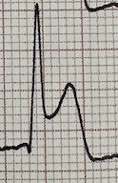
METHODS
✅ STEMI in ECG
✅ ≥ 18 years
✅ Symptoms ≤ 6h
🛑 Pregnant women
🛑 Comatose OHCA
🛑 Cardiogenic shock
Randomisation 1:1 at FMC
🚑
X
💉
70-100IU/kg UFH i.v.
No pretreatment
Primary Efficacy Endpoint: TIMI 2/3
🩸
Primary Safety Endpoint: BARC 3-5 Bleeding
Notes:
We enrolled adult STEMI patients with symptoms of less than 6 hours. The patients were randomised in the field, at the first medical contact, to either receive 70/100 IU/kg of intravenous heparin bolus or to no heparin pretreatment. Our primary efficiacy endpoint was TIMI 2-3 flow at initial coronary angiography. The primary safety endpoint was BARC 3-5 bleeding during index hospitalization.

Slide 7
Secondary endpoints Prespecified subgroups
Postprocedural TIMI 3,
Early ST- resolution,
Cardiac troponin I (cTnI),
Progression to cardiogenic shock,
30-day and 1-year all cause mortality.
Gender,
Age ≤65 years, >65 years,
Infarct related artery,
Delay from symptom onset to UFH (<2 hours, 2–4 hours, >4 hours),
Delay from UFH to CAG (≤1 hour, >1 hour).

Slide 8
STEMI Patients screened (n=1162)
March 2022 - February 2025
Randomization (n=600)
Randomization error (n=2)
Patients enrolled (n=598)
UFH pretreatment
(n=300)
No UFH
pretreatment (n=298)
No informed
consent (n=2)
No informed
consent (n=3)
Analyzed (Intention to treat)
(n=298)
Analyzed (Intention to treat)
(n=295)
Notes:
From March 2022 to February 2025 we randomized 600 patients. 298 patients were eventually analysed in the heparin arm, and 295 in the no heparin pretreatment arm.

Slide 9
BASELINE CHARACTERISTICS
 | UFH (n=298) | No UFH (n=295) | p
Age, years | 64.2±11.7 | 63.0±11.6 | 0.186
Male | 215 (72%) | 225 (76%) | 0.215
Body mass index | 27.8±4.3 | 28.2±4.2 | 0.257
Hypertension | 151/298 (51%) | 159/295 (54%) | 0.431
Diabetes | 52/298 (17%) | 49/295 (17%) | 0.786
Hypercholesterolemia | 98/298 (33%) | 101/295 (34%) | 0.727
Curent smoking | 127/298 (43%) | 117/295 (41%) | 0.464
Previous MI | 30/298 (10%) | 38/295 (13%) | 0.282
Previous stroke | 15/298 (5%) | 11/295 (4%) | 0.438
PAD | 11/298 (4%) | 13/295 (4%) | 0.658
Previous PCI | 36/298 (12%) | 45/295 (15%) | 0.260
Previous CABG | 2/298 (0.7%) | 2/295 (0.7%) | 1.000
Notes:
These are baseline characteristics of our patients. The patients were well balanced between the groups.

Slide 10
PREHOSPITAL TREATMENT
Prehospital treatment | UFH | No UFH
Symptoms to FMC, min* | 70 (35-135) | 66 (35-120) | 0.986
FMC to cathlab, min* | 69 (50-95) | 66 (49-100) | 0.853
Total ischemic time, min* | 145 (107-210) | 150 (104-220) | 0.814
Acetylsalicilic acid at FMC | 296/298 (99.3) | 294/295 (99.7) | 0.569
UFH pretreatment at FMC | 291/298 (97.7) | 5/295 (1.7) | <0.001
Notes:
The time from onset of symptoms to first medical contact was about 70 mins as was the time from first medical contact to cathlab arrival. The total ischemic time was a little below 2.5 hours. Almost all patients received Aspirin at first medical contact. There was a very small crossover between the groups regarding heparin pretreatment.

Slide 11
CORONARY ANGIOGRAPHY AND PCI
Primary PCI | UFH | No UFH
Coronary angiography | 296/298 (99.3) | 292/295 (99.0) | 0.645
Radial access | 229/296 (77.4) | 233/292 (79.8) | 0.473
Obvious IRA | 285/296 (96.3) | 280/292 (95.9) | 0.806
LM | 6 (2.1) | 2 (0.7)
LAD | 97 (34.0) | 120 (42.9)
LCX | 35 (12.3) | 32 (11.4)
RCA | 121 (42.5) | 113 (40.4)
Side branch | 26 (9.1) | 13 (4.6)
Multivessel disease | 108/296 (36.5) | 107/292 (36.6) | 0.968
PCI with stenting | 287/296 (97.0) | 280/296 (94.6) | 0.153
Notes:
Almost all patients underwent coronary angiography. The majority of patients had radial access. There was an obvious infarct related artery in 96% of patients, and the location of culprit artery was balanced between the groups. Multivessel disease was present in 36% of cases. 96% of patients underwent PCI with stenting.

Slide 12
PERIPROCEDURAL TREATMENT AND HAEMOSTASIS
 | UFH | No UFH | p
Total UFH, IE/kg* | 163 (146-181) | 92 (83-100) | <0.001
Eptifibatide | 44/287 (15.3) | 43/280 (15.4) | 0.993
Cangrelor | 13/287 (4.5) | 16/280 (5.7) | 0.522
Oral P2Y₁₂ inhibitor | 287/287 (100.0) | 280/280 (100.0) | 0.282
Hemostasis at puncture site |  |  | 0.102
Radial band | 228/296 (77.0) | 232/292(79.5)
Femoral closure device | 49/296 (16.6) | 53/292 (18.2)
Femoral manual compression | 10/296 (3.4) | 3/292 (1.0)
Radial band and fem. closure device | 8/296 (2.7) | 3/292 (1.0)
Notes:
Almost all patients received periprocedural heparin. The patients that got heparin in the field, got additional heparin according to activated clotting time. This is why the total heparin given was much higher in the heparin pretreatment group. The additional periprocedural medications were balanced between the groups. All patients received P2Y12 inhibitor loading after PCI. There were no differences in haemostasis at puncture sites.

Slide 13
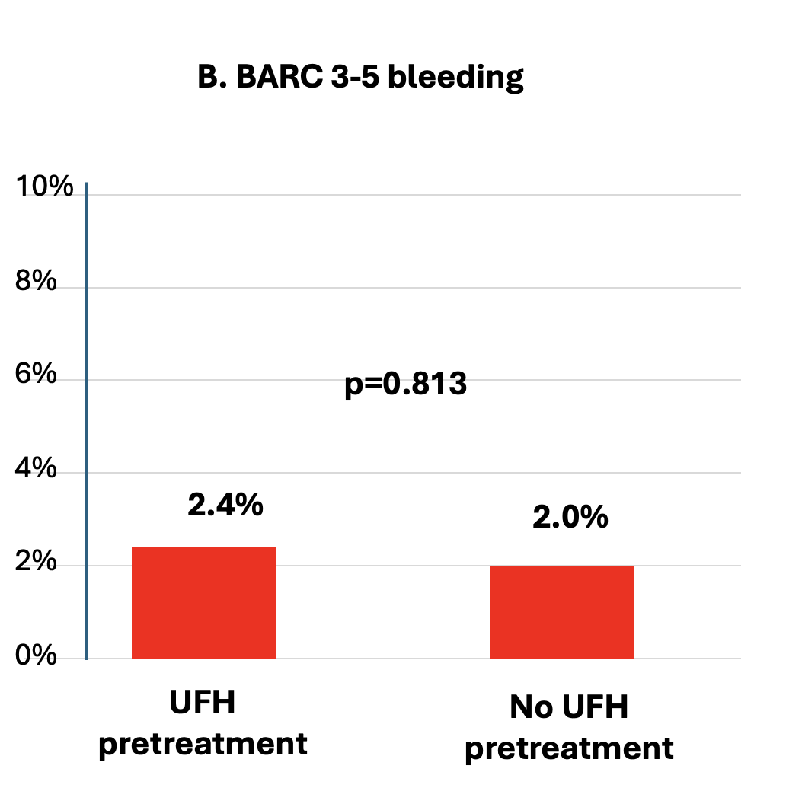
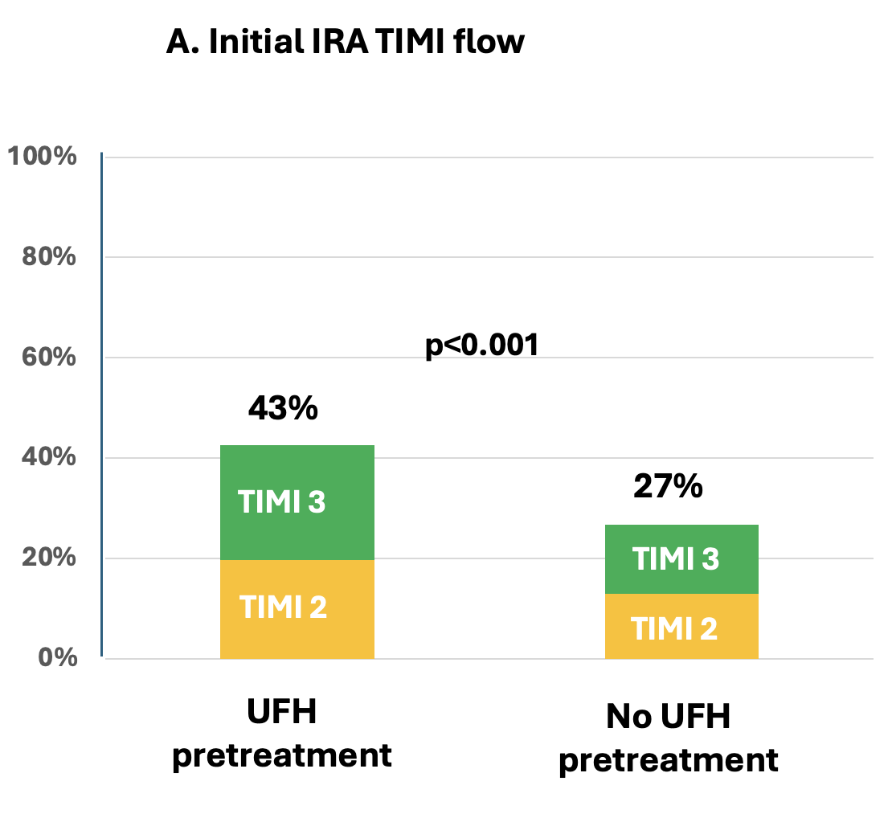
PRIMARY EFFICACY ENDPOINT
PRIMARY SAFETY
ENDPOINT
Notes:
43% of patients that received heparin pretreatment had patent infarct related artery with TIMI 2 to 3 flow whereas only 27% of patients with no pretreatment had TIMI 2/3 flow at initial coronary angiography, so an absolute difference of 16% in IRA patency.
However, there was no significant difference in BARC 3-5 bleeding between the groups at any time during their hospital stay. The rate of bleeding in heparin pretreatment group was 2.4% versus 2% in the no pretreatment arm.

Slide 14
SECONDARY ENDPOINTS
 | UFH | No UFH | RR | p
Final TIMI flow
TIMI 3 | 240/296 (81.1) | 236/292 (80.8) |  | 0.863
ST-resolution,% | 65 (42-88) | 59 (30-80) |  | 0.047
Troponin I 24h, ng/L* | 30.357 (10.272-66.828) | 41.795 (17.550-71.396) |  | 0.036
Peak Troponin I, ng/L* | 43.126 (13.133-96.592) | 46.971 (20.152-94.839) |  | 0.318
Cardiac arrest | 11/298 (3.7) | 14/295 (4.7) |  | 0.523
Shock | 46/298 (15.4) | 41/295 (13.9) | 1.11 (0.75-1.64) | 0.597
Death at 30 days | 7/294 (2.4) | 7/282 (2.5) | 0.96 (0.34-2.70) | 0.937
Death at 1 year | 12/290 (4.1) | 8/282 (2.8) |  | 0.397
Notes:
Among secondary endpoints, the patients in the pretreatment arm had better ST resolution, and had significantly lower troponin level after 24h. There were no differences in other secondary endpoints.

Slide 15
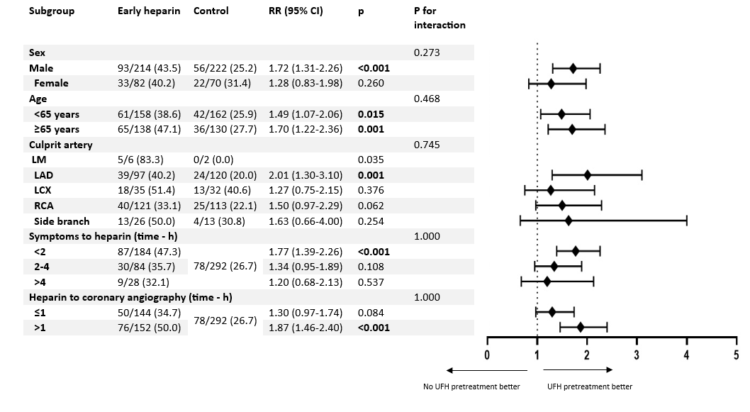
PRESPECIFIED SUBGROUP ANALYSIS
Notes:
All prespecified subgroups favoured heparin pretreatment. There appeared to be a signal in certain subgroups where heparin may appear to be more beneficial – these subgroups were men, patients with LAD as culprit artery, early presenters with less than 2 hours of symptoms before a bolus of heparin, and patients with a longer time from heparin bolus to coronary angiography.

Slide 16
CONCLUSIONS
In this study, patients with STEMI undergoing pPCI, pretreatment with UFH (70-100 IU/kg) at prehospital FMC improved IRA patency without increasing the risk of bleeding
UFH pretreatment at FMC is easy, effective, safe and cheap
The subgroups that appeared to benefit more include men, patients with LAD as a culprit artery, early presenters, and those with longer transfer times to CAG.

Slide 17



PREHOSPITAL HEPARIN ADMINISTRATION IN PATIENTS WITH STEMI UNDERGOING PRIMARY PCI: THE HEPARIN STEMI RANDOMIZED CONTROLLED TRIAL
QR CODE
Misa Fister, Marko Noc, Peter Radsel, Matjaz Bunc, Danilo Franco, Tomaz Goslar for the HEPARIN STEMI study
CIRCULATION. 2026; [PUBLISHED ONLINE AHEAD OF PRINT]. DOI: 10.1161/CIRCULATIONAHA.126.079839
Notes:
This study is simultaneously published in Circulation and you can access it with the QR code.

Slide 18




Best
regards
from
Slovenia-
Europe

