Slide 1
IVUS or angiography guidance for PCI in complex coronary bifurcation lesions: The DKCRUSH VIII Trial
Shao-Liang Chen, MD
On Behalf of All Investigators
Nanjing First Hospital
Nanjing Medical University, China

Slide 2
Disclosure
I, (Dr. Shao-Liang Chen), have nothing to disclose

Slide 3
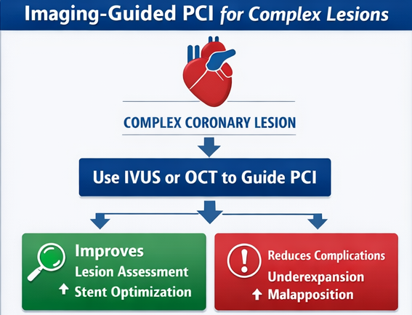
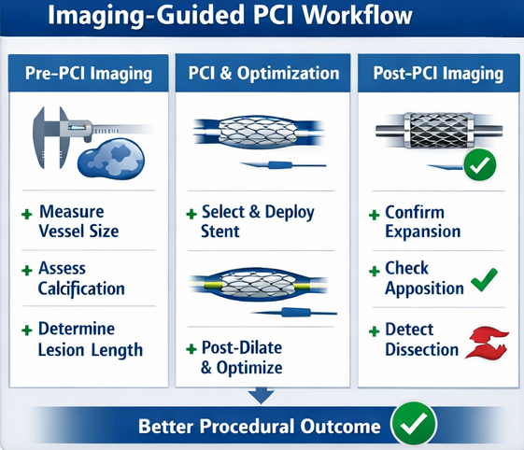
Background (1)
IA
ACC-ESC
Vrints C, et al. Eur Heart J 2024; S.V. Rao et al. Circulation/JACC 2025

Slide 4
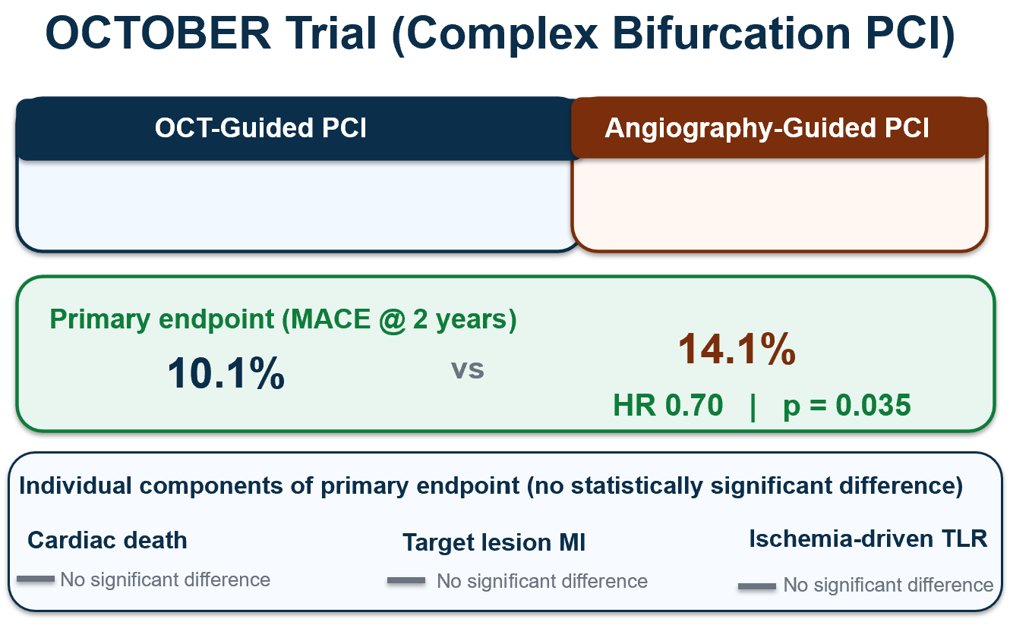
Background (2)
Median SB lesion length = 8.8 mm
More simple bifurcation lesions
DEFINITION Criteria:
complex bifurcations defined as
--SB lesion length ≥ 10-mm
--SB-DS 70% -90%
--Any 2 minor criteria
Holm NR, et al. N Engl J Med. 2023 Chen SL, et al. JACC Cardiovasc Interv. 2014

Slide 5
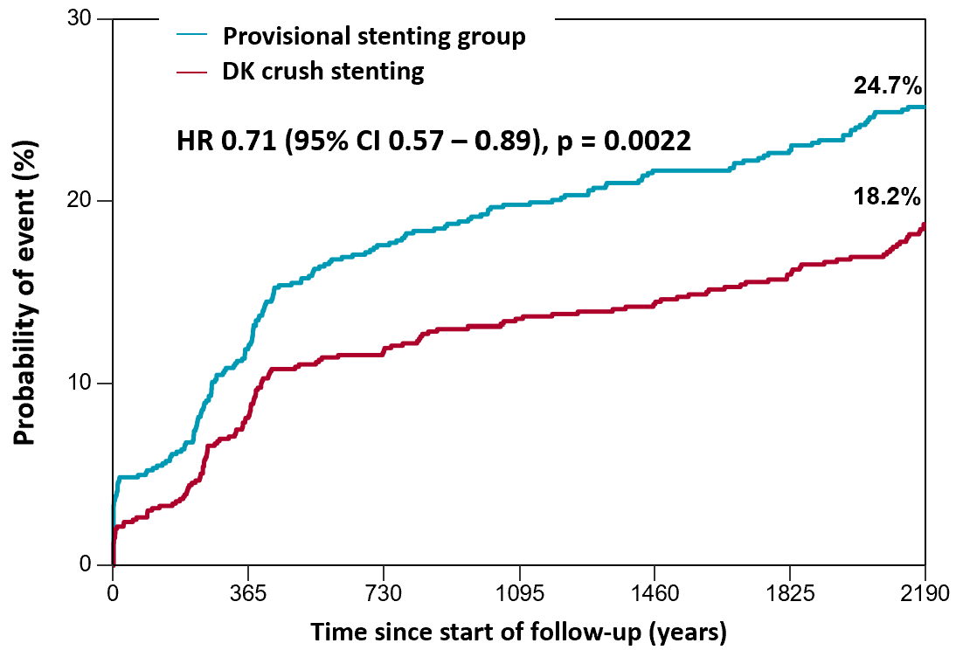
Background (3)
Major finding
-- DK crush had a lower rate of TVF/TLF/MACE
-- This benefit primarily reported in complex
bifurcations
Questions ?
-- IVUS guidance <50%
-- One-year TLF rate ≈6% in DK crush group
-- DK crush consists of multiple steps, proximal
re-wiring is a key step
-- Whether IVUS guidance may further reduce
clinical events in DK crush for complex
bifurcations?
IPD analysis of 4 randomized trials
(DKCRUSH II, III, V, DEFINITION II)
Chen, et al. AsiaIntervention. 2026

Slide 6
Aims
This study aimed to investigate the treatment effect of IVUS–guided PCI, as compared with angiography-guided PCI, in patients with complex bifurcation lesions

Slide 7
Key inclusion criteria Key exclusion criteria
Participants and randomization
*Age≥18 years
*True complex bifurcation lesions
*SB lesion length ≥10 mm, and
*SB- DS≥70% -90%, plus
-- 2 of minor criteria
*moderate to severe calcification
*multiple lesions
*bifurcation angle <45° or >70°
*MV-RVD ≤2.5 mm
*Thrombus-containing lesions, or
*MV lesion length ≥25 mm)
*MV-QFR ≤ 0.8
*Simple bifurcation lesions
*Recent STEMI (<24 h)
*Severe comorbidity limiting survival
*Contraindications to DAPT
*Restenotic lesion
*Heavily calcified lesions requiring Rota
*Failed chronic total occlusions, or
*Major bleeding history

Slide 8
Study Endpoints
Primary endpoint
target vessel failure, including cardiac death, target vessel MI,
or clinically driven target vessel revascularization at 12 months
Secondary endpoints
--individual components of the primary endpoint
--all-cause death
--any revascularization, and in-stent restenosis
*Safety endpoint: definite or probable stent thrombosis

Slide 9
Assumption and Sample size
The anticipated 1-year target vessel failure rate was 11.0% in the angiography-guided DK crush and 4.5% in the IVUS-guided DK crush group
A sample size of 556 patients was required to provide 80% power, assuming a two-sided alpha of 0.05 and a 5% dropout rate

Slide 10
Study flowchart
1466 patients with complex bifurcation lesions were screened
910 excluded
24 Chinese centers
556 patients were randomly assigned
278 assigned to IVUS-guided DK crush
278 assigned to angio-guided DK crush
1466 patients with complex coronary bifurcation lesions screened
1 withdrew before PCI
21 had angio-guided PCI
13 underwent DK crush
8 underwent provisional stenting
256 underwent IVUS-guided PCI
255 underwent DK crush
1 underwent provisional stenting
21 underwent IVUS-guided PCI
21 underwent DK crush
0 underwent provisional stenting
257 underwent angio-guided PCI
248 underwent DK crush
9 underwent provisional stenting

Slide 11
Statistical analysis
ITT analysis
Adjusted for clinical presentation, diabetes, and geographic region
A post hoc landmark analysis:
0-30 days and 31-365 days
Fine and Gray competing risk method
To account for non-cardiac death as a competing event
Cox PH model with shared frailty for site
Per-Protocol analysis

Slide 12
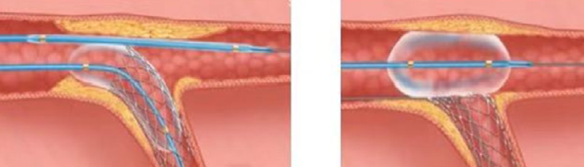
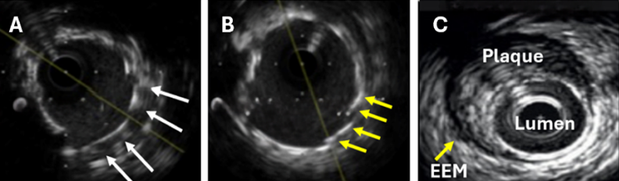
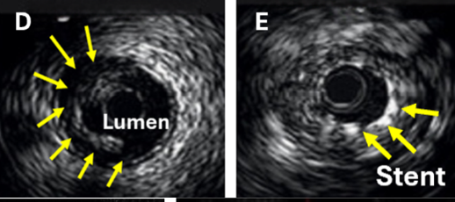
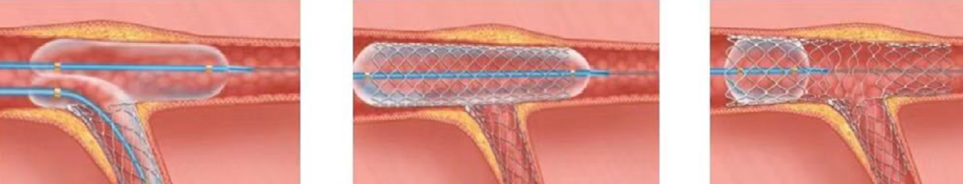
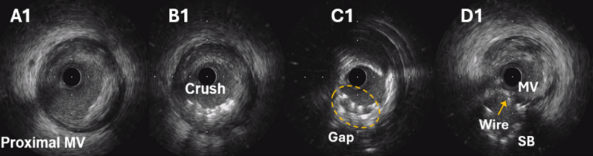
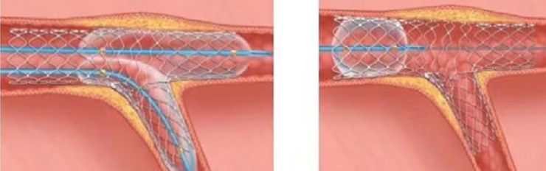
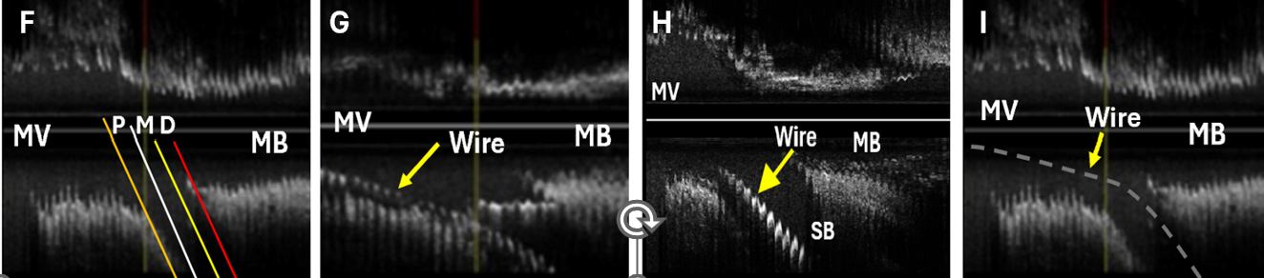
DK crush stenting procedure
Boston Scientific provided IVUS system for all patients

Slide 13
Baseline Characteristics
No. (%) | IVUS group (n=277) | Angiography group (n=278) | P value
Age, yr (median (IQR)) | 67 (58, 73) | 66 (58, 72) | 0.35
Male | 215 (77.6%） | 215 (77.3%） | 1.00
Stable angina | 33 (11.9%) | 33 (11.8%) | 1.00
Unstable angina | 193 (69.7%) | 195 (70.1%) | 0.93
STEMI | 51 (18.5%) | 50 (17.9%) | 0.70
Hypertension | 190 (68.6%) | 171 (61.5%) | 0.09
Diabetes | 89 (32.1%) | 95 (34.2%) | 0.65
Chronic renal dysfunction | 22 (7.9%) | 26 (9.4%) | 0.65
Heart failure | 29 (10.5%) | 32 (11.5%) | 0.79

Slide 14
Lesions and procedural Characteristics
 | IVUS group (n=277) | Angiography group (n=278) | P value
2 or 3 vessel disease, n (%) | 167 (60.3) | 181 (65.1) | 0.26
Distal LM bifurcations | 124 (44.8) | 122 (43.9) | 0.86
LAD-D bifurcations | 147 (53.1) | 146 (52.5) | 0.93
Trans-radial access, n (%) | 237 (85.6) | 231 (83.1) | 0.48
Double kissing crush | 268 (96.8) | 269 (96.8) | 1.00
Provisional stenting | 7 (2.5) | 7 (2.5) | 1.00
Complete revascularization, n (%) | 191 (69.0) | 185 (66.5) | 0.59
MV balloon diameter, mm* | 3.5 (3.0, 3.5) | 3.0 (3.0, 3.5) | 0.015
SB balloon diameter, mm* | 2.75 (2.5, 3.0) | 2.75 (2.5, 3.0) | 0.05
*indicated the balloon diameter for final kissing

Slide 15
IVUS guidance at each step in IVUS group

Slide 16
Major findings from IVUS assessment
 | IVUS assessment | Major findings
Baseline evaluation | 272 (98.2%) | Lesions, techniques, device selection
After balloon crush | 257 (92.8%) | Incomplete crushing in 78 (28.2%) patients
After first rewiring | 229 (82.7%) | Distal rewiring in 95 (41.5%) patients
After stent crush | 237 (85.6%) | Incomplete crushing in 30 (12.7%) patients
After second rewiring | 237 (85.6%) | Rewiring from distal in 52 (21.9%) patients
After final POT | 256 (92.4%) | Suboptimal procedure in 169 (61.0%) patients

Slide 17


30
HR: 0.40 (95% CI: 0.23–0.71); p = 0.0016
25
 | IVUS group | Angio group | HR (95%vCI) | p
TVF without PMI | 10 (3.6%) | 34 (12.2%) | 0.28 (0.14-0.57) | 0.0005
20
Cumulative target vessel failure event rate (%)
14.7%
15
+
10
+
6.1%
5
+
+
0
0
30
90
150
210
270
330
365
Number at Risk
Angiography-guided PCI
278
259
256
254
252
248
246
240
IVUS-guided PCI
277
267
266
265
262
259
258
258

Slide 18
Adjusted Endpoints at 1-year Follow-up
 | IVUS group (n=277) | Angiography group (n=278) | Hazard ratio (95% CI) | P value
Target vessel failure, n (%) | 17 (6.1) | 41 (14.7) | 0.40 (0.23 - 0.71) | 0.0016
Secondary endpoints, n (%)
All-cause death | 4 (1.4) | 3 (1.1) | 1.34 (0.30 - 5.99) | 0.70
Cardiac death | 2 (0.7) | 3 (1.1) | 0.67 (0.11 - 3.99) | 0.66
Target vessel MI | 12 (4.3) | 26 (9.4) | 0.46 (0.23 - 0.90) | 0.02
Spontaneous MI | 5 (1.8) | 17 (6.1) | 0.29 (0.11 - 0.78) | 0.01
Clinically driven TVR | 8 (2.9) | 21 (7.6) | 0.37 (0.16 - 0.84) | 0.02
Definite or probable ST | 1 (0.4) | 3 (1.1) | 0.36 (0.04 - 3.46) | 0.38
Adjusted by sex, sites, and presentations

Slide 19
30
Optimal IVUS-guided PCI
 | Non-left main bif. | LM bif.
MSA (mm2) @ MV-SB-MB | 6-5-5 | 10-6-7
Plaque burden at edges | <55% | <55%
Dissection involving the media | ≤3 mm | ≤3 mm
 | HR (95% CI) | p value
Suboptimal PCI | Reference
Optimal PCI | 0.15 (0.05-0.44) | <0.001
Angiography-group | 0.89 (0.45-1.79) | 0.76
25
20
Suboptimal PCI, 15.9%
Cumulative target vessel failure event rate (%)
+
15
+
Angiography-guided PCI, 14.7%
+
10
+
5
+
Optimal PCI, 2.6%
0
0
30
90
150
210
270
330
365
Number at Risk
Suboptimal PCI
63
56
56
56
54
52
51
51
Angiography
278
259
256
254
252
248
246
240
Optimal PCI
193
192
191
190
189
188
188
188

Slide 20
Prespecified Subgroup Analysis
Number of events/number of patients
Subgroup
IVUS-guided PCI
Angiography-guided PCI
HR (95%CI)
P_{interaction}
Overall
17/277 (6·1%)
41/278 (14·7%)
0·40 (0·23-0·71)
Age
0·76
≥75 years
4/51 (7·8%)
10/46 (21·7%)
0·34 (0·11-1·09)
<75 years
13/226 (5·8%)
31/232 (13·4%)
0·42 (0·22-0·80)
Sex
0·38
Male
11/215 (5·1%)
31/215 (14·4%)
0·34 (0·17-0·68)
Female
6/62 (9·7%)
10/63 (15·9%)
0·60 (0·22-1·64)
Acute coronary syndrome
0·61
Yes
13/244 (5·3%)
34/245 (13·9%)
0·37 (0·20-0·71)
No
4/33 (12·1%)
7/33 (21·2%)
0·53 (0·16-1·83)
Multivessel disease
0·17
Yes
14/167 (8·4%)
28/181 (15·5%)
0·53 (0·28-1·01)
No
3/110 (2·7%)
13/97 (13·4%)
0·20 (0·06-0·69)
Distal left main bifurcation lesions
0·23
Yes
10/124 (8·1%)
17/122 (13·9%)
0·57 (0·26-1·25)
No
7/153 (4·6%)
24/156 (15·4%)
0·29 (0·12-0·66)
0.12
0.25
0.5
1
2
4
Favours IVUS-guided PCI
Favours Angiography-guided PCI

Slide 21
In conclusion
In the present randomized trial, IVUS-guided DK crush led to lower one-year rate of target vessel failure, compared to angiography-guided PCI for complex coronary bifurcation.
This benefit was achieved largely through achievement of IVUS-defined optimization targets rather than IVUS use alone

Slide 22
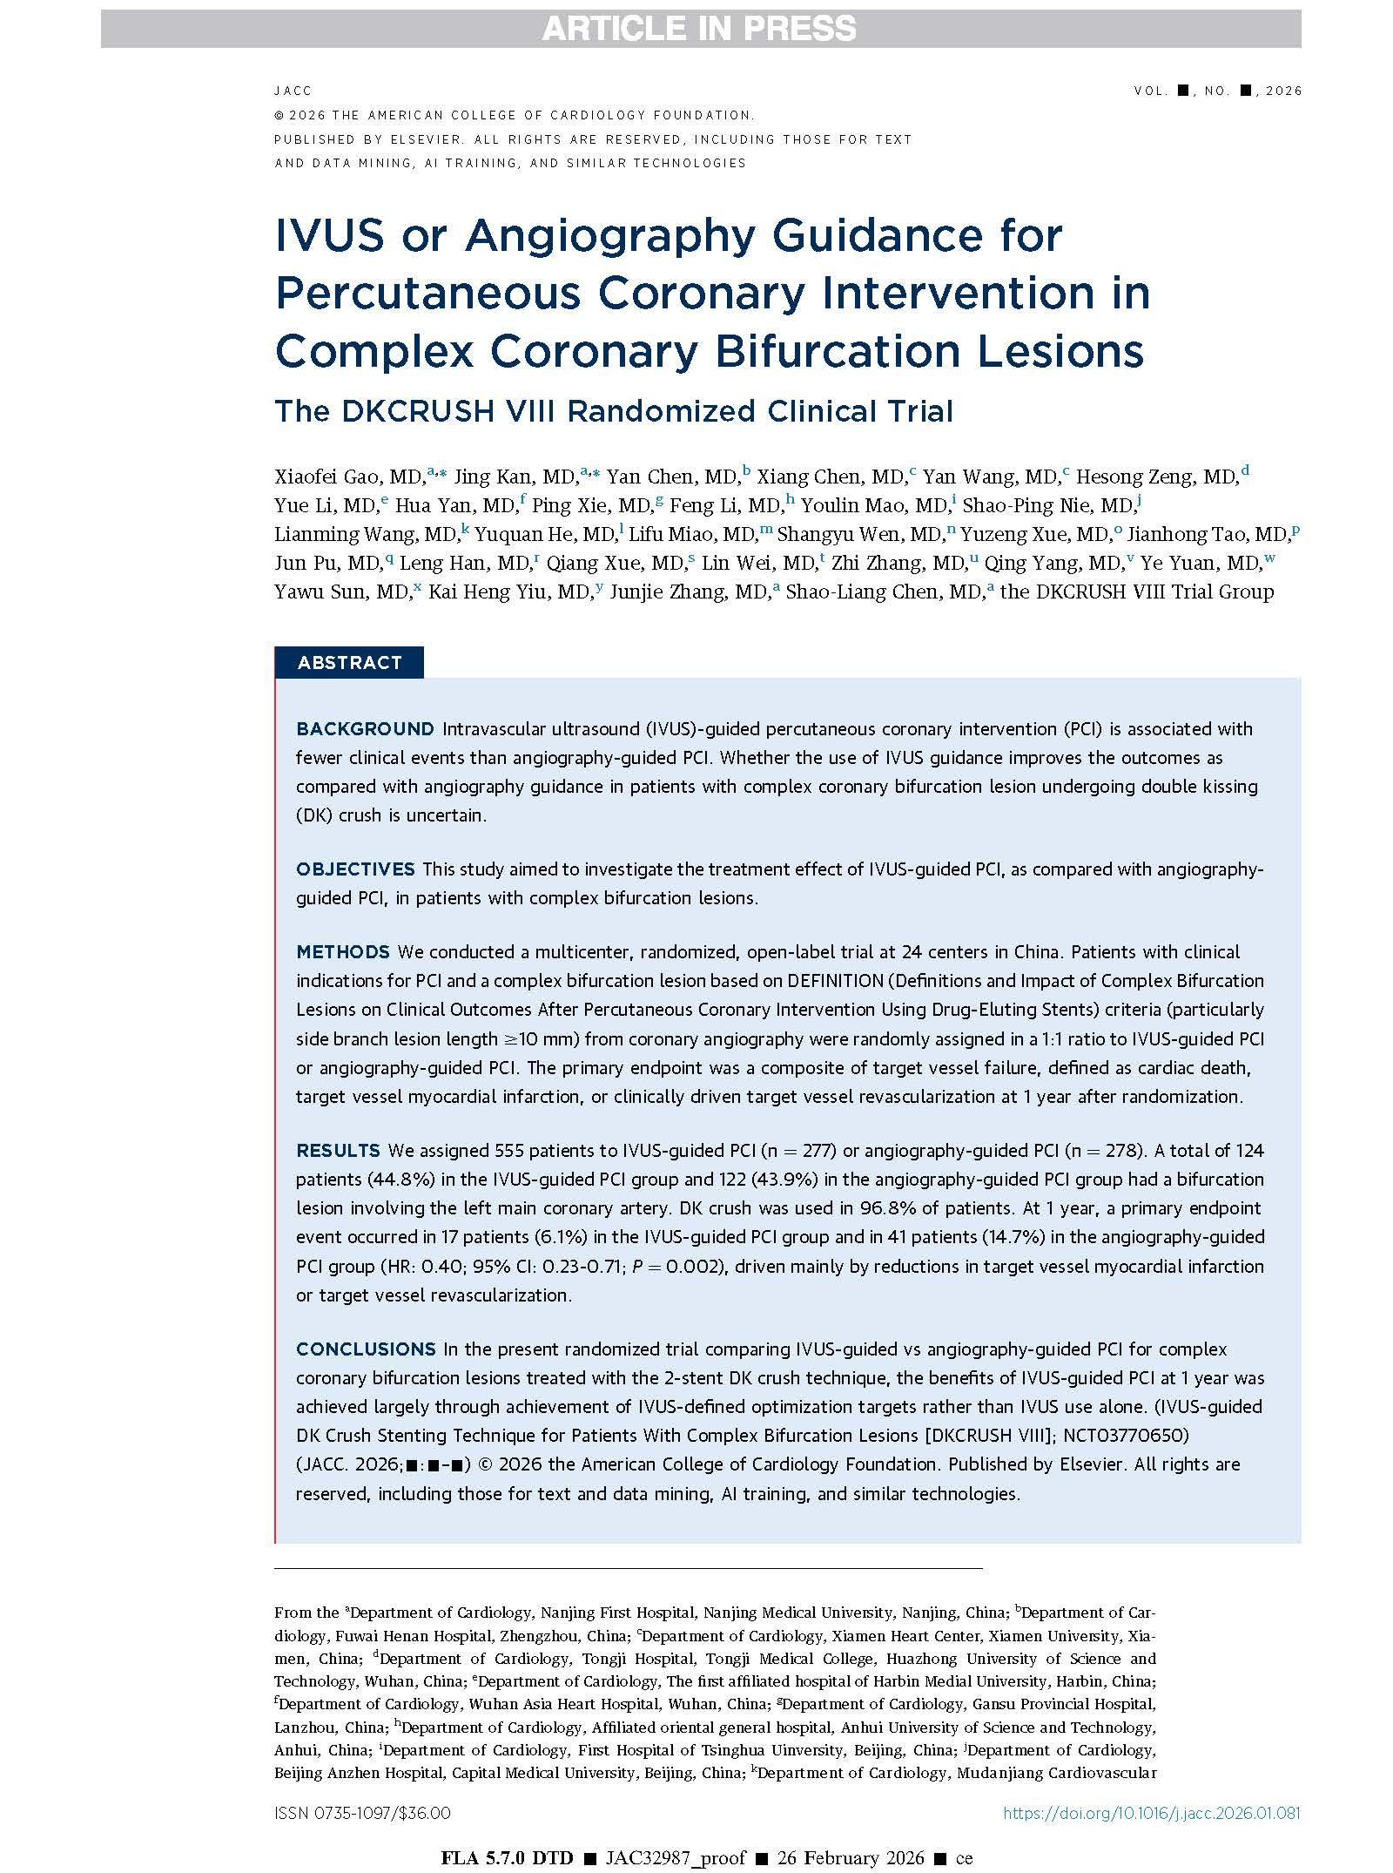
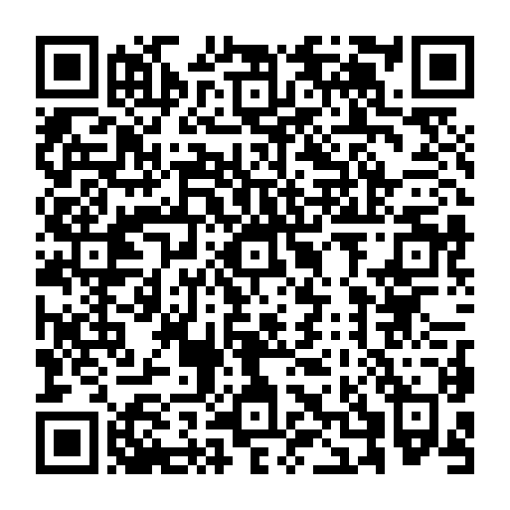

Simultaneously published in JACC

Slide 23
Thanks for your kind attention!

