Slide 1
Automated Alerts to Improve the Timely Evaluation and Treatment of Valvular Heart Disease:
The ALERT Trial
Wayne B. Batchelor, MD, MHS, MBA
On behalf of the ALERT Trial Investigators
President, Medicine Service line, Inova Health System
Schar Chair, Inova Heart and Vascular
Immediate-Past Chair, ACC Interventional Cardiology Section
Vice-Chair, NCDR STS/ACC TVT Registry
Professor of Medicine, Duke University School of Medicine
X (Twitter): @_WayneBatchelor
Notes:
“Good afternoon, on behalf of our investigative team, I am pleased to present the results of the ALERT trial.

Slide 2
Disclosures of Relevant Financial Relationships
Within the prior 24 months, I have had a relevant financial relationship with a company producing, marketing, selling, re-selling, or distributing healthcare products used by or on patients:
Nature of Financial Relationship
Consulting: Medtronic, Boston Scientific, Edwards, Abbott, Johnson and Johnson Research Funding: Abbott, Boston Scientific
All relevant financial relationships have been mitigated.
Faculty disclosure information can be found on the app.

Slide 3
Background
Aortic stenosis (AS) and mitral regurgitation (MR) are common
Untreated AS and MR increase mortality and morbidity
Despite recommendations,^{1,2} <50% of patients receive treatment within 90 days
Disparities across age, sex, race, rurality, and social determinants of health
DETECT AS Trial³:
Electronic clinician notifications (ECN) increased rates of AVR for AS
Single integrated healthcare system
96% White patients
Only AS patients
1. Otto et al, JACC 2021; 77:e25-e197;
2. Jneid et al, JACC 2024; 83:1579-1613; 3. Tanguturi et al, Circulation 2025; 151:1498-1507

Slide 4
ALERT Trial: Objective
To evaluate if automated ECN alerts improve timely multidisciplinary heart team (MHT) evaluation and valve intervention (VI) in a diverse population of patients with significant AS and MR across multiple health systems

Slide 5
ALERT Trial Design
Prospective, Cluster RCT Conducted at 5 Health Systems (35 Hospitals)
Key Eligibility
Significant aortic stenosis (AS) or mitral regurgitation (MR)
AS: any of: AVA ≤1.0 cm², DI ≤0.25, MG ≥40 mmHg, PG ≥64 mmHg, V_{peak} ≥4.0 m/s)
MR: moderate-to-severe (3+) or severe (4+) based on qualitative classification
Echo ordered by non-MHT clinician
No prior target valve intervention
No scheduled or recent MHT visit or scheduled valve intervention
1:1 Clinician Randomization
August 2024 to September 2025
Electronic Clinician Notification (Alert)
Usual Care
(No Alert)
Primary Endpoint:
Hierarchical Composite of Valve Intervention or Multidisciplinary Heart Team Visit within 90 days
AVA=aortic valve area; DI=dimensionless index; MG=mean aortic valve gradient; PG=peak aortic valve gradient; V_{peak}=peak aortic valve systolic velocity

Slide 6






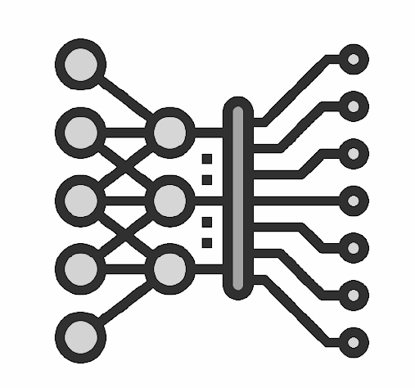




Electronic Notification Alert Process
Real-time patient data stream
Clinician Decision
NLP: analyzes echo data/ reports
Patient
identification
Clinician
notification
90-day
Outcomes
Analyzes EHR data
Significant AS or MR
No MHT care plan
Direct to appropriate care team member
Ongoing tracking
along care continuum
AS=Aortic Stenosis; EHR=electronic health record; MR=Mitral Regurgitation;
NLP=natural language processing (Tempus Next, AI-enabled care pathway platform)

Slide 7

Example: Clinician Notification
Tempus Next, an artificial intelligence clinical decision support software, has identified that Your patient, Doe, Jane (5/5/1950) meets the criteria for significant aortic stenosis based on the echo performed on 9/1/2025.
Per ACC/AHA's Valvular Heart disease guidelines, an intervention may be indicated. A referral requires a multifactorial decision outside the purview of the algorithm. For determining appropriate referral, please evaluate the patient’s record.
If you find a referral is necessary and the patient does not already have a cardiologist, the structural heart valve clinic coordinator will be happy to assist your office in connecting this patient with the multidisciplinary heart team for further evaluation. To do so, please…

Slide 8
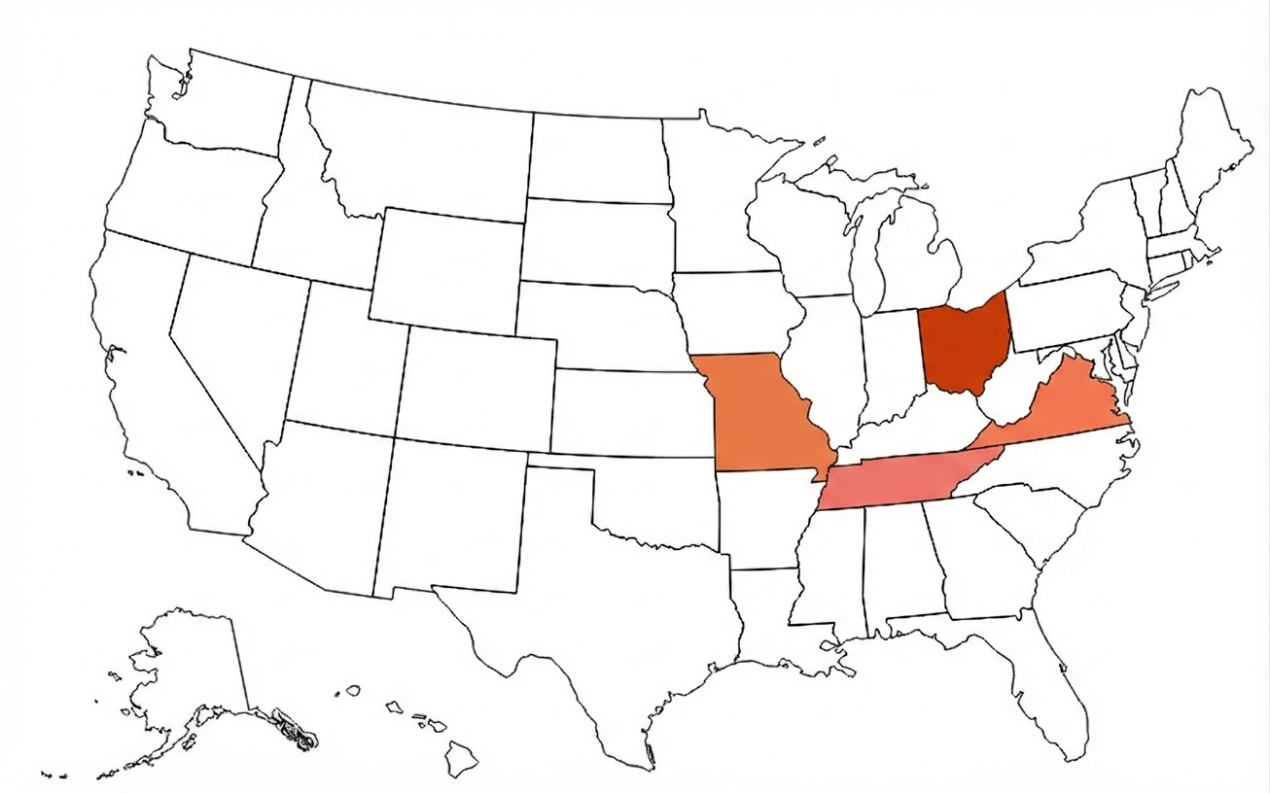
5 US Health Systems (35 Hospitals)
US Health Systems
Bon Secours Mercy Health, Lima, OH
Bon Secours Mercy Health, Richmond, VA
OhioHealth, Columbus, OH
Saint Luke’s Mid America Heart Institute, Kansas City, MO
Vanderbilt University Medical Center, Nashville, TN
1
3
4
2
5
Notes:
.

Slide 9
Patient Flow
Assessed for Eligibility
Hospitals = 35
Clinicians = 6,523
Echos = 147,122
Excluded 139,802 echos
No criteria for AS or MR in echo report
Significant AS or MR
Clinicians = 1,741
Echos = 7,320*
Excluded 5,042 echos
Patient managed by MHT, scheduled for MHT visit or VI, or had prosthetic target valve
Unmanaged AS or MR
Clinicians = 914
Echos = 2,278**
Excluded 160 echos (131 Clinicians)
Ordering Clinician opted out of study
Randomized 1:1
(Clinicians = 783)
ECN Alert
Clinicians = 394
Echos = 1,239
Intention-to-Treat
(ITT) Population
Clinicians = 783
Echos = 2,118
No Alert
Clinicians = 389
Echos = 879
Excluded 102 echos for technical restrictions
Primary
Analysis
ECN Alert
Clinicians = 376
Echos = 1,137
Patients = 1,054
Modified Intention-to-Treat (mITT) Population
Clinicians = 765
Echos = 2,016
Patients = 1,905
No Alert
Clinicians = 389
Echos = 879
Patients = 851
*Prevalence of Significant AS or MR in echo population = 5%
**Patients with Significant AS or MR without evidence of existing treatment plan = 31%

Slide 10
Patient Baseline Characteristics
Characteristic (mean ± SD, or % based on number of echos) | ECN (Alert) Clinicians = 376 Echos = 1137 | Usual Care (No Alert) Clinicians = 389 Echos = 879 | P Value
Age, years | 76.2 ± 12.8 | 76.1 ± 12.9 | .788
Female | 54% | 49% | .048
Black Race | 16% | 15% | .596
Ethnicity |  |  | .002
Non-Hispanic | 70% | 64%
Hispanic | 3.3% | 5.2%
Unknown | 26% | 31%
Disease state |  |  | .817
Aortic stenosis | 62% | 63%
Mitral regurgitation | 38% | 37%
Inpatient Setting | 42% | 33% | <.001
Comorbidities
Coronary artery disease | 47% | 47% | .928
Atrial fibrillation | 42% | 43% | .683
Heart failure | 60% | 58% | .294
Diabetes mellitus | 33% | 32% | .632
Social Deprivation Index | 40.0 ± 28.0 | 39.3 ± 28.3 | .422
ECN=electronic clinician notification; SD=standard deviation.

Slide 11
Baseline Echocardiographic Data
AS Population
Characteristic (mean ± SD, or % based on number of echos) | ECN (Alert) Clinicians = 276 Echos = 705 | Usual Care (No Alert) Clinicians = 291 Echos = 550 | P Value
AV area, cm² | 0.85 ± 0.21 | 0.86 ± 0.19 | .597
AV mean gradient, mmHg | 30.6 ± 12.8 | 30.9 ± 12.2 | .661
AV peak gradient, mmHg | 50.6 ± 20.1 | 51.0 ± 20.0 | .762
AV peak velocity, m/s | 3.50 ± 0.70 | 3.52 ± 0.67 | .549
Dimensionless Index | 0.28 ± 0.08 | 0.28 ± 0.08 | .571
Mean gradient ≥ 40 mmHg | 23% | 24% | .637
MR Population
Characteristic (% based on number of echos) | ECN (Alert) Clinicians = 203 Echos = 432 | Usual Care (No Alert) Clinicians = 193 Echos = 329 | P Value*
Moderate-to-severe MR | 64% | 59% | .350
Severe MR | 36% | 41%
LVEF < 50% | 49% | 48% | .972
AS=aortic stenosis; AV=aortic valve; ECN=electronic clinician notification; MR=mitral regurgitation; SD=standard deviation

Slide 12
Primary
Endpoint
Aortic
Stenosis
705 x 550 = 387,750 pairs
Mitral
Regurgitation
432 x 329 = 142,128 pairs
Alert
Wins
Ties
No Alert
Wins
Alert
Wins
Ties
No Alert
Wins
Valve Intervention
First to transcatheter or surgical valve intervention
51,374
(13%)
304,790
(79%)
31,586
(8%)
13,952
(10%)
115,505
(81%)
12,671
(9%)
MHT Clinic Visit
First to visit with a member of the MHT Team
32,156
(10%)
239,601
(79%)
33,033
(11%)
15,368
(13%)
89,061
(77%)
11,076
(10%)
83,530
(22%)
64,619
(17%)
29,320
(21%)
23,747
(17%)
versus
versus
Win Ratio (95% CI)
1.29 (1.01 - 1.65)
1.23 (0.90 - 1.69)
(P_{int} = 0.82)
Overall stratified win ratio: 1.27 (95% CI: 1.05 - 1.54), p=0.007

Slide 13
Time to Valve Intervention or Multidisciplinary Heart Team Visit
30%
Alert
No Alert
24.3%
Log rank P = 0.010
19.9%
20%
Valve Intervention or MHT Visit
10%
0%
0
30
Time (Days)
60
90
Number at Risk
Alert
1137
879
953
761
867
707
810
679
No Alert
MHT=Multidisciplinary Heart Team

Slide 14
Time to Valve Intervention
30%
Alert
No Alert
20%
Log rank
P = 0.005
Valve Intervention
13.4%
10%
9.6%
0%
0
30
Time (Days)
60
90
Number at risk
1137
879
1080
838
1006
794
921
764
Alert
No Alert

Slide 15
Time to Multidisciplinary Heart Team Visit
30%
Alert
No Alert
22.7%
20%
Log rank
P = 0.005
17.9%
Multidisciplinary Heart Team Visit
10%
0%
0
30
Time (Days)
60
90
Number at risk
Alert
1137
879
961
771
879
719
828
696
No Alert

Slide 16
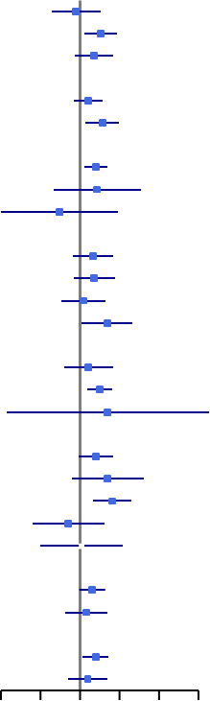
Subgroup | N | Favors No Alert | Favors Alert | Win Ratio (95% CI) | P_{int} Value*
Age, years |  |  |  |  | 0.26
< 65 | 338 |  |  | 0.93 (0.61 − 1.44)
65−80 | 804 |  |  | 1.44 (1.09 − 1.90)
> 80 | 874 |  |  | 1.28 (0.91 − 1.79)
Sex |  |  |  |  | 0.23
Male | 976 |  |  | 1.16 (0.90 − 1.49)
Female | 1040 |  |  | 1.48 (1.10 − 1.99)
Race |  |  |  |  | 0.49
White | 1633 |  |  | 1.32 (1.08 − 1.61)
Black | 306 |  |  | 1.35 (0.63 − 2.90)
Other | 76 |  |  | 0.70 (0.25 − 1.96)
Social Deprivation Index (SDI) |  |  |  |  | 0.59
Least Deprived: SDI ≤ 15 | 548 |  |  | 1.26 (0.88 − 1.80)
Middle—Low: SDI 16 - 36 | 471 |  |  | 1.29 (0.90 − 1.85)
Middle—High: SDI 37 - 62 | 521 |  |  | 1.06 (0.72 − 1.56)
Most Deprived: SDI ≥63 | 468 |  |  | 1.61 (1.03 − 2.51)
Patient Setting |  |  |  |  | 0.71
Inpatient | 766 |  |  | 1.16 (0.76 − 1.78)
Outpatient | 1211 |  |  | 1.41 (1.14 − 1.76)
Other | 39 |  |  | 1.63 (0.28 − 9.64)
Site |  |  |  |  | 0.23
Site A | 743 |  |  | 1.32 (0.98 − 1.78)
Site B | 612 |  |  | 1.63 (0.87 − 3.07)
Site C | 398 |  |  | 1.76 (1.25 − 2.48)
Site D | 167 |  |  | 0.82 (0.44 − 1.54)
Site E | 96 |  |  | 1.03 (0.50 − 2.12)
Provider Specialty |  |  |  |  | 0.64
Cardiologist | 1287 |  |  | 1.24 (0.99 − 1.56)
Non-Cardiologist | 729 |  |  | 1.12 (0.78 − 1.61)
Rural vs Urban |  |  |  |  | 0.52
Urban | 1498 |  |  | 1.32 (1.05 − 1.66)
Rural | 515 |  |  | 1.15 (0.82 − 1.63)
Subgroup Analysis: Win ratios for the primary hierarchical composite outcome
No heterogeneity of treatment effect
0.25 1.0 8.0
*P_{int} = 2-sided P-values

Slide 17
Limitations
Differences in site-level practice patterns, referral networks, and resources
Variability in implementation across sites (e.g., notification wording, clinician awareness)
Implementation required significant institutional and technical resources
Utilized clinician-directed notifications vs. automated referrals
90-day follow-up was insufficient to assess longer-term clinical outcomes (particularly MR)
MR=mitral regurgitation

Slide 18
Conclusions
Automated Electronic Clinician Notification (ECN) Alerts:
Improve referral rates to cardiac specialty care and valve intervention
Lead to shorter times to referral and valve intervention
No heterogeneity of effect across valve disease type and prespecified subgroups
Represent a scalable digital health strategy to reduce undertreatment of VHD

Slide 19
Add:
Published today in JACC
QR code
Get screen shot from journal for citation info

Slide 20





Acknowledgements ALERT Trial Leadership
Wayne Batchelor MD, MHS, MBA
Inova Health System
Antoine Keller
MD, FACC, FACS
Ochsner Lafayette General Hospital
Brian Lindman
MD, MSCI
Vanderbilt University Medical Center
Megan Coylewright MD, MPH
Essentia Health
Sreekanth Vemulapalli MD
Duke University
National PI
Chair, ALERT Steering Committee
Site PIs
Brian R. Lindman, MD, MSCI, Brody Wehman, MD; Adnan Chhatriwalla, MD; Sandeep M. Patel, MD; Kevin Stiver, MD; Firas Zahr, MD
Study sponsor & statistical analysis:
Tempus AI
Funding:
Tempus AI and Medtronic

Slide 21
Thank you
Notes:
Thank-you.

Slide 22
APPENDIX

Slide 23
Outcomes by Strata & Subgroup
Strata & Subgroup | Study Arm | N (echos) | Primary Endpoint Win Ratio (95%CI) | MHT Visit Event Rate n (%) | P Value (Alert vs No Alert) | Valve Intervention Event Rate n (%) | P Value (Alert vs No Alert)
Aortic Stenosis (AS)
All | ECN Alert | 705 | 1.29 (1.01-1.65) | 158 (22.4) | 0.162 | 100 (14.2) | 0.006
 | Usual Care (No Alert) | 550 |  | 105 (19.1) |  | 50 (9.1)
High Gradient Severe AS* | ECN Alert | 161 | 1.67 (1.16-2.42) | 73 (45.3) | 0.072 | 53 (32.9) | 0.035
 | Usual Care (No Alert) | 131 |  | 45 (34.4) |  | 28 (21.4)
Low Gradient AS** | ECN Alert | 541 | 1.15 (0.83-1.60) | 85 (15.7) | 0.585 | 47 (8.7) | 0.041
 | Usual Care (No Alert) | 411 |  | 59 (14.4) |  | 21 (5.1)
Mitral Regurgitation
All Mod-Sev/Severe MR | ECN Alert | 432 | 1.23 (0.90-1.69) | 94 (21.8) | 0.025 | 47 (10.9) | 0.633
 | Usual Care (No Alert) | 329 |  | 50 (15.2) |  | 32 (9.7)
Mod-Sev MR | ECN Alert | 275 | 1.38 (0.85-2.24) | 46 (16.7) | 0.059 | 22 (8.0) | 0.366
 | Usual Care (No Alert) | 193 |  | 10 (10.4) |  | 11 (5.7)
Severe MR | ECN Alert | 157 | 1.24 (0.82-1.88) | 48 (30.6) | 0.113 | 25 (15.9) | >0.999
 | Usual Care (No Alert) | 136 |  | 30 (22.1) |  | 21 (15.4)
Mod-Sev/Severe MR with LVEF ≥ 50% | ECN Alert | 213 | 1.15 (0.76-1.73) | 53 (24.9) | 0.195 | 28 (13.1) | >0.999
 | Usual Care (No Alert) | 167 |  | 30 (18.0) |  | 21 (12.6)
Mod-Sev/Severe MR with LVEF < 50% | ECN Alert | 213 | 1.25 (0.76-2.05) | 38 (17.8) | 0.195 | 16 (7.5) | >0.999
 | Usual Care (No Alert) | 158 |  | 20 (12.7) |  | 11 (7.0)
* Mean aortic valve gradient ≥ 40 mmHg
** Mean aortic valve gradient < 40 mmHg

