Slide 1
Fractional Flow Reserve or 3D-Quantitative-Coronary-Angiography Based Vessel-FFR guided revascularization: the FAST III Trial
Joost Daemen, MD, PhD, FESC
On behalf of the FAST III investigators
Jari van der Eijk, Marco Barbierato, Robert Byrne, Paolo Canova, Giovanni Luigi De Maria, Eric Van Belle, Ignacio Amat-Santos, Antonio Mangieri, Thomas Hovasse, Manel Sabate, Shane Flood, Simone Biscaglia, Fernando Rivero, Domenico D'Amario, Youssef Abdelwahed, Rohit Oemrawsing, Raul Moreno, James Cockburn, Luca Testa, Ton de Vries, Ulf Landmesser, Adrian Banning, Jan Tijssen, Ernest Spitzer
Notes:
Today, on behalf of all the co-investigators, I am honored to present the results of the FAST III trial.

Slide 2

Disclosures
Institutional grants/research support:
Abbott Vascular, Boston Scientific, ACIST Medical, Medtronic, Pie Medical, and ReCor medical.
Consultancy and speaker fees:
Abbott Vascular, ACIST medical, Boston Scientific, Cardialysis, CardiacBooster, Kaminari Medical, ReCor Medical, Pulse Medical, Pie Medical, Shockwave, Siemens Healthineers and Medtronic.

Slide 3

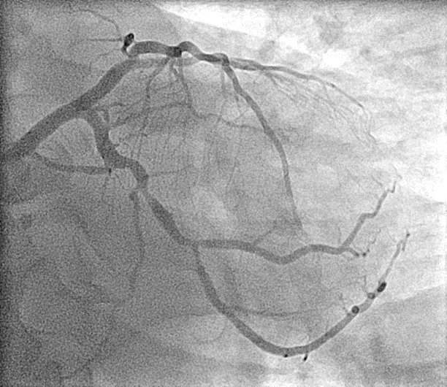
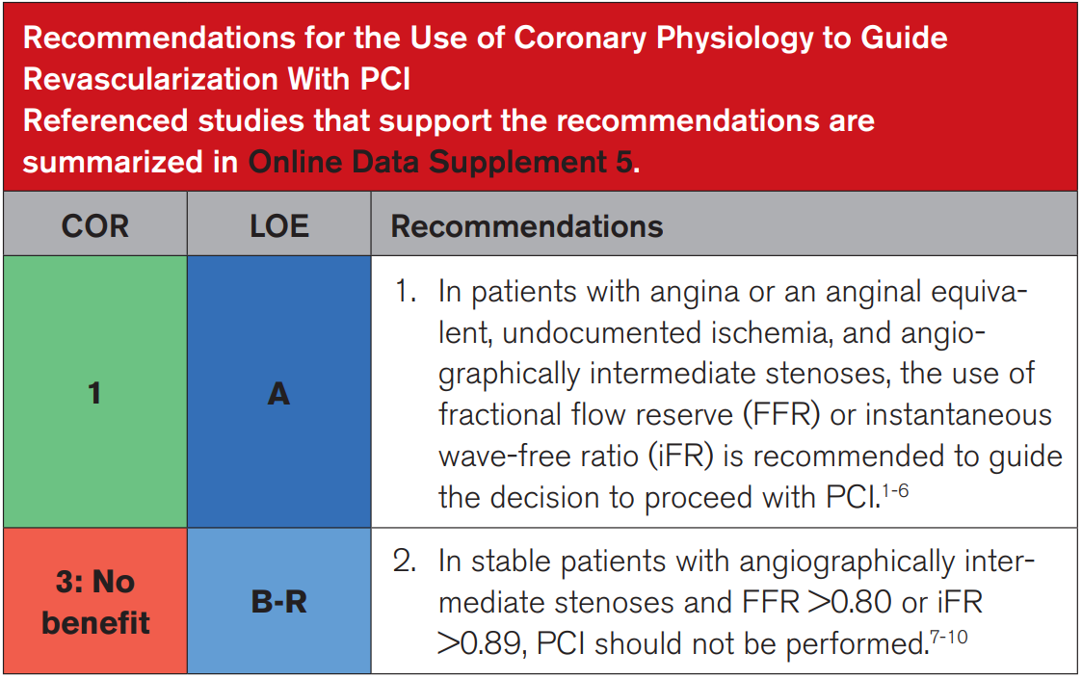
Assessment of intermediate coronary stenosis
2021 ACC/AHA/SCAI Clinical practice guidelines¹
Lawton, et al. 2021. Circulation 2022;145:e18-e114.
Notes:
Guidelines for the management of coronary artery disease recommend using coronary physiology to guide revascularization of intermediate coronary artery lesions in the absence of non-invasive ischemia testing.¹⁻³

Slide 4
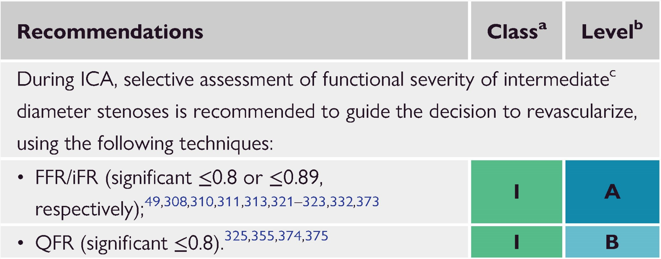
Assessment of intermediate coronary stenosis
2021 ACC/AHA/SCAI Clinical practice guidelines¹
2024 ESC guidelines on Chronic coronary syndrome²
Lawton, et al. 2021. Circulation 2022;145:e18-e114.
Vrints, et al. Eur Heart J 2024;45:3415-537.
Notes:
Within Europe guidelines have recently been updated adding angiography-based physiology as an alternative to FFR or iFR.

Slide 5
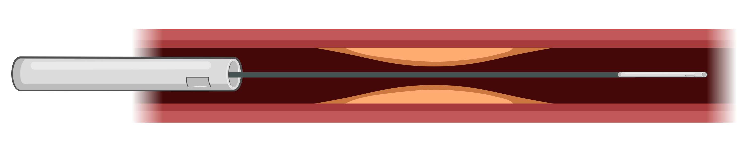
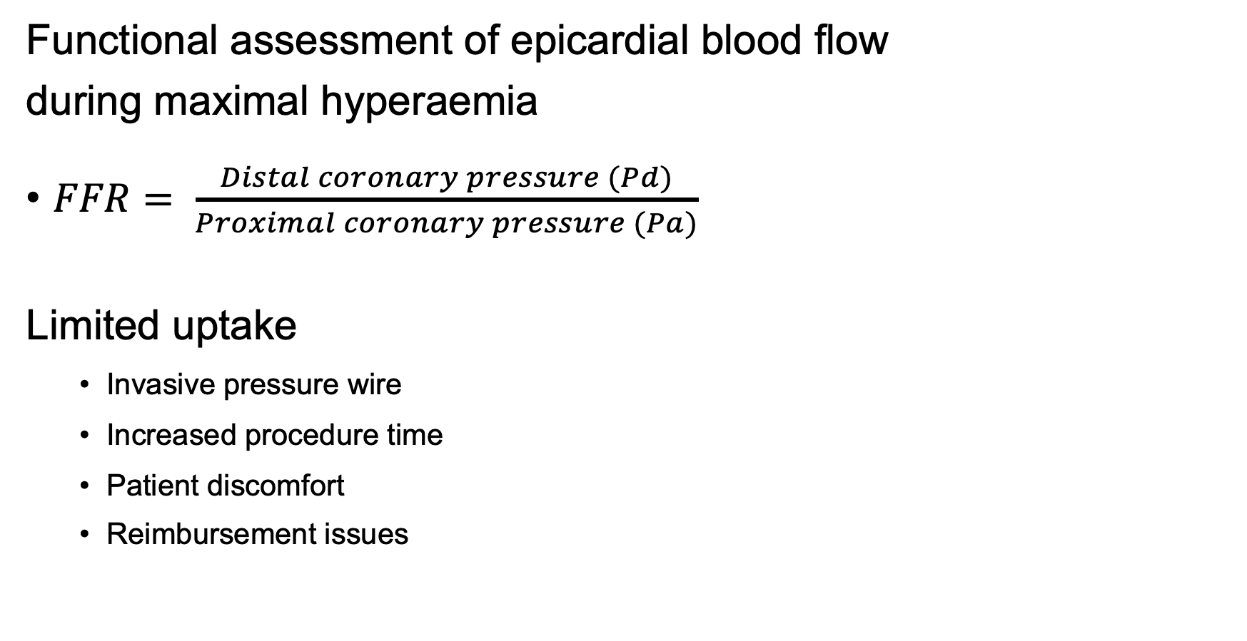
Fractional Flow Feserve (FFR)
Functional assessment of epicardial blood flow
during maximal hyperaemia
$FFR= \frac{Distal coronary pressure (Pd)}{Proximal coronary pressure (Pa)}$
Limited uptake
  Invasive pressure wire
  Increased procedure time
  Patient discomfort
  Reimbursement issues
Proximal pressure
(Pa)
Distal pressure
(Pd)
Notes:
FFR relies on the functional assessment of epicardial coronary blood flow during maximal hyperaemia.
However, despite robust validation, the adoption of coronary physiology in routine practice remains limited.
The main barriers are the need for an invasive pressure wire, longer procedure times, patient discomfort, and reimbursement issues

Slide 6
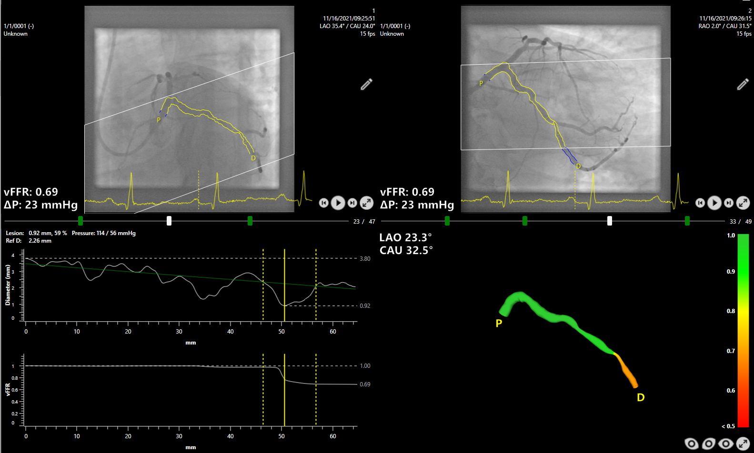
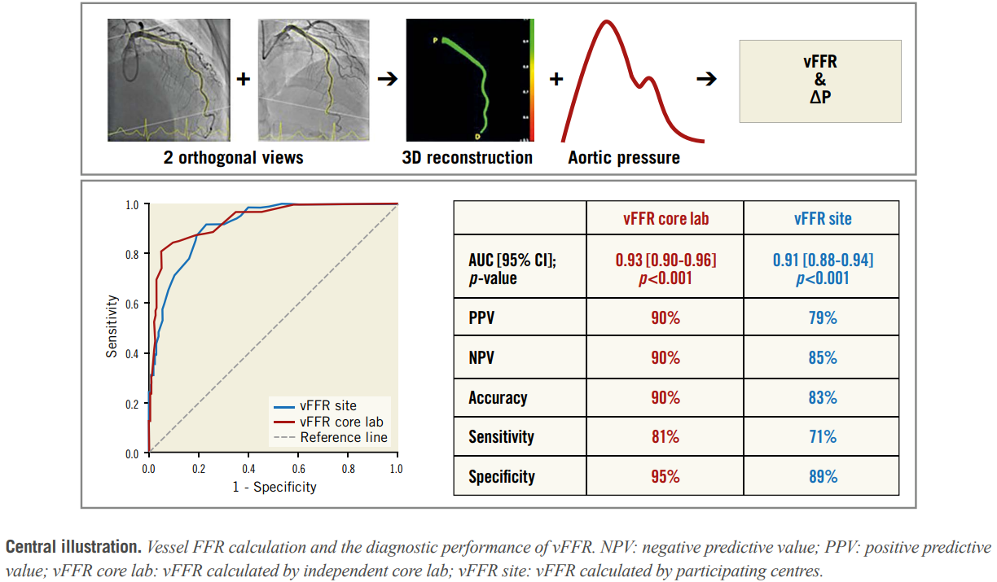
Vessel Fractional Flow Reserve (vFFR)
Vessel Fractional Flow Reserve (vFFR; CAAS workstation, Pie Medical Imaging) is a pressure-wire- and hyperemia-free angiography-based method that derives an FFR value from angiographic images and 3D quantitative coronary angiography
High diagnostic agreement with FFR
Masdjedi K, et al. EuroIntervention 2020;16:591-9. Masdjedi K, et al. EuroIntervention 2022;17:1498-505. Neleman T, et al. JACC Cardiovasc Imaging 2021;14:504-6.
Notes:
With the intention to increase adoption of physiology guidance and reduce procedure time by avoiding intracoronary instrumentation and adenosine-induced hyperemia, angiography-based wireless coronary pressure parameters were developed.

Slide 7
Aim
FAST III was designed to assess whether vFFR-guided revascularization is noninferior to FFR-guided revascularization

Slide 8
Study design
Adult patients with CCS, unstable angina, or NSTEMI and at least one intermediate lesion (30 to 80% diameter stenosis), suitable for physiological assessment
1:1 randomization
vFFR-guided
revascularization
FFR-guided
revascularization

Slide 9
Enrolment criteria
Clinical criteria
Inclusion
Chronic coronary syndrome, Unstable angina, or NSTEMI
Exclusion
STEMI within prior 72 hours
Cardiogenic shock, or hemodynamic instability
Severe valvular heart disease
Contraindications to the use of contrast or adenosine
Life expectancy less than 1 year
Angiographic criteria
Inclusion
Intermediate coronary-artery stenosis (30-80%) in a native vessel ≥ 2.5 mm
Exclusion
Left main coronary artery disease
Aorta-ostial lesions with > 50% stenosis
Lesions located at or supplied by a bypass graft
TIMI flow grade < 3
Evidence of thrombus
Severe vessel tortuosity or overlap
Notes:
Key exclusion criteria included:
recent STEMI, HD instability or severe valvular heart disease
And angiographically
LM or aorta-ostial lesions
Impaired TIMI flow or thrombus containing lesions
And several tortuosity or overlap precluding proper angiographic visualization.

Slide 10
End points
Primary end point
  Composite of all-cause death, any myocardial infarction, or any revascularization within one year after randomization
Secondary end points
  Composite of cardiac death, study-vessel myocardial infarction or
  clinically indicated study-vessel revascularization (study-vessel failure)
  Components of the composite end points
  Stroke
  Definite and probable stent thrombosis

Slide 11
Sample size
1-year event rate of 6.5% in both groups
Non-inferiority margin of 3.0%
80% power, one-sided alpha 2.5%
2122 patients (1061 per group) required
Estimated drop-out rate of 5%
→ Sample size set at 2228 participants.
Notes:
We estimated that a primary end-point event would occur in 6.5% of the patients in each group at 1 year.
We determined that a sample of 2122 patients (1061 in each group) would provide 80% power at a one-
sided alpha level of 2.5% to show non-inferiority with respect to the primary end point.
To account for an estimated 5% of patients discontinuing the trial, we planned to recruit a total of 2228 patients.
Hogere event rate zorgt voor marginaal powerverlies (met deze event rates 79% power)

Slide 12
Study design
2235 patients randomized
1124 assigned to
vFFR-guided revascularization
1111 assigned to
FFR-guided revascularization
Excluding double randomizations, IC issues or patients in who (v)FFR was never attempted
1116 included for primary endpoint
Full analysis set
1095 included for primary endpoint
Full analysis set
Complete (v)FFR assessment per randomization and revascularization in accordance with physiological result
1047 included
Per Protocol analysis
1057 included
Per Protocol analysis
Notes:
The full analysis used for the PEP excluded 24 pts, …

Slide 13
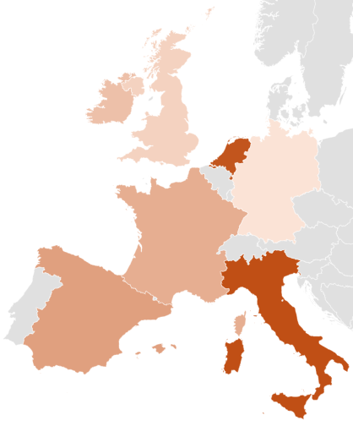
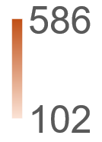
Enrolment chart
Nov 2021 to May 2024, 37 sites in 7 countries
586
102
Notes:
Patients were enrolled between Nov 21 and May 24 in

Slide 14
Baseline characteristics
 | vFFR-guided revascularization (N=1116) | FFR-guided revascularization (N=1095)
Age (years) | 67.6 | 67.1
Female sex | 23.8% | 24.8%
Indication for coronary angiography
Chronic coronary syndrome | 81.6% | 80.9%
Unstable angina | 6.9% | 6.8%
Non-STEMI | 11.5% | 12.2%
Diabetes mellitus | 27.6% | 25.7%
History of PCI | 35.0% | 34.7%
Notes:
The mean age of the patients was 67 years; 24% were women, 19% presented with an ACS, and 27% had DM and about 1/3 had a history of PCI

Slide 15
Angiographic characteristics
 | vFFR-guided revascularization (N=1116) | FFR-guided revascularization (N=1095)
Number of study lesions | 1417 | 1403
Number of study lesions per patient | 1.27 ± 0.55 | 1.28 ± 0.55
Study lesion location
LM | 0.3% | 0.6%
LAD | 52.6% | 55.5%
LCX | 22.2% | 19.3%
RCA | 25.0% | 24.6%
Notes:
The mean number of study lesions per patient was 1.27 in the vFFR group and 1.28 in the FFR group. The location of the study lesions
appeared to be similar in the two groups with LAD lesions being most prominent in both groups.

Slide 16
Procedural characteristics
 | vFFR-guided revascularization (N=1116) | FFR-guided revascularization (N=1095)
Complete physiological assessment | 96.7% | 99.1%
Median vFFR or FFR value (lesion level) | 0.83 (0.74 to 0.89) | 0.85 (0.79 to 0.91)
Revascularization of at least 1 study lesion | 502 (45.0%) | 394 (36.0%)
In accordance with physiology for all study lesions | 482/502 (96.0%) | 379/394 (96.2%)
Any revascularization | 59.1% | 51.9%
No. of stents placed per patient | 0.92 ± 1.13 | 0.80 ± 1.06
Use of intravascular imaging | 10.8% | 9.0%
Procedure time* (minutes) | 55.8 ± 26.8 | 60.9 ± 28.5
* in patients who received PCI
Notes:
Complete physiological assessment with the randomly assigned index occured in 96.7% vs 99.1% in patients in the vFFR and FFR groups resp.
This physiological assessment resulted in a median ….
Revascularization of at least 1 study lesions occured in
Importantly, revasc was in accordance to the physiological result in 96% of the pts in both arms.
Due to the presence of non-study lesions in both arms, the percentage of pts that underwent any revasc was…
As such, the number of stents.

Slide 17
Primary end point (FAS)
Composite of death, any myocardial infarction, or any revascularization
10%
FFR-guided
79/1095
(7.5%)
8%
vFFR-guided
80/1116 (7.5%)
6%
Cumulative incidence
4%
Risk difference
-0.02% (-2.25% to 2.21%)
P_{NI} = 0.004
2%
0%
0
3
6
9
12
Follow-up (months)
Notes:
With a risk difference of -0.02, a CI of …. And a P of 0.004, the trials met its pre defined non inferiority PEP

Slide 18
Primary end point (PP)
Composite of death, any myocardial infarction, or any revascularization
10%
FFR-guided
76/1095 (7.4%)
8%
vFFR-guided
71/1116 (7.0%)
6%
Cumulative incidence
4%
Risk difference
-0.40% (-2.65% to 1.86%)
2%
0%
0
3
6
9
12
Follow-up (months)

Slide 19
Study vessel failure (FAS)
Composite of death from cardiac causes, study-vessel myocardial infarction, or clinically indicated study-vessel revascularization
100%
5%
FFR-guided
49/1095 (4.6%)
4%
vFFR-guided
80%
3%
43/1116 (4.0%)
60%
Cumulative incidence
2%
40%
1%
Risk difference
-0.62% (-2.35% to 1.10%)
20%
0%
0
3
6
9
12
0%
0
3
6
9
12
Follow-up (months)

Slide 20
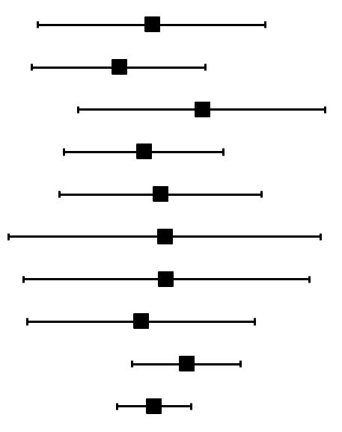

Secondary end points – Full Analysis set
Individual components
Secondary end points | vFFR-guided revascularization (N=1116) | FFR-guided revascularization (N=1095) |  | Risk difference (95% CI)
Death from any cause | 23 (2.2%) | 24 (2.3%) |  | -0.11 (-1.37 to 1.14)
Cardiac death | 11 (1.0) | 16 (1.5) |  | -0.47 (-1.43 to 0.48)
Any myocardial infarction | 31 (2.9) | 26 (2.4) |  | 0.44 (-0.92 to 1.80)
Periprocedural myocardial infarction | 11 (1.0) | 13 (1.2) |  | -0.20 (-1.08 to 0.68)
Study vessel myocardial infarction | 19 (1.8) | 19 (1.8) |  | -0.02 (-1.13 to 1.10)
Any revascularization | 45 (4.2) | 44 (4.2) |  | 0.03 (-1.69 to 1.75)
Clinically indicated revascularization | 38 (3.6) | 37 (3.5) |  | 0.04 (-1.52 to 1.62)
Clinically indicated study-vessel revascularization | 22 (2.1) | 24 (2.3) |  | -0.23 (-1.48 to 1.02)
Any stroke | 7 (0.6) | 4 (0.4) |  | 0.27 (-0.33 to 0.87)
Definite or probable stent thrombosis | 2 (0.2) | 3 (0.3) |  | -0.09 (-0.49 to 0.32)
Notes:
Predefined individual components of the combined endpoints, stroke and def/prob ST were remarkable similar between both groups.

Slide 21
Conclusion
Among patients with intermediate coronary-artery lesions,
a vFFR-guided revascularization strategy was noninferior
to an FFR-guided strategy with respect to a composite of death, myocardial infarction, or revascularization at one year

Slide 22

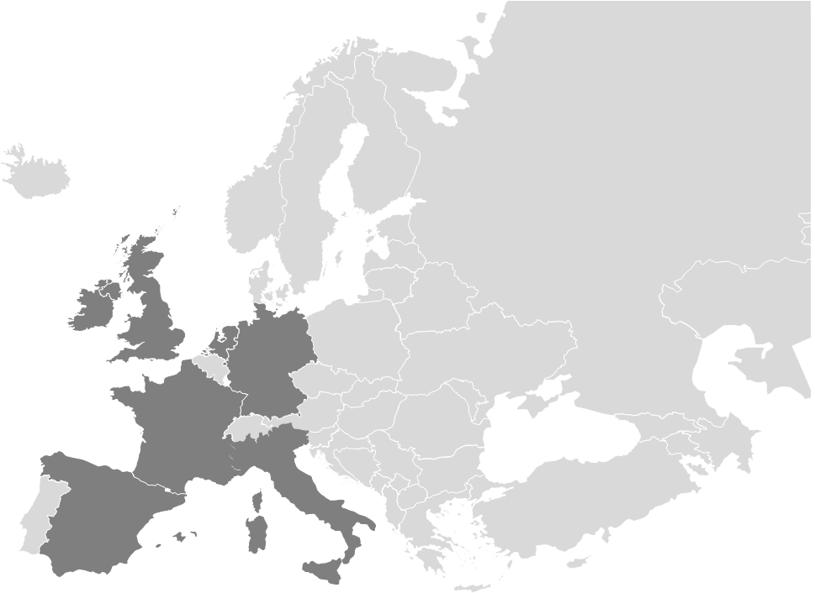




With gratitude to the Investigators!
List of Participating Centers
Institution | Interventional Cardiologist(s)
IRCCS Policlinico San Donato, Milan | Luca Testa
University Medical Center Utrecht, Utrecht | Michiel Voskuil
Tergooi Medical Center, Hilversum | Rutger Van Bommel
Clinique Les Fontaines, Melun | Patrick Dupouy
Clinique St-Hilaire, Rouen | Matthieu Godin
l'institut & l'hôpital Saint-Martin, Caen | Jean Francois Morelle
Golden Jubilee National Hospital, Glasgow | Damien Collison
Hôpital de la Croix Rousse, Hospices Civils de Lyon, Lyon | Brahim Harbaoui
Unfallkrankenhaus Berlin, Berlin | Johannes Beil Steffen Bohl
Ospedale San Bortolo | Andrea Drago Francesco Caprioglio
Amphia Ziekenhuis, Breda | Martijn Meuwissen
Hospital del Mar, Barcelona | Beatriz Vaquerizo
Hospital Universitario Central de Asturias, Oviedo | Pablo Avanzas
St James's Hospital, Dublin | John Cosgrave
Herz- und Diabeteszentrum Nordrhein-Westfalen, Bad Oeynhausen | Regine Brinkmann
Hospital Universitario de León, León | María Thiscal López Lluva Armando Pérez de Prado
Pineta Grande Hospital, Castel Volturno | Arturo Giordano
Marienhaus Klinikum, Mainz | Burkhard Huegl
Saarland-Heilstätten GmbH - Klinik Völklingen, Völklingen | Fernando Gatto
Institution | Interventional Cardiologist(s)
Thoraxcenter, Erasmus University Medical Center, Rotterdam | Joost Daemen
Ospedale Dell'Angelo, Mestre | Marco Barbierato
Mater Private Hospital, Dublin | Robert A. Byrne
Ospedale Papa Giovanni XXIII, Bergamo | Paolo Canova
John Radcliffe Hospital, Oxford University Hospitals, NHS Foundation Trust, Oxford | Giovanni Luigi De Maria
Institut Cœur Poumon, CHU Lille, Université de Lille, Lille | Eric Van Belle
Hospital Clínico Universitario de Valladolid, Valladolid | Ignacio Amat-Santos
IRCCS Humanitas Research Hospital, Milan | Antonio Mangieri
Institut Cardiovasculaire Paris-Sud, Hôpital Jacques Cartier, Ramsay-Santé, Massy | Thomas Hovasse
Cardiovascular Institute (ICCV), Hospital Clinic, IDIBAPS, University of Barcelona, Barcelona | Manel Sabate
Mater Private Cork, Cork | Ronan Margey Shane Flood
Ospedale Sant'Anna, Ferrara | Simone Biscaglia
Hospital Universitario de la Princesa, Madrid | Fernando Rivero
Ospedale Maggiore della Carità, Novara | Domenico D'Amario
Charité Hospital, Universitätsmedizin Berlin, Berlin | Youssef Abdelwahed
Albert Schweitzer Hospital, Dordrecht | Rohit M. Oemrawsingh
La Paz Hospital, Madrid | Raul Moreno
Royal Sussex County Hospital, Brighton | James Cockburn
Steering Committee
Clinical Events Committee
Data and Safety
Monitoring Board
Institution | Name
Thoraxcenter, Erasmus University Medical Center, Rotterdam | Joost Daemen
Mater Private Hospital, Dublin | Robert A. Byrne
John Radcliffe Hospital, Oxford University Hospitals, NHS Foundation Trust, Oxford | Adrian P. Banning
Charité Hospital, Universitätsmedizin Berlin, Berlin | Ulf Landmesser
Hospital Clínico Universitario de Valladolid, Valladolid | Ignacio Amat-Santos
Institut Cœur Poumon, CHU Lille, Université de Lille, Lille | Eric Van Belle
Thoraxcenter, Erasmus University Medical Center, Rotterdam | Jari A. van der Eijk Alessandra Scoccia
Amsterdam University Medical Center, Amsterdam | Jan G.P. Tijssen
European Cardiovascular Research Institute, Rotterdam | Ernest Spitzer
Institution | Name
Cork University Hospital Wilton, Cork | Eugene McFadden
University of Naples Federico II, Frattaminore (Napoli) | Raffaele Piccolo
University of Louvain, Brussels, Belgium | Claude Hanet
Institution | Name
Uppsala University Hospital, Uppsala | Stefan James
Erasmus University Medical Center, Rotterdam | Eric Boersma
Aarhus University Hospital Aarhus | Evald H. Christiansen
Statisticians - Data Managers
Institution | Name
Cardialysis, Rotterdam | Ton de Vries
Cardialysis, Rotterdam | Tessa Rademaker-Havinga
Cardialysis, Rotterdam | Martin Geertsma
Cardialysis, Rotterdam | Matthijs Raven
Cardialysis, Rotterdam | Ingrid de Zwart
FAST III Sponsor
Study Management
Research Organization
Institution | Name
Cardialysis, Rotterdam | Jacintha Ronden
Cardialysis, Rotterdam | Mattis Stek
Cardialysis, Rotterdam | Boudijn Ladan
Cardialysis, Rotterdam | Khang Tran
Core Laboratory
Institution | Name
Cardialysis, Rotterdam | Marcel Turenhout
Cardialysis, Rotterdam | Martin Muurling
Cardialysis, Rotterdam | Lali Sikarulidze
Cardialysis, Rotterdam | Ina Hoekman
Cardialysis, Rotterdam | Jamal Khachabi
FAST III Grant-Givers
vFFR Training
Institution | Name
Pie Medical Imaging | Vineeta Khanapuri
Pie Medical imaging | Jorn Roijen
Notes:
Finally, it goes without saying that FAST III would have never happened without the immens efforts and support of ECRI, Cardialysis, PMI, SHS, and all investigators within the 37 sites involved who turned this trial into a succes.

Slide 23


Notes:
Finally, we are pleased to announce that our work is now available online wihtin the NEJM

