Slide 1
Once-Weekly Tirzepatide Versus Dulaglutide for Heart Failure Outcomes in Patients With Type 2 Diabetes, ASCVD and History of Heart Failure: An Analysis of SURPASS-CVOT
Stephen J Nicholls

Slide 2
Disclosures
Research support: AstraZeneca, Cyclarity, NewAmsterdam Pharma, Amgen, Anthera, Eli Lilly, Esperion, Novartis, Cerenis, The Medicines Company, Resverlogix, InfraReDx, Roche, Sanofi-Regeneron and Liposcience
Consulting and honoraria: AstraZeneca, Abcentra, Amarin, Akcea, Arrowhead, Cyclarity, Eli Lilly, Anthera, Omthera, Merck, Takeda, Resverlogix, Sanofi-Regeneron, CSL Behring, Esperion, Boehringer Ingelheim, Vaxxinity, Scribe Therapeutics, Sequiris
SURPASS-CVOT was sponsored by Eli Lilly & Company

Slide 3
GLP-1 Receptor Agonists and Cardiovascular Outcomes
GLP-1 receptor agonists (GLP-1RA) reduce major adverse cardiovascular events (MACE) in high-risk patients with type 2 diabetes, chronic kidney disease or obesity
These benefits have been extended to the setting of heart failure with improvements in six-minute walk distance and quality of life in patients with obesity associated heart failure with preserved ejection fraction (HFpEF) and a lower rate of hospitalization for heart failure
The findings of these studies have been integrated into clinical guidelines that support their increasing use

Slide 4
Tirzepatide and Cardiovascular Outcomes
Tirzepatide is a dual agonist at the GLP-1 and GIP receptors with incremental benefits on glycemic control, weight loss and associated metabolic risk factors in comparison with selective GLP-1RAs
Tirzepatide produced favorable effects on quality of life, six-minute walk distance and the composite of cardiovascular death or heart failure events in patients with HFpEF and obesity
SURPASS-CVOT demonstrated that tirzepatide was non-inferior to dulaglutide and superior to a putative placebo on MACE
This pre-specified analysis investigated outcomes in patients with and without a prior history of heart failure

Slide 5
Study Design
Key Inclusion Criteria
≥40 years
Diagnosis of type 2 diabetes
Established ASCVD
HbA1c ≥7% and ≤10.5%
Body mass index ≥25 kg/m²
Dulaglutide 1.5 mg QW (with sham dose escalation)
Dulaglutide 1.5 mg QW
Median duration of study follow-up =4 years
15 mg
Tirzepatide MTD QW
Screening
12.5 mg
10 mg
7.5 mg
5 mg
2.5 mg
-2
Weeks
-1
0
4
8
12
16
20
24
Visits continue every 3 months
Randomization
(1:1)
Primary Endpoint
(end of treatment)

Slide 6
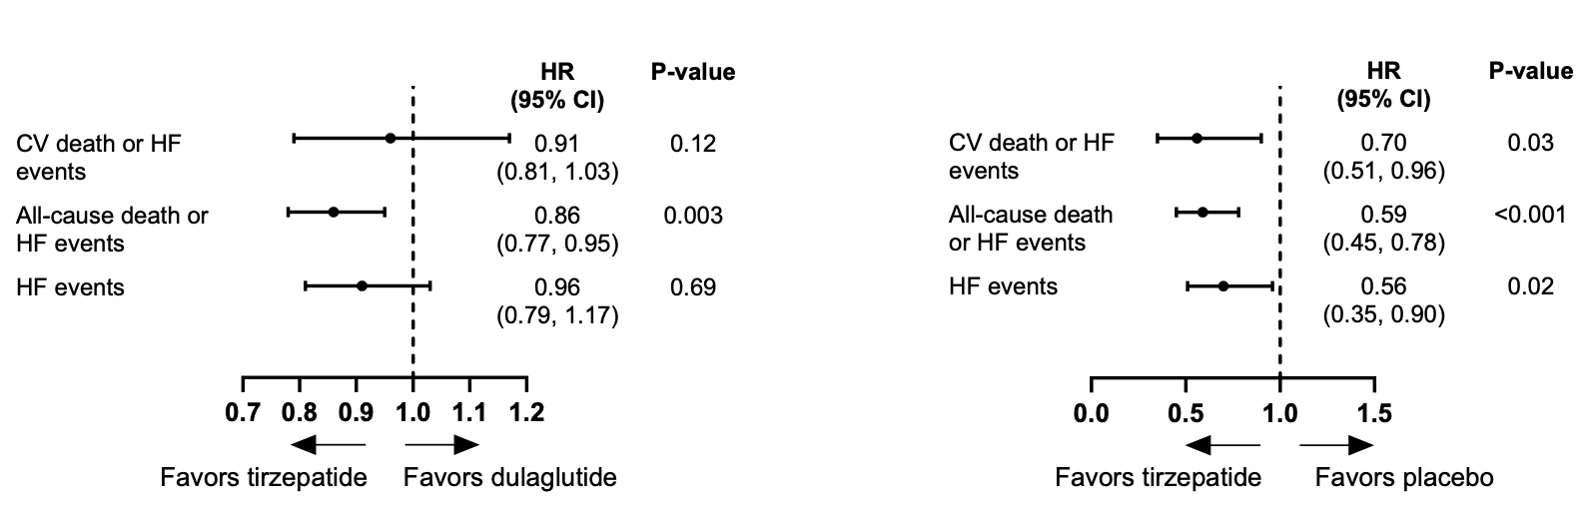
SURPASS-CVOT Heart Failure Outcomes
SURPASS-CVOT:
Tirzepatide vs. Dulaglutide
Indirect Comparison:
Tirzepatide vs. Placebo

Slide 7
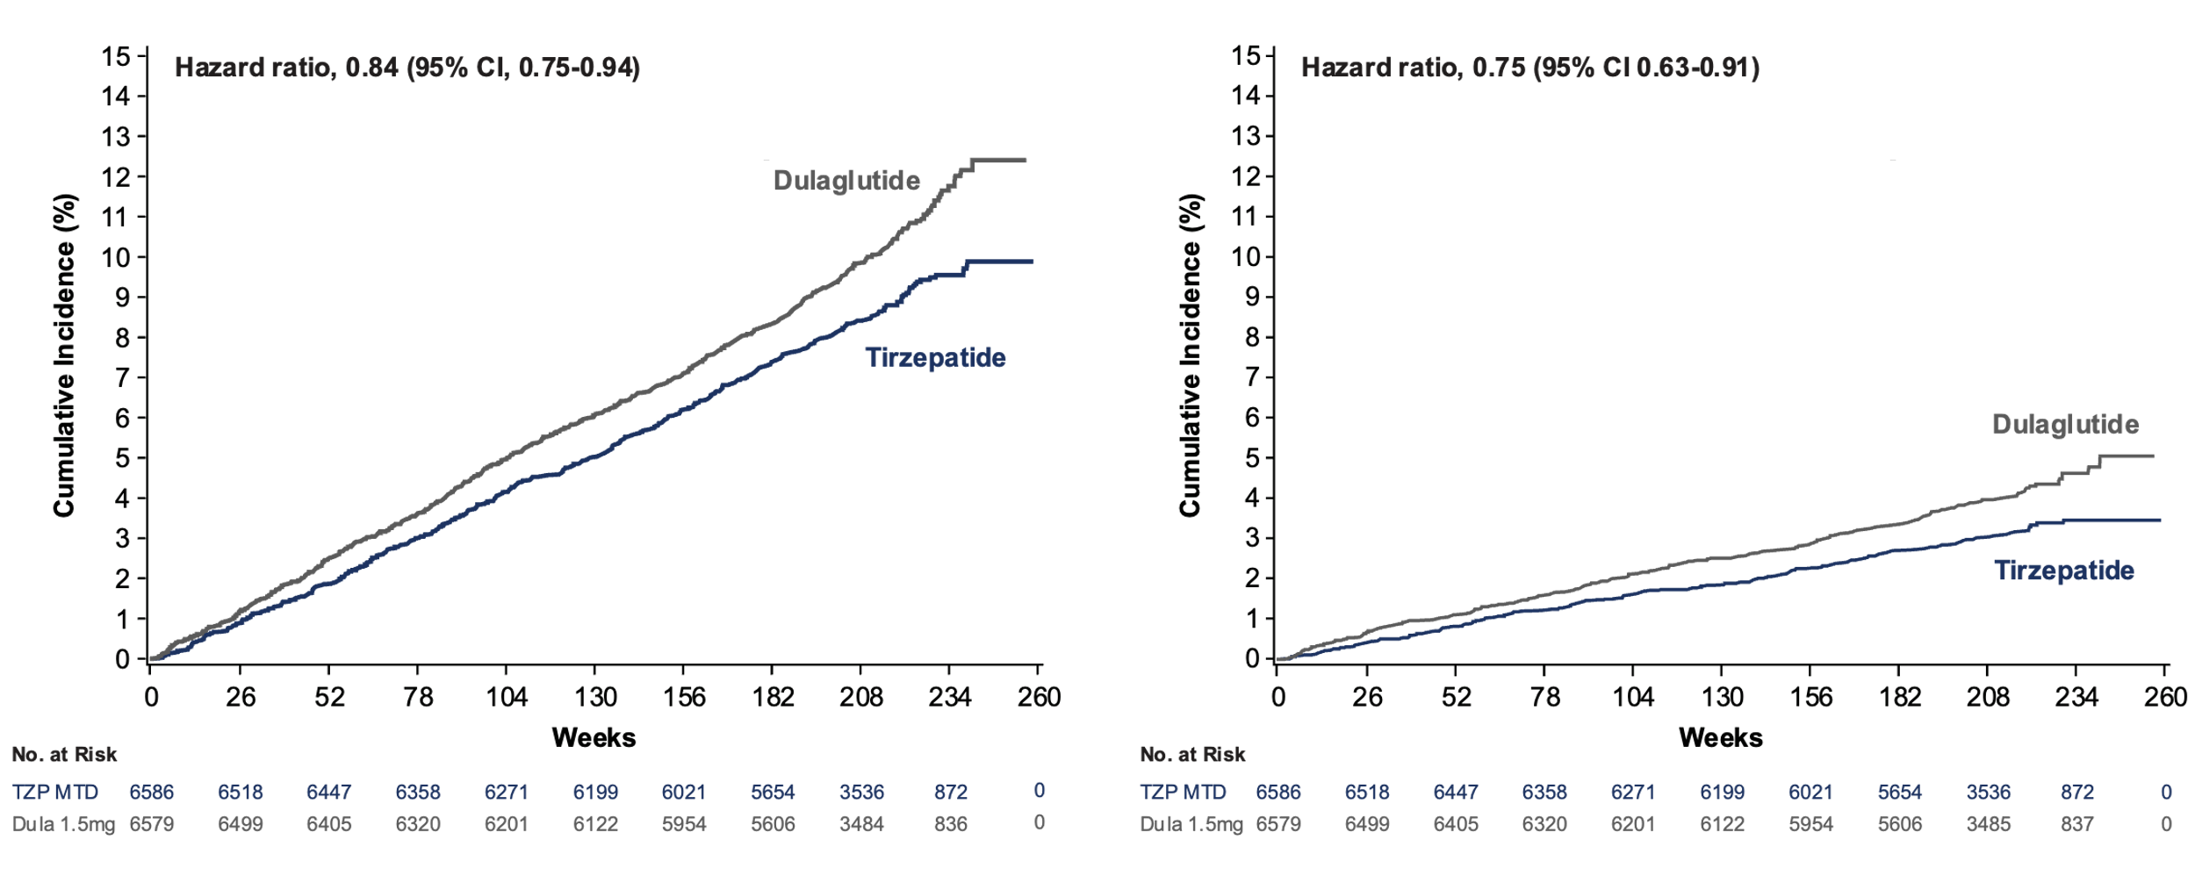
SURPASS-CVOT Mortality Outcomes
All-Cause Mortality
Non-Cardiovascular Death

Slide 8
Baseline Characteristics
Demographic and Clinical Characteristics | History of Heart Failure |  | No History of Heart Failure
 | TZP (N=1310) | Dula (N=1368) | TZP (N=5276) | Dula (N=5211)
Age, years | 64.8 | 64.7 | 63.8 | 64.0
Female, % | 28.3 | 29.8 | 28.8 | 29.1
White, % | 88.4 | 87.8 | 79.8 | 79.7
Prior MI, % | 57.8 | 57.8 | 44.4 | 44.7
Prior stroke, % | 20.5 | 19.1 | 18.7 | 19.4
Peripheral artery disease, % | 26.8 | 28.5 | 24.8 | 24.6
Hypertension, % | 95.2 | 96.0 | 89.0 | 88.7
Diabetes duration, years | 14.8 | 14.5 | 14.8 | 14.7

Slide 9
Baseline Medication Use
Treatment | History of Heart Failure |  | No History of Heart Failure
 | TZP (N=1310) | Dula (N=1368) | TZP (N=5276) | Dula (N=5211)
Statin, % | 88.3 | 85.8 | 85.5 | 85.6
Beta-blockers, % | 78.7 | 77.9 | 62.2 | 61.6
ACE inhibitor, % | 43.1 | 44.2 | 39.6 | 38.1
Angiotensin receptor blocker, % | 41.3 | 40.1 | 39.7 | 41.1
Mineralocorticoid receptor antagonist, % | 25.5 | 23.2 | 5.7 | 5.7
Loop diuretic, % | 45.5 | 41.2 | 17.0 | 15.8
Thiazide diuretic, % | 9.1 | 9.8 | 15.1 | 14.3
Metformin, % | 77.4 | 78.7 | 82.0 | 82.5
SGLT2 inhibitor, % | 31.1 | 30.1 | 30.2 | 31.0
Insulin, % | 51.1 | 48.7 | 49.0 | 48.2

Slide 10
Baseline Metabolic Risk Factors
Characteristic | History of Heart Failure |  | No History of Heart Failure
 | TZP (N=1310) | Dula (N=1368) | TZP (N=5276) | Dula (N=5211)
Weight, kg | 95.9 | 96.7 | 91.8 | 91.4
Body mass index, kg/m² | 33.5 | 33.6 | 32.4 | 32.3
Systolic blood pressure, mmHg | 134.7 | 135.4 | 134.9 | 135.3
Diastolic blood pressure, mmHg | 77.8 | 78.4 | 77.6 | 77.7
HbA1c, % | 8.43 | 8.40 | 8.40 | 8.38
LDL cholesterol, mg/dL | 84.7 | 87.0 | 79.5 | 79.0
Triglycerides, mg/dL | 203.7 | 194.7 | 194.9 | 192.8
eGFR, mL/min/1.73 m² | 71.9 | 74.9 | 80.1 | 80.4
eGFR <60 mL/min/1.73 m², % | 33.3 | 27.9 | 20.9 | 20.1

Slide 11
Change from Baseline in HbA1c and Body Weight

Slide 12
Change from Baseline in Systolic Blood Pressure and eGFR

Slide 13
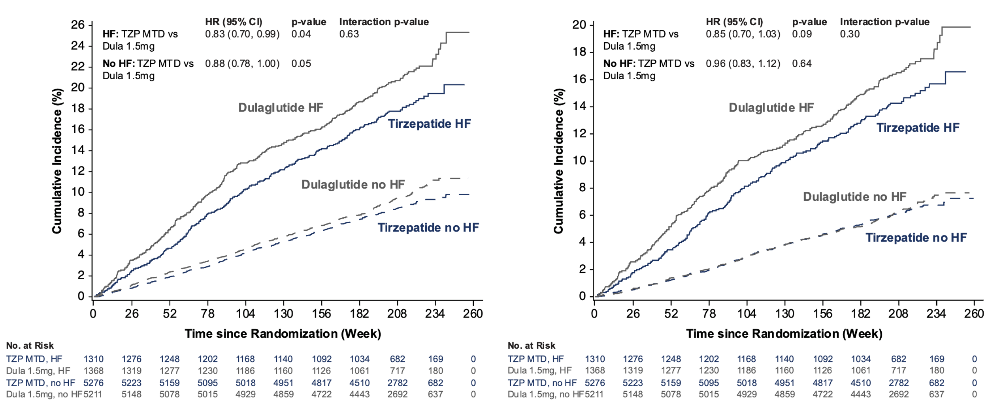
Composite Heart Failure Endpoints
All-Cause Death or Hospitalization or Urgent Visits for Heart Failure
CV Death or Hospitalization or Urgent Visits for Heart Failure

Slide 14
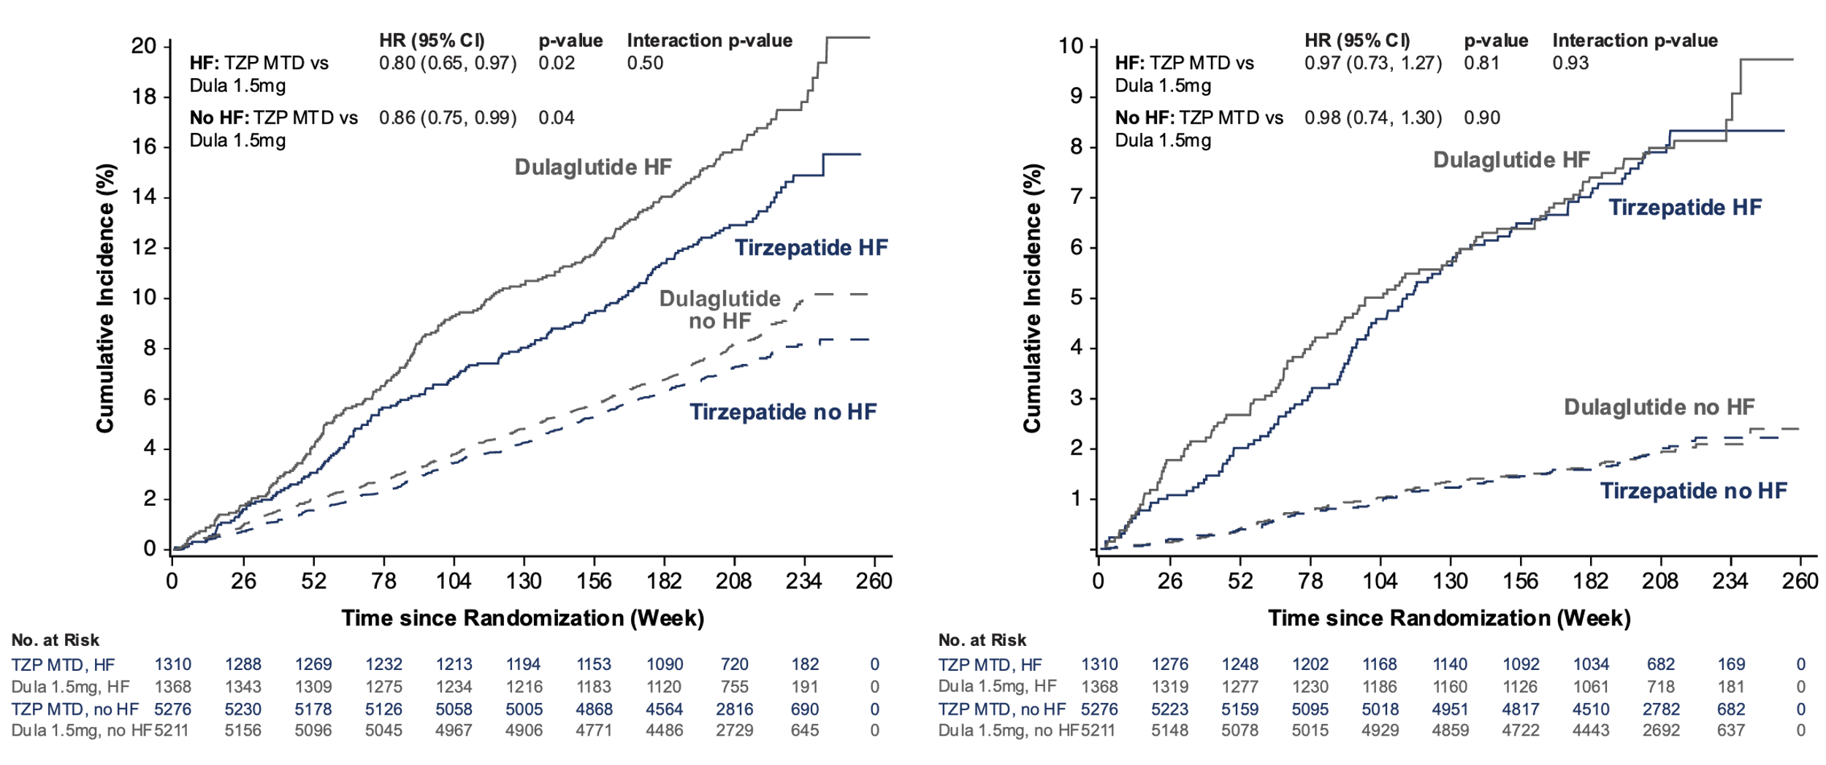
All-Cause Mortality and Heart Failure Events
All-Cause Mortality
Hospitalization or Urgent Visits for Heart Failure

Slide 15
Key Clinical Endpoints
Outcome | History of Heart Failure |  |  | No History of Heart Failure
 | TZP (N=1310) | Dula (N=1368) | HR (95% CI) | TZP (N=5276) | Dula (N=5211) | HR (95% CI)
All-cause death or hospitalization or urgent visits for HF | 18.2 | 21.5 | 0.83 (0.70-0.99) | 8.6 | 9.7 | 0.88 (0.78-1.00)
CV death or hospitalization or urgent visits for HF | 14.4 | 16.7 | 0.85 (0.70-1.03) | 6.1 | 6.3 | 0.96 (0.83-1.12)
All-cause death | 13.5 | 16.7 | 0.80 (0.65-0.97) | 7.4 | 8.4 | 0.86 (0.75-0.99)
CV death | 8.9 | 11.0 | 0.80 (0.63-1.02) | 4.7 | 4.9 | 0.95 (0.80-1.13)
Hospitalization or urgent visits for HF | 7.6 | 7.7 | 0.97 (0.73-1.27) | 1.9 | 1.9 | 0.98 (0.74-1.30)
CV death, MI or stroke | 17.2 | 18.7 | 0.90 (0.76-1.08) | 10.9 | 11.6 | 0.93 (0.83-1.04)
CV death, MI, stroke, coronary revascularization | 20.5 | 24.7 | 0.81 (0.69-0.95) | 15.5 | 16.9 | 0.91 (0.83-1.00)

Slide 16
Change from Baseline in eGFR in High and Very-High Risk CKD

Slide 17
SGLT2 Inhibitor Initiation Post-Baseline

Slide 18
Patient Reported Outcomes: Transformed Total Score of APPADL at Baseline and Month 48
TZP MTD
Dula 1.5 mg

Slide 19
Patient Reported Outcomes: EQ-5D-5L VAS Score at Baseline and Month 48
TZP MTD
Dula 1.5 mg

Slide 20
Safety Overview
Participants, % | Heart Failure |  | No Heart Failure
 | TZP MTD (N=1325) | Dula 1.5 mg (N=1379) | TZP MTD (N=5322) | Dula 1.5 mg (N=5268)
Any TEAE | 90.7 | 90.4 | 89.3 | 88.2
Participants with ≥1 SAE | 35.1 | 37.6 | 31.0 | 30.4
AEs leading to study drug discontinuation | 20.9 | 19.9 | 18.2 | 15.9
TEAEs occurring in ≥1% of participants
Nausea | 23.9 | 21.5 | 25.4 | 22.6
Diarrhea | 24.5 | 17.2 | 24.9 | 19.6
COVID-19 | 14.0 | 15.2 | 17.0 | 16.5
Decreased appetite | 19.2 | 9.2 | 16.6 | 9.9
Constipation | 11.4 | 9.3 | 13.0 | 12.2
Vomiting | 10.6 | 7.5 | 11.9 | 10.2
Dyspepsia | 9.9 | 7.3 | 10.0 | 8.4
Urinary tract infection | 7.8 | 6.7 | 7.0 | 7.6
Dizziness | 7.1 | 7.0 | 7.0 | 6.0
Arthralgia | 5.1 | 5.8 | 6.4 | 6.5
Cataract | 6.0 | 6.4 | 5.7 | 6.1
Back pain | 4.8 | 4.3 | 6.0 | 6.2
Nasopharyngitis | 6.9 | 6.1 | 5.4 | 5.5
Hypertension | 4.2 | 4.7 | 5.1 | 6.2

Slide 21
Limitations
SURPASS-CVOT demonstrated non-inferiority for the primary endpoint and all subsequent analyses should be considered exploratory
SURPASS-CVOT was not a heart failure trial, accordingly ejection fraction, BNP levels or underlying cause of heart failure is not known
The impact of disproportionately greater use of SGLT2 inhibitors during the trial in the dulaglutide group remains to be determined
The profile of sex, race and geographical representation of patients may limit the generalizability of the findings
The mechanism underlying potential benefits of incretin targeted agents on HF outcomes remains to be determined
SURPASS-CVOT was an active comparator trial and did not involve a direct comparison with placebo

Slide 22
Conclusions
Treatment with tirzepatide:
was non-inferior compared with dulaglutide on the composite endpoint of cardiovascular death and HF events
was superior to both a putative placebo and indirect comparison with placebo treated patients from REWIND on the composite endpoint of cardiovascular death and HF events
was superior to dulaglutide on the composite endpoint of all-cause death and HF events in patients with and without a prior history of HF
had favorable effects on HbA1c, body weight, blood pressure and eGFR compared with dulaglutide in patients with and without a prior history of HF
Safety outcomes were similar in the tirzepatide and dulaglutide groups, however an increase in GI adverse events was observed with TZP in patients with and without a prior history of HF
Overall, SURPASS-CVOT demonstrated potentially favorable effects of TZP on HF outcomes in patients with and without a prior history of HF

Slide 23
Final Comment
The finding that tirzepatide was comparable to dulaglutide on a range of cardiovascular outcomes and had favorable effects on mortality and an expanded MACE endpoint including coronary revascularization in patients with and without a history of heart failure further establishes this as a potential therapeutic option for the treatment of patients with type 2 diabetes and atherosclerotic cardiovascular disease

