Slide 1


Appropriate Duration of Antiplatelet and Thrombotic Strategy after 12 Months in Patients with Atrial Fibrillation Treated with Drug-Eluting Stents (ADAPT AF-DES)
Jung-Sun Kim, MD, Ph D, FESC and Hui-Nam Pak, MD, Ph D
On behalf of Investigators
Division of Cardiology, Severance Hospital
Yonsei University College of Medicine

Slide 2
Disclosure of Relevant Financial Relationships
Jung-Sun Kim, MD, PhD:
Research grants from Samjin Pharmaceutical, Yuhan Pharmaceutical, Daiichi-Sankyo, Biosensors, Dio Medical, and Qualitech Korea
Consultant for Abbott Vascular and Philips
Financial interest in Raywatt through stock ownership
The ADAPT AF-DES trial was funded by Cardiovascular Research Center (South Korea) and Samjin Pharmaceutical

Slide 3
Background
Patients with AF require long-term anticoagulation therapy, while patients undergoing PCI with DES implantation are recommended antiplatelet therapy. However, combining anticoagulation and antiplatelet therapies increases the risk of bleeding.
To reduce bleeding complications, current guidelines recommend monotherapy with oral anticoagulants beyond 1 year after PCI, when the patients are stabilized.
However, evidence from randomized trials supporting this approach is limited particularly in the context of the contemporary era of DES and AF management.

Slide 4
Objective of study
- ADAPT AF-DES trial was designed to investigate whether NOAC monotherapy is noninferior to NOAC plus clopidogrel combination therapy in patients with AF and stable coronary artery disease beyond 1 year after DES implantation.

Slide 5
Trial Design and population
Multicenter, randomized, open label, noninferiority trial
At 32 centers in Korea
Enrollment period: April 2020 and May 2024
Inclusion criteria
Age ≥19 years
Patients with AF and CHA₂DS₂-VASc score ≥2
Patients who received DES implantation at least 12 months before enrollment
Key exclusion criteria
Age >85 years
Requirement for anticoagulation therapy due to heart surgery with a mechanical prosthetic valve, moderate-to-severe mitral stenosis, or deep vein thrombosis
Patients who received first-generation DES implantation
History of coagulopathy, recurrent bleeding, or a hemoglobin level of <10 g/dL
History of bleeding in intracranial system within 2 months
History of bleeding in gastrointestinal system within 3 months
Treatment-requiring gastrointestinal tumor

Slide 6
Randomization and follow-up plan
* Superiority of primary endpoint would be tested in case of fulfillment of non-inferiority.
Secondary Endpoints
Individual components of the primary endpoint at 12 months
A composite of major bleeding or clinically relevant nonmajor bleeding at 12 months
A composite of all-cause death, MI, ST, stroke, systemic embolism, or major bleeding at 12 months
A composite of cardiovascular death, MI, ST, ischemic stroke, or systemic embolism at 12 months
Net adverse clinical events at 24 months
Lee SH, et al. Am Heart J 2024;271:48–54
METHOD

Slide 7
Statistical analysis
Power Calculation
The incidence of the primary end point at 12 months was expected to be 18% (NOAC monotherapy) and 23% (combination therapy)
Noninferiority margin 3 percentage points, one-sided type I error rate 2.5%, power 80%
A total of 960 patients required considering an attrition rate of 18%.
A preplanned interim analysis after enrollment of one-third of the estimated sample size.
  Consumed type I error rate for interim analysis: two-sided 0.5%
  Final type I error rate: one-sided 2.4% (according to the O’Brien–Fleming approach)
Statistical Analysis
Primary intention-to-treat analysis was performed to test noninferiority hypothesis and subsequent superiority.
Considering interim analysis, noninferiority was predetermined to be declared if the upper boundary of the one-sided 97.6% confidence intervals (CI) for difference in the incidence of the primary end point was < 3.0 percentage points.
METHOD

Slide 8
Participating Investigators and Trial Organization
Participating principle Investigators (32 Sites in South Korea)
Jung-Sun Kim, Hui-Nam Pak (Severance Hospital, Yonsei University); Jung Ho Heo (Kosin University Gospel Hospital); Sung Gyun Ahn (Wonju Severance Christian Hospital); Sanghoon Shin (Ewha Womans University Seoul Hospital); Joon-Hyung Doh (Ilsan Paik Hospital); Ae-Young Her (Kangwon National University Hospital); Byung-Ryul Cho (Kangwon National University Hospital); Gwang-Sil Kim (Sanggye Paik Hospital); Taek-Geun Kwon (Konyang University Hospital); Sang-Wook Lim (CHA Bundang Medical Center); Jaemin Shim (Korea University Anam Hospital); Ji-Yong Jang (National Health Insurance Service Ilsan Hospital); Kyounghoon Lee (Gachon University Gil Medical Center); Yun-Hyeong Cho (Myongji Hospital); Cheol Ung Choi (Korea University Guro Hospital); Sang-Rok Lee (Jeonbuk National University Hospital); Hyung-Bok Park (Catholic Kwandong University International St. Mary's Hospital); Han Cheol Lee (Pusan National University Hospital); Seunghwan Kim (Haeundae Paik Hospital); Kyeong Ho Yun (Wonkwang University Hospital); Jong-Hwa Ahn (Gyeongsang National University Changwon Hospital); Byoung-Kwon Lee (Gangnam Severance Hospital); Deok-Kyu Cho (ongin Severance Hospital); Song-Yi Kim (Jeju National University Hospital); Ung Kim (Yeungnam University Medical Center); Tae Soo Kang (Dankook University Hospital); Seong Huan Choi (Inha University Hospital); Won-Ho Kim (Eulji University Hospital); Jin Bae Lee (Daegu Catholic University Hospital); Moo-Yong Rhee (Dongguk University Ilsan Hospital); Jin-Bae Kim (Kyung Hee University Hospital); Sang-Ho Jo (Hallym University Sacred Heart Hospital); Dae Woo Hyun (Andong General Hospital)
Executive Committee
Jung-Sun Kim (Trial PI) and Hui-Nam Pak (Trial PI)
Steering Committee
Seung-Jun Lee, Hee Tae Yu, Yong-Joon Lee and Sang-Hyup Lee
Event Adjudication Committee
Eui-Young Choi (Chair), Jung-Woo Son, Darae Kim, Chan Joo Lee and Young Dae Kim
Data & Safety Monitoring Board
Seonghoon Choi (Chair), In-Jeong Cho, Wang Soo Lee, Se-Jung Yoon and Chi Young Shim
Trial Funding Cardiovascular Research Center (South Korea) and Samjin Pharmaceutical
METHOD

Slide 9
Patients disposition
Not Randomized (N=323)
Age >85yr (37), valvular disease (3), Bare-metal stent (12), 1st-generation DES (80), prior ICH (5), recent GI bleeding (7), high-bleeding risk (24), malignancy (18), consent withdrawal/ refusal (40), other reasons (97)
Screened (N=1283)
1:1 Randomized (N=960)
NOAC monotherapy (N=482)
NOAC plus clopidogrel (N=478)
8 Cross-over
7 Cross-over
2 Were lost to follow-up
1 Withdrew consent
2 Were lost to follow-up
2 Withdrew consent
479 (99.4%) Completed
12-month follow-up
474 (99.2%) Completed
12-month follow-up
482 were included in the intention-to-treat analysis
478 were included in the intention-to-treat analysis
RESULTS

Slide 10
Baseline characteristics (1)
Characteristics | NOAC monotherapy (N=482) | Combination therapy (N=478)
Age — yr | 71.0±8.4 | 71.2±8.7
Male sex — no. (%) | 372 (77.2) | 383 (80.1)
Body mass index — kg/m² | 25.2±3.4 | 24.9±3.3
Hypertension — no. (%) | 346 (71.8) | 338 (70.7)
Diabetes mellitus — no. (%) | 192 (39.8) | 179 (37.4)
Chronic kidney disease — no. (%) | 56 (11.6) | 48 (10.0)
Heart failure — no. (%) | 86 (17.8) | 87 (18.2)
CHA₂DS₂-VASc score
Mean | 4.1±1.4 | 4.1±1.3
Median — IQR | 4 (3–5) | 4 (3–5)
HAS-BLED score
Mean | 2.7±0.9 | 2.8±0.9
Median — IQR | 3 (2–3) | 3 (2–3)
CHA₂DS₂-VA score
Mean | 3.9±1.2 | 3.9±1.3
Median — IQR | 4 (3–4) | 4 (3–5)
RESULTS

Slide 11
Baseline characteristics (2)
Characteristics | NOAC monotherapy (N=482) | Combination therapy (N=478)
Acute coronary syndrome at index PCI — no. (%) | 312 (64.7) | 310 (64.9)
Prior myocardial infarction — no. (%) | 167 (34.6) | 172 (36.0)
Prior coronary bypass graft surgery — no. (%) | 8 (1.7) | 16 (3.4)
Left ventricular ejection fraction, % | 58.8±10.7 | 57.9±11.2
Type of atrial fibrillation
Paroxysmal | 183 (38.0) | 190 (39.7)
Persistent or permanent | 299 (62.0) | 288 (60.3)
NOAC type
Apixaban | 294 (61.0) | 299 (62.6)
Rivaroxaban | 166 (34.4) | 156 (32.6)
Edoxaban | 19 (3.9) | 23 (4.8)
Warfarin | 3 (0.6) | 0
RESULTS

Slide 12
Complex Pci characteristics
Characteristics | NOAC monotherapy (N=482) | Combination therapy (N=478)
Complex PCI ⎯ no. (%) | 126 (26.1) | 121 (25.3)
≥3 stents implanted | 52 (10.8) | 45 (9.4)
≥3 lesions treated | 22 (4.6) | 18 (3.8)
Bifurcation with 2 stents implanted | 13 (2.7) | 12 (2.5)
Total stent length, ≥60 mm | 70 (14.5) | 72 (15.1)
Left main lesion treated | 28 (5.8) | 34 (7.1)
Chronic total occlusion | 34 (7.1) | 26 (5.4)
Without complex PCI feature ⎯ no. (%) | 356 (73.9) | 357 (74.7)
The median time between PCI and randomization was 32.8 months (interquartile range, 15.1 to 73.5)
RESULTS

Slide 13
Primary endpoint: net adverse clinical event
25
20
Hazard ratio, 0.54 (95.2% CI, 0.37–0.77)
P<0.001 for noninferiority
P<0.001 for superiority
17.2 %
15
Combination therapy
(NOAC + clopidogrel)
Cumulative Incidence (%)
10
9.6 %
5
NOAC monotherapy
0
0
3
6
9
12
Months since Randomization
No. at Risk
Combination therapy
478
465
446
435
394
NOAC monotherapy
482
476
464
452
434
RESULTS

Slide 14
Key secondary endpoint: major bleeding or clinically relevant nonmajor bleeding
20
Hazard ratio, 0.38 (95% CI, 0.24–0.60)
15
13.2 %
Combination therapy
(NOAC + clopidogrel)
Cumulative Incidence (%)
10
5.2 %
5
NOAC monotherapy
0
0
3
6
9
12
Months since Randomization
No. at Risk
Combination therapy
478
467
448
436
400
NOAC monotherapy
482
478
469
457
443
RESULTS

Slide 15
Key secondary endpoint a composite of cV death, MI, st, ischemic stroke, or systemic embolism
5
Hazard ratio, 0.84 (95% CI, 0.43–1.63)
4
3.3 %
3
Cumulative Incidence (%)
NOAC monotherapy
2
4.0 %
1
Combination therapy
(NOAC + clopidogrel)
0
0
3
6
9
12
Months since Randomization
No. at Risk
Combination therapy
478
474
472
469
448
NOAC monotherapy
482
478
471
467
457
RESULTS

Slide 16
Clinical outcomes
Outcomes | NOAC monotherapy (N=482) | Combination therapy (N=478) | Differences (95% CI) | HR (95% CI)
Primary End Point
Net adverse clinical events§ | 46 (9.6) | 82 (17.2) | -7.6 (-11.9 to -3.3)* | 0.54 (0.37–0.77)
Secondary End Points||
All-cause death | 14 (2.9) | 19 (4.0) | -1.1 (-3.4 to 1.2) | 0.73 (0.37–1.46)
Cardiovascular death | 7 (1.5) | 11 (2.3) | -0.9 (-2.6 to 0.9) | 0.63 (0.24–1.63)
Myocardial infarction | 4 (0.8) | 6 (1.3) | -0.4 (-1.7 to 0.9) | 0.66 (0.19–2.34)
Stent thrombosis | 2 (0.4) | 2 (0.4) | 0.0 (-0.8 to 0.8) | 0.99 (0.14–7.02)
Systemic embolism | 0 | 0 | NA | NA
Stroke | 5 (1.0) | 4 (0.8) | 0.2 (-1.0 to 1.4) | 1.24 (0.33–4.64)
Ischemic event | 5 (1.0) | 2 (0.4) | 0.6 (-0.5 to 1.7) | 2.49 (0.48–12.85)
Hemorrhagic event | 0 | 2 (0.4) | -0.4 (-1.0 to 0.2) | NA
Major or clinically relevant nonmajor bleeding | 25 (5.2) | 63 (13.2) | -8.0 (-11.6 to -4.4) | 0.38 (0.24–0.60)
Major bleeding | 11 (2.3) | 29 (6.1) | -3.8 (-6.3 to -1.3) | 0.37 (0.18–0.74)
Clinically relevant nonmajor bleeding | 14 (2.9) | 34 (7.1) | -4.2 (-7.0 to -1.5) | 0.40 (0.21–0.74)
Composite of all-cause death, MI, stent thrombosis, stroke, systemic embolism, or ISTH major bleeding | 33 (6.8) | 49 (10.3) | -3.4 (-6.9 to 0.1) | 0.66 (0.42–1.03)
Composite of cardiovascular death, MI, stent thrombosis, stroke, or systemic embolism | 16 (3.3) | 19 (4.0) | -0.7 (-3.0 to 1.7) | 0.84 (0.43–1.63)
* Accounting for the interim analysis, 95.2% CI was presented for primary end point. The prespecified noninferiority margin was 3.0 percentage points. P<0.001 for noninferiority.
RESULTS

Slide 17
subgroup analysis (1)
Subgroup | No. of events /total no. of patients (cumulative incidence, %) |  | Hazard Ratio (95.2% CI)
 | NOAC monotherapy | Combination therapy
All patients | 46/482 (9.6) | 82/478 (17.2) |  | 0.54 (0.37-0.77)
Age
<75 years | 28/299 (9.4) | 39/285 (13.7) |  | 0.67 (0.41-1.09)
≥75 years | 18/183 (9.8) | 43/193 (22.3) |  | 0.41 (0.24-0.71)
Sex
Female | 9/110 (8.2) | 22/95(23.2) |  | 0.32 (0.15-0.70)
Male | 37/372 (9.9) | 60/383(15.7) |  | 0.62 (0.41-0.93)
Time of PCI before randomization
<24 months | 20/184 (10.9) | 31/199 (15.6) |  | 0.69 (0.39-1.20)
≥24 months | 26/298 (8.7) | 51/279 (18.3) |  | 0.45 (0.28-0.73)
Clinical presentation at PCI
Stable coronary artery disease | 16/170 (9.4) | 24/168 (14.3) |  | 0.63 (0.33-1.18)
Acute coronary syndrome | 30/312 (9.6) | 58/310 (18.7) |  | 0.50 (0.32-0.77)
Type of NOAC
Apixaban | 30/294 (10.2) | 53/299 (17.7) |  | 0.56 (0.36-0.87)
Rivaroxaban | 16/166 (9.6) | 27/156 (17.3) |  | 0.53 (0.29-0.98)
Edoxaban or Warfarin | 0/22 (0.0) | 2/23 (8.7) |  | N/A
0.1
1
10
NOAC monotherapy Better
Combination therapy Better
RESULTS

Slide 18
subgroup analysis (2)
Subgroup | No. of events /total no. of patients (cumulative incidence, %) |  | Hazard Ratio (95.2% CI)
 | NOAC monotherapy | Combination therapy
CHA₂DS₂-VASc score
≥4 | 31/322 (9.6) | 59/301 (19.6) |  | 0.46 (0.30-0.72)
<4 | 15/160 (9.4) | 23/177 (13.0) |  | 0.72 (0.38-1.38)
HAS-BLED score
≥3 | 30/314 (9.6) | 54/318 (17.0) |  | 0.54 (0.35-0.84)
<3 | 16/168 (9.5) | 28/160 (17.5) |  | 0.53 (0.29-0.97)
Complex PCI
Yes | 12/126 (9.5) | 26/121 (21.5) |  | 0.42 (0.21-0.83)
No | 34/356 (9.6) | 56/357 (15.7) |  | 0.59 (0.39-0.90)
DES generation
Second-generation | 21/205 (10.3) | 36/214 (16.8) |  | 0.59 (0.34-1.01)
Third-generation | 25/277 (9.0) | 46/264 (17.4) |  | 0.50 (0.31-0.81)
0.1
1
10
NOAC monotherapy Better
Combination therapy Better
RESULTS

Slide 19
Study limitations
This was an open-label trial.
As the trial was primarily designed for noninferiority, findings suggesting superiority should be interpreted with caution.
Since only apixaban and rivaroxaban were used in the trial, extrapolation of the results to other NOACs requires caution.
This trial included only East Asian participants from a single country, who may have different ischemic and bleeding risks compared with other populations.
The follow-up period was 1 year, which may be relatively short to reflect the longer-term effects of the two treatment strategies; consequently, prespecified secondary analyses with extended follow-up of up to 2 years are currently ongoing.
DISCUSSION

Slide 20
Summary for the Adapt af-des Trial
The trial demonstrated noninferiority of NOAC monotherapy, as compared with combination therapy with a NOAC and clopidogrel, for the composite of all-cause death, myocardial infarction, stent thrombosis, stroke, systemic embolism, or major bleeding or clinically relevant nonmajor bleeding at 12 months.
In a prespecified analysis, NOAC monotherapy was also superior to combination therapy for NACE.
- The benefit was driven mainly by a marked reduction in bleeding, while ischemic outcomes remained comparable between the two groups.
DISCUSSION

Slide 21
Conclusion
In the ADAPT AF-DES trial involving patients with AF and stable coronary artery disease more than one year after PCI with current generation DES, NOAC monotherapy was associated with a lower 12-month risk of the composite of all-cause death, myocardial infarction, stent thrombosis, stroke, systemic embolism, or major or clinically relevant nonmajor bleeding than combination therapy.
DISCUSSION

Slide 22
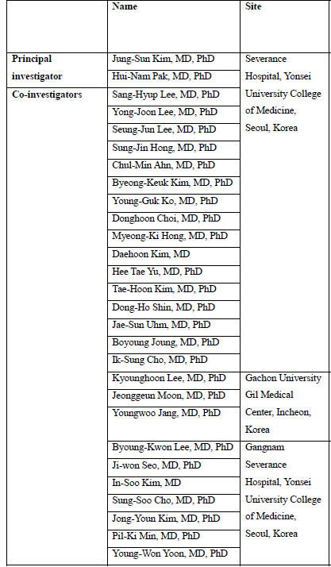
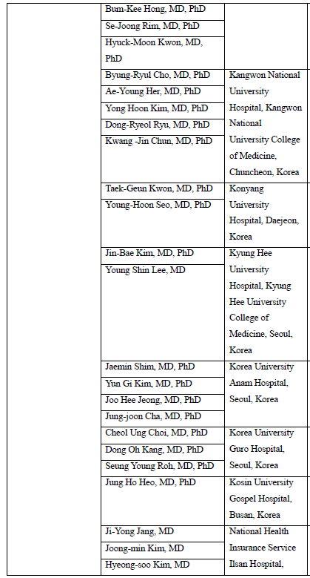
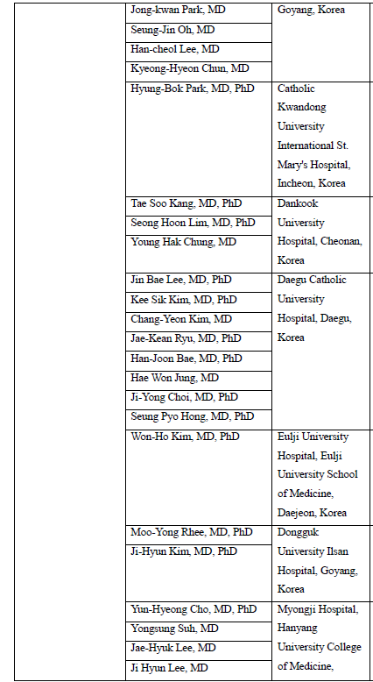
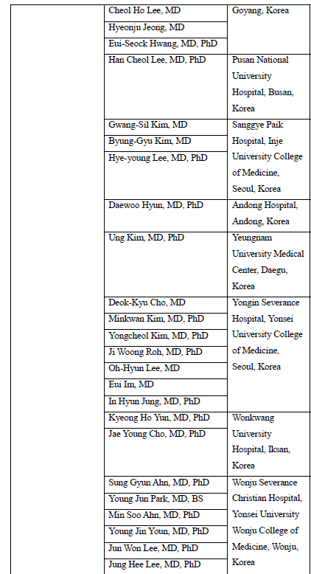
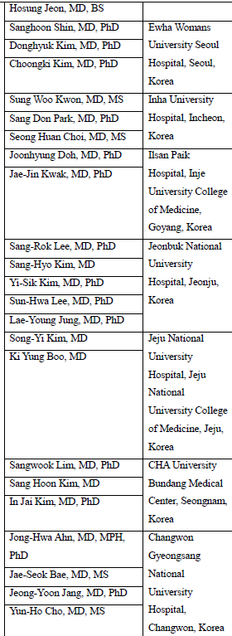
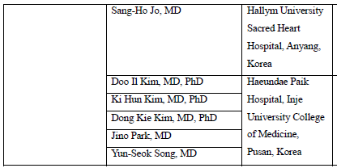
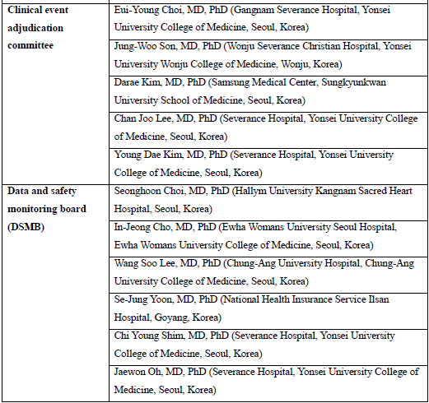
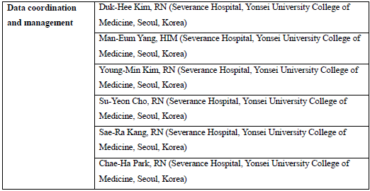
Thank You to the ADAPT AF-DES Trial Team, Investigators, sites, and patients

Slide 23
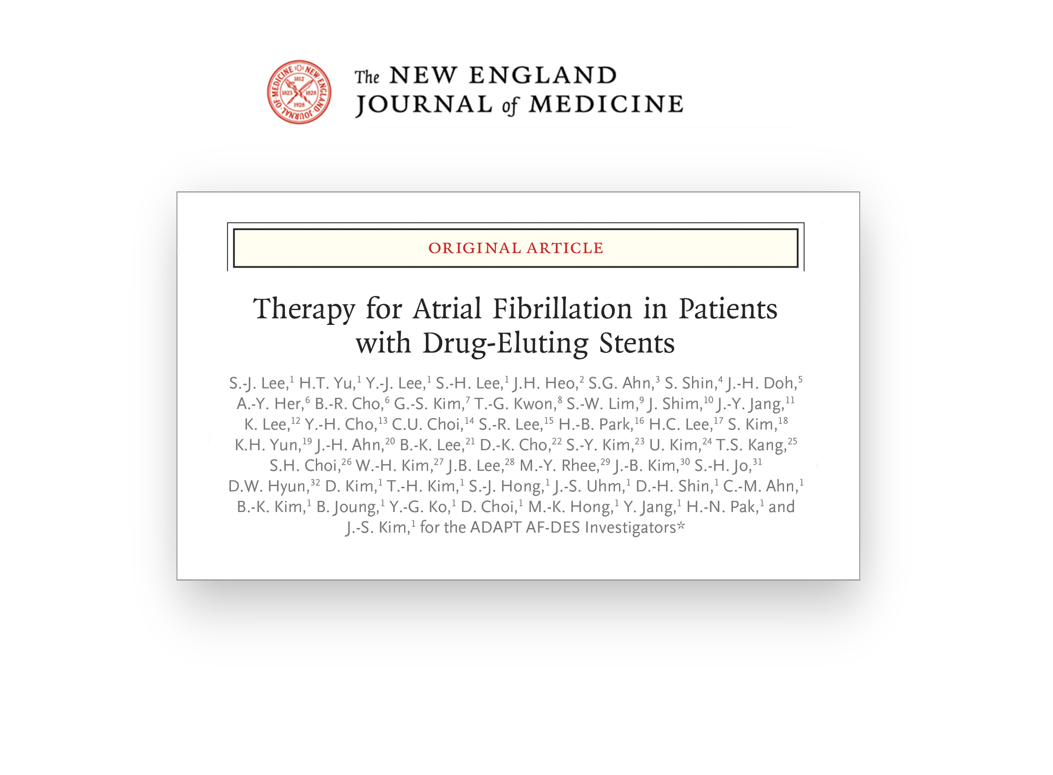


Slide 24
Thank you for Your Attention

