Slide 1

Complete Revascularization Trialists’ Collaboration Final Results
An individual patient data meta-analysis of randomized trials
comparing complete versus culprit lesion-only
revascularisation for acute myocardial infarction:
THE COMPLETE REVASCULARISATION TRIALISTS’ COLLABORATION
Shamir R. Mehta, Denise TW Tiong, Felix Böhm, Chinthanie Ramasundarahettige,
Simone Biscaglia, Gianluca Campo, Stefan James, Pieter C Smits, Daniele Giacoppo,
Gerry P McCann, Amerjeet Banning, Dan Eik Høfsten, Gianni Casella, Faith R Kirabo,
Helen Nguyen, David A Wood, John A Cairns, Thomas Engstrøm

Slide 2
Background
Patients undergoing PCI of the culprit lesion for ACS are often found to have multivessel CAD, with 1 or more non-culprit lesions.
RCT’s have evaluated whether to routinely perform complete revascularisation (multi-vessel PCI of all non-culprit lesions, in addition to the culprit lesion) or manage the non-culprit lesions conservatively (culprit lesion-only PCI).
Most (but not all), RCT’s have shown that complete revascularization reduces non-fatal events, but there remains uncertainty regarding:
1. the robustness of this benefit when considering the totality of RCT data
2. whether complete revascularization reduces cardiovascular death

Slide 3
Objective
To perform a collaborative individual patient data meta-analysis to determine the robustness of the effect of complete revascularization on CV death or new MI and CV death alone, based on the totality of data from RCT’s

Slide 4
Outcomes
Primary Outcomes
CV death or New MI
CV death alone
Secondary Outcome
All-cause death
Other Outcomes
New MI
Non-CV death

Slide 5
Methods
Inclusion Criteria: RCT’s enrolling at least 250 patients with STEMI or NSTEMI comparing complete revascularisation strategy (with PCI) with either an angiography-guided or physiology guided strategy to a culprit lesion-only PCI strategy
Exclusion: Trials enrolling patients with cardiogenic shock or stable coronary artery disease
Search Strategy: Embase, Ovid MEDLINE and the Cochrane Central Register of Controlled Trials (CENTRAL) from 1996 to 2025 September 15
Analysis: ITT population, data pooled and analyses using a Cox Frailty Model with clustering of trials using a random effect.
The first primary outcome evaluated pre-specified 𝝰=0.04. If statistically significant, the 𝝰 was considered “unused” and transferred to the second primary outcome, which was then tested at the full 0.05 level. If the first primary outcome was not significant, the second primary outcome was tested at 𝝰=0.01.
Sensitivity Analysis: 2-Stage analysis with PRAMI included

Slide 6
Included Trials
TRIAL | N | INVESTIGATORS
Compare-Acute | 885 | P. Smits, D. Giacoppo
DANAMI-3 PRIMULTI | 627 | T. Engstrøm, D.E. Høfsten
Cvlprit | 296 | A. Banning, G. McCann
COMPLETE | 4041 | S. Mehta, D. Wood, J. Cairns
FIRE | 1445 | S. Biscaglia, G. Casella, G. Campo
FULL REVASC | 1542 | F. Böhm, S. James
Total | 8836

Slide 7
Baseline Characteristics
 | Complete N=4,259 | Culprit-only N=4,577
Median Age, years | 65.5 (56.8, 76.0) | 66 (57.0,76.0)
Male sex | 77.3% | 75.5%
Female sex | 22.7% | 24.5%
Diabetes | 19.5% | 20.1%
Chronic renal insuff. | 12.8% | 11.9%
Clinical Presentation
STEMI | 87.4% | 88.4%
NSTEMI | 12.6% | 11.6%
Previous MI | 8.7% | 8.8%
Current smoker | 34.7% | 34.5%
Hypertension | 53.6% | 54.8%
Dyslipidaemia | 36.9% | 36.6%
Previous PCI | 8.9% | 8.9%
Killip class ≥II | 11.8% | 11.6%
 | Complete N=4,259 | Culprit-only N=4,577
Symptom onset to index PCI
<6 hr | 72.3% | 72.4%
6-12 hr | 15.9% | 15.9%
>12 hr | 11.8% | 11.6%
Medications at discharge
Aspirin | 98.6% | 98.4%
P2Y12 Inhibitor
Any | 97.7% | 98.2%
Ticagrelor | 59.0% | 57.0%
Prasugrel | 11.9% | 12.9%
Clopidogrel | 26.9% | 28.3%
Beta blocker | 85.9% | 86.1%
ACEi/ARB | 81.0% | 80.4%
Statin | 97.7% | 96.7%

Slide 8
Procedural/Angiographic Characteristics
 | Complete N=4,259 | Culprit-only N=4,577
Radial access | 79.5% | 73.5%
Culprit lesion location*
LM | 44/3831 (1.1%) | 46/4167 (1.1%)
LAD | 1408/3831 (36.7%) | 1520/4167 (36.5%)
Circ | 731/3831 (19.0%) | 741/4167 (17.8%)
RCA | 1655/3831 (43.2%) | 1870/4167 (44.9%)
No. of NCL vessels
1 | 73.7% | 73.3%
≥2 | 26.3% | 26.6%
NCL diameter stenosis*
50-<70% | 743/5273 (14.1%) | 736/4895 (15.0%)
70-<90% | 3098/5273 (58.8%) | 2929/4895 (59.8%)
90-<100% | 1145/5273 (21.7%) | 960/4895 (19.6%)
100% | 287/5273 (5.4%) | 270/4895 (5.5%)
 | Complete N=4,259 | Culprit-only N=4,577
Non-culprit lesion location*
Left main | 13/4888 (0.3%) | 7/5089 (0.1%)
LAD | 1961/4888 (40.1%) | 2190/5089 (43.0%)
Proximal LAD | 514/4888 (10.5%) | 543/5089 (10.7%)
Mid LAD | 739/4888 (15.1%) | 857/5089 (16.8%)
Circumflex | 1832/4888 (37.5%) | 1914/5089 (37.6%)
Prox Circ | 897/4888 (18.4%) | 964/5089 (18.9%)
Distal Circ/PLV | 330/4888 (6.8%) | 366/5089 (7.2%)
RCA | 1174/4888 (24.0%) | 1173/5089 (23.0%)
*Per Lesion

Slide 9
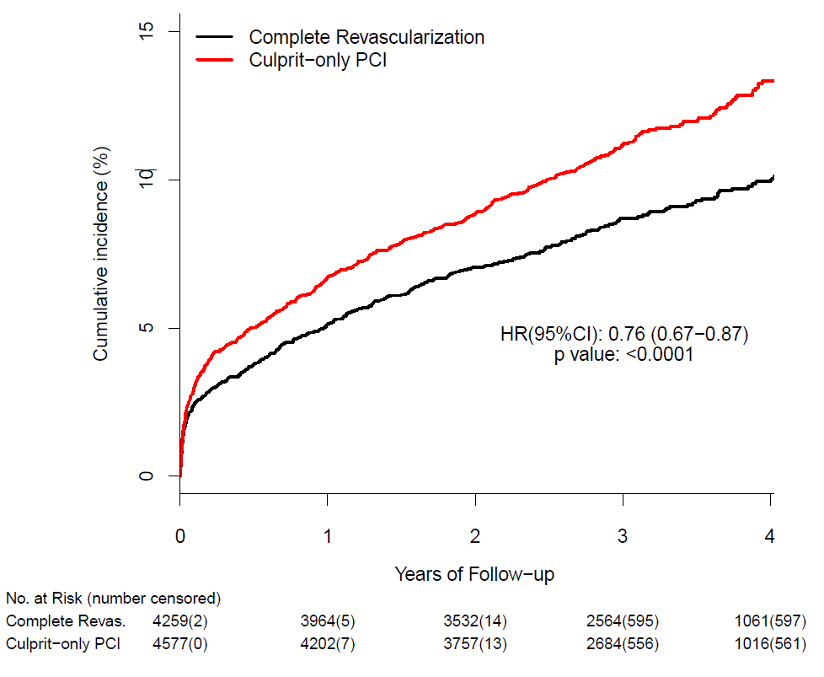
Primary Outcome:
CV Death or New MI
Culprit Lesion-Only PCI
(N=4,577)
11.5% (528 events)
9.0% (382 events)
Complete Revascularization
(N=4,259)
HR 0.76
95% CI 0.67-0.87
P<0.0001

Slide 10
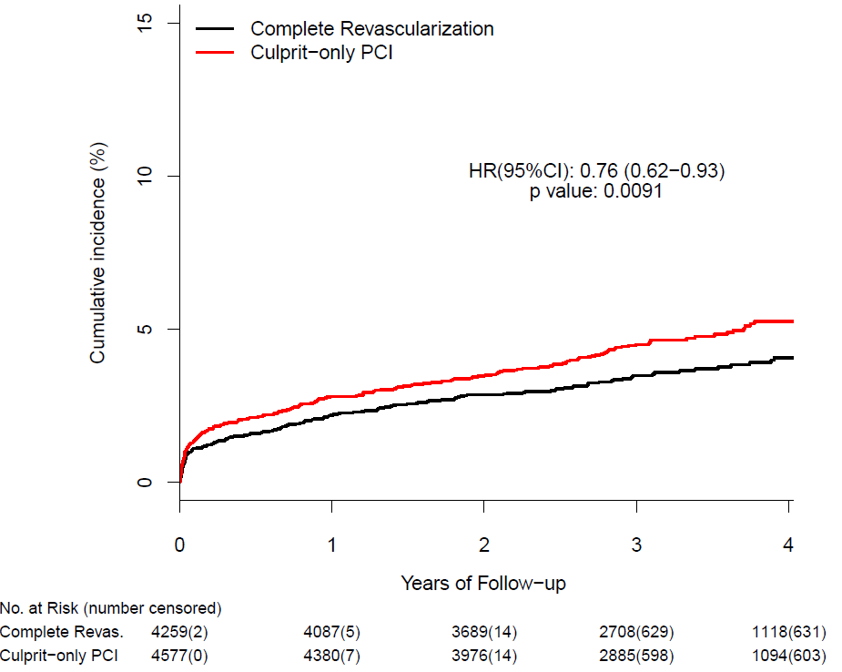
Primary Outcome:
CV Death
HR 0.76
95% CI 0.62-0.93
P=0.0091
Culprit Lesion-Only PCI
(N=4,577)
4.6% (209 events)
3.6% (155 events)
Complete Revascularization
(N=4,259)

Slide 11
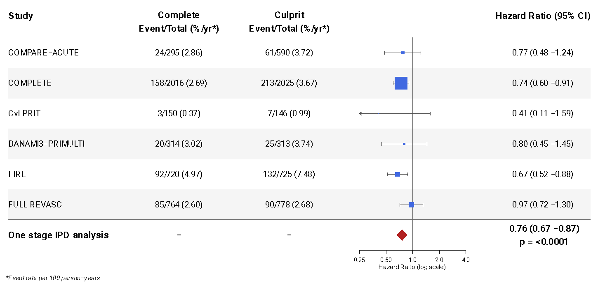
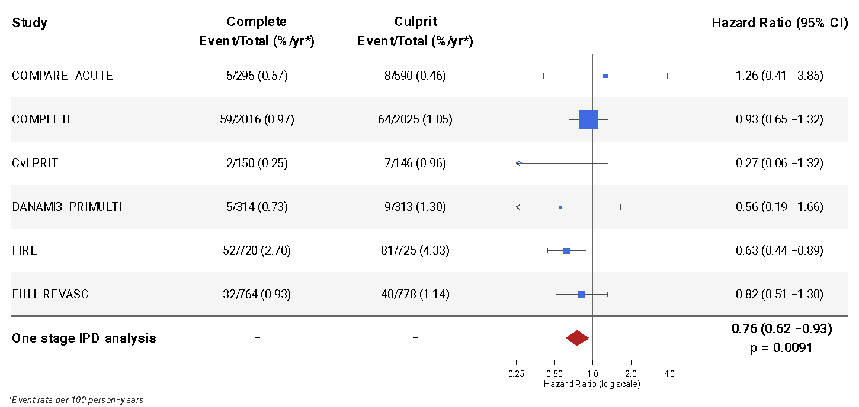
CV Death or New MI
Primary Outcomes
Forest Plots
P heterogeneity=0.49
CV Death
P heterogeneity=0.38

Slide 12
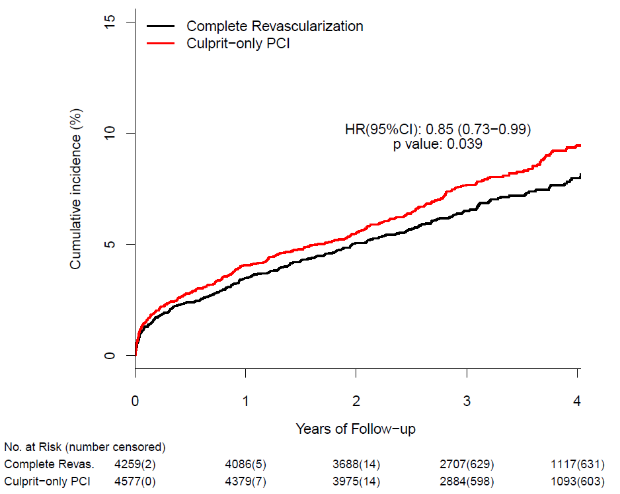
Secondary Outcome
All-cause Death
HR 0.85
95% CI 0.73-0.99
P=0.039
8.1% (370 deaths)
Culprit Lesion-Only PCI
(N=4,577)
Median
Follow-up
3 years
7.2% (308 deaths)
Complete Revascularization
(N=4,259)

Slide 13
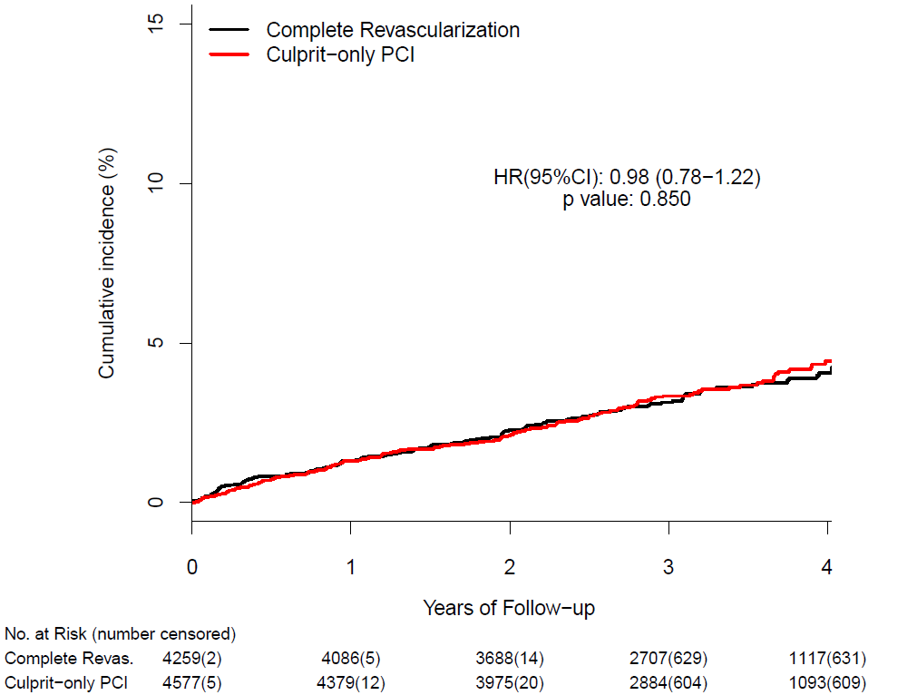
CV Death and Non-CV Death
CV Death
Non-CV Death
HR 0.76
95% CI 0.62-0.93
P=0.0091
HR 0.98
95% CI 0.78-1.22
P=0.850
Culprit Lesion-Only PCI
(N=4,577)
4.6% (209 events)
3.5% (161 events)
Culprit Lesion-Only PCI
(N=4,577)
3.6% (155 events)
3.6% (153 events)
Complete Revascularization
(N=4,259)
Complete Revascularization
(N=4,259)

Slide 14
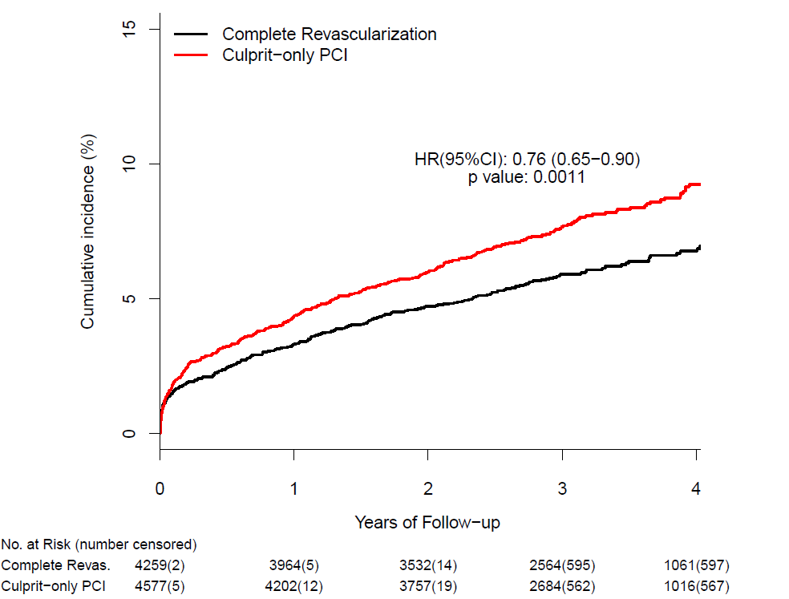
New MI
HR 0.76
95% CI 0.65-0.90
P<0.0001
Culprit Lesion-Only PCI
(N=4,577)
7.8% (357 events)
6.0% (255 events)
Complete Revascularization
(N=4,259)

Slide 15
Summary of Main Outcomes
Median Follow-up 3 Years
Outcome | Complete Revasc (N=4259) | Culprit Lesion-only PCI (N=4577) | HR (95% CI) | P-value
Primary Outcome: CV death or new MI | 382 (9.0%) | 528 (11.5%) | 0.76 (0.67-0.87) | <0.0001
Primary Outcome: CV death | 155 (3.6%) | 209 (4.6%) | 0.76 (0.62-0.93) | 0.0091
Secondary Outcome: All-cause death | 308 (7.2%) | 370 (8.1%) | 0.85 (0.73-0.99) | 0.039
Non-CV death | 153 (3.6%) | 161 (3.5%) | 0.98 (0.78-1.22) | 0.85
New MI | 255 (6.0%) | 357 (7.8%) | 0.76 (0.65-0.90) | 0.0011

Slide 16
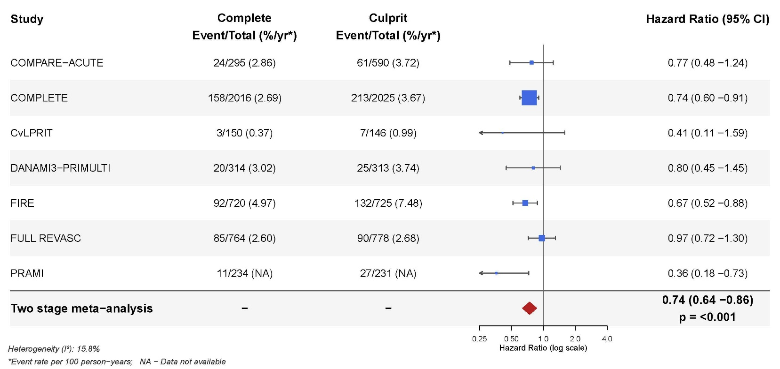
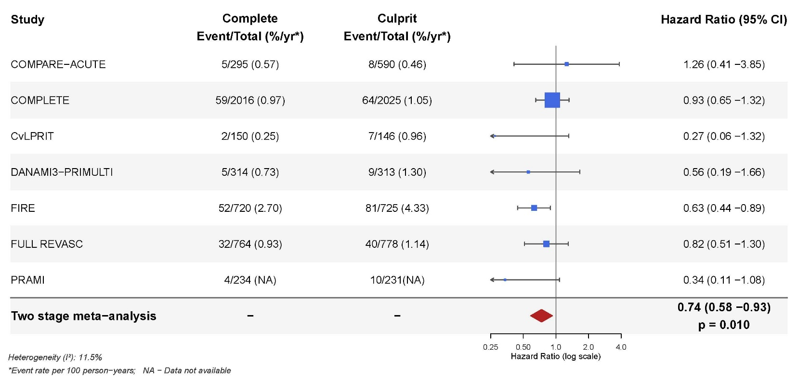
CV Death or New MI
Sensitivity Analysis:
Two stage approach including PRAMI
CV Death

Slide 17
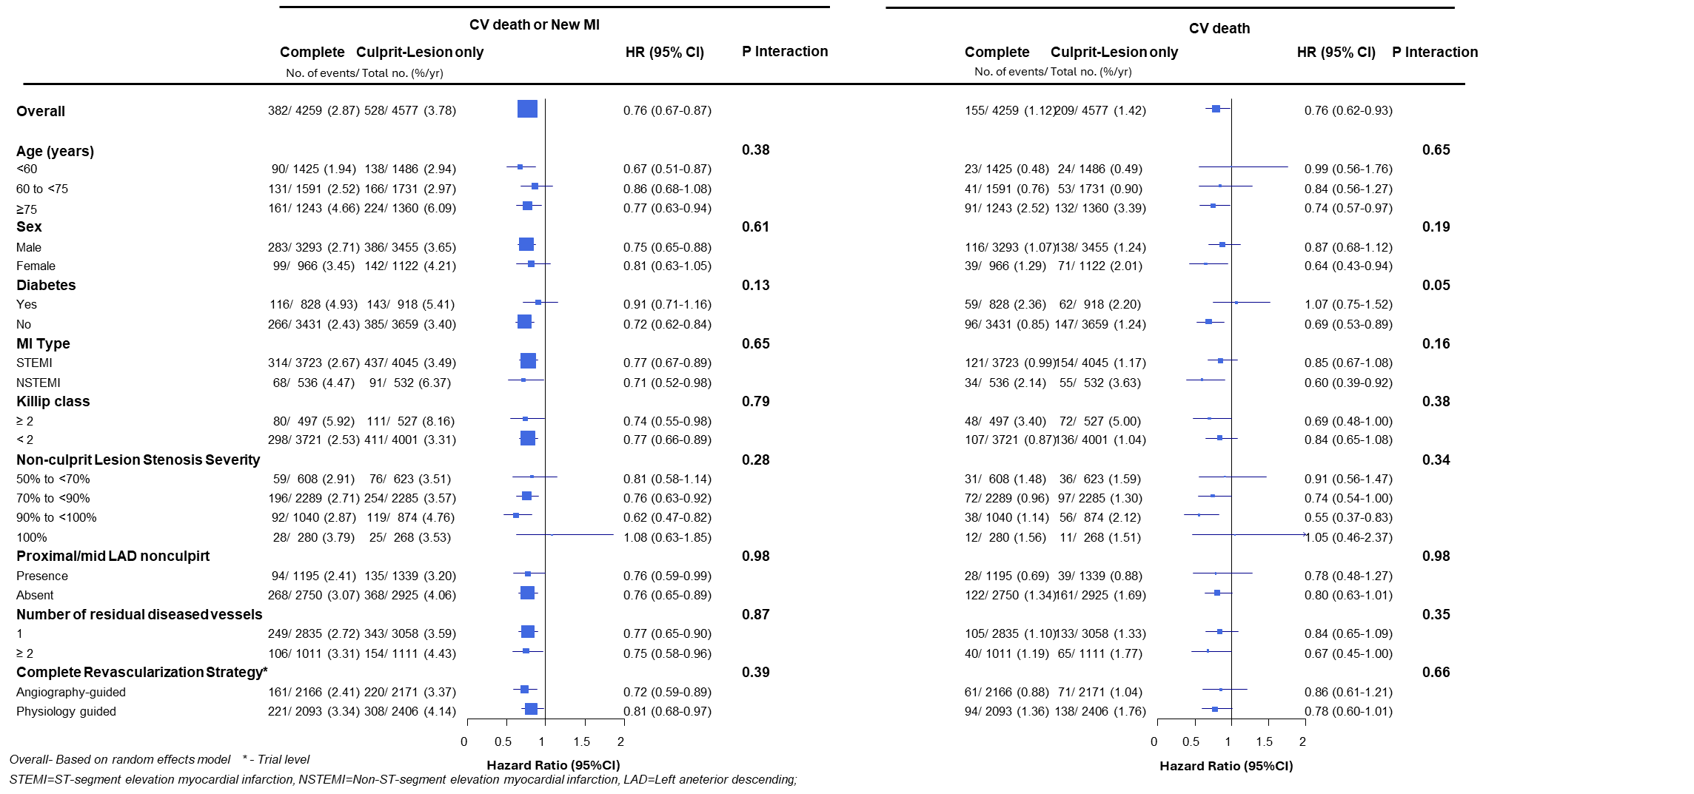
Subgroups

Slide 18
Subgroups
Consistent results for both primary outcomes:
Age <60, 60 to <75, ≥75
Women vs men
Diabetes vs No Diabetes
STEMI vs NSTEMI
Killip Class ≥2 vs < 2
NCL Stenosis Severity 50-<70%, 70 to <90%, 90 to 99%, 100%
Prox/mid LAD NCL vs other location
Number of residual diseased vessels: 1 vs 2
Complete Revasc Strategy: Angio-guided vs Physio-guided

Slide 19
Conclusions
This IPD involving 8,836 patients from 6 multicentre randomized trials demonstrated that, compared with culprit lesion-only PCI, complete revascularisation:
Reduced CV death or new MI by 24% (P<0.0001)
Reduced CV death alone by 24% (P=0.0091)
Reduced all-cause death by 15% P=0.039)
Reduced new MI by 24% (P=0.0011)
Had no effect on Non-CV Death
This benefit was consistent in all subgroups studied, including:
Women and men
Younger and older patients
STEMI and NSTEMI
Physiology-guided and angiography-guided NCL PCI strategies

Slide 20
Implications
These data provide the strongest evidence that complete revascularisation improves important clinical outcomes in patients with acute MI and multivessel CAD
The number needed to treat to prevent 1 CV death or new MI is 41 patients and to prevent 1 CV death is 99 over 3 years.
Data from the IPD establish complete revascularization for patients with acute MI as one of the few clinical indications where a PCI-based strategy reduces cardiovascular and all-cause death

Slide 21

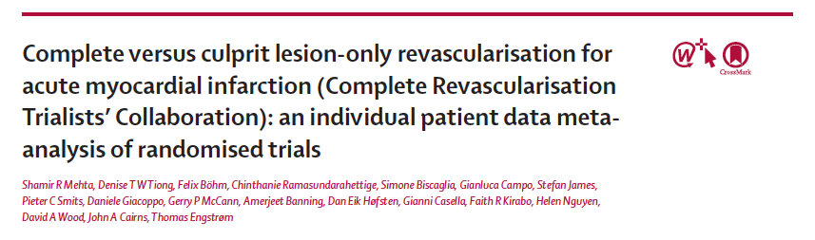
Simultaneously Published in:

