Slide 1
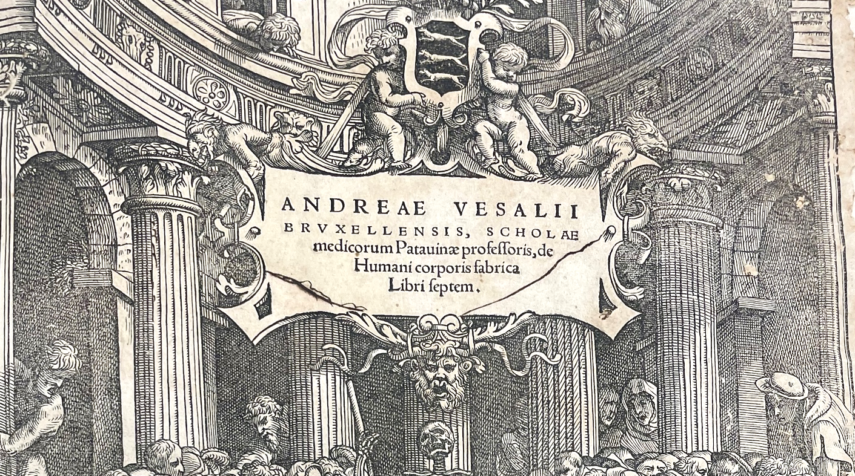



The Effect of EVolocumab in PatiEntS at High CArdiovascuLar RIsk WithoUt Prior Myocardial Infarction or Stroke: Primary Results of the VESALIUS-CV Study
Erin Bohula, MD DPhil
On behalf of the VESALIUS-CV Investigators
American Heart Association Scientific Sessions
November 8, 2025

Slide 2
Disclosures
TIMI Study Group receives grant support through Brigham and Women’s Hospital
Abbott, Amgen, Anthos Therapeutics, ARCA Biopharma, Inc., AstraZeneca, Boehringer Ingelheim, Daiichi-Sankyo, Ionis Pharmaceuticals, Inc., Marea; Merck, Novartis, Pfizer, Regeneron Pharmaceuticals, Inc., Roche, Saghmos Therapeutics, Siemens Healthcare Diagnostics, Inc., Softcell Medical Limited, Verve Therapeutics, and Zora Biosciences.
Personal fees
Amgen, Celecor, Esperion, Kowa, Novo Nordisk, Scleroderma Research Foundation, and Servier

Slide 3
Background
LDL-C is a well-established, modifiable CV risk factor
Lowering LDL-C with PCSK9 inhibitors, including evolocumab, ↓ the risk of CV events in patients with a prior, major ASCVD event, such as MI or stroke
Clinical benefit of PCSK9 inhibition in patients without a prior MI or stroke is unknown
Sabatine MS, et al. NEJM. 2017;376:1713-22.
Schwartz GG, et al. NEJM. 2018;379:2097-107.

Slide 4
ASCVD Continuum
No Known ASCVD
Known ASCVD
Increasing risk for development of ASCVD
Increasing severity of ASCVD
Low-CV Risk
(w/o known ASCVD)
High-CV Risk
(w/o known ASCVD)
Atherosclerosis w/o Prior Event
Major ASCVD Event
Diabetes
+ risk enhancer
Coronary disease,
Cerebrovascular disease, or
Peripheral artery disease,
+ risk enhancer
No MI or Stroke
Prior MI
Prior Stroke
Symptomatic PAD
+ risk enhancer
VESALIUS-CV
FOURIER and
ODYSSEY-OUTCOMES

Slide 5
Trial Design
Stable patients at high-risk for CV events but no prior MI or stroke*
N= 12,257
LDL-C ≥ 90 mg/dL or non-HDL-C ≥ 120 mg/dL or
ApoB ≥ 80mg/dL
On optimized statin therapy (± ezetimibe)
*At least one of the following:
CAD without MI
CVD without stroke
PAD
High-risk diabetes mellitus
Event & f/up driven trial:
3-P MACE ≥ 751 events
4-P MACE ≥ 1,254 events
Median f/up ≥ 4.5yrs
1:1
Randomization
Evolocumab SC
140 mg Q2W
Placebo SC
Q2W
Dual Primary End Points:
Time to coronary heart disease death, MI, or ischemic stroke (3-P MACE)
Time to 3-P MACE plus ischemia-driven arterial revascularization (4-P MACE)
Bohula EA, et al. Am Heart J. 2024;269:179-190.

Slide 6
Trial Organization
TIMI Study Group Marc Sabatine (Study Chair) Robert Giugliano (Co-Principal Investigator) Erin Bohula (Co-Principal Investigator) Nicholas Marston (Investigator) | P. Fish, A. Pricken, R. Striar, S. Ewing (Ops) S. Murphy, J. Kuder, JG. Park (Stats) Christian Ruff (CEC)
Amgen (Sponsor) Narimon Honarpour E. Magnus Ohman Gabriel Paiva da Silva Lima | Ajay Bhatia, Marcoli Cyrille J. Bayley, G. Harding, Y. Potapova (Ops) H. Wang, L. Liu, E. Walsh (Stats)
Executive Committee Marc Sabatine (Chair) Robert Giugliano Jose Nicolau | Lawrence Leiter Gaetano De Ferrari
Independent Data Monitoring Committee Charles Hennekens (Chair) Felicita Andreotti | W. Virgil Brown Barry Davis

Slide 7
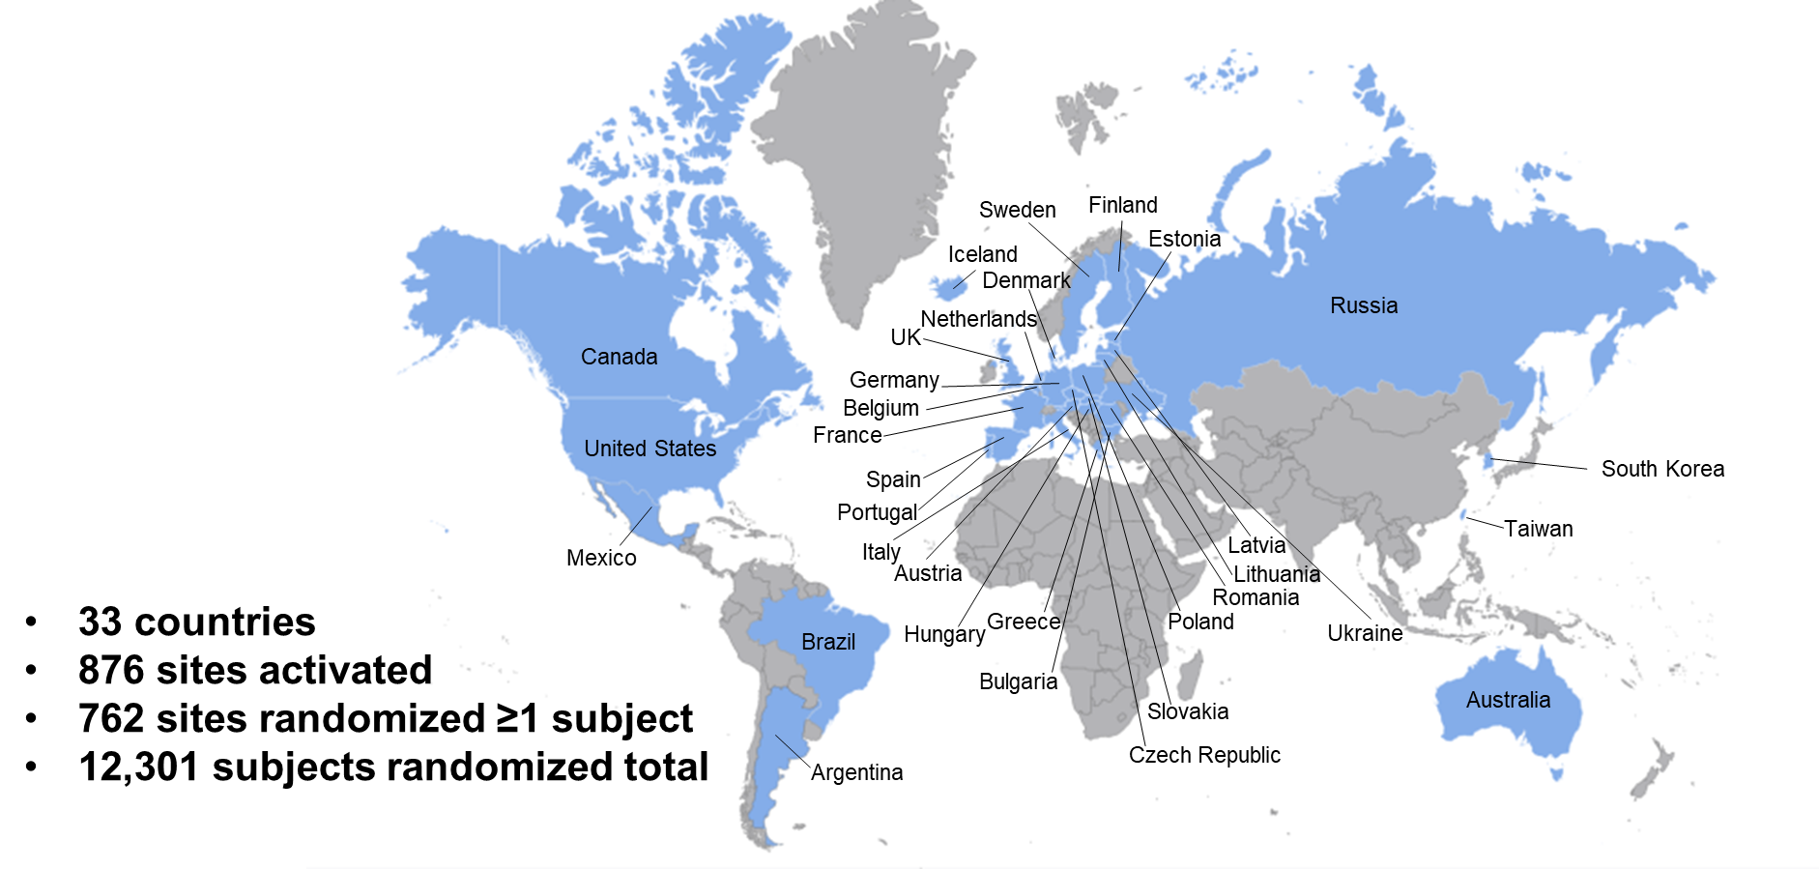
Enrollment and Retention
745 enrolling sites from 33 countries
12,257† in analytic population
Over a median follow up of 4.6 years, annualized rates of:
Premature drug d/c: 4.5%
Withdrawal of consent: 0.3%
Lost to follow-up: 0.08%
Follow up for primary end points for 98.7% of total potential patient-years
†Excludes 44 from site with serious breach and GCP violations

Slide 8
Baseline Characteristics
Demographics | N=12,257
Age (years) | 66 [60, 71]
Female | 43%
White | 93%
Hispanic | 17%
Diabetes | 58%
Qualifying Disease Categories*
Any qualifying atherosclerosis | 67%
CAD w/o MI | 45%
CVD w/o stroke | 10%
PAD | 17%
High-risk diabetes | 49%
With no qualifying atherosclerosis | 33%
Lipid-lowering therapy (LLT)
Any LLT | 92%
High-intensity LLT regimen | 72%
Any statin | 87%
High-intensity statin | 68%
Ezetimibe | 20%
Lipid Values (mg/dL)
LDL-C | 122 [104, 149]
Non-HDL-C | 153 [130, 182]
Apolipoprotein-B | 100 [89, 121]
% or median and interquartile range.
Pooled data; no difference between treatment arms.
*Qualifying disease categories of CAD CVD, PAD and high-risk diabetes are not mutually exclusive

Slide 9
LDL-C Over Time
Baseline
Median 115 mg/dL
(IQR 94-143 mg/dL)
Median 109 mg/dL
(IQR 86-144 mg/dL)
Placebo
55% reduction
p<0.0001
Absolute ↓ 63 mg/dL
Median 45 mg/dL
(IQR 26-73 mg/dL)
Evolocumab
Lipid sub-study in N=1891

Slide 10
Dual Primary End Point
3-P MACE (CHD death, MI, or ischemic stroke)
25% Relative Risk Reduction
HR (95% CI): 0.75 (0.65, 0.86)
p-value < 0.0001
8.0% (N=443)
6.2% (N=336)
(N=6,128)
(N=6,129)
CHD, coronary heart disease

Slide 11
Dual Primary End Point
4-P MACE (CHD death, MI, ischemic stroke, or IDR)
19% Relative Risk Reduction
HR (95% CI): 0.81 (0.73, 0.89)
p-value < 0.0001
16.2% (N=907)
13.4% (N=747)
(N=6,128)
(N=6,129)
CHD, coronary heart disease; IDR, ischemia-driven arterial revasc

Slide 12
Primary & Key Secondary EPs
Dual Primary End Points |  |  | HR (95% CI) | p-value
 | 3-P MACE |  | 0.75 (0.65, 0.86) | <0.0001
 | 4-P MACE |  | 0.81 (0.73, 0.89) | <0.0001
Key Secondary End Points (in testing order)
Composite End Points | MI, ischemic stroke, or IDR |  | 0.79 (0.72, 0.88) | <0.0001
 | CHD death, MI, or IDR |  | 0.79 (0.72, 0.88) | <0.0001
 | CV death, MI, or ischemic stroke |  | 0.73 (0.64, 0.84) | <0.0001
 | CHD death or MI |  | 0.73 (0.62, 0.87) | 0.0003
Individual End Points | MI |  | 0.64 (0.52, 0.79) | <0.0001
 | IDR |  | 0.79 (0.70, 0.88) | <0.0001
 | CHD death |  | 0.89 (0.68, 1.16) | 0.39
 | CV death |  | 0.79 (0.64, 0.98) | 0.032*
 | All-cause death |  | 0.80 (0.70, 0.91) | 0.0005*
 | Ischemic stroke |  | 0.79 (0.62, 1.01) | 0.062*
0.5
1.0
1.5
*Nominal p-value
Hazard Ratio (95% CI)
Favors Evo
Favors Pbo
CHD, coronary heart disease
IDR, ischemia-driven arterial revasc

Slide 13
All-Cause Death
9.7% (N=539)
HR (95% CI): 0.80 (0.70, 0.91)
Nominal p=0.0005
7.9% (N=434)
(N=6,128)
(N=6,129)

Slide 14

Key Subgroups
 | 3-P MACE |  |  |  | 4-P MACE
Subgroup | Evo (%) | Pbo (%) |  | HR | Evo (%) | Pbo (%) |  | HR
Overall | 5.5 | 7.2 |  | 0.75 | 12.2 | 14.8 |  | 0.81
Demographics
Age < 65 | 5.2 | 6.0 |  | 0.86 | 11.2 | 13.2 |  | 0.83
Age ≥ 65 | 5.7 | 8.2 |  | 0.68 | 13.0 | 16.1 |  | 0.79
Male | 6.4 | 8.4 |  | 0.75 | 14.5 | 17.2 |  | 0.83
Female | 4.2 | 5.7 |  | 0.74 | 9.0 | 11.6 |  | 0.77
Qualifying Disease State
Any qualifying athero | 5.8 | 7.5 |  | 0.76 | 14.3 | 16.7 |  | 0.84
High risk DM w/o qualifying athero | 4.9 | 6.8 |  | 0.71 | 8.1 | 10.8 |  | 0.74
Lipid Related
Baseline LDL-C (mg/dL)
1st quartile (≤104) | 5.2 | 6.7 |  | 0.77 | 12.2 | 14.4 |  | 0.83
2nd quartile (>104-122) | 5.8 | 7.3 |  | 0.78 | 13.8 | 15.6 |  | 0.88
3rd quartile (>122-149) | 4.8 | 7.7 |  | 0.60 | 10.8 | 14.9 |  | 0.70
4th quartile (>149) | 6.2 | 7.3 |  | 0.85 | 12.0 | 14.4 |  | 0.83
Statin Intensity
High intensity | 4.9 | 6.9 |  | 0.70 | 11.0 | 13.5 |  | 0.80
Moderate or low | 6.0 | 7.1 |  | 0.81 | 13.5 | 16.4 |  | 0.79
None | 7.8 | 9.0 |  | 0.88 | 16.5 | 18.9 |  | 0.87
Ezetimibe | 5.3 | 6.9 |  | 0.74 | 13.6 | 16.4 |  | 0.80
No ezetimibe | 5.5 | 7.3 |  | 0.75 | 11.8 | 14.4 |  | 0.81
0.5
0.75
1.0
1.5
0.5
0.75
1.0
1.5
%, n/N.
P-interaction = NS for all
Hazard Ratio (95% CI)
Hazard Ratio (95% CI)
Favors Evo
Favors Pbo
Favors Evo
Favors Pbo

Slide 15
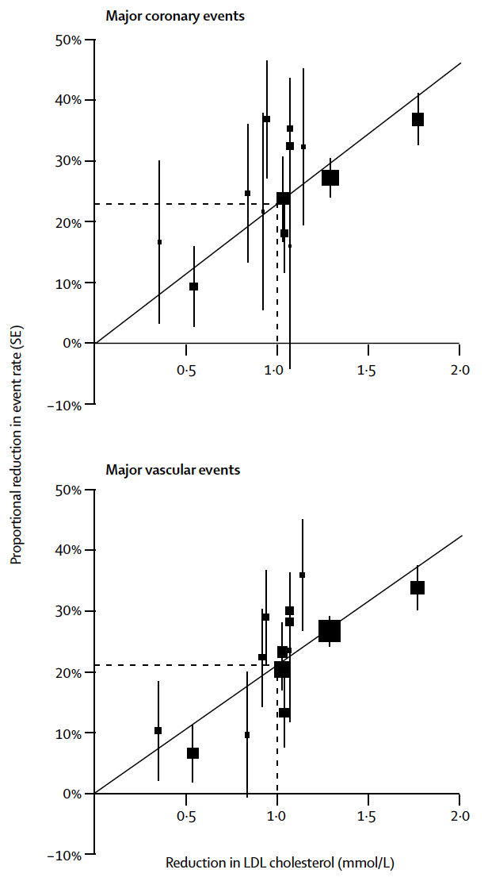
CTTC Meta-Regression
Major Coronary Event [MCE]
(Death due to AMI, MI)
Major Vascular Event [MVE]
(MCE, fatal/non-fatal stroke, cor revasc)
VESALIUS-CV
VESALIUS-CV
Lancet. 2005;366:1267-78.
Lancet. 2010;376:1670-81.

Slide 16
Summary
In pts at high CV risk w/o prior MI or stroke, addition of the PCSK9 inhibitor, evolocumab, to baseline LLRx resulted in:
Median achieved LDL-C of 45 mg/dL (1.16 mmol/L)
25% ↓ in 3-P MACE and 19% ↓ in 4-P MACE
Consistency across subgroups, including in those with diabetes and no qualifying atherosclerosis
27% ↓ in CV death, MI or ischemic stroke and 36% ↓ in MI
Nominally lower rates of CV and all-cause death

Slide 17
Conclusion
Guidelines have progressively recommended lower LDL-C goals of <70 or <55 mg/dL in very high-risk patients, and most recently <40 mg/dL in extreme-risk patients.
The reduction in MACE seen in VESALIUS-CV, with an achieved LDL-C of ~40 mg/dL in the evolocumab arm, supports intensive LDL-C lowering to this level, even in patients without a prior major ASCVD event.
Grundy SM et al. Circulation. 2019;139:e1046-e81.
Mach F et al. Eur Heart J. 2020;41:111-88.
Mach F et al. Atheroclerosis. 2025:120479.

Slide 18
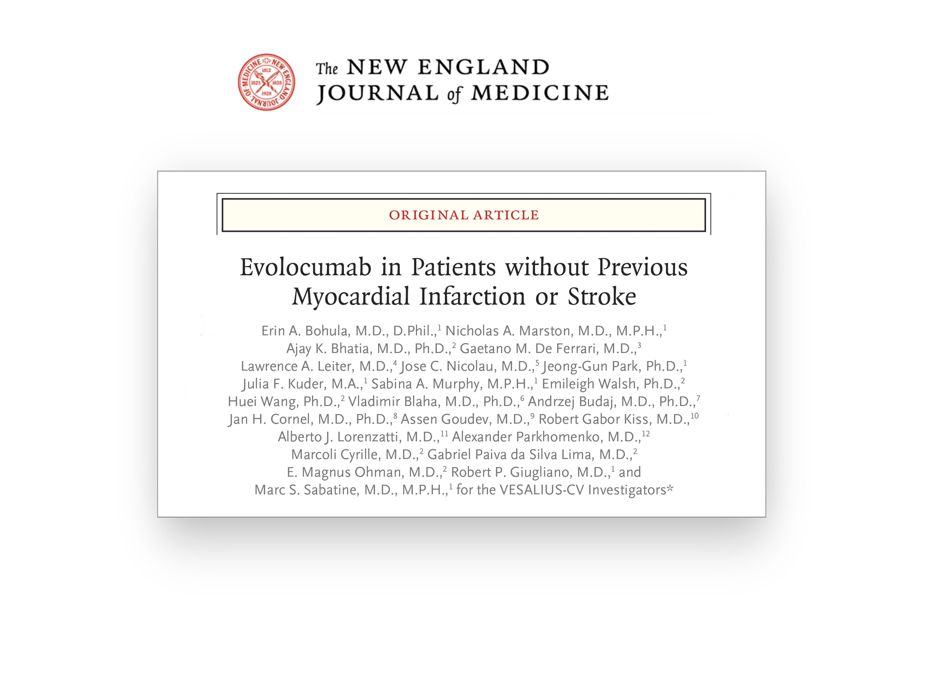

www.timi.org
www.vesalius.org

