Slide 1





The Coronary Microvascular Angina Cardiac Magnetic Resonance Imaging Trial
CorCMR
Colin Berry, Professor of Cardiology, University of Glasgow

Slide 2

DISCLOSURES
This study was funded by a peer-reviewed Project Grant from the British Heart Foundation (PG/19/28/34310).
The University of Glasgow receives funding from the British Heart Foundation for research undertaken by Colin Berry (RG/F/23/110104; PG/19/28/34310).
Colin Berry is employed by the University of Glasgow which holds consultancy and research agreements for his work with Abbott Vascular, AskBio, AstraZeneca, Boehringer Ingelheim, CorFlow, Edwards Lifesciences, MAIA Pharmaceuticals, Merck, Servier, Novartis, Xylocor and Zoll Medical.
These companies had no involvement in the CorCMR study.

Slide 3
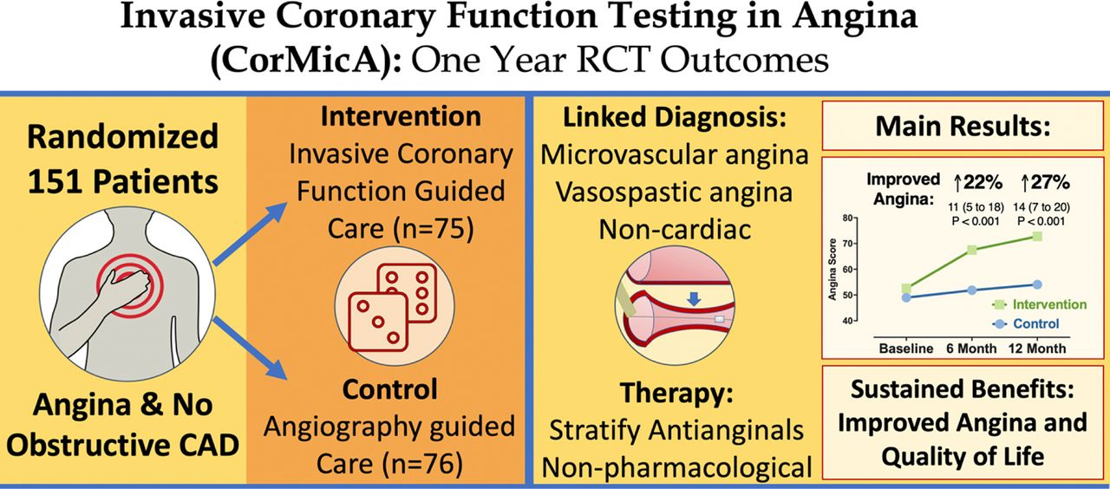
BACKGROUND
Chest pain - second most common reason adults visit hospital emergency departments in the U.S., accounting for more than 6.5 million visits each year (about 1 in 20 ED visits). Four million outpatient visits annually (AHA, 2025).
Coronary angiogram → 4 million in Europe and United States annually.
Half of patients have no obstructive coronary artery disease → repeated episodes of care.
CorMicA Trial
Invasive coronary function testing in suspected angina
Ford TJ, Berry C et al. CorMicA. JACC 2018

Slide 4
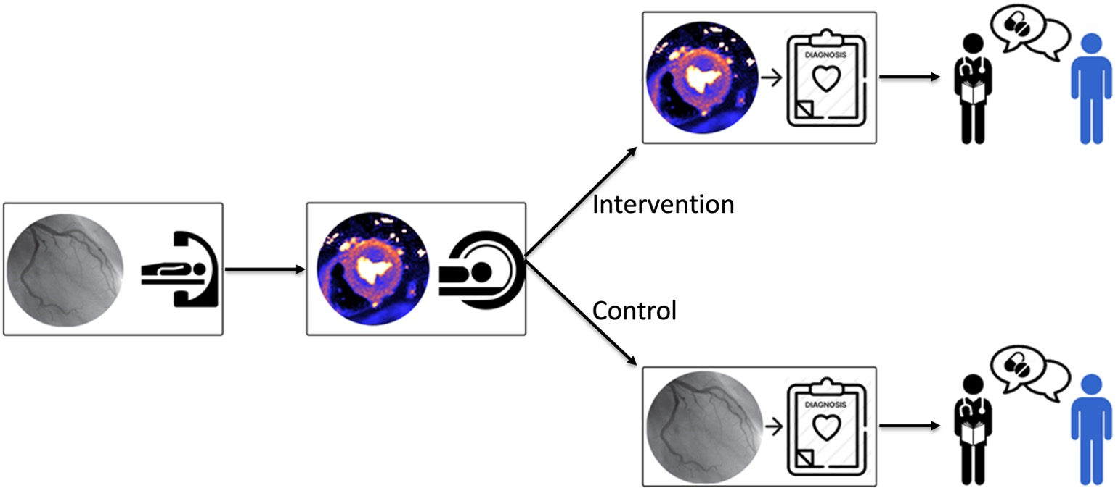
STUDY QUESTION AND HYPOTHESeS
Q. Noninvasive Imaging Myocardial Blood Flow: Effects on Diagnosis and Health Status?
Coronary functional endotypes are prevalent in a post-angiography chest pain population with no obstructive arteries.
Compared with angiography-guided management, stress CMR imaging-guided management changes the diagnosis and improves symptoms and health-related quality of life.
The hypotheses were assessed in a diagnostic study and the nested, randomized, double-blind trial.
Blinded
Angiogram Stress MRI
Myocardial blood flow map
ml/min/g
Blinded
Blinded
4
Notes:
We hypothesized, first, that coronary vasomotor endotypes are prevalent in a post-angiography population with no obstructive coronary arteries and, second, compared with angiography-guided management, MRI-guided management changes the diagnosis and improves symptoms and health-related quality of life.
The hypotheses were assessed in the diagnostic study and the nested, randomized, double-blind trial.

Slide 5
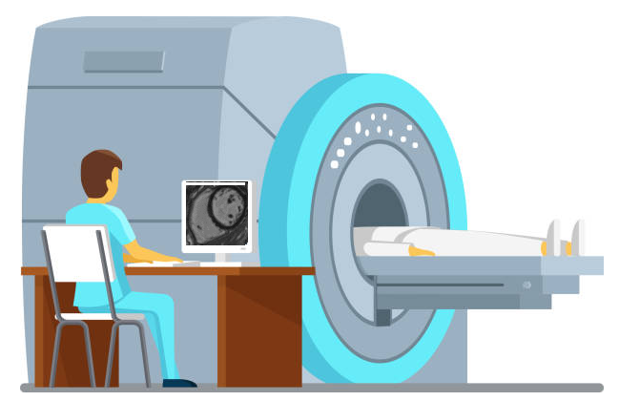

STUDY design
Prospective, multicenter, parallel group, 1:1 randomized, double-blind superiority trial of stress CMR-guided management vs. angiography-guided management in patients with chest pain and nonobstructive coronary arteries.
Diagnostic study of coronary endotypes revealed by CMR imaging
A nested, randomized, controlled trial of the effects of inclusion of the myocardial blood flow results to inform the final diagnosis.
The participants and healthcare staff were blind to the myocardial blood flow results and the randomized group of individual participants.
Independent Trials Unit – data, statistics
Clinicaltrials.gov NCT04805814
https://www.bachelorprint.com/
Bradley CP, Berry C, et al. Am Heart J 2023
Notes:
This was a prospective, multicenter, parallel group, 1:1 randomized, controlled, double-blind superiority trial of stress perfusion cardiovascular MRI-guided management, compared to standard angiography-guided management, in patients with chest pain and nonobstructive coronary arteries.
The protocol was developed through peer review including individuals with lived experience. The trial design was guided by statisticians in the Robertson Centre for Biostatistics, University of Glasgow, an independent Clinical Trials Unit.
The study design involved two parts; first, a diagnostic study of coronary endotypes and second, a nested, randomized, controlled trial of the effects of inclusion of the myocardial blood flow results to inform the final diagnosis.
The trial was publicly registered before the first participant was enrolled: https://clinicaltrials.gov/study/NCT04805814
The participants and healthcare staff were blind to the myocardial blood flow results and the randomized group of individual participants.
Medical management was implemented by blinded clinicians in primary and secondary care. This design minimized bias that occurs with an open-label design when unblinded staff implement medical care which may be more or less intensive in the intervention group than in the control group.

Slide 6
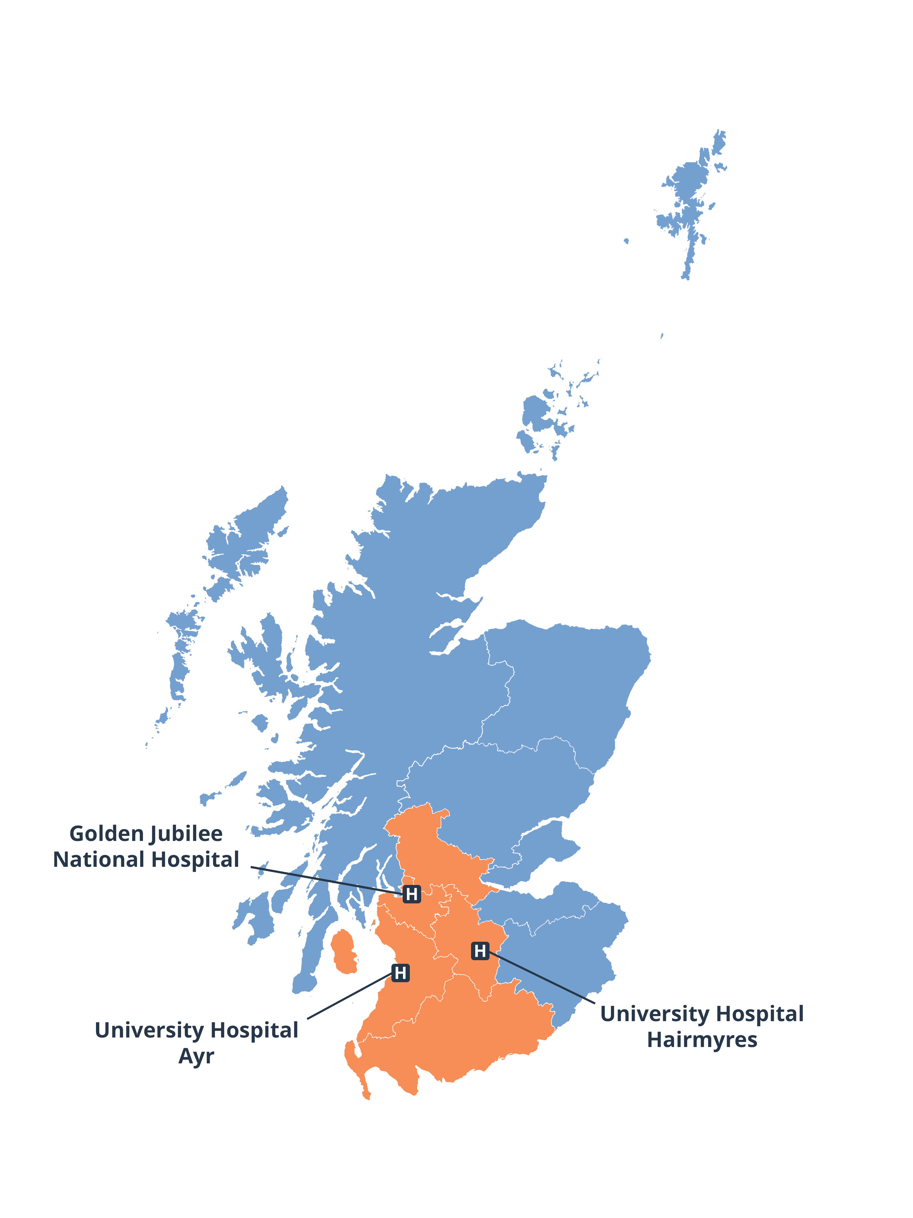
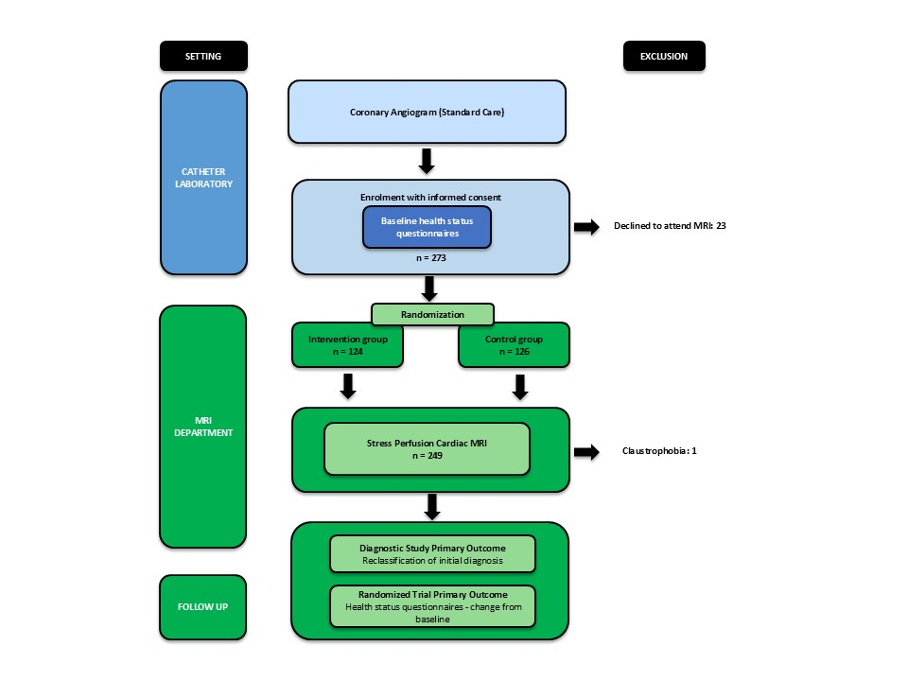
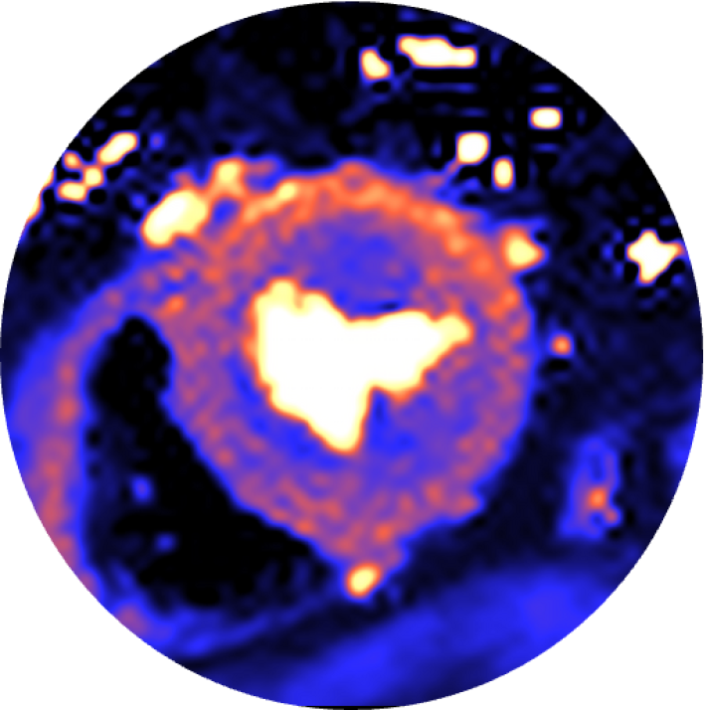
STUDY methods
MRI intervention
Scotland, UK
Hospital population, 2.5 million
Enrolment: 9 February 2021 - 18 August 2023
Notes:
Setting: three hospitals in the West of Scotland (population 2.5 million)
9 February 2021 - 18 August 2023: 273 outpatients who had undergone clinically-indicated invasive coronary angiography for investigation of chest pain and had a report of no obstructive coronary artery disease were prospectively were enrolled within three months of the angiogram.
Stress/rest perfusion CMR imaging
CMR imaging was performed at 1.5 Tesla using a standardized protocol. Vasodilator stress was achieved by intravenous infusion of adenosine at a dose of 140μg/kg/min for 4 min (increased to 210μg/kg/min for a further 2 minutes if no symptoms or less than 10% heart rate increase). Automated quantitative myocardial blood flow mapping was performed using the method described by Kellman et al.
The myocardial blood flow results were used by the imaging cardiologist to define the final according to diagnostic criteria. In the intervention group, these findings were used to revise the final diagnosis and stratify patients into sub-groups (endotypes: microvascular angina, vasospastic angina, non-cardiac chest pain, obstructive coronary artery disease). In the control group, the myocardial blood flow results were not used to revise the final diagnosis.
Any clinically significant incidental finding (cardiac or extra-cardiac) identified during CMR imaging was disclosed and the participant’s management followed standard care for this finding.

Slide 7

TRIAL OUTCOMES
Diagnostic study
The primary outcome of the diagnostic study was the reclassification of the diagnosis after stress perfusion CMR imaging vs. the initial diagnosis based on the angiogram.
Nested Randomized Trial
Angina was assessed using the Seattle Anqina Questionnaire (SAQ) (primary outcome).
Health-related quality of life was assessed using the EuroQoL-5-dimension 5-level questionnaire (secondary outcome).
Follow-up continued until 1 September 2024, median (interquartile range) 386 (371, 398) days and 383 (370, 396) days in the intervention and control groups, respectively.
Visits were completed in all (100%) participants at 6- and 12-months.
Blinding effectiveness at 12-months was prospectively assessed and confirmed in all (n=250) participants, followed by unblinding.
The statistical analysis plan was established before database lock.
https://www.bachelorprint.com/
Notes:
Diagnostic study
The clinical diagnosis established by the invasive (attending) cardiologist post-angiography was recorded. This diagnosis was re-evaluated following stress perfusion CMR imaging.
The primary outcome of the diagnostic study was the reclassification of the initial diagnosis based on the angiogram.
Nested Randomized Trial
Angina was assessed using the Seattle Anqina Questionnaire (SAQ) (primary outcome of the trial).
Health-related quality of life was assessed using the EuroQoL-5-dimension 5-level questionnaire (secondary outcome)
Follow-up continued until 1 September 2024, representing a median (interquartile range) follow-up period of 386 (371.0, 398.0) days and 383 (370.0, 396.0) days and in the intervention and control groups, respectively. Follow-up visits were completed in all participants at 6- and 12-months. Blinding effectiveness at twelve months post-randomization was prospectively assessed and confirmed in all (n=250) participants.
The statistical analysis plan was established before database lock. The results were analyzed by a statistician independent of the clinical team.

Slide 8
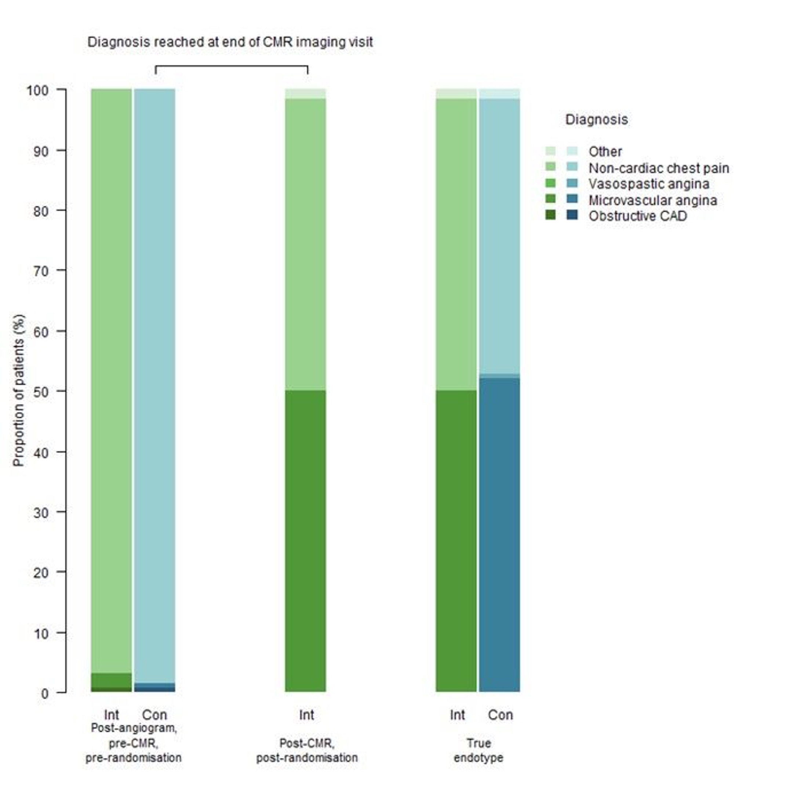
results
Diagnosis at end of CMR imaging visit
Diagnostic study
250 patients (mean age, 63.3 years, 51% female), chest pain and unobstructed coronary arteries included.
56 (22%) patients - previous coronary angiogram
i.e., ≥ 2 angiograms.
14 (5.6%) patients - coronary function testing during invasive management.
After MRI
Reclassification of the initial diagnosis based on the angiogram occurred in 131 (53.0%, [95% CI: 46.6%, 59.3%]; p<0.001) patients, indicating the primary outcome for the diagnostic study was met.
Incidental findings
Four patients: Myocarditis n=2, cardiomyopathy n=2
Safety
No adverse events related to stress MRI
Int Con
Int
Int Con
Post-angiogram
Pre-CMR
Pre-randomisation
Post-CMR
Post-randomization
True endotype
CAD – coronary artery disease
CMR – Cardiovascular magnetic resonance
Con – Control
Int – Intervention

Slide 9
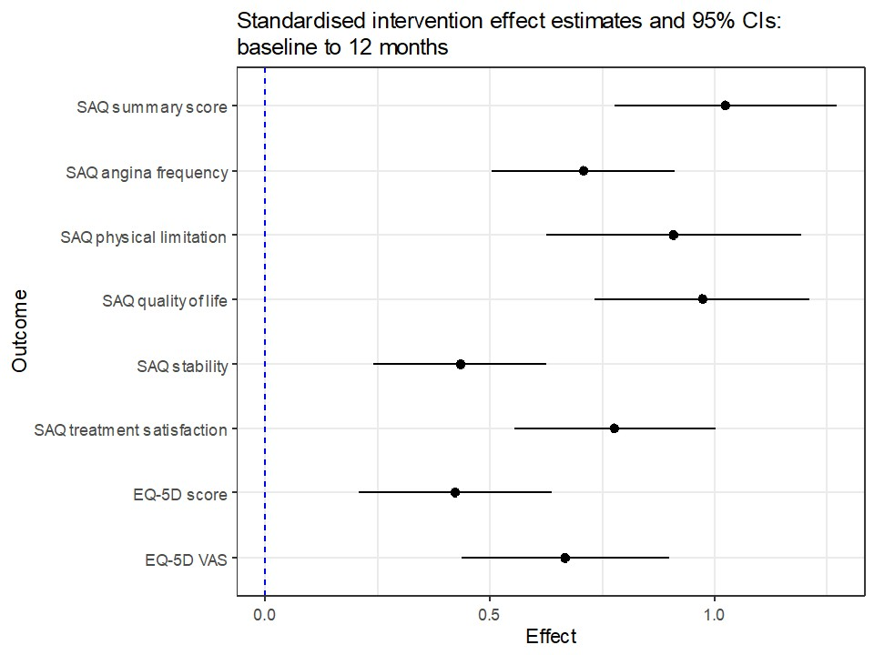
results
Randomized, double-blind trial Intervention effect relative to control
Intervention vs Control
↑ SAQ @ 12 months, less angina
Intervention 70.9±23.6 (21.7±22.6 Δ from baseline)
Control 52.1±24.1 (-0.8±20.4 Δ from baseline)
Adjusted mean difference 20.9 [95% CI 15.8, 26.0]
↑ EuroQol 5D 5L @12 months, improved QoL
Adjusted mean difference 0.09 [95% CI 0.04, 0.13]
↑ Medical therapy @ 12 months
Anti-anginal medicines (84% vs 64%; p=0.001)
Aspirin (77 % vs 56%; p<0.001)
Statins (82% vs 62%; p=0.001)
Notes:
SAQ @ 12 months
intervention 70.9±23.6 (21.7±22.6 change from baseline)
control 52.1±24.1 (-0.8±20.4 change from baseline) (adjusted mean difference: 20.9 [95% CI 15.8, 26.0])
Improvements also occurred in EuroQol 5-Dimension 5-Level questionnaire at 12 months (adjusted mean difference 0.09 [95% CI 0.04, 0.13]).
Intervention group, compared to in the control group, in keeping with the higher proportions of patients diagnosed with ANOCA endotypes, participants were more frequently prescribed antianginal drug therapy at the 12-months (83.9% vs 64.3%; p=0.001) and more frequently prescribed aspirin (77.4% vs 56.3%; p<0.001) and statins (81.5% vs 61.9%; p=0.001).

Slide 10
conclusions
In this randomized trial, disclosure of myocardial blood flow by stress CMR imaging in patients with chest pain and no obstructive coronary arteries improved diagnosing the cause of angina and clinical outcomes.
Following standard angiography, microvascular angina was commonly mis-diagnosed as non-cardiac chest pain.
Endotyping-informed therapy in the MRI-guided intervention group led to improvements in angina burden and health-related quality of life.
In patients with suspected angina and no obstructive coronary arteries, angiography without functional testing commonly results in misdiagnosis, worse angina and reduced health-related quality of life.
The results apply equally by sex.
Nature Medicine, 2025
https://www.nature.com/articles/s41591-025-04044-4

Slide 11
Thank you

