Slide 1

Metformin as an Adjunctive Therapy to Catheter Ablation of Atrial Fibrillation (META-AF)
Amrish Deshmukh, Muazzum M Shah, Paul Kozlowski, Apurba Chakrabarti, Alex Turin, Kelly Arps, Michael Ghannam, Jackson J. Liang, Mohammed Saeed, Ryan Cunnane, Hamid Ghanbari, Rakesh Latchamsetty, Thomas Crawford, Krit Jongnarangsin, Frank Pelosi Jr., Frank Bogun, Aman Chugh, Fred Morady, Elif A Oral, Hakan Oral

Slide 2
Disclosures
Off label use of metformin in the treatment of atrial fibrillation (AF)

Slide 3
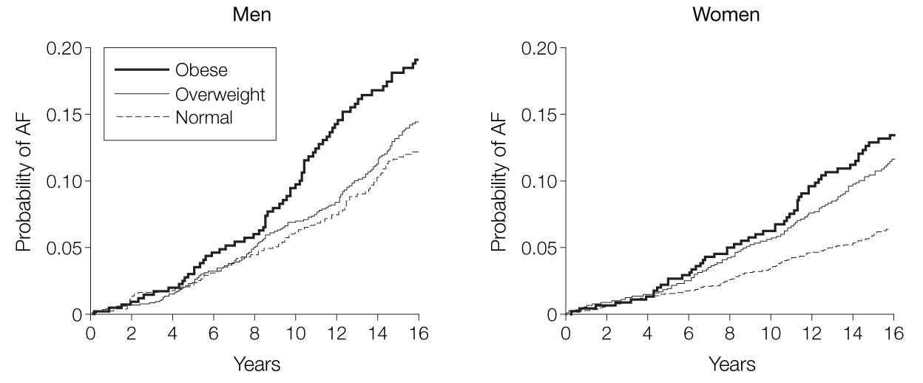
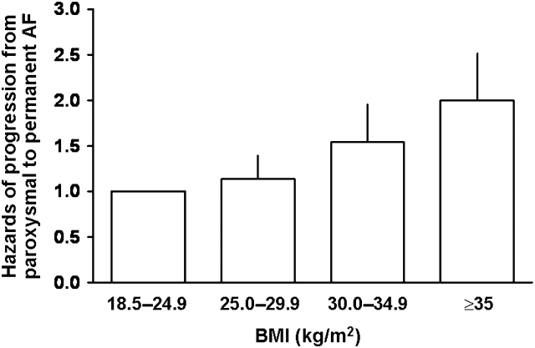
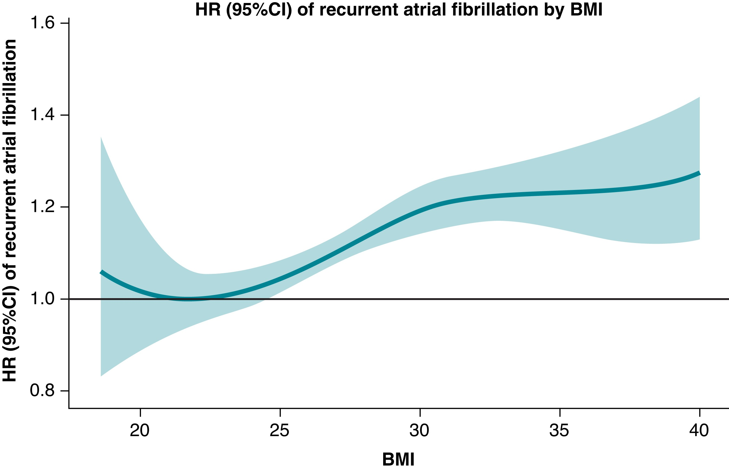
Obesity and AF
Obesity is a common risk factor for AF
↑ BMI is associated with
Risk of AF
Progression of AF
Failure of catheter ablation

Slide 4
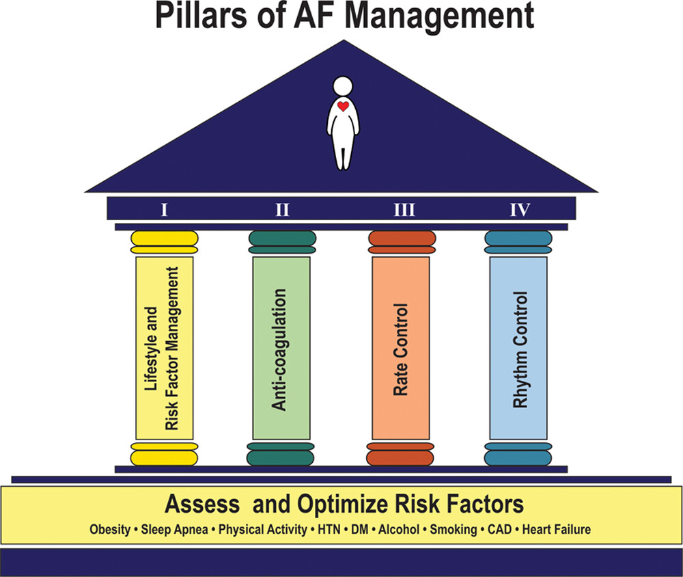
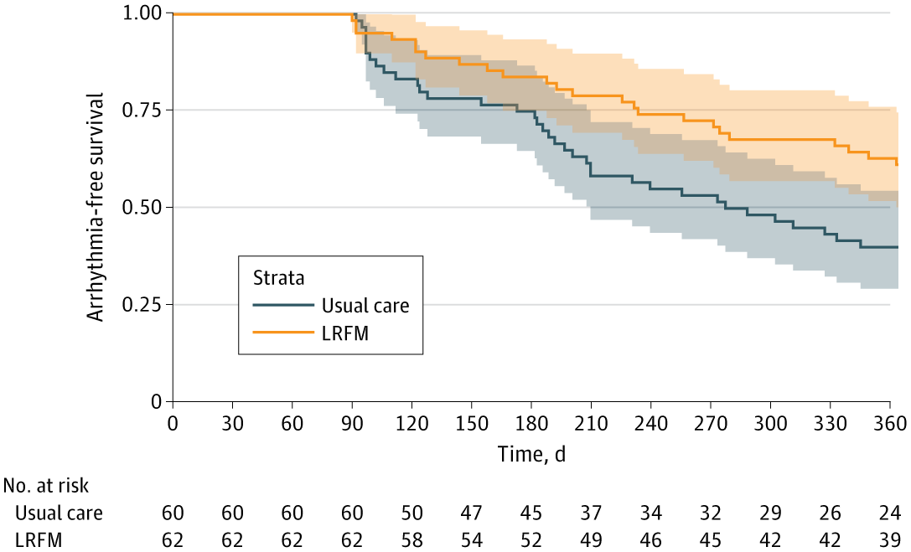
Lifestyle and Risk Factor Modification

Slide 5
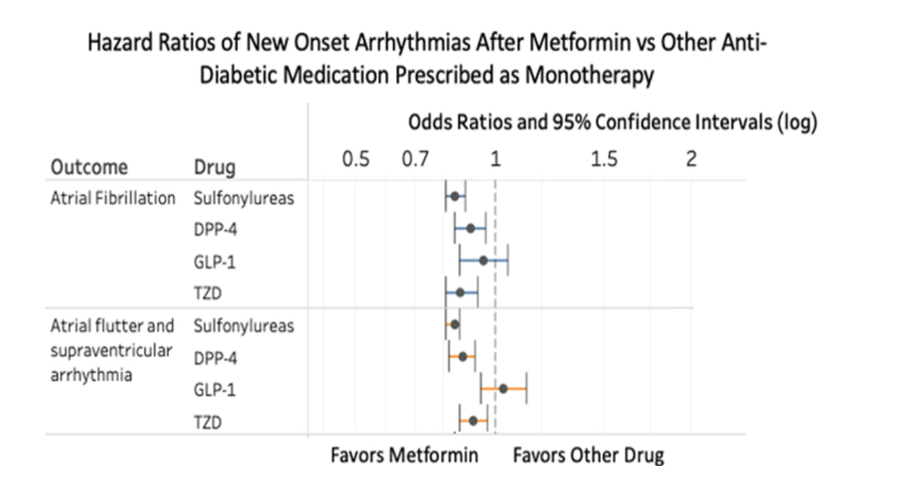
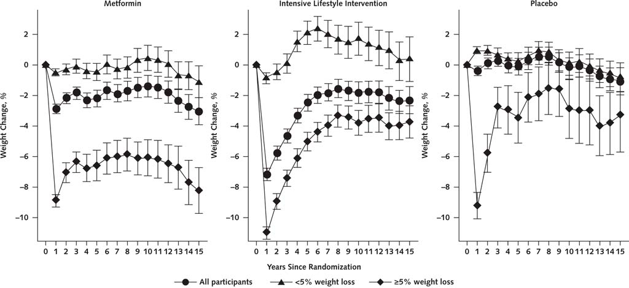
METFormin and AF
Metformin is associated with ↓ AF in observational cohorts and experimental models
In prior RCTs of patients without diabetes, metformin is associated with:
Modest weight loss
Reductions in LV mass

Slide 6
META-AF
Hypothesis: Treatment with metformin in patients with BMI ≥ 25 kg/m² and without diabetes will reduce the recurrence of atrial arrythmias after catheter ablation
Design: Randomized, parallel group, open-label trial

Slide 7
META-AF
Inclusion Criteria
Exclusion Criteria
Paroxysmal or persistent AF undergoing AF ablation
Age ≥ 18 years
BMI ≥ 25 kg/m²
Diabetes Mellitus
Current or planned antidiabetic medications
GFR < 30 mL/min per 1.73m²
Chronic metabolic acidosis or use of carbonic anhydrase inhibitors
Use >2 EtOH drinks/day on average
NYHA class III or IV heart failure
Pregnancy or nursing

Slide 8
META-AF
Intervention: Metformin initiated 0-6 weeks prior to ablation
6-week titration to maximum tolerated dose (1000 mg twice daily)

Slide 9
META-AF
Intervention: Metformin initiated 0-6 weeks prior to ablation
6-week titration to maximum tolerated dose (1000 mg twice daily)
In all patients:
Counseling for LRFM (Weight loss, exercise, OSA, tobacco, EtOH)

Slide 10
META-AF
Intervention: Metformin initiated 0-6 weeks prior to ablation
6-week titration to maximum tolerated dose (1000 mg twice daily)
In all patients:
Counseling for LRFM (Weight loss, exercise, OSA, tobacco, EtOH)
Ablation targeting antral PVI
Additional ablation and AADs per treating electrophysiologist

Slide 11
META-AF
Intervention: Metformin initiated 0-6 weeks prior to ablation
6-week titration to maximum tolerated dose (1000 mg twice daily)
In all patients:
Counseling for LRFM (Weight loss, exercise, OSA, tobacco, EtOH)
Ablation targeting antral PVI
Additional ablation and AADs per treating electrophysiologist
Hand-held ECG device (AliveCor KardiaMobile)
Symptoms, weekly, or daily when notified of AF

Slide 12
Outcomes
Primary Outcome
Atrial arrhythmia recurrence > 30 s after a single procedure at 12 months after a 3-month blanking period
Secondary Outcomes
Atrial arrhythmia burden via patient self monitoring, event monitors, and CIED
Quality of life by Atrial Fibrillation Severity Scale (AFSS)
Change in weight
Change in HbA1c

Slide 13
META-AF

Slide 14
META-AF

Slide 15
META-AF

Slide 16
Baseline Characteristics
 | Metformin + Ablation (n=49) | Ablation (n= 50)
Age (years) | 62.0±8.2 | 63.2±10.5
Male (%) | 37 (76%) | 32 (64%)
Body mass index (kg/m²) | 32.1±5.3 | 32.8±5.5
Hemoglobin A1c | 5.6±0.42 | 5.7±0.52
Paroxysmal AF | 24 (49%) | 22 (44%)
Prior Ablation for AF | 13 (27%) | 9 (18%)
Prior Cardioversion | 25 (51%) | 24 (48%)
Heart Failure | 6 (12%) | 5 (10%)
Hypertension | 36 (73%) | 37 (74%)
Coronary artery disease | 15 (31%) | 8 (16%)
Obstructive sleep apnea | 33 (67%) | 33 (66%)
Prior stroke | 6 (12%) | 6 (12%)
Pre-Diabetes | 18 (37%) | 23 (46%)

Slide 17
Ablation Characteristics
 | Metformin + Ablation (n=49) | Ablation (n=50) | p
Ablation Energy
Radiofrequency | 43 (88%) | 48 (96%) | 0.17
Cryoballoon | 2 (4%) | 2 (4%)
Pulsed field | 4 (8%) | 0 (0%)
Pulmonary vein reconnection after prior ablation | 7 (14%) | 9 (18%) | 0.62
Pulmonary vein isolation | 48 (98%) | 50 (100%) | 0.5
LA posterior wall isolation | 10 (20%) | 15 (30%) | 0.27
Roof line w/o posterior wall | 7 (14%) | 4 (8%) | 0.32
Lateral mitral isthmus line | 4 (8%) | 4 (8%) | 0.98
Cavotricuspid isthmus line | 14 (29%) | 14 (28%) | 0.95
Anterior left atrial line | 3 (6%) | 5 (10%) | 0.48
Vein of Marshall ethanol ablation | 0 (0%) | 2 (4%) | 0.5

Slide 18
Rhythm Monitoring
 | Metformin + Ablation (n=49) | Ablation (n= 50) | p
Hand-held ECG transmissions/patient | 31 (IQR:5-62) | 21 (IQR 0-66) | 0.3
CIED present post ablation | 8 (16%) | 7 (14%) | 0.7
Event Monitor use post ablation | 23 (47%) | 21 (42%) | 0.6
Days of event monitoring | 14 IQR: (14-14) | 14 IQR: (14-27)

Slide 19
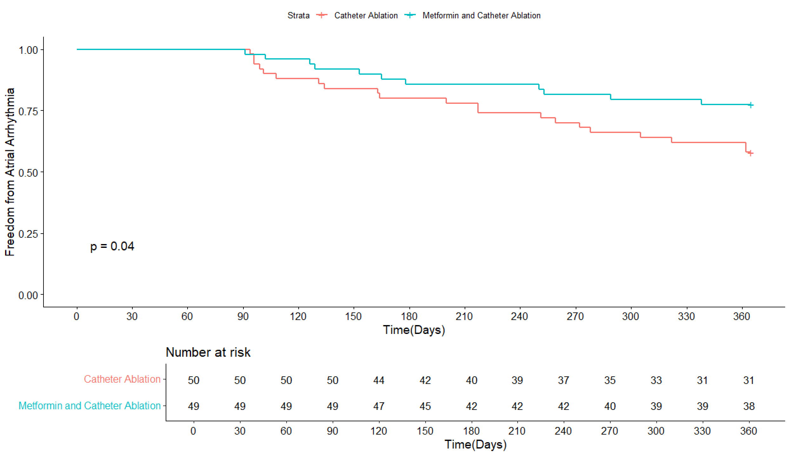
Primary Outcome
HR: 0.50 (0.2-0.9), p=0.04

Slide 20
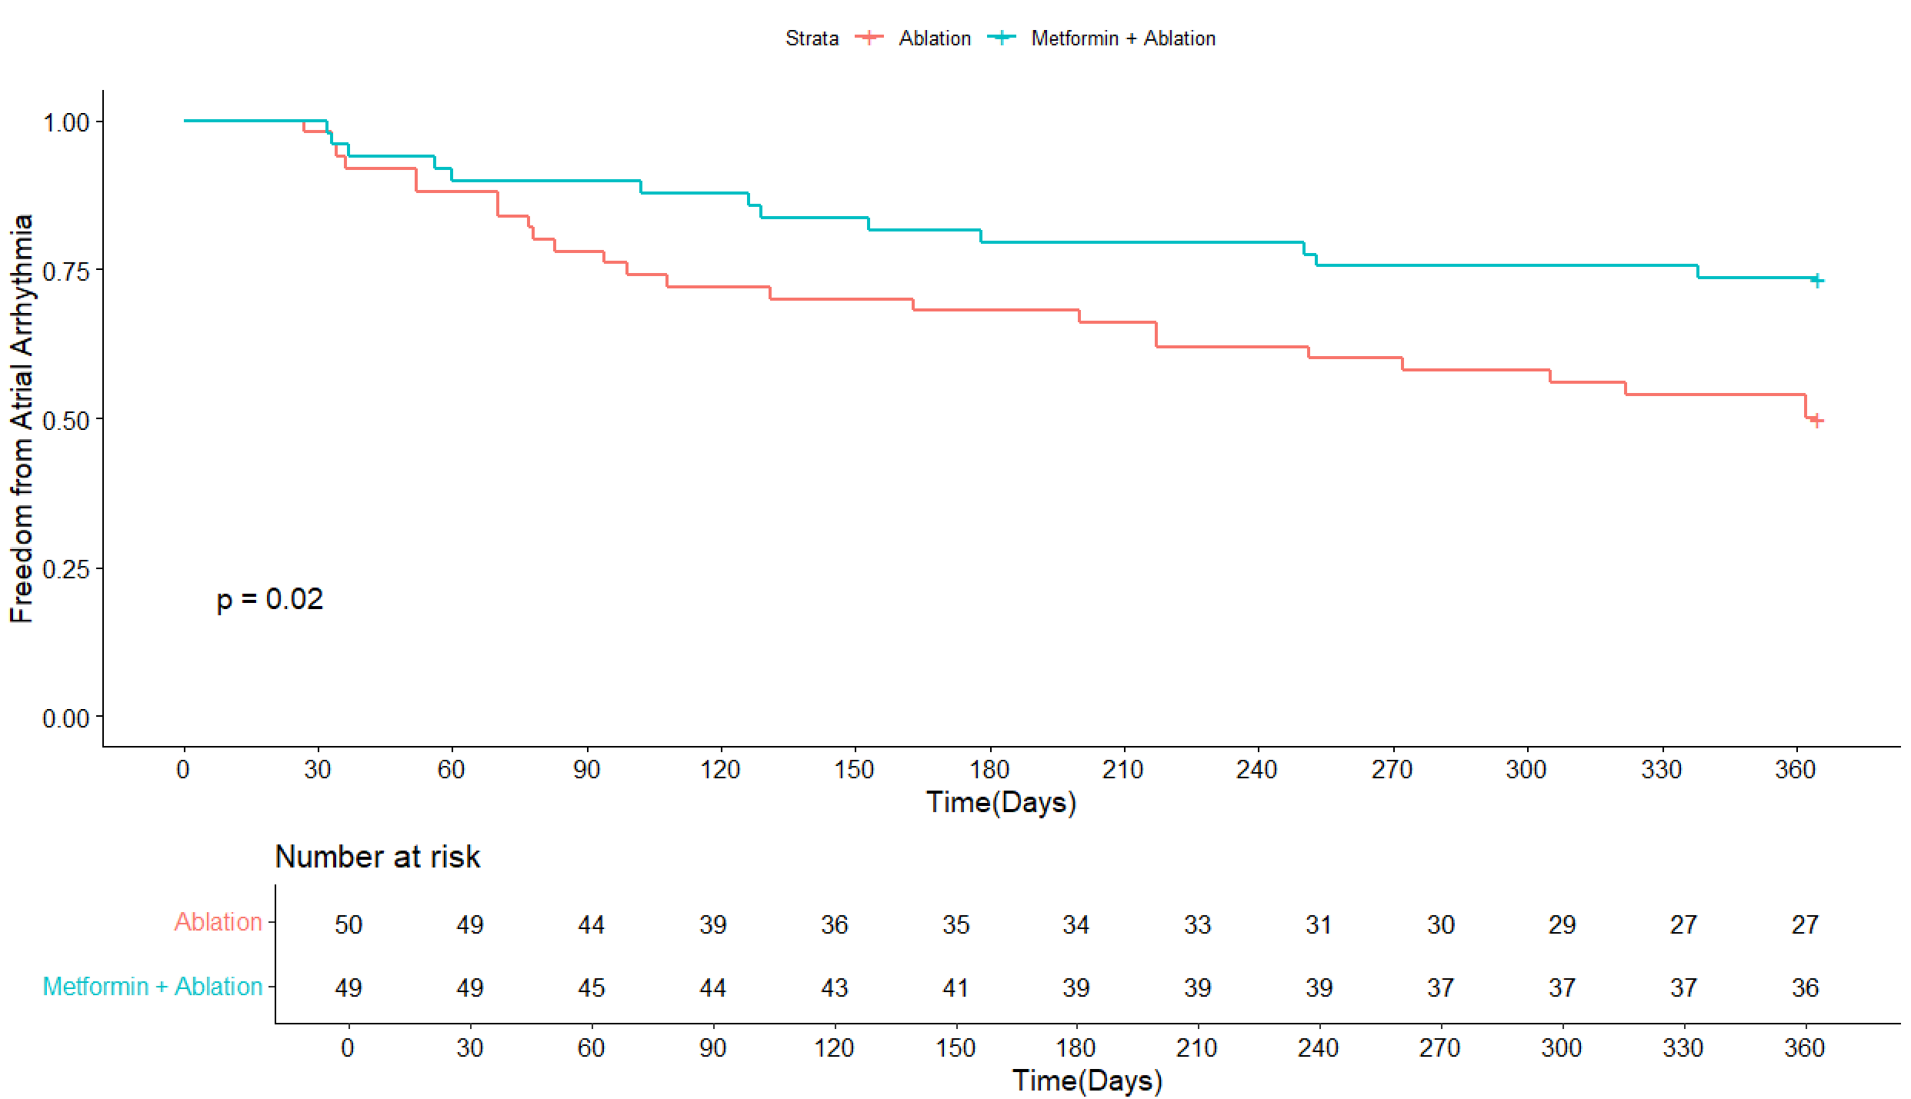
Primary Outcome (1 Month Blanking)
HR: 0.45 (0.2-0.9), p=0.02

Slide 21
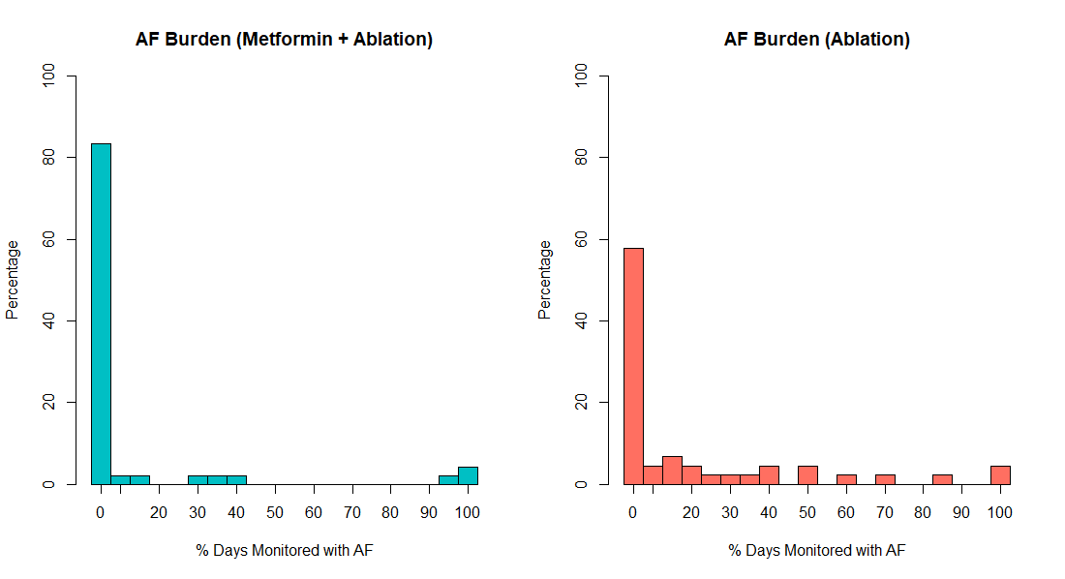
Secondary Outcome: AF burden
Average: 8%
Average: 16%
p = 0.02
Antiarrhythmic medication use: 8% (Metformin + Ablation) vs. 18% (Ablation)
Repeat ablation or cardioversion: 6% (Metformin + Ablation) vs. 16% (Ablation)

Slide 22
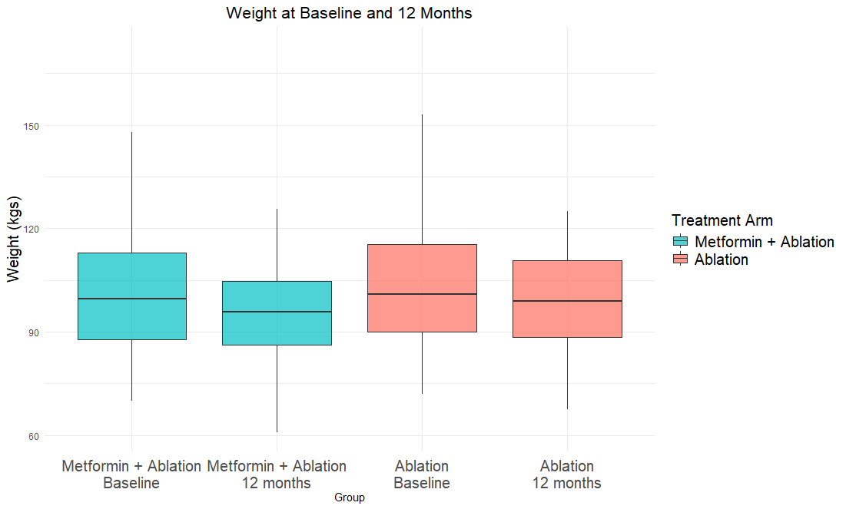
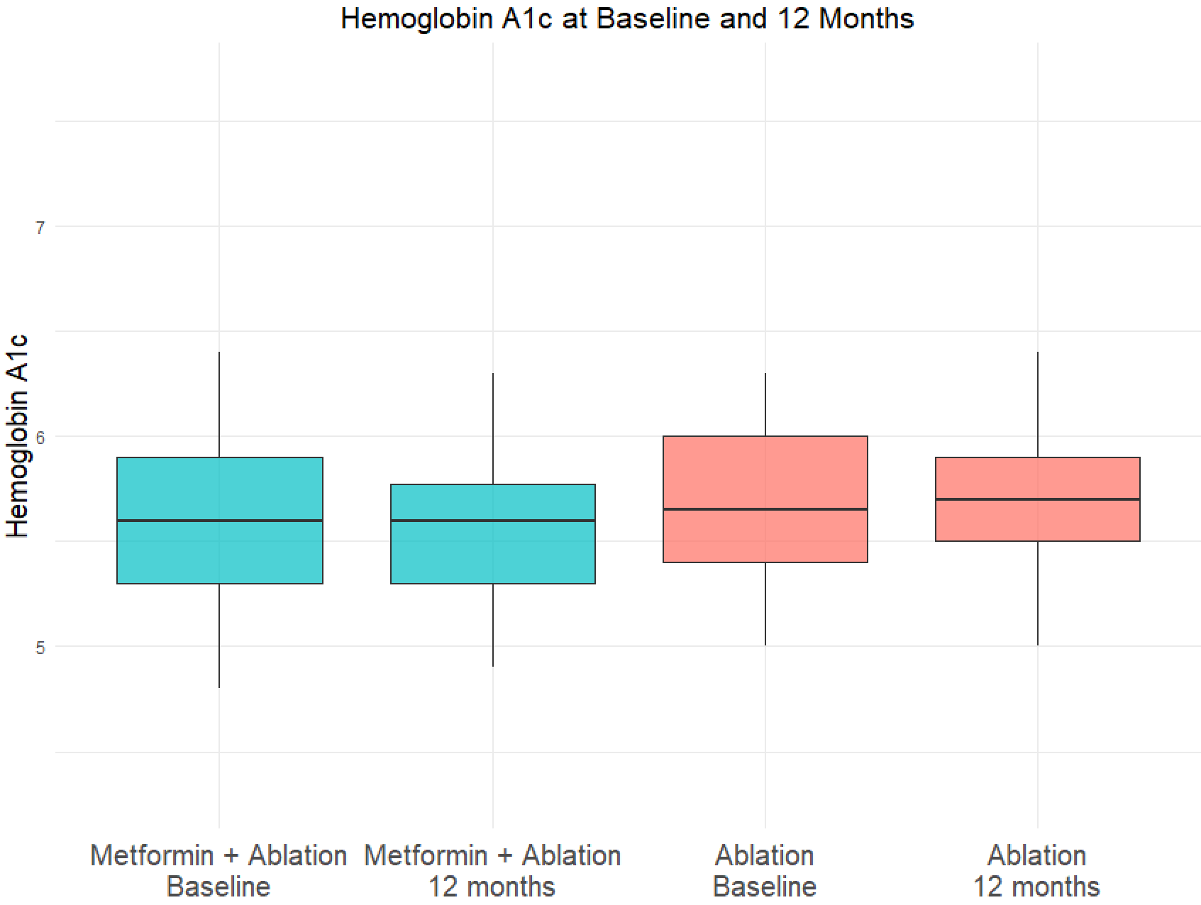
Secondary Outcome: WEIGHT and HbA1c
Notes:
103, 97, 104, 101

Slide 23
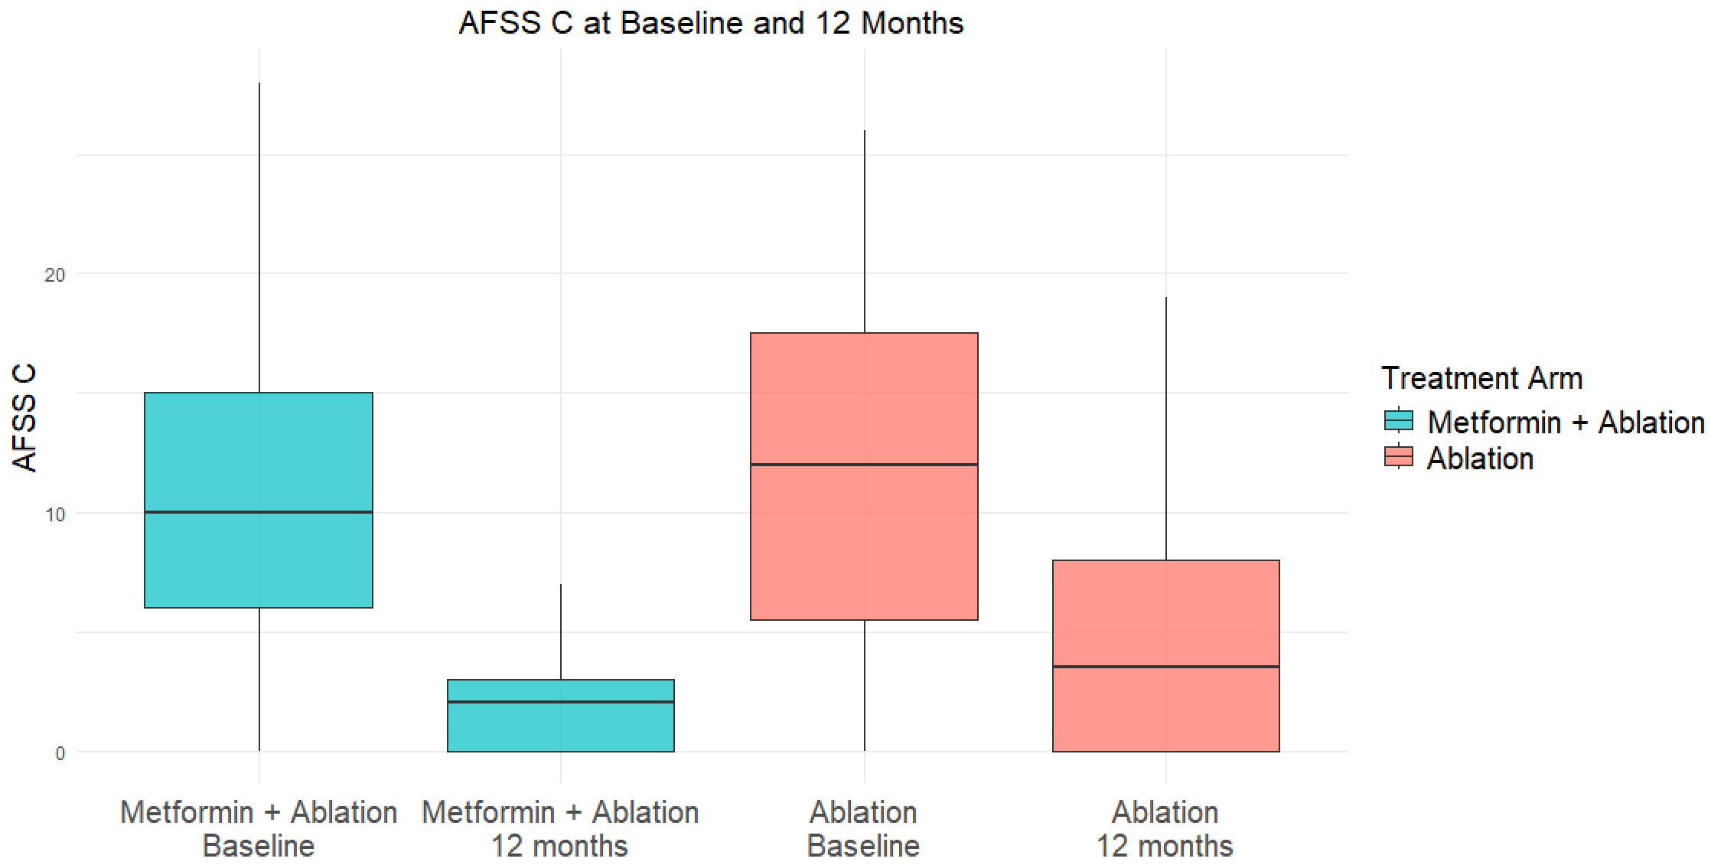
Secondary Outcome: AFSS
Notes:
103, 97, 104, 101

Slide 24
LIMITATIONS
Open label intervention
Single center with majority of ablation via radiofrequency energy
Size limits precision regarding effect size
Study was not powered to detect difference in secondary endpoints
Longer term effect of treatment was not studied

Slide 25
Summary
In patients with BMI ≥ 25 kg/m2 and without diabetes, metformin resulted in greater freedom from recurrent atrial arrhythmia and decreased AF burden
Metformin was well tolerated by a majority of patients
Large changes in weight and glycemic control were not observed with metformin treatment as compared to usual care

Slide 26
Thank you
Participants
Fischer Arrhythmia Fund

